Slide 1
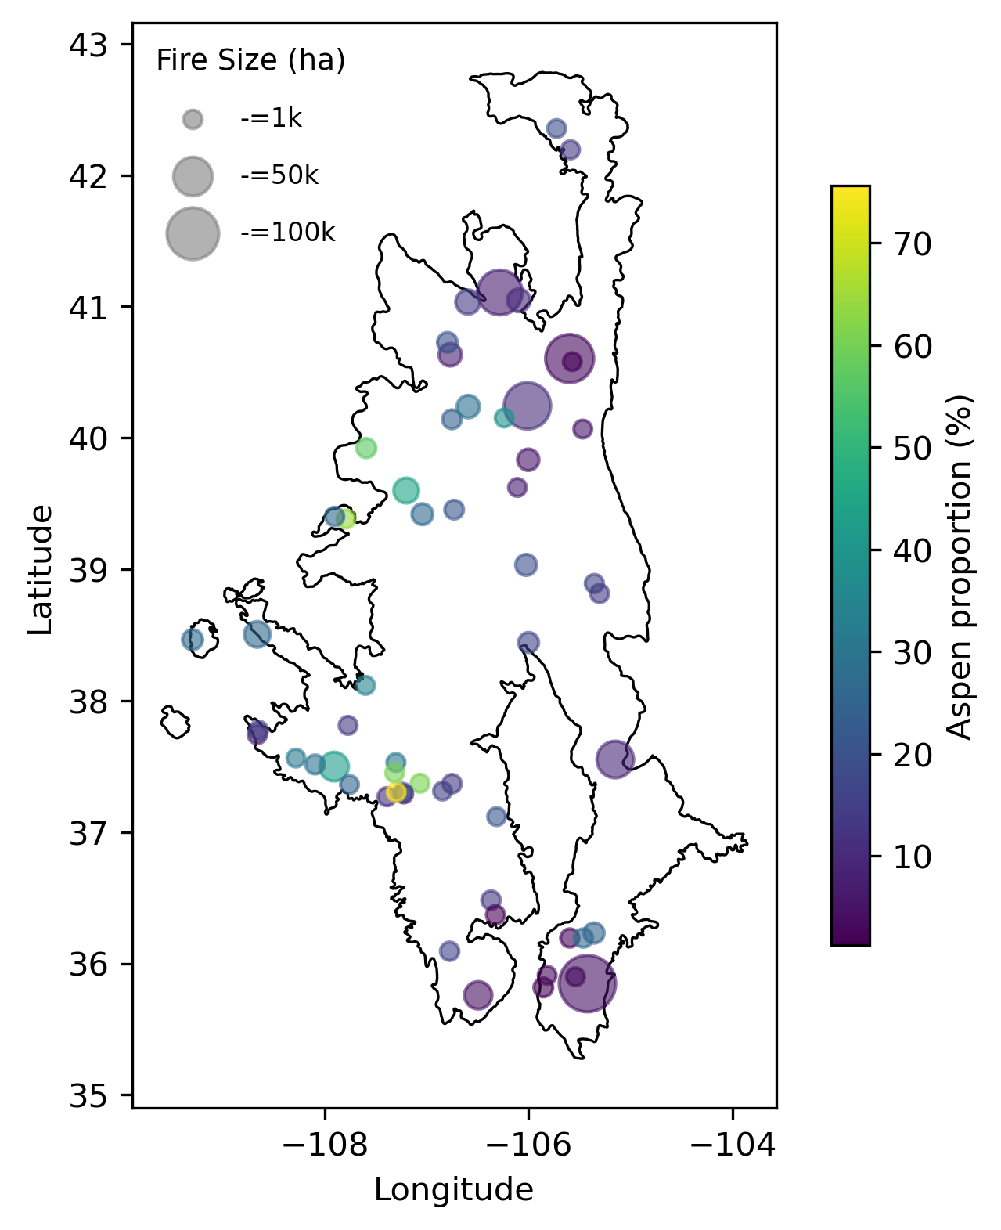
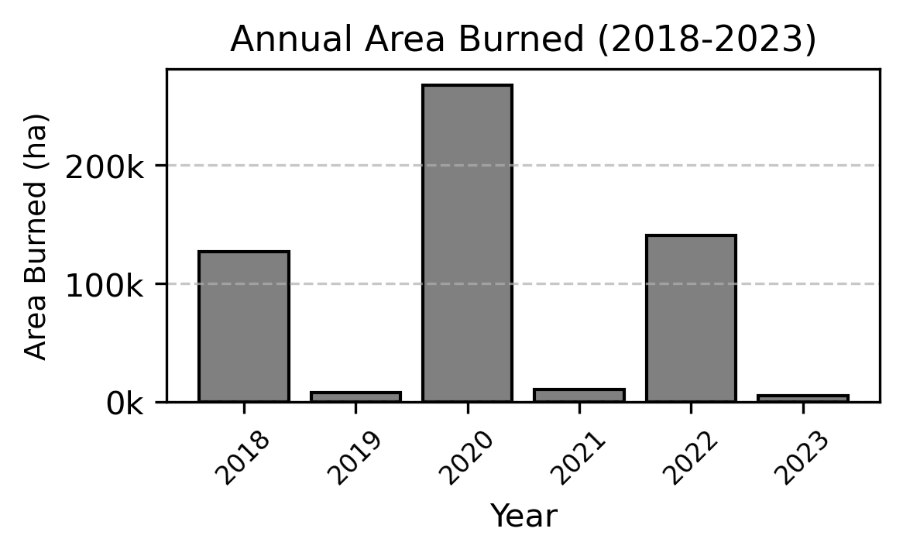
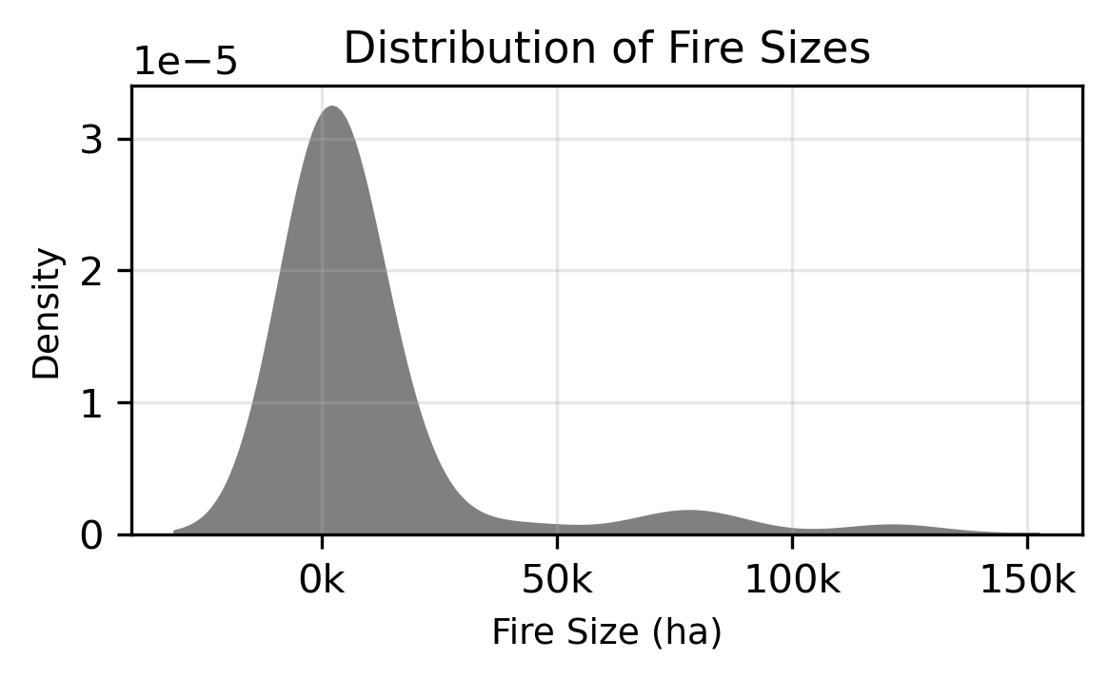
Figure 1. Study region and wildfire events. (A) Map of the Southern Rockies showing the locations of wildfire events with >1% pre-fire aspen cover. Point size represents the burned area, color scale represents the percentage of aspen forest cover. (B) Fractional area of forest types from the USFS TreeMap (ca. 2016) making up 97% of total burned area across events. (C) Some other fire statistic (?)

Slide 2
Figure 2. Example of VIIRS fire radiative power allocations and summary statistics. (A-B) Allocation procedure onto regular grid (cumulative and maximum). (C) Total radiative power released by fire events in the study by forest type.

Slide 3
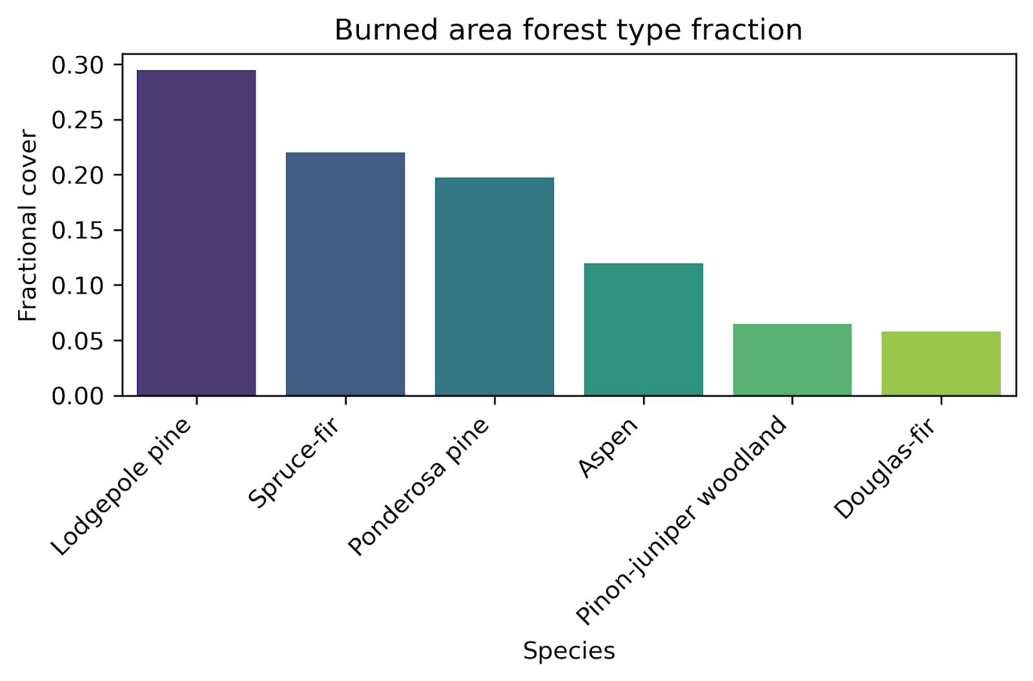
Figure 3. Maximum FRP by dominant (>90% of grid cell area) forest type.

Slide 4
