Slide 1
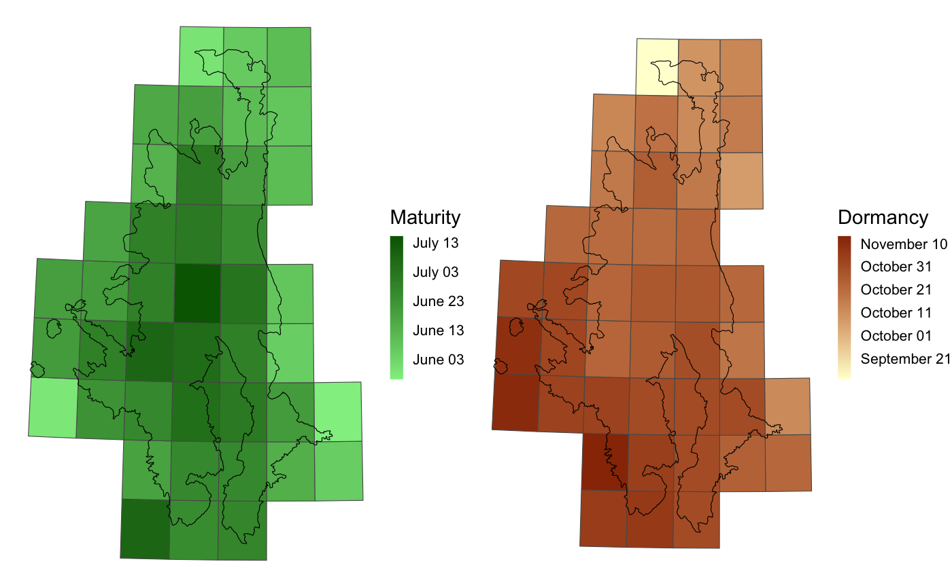
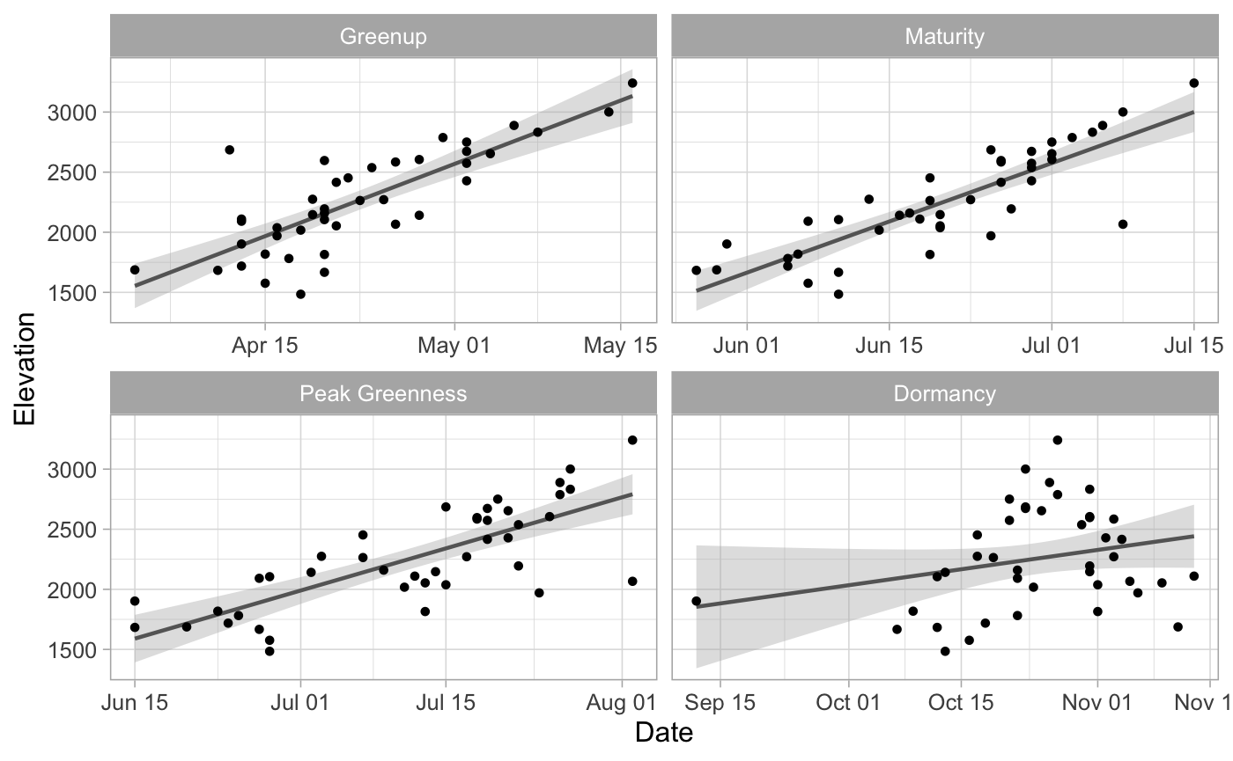

Slide 2
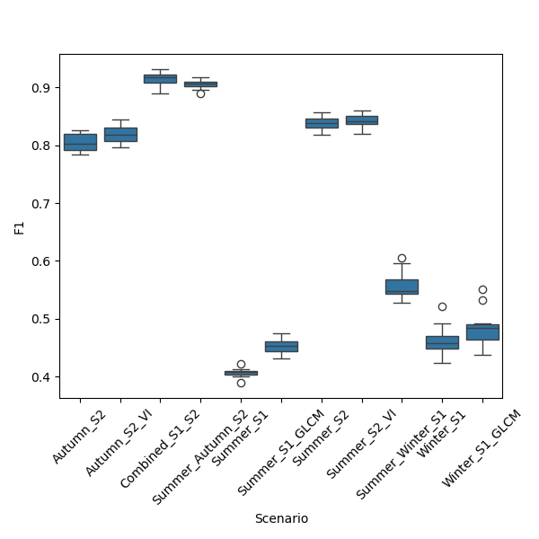
Classification Scenario | Description | Number of Features | F1-Score
Combined_S1_S2 |  | 55 | 0.9143
Summer_Autumn_S2 |  |  | 0.9053
Summer_S2_VI |  |  | 0.8421
Summer_S2 |  |  | 0.8372
Autumn_S2_VI |  |  | 0.8198
Autumn_S2 |  |  | 0.8049
Summer_Winter_S1 |  |  | 0.5574
Winter_S1_GLCM |  |  | 0.4857
Winter_S1 |  |  | 0.4629
Summer_S1_GLCM |  |  | 0.4531
Summer_S1 |  |  | 0.4065

