Slide 1
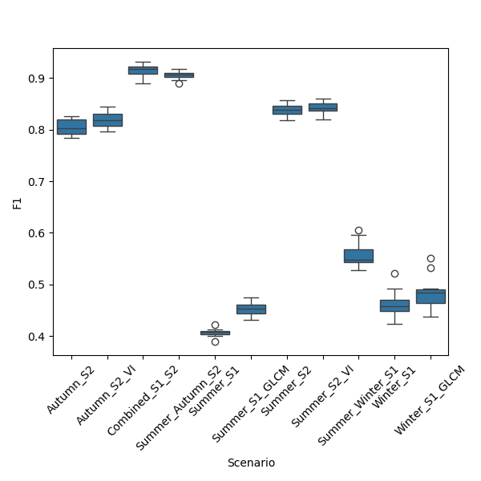
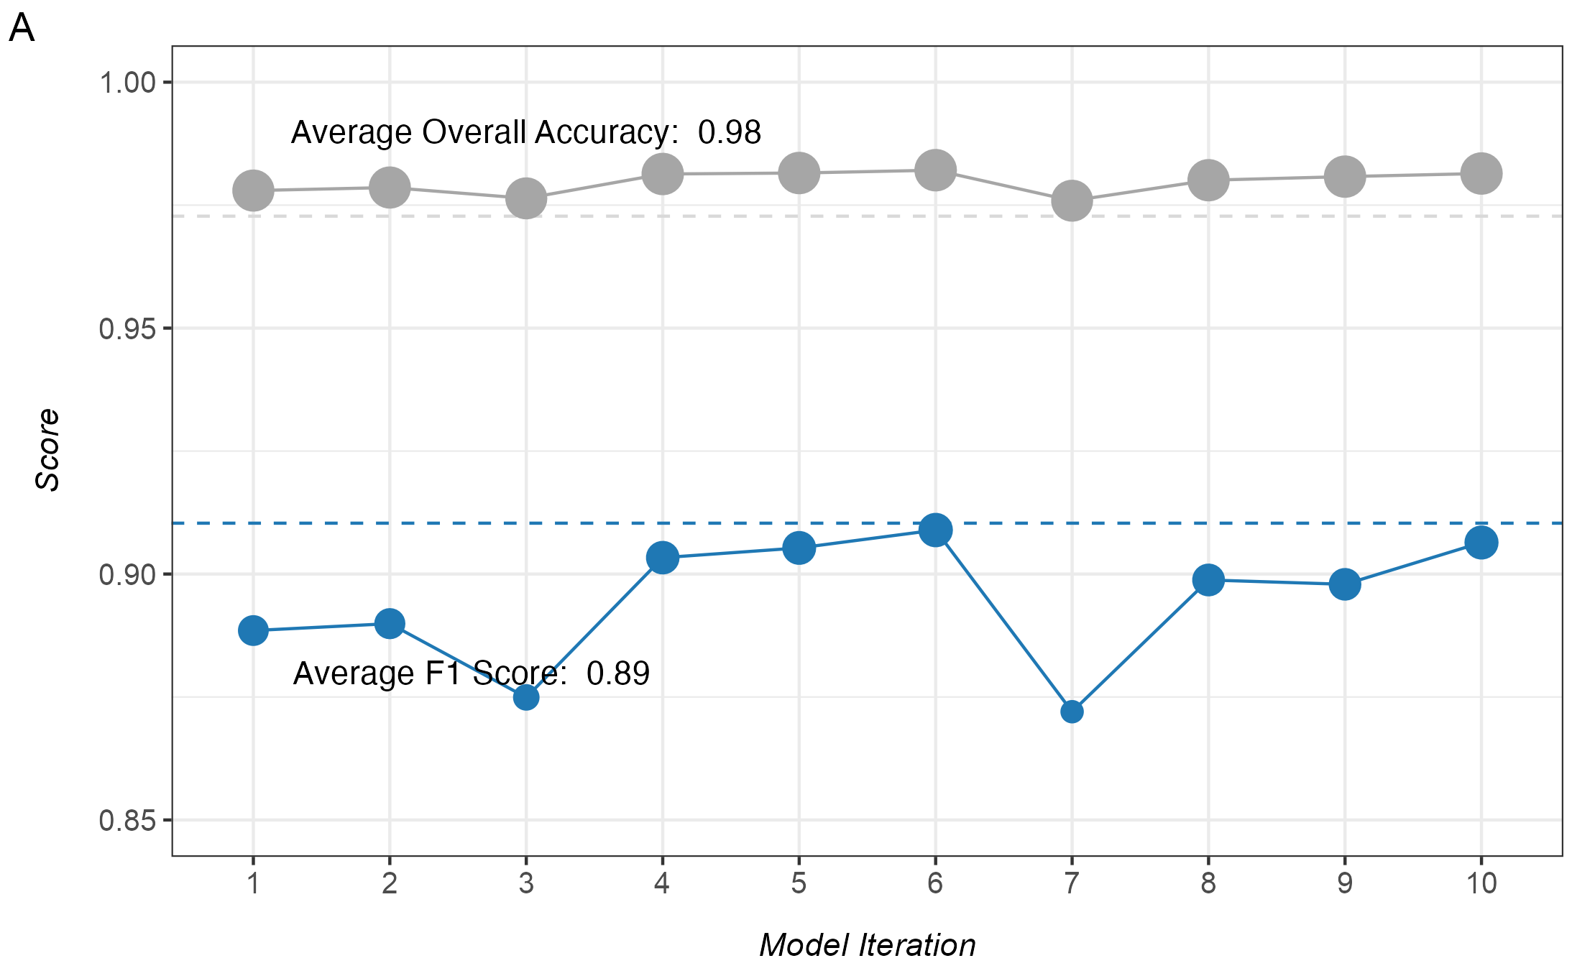
Model Selection, Performance, Accuracy Assessment
Name | Desc. | F1-score
Precision | Recall | F1-score
Fig. 4. Model performance and sensitivity to input features. (A) Overall accuracy and F1 score for each of the 10 model iterations for the best performing model. Dashed lines represent the average across all 10 model iterations. (B) Sensitivity analysis demonstrating the performance (F1 score) of different combinations of the input features. Models M1-M4 include only radar features, M5-M7 include only spectral features, and the M8-M10 include some combination of both spectral and radar features. The best performing model included all spectral and radar features with multicollinear bands removed.

Slide 2
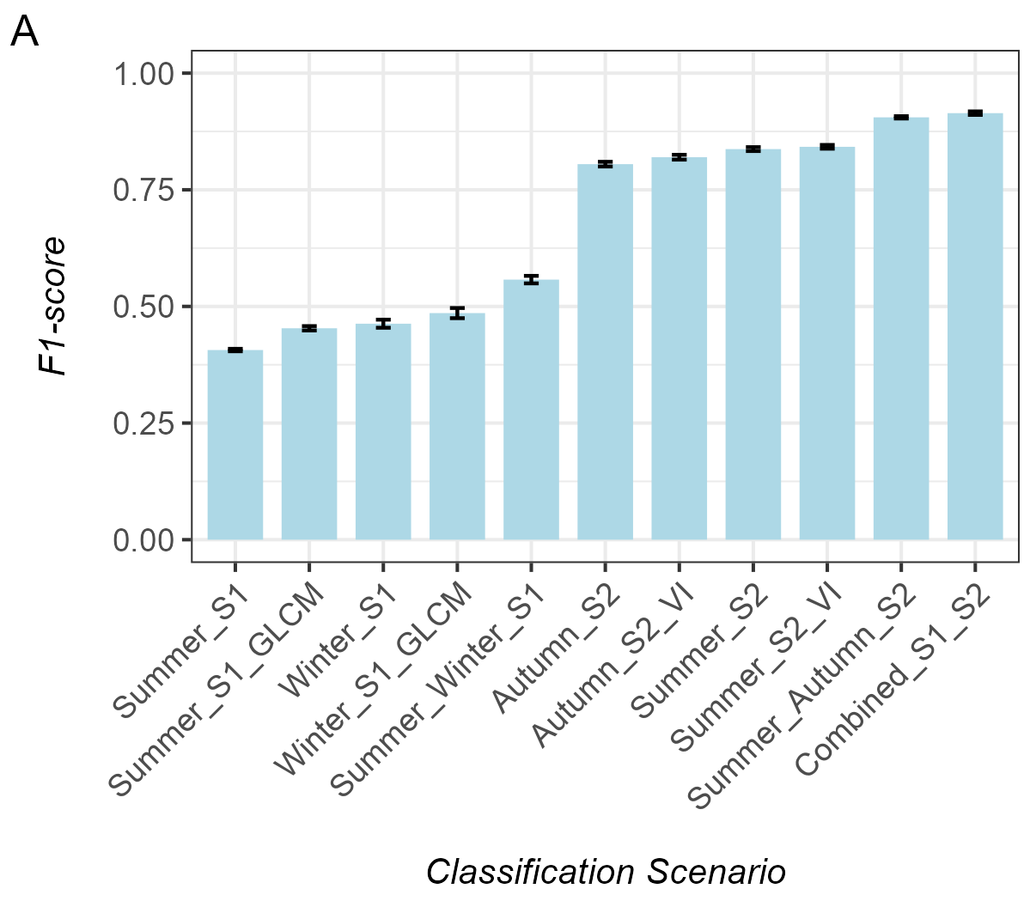
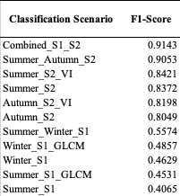
Model Selection, Performance, Accuracy Assessment

Slide 3
Agreement Assessment

