Slide 1
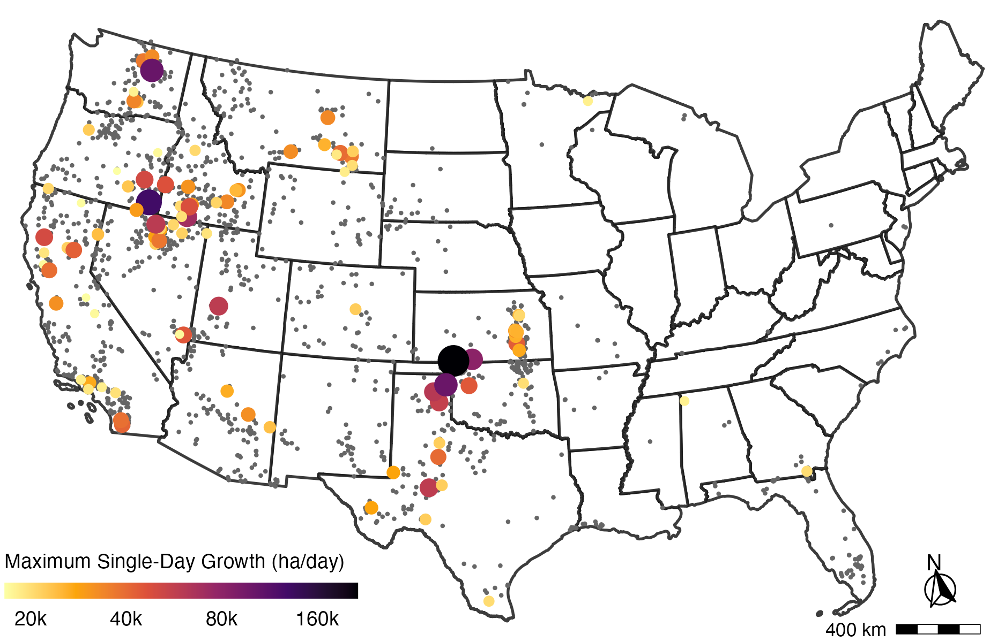
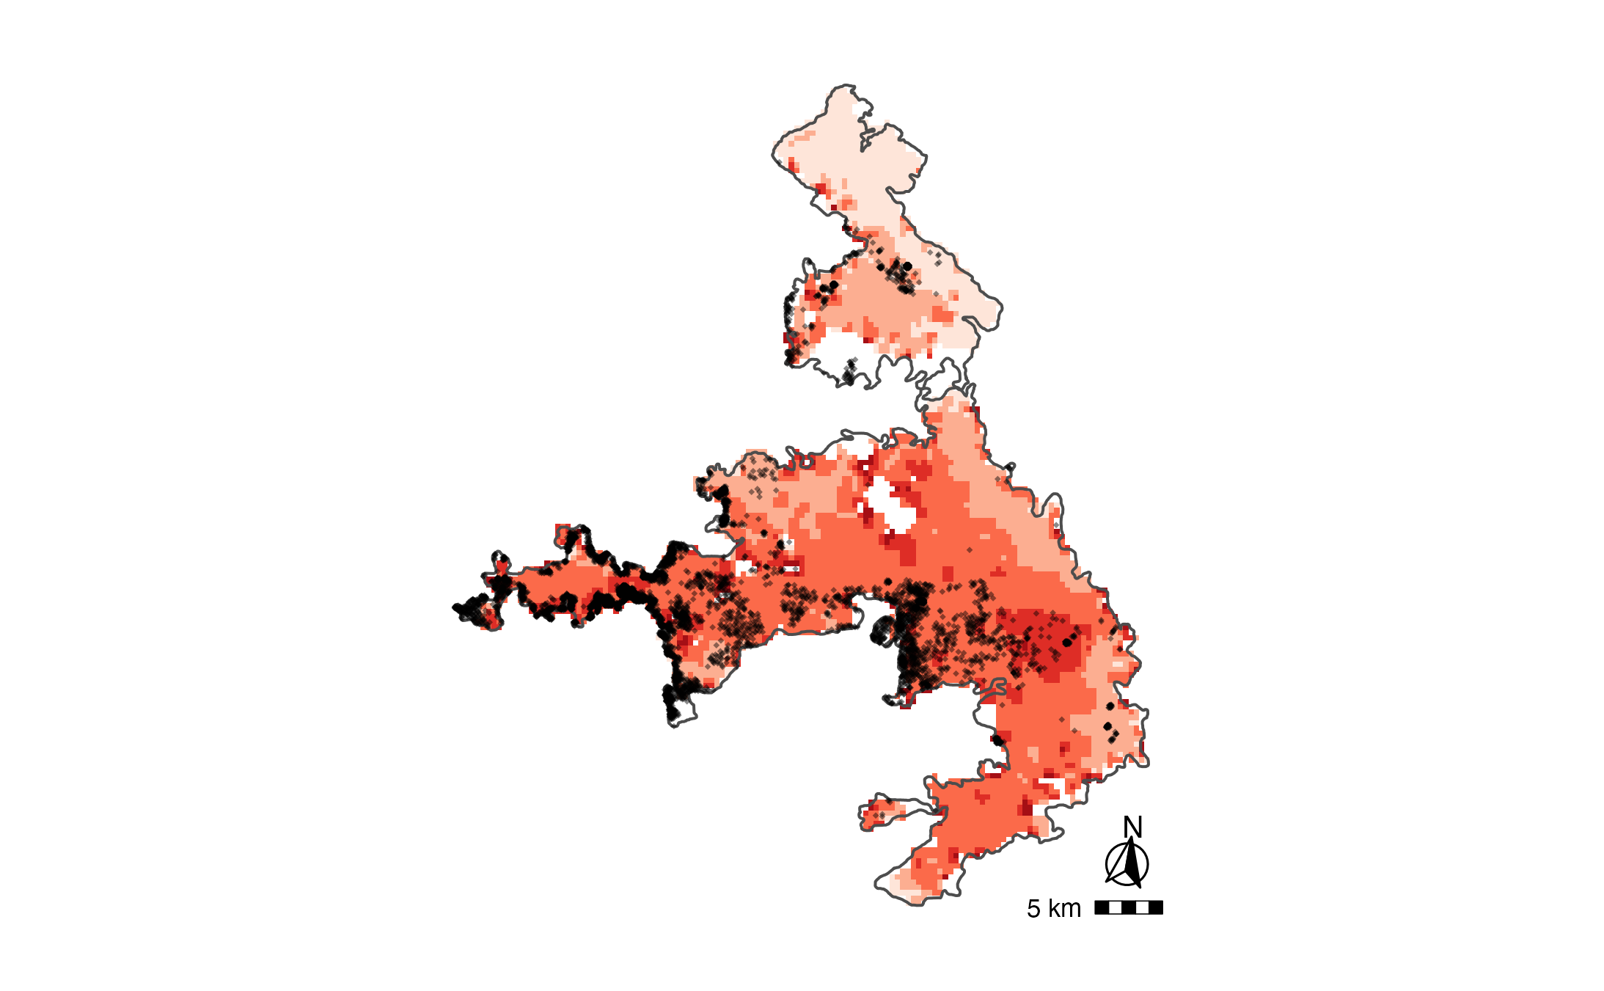
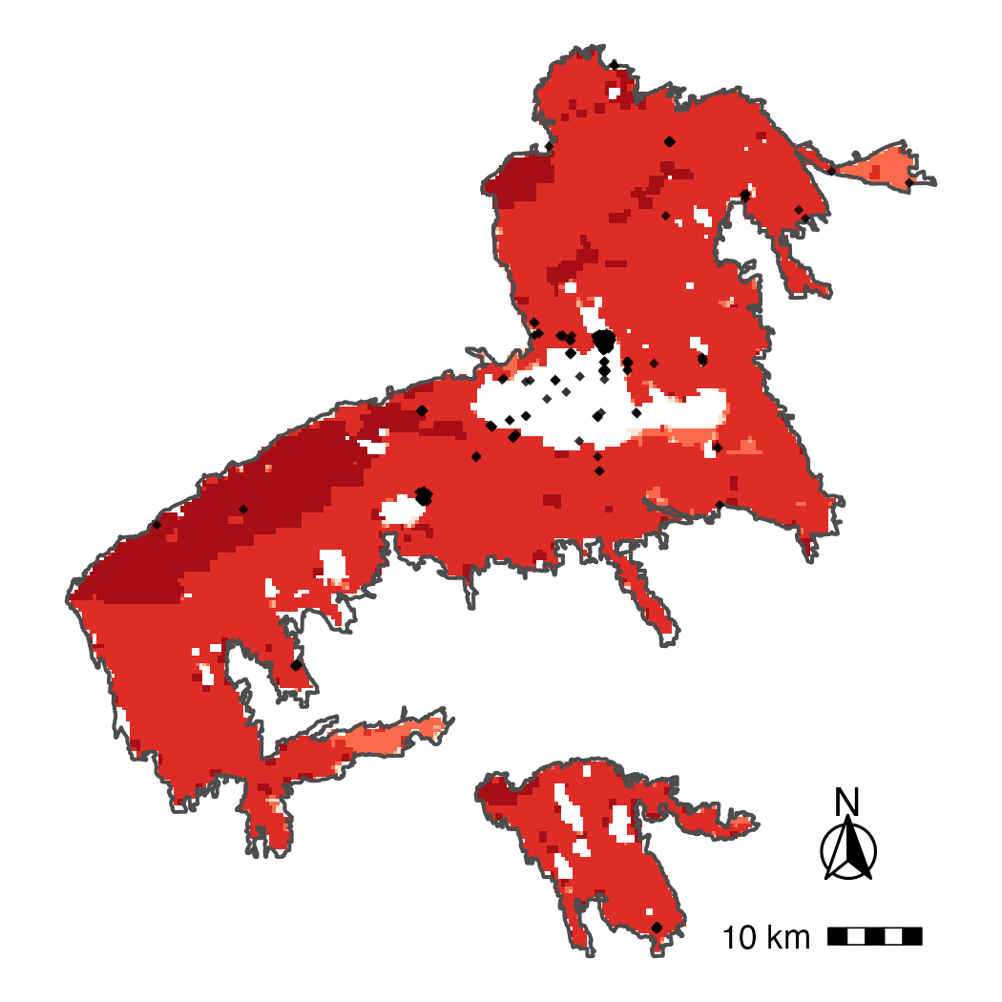
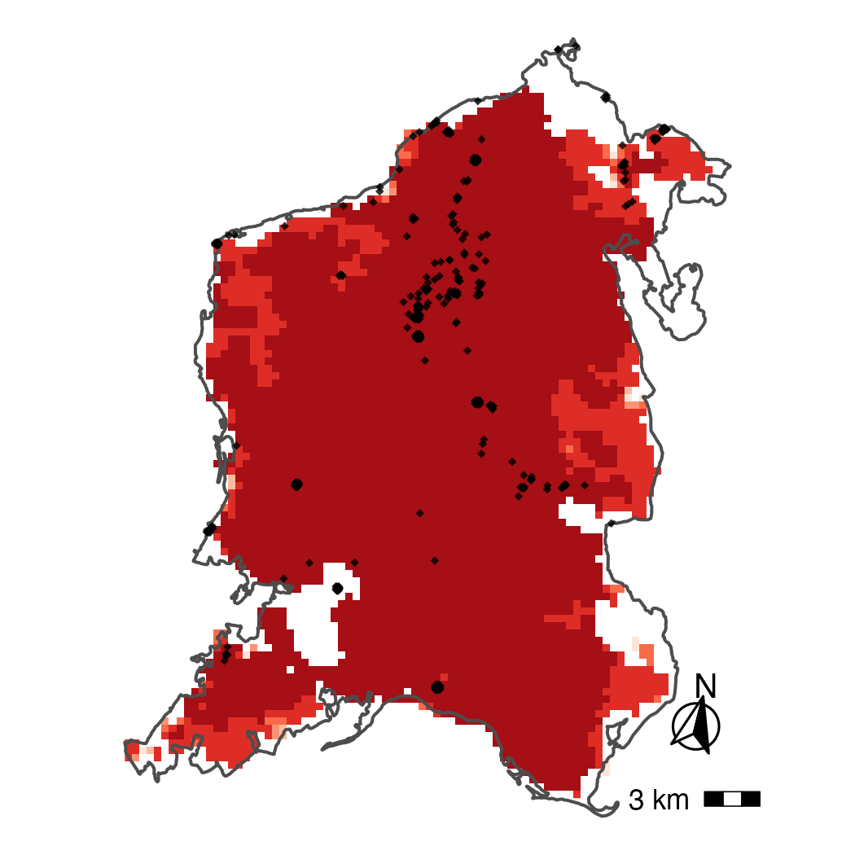
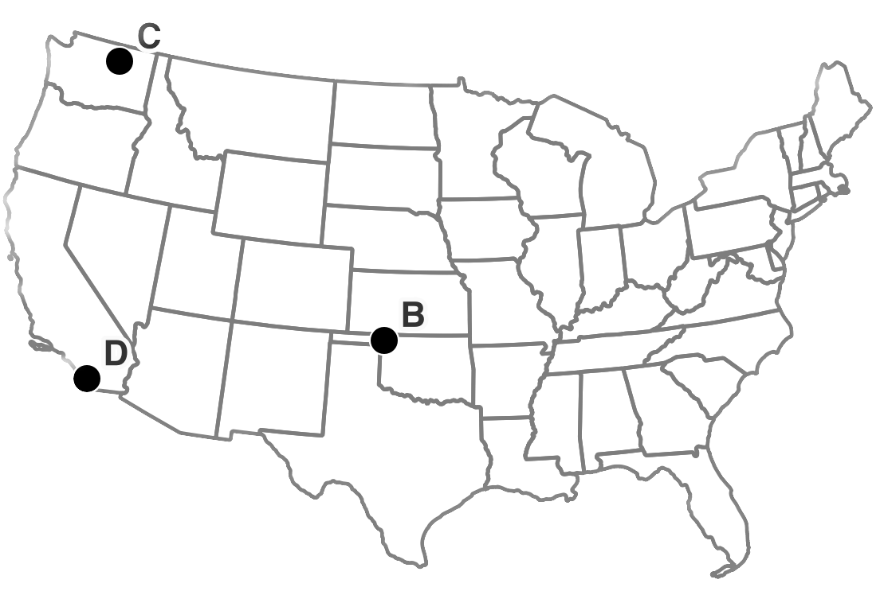
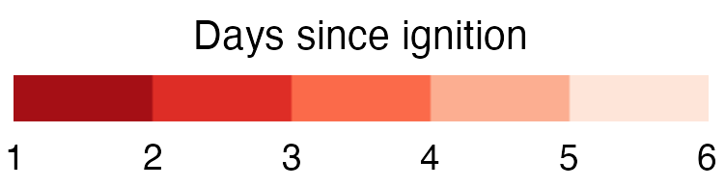
A
B
NW Oklahoma Complex (2018)
C
Cold Springs (2020)
D
Witch-Poomacha (2007)
Woodward, OK
Wenatchee, WA
San Diego, CA
40Km
100Km
50Km
Property records (HISDAC-US)
Wildfire perimeter (MTBS)

Slide 2
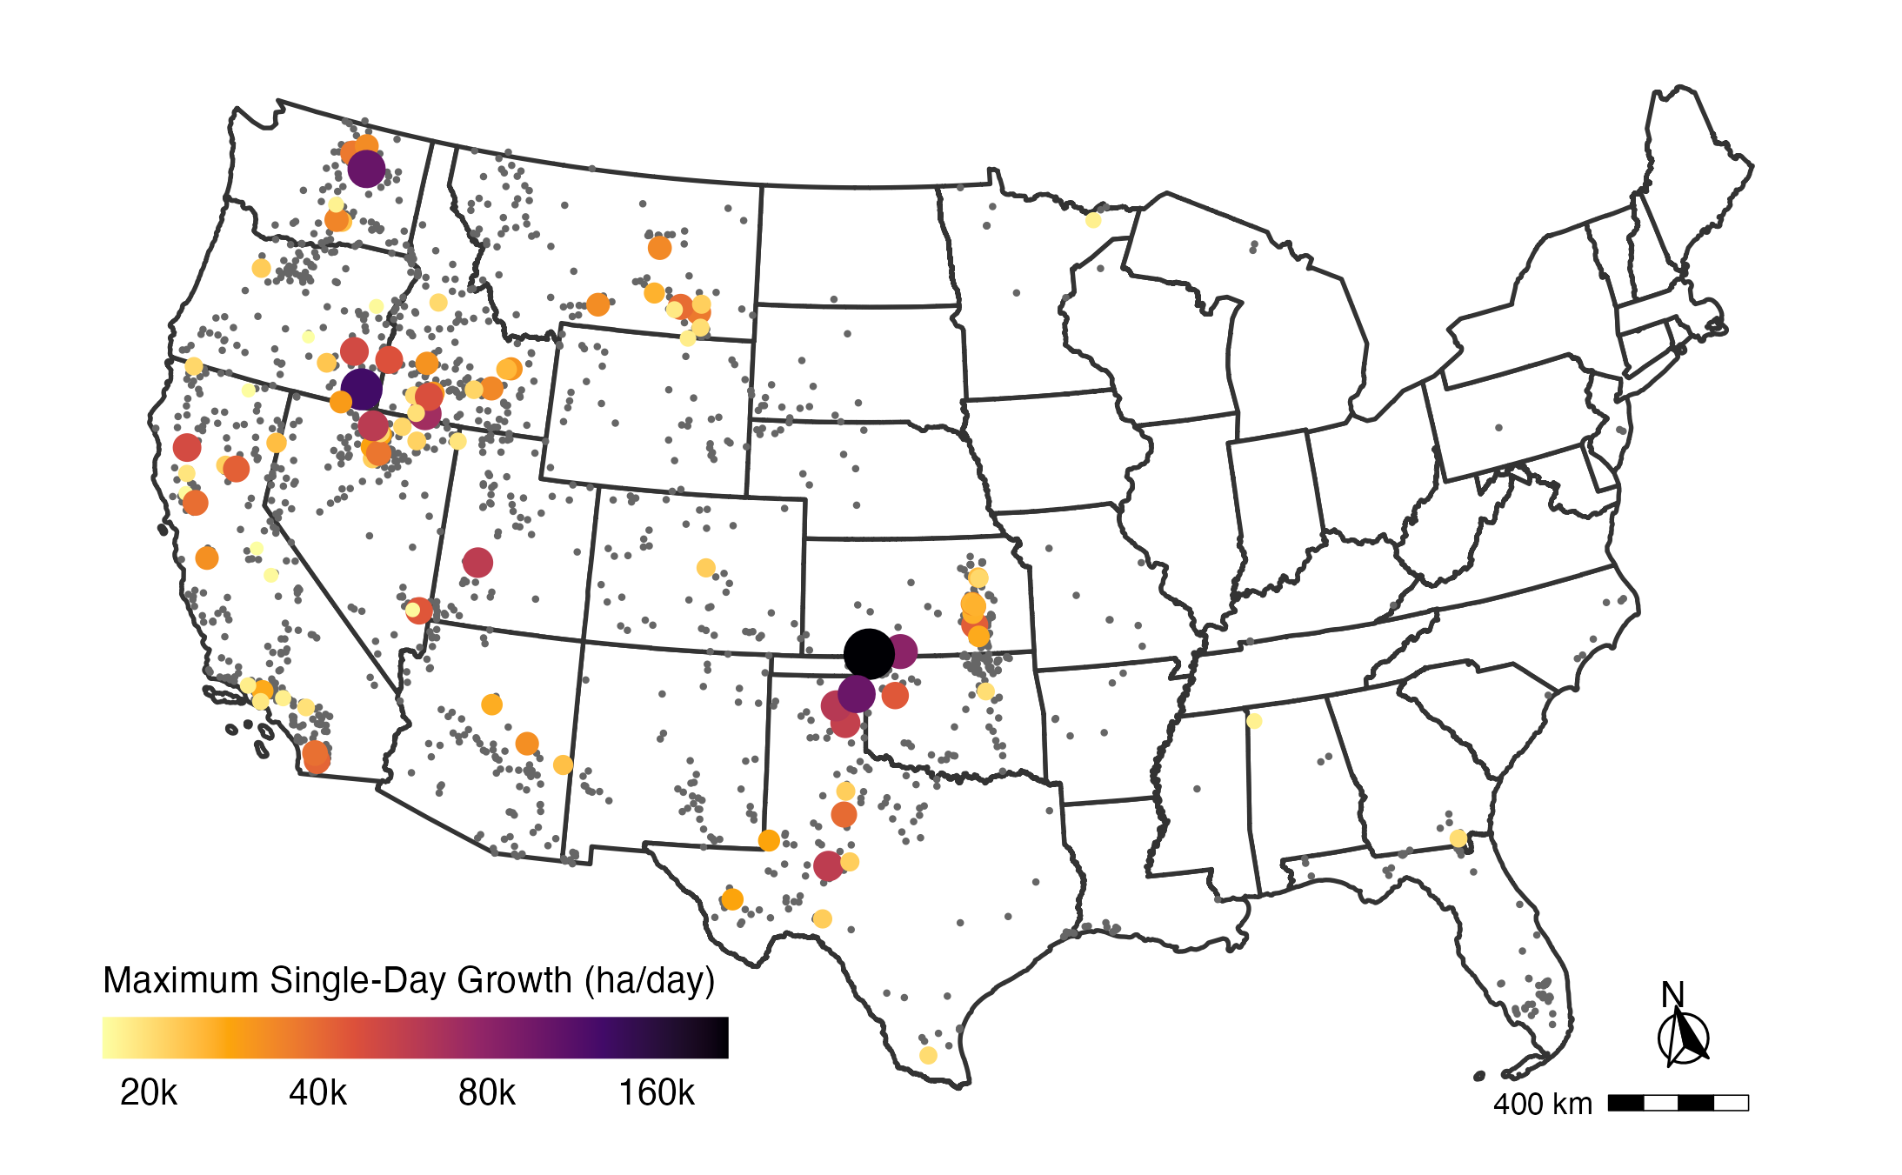
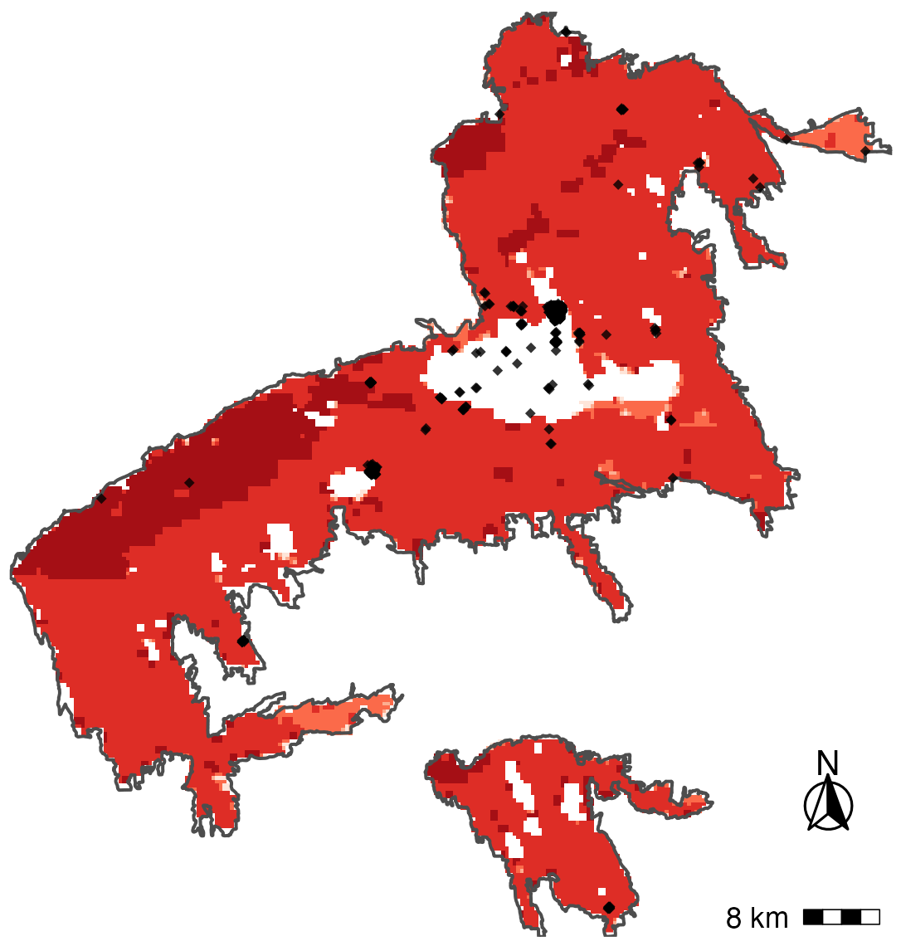
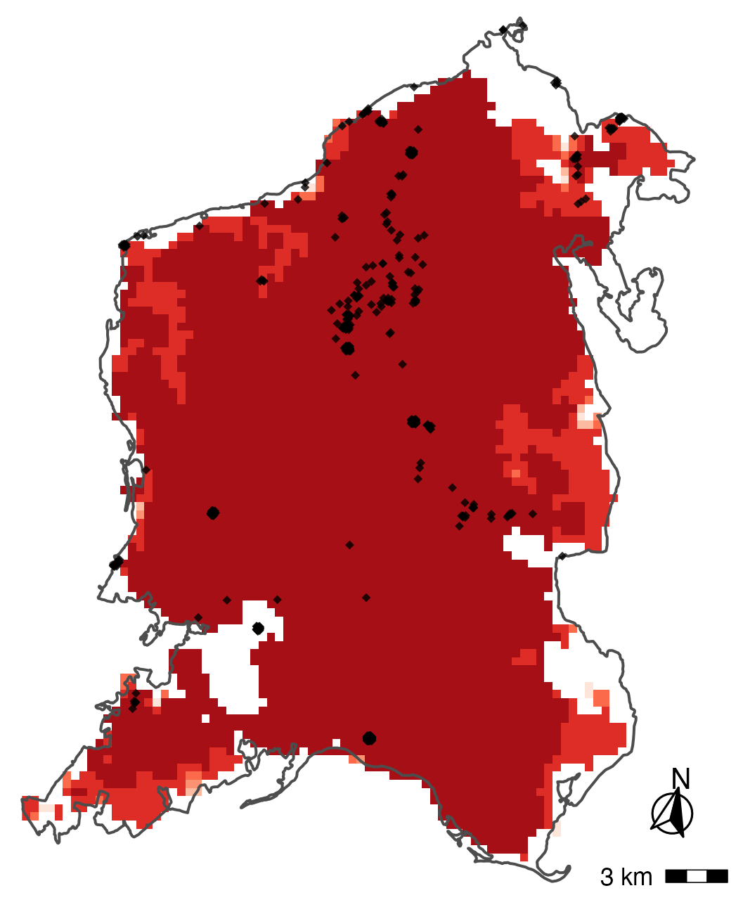
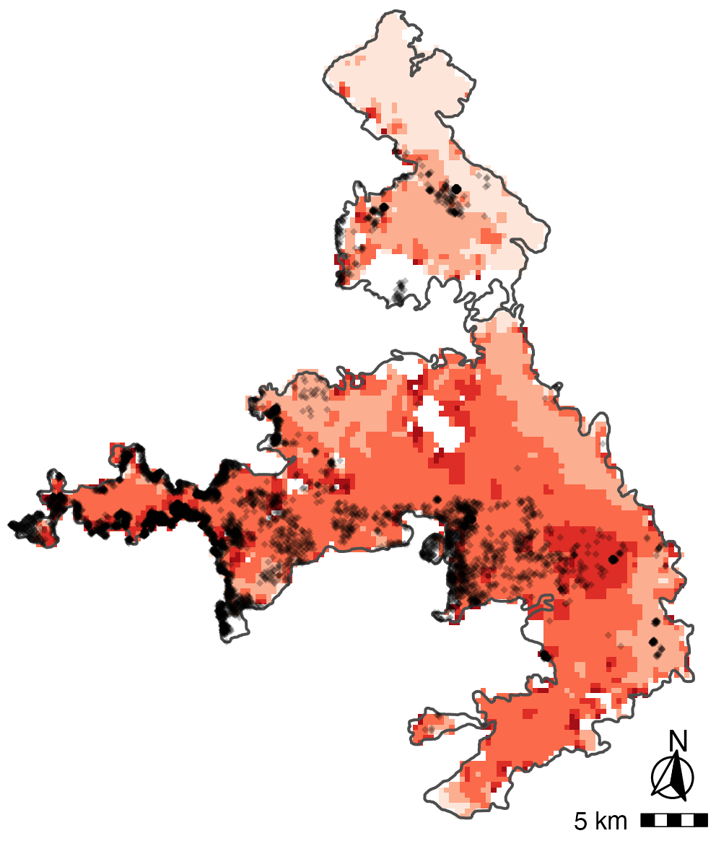
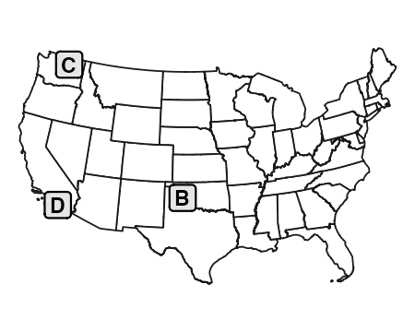
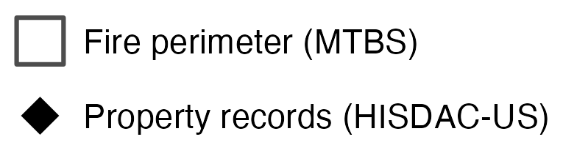
A
B
NW Oklahoma Complex (2018)
C
Cold Springs (2020)
D
Witch-Poomacha (2007)
Woodward, OK
Wenatchee, WA
San Diego, CA
40Km
100Km
50Km

