Slide 1
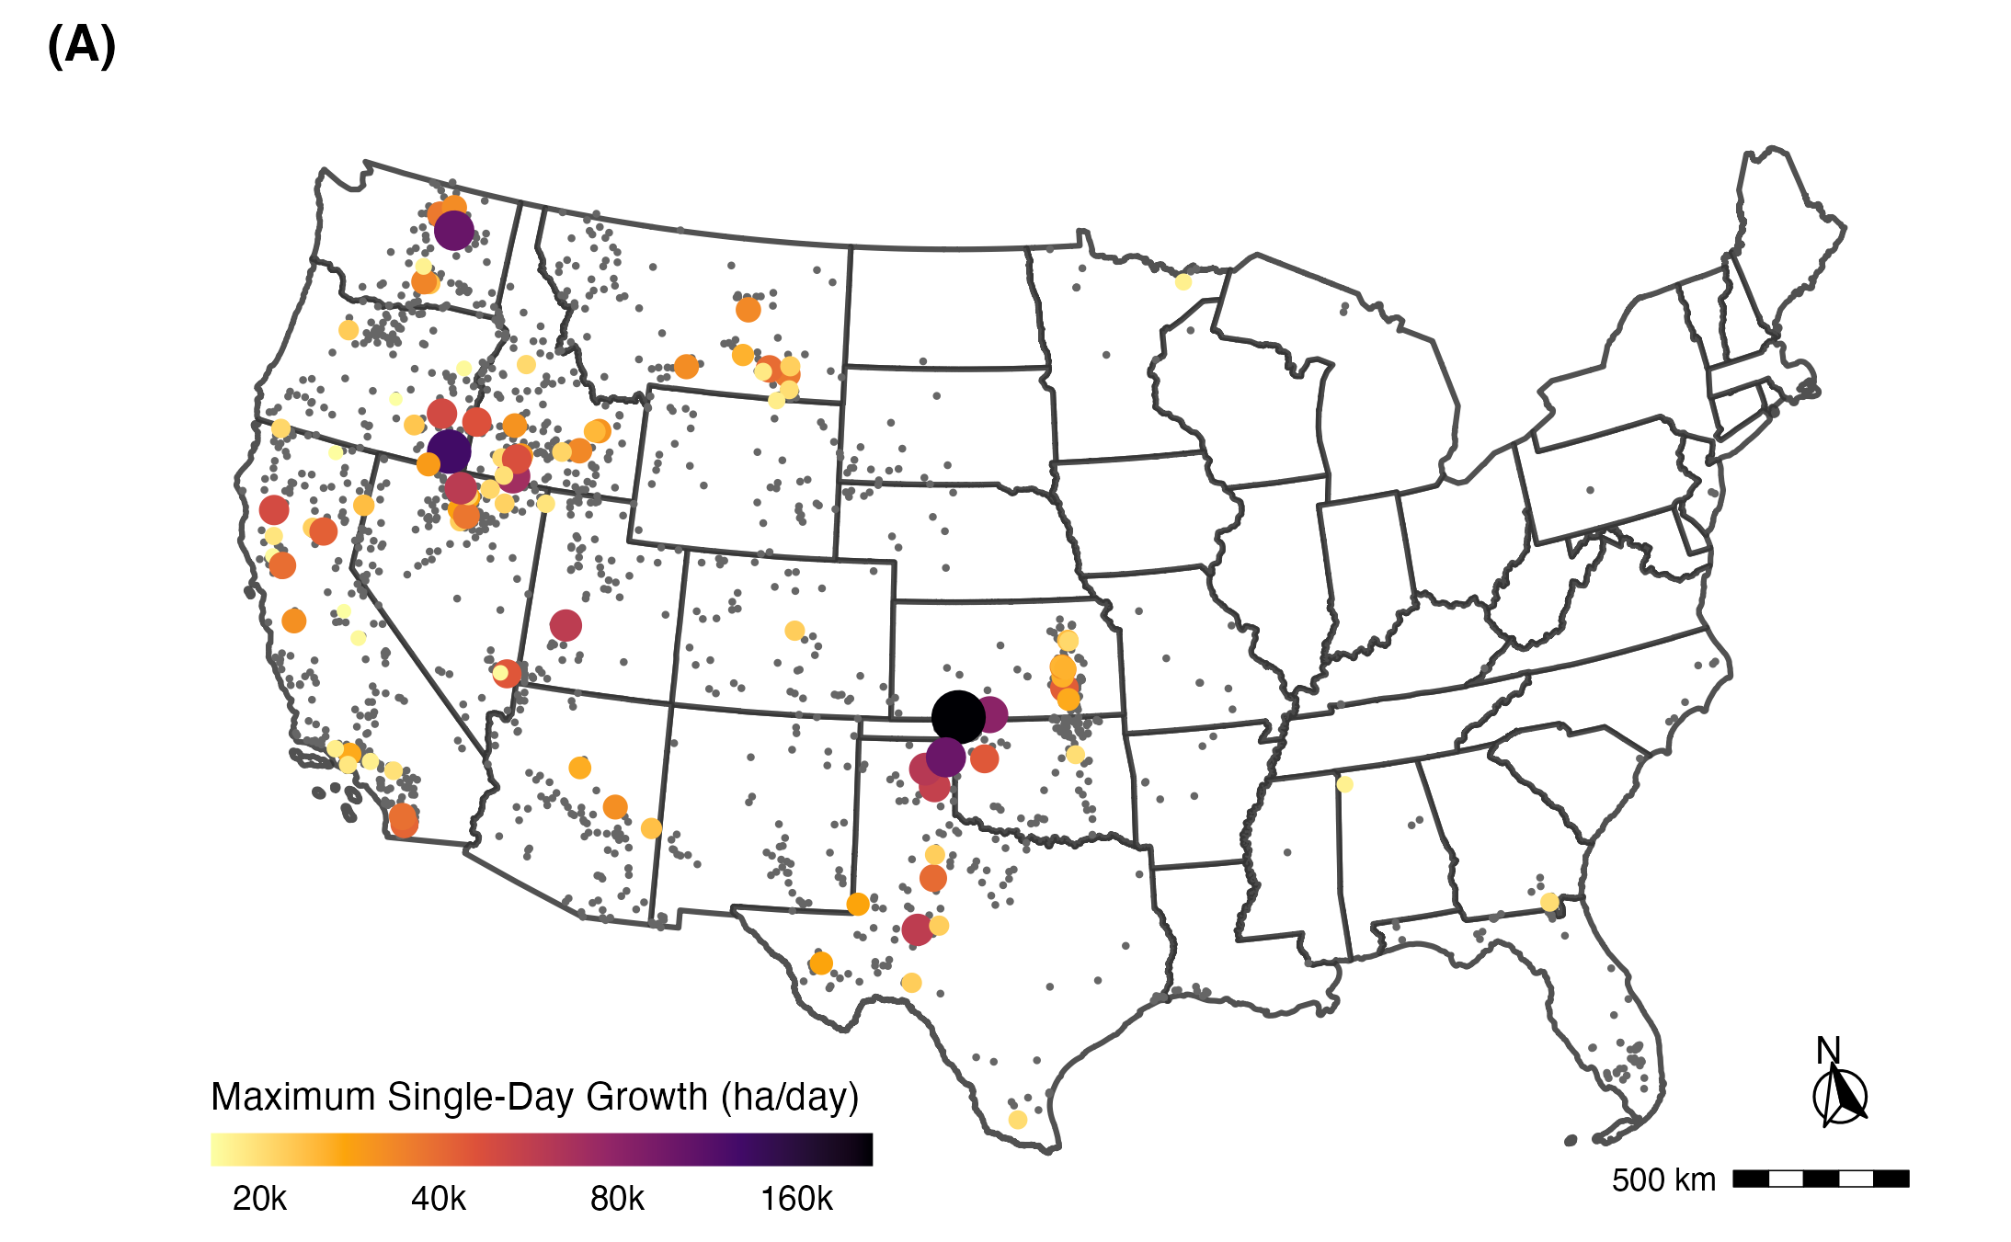
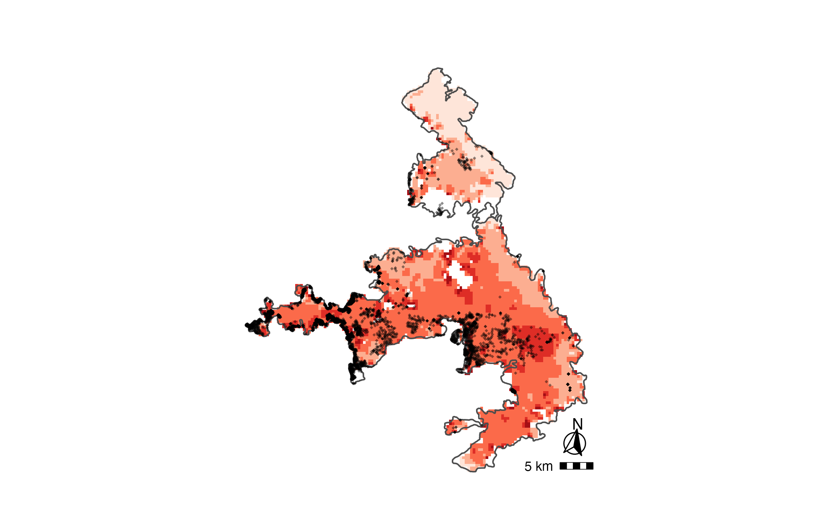
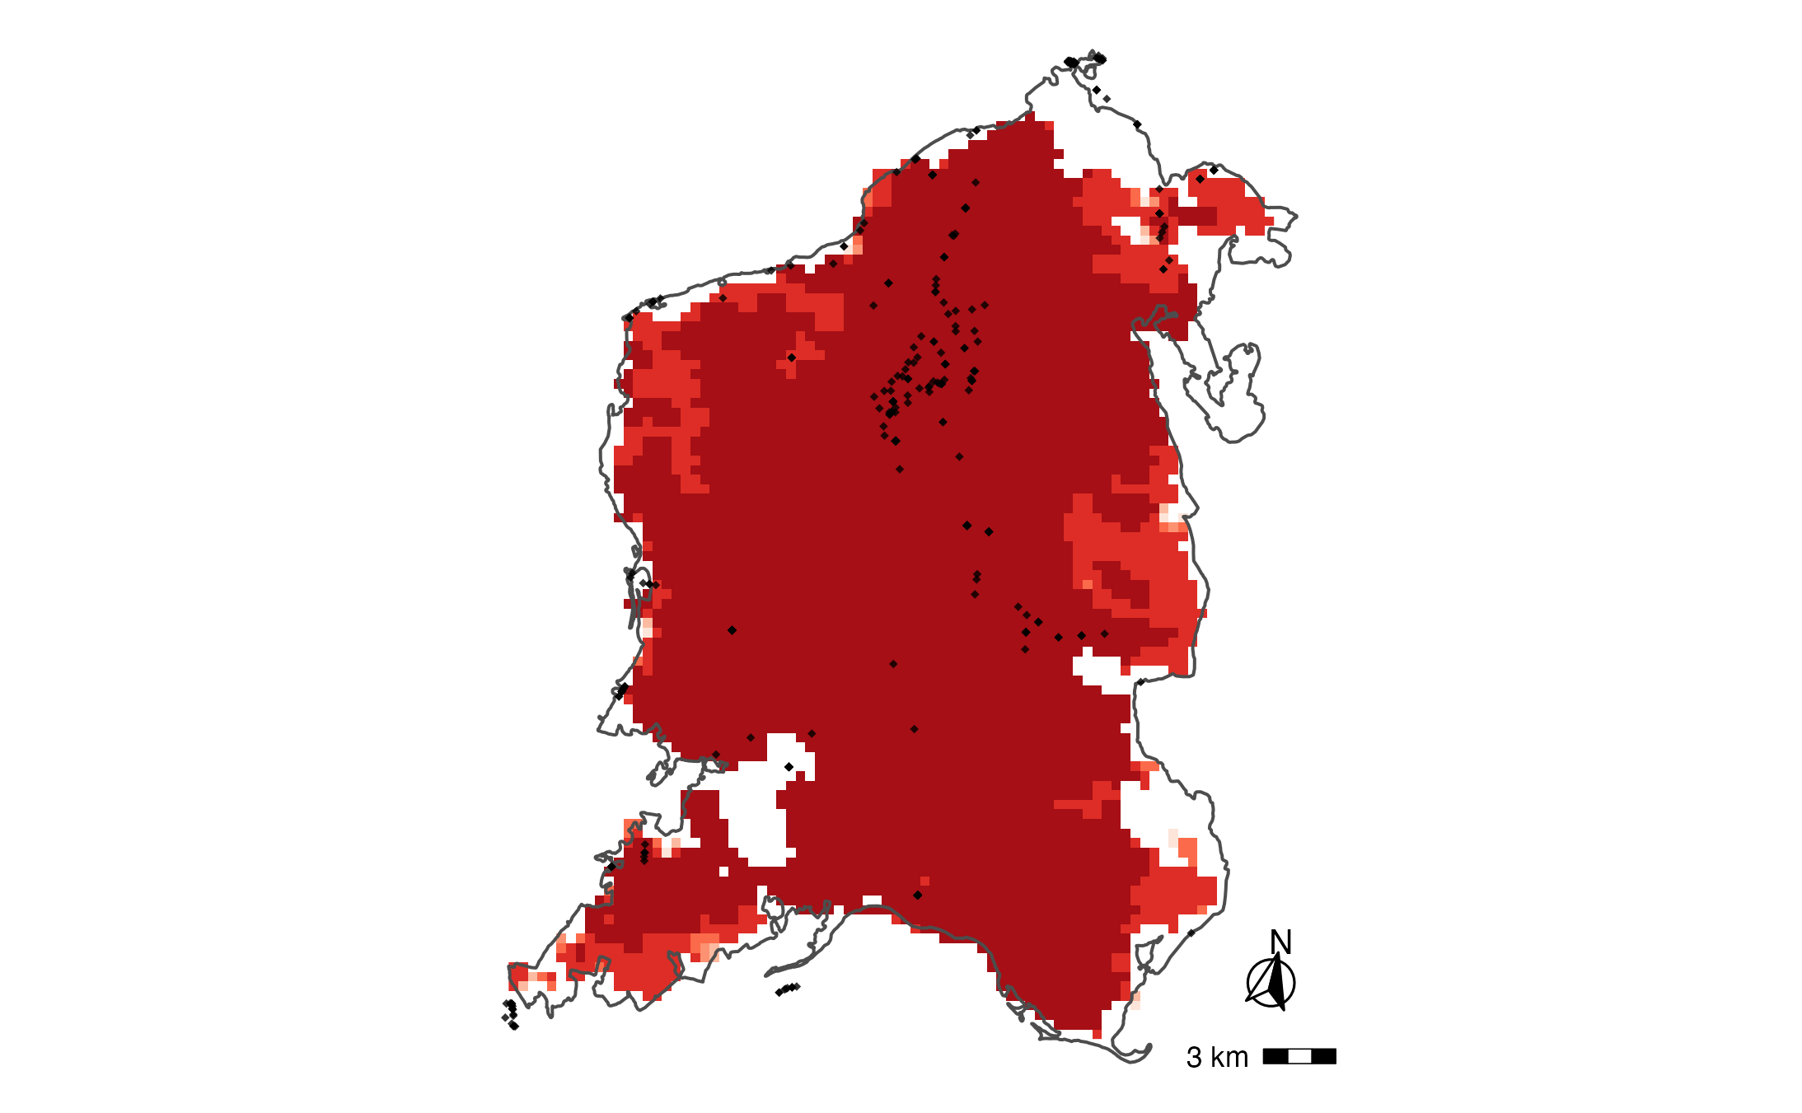
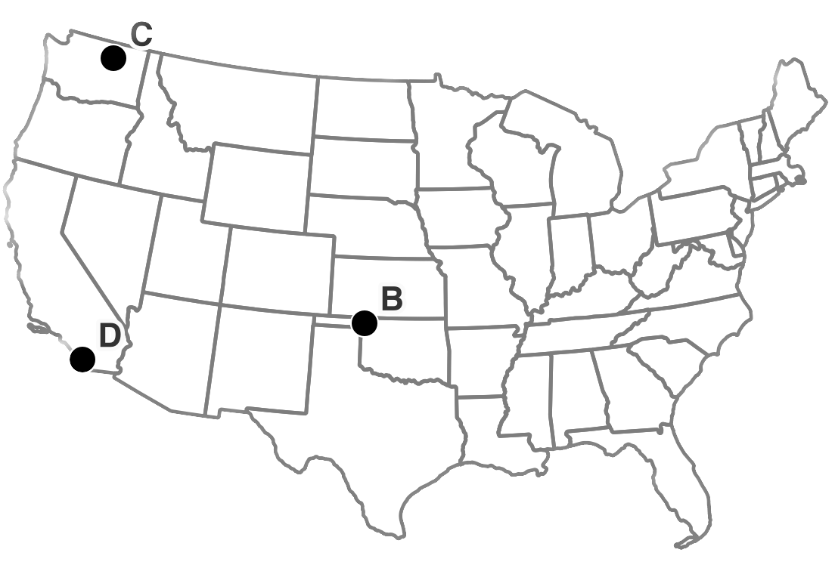
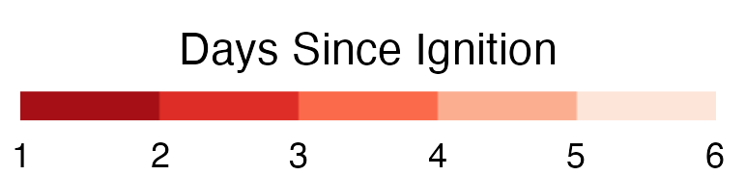
(B)
NW Oklahoma Complex (2018)
(C)
Cold Springs (2020)
(D)
Witch-Poomacha (2007)
Woodward, OK
Wenatchee, WA
San Diego, CA
40Km
100Km
50Km
Property locations (HISDAC-US)
Wildfire perimeter (MTBS)

