Slide 1

fuelscape/
models/
weather/
spread/
suppression/
fb_tools
A Python Wrapper for Fire Behavior Modeling
CFRI Spatial Analyst Capability Area
06.10.2026
github.com/maxwellCcook/fb_tools

Slide 2
What is fb_tools?
Python wrapper
fuelscape/
1
LANDFIRE + LCP + apply treatment, etc.
for CLI fire behavior models: FlamMap, FSPro, FSim, MTT, Cell2Fire, QuicFire, etc.
Integration with CFRI workflows
models/
2
LANDFIRE acquisition, “treated” fuelscapes, FlamMap, delta SDI, fire transmission
FlamMap · FSPro · MTT
weather/
3
Scriptable modeling
HRRR · GridMET · RTMA
Repeatable, batch-capable fire behavior analysis for expanded model runs, ensembles, and integration with other workflows (e.g., TEALOM)
spread/
4
Open source
Burn probability · Perimeters
github.com/maxwellCcook/fb_tools (need to transition to CFRI GitHub)
Flexible
suppression/
5
SDI
Integration of other models, data acquisitions, weather summaries, external libraries (e.g., rastertools), cloud-compute / batch analysis

Slide 3
Workflows Overview
INPUTS / ACQUISITION
MODELS
OUTPUTS / ANALYSIS
LANDFIRE
fuelscape/lfps.py
FlamMap
scenarios · batch
Burn Probability
spread/bp.py
NOAA HRRR Winds
weather/hrrr.py
FSPro / FSim
counterfactuals
Event Sets
spread/perimeters.py
GridMET ERC +
weather/gridmet.py
MTT
batch runs
Suppression Difficulty Index
suppression/sdi.py
RTMA Fuel Moisture +
weather/rtma.py
Cell2Fire
Zonal Statistics
analysis/zonal.py
OpenStreetMap
suppression/roads.py
WindNinja
Geospatial Utilities
utils/geo.py
ArcGIS REST Services
utils/rest_api
QuicFire
Plotting
utils/plot.py + plotting/
Other not-yet-implemented (for example)
RAWS data scraping
rastertools (USFS) integration
MacOS compatibility (for fire models)
End-to-end test suite / training notebooks
Ember cast models

Slide 4
Implemented Methods
fuelscape/
models/
• LANDFIRE download (LFPS REST API)
• FlamMap/MTT batch scenarios [run_batch()]
• LCP raster stacking
• FSPro counterfactual pairs [treated/un-treated]
• Fuel treatment adjustments
weather/
spread/
• HRRR wind climatology (via HERBIE)
• Delta burn probability (‘upwind’ from value)
• GridMET ERC climatology + classes (via GEE)
• Delta arrival time (to value)
• RTMA hourly dead FM & live FM (via GEE)
• Perimeter set (FSPro/Fsim) analysis [size, shape, etc.]
suppression/
analysis/ & utils/
• calculate_sdi() — SDI raster
• Zonal statistics helpers
• calculate_delta_sdi() — treatment delta
• Raster and vector processing
• Plotting

Slide 5
fuelscape/
models/
weather/
spread/
suppression/
HRRR
GridMET
NWS RTMA
Hourly · via Herbie
Daily · GEE export
Hourly · GEE · 2.5 km
Variables
Variables
Variables
• Wind speed
• ERC climatology
• FM1/FM10/FM100 (dead)
• Wind direction
• ERC classes (5 bands)
• FM_herb/FM_woody (live)
• FM100/FM1000
• Fire-masked pyrome means
weather/hrrr.py
weather/gridmet.py
weather/rtma.py
build_flammap_wind_data()
build_flammap_scenario_cache()
build_rtma_scenario_fm()
ERC GridMET-derived — the FSPro/FSim daily-climatology
RTMA upgrades the dead-FM and live-FM legs of FlamMap percentile scenarios via NFDRS78 time-lag recursion and GSI at 1-hour time steps.

Slide 6
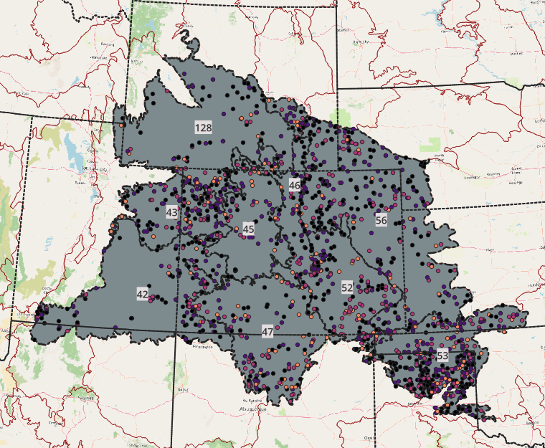
fuelscape/
models/
weather/
spread/
suppression/
What is NWS RTMA?
Resolution
NOAA / NWS Real-Time Mesoscale Analysis
2.5 km (CONUS)
Produced by NOAA/NWS using the Rapid Refresh (RAP) assimilation system. Ingests surface observations, radar, satellite, and NWP model output to produce a gridded, analysis-quality surface weather field at hourly cadence.
Cadence
Hourly
• Continuous hourly archive from 2011 to present
Archive
2011–present (15 years)
• CONUS coverage at native 2.5 km resolution
GEE
• Available via Google Earth Engine: NOAA/NWS/RTMA
NOAA/NWS/RTMA
• Key bands: TMP (°C), DPT (°C), ACPC01 (precip, mm/hr)
CO Pyromes
42, 43, 45, 46, 47, 52, 53, 56, 128
• Derived: RH (%), VPD (Pa), EMC (%) computed per-pixel in GEE
Fire season
April 1 – October 31

Slide 7
fuelscape/
models/
weather/
spread/
suppression/
NWS RTMA Fuel Moisture Pipeline
1
GEE Export
EMC per-pixel in GEE before spatial averaging — avoids EMC(mean T, mean RH) bias
Hourly RTMA (2.5 km, 2011–present) → pyrome-mean CSV, fire-masked to MODIS 2001–2022
2
Dead FM
build_rtma_dead_fm() → FM1 / FM10 / FM100
NFDRS78 time-lag recursion at 1-hr steps · saturation-stall precip handling (Bradshaw 1984) – follows National Fire Danger Rating Index (NFDRS)
3
Live FM
build_rtma_live_fm() → FM_herb / FM_woody
Growing Season Index (GSI)-based herb/woody using daytime VPD window 13:00–16:00 LST and daily Tmin (Jolly et al 2005, 2024)
4
Peak-Hour Collapse
collapse_to_peak_hour()
Resample to daily rows at 14:00 LST to match RAWS / FireFamilyPlus convention
5
Scenario Medians
build_rtma_scenario_fm() — used when dead_fm_source='rtma'
Per-pyrome, per-ERC-band FM medians → consumed by FlamMap scenario builder

Slide 8
fuelscape/
models/
weather/
spread/
suppression/
GEE Export Pipeline
1
Pull RTMA Collection
Bands kept: TMP, DPT, ACPC01 (drop unused bands early for speed)
NOAA/NWS/RTMA filtered to CO pyrome bounds · April 1 – October 31 · one year per export task
2
Per-pixel Derived Bands
EMC per pixel BEFORE spatial averaging — avoids EMC(mean T, mean RH) nonlinear bias
T°C → T°F · Magnus formula → RH (%) and VPD (Pa) · 3-regime NFDRS EMC (Cohen & Deeming 1985)
3
Apply MODIS Fire Mask
Restricts all pyrome reductions to historically burnable pixels
MCD64A1 burned area 2001–2022 → ever_burned_500m → aggregated to 2.5 km via reduceResolution
4
Batch Reduce to Pyrome Means
tileScale=4 prevents memory-limit errors on large pyrome geometries
reduceRegions across 9 CO pyromes in one server operation (replaced 9 serial reduceRegion calls)
5
Export CSV to Google Drive
Schema: pyrome_id, datetime_utc, tmp_f, rh_pct, emc_pct, vpd_pa, pcp_mm_hr
One task per year → fb_tools_weather/rtma_hourly_CO_pyromes_YYYY.csv
Output: 15 yearly CSVs · 683,676 hourly rows · 9 CO pyromes · 2011–2025

Slide 9
fuelscape/
models/
weather/
spread/
suppression/
Dead Fuel Moisture — Equilibrium Moisture Content (EMC)
National Fire Danger Rating System (NFDRS) standard equations based on the EMC (Cohen & Deeming, 1985)
① RTMA Inputs
② EMC (per pixel, GEE)
③ NFDRS78 Time-Lag
Outputs
T (°F) — TMP band
Cohen & Deeming (1985)
Each hour: fuel moisture nudges toward EMC
FM1
RH (%) — from T / Td bands
→
3-regime piecewise in T, RH
→
How fast depends on the time constant (τ)
→
FM10
Precip (mm/hr) — ACPC01 band
"moisture fuels aim for"
FM1 nearly tracks EMC; FM100 integrates weeks
FM100
Hourly · 2.5 km · GEE
→ per pixel before avg
Run hourly per-pyrome on the RTMA export
How fast does each fuel class respond?
FM1
τ = 1 hr
FM10
τ = 10 hr
FM100
τ = 100 hr
α ≈ 0.63/hr
α ≈ 0.095/hr
α ≈ 0.010/hr
Responds within 1–2 hours. Tracks EMC almost instantly — very sensitive to afternoon drying.
~1-day memory. Smooths the diurnal cycle; rises overnight, falls through the afternoon.
~3-week memory. Reflects antecedent drought history — slow to dry, slow to recover.

Slide 10
fuelscape/
models/
weather/
spread/
suppression/
Live Fuel Moisture — Growing Season Index (GSI)
Three weather attributes multiply to give a 0–1 greenness index (Jolly et al. 2005, 2024)
i_Tmin
Minimum Temperature
GSI i_Tmin × i_VPD × i_Photo (0 – 1)
FM outputs
Daily Tmin
→
Freezing → dormant: ≤ −2°C → i = 0
FM_herb
Warm enough → active: ≥ 5°C → i = 1
Herbaceous
×
→
GSI = 0 → 30% (dormant)
i_VPD
Vapour Pressure Deficit
GSI = 1 → 250% (fully green)
Mean VPD 13:00–16:00 LST
Very dry → stomata close: ≥ 4100 Pa → i = 0
FM_woody
0 = dormant 1 = fully green
Woody
Moist enough → active: ≤ 900 Pa → i = 1
×
GSI = 0 → 60% (dormant)
GSI = 1 → 200% (fully green)
i_Photo
Daylength
Photoperiod (sunrise → sunset)
Short days → dormant: ≤ 10 hr → i = 0
Long days → active: ≥ 11 hr → i = 1

Slide 11
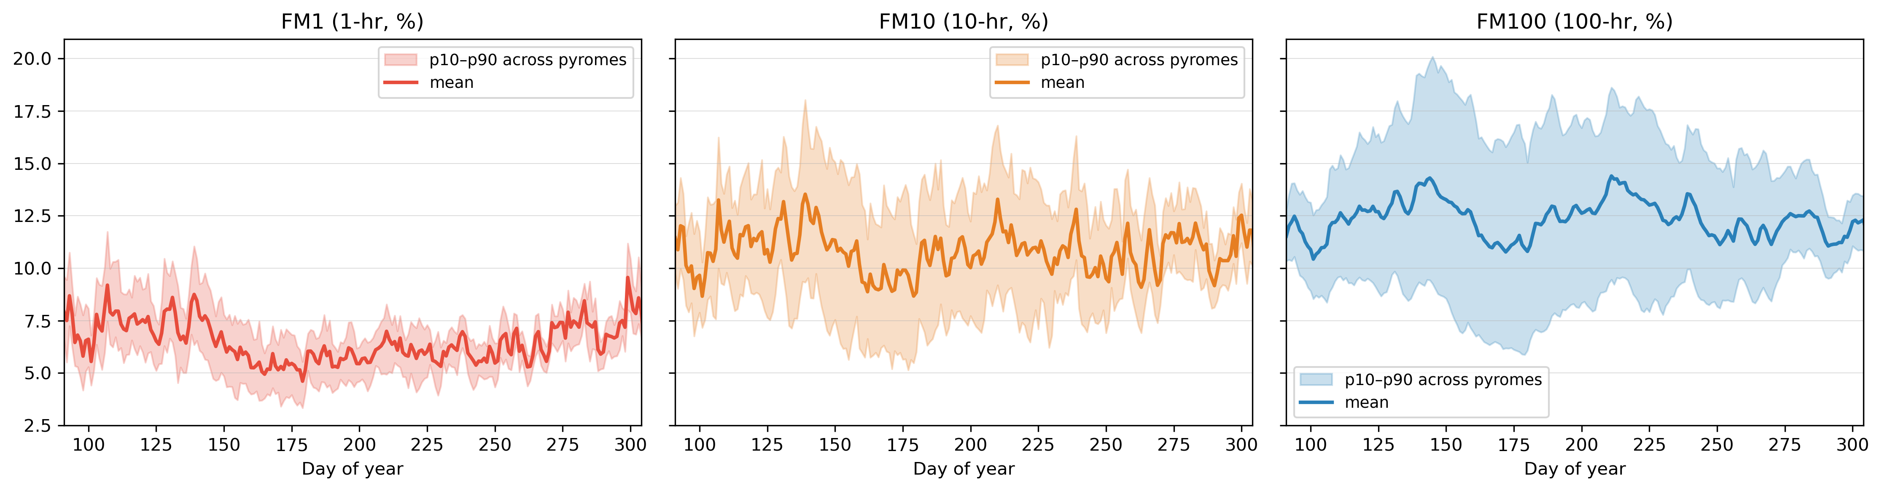
fuelscape/
models/
weather/
spread/
suppression/
NWS RTMA Dead Fuel Moisture (NFDRS-based)
Seasonal climatology of dead FM — all CO pyromes, 2011–2025 (April 1 – October 31, daily peak hour 14:00 LST):
RTMA scenario FM at p50 / p90 / p97 — Pyrome 46 (Front Range) example (from build_rtma_scenario_fm):
ERC pct
FM1
FM10
FM100
FM_herb
FM_woody
ERC center
Dead FM Note
p50
6.5
10.4
13.2
89.1
97.6
48.0
p90
4.5
7.4
10.1
49.3
72.3
67.0
p97
3.8
6.0
7.9
30.0
60.0
74.0

Slide 12
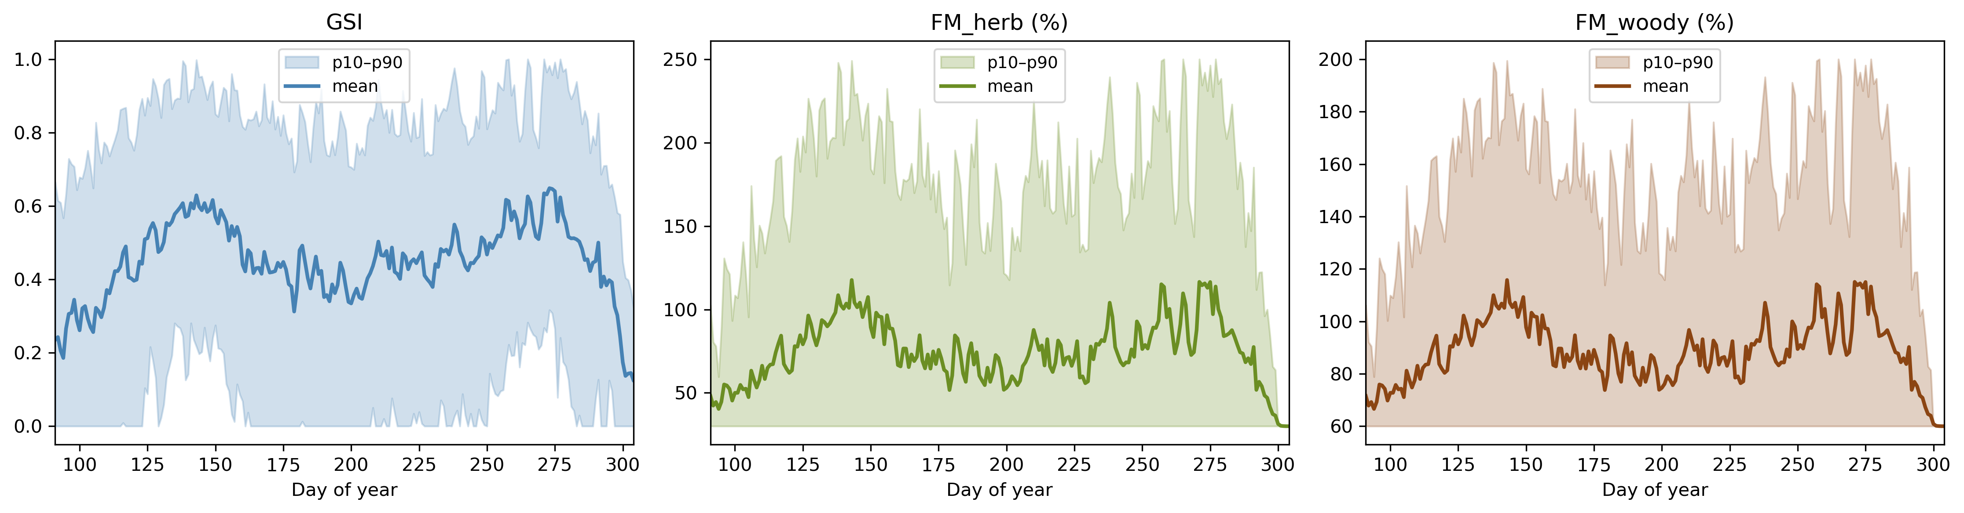
fuelscape/
models/
weather/
spread/
suppression/
NWS RTMA Live Fuel Moisture (GSI-based)
Seasonal climatology of GSI and live FM — all pyromes, 2011–2025 (mean ± p10–p90 ribbon):
RTMA scenario FM at p50 / p90 / p97 — Pyrome 46 (Front Range) example (from build_rtma_scenario_fm):
ERC pct
FM1
FM10
FM100
FM_herb
FM_woody
ERC center
GSI note
FM_herb/FM_woody collapse to dormant floor (30/60%) at p90–p97 — GSI compressed near zero during extreme fire weather in semi-arid CO.
p50
6.5
10.4
13.2
89.1
97.6
48.0
p90
4.5
7.4
10.1
49.3
72.3
67.0
p97
3.8
6.0
7.9
30.0
60.0
74.0

Slide 13
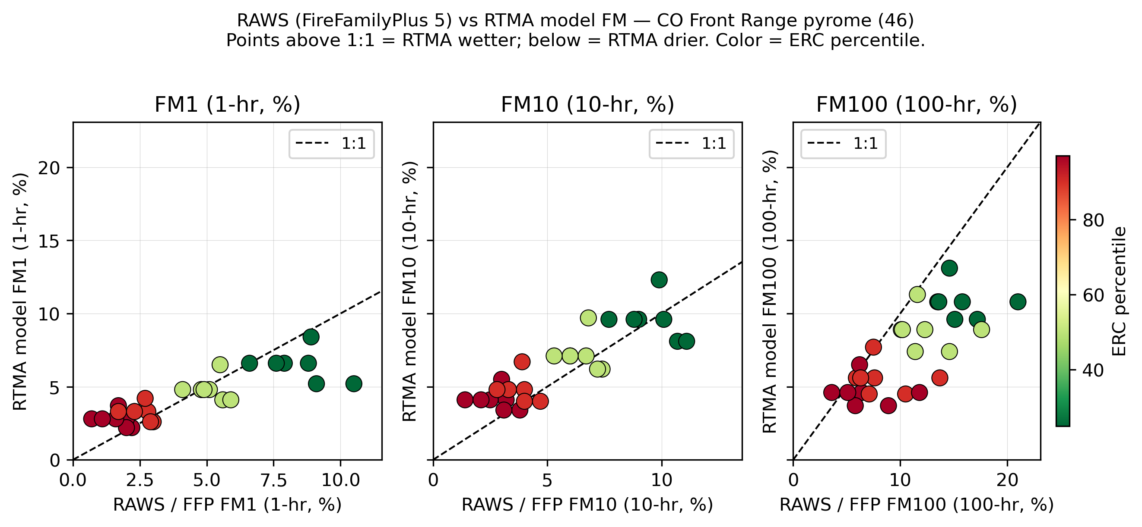
fuelscape/
models/
weather/
spread/
suppression/
RTMA vs. RAWS Station Summaries
Do FM distributions match?
RTMA pyrome-mean FM vs. local RAWS summaries by ERC class
Are scenario FMs realistic?
RTMA percentile-band medians vs. RAWS/FireFamilyPlus values
Known GSI limitation
Jolly et al. (2005) thresholds calibrated temperate/boreal — may underperform in semi-arid western CO
Comparison against Rhea et al. 2024 (Denver Water, 9 RAWS station data)

Slide 14
fuelscape/
models/
weather/
spread/
suppression/
HRRR Wind
HRRR + HERBIE
Fire-hour wind extraction from NOAA High-Resolution Rapid Refresh at fire occurrence locations
What is HRRR?
Extraction workflow
• 3 km hourly analysis product from NOAA Rapid Refresh assimilation cycle
1
Fire occurrence database (FOD)
Filter to 2016+, spatial join to pyrome, retain ignition date + coordinates
• AWS archive via herbie-data: s3://noaa-hrrr-bdp-pds/ (2016–present)
2
Build download schedule
• 10m winds: UGRD / VGRD components (m/s) → speed (mph) + direction (°FROM)
Each fire × n_days × 4 UTC fire-hours [19,20,21,22] → deduplicated (date, hour) pairs
• Analysis F00 — not a forecast; represents best-estimate at time of issue
3
Herbie download + cache
One GRIB2 per (date, hour); cached to disk — ~6 GB for ~900 CO fires 2016–2023
Fire hours: 19–22Z ≈ 13:00–16:00 MDT (peak spread window) · n_days=5 (ignition + 4 spread days) · k=9 neighbors to boost obs without extra downloads · HRRR archive starts 2016 reliably
4
KD-tree wind extraction
HRRR lon 0–360 → −180/180; tree built once per file; k=9 neighbors (~9×9 km) per fire
5
Build WindCellValues
Group by pyrome → 6-speed × 8-direction frequency table + CalmValue; write JSON cache

Slide 15
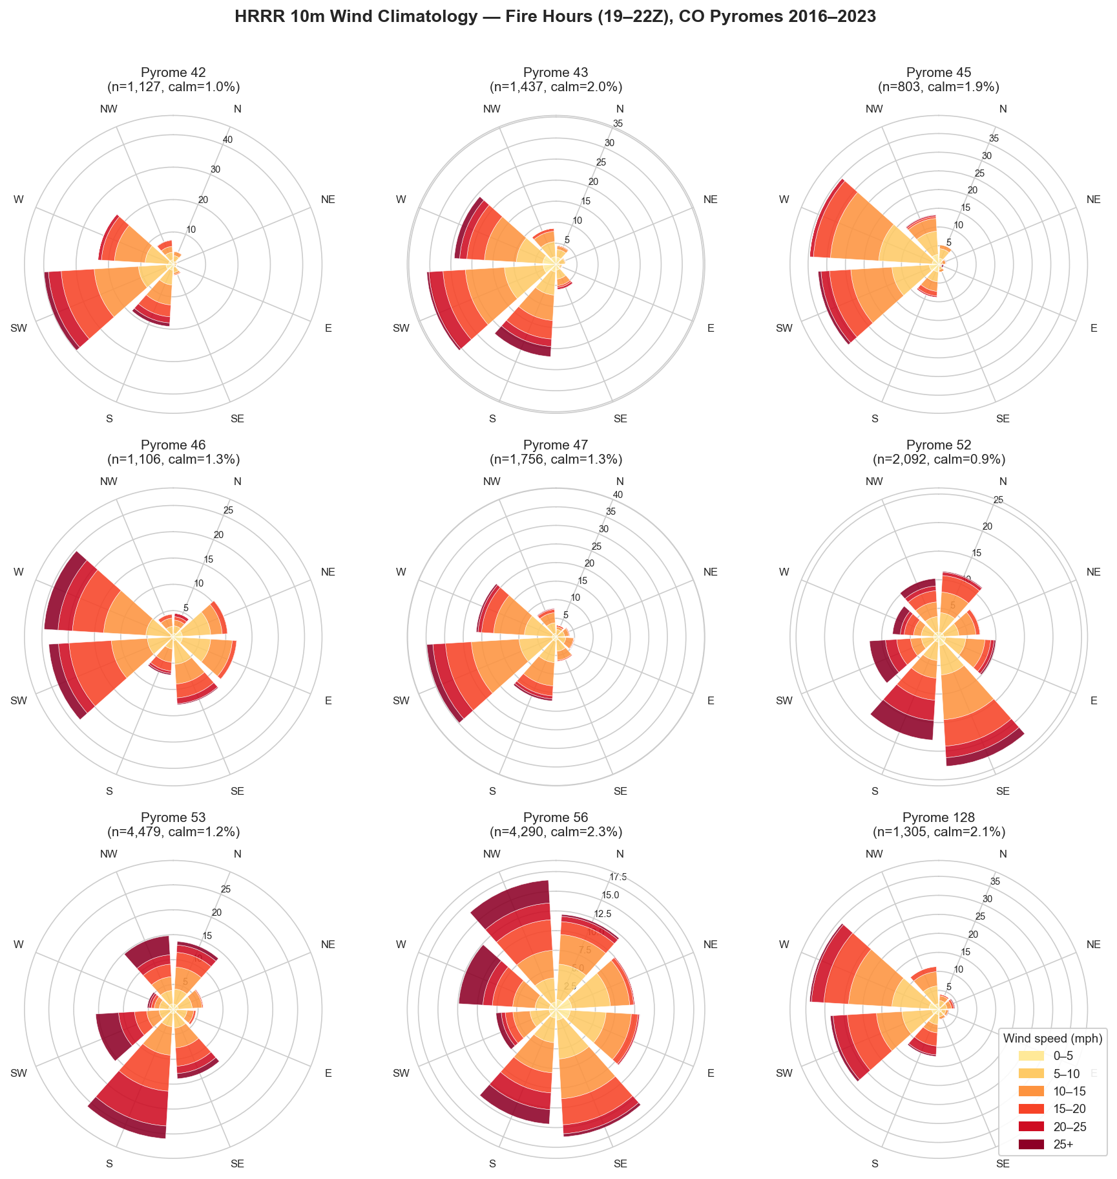
fuelscape/
models/
weather/
spread/
suppression/
HRRR Wind
Per-pyrome wind summary (peak fire hours, 2016–2023)
Pyrome
n obs
Calm %
Dom. dir
Dom. spd bin
42
1,127
1.0%
SW/W (248°)
10–15 mph
43
1,437
2.0%
SW/W (248°)
5–15 mph
45
803
1.9%
W/NW (292°)
5–15 mph
46
1,106
1.3%
W/NW (292°)
10–20 mph
47
1,756
1.3%
SW/W (248°)
10–15 mph
52
2,092
0.9%
S (158°)
10–20 mph
53
4,479
1.2%
SW (202°)
10–25 mph
56
4,290
2.3%
N (338°)
5–15 mph
128
1,305
2.1%
NW (292°)
5–15 mph

Slide 16
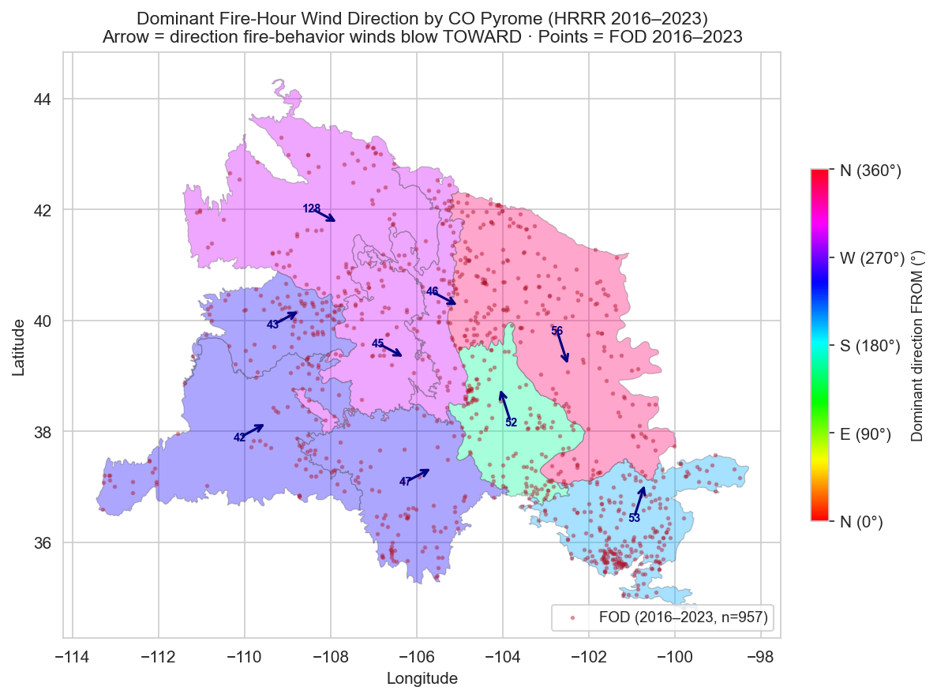
fuelscape/
models/
weather/
spread/
suppression/
HRRR Wind
Per-pyrome wind summary (peak fire hours, 2016–2023)
Pyrome
n obs
Calm %
Dom. dir
Dom. spd bin
42
1,127
1.0%
SW/W (248°)
10–15 mph
43
1,437
2.0%
SW/W (248°)
5–15 mph
45
803
1.9%
W/NW (292°)
5–15 mph
46
1,106
1.3%
W/NW (292°)
10–20 mph
47
1,756
1.3%
SW/W (248°)
10–15 mph
52
2,092
0.9%
S (158°)
10–20 mph
53
4,479
1.2%
SW (202°)
10–25 mph
56
4,290
2.3%
N (338°)
5–15 mph
128
1,305
2.1%
NW (292°)
5–15 mph

Slide 17
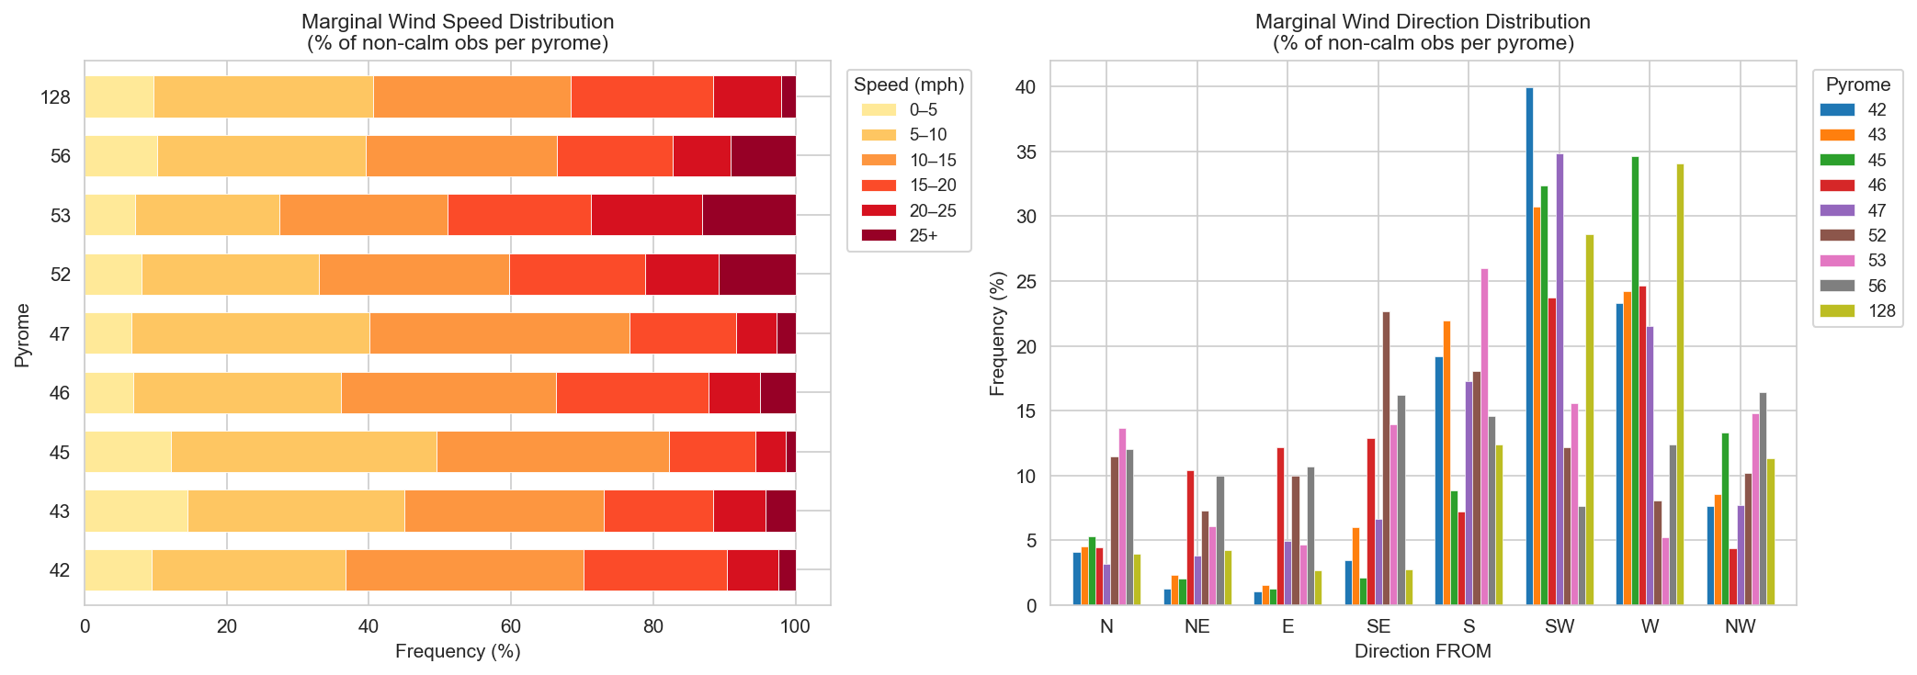
fuelscape/
models/
weather/
spread/
suppression/
HRRR Wind
Proportion of valid wind observations across wind speed bins and wind direction (from)

Slide 18
fuelscape/
models/
weather/
spread/
suppression/
Ex. FlamMap Input
Demo !
https://github.com/maxwellCcook/fb_tools/blob/main/code/notebooks/__Modules_Test.ipynb
1
Download LANDFIRE
lfps_request(), stack_rasters()
LFPS REST API → topo + fuel layers → stack into LCP
2
Adjust Fuels
apply_treatment()
Apply treatment scenarios to fuel model / canopy layers (optional adjustments e.g., lodgepole)
3
Assemble Weather
build_flammap_wind_data()
Wind cells (HRRR) · fuel moisture (RTMA) · ERC (GridMET), Pyrome-specific
4
Build & Run
run_flammap_scenarios()
Generate config files and execute batch FlamMap scenarios
5
Outputs
.tif rasters
Flame length · spread rate · crown fire fraction rasters

Slide 19
fuelscape/
models/
weather/
spread/
suppression/
Ex. FSPro Counterfactuals Input
Objective: Did this treatment meaningfully reduce potential fire spread, arrival time, behavior relative to values at risk?
DESIGN
OUTPUTS
1
Spatial unit
Delta Burn Probability / Arrival Time
HUC12 / fireshed / POD — any spatial container
Treated minus Baseline — pixel-wise BP change
delta_burn_probability()
2
Ignitions
Polygon/polyline boundary (buffered point), can use known ignition locations, generate random ignitions, or conditional ignition (upwind, within a distance). Select N ignitions for ensemble.
Early-Growth Metrics
Area at day 3/7, arrival at treatment boundary
Paired runs
summarize_early_growth()
3
Baseline LCP vs. Treated LCP — same input file, same SPOTTING_SEED
Growth Curves
4
Weather
Paired baseline vs. treated fire growth comparison
Identical conditioning using SPOTTING_SEED: same ERC climatology, same wind cells for both runs, Pyrome-specific
compare_growth()
SPOTTING_SEED pairing — every ignition has an identical twin, differing only in fuel state

Slide 20
fuelscape/
models/
weather/
spread/
suppression/
Wind Conditioning — FSPro / FSim
WindCellValues
HRRR fire-hour climatology → probabilistic joint speed-direction distribution per pyrome
1
Fire occurrence database (FOD)
FSPro Input File — Wind Section
Filter to 2016+ · spatial join to CO pyromes
NumWindSpeeds
6 (speed bins)
2
HRRR extraction (weather/hrrr.py)
Fire hours 19–22Z · n_days = 5 · k = 9 neighbors per ignition
NumWindDirs
8 (N NE E SE S SW W NW)
3
build_wind_cells()
WindSpeedBreaks_mph
5 10 15 20 25 30
Group by pyrome → 6-speed × 8-dir frequency table + CalmValue
WindDirBreaks_deg
22.5 67.5 112.5 157.5 202.5 247.5 292.5 337.5
4
JSON cache (data/weather/pyrome_wind/)
One pyrome_XX.json per pyrome · reloaded by build_fspro_inputs()
CalmValue
% of fire-hour obs with speed < first bin
5
build_fspro_inputs() (models/fspro.py)
WindCellValues
6 rows × 8 cols · % frequency · rows sum ≈ 100 − Calm
Writes WindCellValues + CalmValue into FSPRO-Inputs-File-Version-4
FSPro draws independently from this joint distribution for each simulated fire — capturing the observed spread of fire-weather wind conditions rather than a single assumed scenario.
Notes:
The 6×8 WindCellValues table is a joint probability distribution (speed AND direction together), not independent marginals. CalmValue is kept separate because calm obs have no meaningful direction. The k=9 neighbor approach boosts sample size ~9× without extra GRIB downloads — valid because HRRR 3-km resolution means adjacent cells are nearly identical for synoptic-scale fire-weather winds. Calm % of ~1-2% at fire hours (19-22Z) confirms the UTC window captures active fire weather.

Slide 21
fuelscape/
models/
weather/
spread/
suppression/
ERC Conditioning — FSPro / FSim
GridMET → ERC Classes
GridMET pyrome climatology → 15-year historical ERC record + class-based fuel moisture lookups
1
GEE GridMET export (weather/gridmet.py)
FSPro Input File — ERC Sections
Pyrome-mean daily ERC · April 1–Oct 31 · 2008–2022 · CSV per pyrome
NumERCYears / NumWxPerYear
15 years × 214 days (April 1 – Oct 31)
2
load_gridmet_erc()
CSV → 15-year × 214-day ERC array · plus FM100, Tmax, RHmin, VPD
HistoricERCValues
15 × 214 daily ERC values · FSPro draws a random year per ignition
3
build_erc_classes()
5 percentile bins → lower/upper + FM1/FM10/FM100/FM_herb/FM_woody + spot params (RTMA-based)
ERC class table (5 rows)
lower upper fm1 fm10 fm100 fm_herb fm_woody spot_dist spot_prob spot2
4
build_fspro_inputs() (models/fspro.py)
CurrentERCValues
Writes HistoricERCValues, ERC class rows, CurrentERCValues to input file
~79-day climatological median · sets ERC trajectory for scenario window, can be based on any given ignition date
ERC is the conditioning index: FSPro draws a random year from HistoricERCValues, maps the ERC at the ignition date to an ERC class row, and reads FM inputs from that row. Spread is probabilistic — not a single deterministic weather scenario.
Notes:
The 5 ERC class bins are typically set at roughly the 20th, 40th, 60th, 80th, and 97th percentile of the historical ERC distribution per pyrome. The FM values in each class come from build_erc_classes() — either the GridMET snapshot path (FM10 ≈ 1.28×EMC) or the RTMA hourly-lag path for improved FM1/FM10. SPOTTING_SEED is held constant across baseline/treated pairs for the counterfactual delta-burn-probability comparison. CurrentERCValues covers the ~79-day peak fire-season window (approx. late July through Sept).

Slide 22
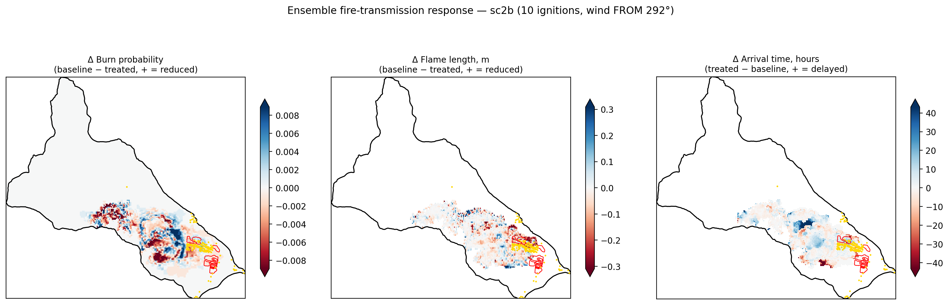
fuelscape/
models/
weather/
spread/
suppression/
Ex. FSPro Counterfactuals: North Cottonwood (COSWAP)
Sample run of FSPro counterfactuals on the North Cottonwood project (Chaffee County, COSWAP) with minimal inputs (10 ignitions, 7 days burning, ignitions within 0.5-3 km from project, upwind
Note: 20 ignitions simulating 301 fires is likely not enough for “production” – closer to 1000 runs is more reliable and aligns with operation use of FSPro

Slide 23
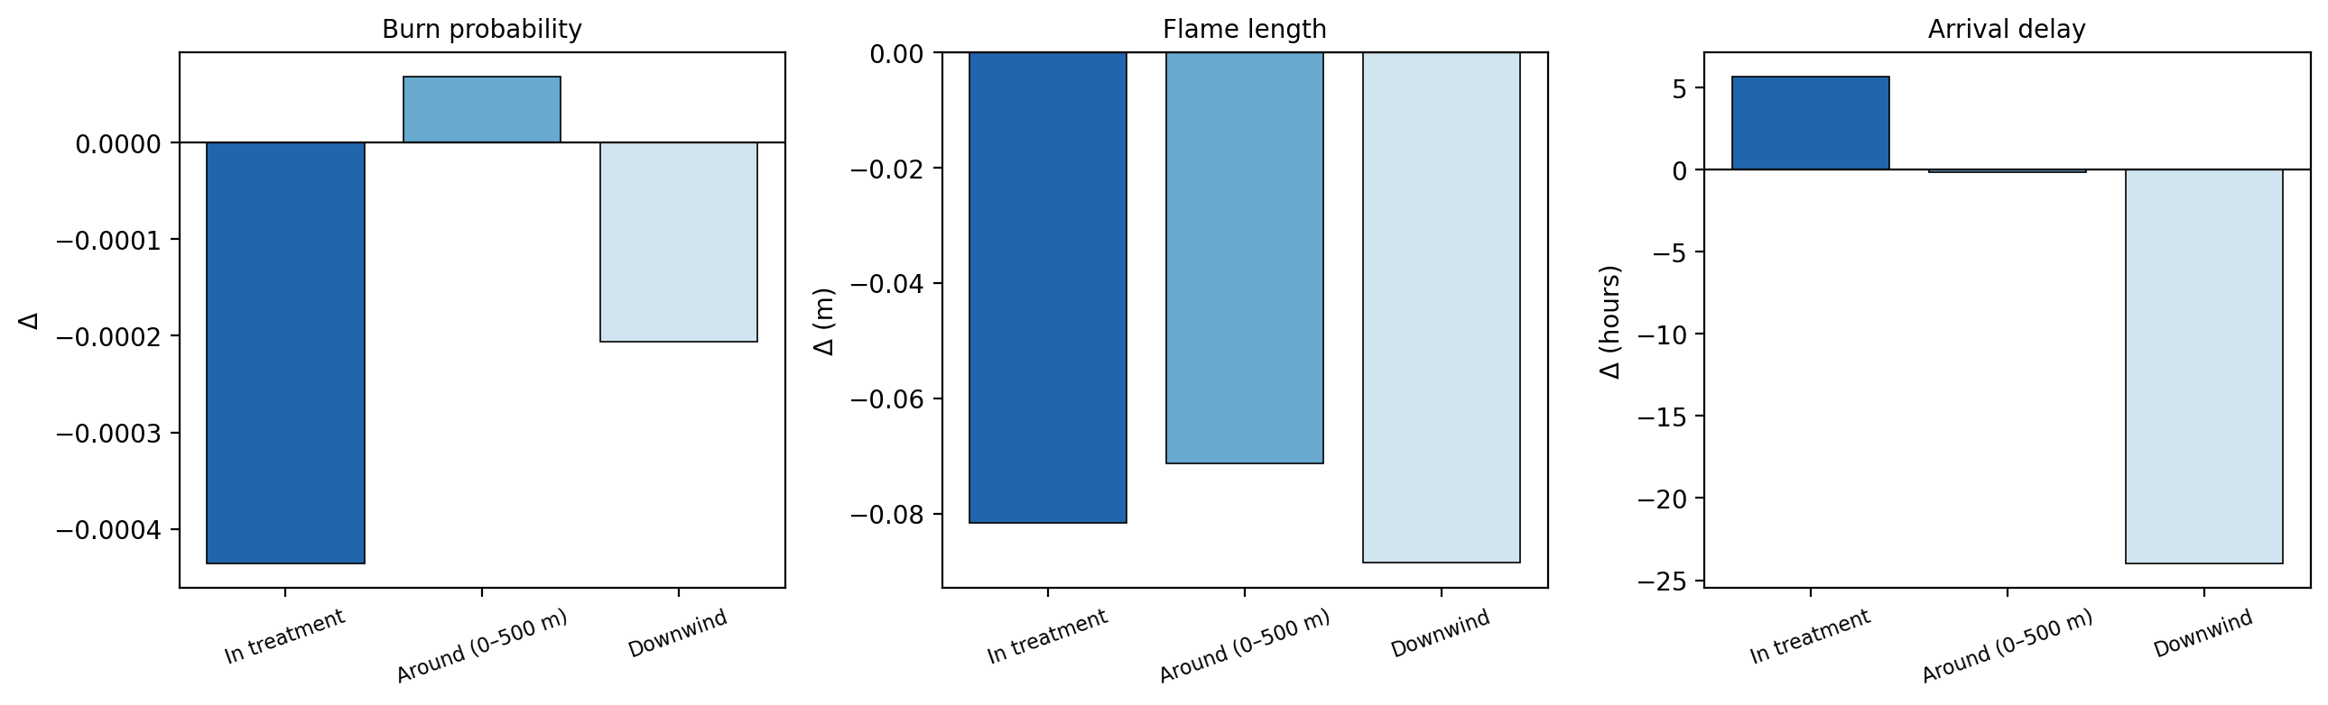
fuelscape/
models/
weather/
spread/
suppression/
Ex. FSPro Counterfactuals: North Cottonwood (COSWAP)
Note: 10 ignitions simulating 101 fires is not enough – likely need closer to 1000 runs for reliable estimates and to align with operation use of FSPro

Slide 24
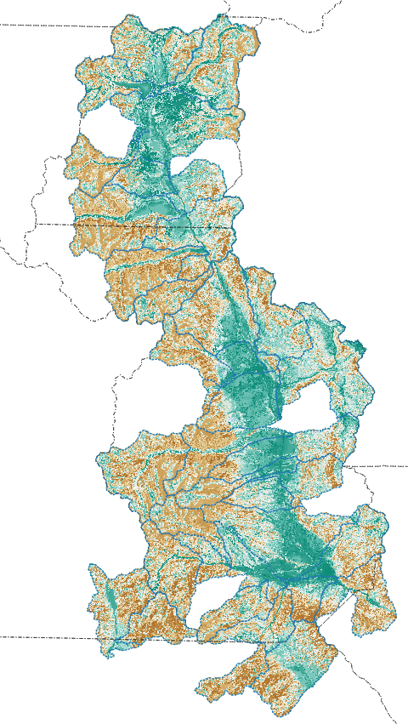
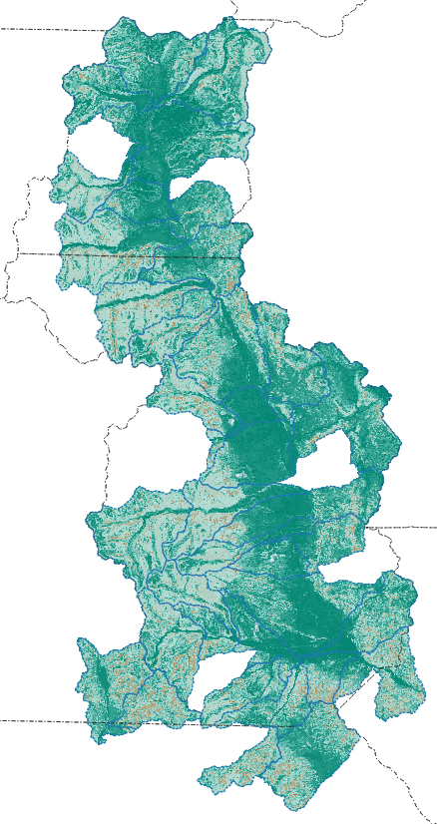
fuelscape/
models/
weather/
spread/
suppression/
Suppression Difficulty Index (SDI)
Rodriguez y Silva method
Mech Thin + Surface Mgmt
Baseline
Combines topography, vegetation structure, and road accessibility to estimate relative suppression difficulty across the landscape.
calculate_sdi()
SDI raster from LCP inputs (slope, canopy, surface fuel model)
OpenStreetMap roads and trails
calculate_delta_sdi()
Change in SDI between baseline and treated landscape

Slide 25
Installing fb_tools
Python 3.10–3.12 · conda-forge · pip editable install · GitHub
Critical path (run in order) – more instructions on GitHub README
① Clone the repository
⑤ Optional — HRRR wind extraction only
$
$
git clone https://github.com/maxwellCcook/fb_tools.git
pip install herbie-data
$
cd fb_tools
Not in conda-forge; omit if HRRR winds are not needed.
② Set conda channel priority
Windows note:
Always create and activate the environment from Anaconda Prompt, not PowerShell. Anaconda Prompt sets the DLL search path correctly for the geospatial stack.
$
conda config --set channel_priority strict
③ Create and activate the conda environment
$
conda env create -f environment.yml
Why --no-deps?
$
conda activate fb_tools
conda builds GDAL, PROJ, rasterio, and rioxarray against shared C libraries. If pip re-resolves dependencies it overwrites those builds with PyPI wheels that carry their own GDAL — and the two versions conflict at import time. --no-deps tells pip to install only fb_tools itself, leaving the geospatial stack untouched.
④ Editable install — --no-deps is required
$
pip install –e . --no-deps

Slide 26
Roadmap — Not Yet Fully Implemented
Cell2Fire wrapper
High
cell2fire.py stub + spread/convert.py — alternative fire spread engine
Ember cast and probabilistic flowpaths
High
MTT-based probabilistic
QuicFire wrapper
Medium
Python CLI integration
Integration/Sensitivity Tests
Medium
End-to-end Fsim, MTT and FSPro tests vs. known outputs
Low
Integration with rastertools
USFS rastertools (John Hogland) can improve on some of the workflows
Low
Real-time ERC (GEE)
fetch_current_erc_gee() — operational CurrentERCValues for live runs
Many others … ?

Slide 27
Summary & Next Steps
CURRENT CAPABILITIES DEMONSTRATED
ONGOING
• RTMA-based hourly fuel moisture pipeline (and HRR, GridMET)
• Cloud processing (CSU HPC)
• End-to-end FlamMap batch runs
• Fsim calibration to known outputs for sensitivity testing
• FSPro counterfactual paired comparisons
• Probabilistic MTT (Monte Carlo) for ember cast and flowpaths
• Suppression Difficulty Index
• Cell2Fire for alternative spread model (MacOS capable)
• fb_tools <-> tealom (not presented, highlight here)
github.com/maxwellCcook/fb_tools
https://github.com/Colorado-Forest-Restoration-Institute/TEALOM
maxwell.cook@colostate.edu

Slide 28
References & Data Sources
DEAD FUEL MOISTURE / NFDRS
LIVE FUEL MOISTURE
Byram & Jemison (1943)
Jolly, Nemani & Running (2005)
Solar radiation and forest fuel moisture. J. Agric. Res., 67(4), 149–176.
A generalized bioclimatic index to predict foliar phenology in response to climate. Glob. Change Biol., 11(4), 619–632. doi:10.1111/j.1365-2486.2005.00930.x
Deeming, Burgan & Cohen (1977)
The National Fire-Danger Rating System—1978. USDA FS GTR INT-39, 63 p.
WEATHER DATA
Bradshaw, Deeming, Burgan & Cohen (1984)
De Pondeca et al. (2011)
The 1978 National Fire-Danger Rating System: Technical documentation. USDA FS GTR INT-169, 44 p.
The Real-Time Mesoscale Analysis at NOAA's NCEP: Current status and development. Weather Forecast., 26(5), 593–612. doi:10.1175/WAF-D-10-05037.1
Dowell et al. (2022)
EQUILIBRIUM MOISTURE CONTENT
The High-Resolution Rapid Refresh (HRRR): An hourly updating convection-allowing forecast model. Weather Forecast., 37(8), 1371–1395. doi:10.1175/WAF-D-21-0151.1
Nelson (1984)
Abatzoglou (2013)
A method for describing equilibrium moisture content of forest fuels. Can. J. For. Res., 14(4), 597–600. doi:10.1139/x84-108
Development of gridded surface meteorological data for ecological applications and modelling. Int. J. Climatol., 33(1), 121–131. doi:10.1002/joc.3413
Cohen & Deeming (1985)
The National Fire-Danger Rating System: Basic equations. USDA FS GTR PSW-82, 16 p.
SUPPORTING INFRASTRUCTURE
Gorelick et al. (2017)
Google Earth Engine: Planetary-scale geospatial analysis for everyone. Remote Sens. Environ., 202, 18–27. doi:10.1016/j.rse.2017.06.031
Short (2022)
Spatial wildfire occurrence data for the United States, 1992–2020 [FPA FOD]. USDA FS Research Data Archive. doi:10.2737/RDS-2013-0009.6
Notes:
Citation notes: Deeming et al. (1977) describes the '1978 NFDRS' — the year discrepancy is intentional (published 1977, describes system effective 1978). Bradshaw et al. (1984) is the technical documentation that specifies the precip saturation ceiling (FM10=35%, FM100=50%). Jolly et al. (2005) GSI thresholds were calibrated on temperate/boreal flux tower sites — not validated for semi-arid intermountain systems. HRRR reference is Part I (model description); Part II (data assimilation) is Dowell et al. 2022 doi:10.1175/WAF-D-21-0152.1.

