Slide 1
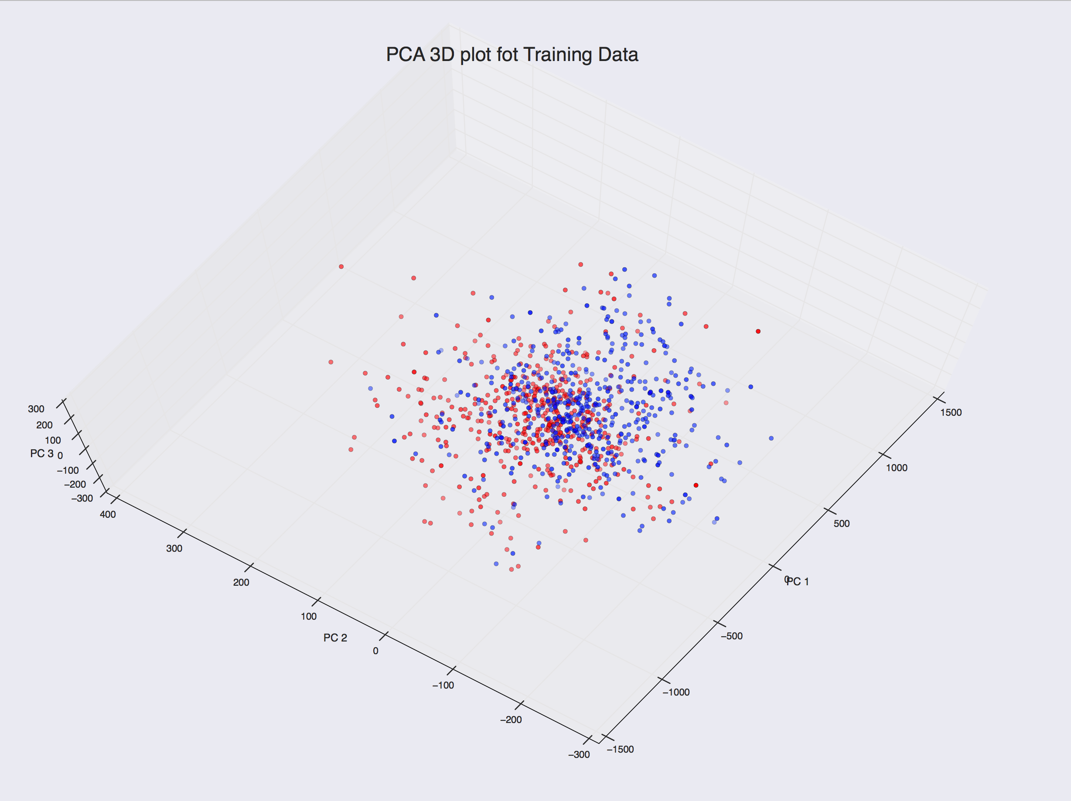
Team 1 Lose
Team 1 Win

Slide 2
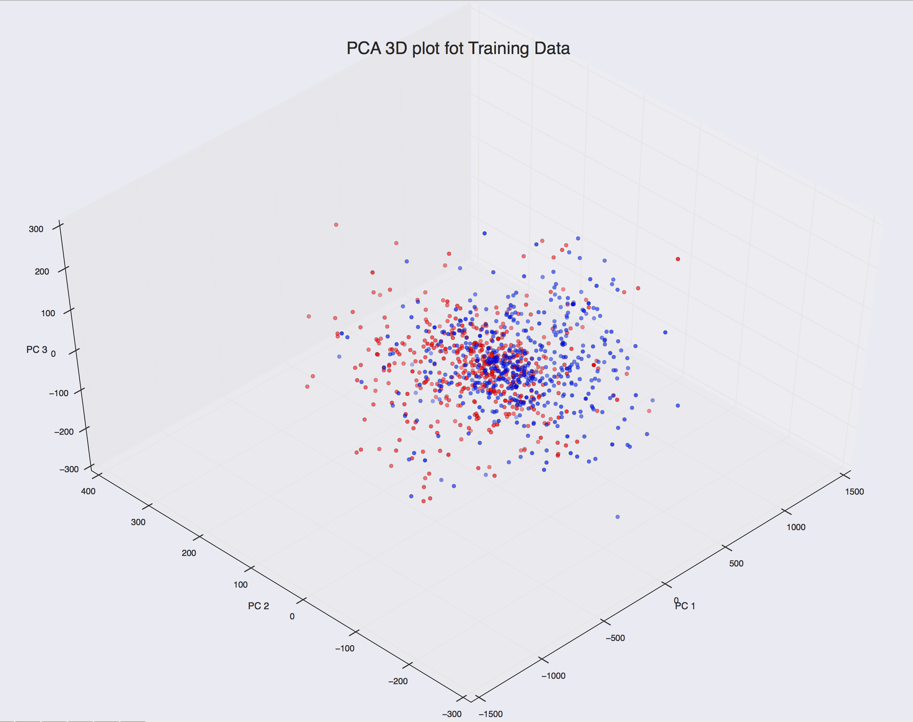
Team 1 Lose
Team 1 Win

Slide 3
Team 1 Lose
Team 1 Win

Slide 4
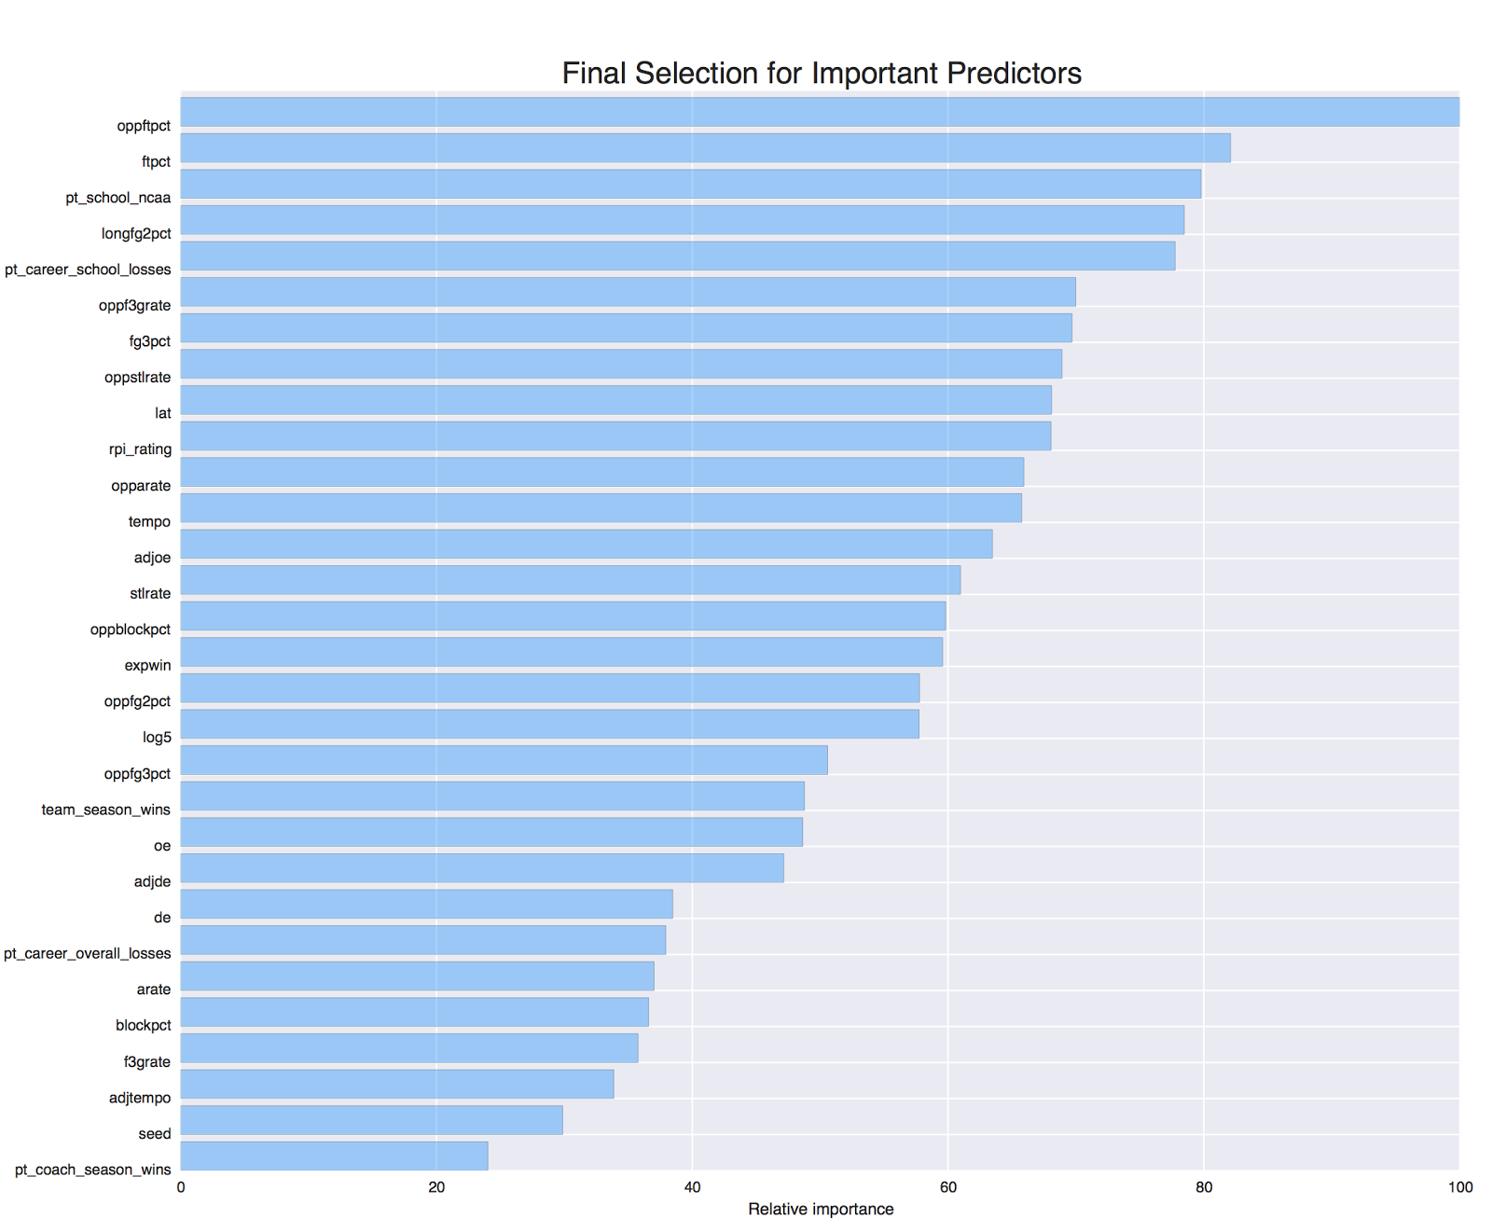
Shooting Percentage on Free Throws
Distance Shooting
Latitude Difference Between the Host and Home Campus

