Slide 1
Using Machine Learning to Create a Movie Recommendation System
Maxwell Owusu, Michael Womble, Yaswanth Sai Devisetti
DATS 6202

Slide 2
Outline
I. Data Overview
II. Overview of Movie Recommendation System
III. Predicting Movie Popularity
a. Training and Testing
b. Model Selection and Results
IV. Predicting Movie Similarity
a. Training and Testing
b. Model Selection and Results
V. Conclusions

Slide 3
Dataset Overview

Slide 4
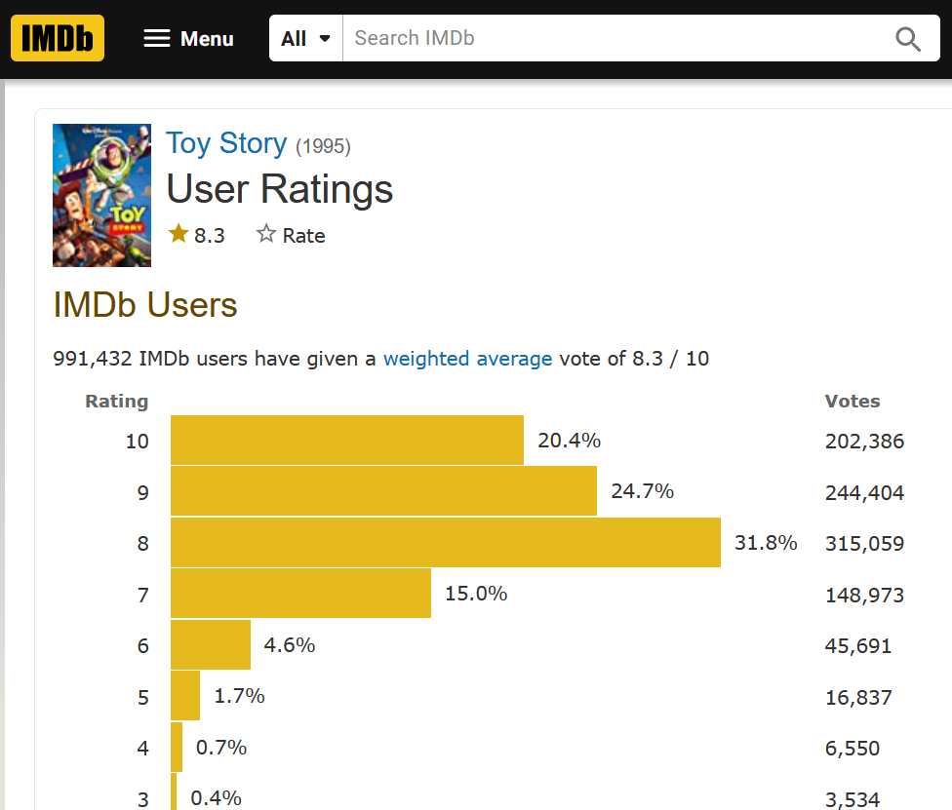
Webscraping
Feature
Target
Indicator of movie popularity
A movie can have a good rating without being seen by many people,

Slide 5
Overview of Movie Recommendation System
Predicting Movie Popularity
Recommended Movies
Rank By:
Predicted Popularity
Movie Similarity Clustering
Genre
Production
Topic

Slide 6
Predicting Movie Popularity

Slide 7
Predicting Movie Similarity

Slide 8
Conclusions

Slide 9
Questions?

