Slide 1

Medical Image Classification for Disease Diagnosis
Using Deep Neural Networks with Hyperparameter Optimization
Group Members:
Kirandeep Kaur
Ibrahim Balogun
Elijah Ojelabi
Maxwell Owusu-Edusei

Slide 2

Contents
Introduction
Project Description
Objectives
Literature Review
Data Source
Methodology
Results
Conclusion
References

Slide 3
Introduction
Medical image classification is crucial in healthcare, especially for detecting conditions like pneumonia, edema, and cardiomegaly using chest X-rays.
In this we applied a CNN to a subset of the NIH ChestX-ray14 dataset to perform multi-label classification, allowing the model to identify multiple diseases in one X-ray.
We explored how choices in activation functions, loss functions, optimizers, and hyperparameter tuning affect overall model performance.
Decision thresholds were also tested to understand the balance between precision and recall an important factor in clinical decision-making.
The full dataset is large (about 42 GB), and training on all images requires strong GPU resources.

Slide 4
Project description
This project built a deep learning model to classify chest X-rays into multiple disease categories using a subset of the NIH ChestX-ray14 dataset. A smaller preprocessed dataset was used due to the large size of the full dataset and limited GPU resources. It is improved through random-search hyperparameter tuning, testing learning rates, batch sizes, and filter sizes. We also evaluated different decision thresholds to study precision recall tradeoffs important in clinical use. The workflow included data preparation, baseline model design, tuning, evaluation using macro AUC, and interpretation of results.
4

Slide 5

Objectives
The primary objective of this study is to develop a deep learning model for classifying medical images using a pre-processed subset of the ChestX-ray14 dataset. Specifically, the study aims to:
Model Development
Hyperparameter Tuning
Model Validation and Evaluation

Slide 6
Literature Review
Deep learning has become central to medical image analysis, with surveys by Litjens et al. (2017) showing CNNs as the leading method for detection, classification, and segmentation tasks. A major boost to the field came from the ChestX-ray14 dataset, which enabled large-scale training and benchmarking for thoracic disease classification. Foundational work by Goodfellow et al. (2016) established CNNs as powerful hierarchical feature extractors that outperform traditional handcrafted approaches. Training efficiency has been further improved through optimization methods like Adam and systematic hyperparameter tuning strategies, all of which contribute to building high-performing deep learning models in medical imaging.

Slide 7
Data source
The study uses the NIH ChestX-ray14 dataset, containing 112,120 frontal chest X-rays from 30,805 patients, annotated for 14 thoracic diseases. The dataset includes demographic information (age, gender) and image acquisition details (PA and AP views). Disease labels include Infiltration, Atelectasis, Pneumonia, Pneumothorax, Consolidation, Edema, Emphysema, Fibrosis, Effusion, Pleural Thickening, Cardiomegaly, Nodule, Mass, and Hernia. The dataset is highly imbalanced, with “No Finding” accounting for 53.8% of images and disease prevalence ranging from 0.2% (Hernia) to 17.7% (Infiltration).

Slide 8
methodology
Data Preprocessing : Firstly we resized all the iamges. Pixel values were normalized to the [0,1] range by dividing by 255. Grayscale X-rays were converted to RGB by stacking the single channel three times to match CNN input requirements.
Baseline CNN Architecture : The baseline model is a convlutional neural network(CNN) using the pretrained DenseNet architecture as the feature extraction.
Training Protocol : Training incorporated several optimization strategies to improve convergence and prevent overfitting. Early stopping was applied by monitoring the validation loss with a patience of five epochs, restoring the model weights from the best-performing epoch.

Slide 9
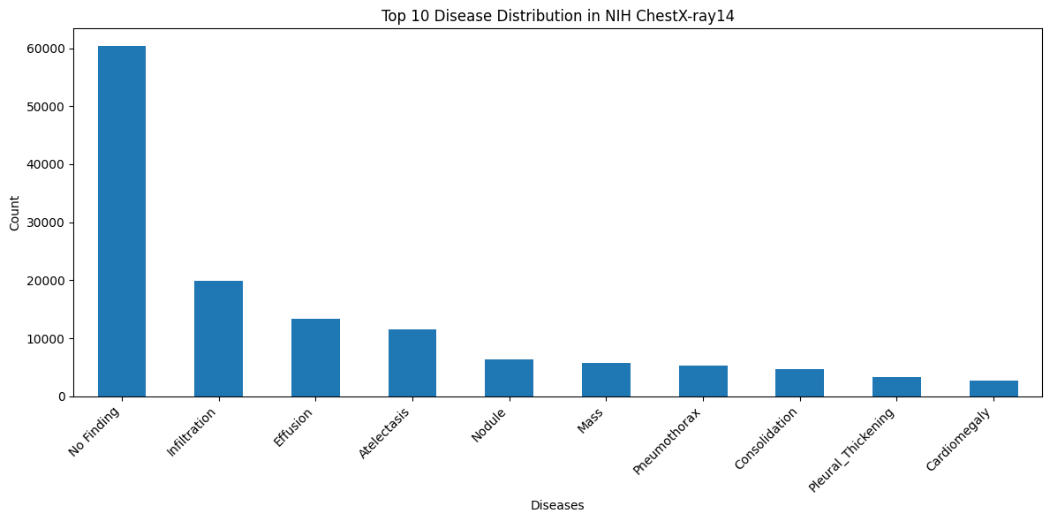
results
Observation:
The label counts show imbalance. No Finding dominates the dataset with more than 60,000 cases.
Lower-frequency classes like Nodule, Mass, Pneumothorax, and Cardiomegaly sit in the long tail, which makes them harder for a CNN to learn without threshold tuning, class balancing, or careful evaluation

Slide 10
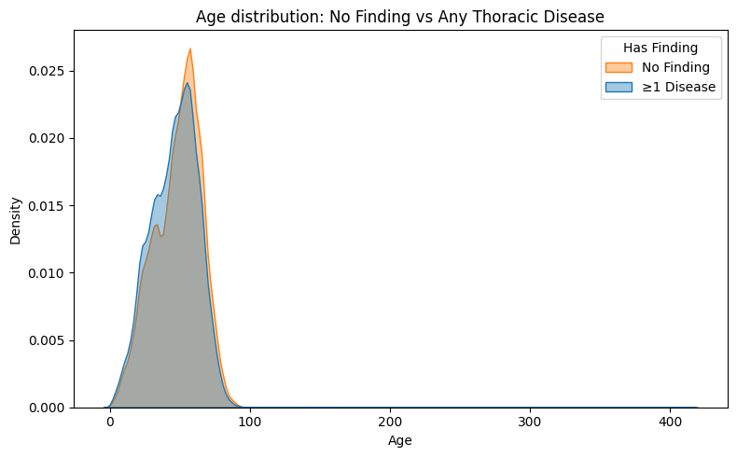
Observation
The age curves for No Finding and ≥1 Disease overlap almost completely. This shows that age alone does not separate healthy from diseased cases in this dataset.
Both groups peak around the same adult age range, with only small shifts in density.

Slide 11
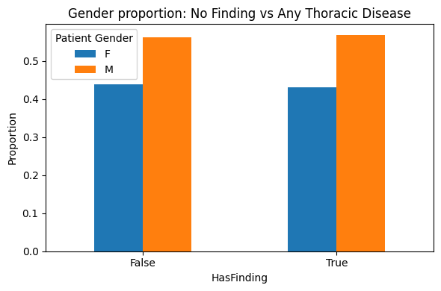
Observations
The gender distribution is similar across both groups. Males appear slightly more often in both the No Finding and Has Finding categories, but the proportions differ by less than one percent.
This suggests gender is not a strong distinguishing factor for disease presence in this dataset.

Slide 12
Data Split
For practical experimentation within available computational resources, this study used a curated subset of the ChestX-ray14 dataset consisting of 53,822 training images and 11,221 validation images, derived from a larger pool of patient-level–filtered samples. An additional test set of 11,196 images was maintained for final model evaluation. All splits were generated using patient-level stratification, ensuring that no patient appeared in more than one subset. This approach prevents data leakage, maintains subject independence between splits, and preserves the validity of performance estimates.

Slide 13
Decision Threshold Optimization
Using the default 0.50 threshold caused almost all predictions to be negative because of class imbalance.
Lower thresholds were tested to improve sensitivity.
A threshold of 0.20 provided the best balance between detecting diseases and limiting false positives.
Threshold 0.10 increased recall further but introduced too many false alarms.
Test Set Composition
The held-out test set contained 11,196 chest radiographs, each annotated with 14 possible thoracic disease labels. All images were successfully loaded with no missing files. The distribution of positive cases across disease classes was highly imbalanced, with common conditions such as Infiltration (1,985 cases), Effusion (1,488 cases), and Atelectasis (1,173 cases) appearing far more frequently than rare conditions such as Hernia (20 cases), Pneumonia (134 cases), and Fibrosis (139 cases). This imbalance is consistent with the characteristics of the original NIH ChestX-ray14 dataset and significantly influences model performance, particularly recall on rare diseases.

Slide 14
Clinical Interpretation
The final DenseNet121 model achieved a macro AUC of 0.691, showing moderate ability to rank diseased vs. non-diseased cases. Common conditions such as Effusion, Edema, Pneumothorax, and Consolidation were detected more reliably, while rare labels like Hernia, Fibrosis, and Pneumonia showed very low recall due to limited examples.

Slide 15
conclusion
The fine-tuned DenseNet121 achieved a macro AUC of 0.691, indicating moderate ability to rank thoracic disease likelihood.
Lowering the decision threshold to improved sensitivity, emphasizing the role of threshold tuning in clinical settings.
Performance was strongest for common conditions like Effusion and Edema, while rare diseases remained challenging due to class imbalance.
The model demonstrates potential as a computer-aided detection (CAD) tool to prioritize likely abnormalities.
Clinicians remain essential for final diagnosis decisions despite model support.

Slide 16
references
Wang X, Peng Y, Lu L, Lu Z, Bagheri M, Summers RM. ChestX-ray8: Hospital-scale Chest X-ray Database and Benchmarks on Weakly-Supervised Classification and Localization of Common Thorax Diseases. Proceedings of the IEEE Conference on Computer Vision and Pattern Recognition (CVPR). 2017. Available at: https://arxiv.org/abs/1705.02315. Accessed November 25, 2025.
Kingma DP, Ba J. Adam: A Method for Stochastic Optimization. International Conference on
Learning Representations (ICLR). 2015. Available at: https://arxiv.org/abs/1412.6980. Accessed November 25, 2025.
Goodfellow I, Bengio Y, Courville A. Deep Learning. MIT Press; 2016. Chapters 6 and 8. Available at: https://www.deeplearningbook.org/. Accessed November 25, 2025.
Chen R, Stewart WF, Sun J, et al. Development and validation of a deep learning algorithm for detection of diabetic retinopathy in retinal fundus photographs. JAMA. 2016;304(6):649-656. doi:10.1001/jama.2016.13416. Accessed November 25, 2025.
GeeksforGeeks. ML - Stochastic Gradient Descent (SGD). Available at: https://www.geeksforgeeks.org/machine-learning/ml-stochastic-gradient-descent-sgd/. Accessed November 25, 2025.
Kaggle Dataset. NIH Chest X-ray Dataset. Available at: https://www.kaggle.com/datasets/nih- chest-xrays/data. Accessed November 25, 2025.

Slide 17
Thank you

