Slide 1
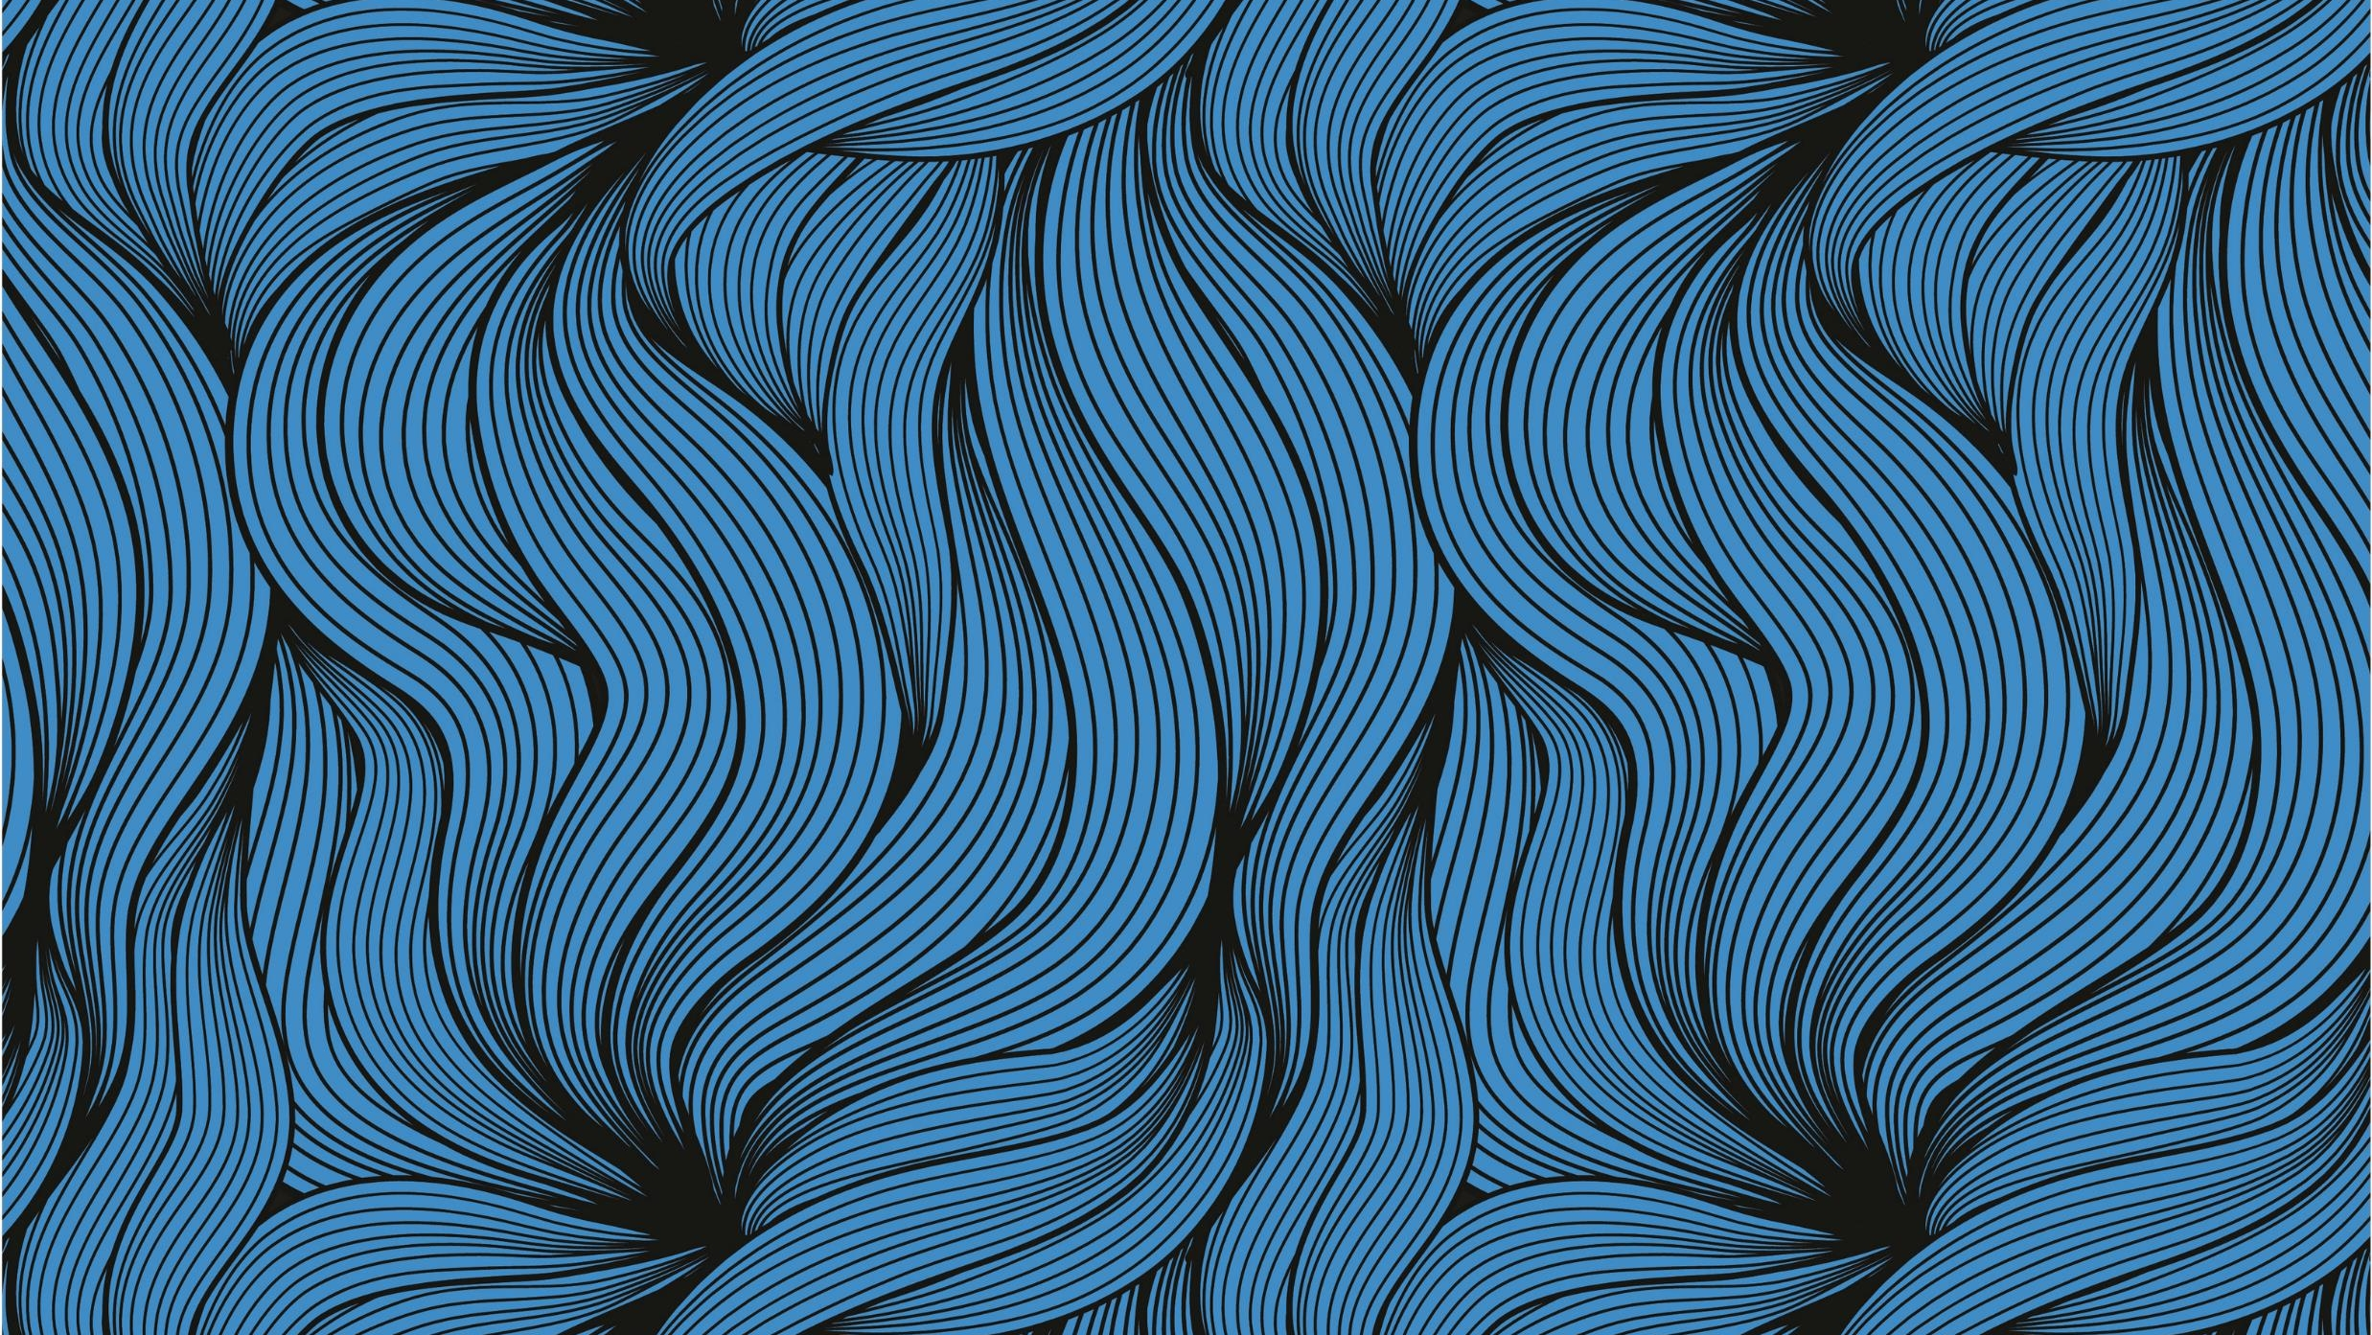
COASTAL KELP FOREST AND ENVIRONMENT
By Andy Monteon

Slide 2
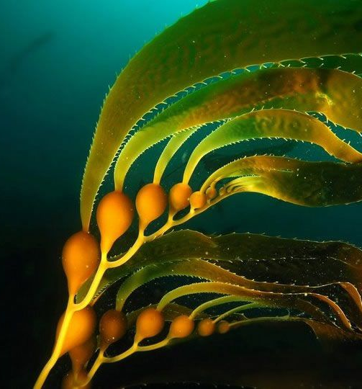
Giant Kelp
Macrocystis Pyrifera
Class: Phaeophycean (Brown Algae)
Family: Laminariaceae (Kelps and Relatives)
Fun Fact!! Not a plant but actually the Largest Protist in the world!! And a very complex species!
Giant kelp grows gas bladders that are known as pneumatocysts.(Shown Here) These bladders keep the kelp from falling to the bottom of the ocean where it would ultimately die.

Slide 3
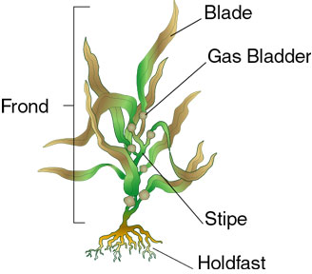
Structure
Kelp is not a plant, although it is photosynthetic with structures that look just like roots, stems, and leaves, it belongs to a separate kingdom known as protists.
All stipes do is connect the kelp to the holdfast keeping it from drifting away.
Holdfasts keep the kelp anchored to the rocks they grow on but do not move nutrients from the rocks to the rest of the protist.
As kelp grows, a blade at the tip of each frond separates, producing a series of tiny new blades

Slide 4
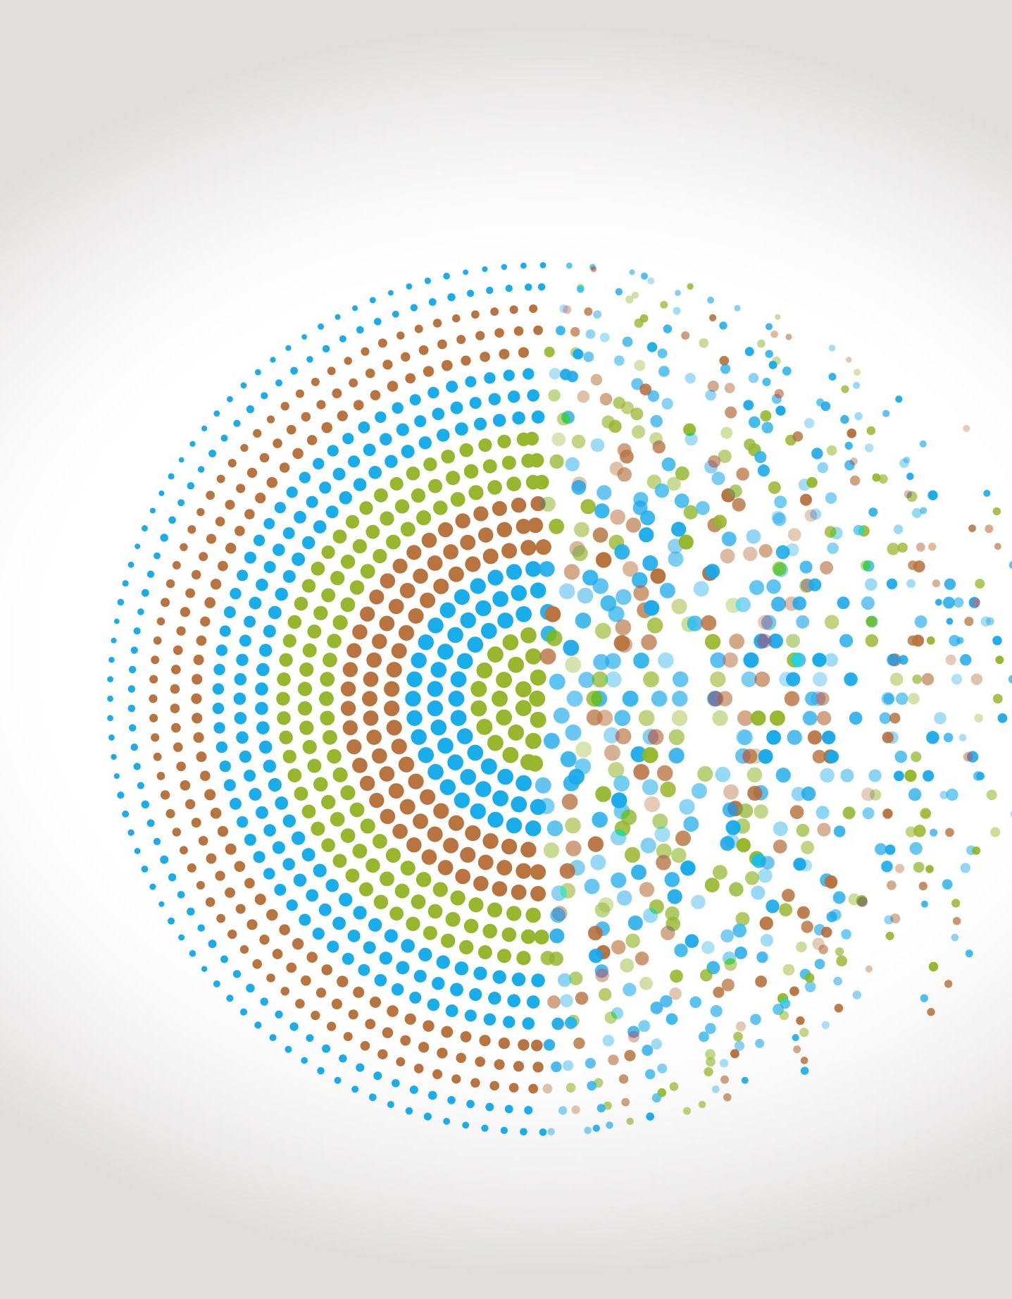
Multicellular?
Protist?
Not all protists are single-celled, and that means kelp is multicellular as it possesses different cells with different functions, especially for nutrition and growth.
Kelp has cell walls, and they are made primarily of cellulose in the inner part, while the outer layer wall is made of a substance known as algin.
Algin is used to make medicine. Algin is used to lower cholesterol levels and to reduce the amount of heavy chemicals including strontium, barium, tin, cadmium, manganese, zinc, and mercury that are taken up by the body.

Slide 5
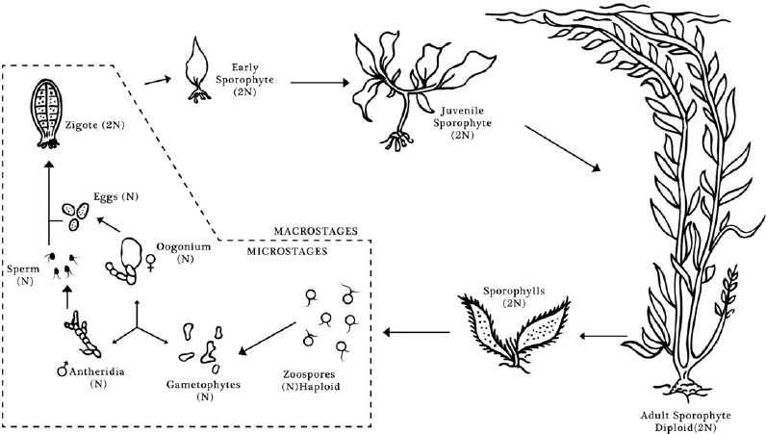
Sexual Reproduction
Sperm will attach to an egg cell to form a zygote, which undergoes rapid cell division to form the early sporophyte pictured below. If for some reason the sperm and egg detach, the cells can still continue to search for another. Continued cell division will result in the growth of an adult sporophyte

Slide 6
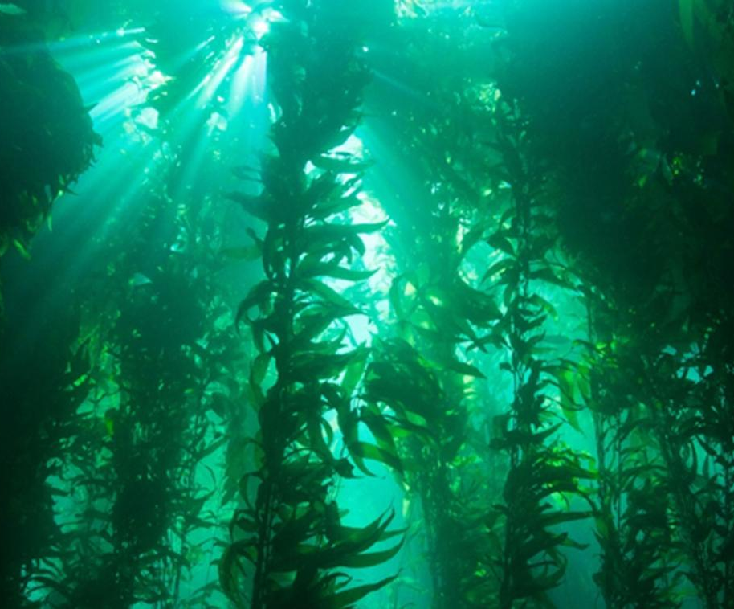
Their Own Forest Under Water.
Kelp grows in temperate water and can be seen in forests.
For feeding, kelp stores food in laminarin and the reproductive part of kelp; it possesses sperm and spores, which can undergo both sexual and asexual reproduction. Also, some kelp cells can grow so significant because it has all that is required to overgrow.

Slide 7
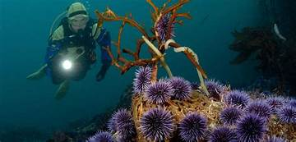
Giant Buffets
Giant kelp grow to 100 feet (30 m) on average but can reach lengths of 175 feet (53 m) in ideal conditions.
Giant kelp grow at an average rate of 11 inches (28 cm) a day but can grow 24 inches (61 cm) a day in ideal conditions.
In all this there are still plenty living around and near these beautiful forests. Including their Predators.

Slide 8
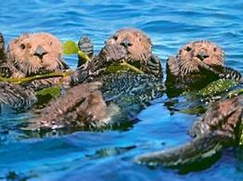
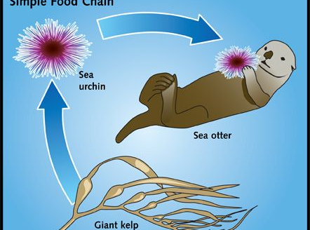
Kelp is eaten by a lot of invertebrate species. (Invertebrates are animals without backbones.) Invertebrates that eat kelp include snails and shellfish such as crabs, sea urchins and abalone. These shellfish are themselves eaten by other creatures. Such as Cheeky Otters

Slide 9
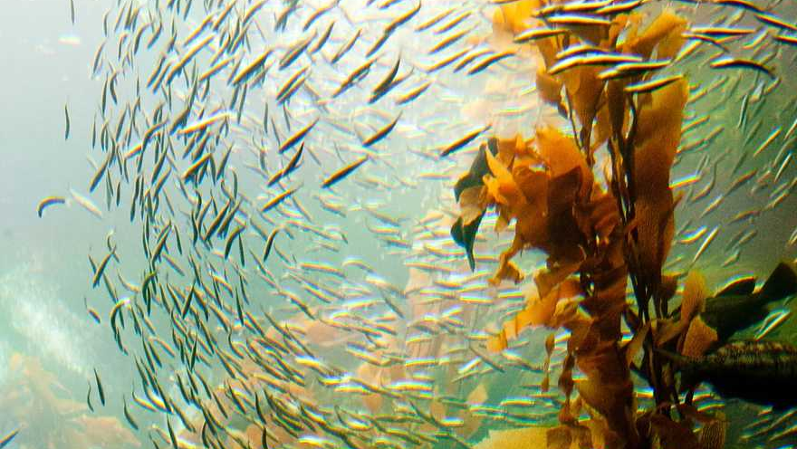
Whole Communities!
Invertebrates graze on the blades, fish seek shelter in the fronds, and thousands of invertebrates live in the rootlike holdfast, including brittle stars, sea stars, anemones, sponges and tunicates.
Found mostly in nearshore waters, this algae is perennial but that doesn’t stop schools from enjoying a swim through the neighborhood.

Slide 10
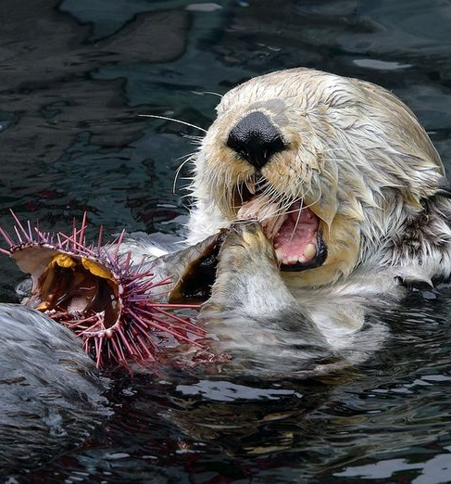
Furry Friendly Guardian
Sea otters also like to hang out in the kelp forest, where they find their favorite foods and can wrap up in a kelp frond to keep from drifting away at naptime.
Sea otters play a particularly important role in the health of the bay’s kelp forests; without them, sea urchins — which normally eat pieces of kelp that fall to the seafloor — will feed on the stripes of giant kelp plants and can completely destroy a kelp bed. Otters keep the urchin populations in check so the kelp forests can thrive.

Slide 11
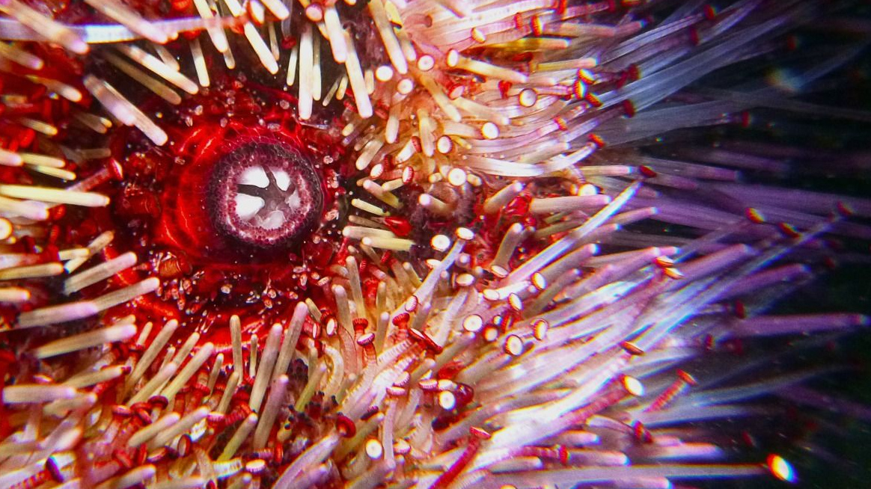
Hungry Horrors
Sea urchins use their sensory tube feet to catch drifting kelp and carry it to its mouth on the underside. Its five-part jaw efficiently cuts off pieces to eat.
Just one wouldn’t be much to worry about for such a large specimen but with the Holdfast being the first part to be eaten, it can send a Kelp strand driftring away with little left to support itself in the tidal waters.

Slide 12
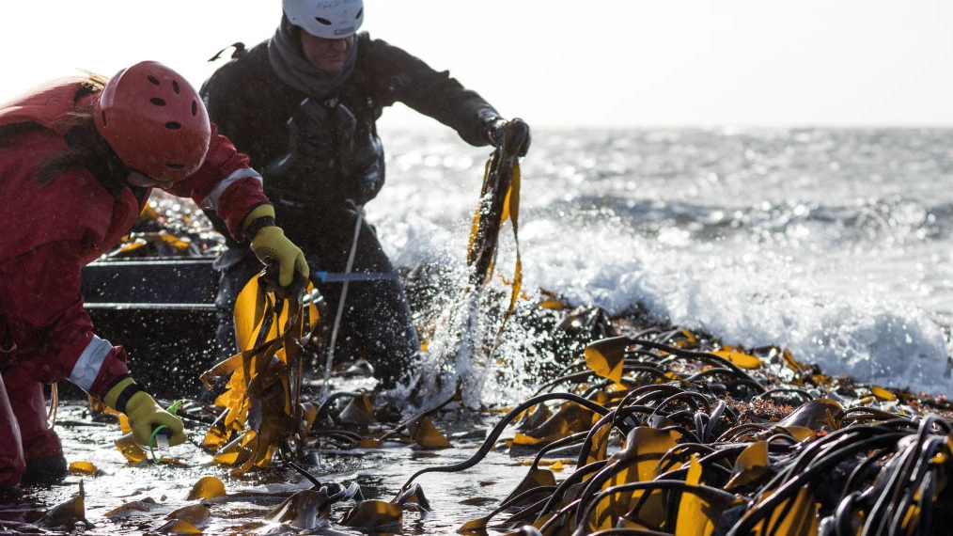
Humans Benefit As Well
In California, 100,000 to 170,000 wet tons of kelp are harvested each year. Commercial harvesting in California is highly regulated to protect our kelp forests from improper or over harvesting. In addition to possessing a license, harvesters must trim kelp from the top, may not go more than four feet (1.2 m) below the surface of the water and may only collect in designated areas.
Giant kelp is harvested as a source of algin, an emulsifying and binding agent used in the production of many foods and cosmetics, like ice cream, cereal and toothpaste. Many of which are processed or made by our very own companies here in California.
Kelp is harvested for use in aquaculture and can be found in many food products. Due to it’s fast growth rate, kelp is often viewed as a sustaining resource. Factors such as climate change, pollution, habitat degradation, boating and kelp harvesting can play a role in the health of a kelp forest.

Slide 13

All things with Moderation
Commercial kelp harvesting is potentially the greatest threat to long-term kelp stability. It has supported a multitude of industries over the past century. From the extractions of kelp during World War I for potash to the modern use of kelp for food additives and pharmaceutical products, kelp has proven to be a dynamic and highly demanded product.
For all it’s uses some products still won't see the light of day but more often then not it has been proven very useful.
By most accounts, because of its spectacular growth rates, kelp recovers quickly from physical disturbances such as storms that might uproot the fragile plants. However, as in all natural environments, the health is proportional to the number of adverse conditions to which it is exposed.

Slide 14
A Brief History of the Help From Kelp.
Kelp harvesting during World War I peaked in 1919 when 400,000 wet tons were used to make potash for gunpowder and fertilizer.
In the 1930s the food, pharmaceutical, and scientific communities began extracting algin, a thickening, stabilizing, suspending, and gelling agent.
In the 1980's alone, kelp harvesting supported an industry worth more than $40 million a year, and in 1993, more than 4,700 wet tons of kelp were extracted from the Monterey Bay National Marine Sanctuary.
Algin is an additive used in a wide variety of dairy products, frozen foods, cakes, puddings, salad dressings, shampoos, and toothpastes. It smooths and thickens ice cream, emulsifies salad dressing, and keeps pigments uniformly mixed in paints and cosmetics
. Additionally, some mariculture farms hand-harvest kelp to feed abalone.

Slide 15
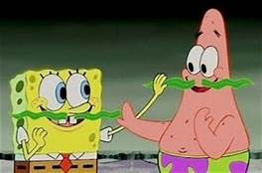
The Friend We Didn’t Know We Had.
Pieces of decomposing kelp (known as detritus) sink to the depths of the ocean, providing food for deep-sea creatures. (Or even Mustaches)
The pieces that don’t float away and get eaten help it propagate and supply not only homes, but ecosystems for Mammals and Mollusk alike.
In our food and our face creams as well as the very waters we surf in Kelp has been the most helpful Protist that doesn’t get enough credit.

Slide 16
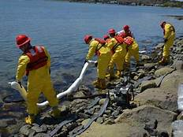
How can we Help Kelp?
As in all ecosystems, a balance exists in this complex environment, and the predators such as sea otters generally contain sea urchins or grazing fishes enough to limit the damage by grazing. This balance of power is usurped when the predatory populations go into decline, as exemplified by the huge explosion of sea urchins when otter populations suffer from oil spills or disease.

Slide 17
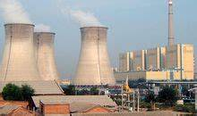
Minding Our Messes
Non-point and point source pollution including sewage, industrial disposal, and coastal runoff might contribute to kelp forest degradation. For instance, high sedimentation from coastal run-off may bury new plant shoots.
Similarly, kelp may experience reduced growth rates and reproductive success in more toxic waters and sediments. Studies on microscopic stages of kelp suggest that kelp is sensitive to sewage, industrial waste discharges, and other causes of poor water and sediment quality.

Slide 18
The Hard Truth
Today, our kelp forests are in serious trouble. Though annually variable, in the past five years, California’s kelp forests have decreased by 93% of normal. Higher sea surface temperatures in recent years have limited kelp growth, and sea star wasting disease has removed a key predator of purple sea urchins, a veracious eater of kelp. Though our waters have cooled this past year, the explosion of the purple urchin population—60 times higher than normal—and has prevented the kelp forests from recovering from these multiple blows.
The effects of the kelp forest loss reach from the ocean to the shore. The red abalone fishery, severely impacted by a lack of food, has been closed this year. Fewer fish has meant that shore birds do not have enough food for their chicks. This year, 90% of the local cormorant and 80% of the black oystercatcher nestlings failed to survive. Fewer young fish also means fewer larger fish for marine mammals, such as harbor seals and sea lions.

Slide 19
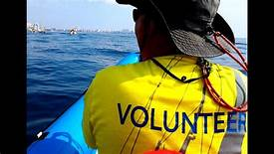
Learn How To Help
We live in a coastal environment reliant on our local ocean resources, whether for our job, our dinner, our vacation, or our enjoyment. To turn this crisis around, we will need the support of everyone, whether as a dockside sampler of purple urchin coming in, as a donor of our effort, more eyes in the water,
Scientists will be working hard to identify the research needed to facilitate broad scale recovery and increase the resilience of kelp forest ecosystems in the face of increasing climatic and ecological stressors.

