Slide 1
Homework 5
Using http://www.nndc.bnl.gov/chart/ find one-and two-nucleon separation energies of ⁶He, ⁷He, ⁸He, ¹⁴¹Ho, and ¹³²Sn. Discuss the result.
(keV) | ⁶He | ⁷He | ⁸He | ¹⁴¹Ho | ¹³²Sn
S_{n} | 1710 | -410 | 2535 | 1.32E+4 | 7343
S_{2n} | 975.45 | 1301 | 2125.05 | - | 12554
S_{p} | 2.259E+4 | 2.31E+4 | 2.48E+4 | -1177 | 15807
S_{2p} | - | - | - | 8E+2 | 2.959E+4

Slide 2
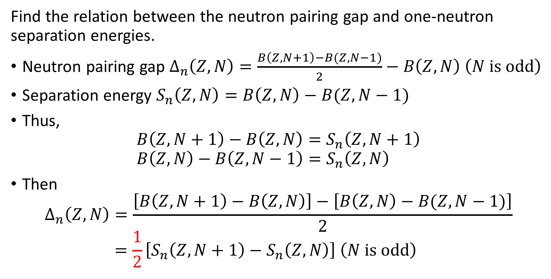
Find the relation between the neutron pairing gap and one-neutron separation energies.
Neutron pairing gap $∆_{n}\left(Z,N\right)=\frac{B\left(Z,N+1\right)−B(Z,N−1)}{2}−B\left(Z,N\right) \left(N is odd\right)$
Separation energy $S_{n}\left(Z,N\right)=B\left(Z,N\right)−B(Z,N−1)$
Thus,
$$B\left(Z,N+1\right)−B\left(Z,N\right)=S_{n}\left(Z,N+1\right) \\ B\left(Z,N\right)−B\left(Z,N−1\right)=S_{n}\left(Z,N\right)$$
Then $∆_{n}\left(Z,N\right)=\frac{\left[B\left(Z,N+1\right)−B\left(Z,N\right)\right]−\left[B\left(Z,N\right)−B(Z,N−1)\right]}{2}$ $=\frac{1}{2}\left[S_{n}\left(Z,N+1\right)−S_{n}\left(Z,N\right)\right] \left(N is odd\right)$
N-odd, even

Slide 3
Using http://www.nndc.bnl.gov/chart/ plot neutron pairing gaps for Hf (Z=72) isotopes as a function of N.
N is odd.

