Slide 1
s_{1/2}
Extend the nuclear shell model scheme beyond Z=82, N=126. What should be the next neutron and proton magic numbers in superheavy/hyperheavy nuclei?
4s
d_{3/2}
3d
g_{7/2}
d_{5/2}
N=6
2g
j_{15/2}
i_{11/2}
g_{9/2}
1i
126
p_{1/2}
3p
f_{5/2}
i_{13/2}
N=5
2f
p_{3/2}
The total number of states in the h.o. shell is
(N+1)(N+2)
The spherical extruder orbit with l=N, j=N+½ shifted down to the lower (N-1) shell
It is replaced by the spherical intruder orbit with l=N+1, j=N+1+½
The total number of states in the Woods-Saxon shell N is:p=(N+1)(N+2)+2
h_{9/2}
f_{7/2}
1h
82
d_{3/2}
3s
s_{1/2}
N=4
h_{11/2}
2d
g_{7/2}
d_{5/2}
1g
50
g_{9/2}
N=3, p=22, magic number is 28+22=50
N=4, p=32, magic number is 50+32=82
N=5, p=44, magic number is 82+44=126
N=6, p=58, magic number is 126+58=184
N=7, p=74, magic number is 184+74=258
N=8, p=92, magic number is 258+92=350
Harmonic
oscillator
+flat bottom
+spin-orbit

Slide 2
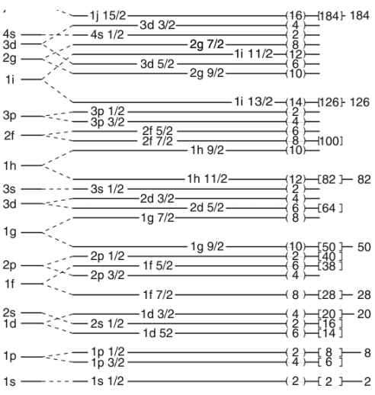
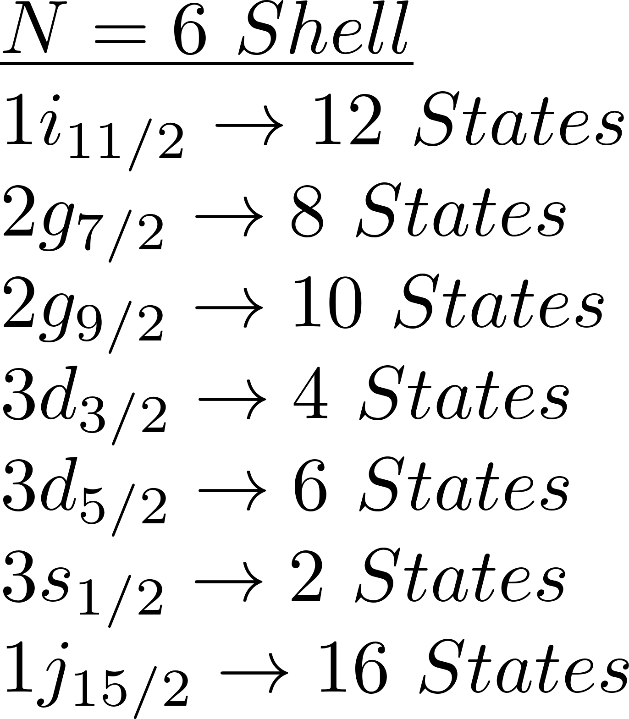
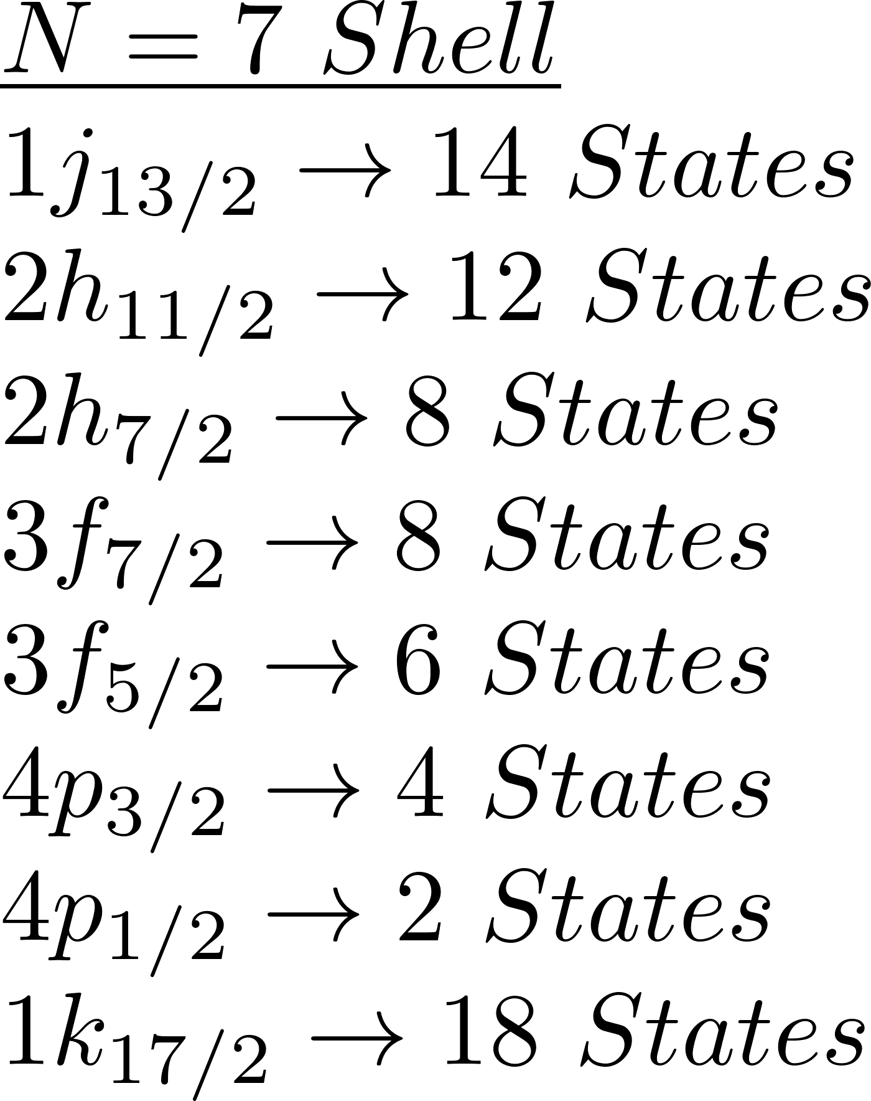

Slide 4
Erler et al., Nature 486, 509 (2012)

