Slide 1
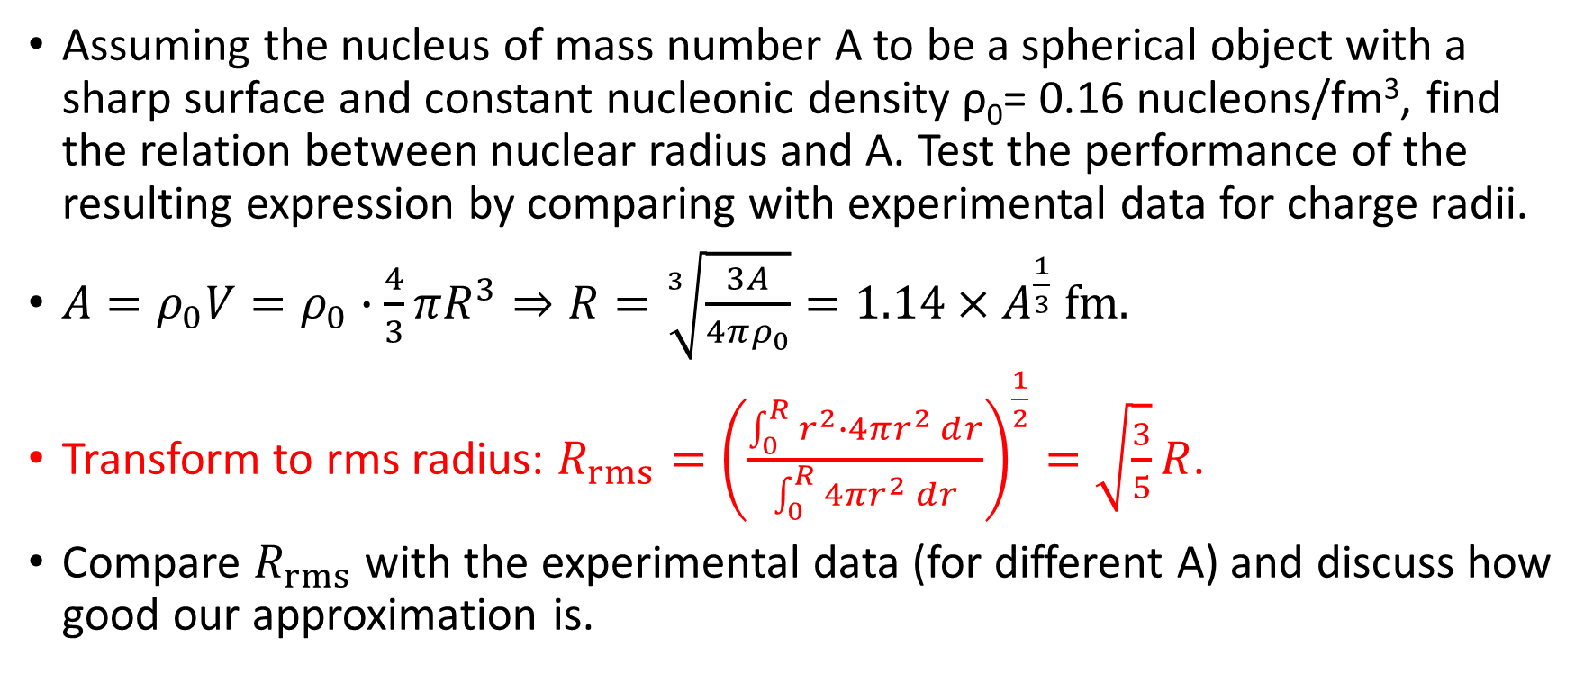
Homework 4
Assuming the nucleus of mass number A to be a spherical object with a sharp surface and constant nucleonic density ρ₀= 0.16 nucleons/fm³, find the relation between nuclear radius and A. Test the performance of the resulting expression by comparing with experimental data for charge radii.
${A=ρ}_{0}V=ρ_{0}∙\frac{4}{3}πR^{3}⇒R=\sqrt[3]{\frac{3A}{4πρ_{0}}}=1.14×A^{\frac{1}{3}} fm.$
Transform to rms radius: $R_{rms}={\left(\frac{\int_{0}^{R}{r^{2}∙4πr^{2}ⅆr}}{\int_{0}^{R}{4πr^{2}ⅆr}}\right)}^{\frac{1}{2}}=\sqrt{\frac{3}{5}}R$.
Compare $R_{rms}$ with the experimental data (for different A) and discuss how good our approximation is.

Slide 2
