Slide 1
COMP1140 Assignment 2
Renier
Thu14e

Slide 2
Design Philosophy
We decided to perform a study on our potential players
<number>/153

Slide 3
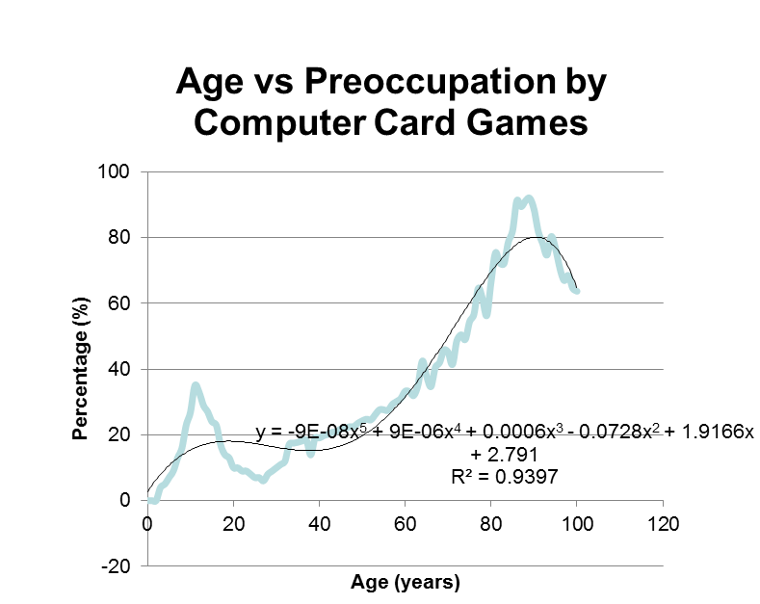
Preliminary Analysis
From analysis, we observe that older audience spend most leisure time on computer card games
<number>/153

Slide 4
Design Philosophy
From preliminary analysis, it is clear that we should focus our efforts to create a game targeting older audiences
Thus, the game should be easy to play, conservative and less challenging.
<number>/153

Slide 5
BUT

