Slide 1
Dynamical changes upon CO2 sorption in a nanometer-thin film of polyethylene imine
Max Wolters
09.07.2026

Slide 2
Sample and Measurement
25 kg/mol PEI​, 5mg/mL solution
Spin-cast​ing, roughly 40 nm thin film (AFM)
Heating, tempering, cooling, equilibration, absorption, desorption
BDS: 100 Hz – 0.9 GHz (logarithmic scale), 24 measuring points, 6 per decade
Temperatures: (50, 60, 70, 80, 90)°C

Slide 3
Analysis
Determination of atmosphere switch point
Interpolation
Step hight

Slide 4
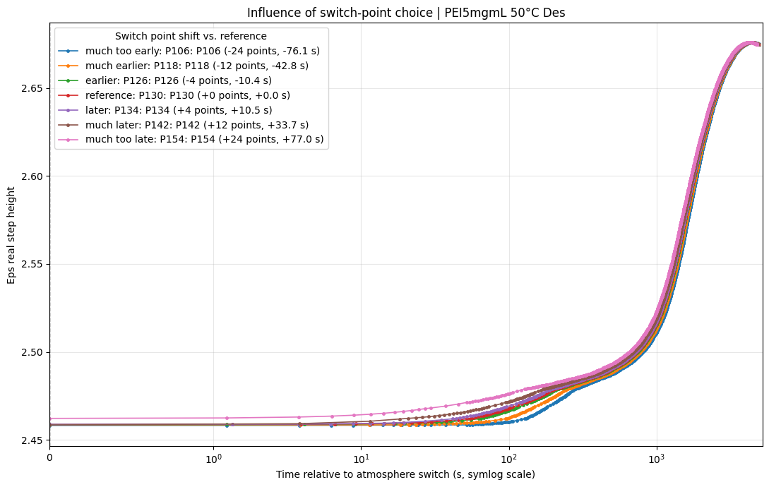
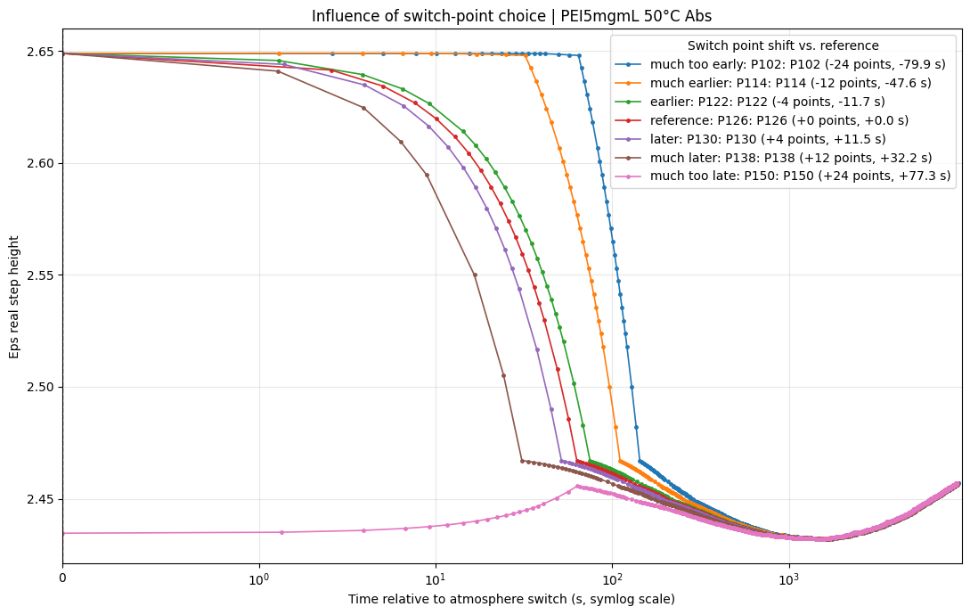
Influence of switch point on step hight

Slide 5
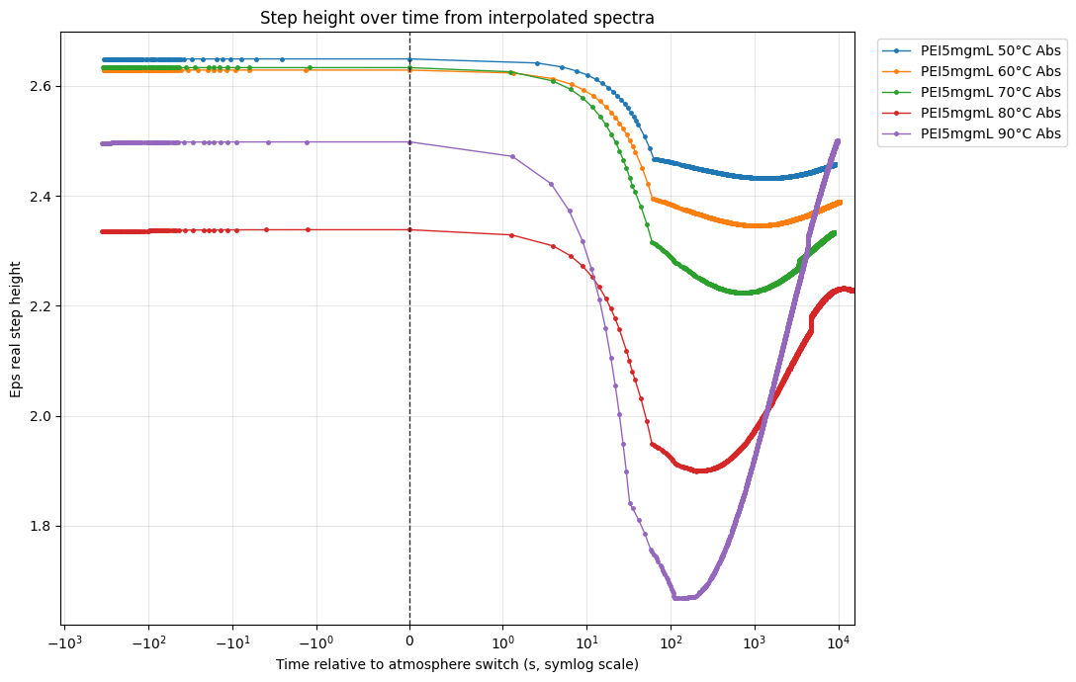
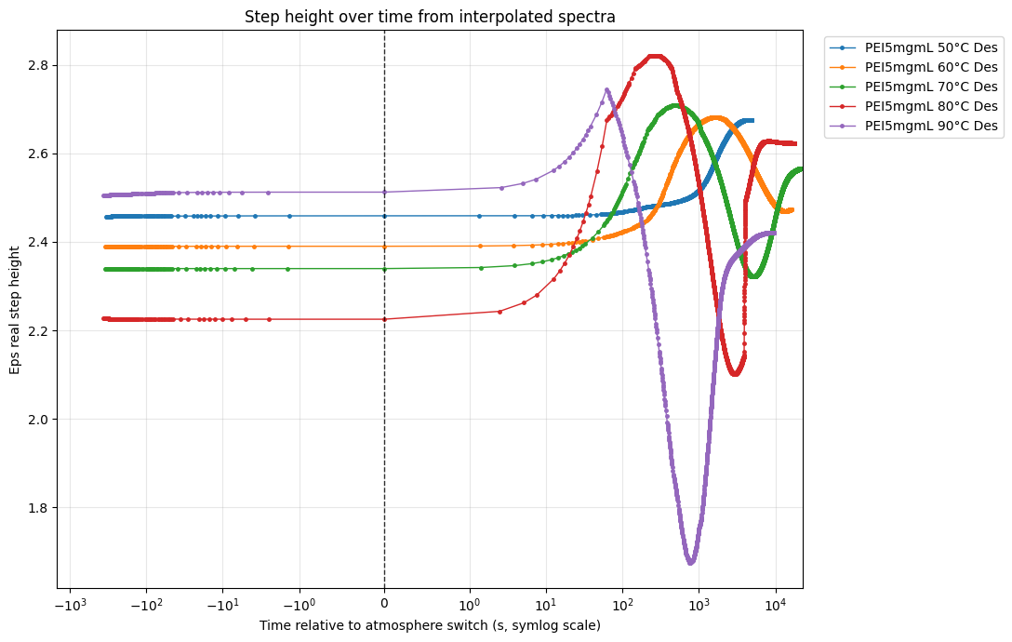
delta_epsilon_step
Absorption
Interpolation artefact
Desorption
Two-step process

Slide 6
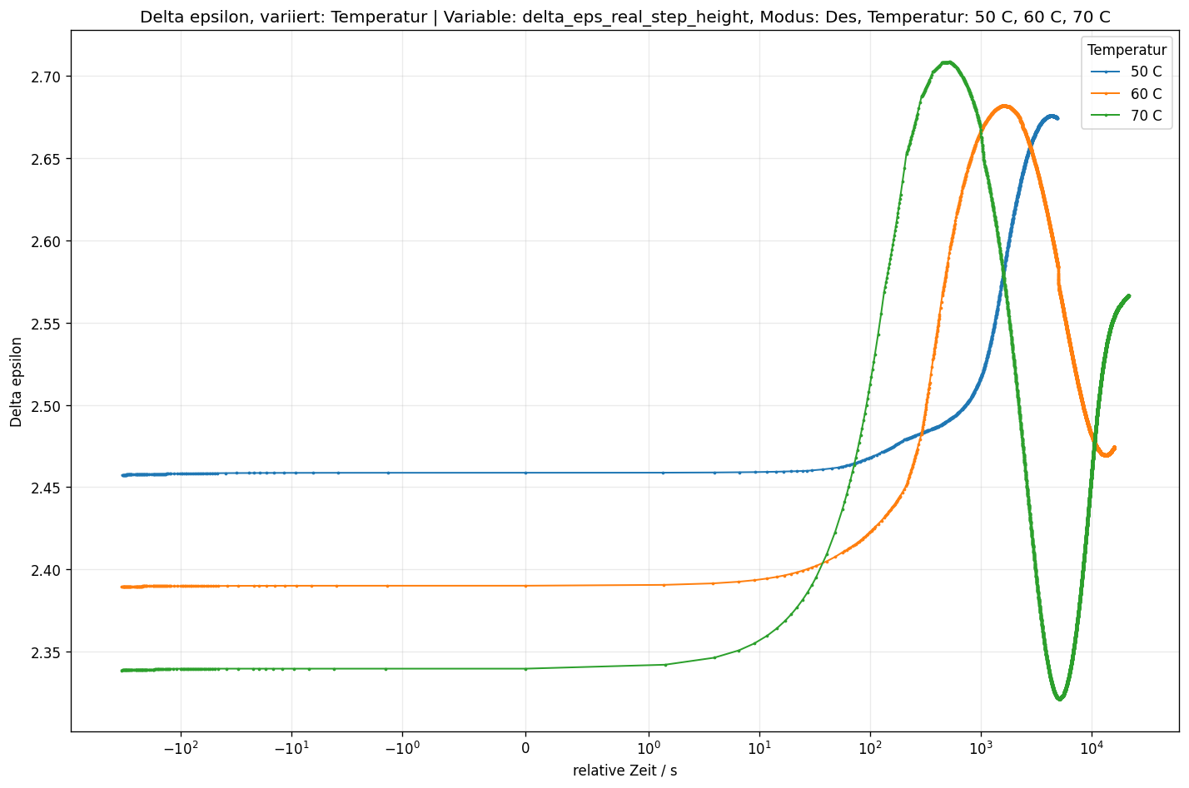
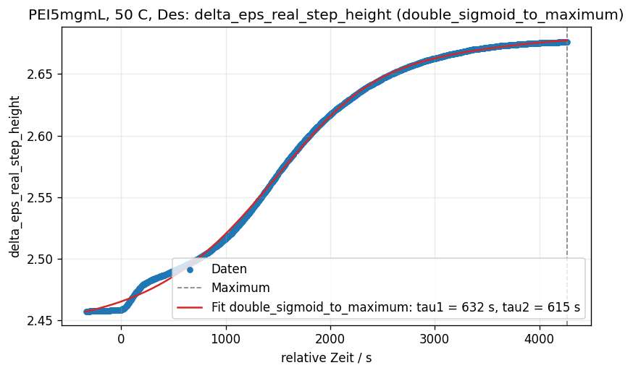
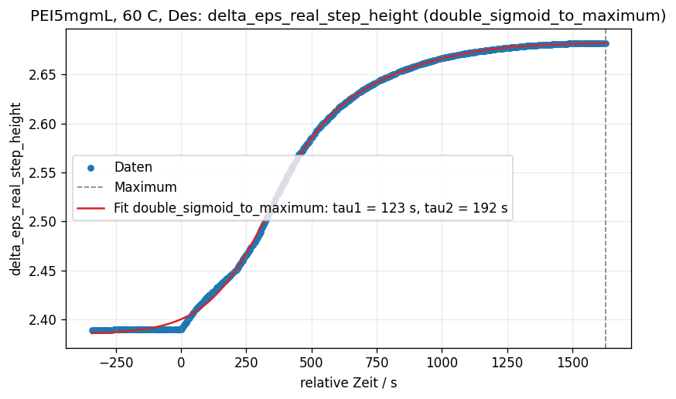
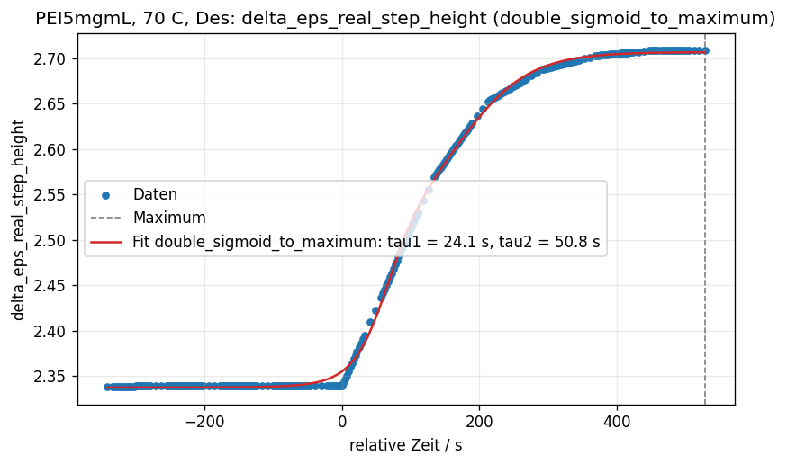
Delta_epsilon_step Desorption
Fit-function: double sigmoid
Does not really include first step
Vanishes for high T

Slide 7
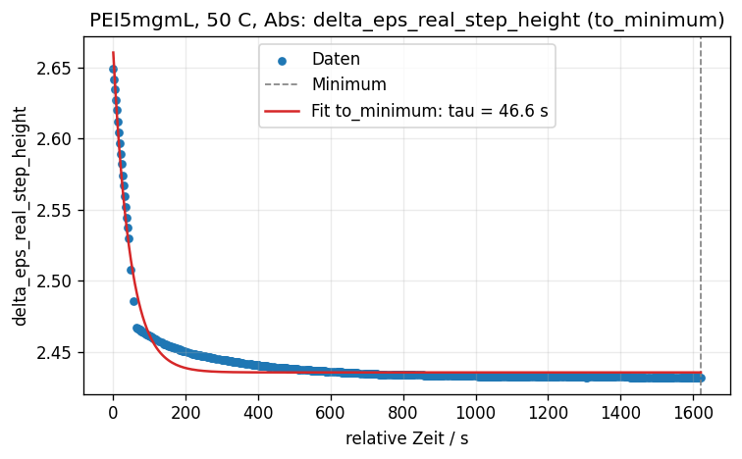
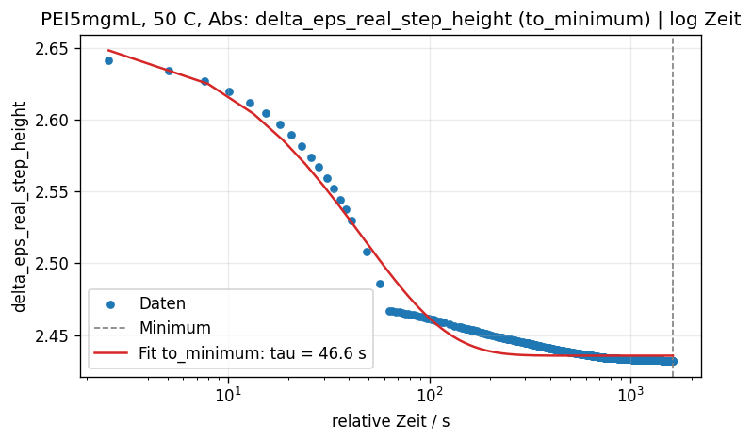
Delta_epsilon_step Absorption (1)
First part:
50 °C: 46.6 s
60 °C: 45.5 s
70 °C: 48.9 s
80 °C: 35.7 s
90 °C: 25.2 s
Const. for (50, 60, 70) °C, should be T-dependent?
Better fit function?

Slide 8
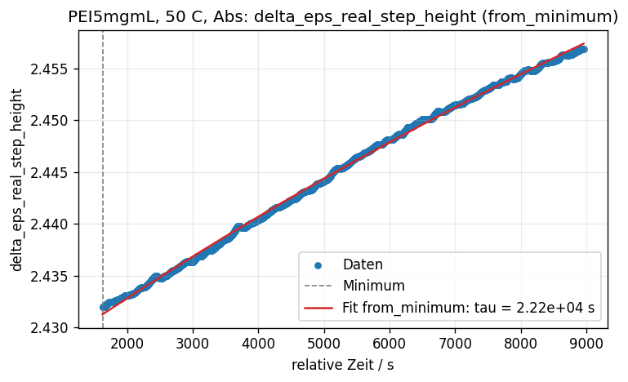
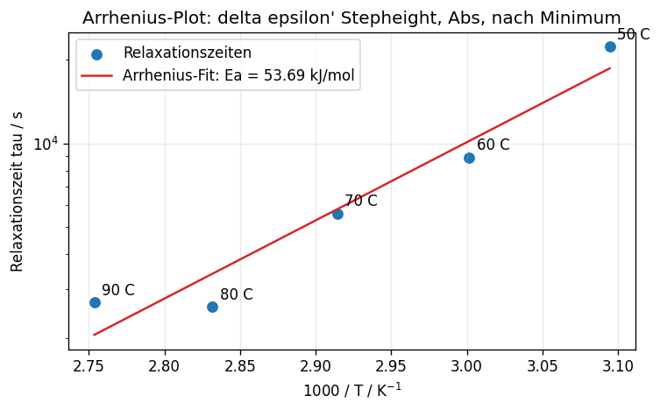
Delta_epsilon_step Absorption (2)
Second part:
Fit works quiet well
Arrhenius function
There might be even a third part

Slide 9
Analysis
Numerical differentiation
Manipulation
Fitting

Slide 10
Fitting
Epsilon_real_derivative in log space
HN function + power law baseline
sequential time-series fitting
Parameters:
Peak height
Slopes: alpha, alpha_beta
Peak position: omega_p
Baseline (slope smoothed to reduce noise)
So far for (50, 60, 70)°C
For (80, 90)°C poor data quality + other model necessary

Slide 11
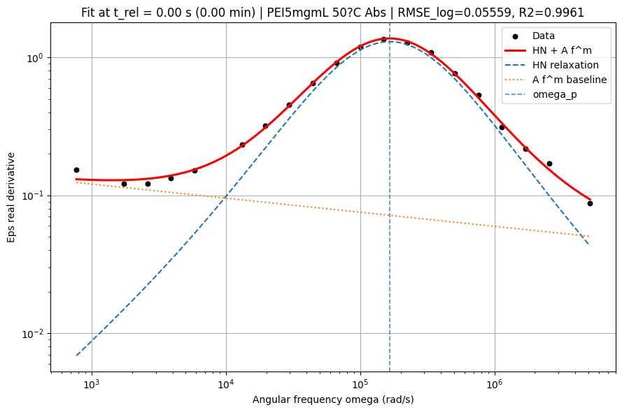
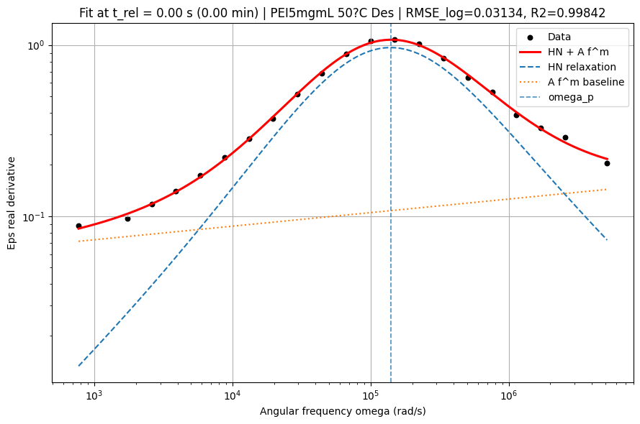
Example: 50°C
Start Absorption
Start Desorption

Slide 12
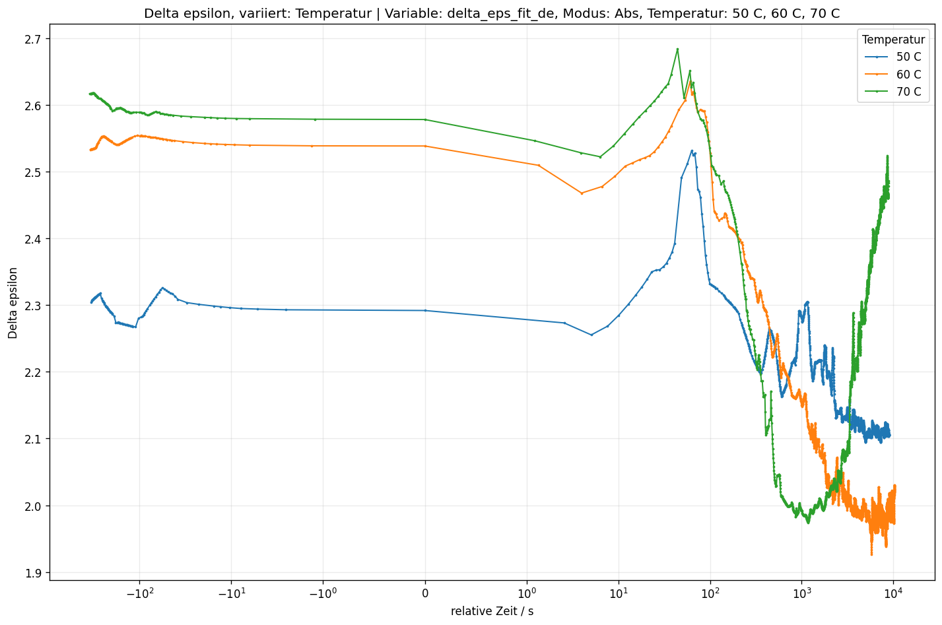
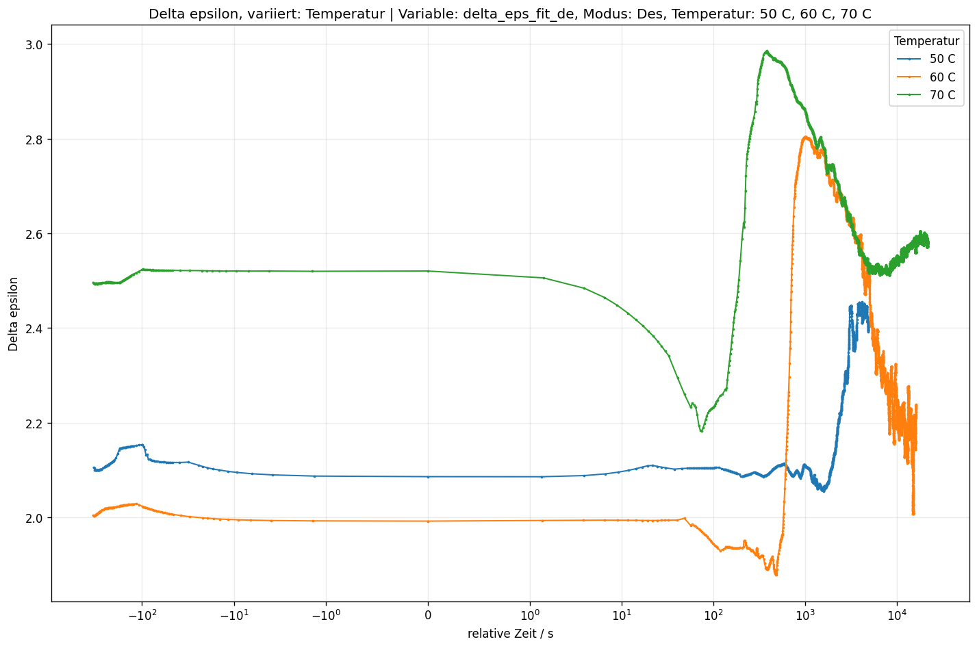
Delta_epsilon_fit
Absorption
Desorption

Slide 13
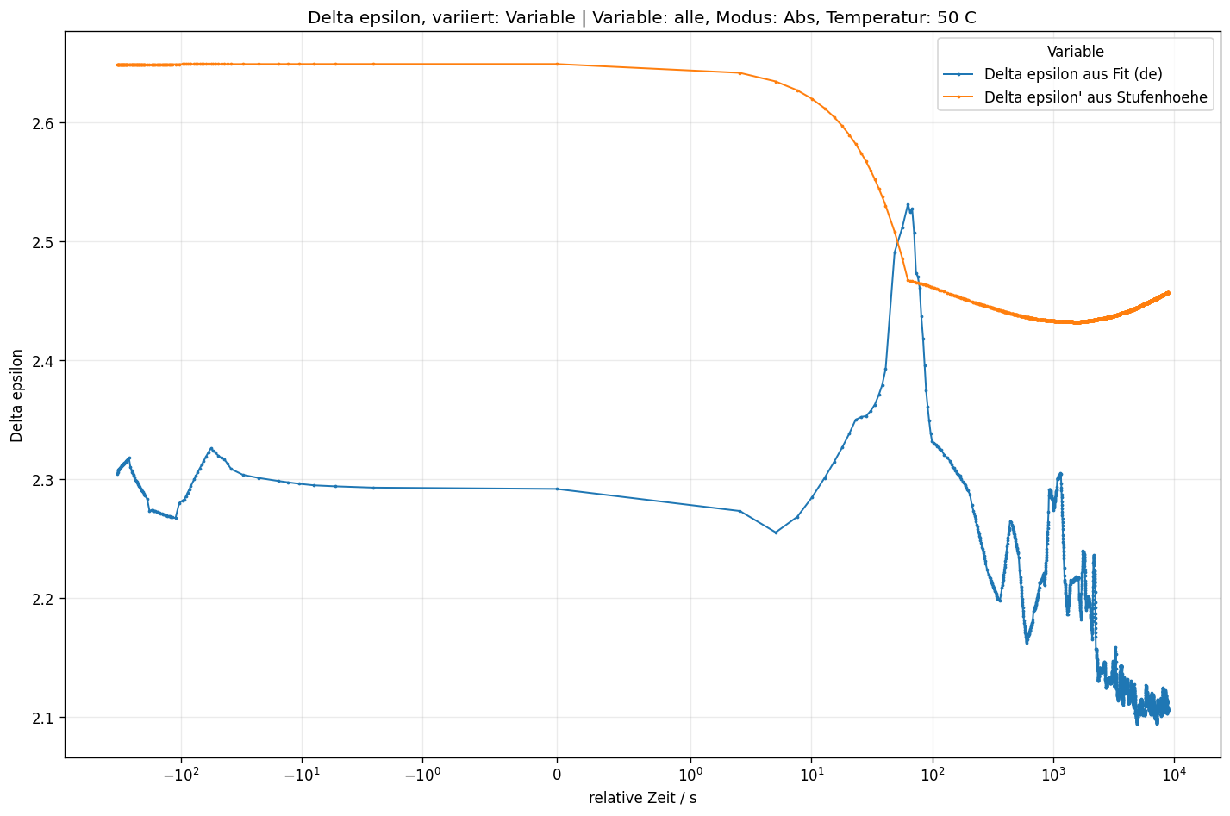
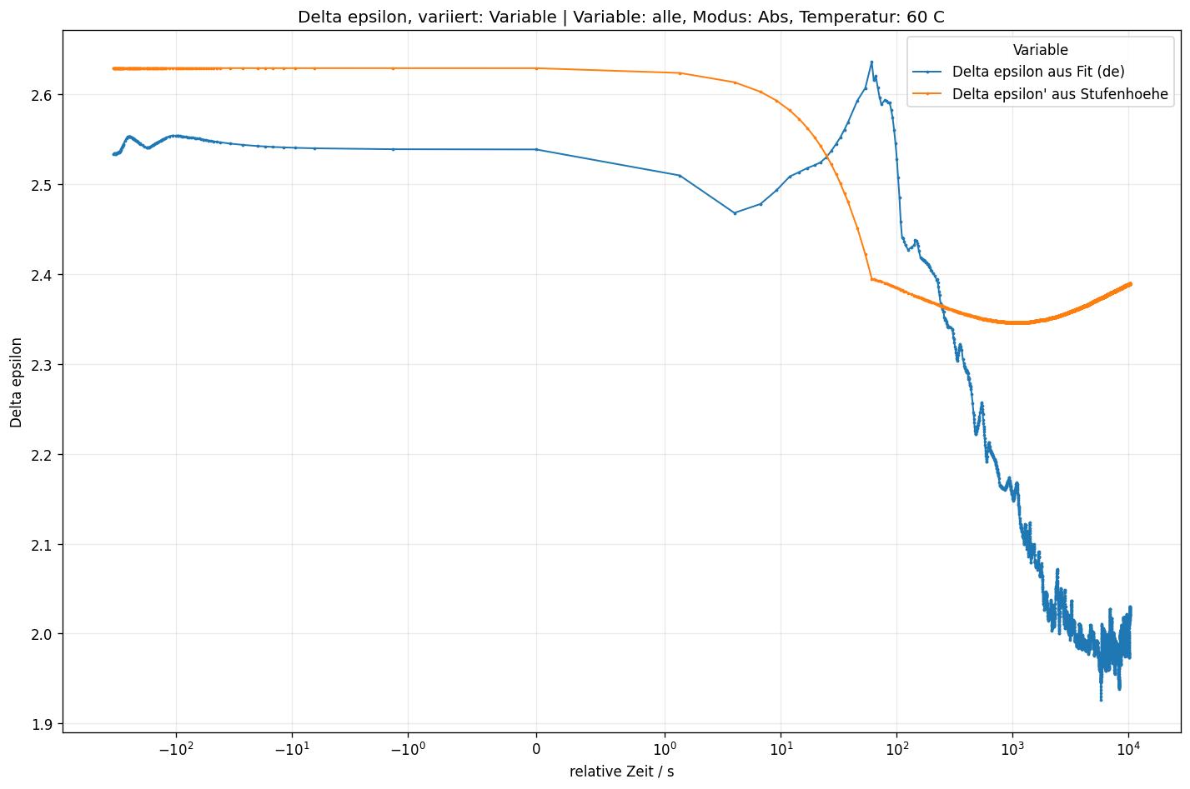
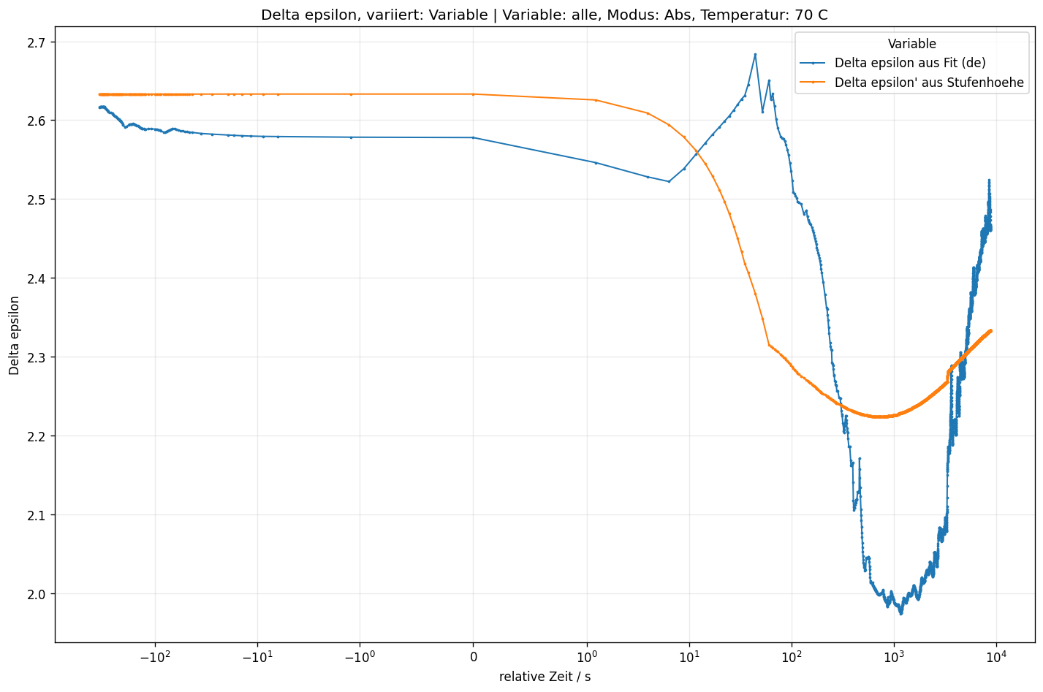
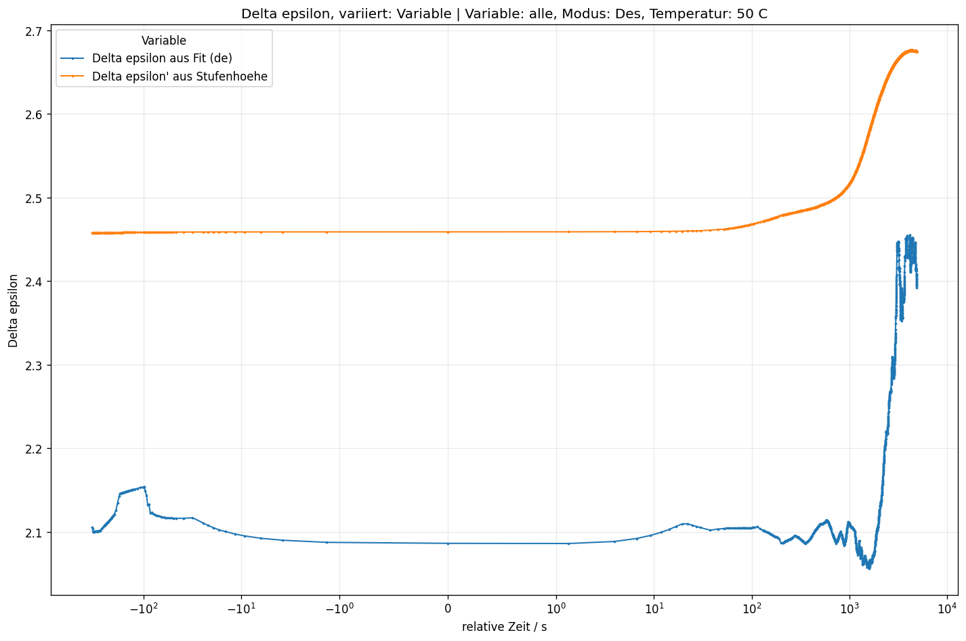
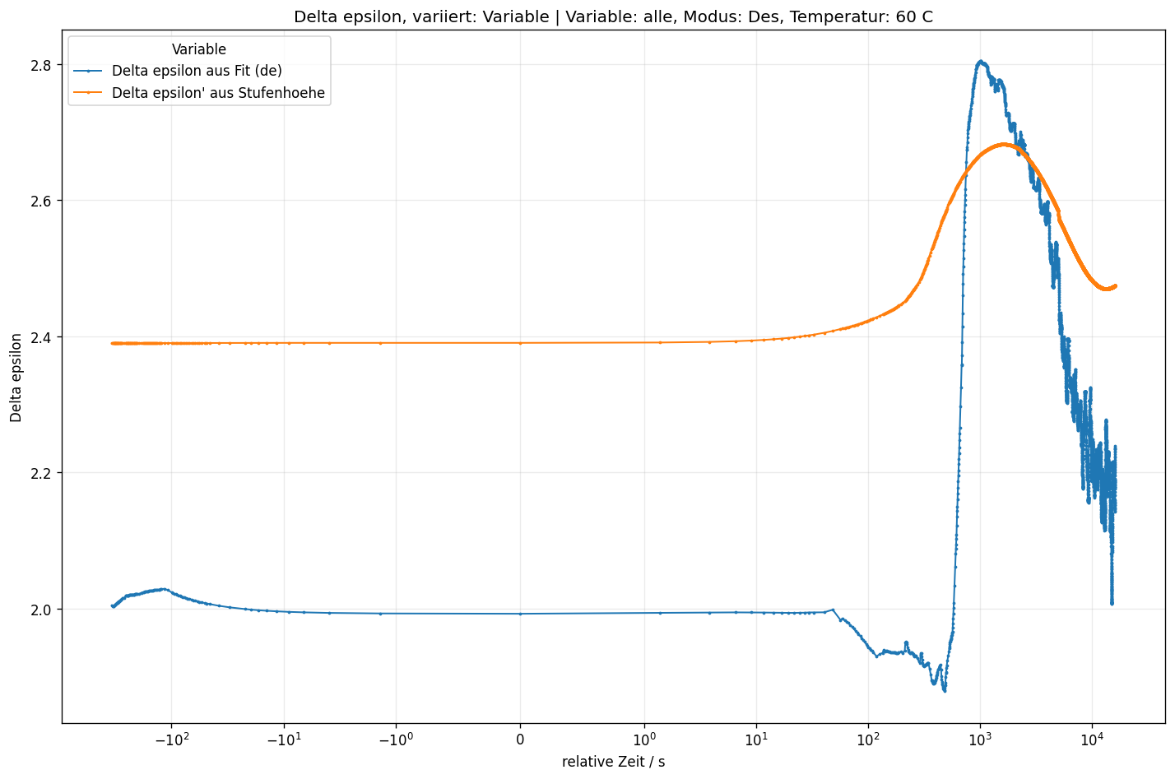
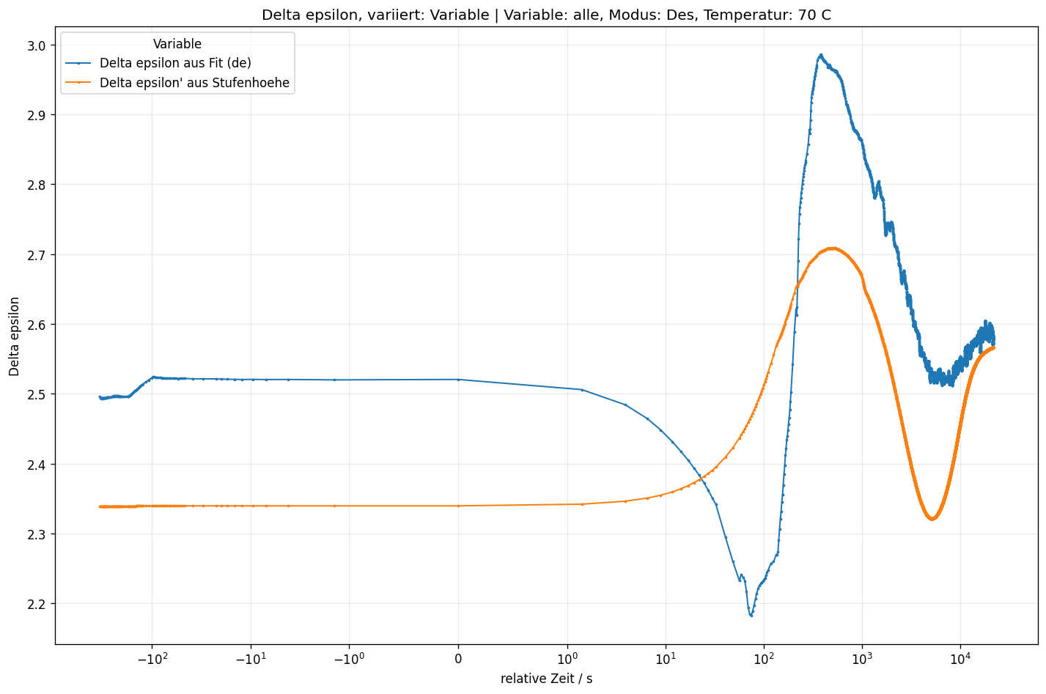
Comparisson delta_epsilon_step vs delta_epsilon_fit

Slide 14
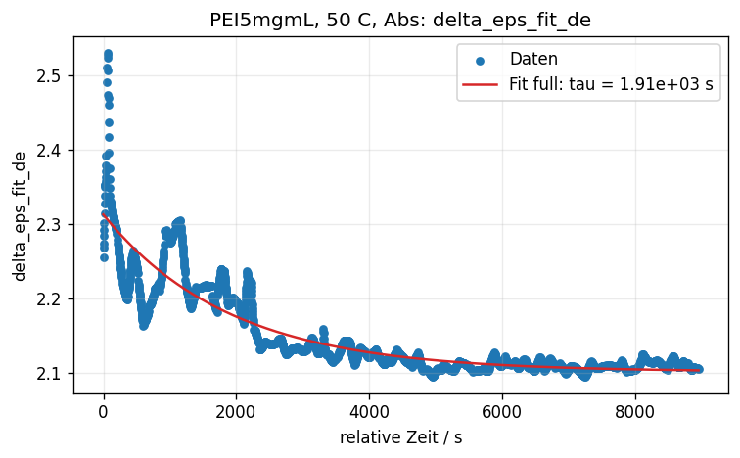
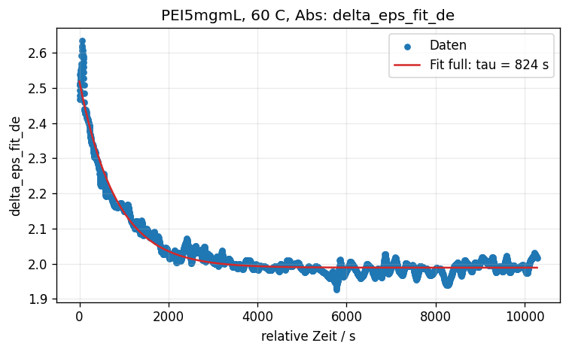
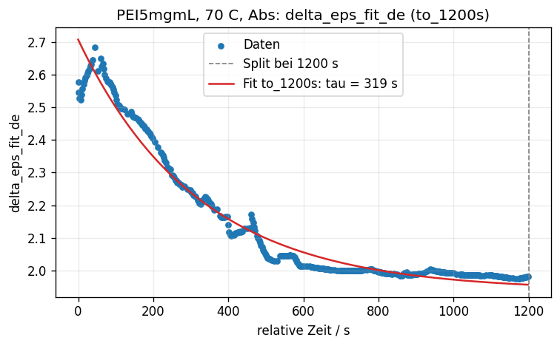
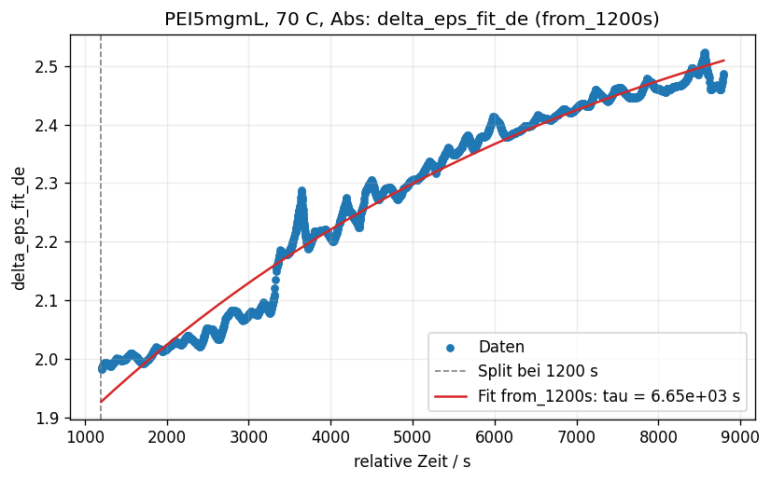
Delta_epsilon_fit Absorption
For (50, 60) °C only first part visible
What about second (or even third) part?
Decreasing time constant in different order of magnitude compared to const. 47 s for delta_epsilon_step

Slide 15
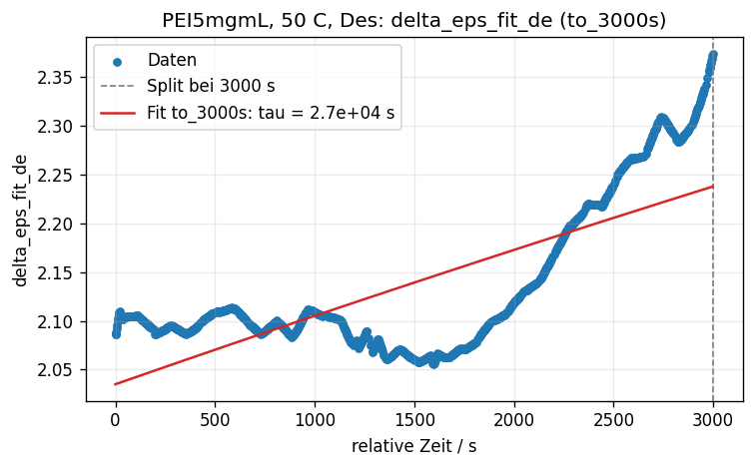
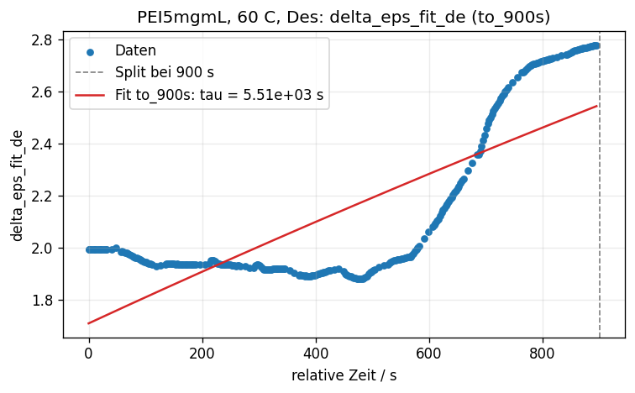
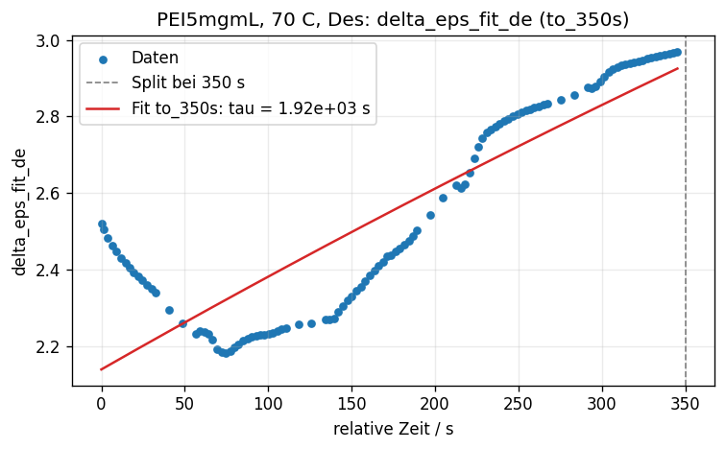
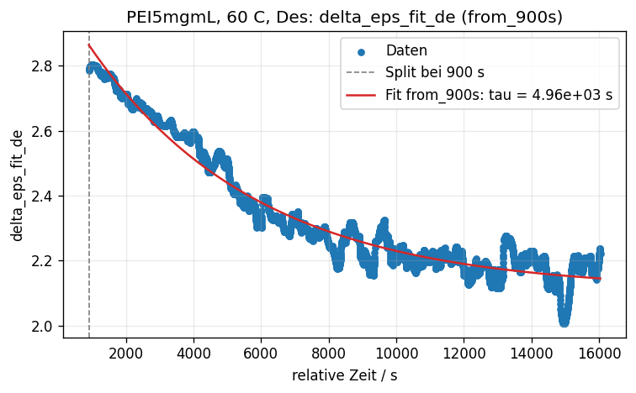
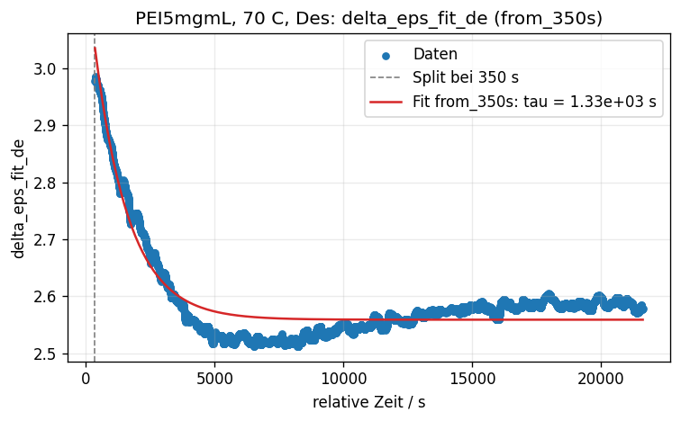
Delta_epsilon_fit Desorption
No second part for 50 °C
Fit for first party doesn’t really work

Slide 16
Summary
Switch point important
Two step process desorption
Delta_epsilon_step: yet unknown long-term behaviour
Delta_epsilon_step vs delta_epsilon_fit
Delta_epsilon_fit Only accounts for one process

