Slide 1
Course 2
EBGN 632
Maxwell Brown
9/9/2019

Slide 2
Agenda
Discussion of homework 1
Overview of Git via Git Extensions
Course repo: https://github.com/maxxb77/EBGN632_2019
Example problem: Lou’s Workshop
Math
Start GAMS code

Slide 3
Homework 1
Purpose:
See where the class is with respect to developing problems and writing math
Make sure everyone can run a GAMS model
Feedback on ideas for class projects
Exercise independence – slight struggle to start
Main thoughts:
Great ideas – excited to work on these together
Need to follow directions
Pattern of Indices/parameters/variables/objective function/constraint(s)
Units!
Set notation versus explicit variables
Requested revisions due 9/15

Slide 4
Homework 2
Create a Git repo
Commit a single file to the Git repo (preferably a simple .txt file)
Send me the link to your repo by 9/15

Slide 5

Math notation example 1 – What not to do…
Indices: None
Parameters:
C1: Cost of mine 1
C2: Cost of mine 2
C3: Cost of mine 3
…
k: capacity of all mines
Variables:
X1: Production from mine 1
X2: Production from mine 2
X3: Production from mine 3
…
Objective function:
$$\begin{matrix}Min \\ X1, X2, X3,…\end{matrix}C1∗X1+C2∗X2+…$$
S.T.:
$$k≥X1+X2+X3+…$$

Slide 6

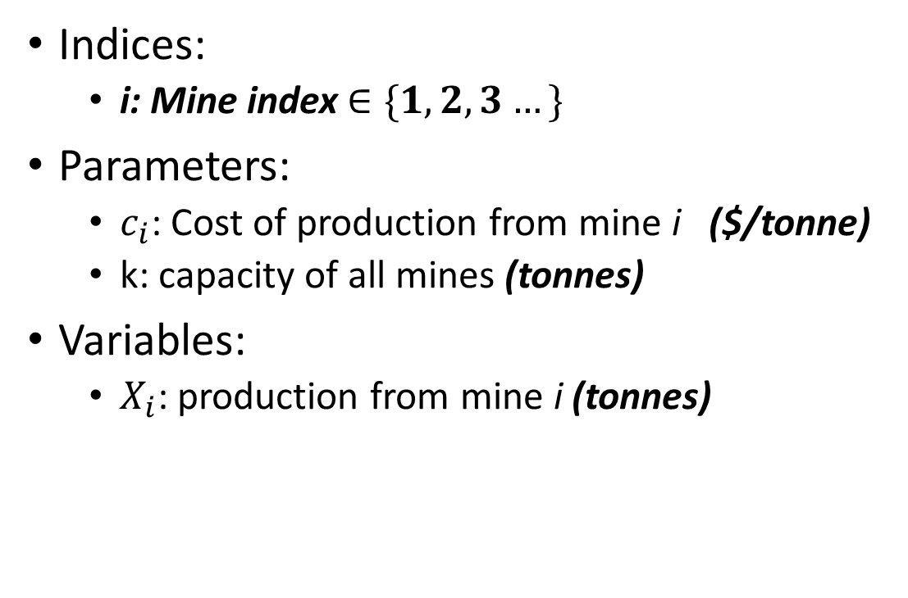
Math notation example 1 – What to do…
Indices:
i: Mine index $∈\{1,2,3…\}$
Parameters:
$c_{i}$: Cost of production from mine i ($/tonne)
k: capacity of all mines (tonnes)
Variables:
$X_{i}$: production from mine i (tonnes)
Objective function:
$$\begin{matrix}Min \\ X_{i}\end{matrix}\sum_{i}{c_{i}X_{i}}$$
S.T.:
$$k≥\sum_{i}{X_{i}}$$

Slide 7

Math notation example 2 – What not to do…
Indices: None
Parameters:
C: cost to produce product 1
D: cost to produce product 2
E: capacity of product 1
F: capacity of product 2
G: cost to procure input 1
H: cost to produce input 2
Variables:
A: production of product 1
B: production of product 2
X: production of input 1
Y: production of input 2
Objective function:
$$\begin{matrix}Min \\ A,B,X,Y\end{matrix}C∗A+D∗B+G∗X+H∗Y$$
S.T.:
$$E≥A$$
$$F≥B$$
$$\frac{2}{5}X≥A$$
$$\frac{3}{7}Y≥B$$

Slide 8
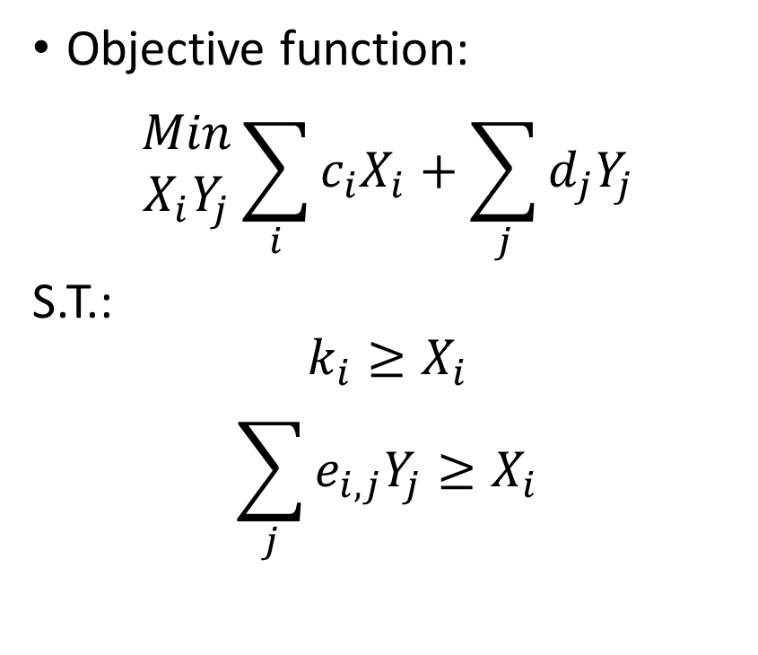
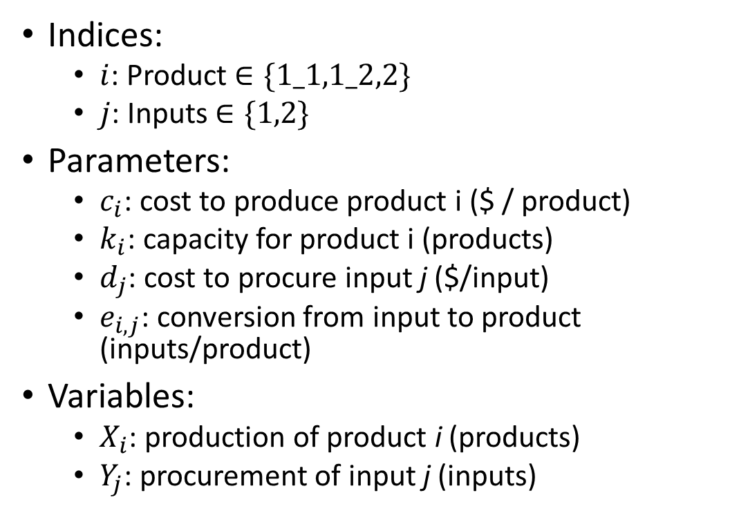
Math notation example 2 – What to do…
Indices:
$i$: Product $∈\{1_1,1_2,2\}$
$j$: Inputs $∈\{1,2\}$
Parameters:
$c_{i}$: cost to produce product i ($ / product)
$k_{i}$: capacity for product i (products)
$d_{j}$: cost to procure input j ($/input)
$e_{i,j}$: conversion from input to product (inputs/product)
Variables:
$X_{i}$: production of product i (products)
$Y_{j}$: procurement of input j (inputs)
Objective function:
$$\begin{matrix}Min \\ X_{i}Y_{j}\end{matrix}\sum_{i}{c_{i}X_{i}}+\sum_{j}{d_{j}Y_{j}}$$
S.T.:
$$k_{i}≥X_{i}$$
$$\sum_{j}{e_{i,j}Y_{j}≥X_{i}}$$
 |  | j
 |  | 1 | 2
i | 1 | 2/5
 | 2 |  | 3/7

Slide 9
Git
Used to store, share, and track development
Great for team development
Industry standard – use of SVN is waning
Git vs Github –
Git is the standard/software
Github is a service – purchased by Microsoft for $7.5B in 2018
We’ll be using a graphical user interface (GUI) for Git, Git Extensions or Git Kraken, as opposed to the command line version – has benefits and tradeoffs but better for beginners

Slide 10
Basic Terms
Master: Main branch of code – the ‘trunk of the tree’
Branch: Separate workflow
Repository (“repo”): The code stored on the git server
Clone: Copying a repository to your machine
Merge: Combining two branches
Commit: Saving your changes to your local machine
Push: Saving your changes to the repository
Pull: Extracting changes from the repository to your machine
Hash/Tag: Unique ID for your most-recent commit/push

Slide 11
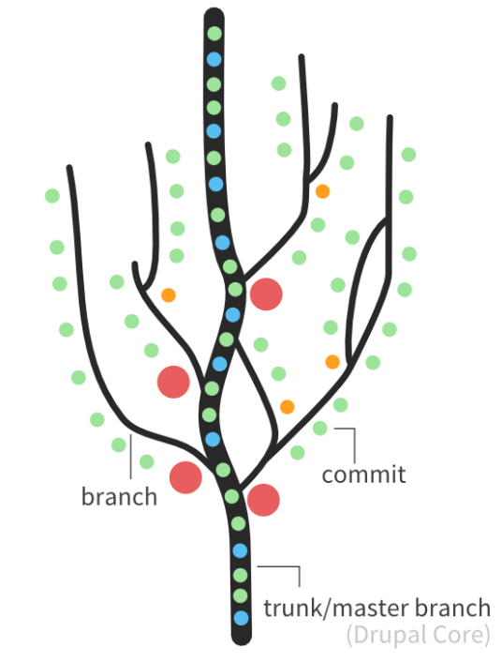
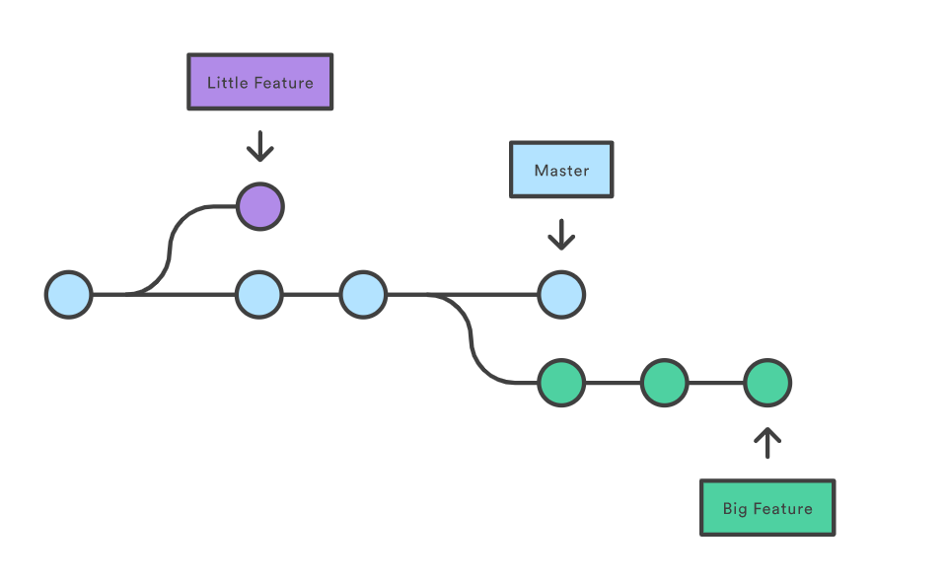
Git ‘Trees’

Slide 12
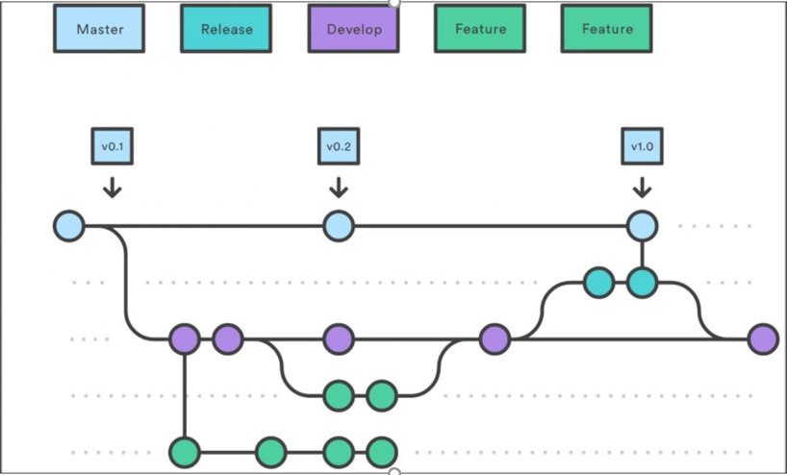
Workflow

Slide 13
Gitting started…
Create a Github.com account
In order:
Download/install Git: https://git-scm.com/downloads
Download/install kdiff3: https://sourceforge.net/projects/kdiff3/
Download/install Git extensions – use OpenSSH not putty when prompted: https://sourceforge.net/projects/gitextensions/
You may have to assign the kdiff3 directory in settings
AFTER installing all software, open Git extensions <- won’t cause issues if opened prematurely but prevents warnings etc

Slide 14
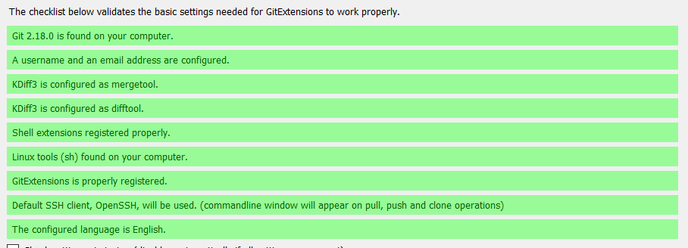
Input user name and email address
Assign kdiff3 directory
OpenSSH or Putty
should work

Slide 15
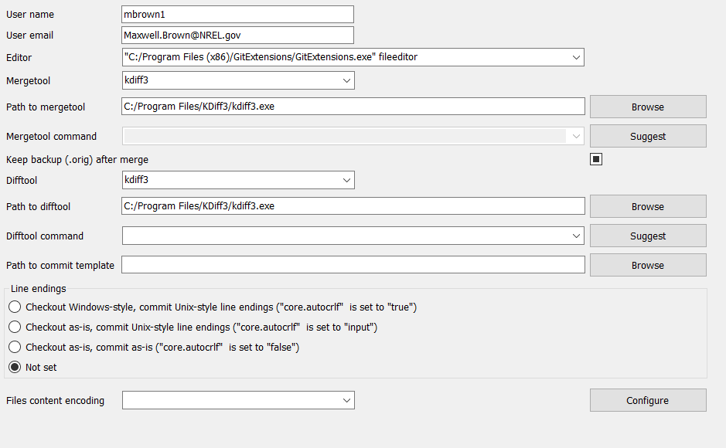
My Git Settings

Slide 16
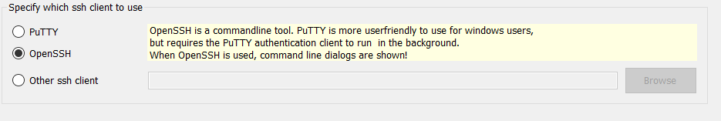
If you forgot to select ‘OpenSSH’
Tools -> Settings -> SSH:

Slide 17
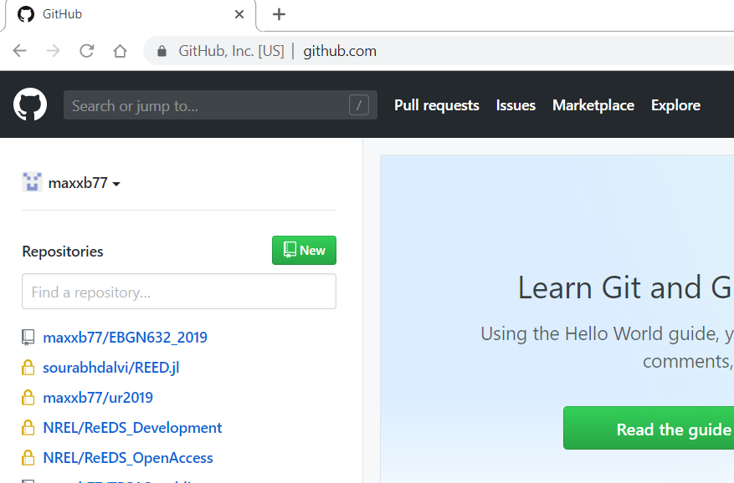
Creating a repository

Slide 18
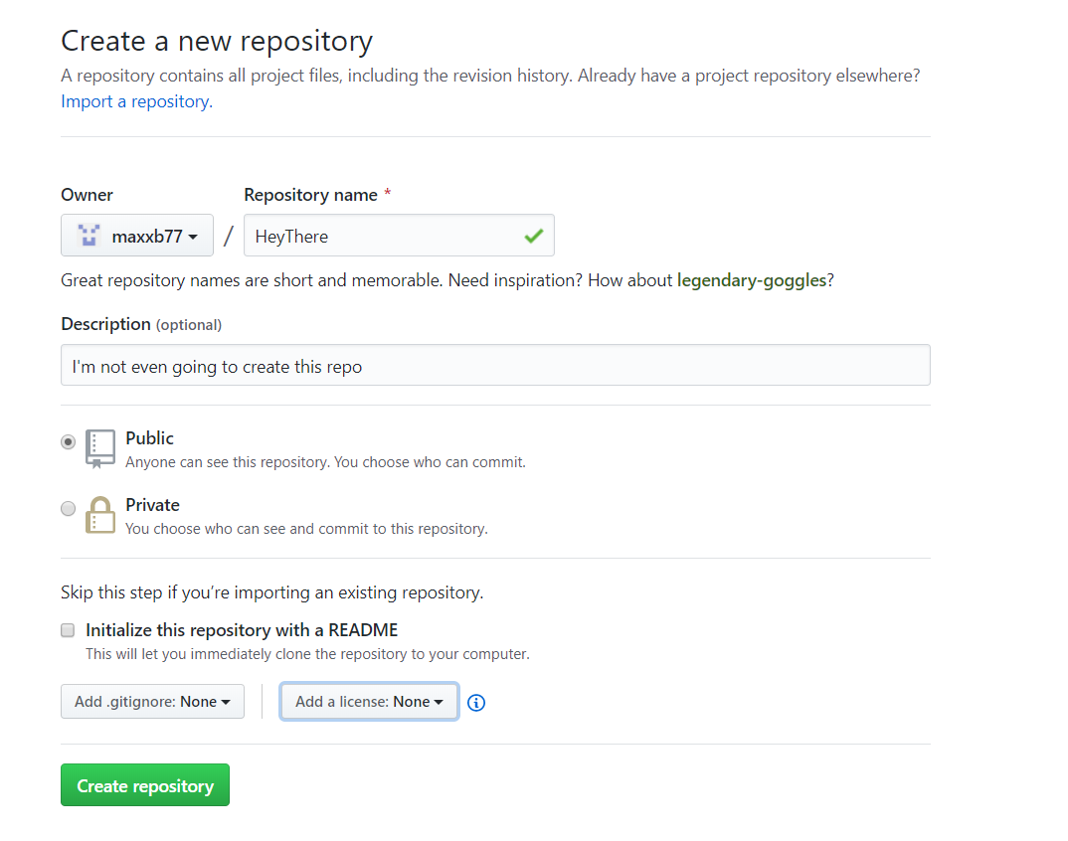

Slide 19
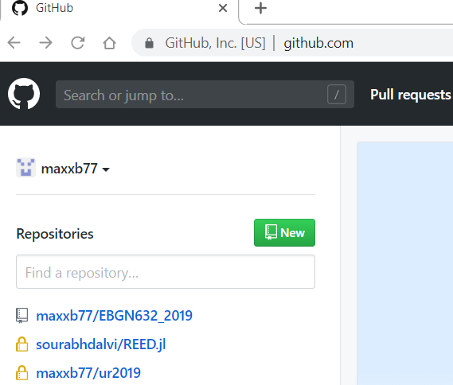
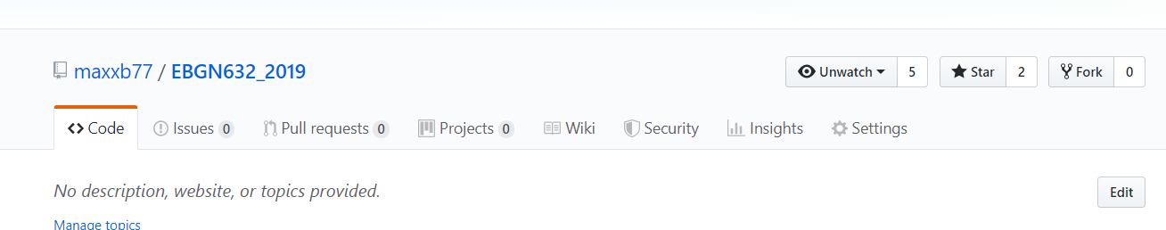
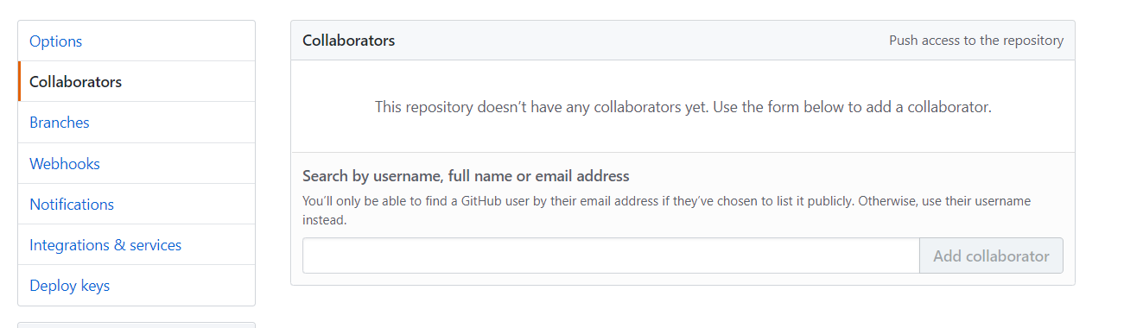
Adding collaborators:

Slide 20
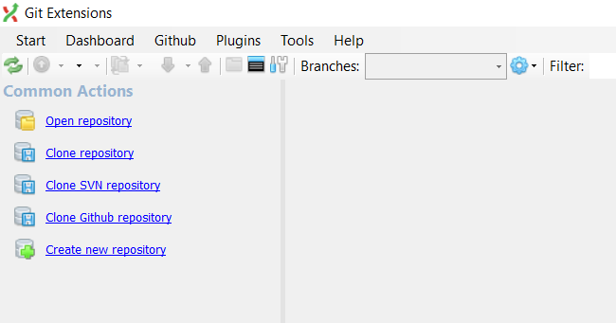
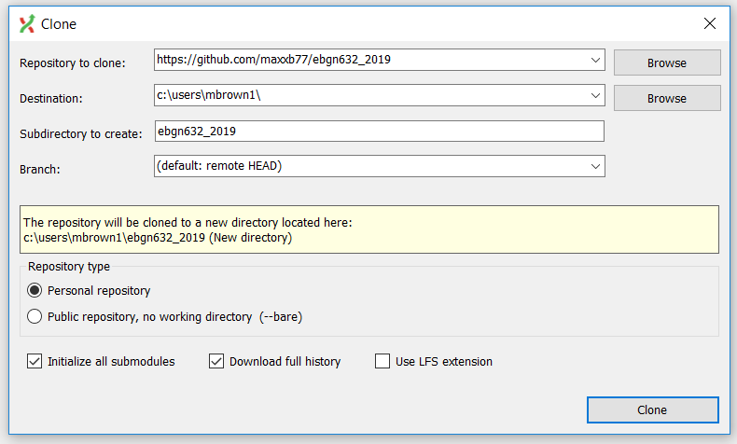
Cloning a repository…

Slide 21
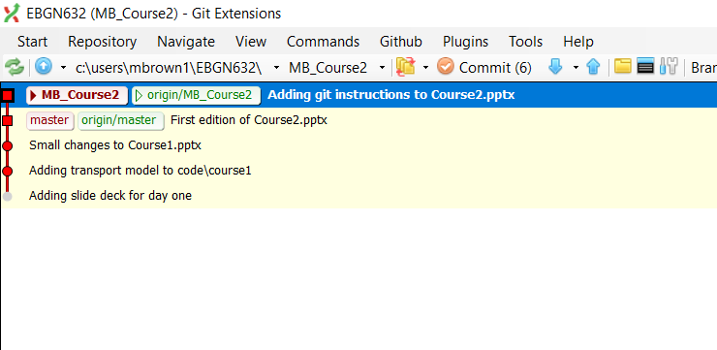
Pushing Changes
Say I created a new file – maxbrown.txt
I now want that new file stored in my repo
Step 1 – click ‘commit’:
Current branch –
use to change branches
Current directory – use to change repo
Branch names
Red==Local
Green==Server-stored

Slide 22
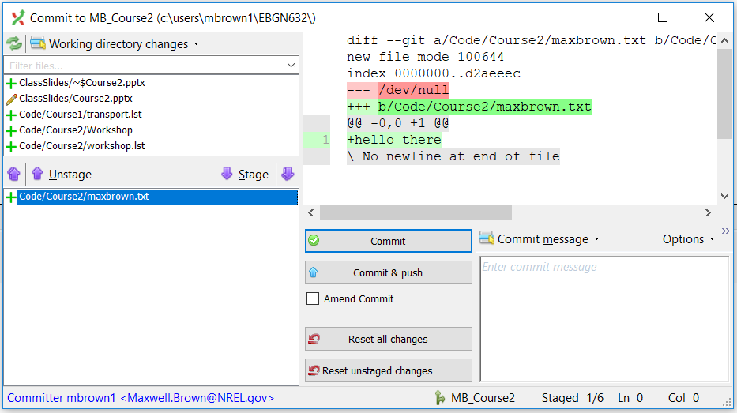
The commit screen
Files that have been changed or added
File Contents
Files to be committed/pushed
Commit Message

Slide 23
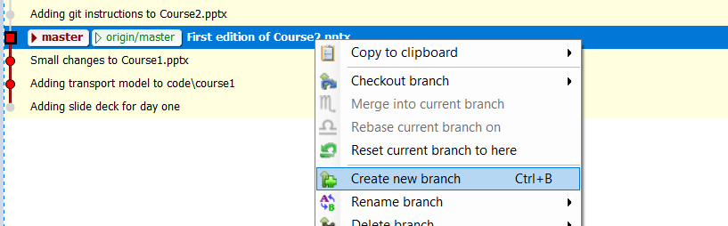
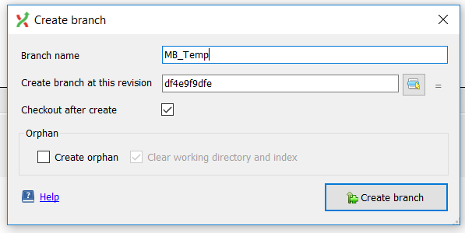
Creating a branch I
Now I want to start a new branch off the master branch for making some development changes
Step 1 – right click where you want to branch off from
Name your branch

Slide 24
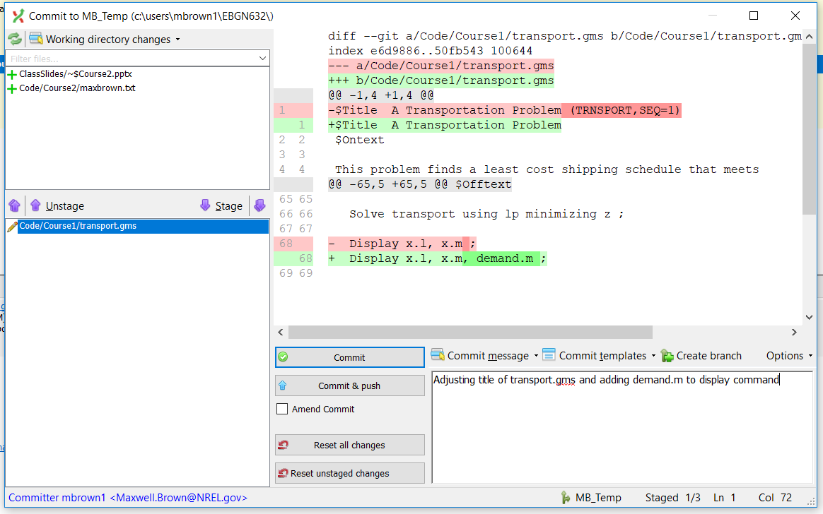
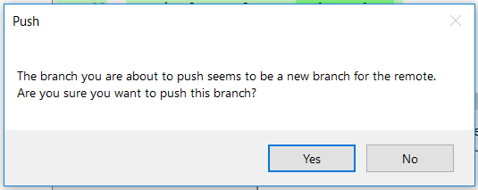
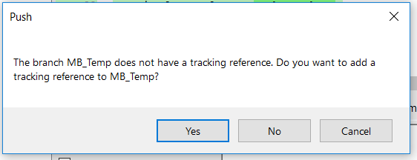
Creating a branch II
Same process as committing:
Stage your files -> Write a message -> Commit & Push

Slide 25
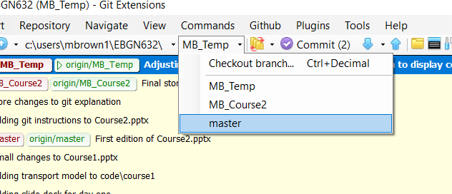
Merging a branch into master I
If master has changed, first merge master into your branch
Otherwise – switch back to the master branch
Note that sometimes switching branches will require you to ‘reset changes’

Slide 26
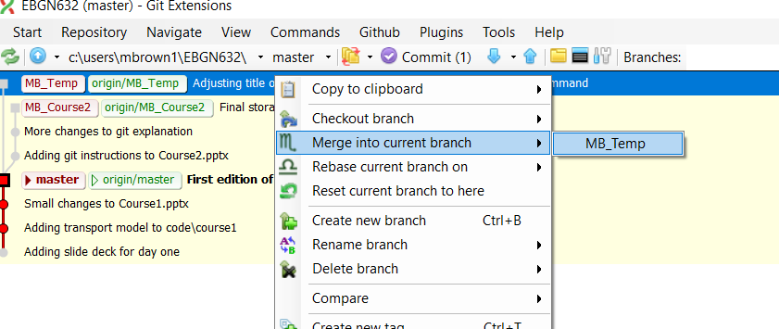
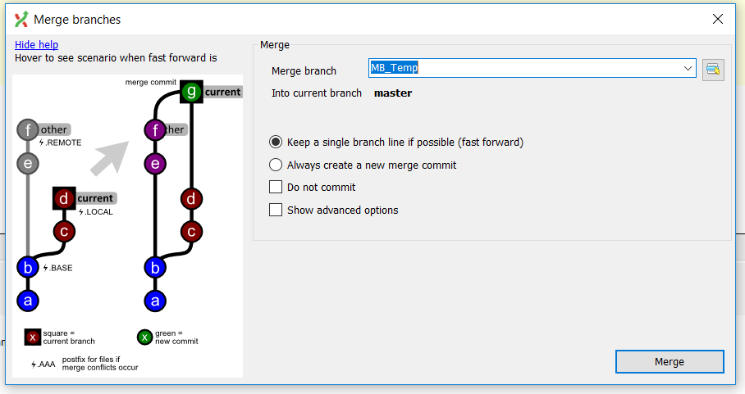
Merging a branch into master II
Right click the branch you want to merge into your current branch:
Afterwards – might need to push
Commands -> Push

Slide 27
Dealing with merge conflicts
Say the branch you have is not up-to-date with master
i.e. master branch was updated after you branched off from it
This causes a merge conflict and is why we installed kdiff3
Good video explanation: https://youtu.be/Kmc39RvuGM8
Will have an example in class next time

Slide 28
That’s ~90% of Git
Other things to investigate if you’re curious:
Rebasing
Forking
Submodules
Squashing
Orphans

Slide 29
Louis’ workshop
Louis runs a woodworking business where he builds and sells bowls, tables, and chairs. In building a bowl, Louis requires a blank. To build a table, Louis requires two maple boards and one cherry board. To build a chair, Louis requires one cherry board. Louis can sell chairs standalone but each table requires four chairs (not included in the sale price). Finally, Louis only has forty hours to work each week. The prices, costs, and hour requirements are:
Questions:
What is Louis’ profit maximizing production profile?
Louis’ wife, Tilly, doesn’t want Louis to buy a bandsaw (cost = $1000). However, the bandsaw would reduce all costs by 10%. If Louis bought the bandsaw today, how many weeks of work would it take for Louis to pay off the bandsaw purchase solely through the reduced costs?
Product | Price ($/unit)
Bowl | 30
Table | 200
Chair | 50
Input | Cost ($/unit)
Bowl Blank | 5
Maple Board | 15
Cherry Board | 10
Product | Hours
Bowl | 3
Table | 20
Chair | 4

Slide 30
Louis’ workshop extensions
Admittedly a very simple model that introduces the concept of a corner solution where optimal behavior is to do a single action (e.g. Louis will only make bowls)
Therefore, going to sequentially add extensions:
Demand schedules/curves for all products
Supply costs by lumber store
Driving distances
Fixed expenses for equipment
Note: Continuous variables to represent works in progress

Slide 31
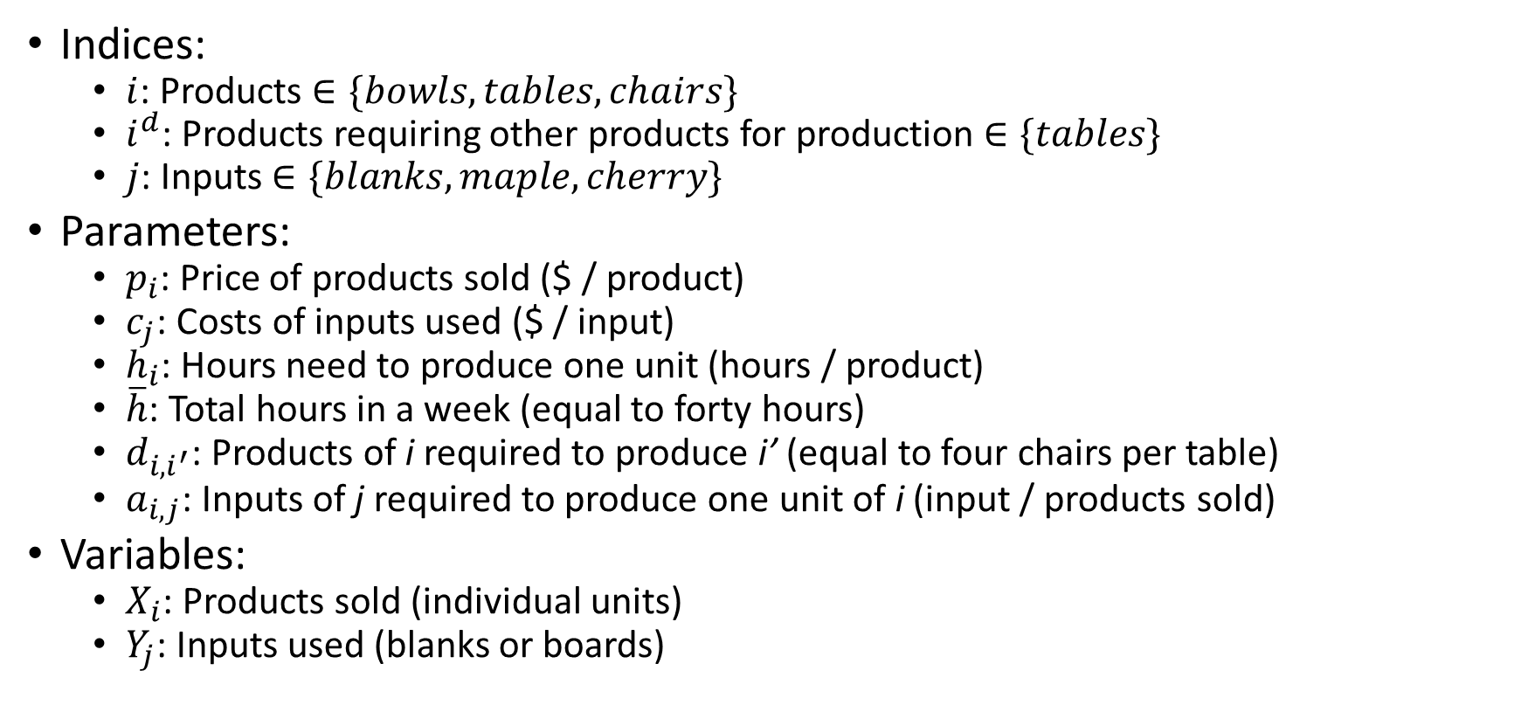
Problem setup I
Indices:
$i$: Products $∈\{bowls, tables, chairs\}$
$i^{d}$: Products requiring other products for production $∈\{tables\}$
$j$: Inputs $∈\{blanks, maple, cherry\}$
Parameters:
$p_{i}$: Price of products sold ($ / product)
$c_{j}$: Costs of inputs used ($ / input)
$h_{i}$: Hours need to produce one unit (hours / product)
$\overline{h}$: Total hours in a week (equal to forty hours)
$d_{i,i^{′}}$: Products of i required to produce i’ (equal to four chairs per table)
$a_{i,j}$: Inputs of j required to produce one unit of i (input / products sold)
Variables:
$X_{i}$: Products sold (individual units)
$Y_{j}$: Inputs used (blanks or boards)
i \ j | Blanks | Maple | Cherry
Bowl | 1
Table |  | 2 | 1
Chair |  |  | 1

Slide 32
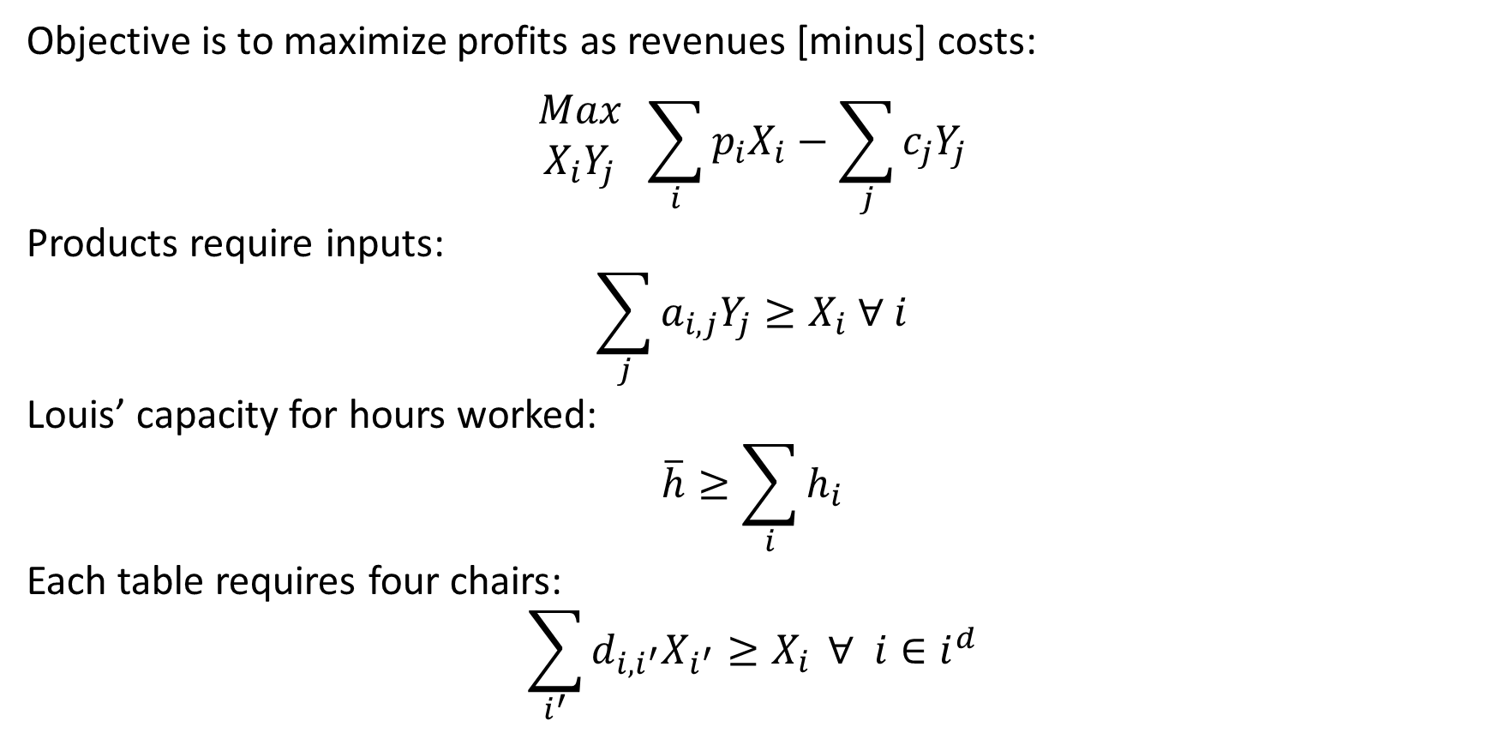
Problem setup II
Objective is to maximize profits as revenues [minus] costs:
$$\begin{matrix}Max \\ X_{i}Y_{j}\end{matrix} \sum_{i}{{p_{i}X}_{i}}−\sum_{j}{c_{j}Y_{j}}$$
Products require inputs:
$$\sum_{j}{a_{i,j}Y_{j}}≥X_{i} ∀ i$$
Louis’ capacity for hours worked:
$$\overline{h}≥\sum_{i}{h_{i}}$$
Each table requires four chairs:
$$\sum_{i^{′}}{d_{i,i^{′}}X_{i^{′}}≥X_{i}} ∀ i∈i^{d}$$

Slide 33
Building a model from scratch Code will be in code\course2\workshop.gms

