Slide 1
Github Desktop Basics
Maxwell Brown
EBGN 632: Course 2 Supplementary

Slide 2
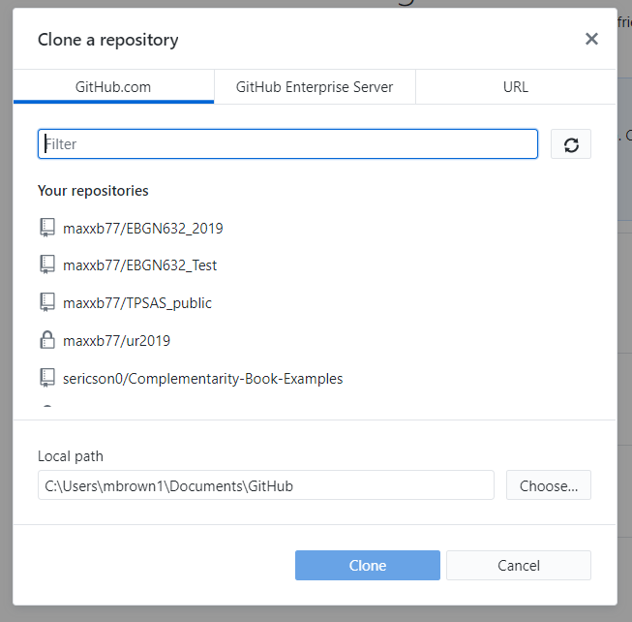
Cloning a repository
File -> Clone a repository
From GitHub.com tab, can choose the repositories that you’ve created or that have been shared with you
The ‘URL’ tab will allow you to clone someone else’s repository
NB: Local Path indicates the directory on your machine where the repo will be cloned

Slide 3
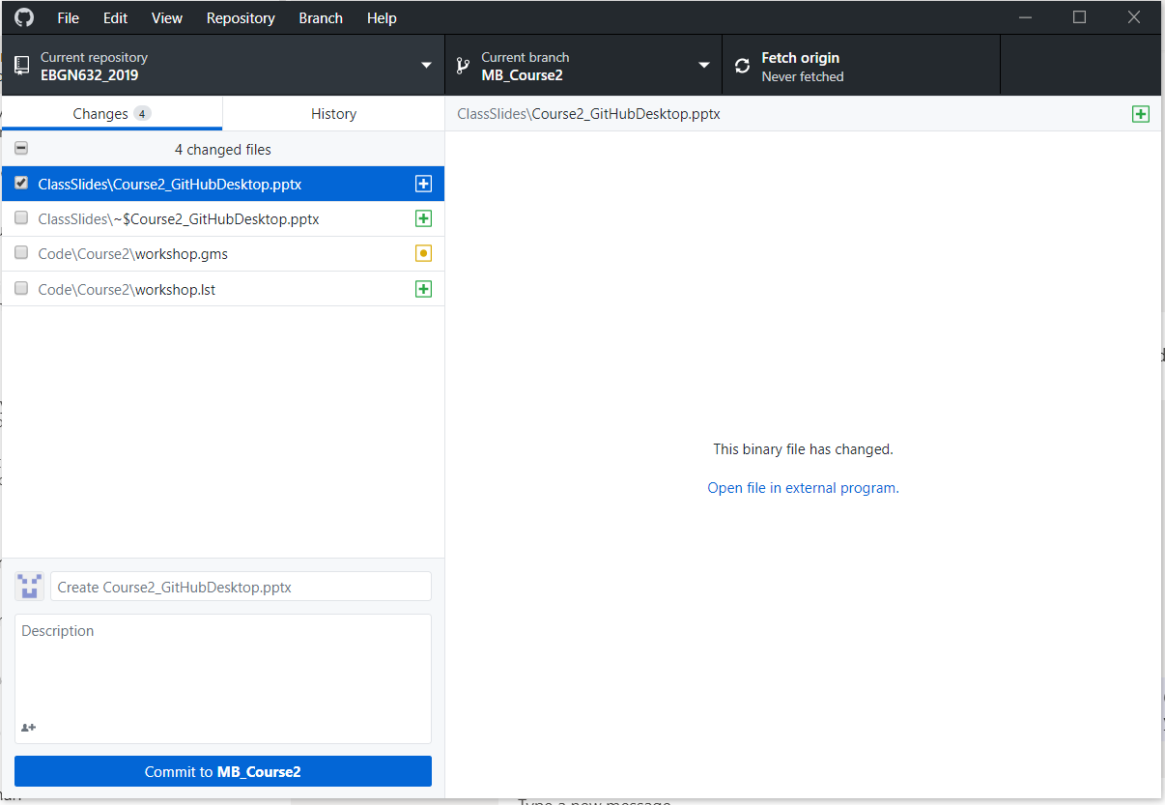
Committing Changes
Slight difference from Git Extensions in that you need to select the files you want to commit (as opposed to staging them) and commit to the local repo before you push
1. Select files you want to commit via check boxes
2. Commit – note this will only be to your local repo

Slide 4
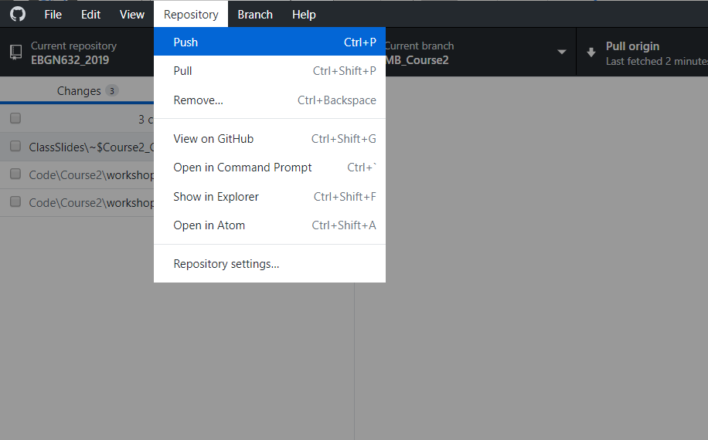
Pushing
After you’ve committed files, pushing is easy
Simply repository -> push (or ctrl+p)

Slide 5
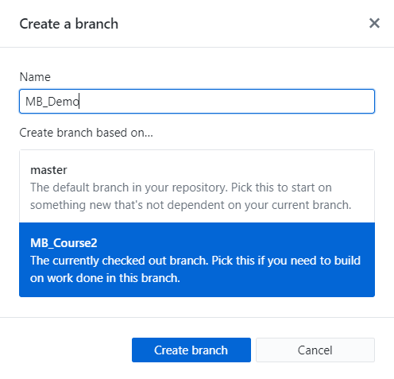
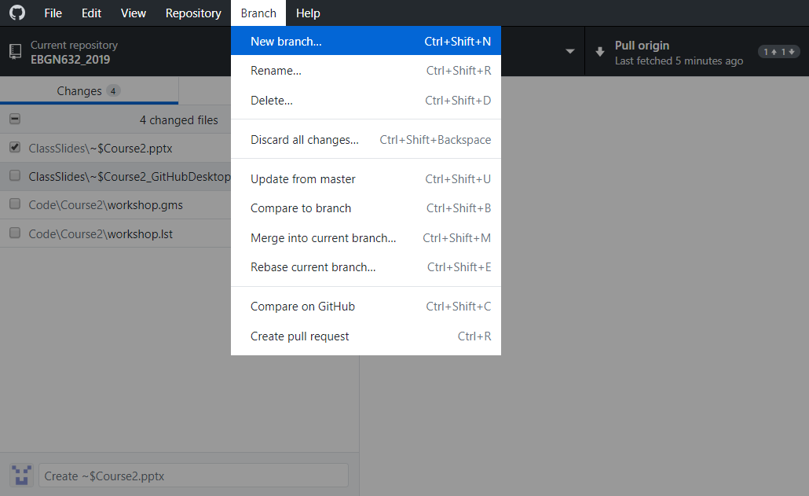
Creating a branch
Branch -> Create new branch
Here – Choose which branch you want to break off of

Slide 6
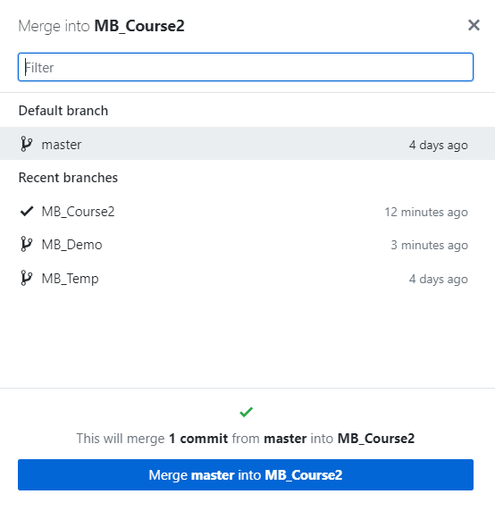
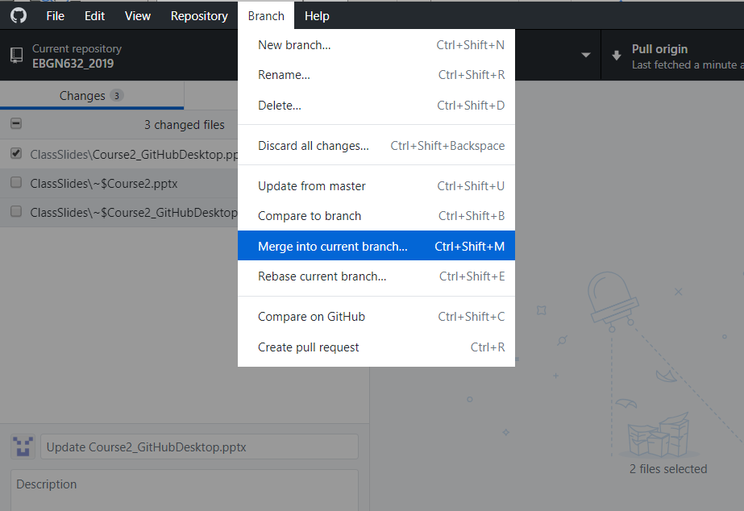
Merging a branch
Choose the branch you want to merge into the current branch

