Slide 1
Course 3
EBGN 632
Maxwell Brown
9/16/2019

Slide 2
Recall Louis’ Workshop… We’ll start by developing code\course2\workshop.gms -- In code\course3\.. We’ll add customers in ..\workshop_customers.gms Then add suppliers in ..\workshop_suppliers.gms

Slide 3
Homework
Commit/push your set, parameter, variable declarations to your github repo
Send me:
The link to your repo
The hash/tag of your commit
Your .gms and .lst files
Due: 9/22

Slide 4
Louis’ workshop
Louis runs a woodworking business where he builds and sells bowls, tables, and chairs. In building a bowl, Louis requires a blank. To build a table, Louis requires two maple boards and one cherry board. To build a chair, Louis requires one cherry board. Louis can sell chairs standalone but each table requires four chairs (not included in the sale price). Finally, Louis only has forty hours to work each week. The prices, costs, and hour requirements are:
Questions:
What is Louis’ profit maximizing production profile?
Louis’ wife, Tilly, doesn’t want Louis to buy a bandsaw (cost = $1000). However, the bandsaw would reduce all costs by 10%. If Louis bought the bandsaw today, how many weeks of work would it take for Louis to pay off the bandsaw purchase solely through the reduced costs?
Product | Price ($/unit)
Bowl | 30
Table | 200
Chair | 50
Input | Cost ($/unit)
Bowl Blank | 5
Maple Board | 15
Cherry Board | 10
Product | Hours
Bowl | 3
Table | 20
Chair | 4

Slide 5
Louis’ workshop extensions
Admittedly a very simple model that introduces the concept of a corner solution where optimal behavior is to do a single action (e.g. Louis will only make bowls)
Therefore, going to sequentially add extensions:
Demand schedules/curves for all products
Supply costs by lumber store
Driving distances
Fixed expenses for equipment
Note: Continuous variables to represent works in progress

Slide 6
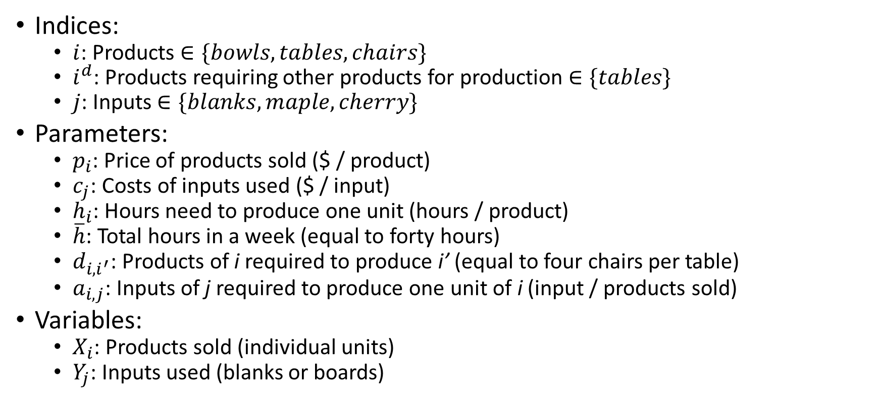
Problem setup I
Indices:
$i$: Products $∈\{bowls, tables, chairs\}$
$i^{d}$: Products requiring other products for production $∈\{tables\}$
$j$: Inputs $∈\{blanks, maple, cherry\}$
Parameters:
$p_{i}$: Price of products sold ($ / product)
$c_{j}$: Costs of inputs used ($ / input)
$h_{i}$: Hours need to produce one unit (hours / product)
$\overline{h}$: Total hours in a week (equal to forty hours)
$d_{i,i^{′}}$: Products of i required to produce i’ (equal to four chairs per table)
$a_{i,j}$: Inputs of j required to produce one unit of i (input / products sold)
Variables:
$X_{i}$: Products sold (individual units)
$Y_{j}$: Inputs used (blanks or boards)
i \ j | Blanks | Maple | Cherry
Bowl | 1
Table |  | 2 | 1
Chair |  |  | 1

Slide 7
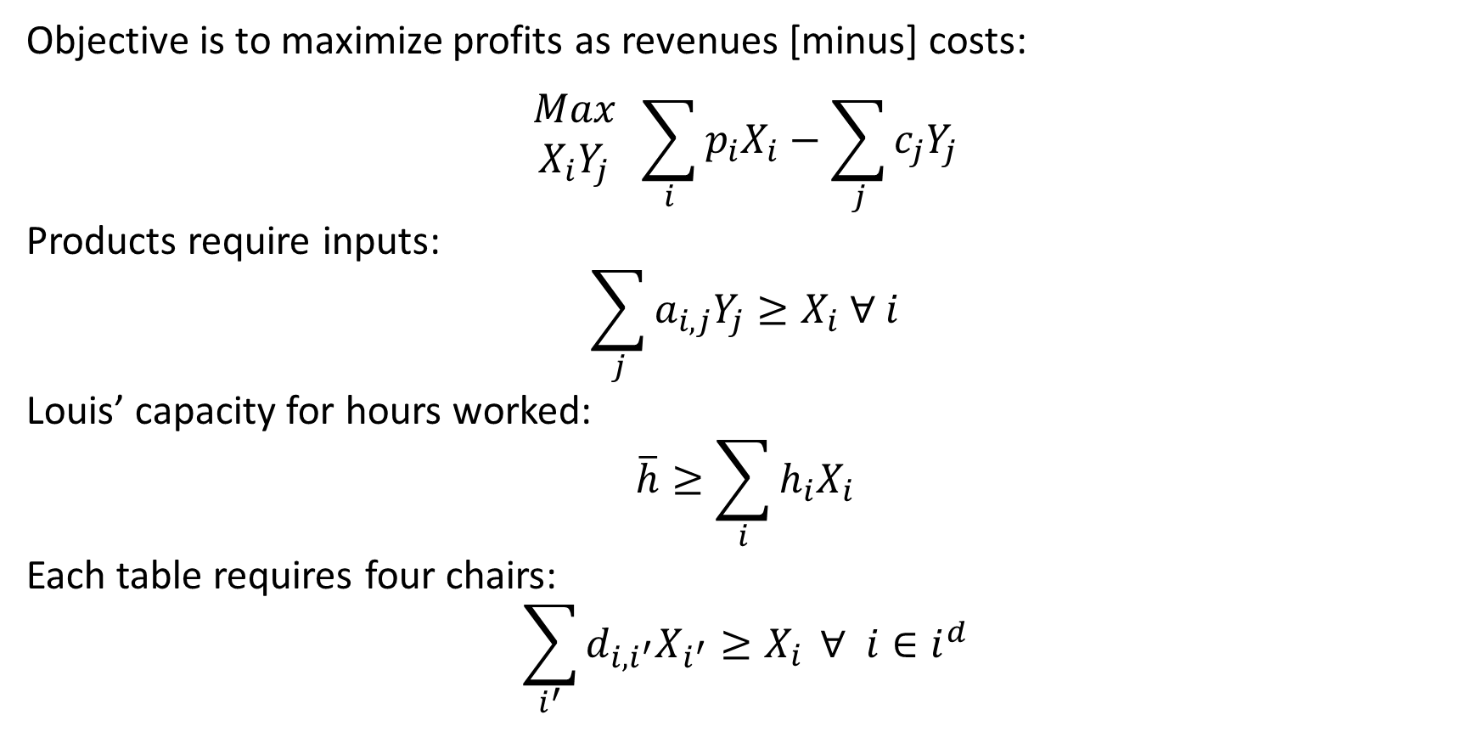
Problem setup II
Objective is to maximize profits as revenues [minus] costs:
$$\begin{matrix}Max \\ X_{i}Y_{j}\end{matrix} \sum_{i}{{p_{i}X}_{i}}−\sum_{j}{c_{j}Y_{j}}$$
Products require inputs:
$$\sum_{j}{a_{i,j}Y_{j}}≥X_{i} ∀ i$$
Louis’ capacity for hours worked:
$$\overline{h}≥\sum_{i}{h_{i}X_{i}}$$
Each table requires four chairs:
$$\sum_{i^{′}}{d_{i,i^{′}}X_{i^{′}}≥X_{i}} ∀ i∈i^{d}$$

Slide 8
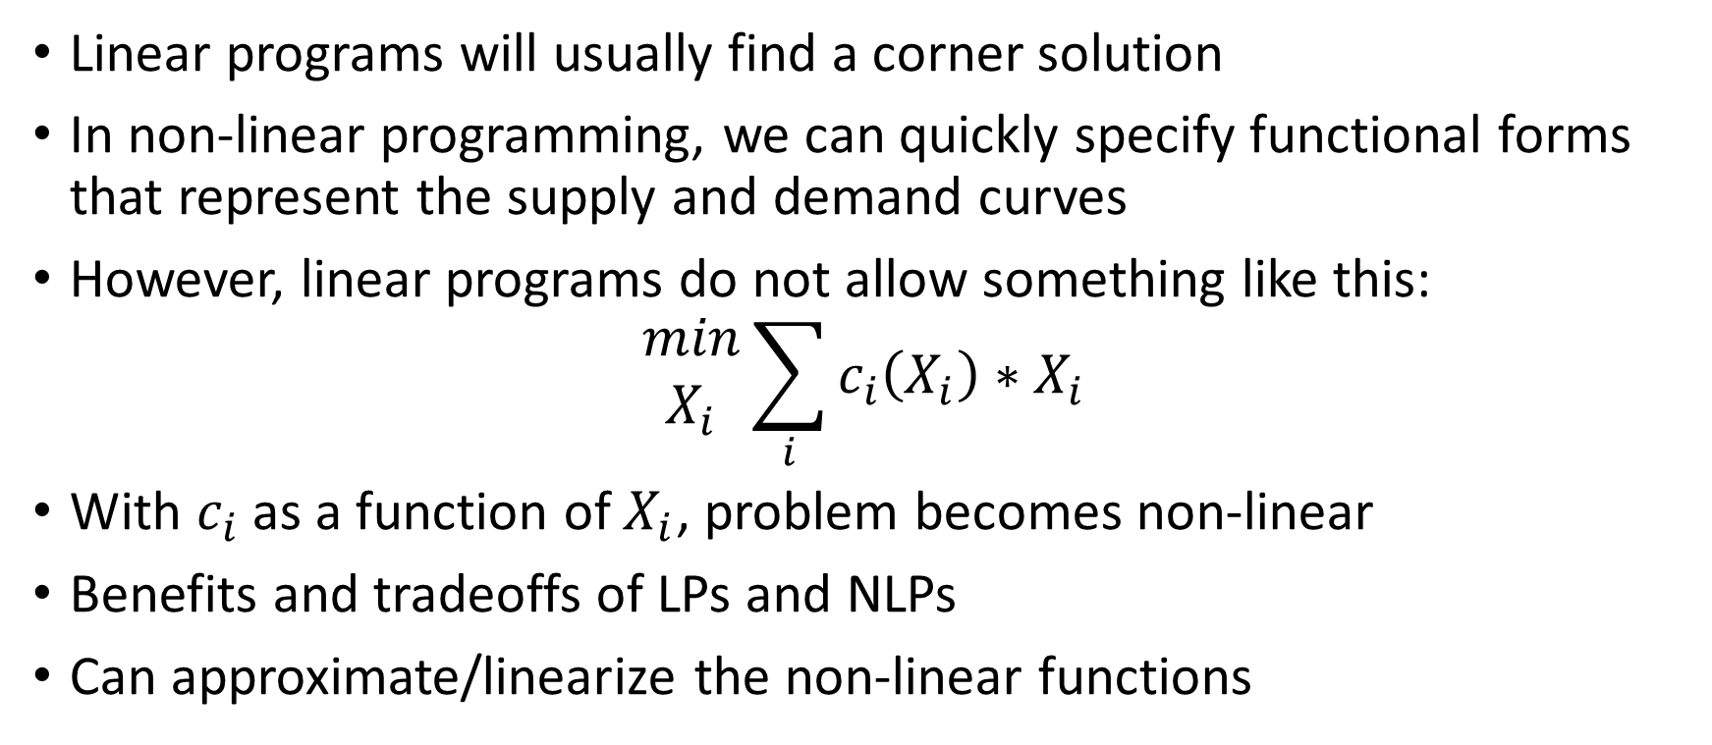
Why do we need supply and demand schedules?
Linear programs will usually find a corner solution
In non-linear programming, we can quickly specify functional forms that represent the supply and demand curves
However, linear programs do not allow something like this:
$$\begin{matrix}min \\ X_{i}\end{matrix}\sum_{i}{c_{i}\left(X_{i}\right)∗X_{i}}$$
With $c_{i}$ as a function of $X_{i}$, problem becomes non-linear
Benefits and tradeoffs of LPs and NLPs
Can approximate/linearize the non-linear functions

Slide 9
End 9/16/19
Begin 9/23/19
Homework 1 due ASAP
Homework 3 due 9/29/19

Slide 10
Few requests…
Examples of real-world models
Investment decision-making
Slow down – review last week’s code
Reference material:
GAMS McCarl users guide: https://www.gams.com/fileadmin/community/contrib/doc/mccarlgamsuserguide.pdf

Slide 11
Next classes…
Theory of optimization – can vote on this
Simplex method (if you’re up to date on matrix algebra)
Duality
Then:
More GAMS practice // Advanced GAMS features
Using the command prompt, creating .bat/.sh files
Dealing with outputs in R
Running scenarios

Slide 12
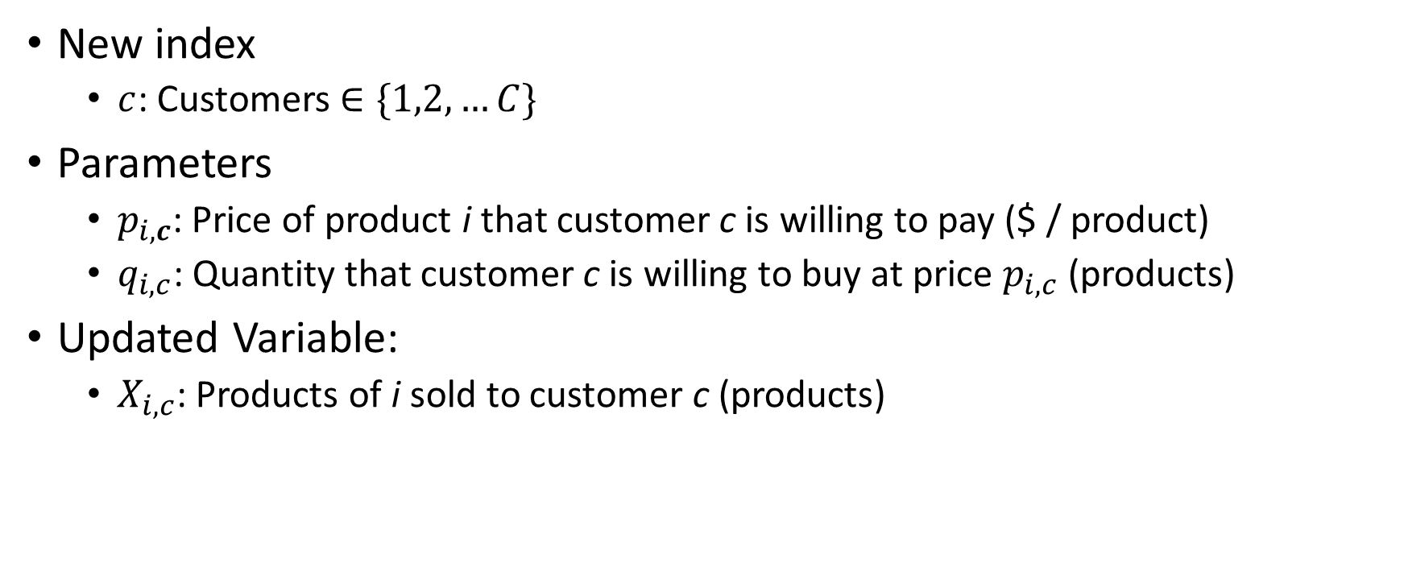
Now let’s add customers….
New index
$c$: Customers $∈\{1,2,…C\}$
Parameters
$p_{i,c}$: Price of product i that customer c is willing to pay ($ / product)
$q_{i,c}$: Quantity that customer c is willing to buy at price $p_{i,c}$ (products)
Updated Variable:
$X_{i,c}$: Products of i sold to customer c (products)

Slide 13
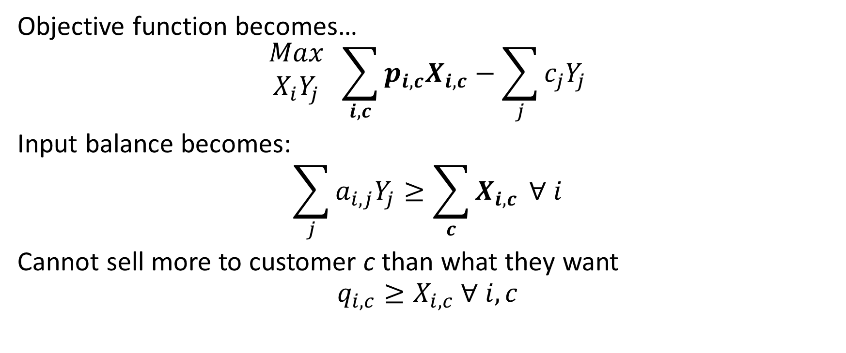
Updated Equations with Customers
Objective function becomes…
$$\begin{matrix}Max \\ X_{i}Y_{j}\end{matrix} \sum_{i,c}{{p_{i,c}X}_{i,c}}−\sum_{j}{c_{j}Y_{j}}$$
Input balance becomes:
$$\sum_{j}{a_{i,j}Y_{j}}≥\sum_{c}{X_{i,c}} ∀ i$$
Cannot sell more to customer c than what they want
$$q_{i,c}≥X_{i,c} ∀ i,c$$

Slide 14

Demand Schedules
Customer c is willing to pay $p_{i,c}$ up to $q_{i,c}$
Examples of demand schedule for different products…
Bowls |  |  |  | Tables |  |  |  | Chairs
Customer | Price | Quantity |  | Customer | Price | Quantity |  | Customer | Price | Quantity
1 | 90 | 2 |  | 1 | 400 | 1 |  | 1 | 70 | 3
2 | 80 | 3 |  | 2 | 350 | 2 |  | 2 | 65 | 5
3 | 70 | 4 |  | 3 | 300 | 2 |  | 3 | 60 | 3
4 | 60 | 4 |  | 4 | 250 | 3 |  | 4 | 55 | 2
5 | 50 | 5 |  | 5 | 200 | 4 |  | 5 | 50 | 3
6 | 40 | 6 |  |  |  |  |  | 6 | 45 | 4
 |  |  |  |  |  |  |  | 7 | 40 | 5

Slide 15
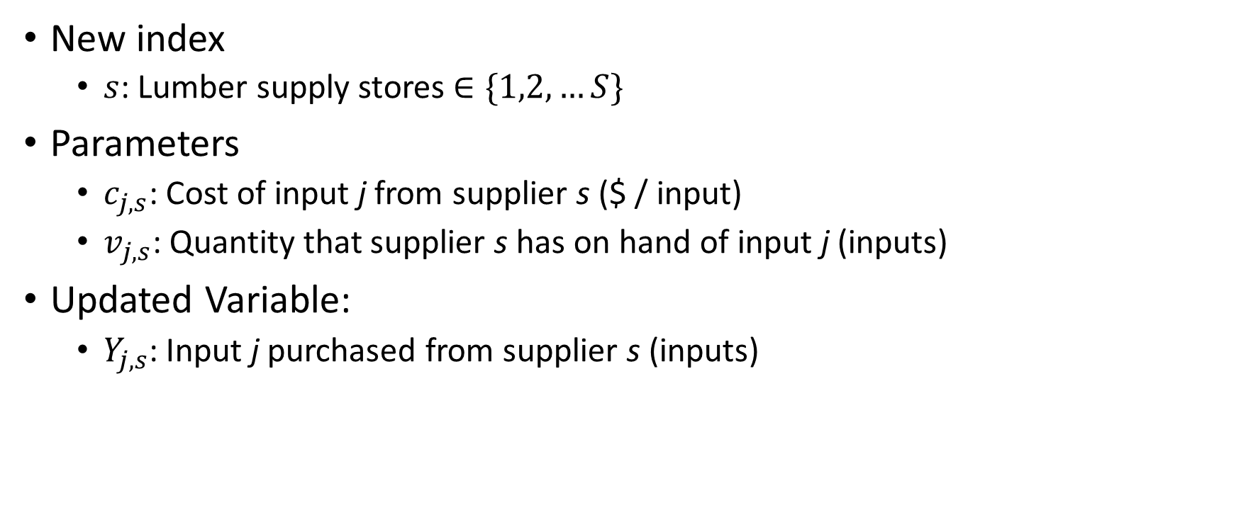
Now let’s add suppliers….
New index
$s$: Lumber supply stores $∈\{1,2,…S\}$
Parameters
$c_{j,s}$: Cost of input j from supplier s ($ / input)
$v_{j,s}$: Quantity that supplier s has on hand of input j (inputs)
Updated Variable:
$Y_{j,s}$: Input j purchased from supplier s (inputs)

Slide 16
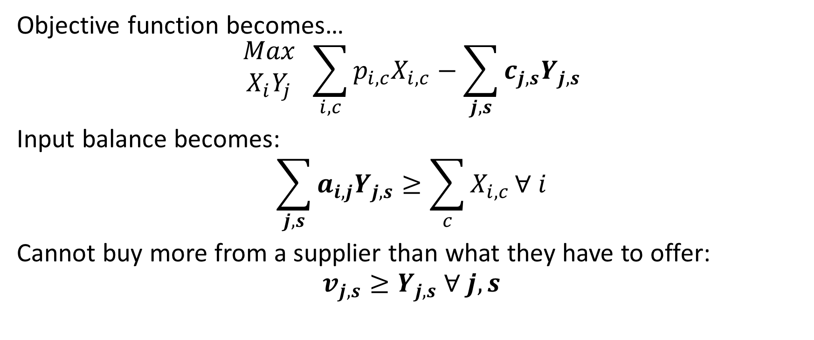
Updated Equations with Suppliers
Objective function becomes…
$$\begin{matrix}Max \\ X_{i}Y_{j}\end{matrix} \sum_{i,c}{{p_{i,c}X}_{i,c}}−\sum_{j,s}{c_{j,s}Y_{j,s}}$$
Input balance becomes:
$$\sum_{j,s}{a_{i,j}Y_{j,s}}≥\sum_{c}{X_{i,c}}∀ i$$
Cannot buy more from a supplier than what they have to offer:
$$v_{j,s}≥Y_{j,s} ∀ j,s$$

Slide 17

Supply schedules
Supplier s is willing/able to sell $v_{j,s}$ for $c_{j,s}$
Blanks |  |  |  | Maple |  |  |  | Cherry
Supplier | Cost | Quantity |  | Supplier | Cost | Quantity |  | Supplier | Cost | Quantity
1 | 5 | 2 |  | 1 | 8 | 1 |  | 1 | 7 | 1
2 | 7 | 3 |  | 2 | 11 | 3 |  | 2 | 8 | 2
3 | 9 | 3 |  | 3 | 15 | 4 |  | 3 | 9 | 2
4 | 11 | 4 |  | 4 | 20 | 4 |  | 4 | 10 | 2
5 | 15 | 5 |  | 5 | 22 | 6 |  | 5 | 16 | 4
 |  |  |  | 6 | 23 | 5 |  | 6 | 22 | 6
 |  |  |  | 7 | 30 | 4

