Slide 1
Github Desktop Basics
Maxwell Brown
EBGN 632: Course 2 Supplementary

Slide 2
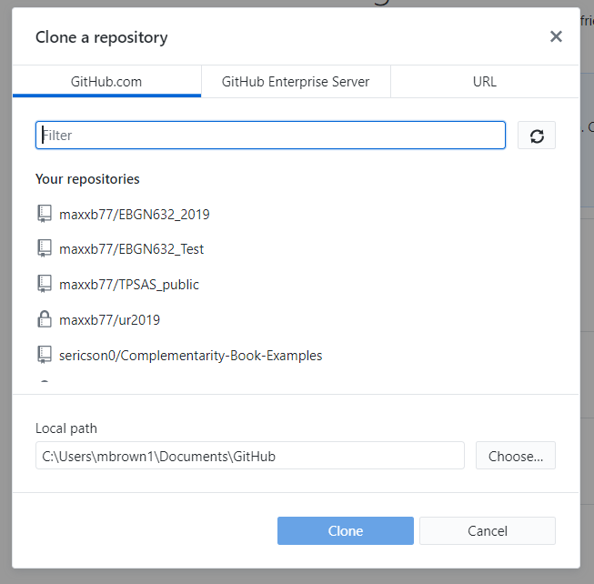
Cloning a repository
File -> Clone a repository
From GitHub.com tab, can choose the repositories that you’ve created or that have been shared with you
The ‘URL’ tab will allow you to clone someone else’s repository
NB: Local Path indicates the directory on your machine where the repo will be cloned

Slide 3
Pushing Changes

