Slide 1
Course 4a
EBGN 632
Maxwell Brown
10/28/2019

Slide 2
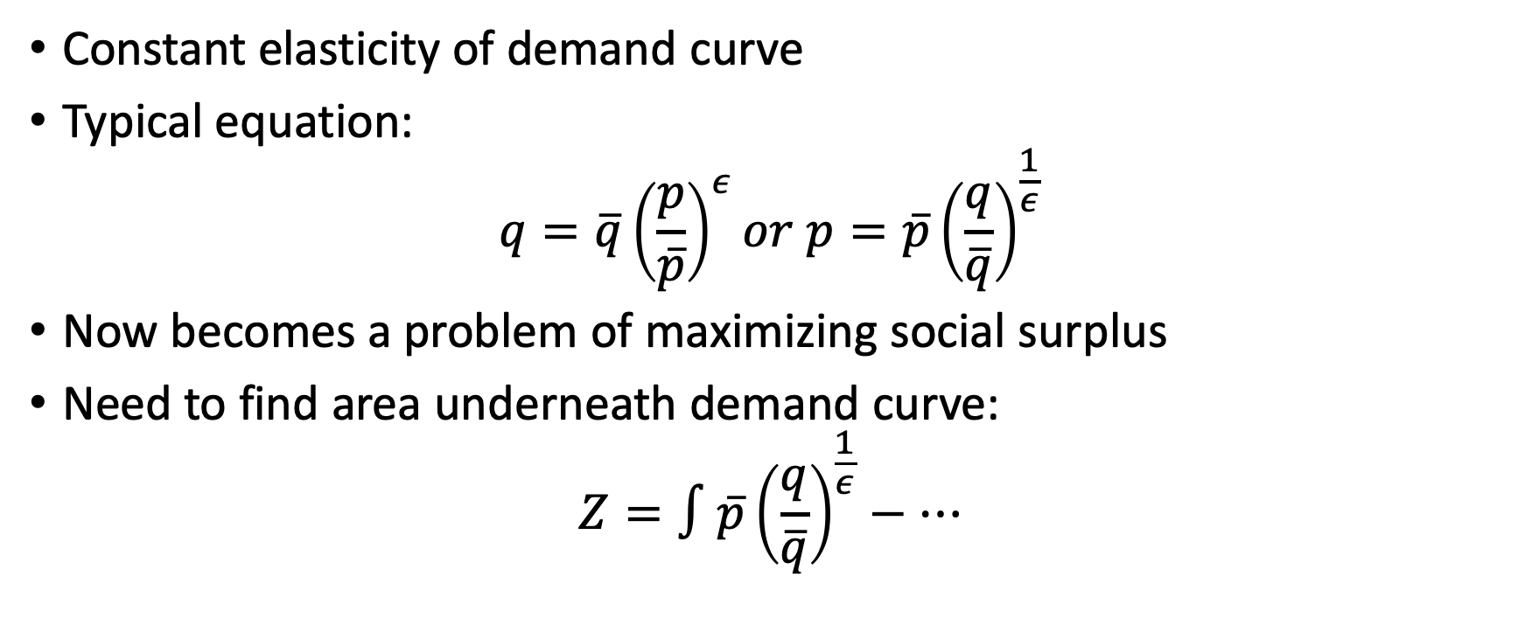
Adding a demand curve
Constant elasticity of demand curve
Typical equation:
$$q=\overline{q}{\left(\frac{p}{\overline{p}}\right)}^{ε}or p=\overline{p}{\left(\frac{q}{\overline{q}}\right)}^{\frac{1}{ε}}$$
Now becomes a problem of maximizing social surplus
Need to find area underneath demand curve:
$$Z=∫\overline{p}{\left(\frac{q}{\overline{q}}\right)}^{\frac{1}{ε}}−…$$

Slide 3
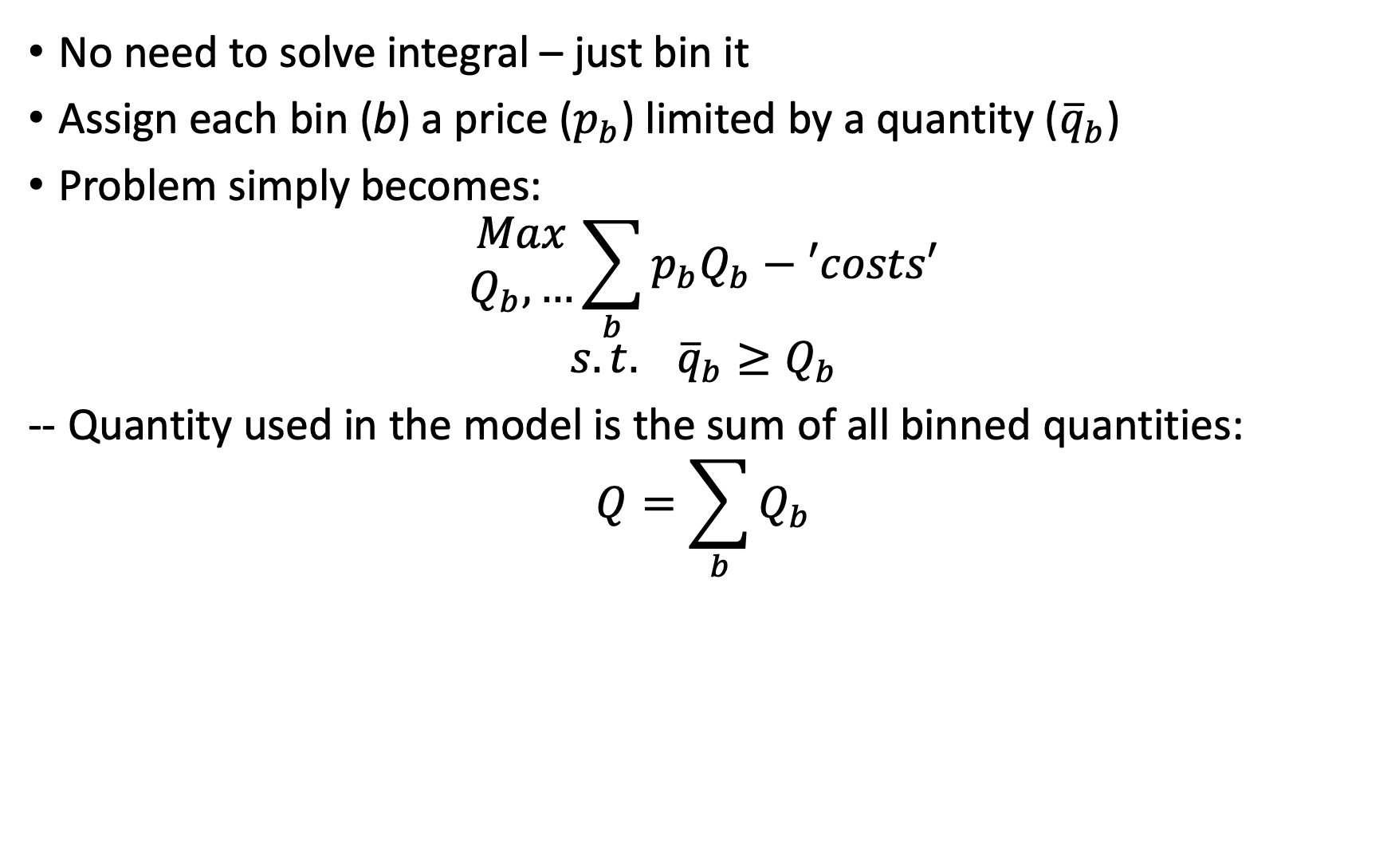
Adding a demand curve (cont)
No need to solve integral – just bin it
Assign each bin (b) a price ($p_{b}$) limited by a quantity (${\overline{q}}_{b}$)
Problem simply becomes:
$$\begin{matrix}Max \\ Q_{b},…\end{matrix}\sum_{b}{p_{b}Q_{b}}−′costs′$$
$$s.t. {\overline{q}}_{b}≥Q_{b}$$
-- Quantity used in the model is the sum of all binned quantities:
$$Q=\sum_{b}{Q_{b}}$$

Slide 4
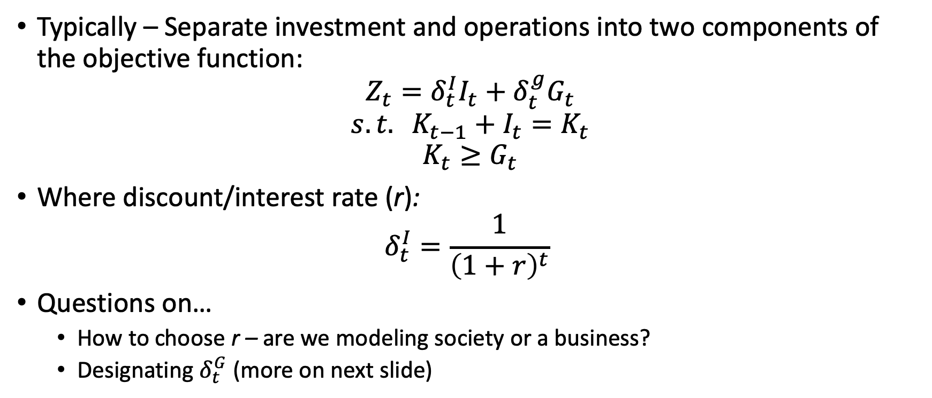
Investment Considerations
Typically – Separate investment and operations into two components of the objective function:
$$Z_{t}=δ_{t}^{I}I_{t}+δ_{t}^{g}G_{t}$$
$$s.t. K_{t−1}+I_{t}=K_{t}$$
$$K_{t}≥G_{t}$$
Where discount/interest rate (r):
$$δ_{t}^{I}=\frac{1}{{\left(1+r\right)}^{t}}$$
Questions on…
How to choose r – are we modeling society or a business?
Designating $δ_{t}^{G}$ (more on next slide)

Slide 5
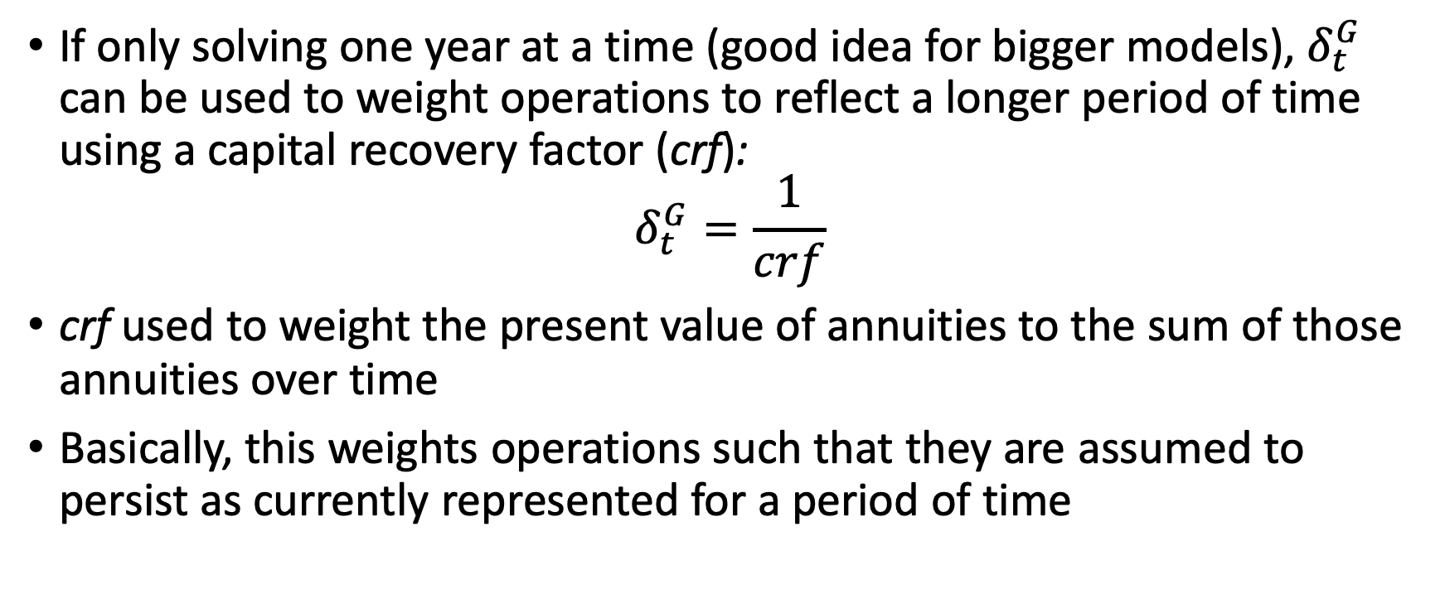
Weighting the operations - myopic
If only solving one year at a time (good idea for bigger models), $δ_{t}^{G}$ can be used to weight operations to reflect a longer period of time using a capital recovery factor (crf):
$$δ_{t}^{G}=\frac{1}{crf}$$
crf used to weight the present value of annuities to the sum of those annuities over time
Basically, this weights operations such that they are assumed to persist as currently represented for a period of time

Slide 6

Weighting operations - Intertemporal
If not skipping years:
$$δ_{t}^{G}=δ_{t}^{I}$$
If skipping years out to y, can weight as sum over those years:
$$δ_{t}^{G}=\sum_{t^{′}∈\left(t,..,t+y\right)}{δ_{t^{′}}^{I}}$$
Consideration for final year weighting – lots of methods for terminal period weighting:
Can equal $\frac{1}{crf}$
Barr-Manne weighting (for next semester)
Run past usual horizon, cut results early

