Slide 1
Mineral, Energy, and Economic Modeling
Maxwell Brown
EBGN 632 – Day 1
8/26/2019

Slide 2
Who am I?
Currently working at NREL
Re-developed ReEDS model from scratch
Linked ReEDS 2.0 with multi-sector models
History:
PhD from Mines in 2017
Critical Materials Institute
Payne Institute for Earth Resources
NREL/ORNL
Before that -
Oak Ridge National Laboratory
University of Maine
North Dakota State University
North Dakota State College of Science
Personal:
Native of Fargo, ND
Woodworker
Gardener
Handyman/mechanic

Slide 3
My goals in teaching this course:
Create a judgment-free zone where we work and learn together
Prepare students for technical roles in industry, academia, and government
Provide tools to advance students towards their interests
Coding ability for some, creativity for others
Treat others with respect
Learn from your mistakes – I am not going to write your code
Google and StackOverflow will be your best friends
Stay up to date on homework
Tell me when…
Something doesn’t make sense
Something doesn’t seem right
The firehose is on
Your obligations:

Slide 4
What to expect when we’re done…
Knowledge of best practices in programming for economists
Real world examples and skills – things to put on your resume/CV
Developing in a team environment
Tools to teach yourselves – can’t teach you everything
Confidence in building a robust linear programming model from scratch and understanding its results
Using the GAMS language
Designing constraints
Generalization
Diagnosing issues
Choosing the right algorithm and adjusting it for your problem
Familiarity with:
Results processing – automating graphics/data
Workflow – writing code to do your work faster and smarter

Slide 5
Course topics
Optimization
Linear programming
Duality
Simplex method
Other topics/skills to be voted on later in the course
Main software used (URLs in last slide):
GAMS – The model itself
R – Visualization, (some) data handling
Python – Front end, scenario management, (some) data handling
Git – Version tracking (Personal preference towards Git GUIs)
Other software to keep in mind: AMPL, Julia/JuMP
Example using ReEDS 2.0
Open-sourced model of the US electricity sector

Slide 6
Optional course topics, should we have time
Methods:
Non-linear programming – variables that play together, stay together
Integer variables – on/off switches
Stochasticity – uncertain futures and how they impact decisions
Skills:
Data management – interfacing with APIs, data formatting, etc
Parallelization – makes things faster
Machine learning – black box estimation techniques
Calibration – getting closer to the real world
Other languages for model building (Python/Pyomo; Julia/JuMP)

Slide 7
Homework, Tests, and Grading
Homework
Building a model through the course that will be used in the final exam
Can be done in collaboration - but - everyone needs to contribute equally
Will track your contributions through Git
Tell me if you are falling behind before it becomes an issue
Generally pass/fail
Final exam
Use the model you’ve built throughout this semester to do a simple analysis
Not a group exam – each student to do their own

Slide 8
Writing math for modeling
Using the transport model as an example
Install GAMS
Model Libraries -> TRNSPORT
Classic example in linear programming
Steps:
Define indices/sets
Define parameters (data and assumptions)
Define variables (what we’ll solve for)
Objective function
Constraints

Slide 9
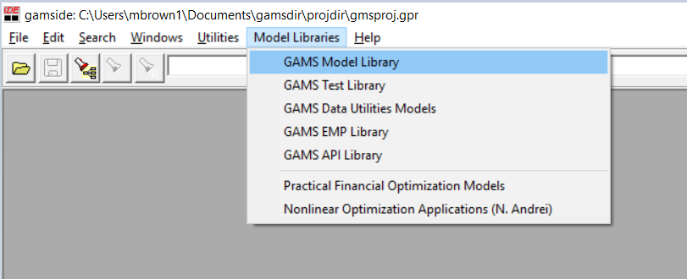
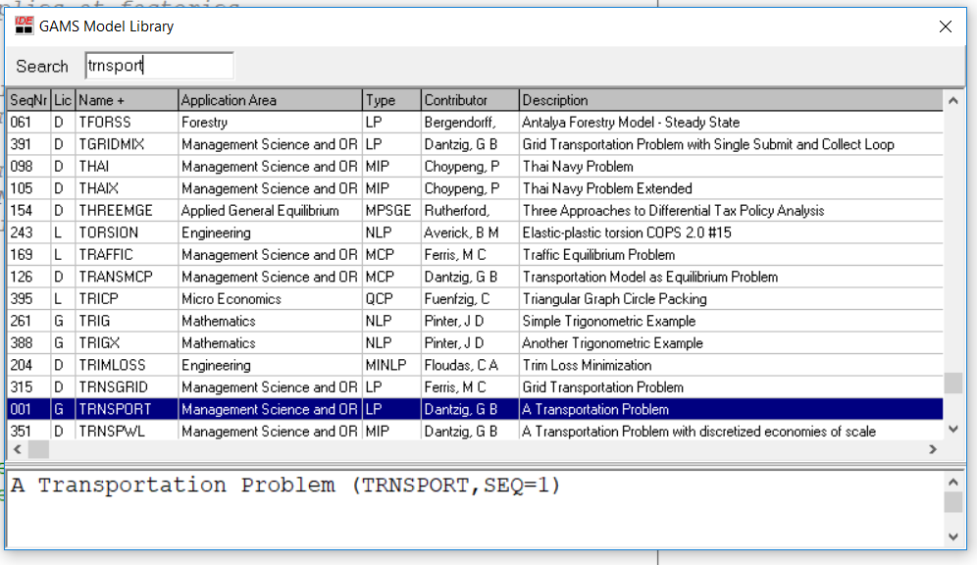
Running the TRNSPORT model…

Slide 10
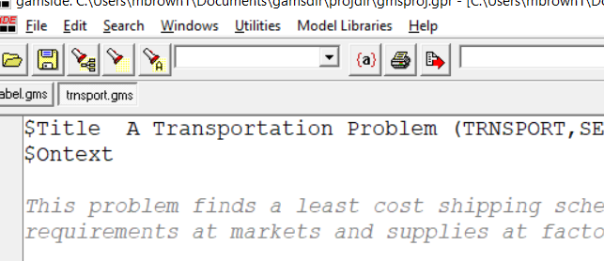
Running a GAMS model…
In the GAMS IDE:
In the command prompt:
May need to add the GAMS directory to your
path environment variable…
.. or press F9
When ran correctly, there should be a transport.lst file in the directory

Slide 11
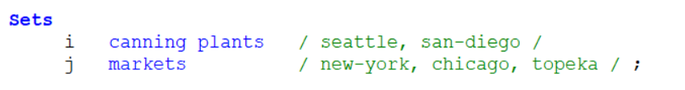
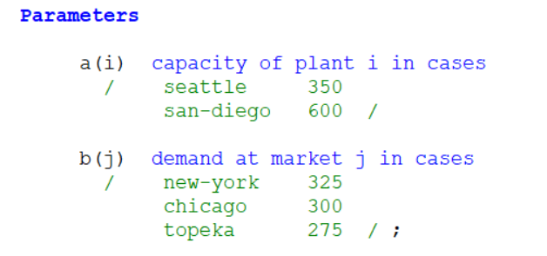
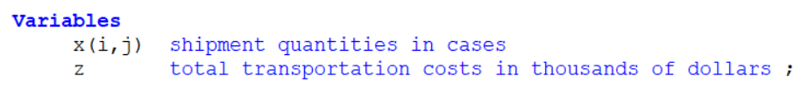
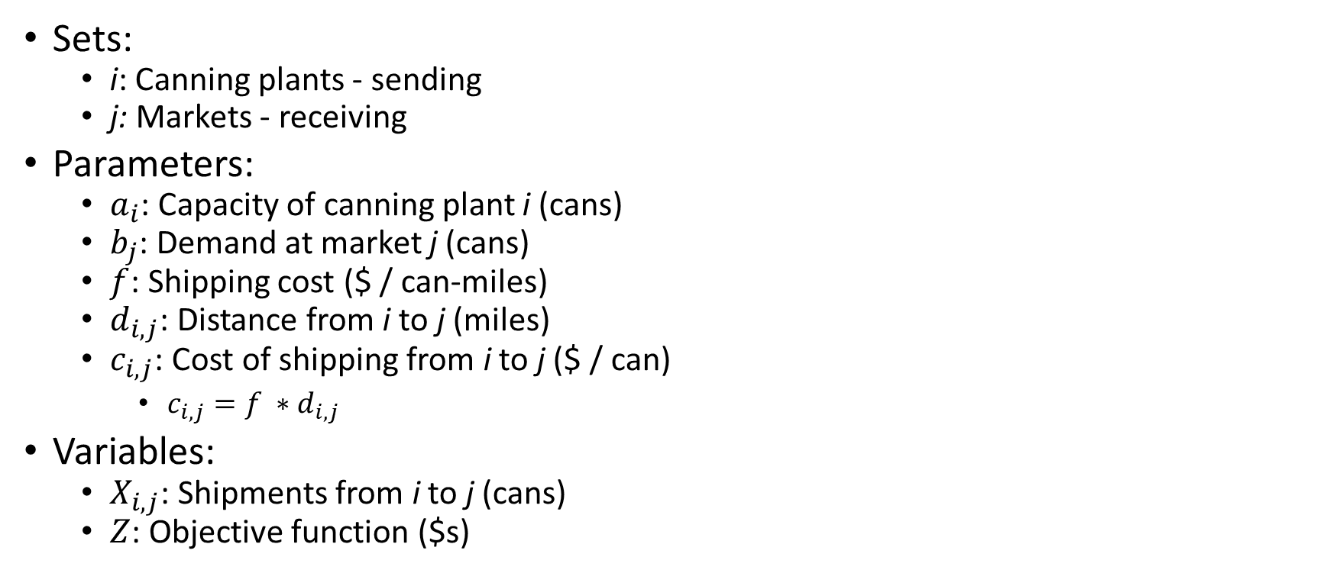
Sets, parameters, and variables for the Transport model
Sets:
i: Canning plants - sending
j: Markets - receiving
Parameters:
$a_{i}$: Capacity of canning plant i (cans)
$b_{j}$: Demand at market j (cans)
$f$: Shipping cost ($ / can-miles)
$d_{i,j}$: Distance from i to j (miles)
$c_{i,j}$: Cost of shipping from i to j ($ / can)
$c_{i,j}=f ∗d_{i,j}$
Variables:
$X_{i,j}$: Shipments from i to j (cans)
$Z$: Objective function ($s)

Slide 12
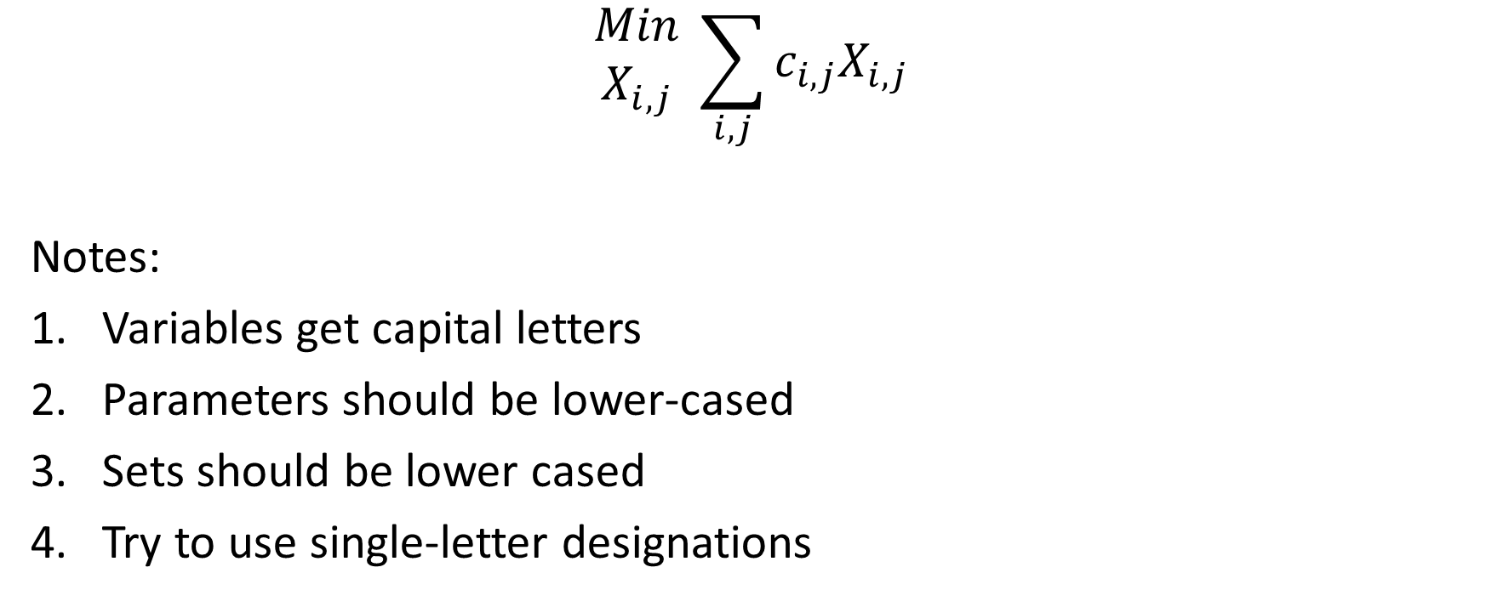
Transport model math – the objective function
The direction of the optimization
$$\begin{matrix}Min \\ X_{i,j}\end{matrix} \sum_{i,j}{c_{i,j}X_{i,j}}$$
Notes:
Variables get capital letters
Parameters should be lower-cased
Sets should be lower cased
Try to use single-letter designations
Costs (or benefits)
Variables the models will choose, optional for bigger models

Slide 13


Transport model math – the objective function in GAMS
$$\begin{matrix}Min \\ X_{i,j}\end{matrix} \sum_{i,j}{c_{i,j}X_{i,j}}$$

Slide 14

Transport model math - Constraints
Amount shipped from plant i cannot exceed its capacity:
$$a_{i}≥\sum_{j}{X_{i,j}}$$
Demand must be met at market j:
$$\sum_{i}{X_{i,j}≥b_{j}}$$

Slide 15

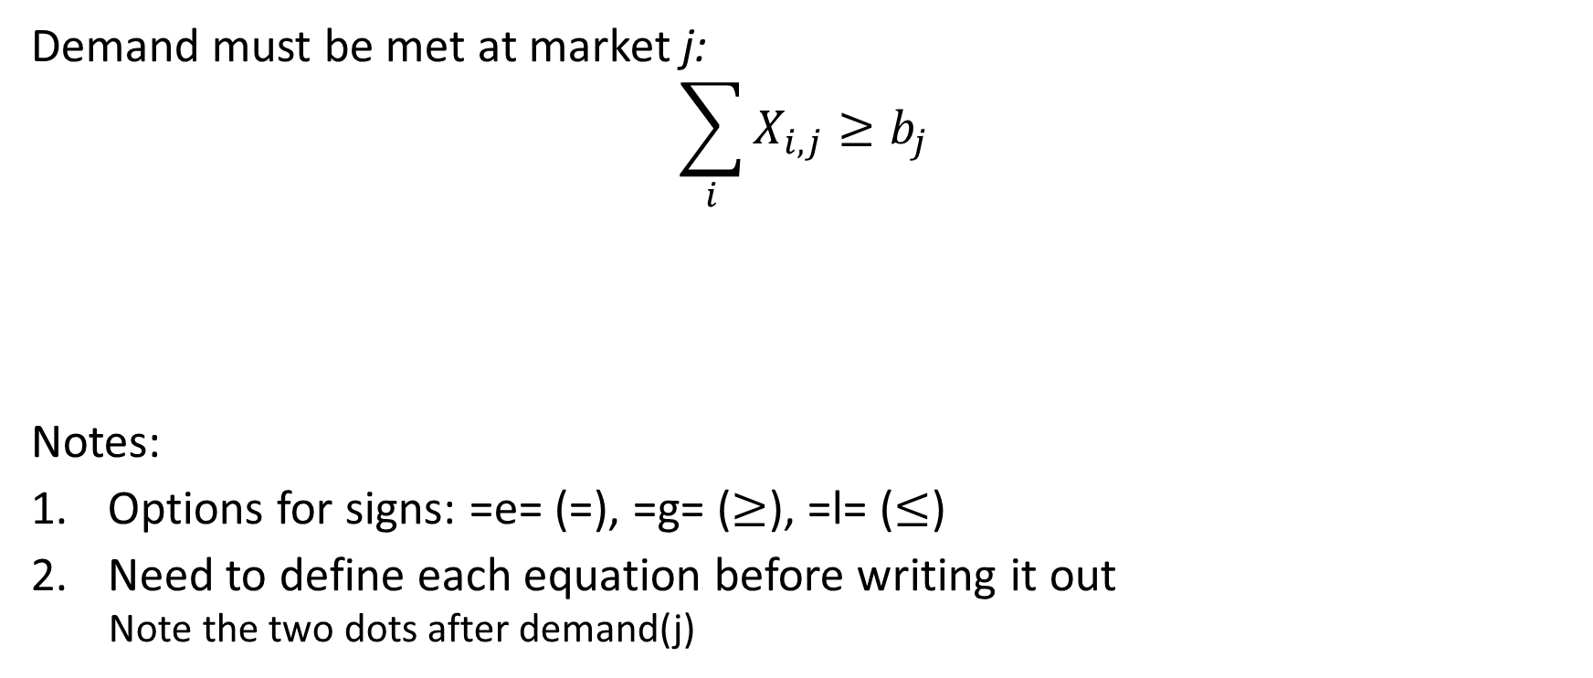
Transport model math – Constraints
Demand must be met at market j:
$$\sum_{i}{X_{i,j}≥b_{j}}$$
Notes:
Options for signs: =e= (=), =g= ($≥$), =l= ($≤$)
Need to define each equation before writing it out
Note the two dots after demand(j)

Slide 16
Your first homework
Three smaller assignments due 9/6/19
Send as one email to: Maxwell.L.Brown@gmail.com
Install GAMS and run the TRNSPORT model – send me the .lst file
Describe the type of model you plan to build (3-4 pages)
Text description
Data sources and descriptions
Mathematical writeup – If uncertain, adapt something from the Model Library
Create a Git account and install Git Extensions – next class will focus on how to use GAMS and Git via a GUI (for now)

Slide 17
Software links
Course github repo: https://github.com/maxxb77/EBGN632_2019.git
GAMS: https://www.gams.com/download/
R
R: https://cran.r-project.org/mirrors.html <- install base R before installing RStudio
RStudio: https://www.rstudio.com/products/rstudio/download/
Python/Anaconda
https://www.anaconda.com/distribution/#download-section
Use Python 3.7
Spyder is pretty good but other Python IDEs exist
Optional IDEs / editors:
SublimeText: https://www.sublimetext.com/3
Install GAMS package: https://github.com/lolow/sublime-gams
Atom: https://ide.atom.io/
Notepad++ : https://notepad-plus-plus.org/

