Slide 1
Course 2
EBGN 632
Maxwell Brown
9/9/2019

Slide 2
Agenda
Discussion of homework 1
Overview of Git via Git Extensions
Example problem: Lou’s Workshop
Math
Start GAMS code

Slide 3
Homework 1
Purpose:
See where the class is with respect to developing problems and writing math
Feedback on ideas for class projects
Exercise independence – slight struggle to start
Main thoughts:
Great ideas – excited to work on these together
Need to follow directions
Pattern of Indices/parameters/variables/objective function/constraint(s)
Units!
Set notation versus explicit variables
Responses to comments due 9/15

Slide 4

Math notation example 1 – What not to do…
Indices: None
Parameters:
C1: Cost of mine 1
C2: Cost of mine 2
C3: Cost of mine 3
…
k: capacity of all mines
Variables:
X1: Production from mine 1
X2: Production from mine 2
X3: Production from mine 3
…
Objective function:
$$\begin{matrix}Min \\ X1, X2, X3,…\end{matrix}C1∗X1+C2∗X2+…$$
S.T.:
$$k≥X1+X2+X3+…$$

Slide 5

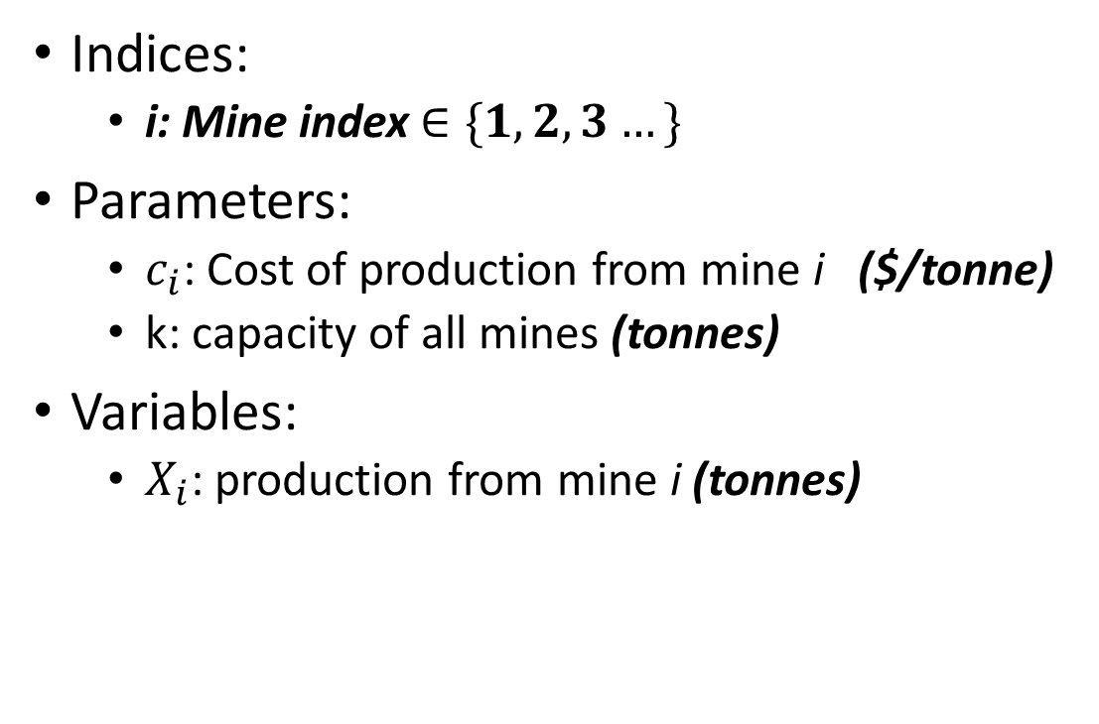
Math notation example 1 – What to do…
Indices:
i: Mine index $∈\{1,2,3…\}$
Parameters:
$c_{i}$: Cost of production from mine i ($/tonne)
k: capacity of all mines (tonnes)
Variables:
$X_{i}$: production from mine i (tonnes)
Objective function:
$$\begin{matrix}Min \\ X_{i}\end{matrix}\sum_{i}{c_{i}X_{i}}$$
S.T.:
$$k≥\sum_{i}{X_{i}}$$

Slide 6

Math notation example 2 – What not to do…
Indices: None
Parameters:
C: cost to produce product 1
D: cost to produce product 2
E: capacity of product 1
F: capacity of product 2
G: cost to procure input 1
H: cost to produce input 2
Variables:
A: production of product 1
B: production of product 2
X: production of input 1
Y: production of input 2
Objective function:
$$\begin{matrix}Min \\ A,B,X,Y\end{matrix}C∗A+D∗B+G∗X+H∗Y$$
S.T.:
$$E≥A$$
$$F≥B$$
$$\frac{2}{5}X≥A$$
$$\frac{3}{7}Y≥B$$

Slide 7
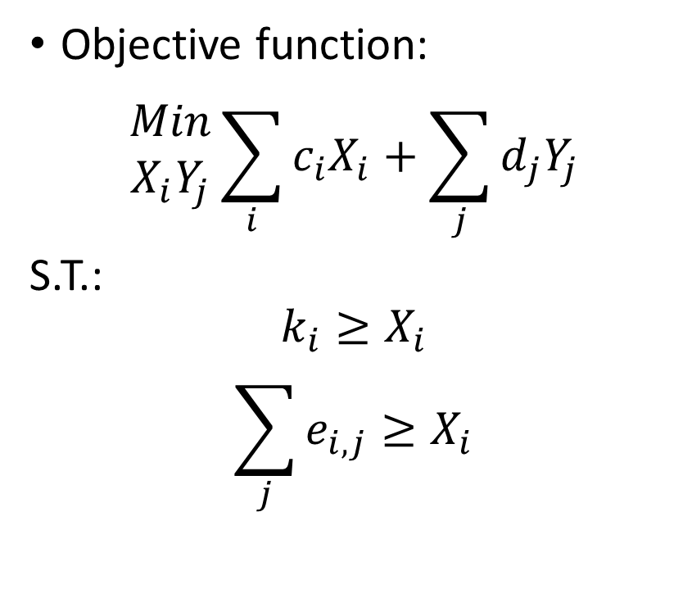
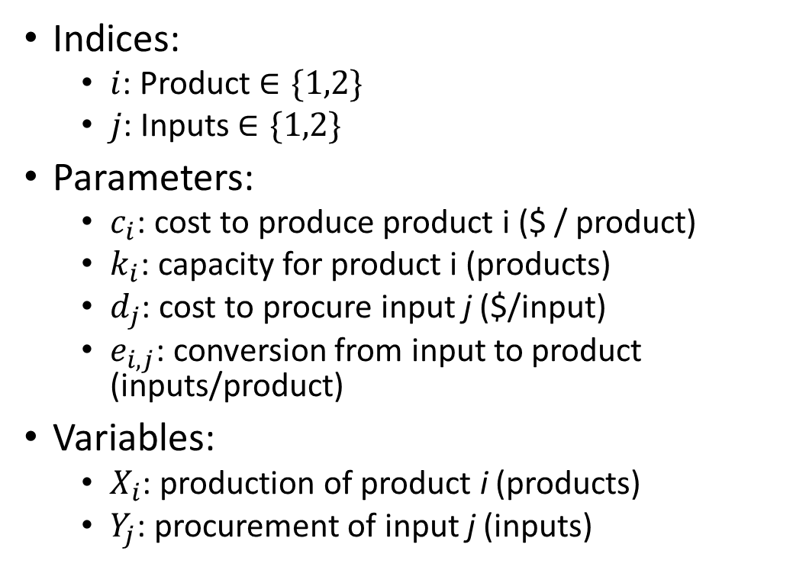
Math notation example 2 – What to do…
Indices:
$i$: Product $∈\{1,2\}$
$j$: Inputs $∈\{1,2\}$
Parameters:
$c_{i}$: cost to produce product i ($ / product)
$k_{i}$: capacity for product i (products)
$d_{j}$: cost to procure input j ($/input)
$e_{i,j}$: conversion from input to product (inputs/product)
Variables:
$X_{i}$: production of product i (products)
$Y_{j}$: procurement of input j (inputs)
Objective function:
$$\begin{matrix}Min \\ X_{i}Y_{j}\end{matrix}\sum_{i}{c_{i}X_{i}}+\sum_{j}{d_{j}Y_{j}}$$
S.T.:
$$k_{i}≥X_{i}$$
$$\sum_{j}{e_{i,j}≥X_{i}}$$
 |  | j
 |  | 1 | 2
i | 1 | 2/5
 | 2 |  | 3/7

Slide 8
Git
Used to store, share, and track development
Great for team development
Industry standard – use of SVN is waning
Git vs Github –
Git is the standard/software
Github is a service – purchased by Microsoft for $7.5B in 2018
We’ll be using a graphical user interface (GUI) for Git, Git Extensions or Git Kraken, as opposed to the command line version – has benefits and tradeoffs but better for beginners

Slide 9
Basic Terms
Master: Main branch of code – the ‘trunk of the tree’
Branch: Separate workflow
Repository (“repo”): The code stored on the git server
Clone: Copying a repository to your machine
Merge: Combining two branches
Commit: Saving your changes to your local machine
Push: Saving your changes to the repository
Pull: Extracting changes from the repository to your machine
Hash/Tag: Unique ID for your most-recent commit/push

Slide 10
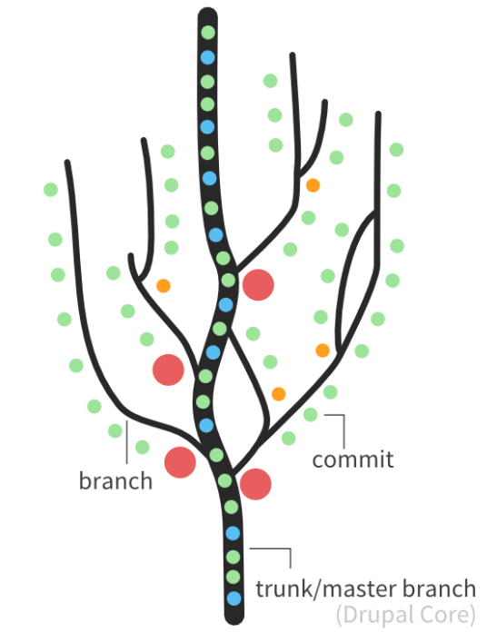
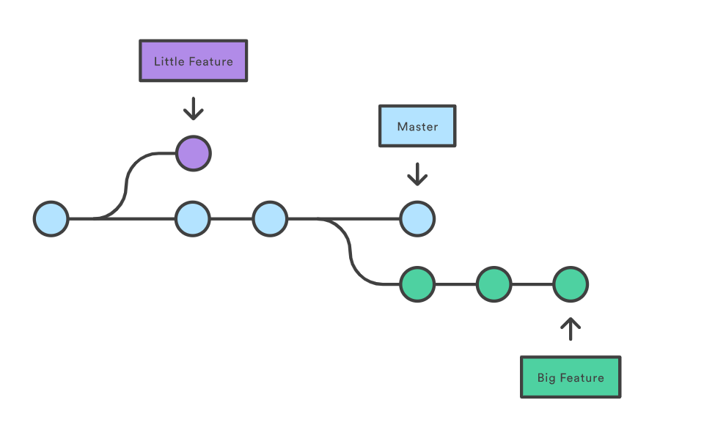
Git ‘Trees’

Slide 11
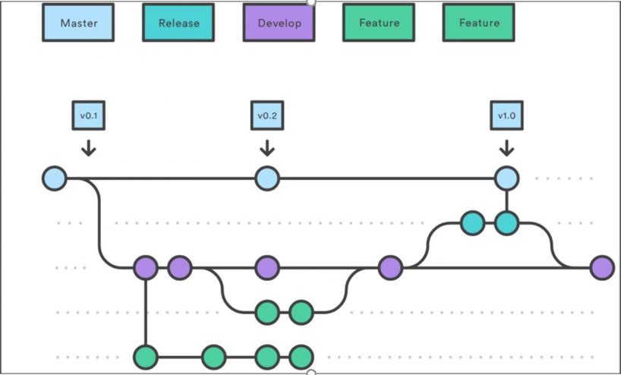
Workflow

