Slide 1
EBGN645: Day 5

Slide 2
Questions/Comments
Questions:
Can I do my project on X?
Getting data out of GAMS
Using Python/Julia/…
Will commit examples of each in the repo
Guest lecture for GAMSPy
Readings
Comments:
Presenting on recent work: Friday 9/27, 10-11:30AM
Model development, 111, CCS, electricity policy, …
Purpose of homework

Slide 3
Agenda for today
Note on Franzi’s forestry
Conditionals, sparse matrix constructions
Electricity example(s)
Very simple
Less simple but still simple
Adding demand elasticity
Taking on non-linearities
Longer term
Ramsey model
Natural gas model
Duality, conversions to MCPs

Slide 4
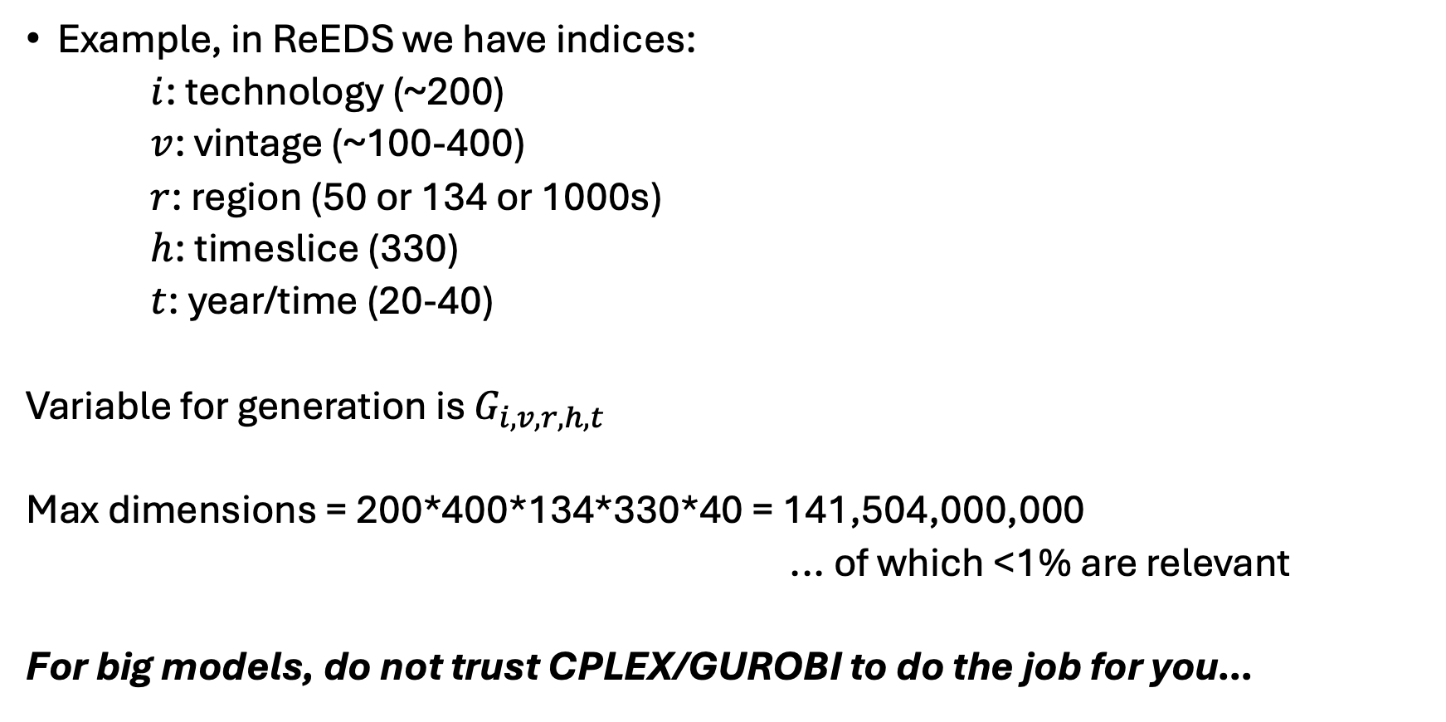
Why conditionals?
Example, in ReEDS we have indices:
$i$: technology (~200)
$v$: vintage (~100-400)
$r$: region (50 or 134 or 1000s)
$h$: timeslice (330)
$t$: year/time (20-40)
Variable for generation is $G_{i,v,r,h,t}$
Max dimensions = 200*400*134*330*40 = 141,504,000,000
... of which <1% are relevant
For big models, do not trust CPLEX/GUROBI to do the job for you…

Slide 5
More specifically: sparse matrix construction
Put simply: We do not want to burden the model with irrelevant constraints or decision variables
In GAMS, reducing equation population via…
eq_caplim(i,v,r,h,t)$valid_generation(i,v,r,h,t)..
and reducing variable consideration via:
… + sum{(i,v,r,h,t)$valid_generation(i,v,r,h,t), GEN(i,v,r,h,t) }

Slide 6
GAMS does not export zeros
Two options if you really need them:
Use a 1e-8 then round to the >=7th decimal in your post-processing.
When need more often, I usually do something like this:
From terminal:
gams myprogram.gms (export the gdx file ‘mydata.gdx’)
gdxdump mydata.gdx format=csv symb=report_parameter > report_parameter.csv
… then have a python program:
def popzero(df,value):
df.pivot(*df.columns).fillna(0).stack().to_frame(value).reset_index()
data_in = pd.read_csv(‘report_parameter.csv’)
data_withcombos = popzero(data_in,’val’)
Special thanks to:
https://stackoverflow.com/questions/58962237/pandas-create-missing-combination-rows-with-zero-values

Slide 7

Example 4: Elmo’s Electricity
Elmo runs a small electricity utility with two regions. He has three electricity facilities: coal, gas, and wind. Each technology has its own cost and capacity. He must meet the hourly demand of his small towns that are connected via a single transmission line. What is Elmo’s cost-minimizing set of operational decisions?

Slide 8
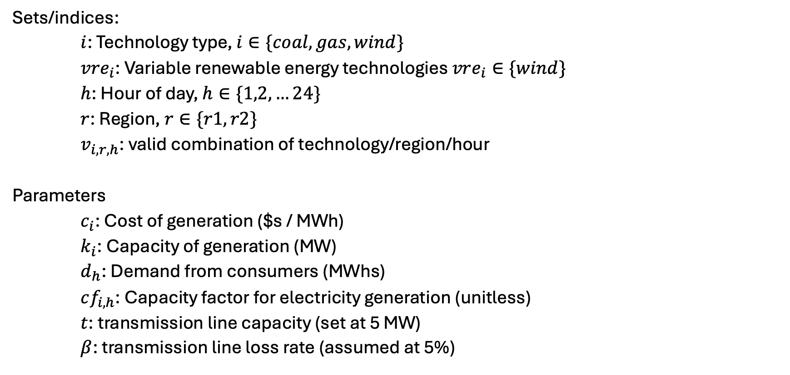
Elmo’s Electricity [I] – Sets and parameters
Sets/indices:
$i$: Technology type, $i∈\{coal, gas, wind\}$
$vre_{i}$: Variable renewable energy technologies $vre_{i}∈\{wind\}$
$h$: Hour of day, $h∈\{1,2,…24\}$
$r$: Region, $r∈\{r1,r2\}$
$v_{i,r,h}$: valid combination of technology/region/hour
Parameters
$c_{i}$: Cost of generation ($s / MWh)
$k_{i}$: Capacity of generation (MW)
$d_{h}$: Demand from consumers (MWhs)
$cf_{i,h}$: Capacity factor for electricity generation (unitless)
$t$: transmission line capacity (set at 5 MW)
$β$: transmission line loss rate (assumed at 5%)

Slide 9
Elmo’s electricity [II] - data
See spreadsheet - EBGN645_Data_Elmo.xlsx
Getting data into GAMS… starting simple with CSVs.. all sorts of ways

Slide 10
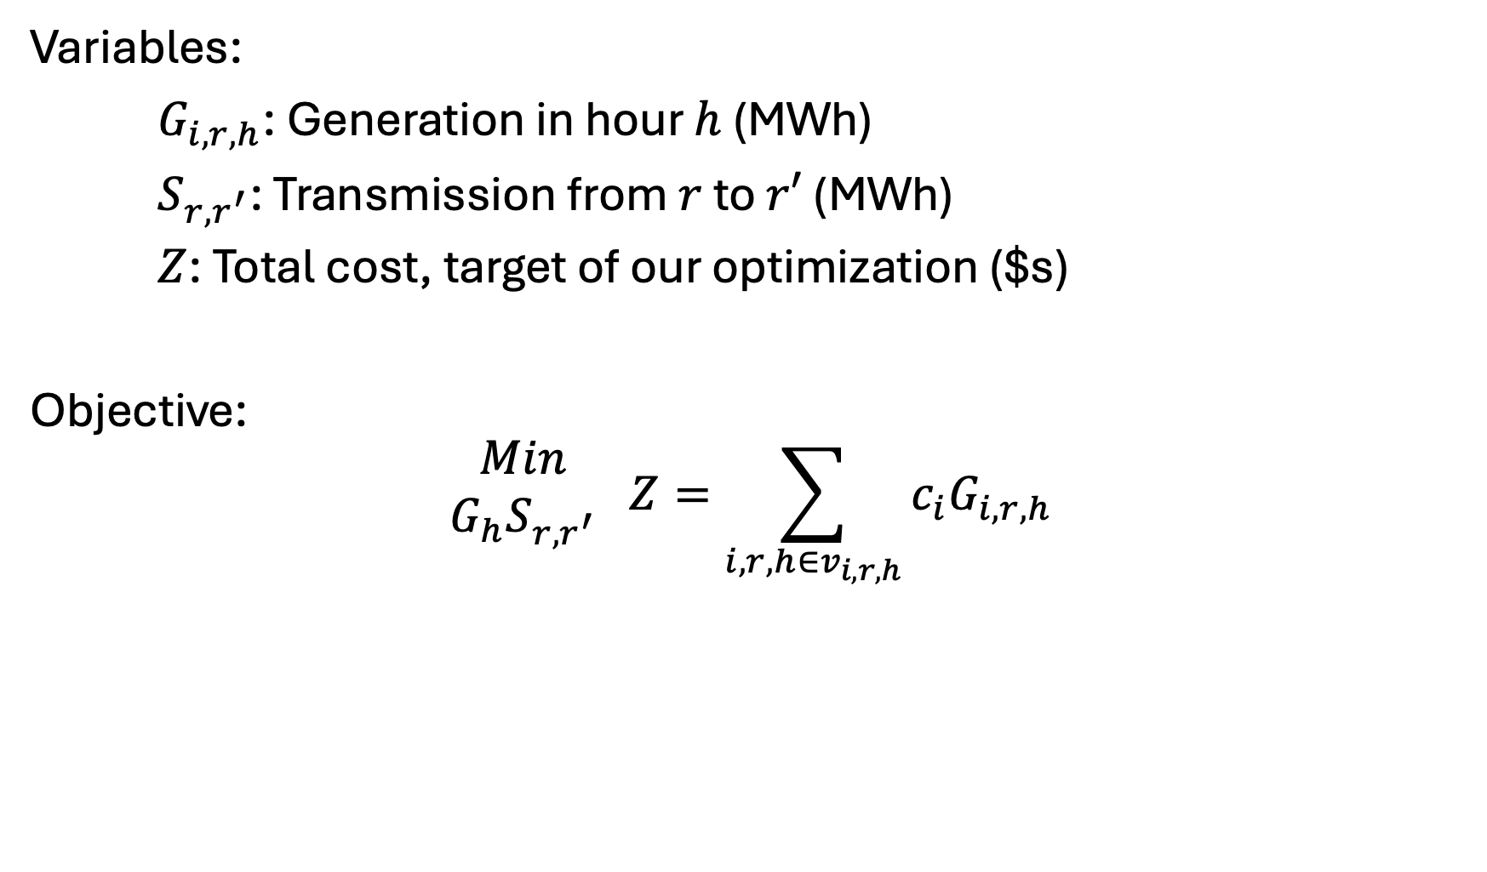
Elmo’s Electricity [III] – Variables and objective
Variables:
$G_{i,r,h}$: Generation in hour $h$ (MWh)
$S_{r,r^{′}}$: Transmission from $r$ to $r′$ (MWh)
$Z$: Total cost, target of our optimization ($s)
Objective:
$$\begin{matrix}Min \\ G_{h}S_{r,r^{′}}\end{matrix} Z=\sum_{i,r,h∈v_{i,r,h}}{c_{i}G_{i,r,h}}$$

Slide 11
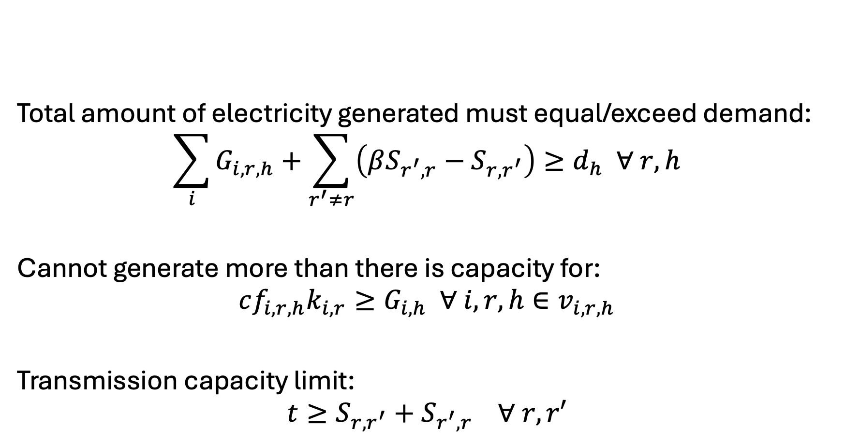
Elmo’s Electricity [IV] - Constraints
Total amount of electricity generated must equal/exceed demand:
$$\sum_{i}{G_{i,r,h}}+\sum_{r^{′}≠r}{\left(βS_{r^{′},r}−S_{r,r^{′}}\right)}≥d_{h} ∀ r,h$$
Cannot generate more than there is capacity for:
$$cf_{i,r,h}k_{i,r}≥G_{i,h} ∀ i,r,h∈v_{i,r,h}$$
Transmission capacity limit:
$$t≥S_{r,r^{′}}+S_{r^{′},r} ∀ r,r′$$

Slide 12
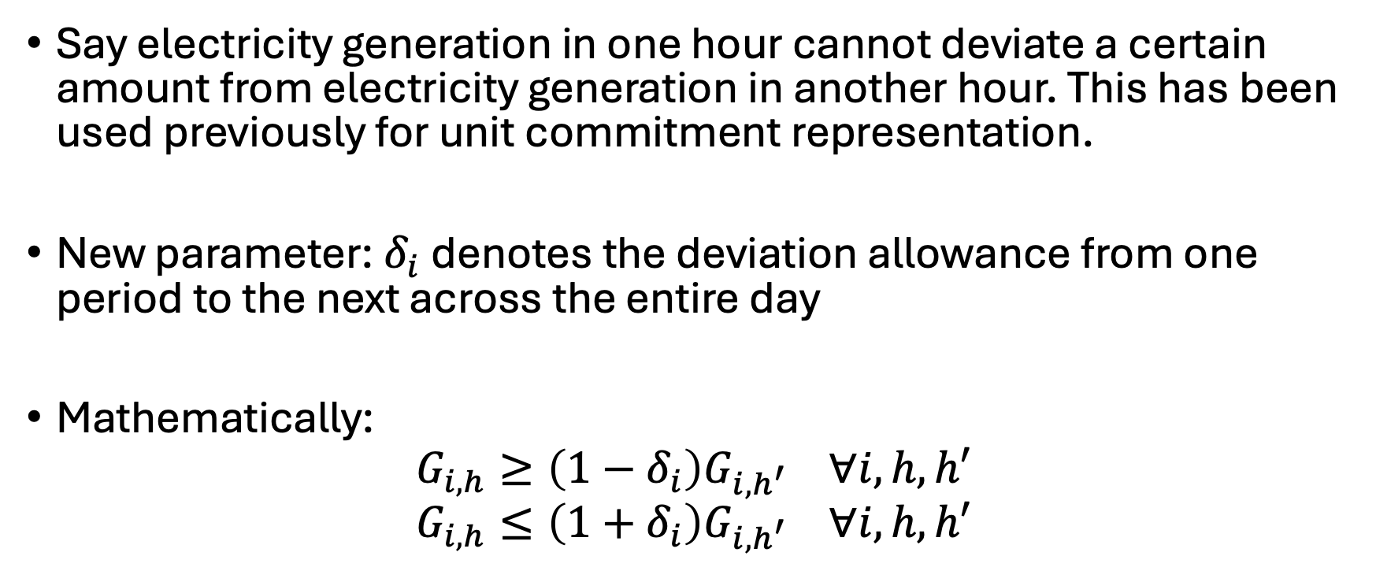
Another use of aliases
Say electricity generation in one hour cannot deviate a certain amount from electricity generation in another hour. This has been used previously for unit commitment representation.
New parameter: $δ_{i}$ denotes the deviation allowance from one period to the next across the entire day
Mathematically:
$$G_{i,h}≥\left(1−δ_{i}\right)G_{i,h^{′}} ∀i,h,h′$$
$$G_{i,h}≤\left(1+δ_{i}\right)G_{i,h^{′}} ∀i,h,h′$$

Slide 13
A (slightly) more complicated model
A simple model of the Colorado/Wyoming electricity dispatch
24-hour time period
Unit-level resolution
Adding on emissions policies
Grabbing data from 2018 – Unit-level capacity, costs, and heat rates
Happy to talk ReEDS data
Average hourly demand – Use of a global
Important to understand: We will eventually convert this to an MCP
Currently: no transmission

Slide 14
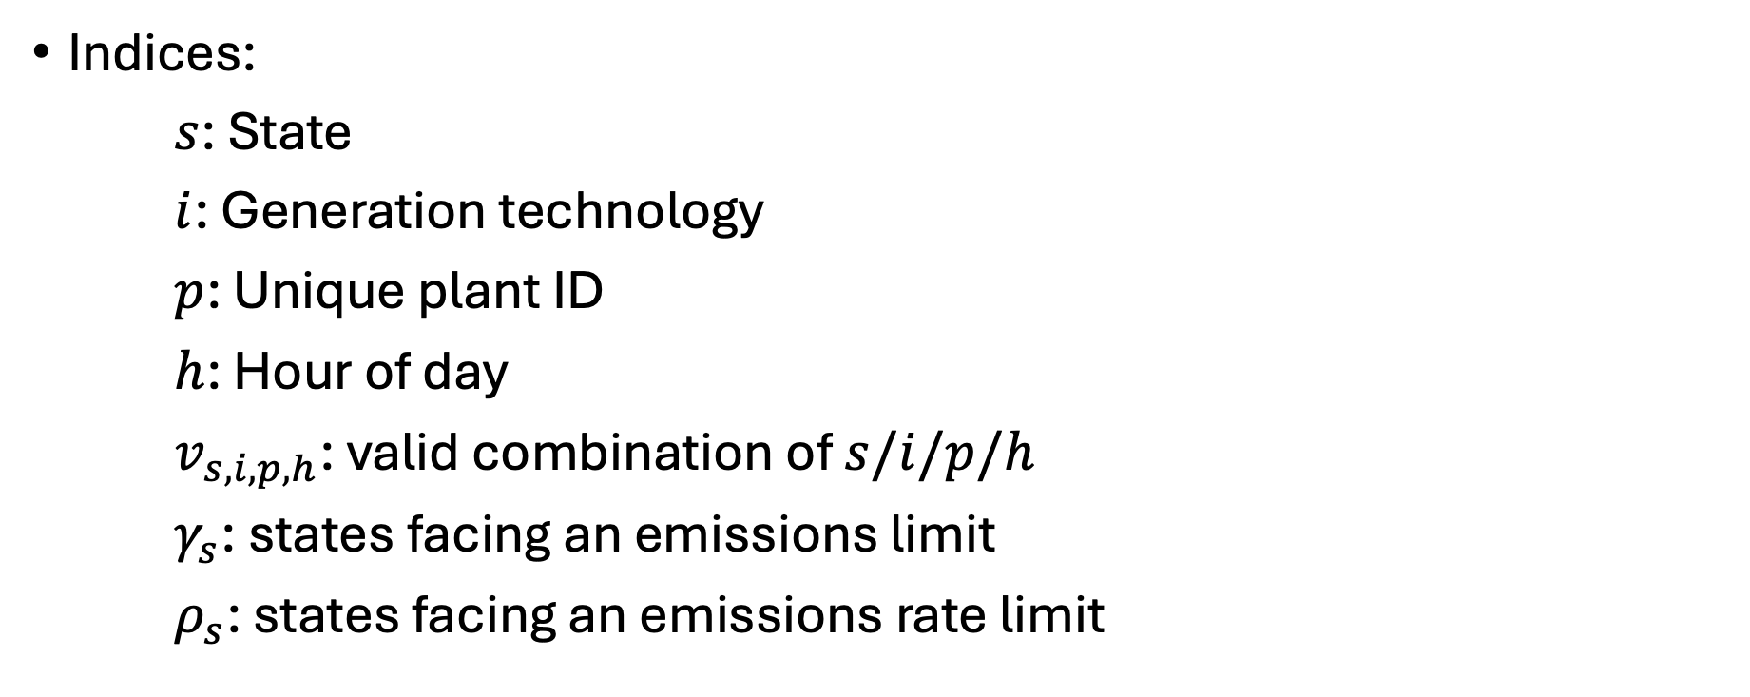
Electricity dispatch problem
Indices:
$s$: State
$i$: Generation technology
$p$: Unique plant ID
$h$: Hour of day
$v_{s,i,p,h}$: valid combination of $s/i/p/h$
$γ_{s}$: states facing an emissions limit
$ρ_{s}$: states facing an emissions rate limit

Slide 15
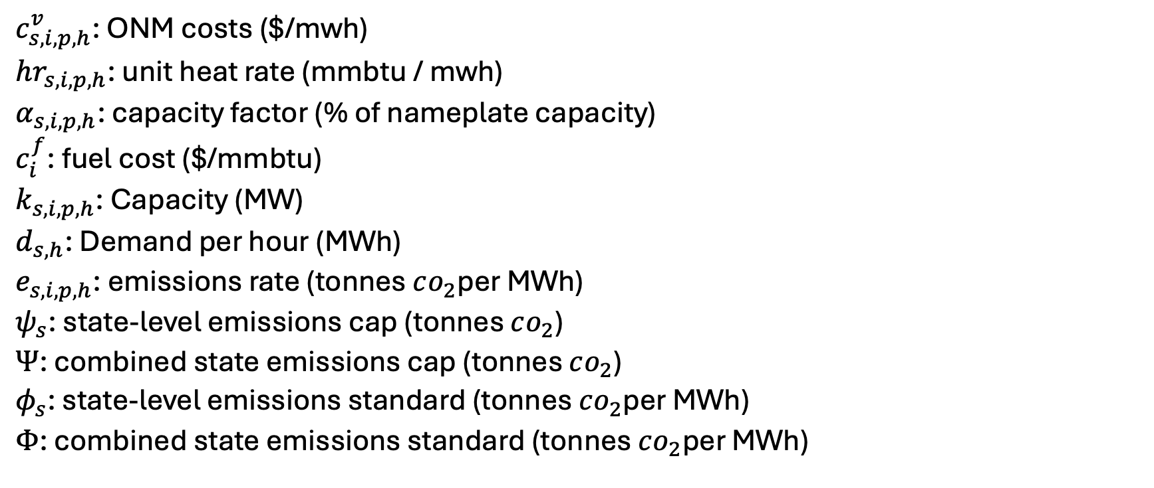
Parameters
$c_{s,i,p,h}^{v}$: ONM costs ($/mwh)
$hr_{s,i,p,h}$: unit heat rate (mmbtu / mwh)
$α_{s,i,p,h}$: capacity factor (% of nameplate capacity)
$c_{i}^{f}$: fuel cost ($/mmbtu)
$k_{s,i,p,h}$: Capacity (MW)
$d_{s,h}$: Demand per hour (MWh)
$e_{s,i,p,h}$: emissions rate (tonnes $co_{2}$per MWh)
$ψ_{s}$: state-level emissions cap (tonnes $co_{2}$)
$Ψ$: combined state emissions cap (tonnes $co_{2}$)
$φ_{s}$: state-level emissions standard (tonnes $co_{2}$per MWh)
$Φ$: combined state emissions standard (tonnes $co_{2}$per MWh)

Slide 16
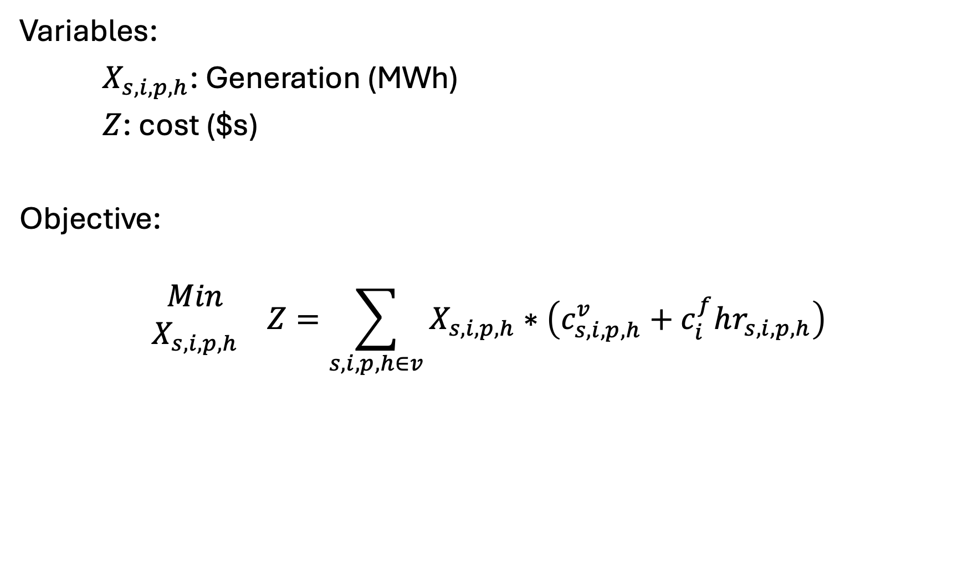
Variables, Objective
Variables:
$X_{s,i,p,h}$: Generation (MWh)
$Z$: cost ($s)
Objective:
$$\begin{matrix}Min \\ X_{s,i,p,h}\end{matrix} Z=\sum_{s,i,p,h∈v}{X_{s,i,p,h}}∗\left(c_{s,i,p,h}^{v}+c_{i}^{f}hr_{s,i,p,h}\right)$$

Slide 17
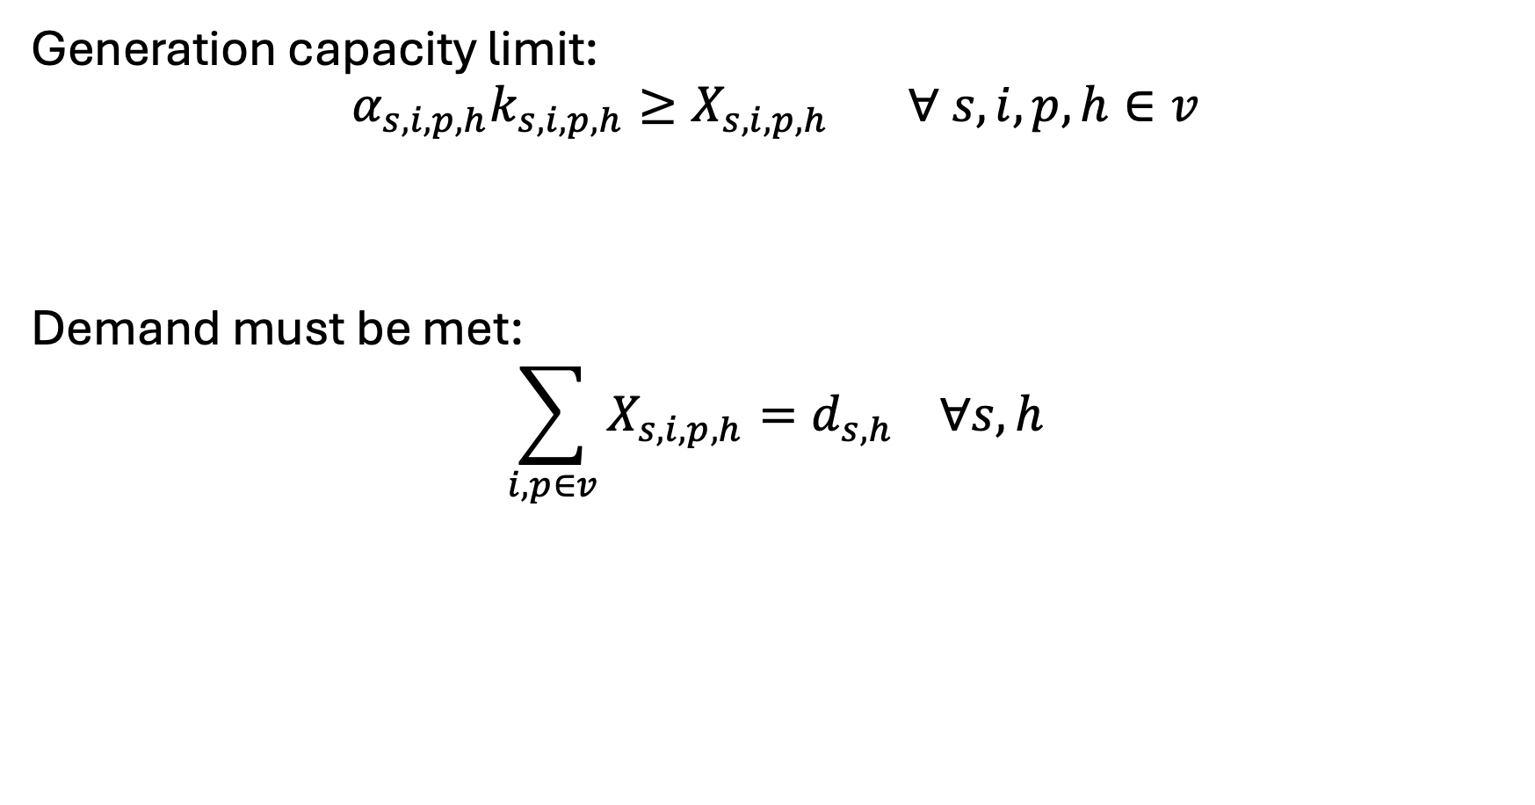
Constraints - basics
Generation capacity limit:
$$α_{s,i,p,h}k_{s,i,p,h}≥X_{s,i,p,h} ∀ s,i,p,h∈v$$
Demand must be met:
$$\sum_{i,p∈v}{X_{s,i,p,h}}=d_{s,h} ∀s,h$$

Slide 18
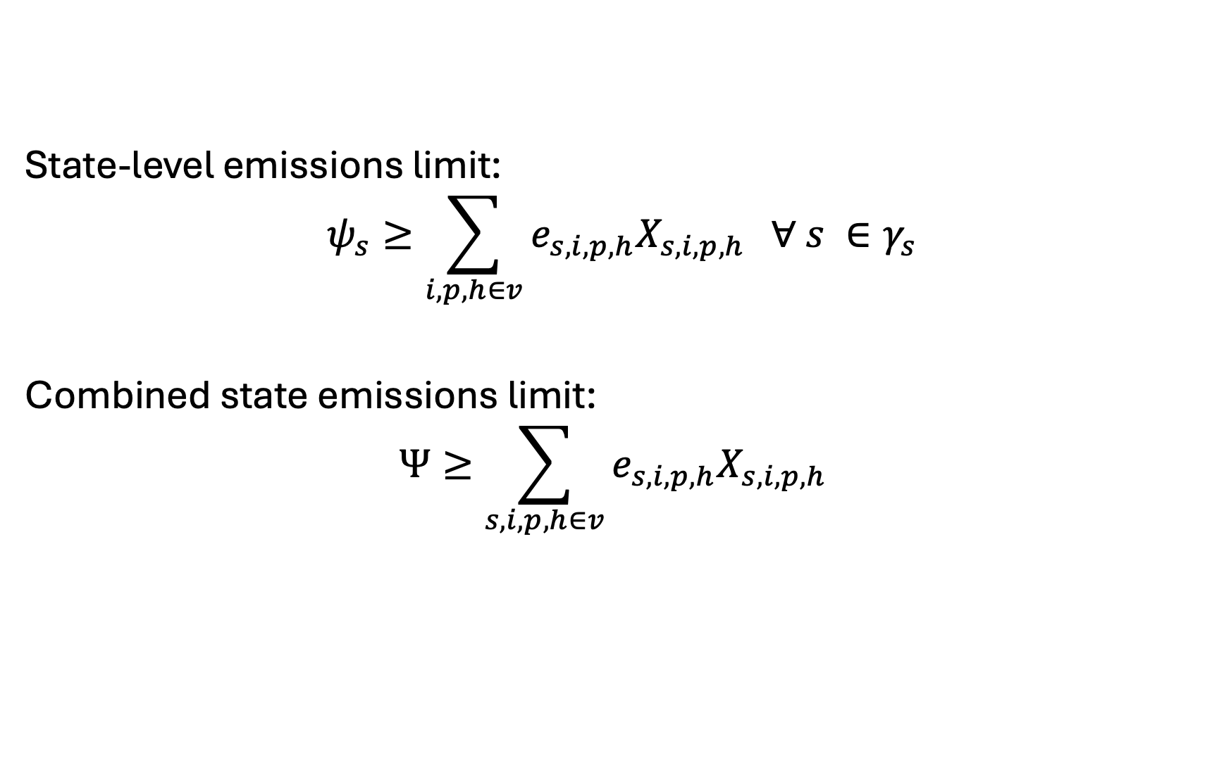
Constraints – Mass-based Policies
State-level emissions limit:
$$ψ_{s}≥\sum_{i,p,h∈v}{e_{s,i,p,h}X_{s,i,p,h}} ∀ s ∈γ_{s}$$
Combined state emissions limit:
$$Ψ≥\sum_{s,i,p,h∈v}{e_{s,i,p,h}X_{s,i,p,h}}$$

Slide 19
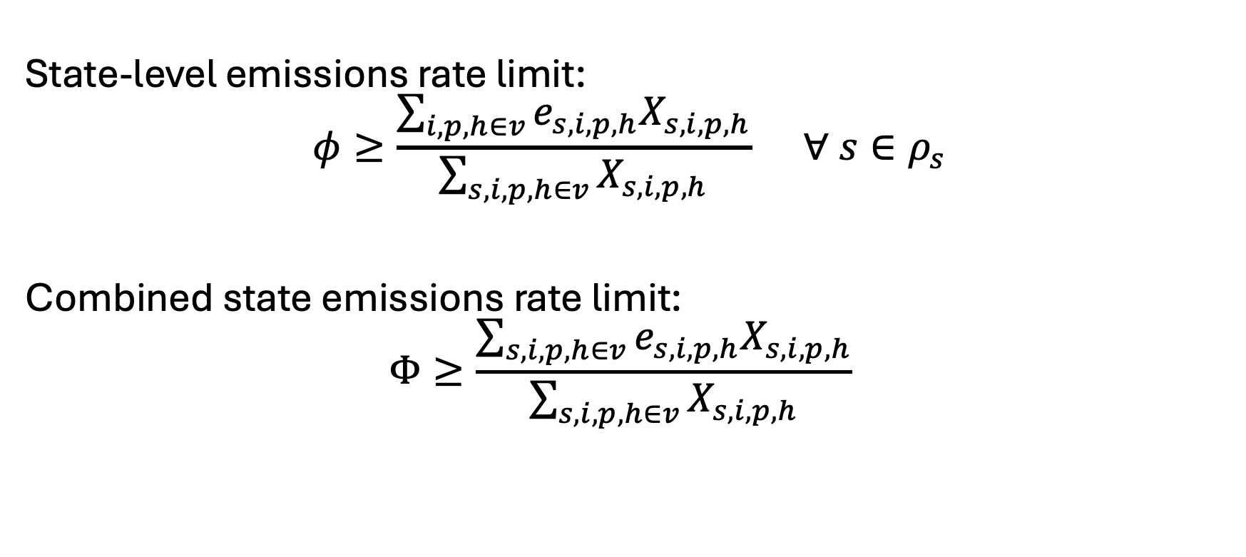
Constraints – Rate-based Policies
State-level emissions rate limit:
$$φ≥\frac{\sum_{i,p,h∈v}{e_{s,i,p,h}X_{s,i,p,h}}}{\sum_{s,i,p,h∈v}{X_{s,i,p,h}}} ∀ s∈ρ_{s}$$
Combined state emissions rate limit:
$$Φ≥\frac{\sum_{s,i,p,h∈v}{e_{s,i,p,h}X_{s,i,p,h}}}{\sum_{s,i,p,h∈v}{X_{s,i,p,h}}}$$

Slide 20
Limitations of LPs
Why are the mass- and rate-based emissions policy results the same?
How do we overcome this?
LPs -> NLP
Linearizing non-linear functions
NLP examples:
Natural gas extraction
Ramsey growth model
Anything else?

