Slide 1
EBGN645: Day 6

Slide 2
Questions and Comments
No questions yet…
GAMSPy discussion – guest lecture soon
Everything you’ve learned in your math/micro econ classes can be modeled
Consumer utility subject to budget constraints
Profit maximization
Cost minimization
Supply/demand
Cash flow, investments
Maybe I’ll ramble for a bit on recent work…

Slide 3
Agenda for today
Review Monday
Overview of aliases
Using conditionals
(Slightly) more complicated electricity dispatch model
We can make these very complicated quickly
Still avoiding investment/expansion – will use ReEDS here
Longer term
Ramsey model
Natural gas model
Duality, conversions to MCPs

Slide 4

Meme [I]

Slide 5
A (slightly) more complicated electricity model
A simple model of the Colorado/Wyoming (COWY) electricity dispatch
24-hour time period
Unit-level resolution
Adding on emissions policies
Grabbing data from 2018 – Unit-level capacity, VOM costs, and heat rates
Happy to talk ReEDS data
(terrible) assumptions on capacity factors
Average hourly demand – Use of a global
Important to understand: We will eventually convert this to an MCP
Currently: no transmission

Slide 6
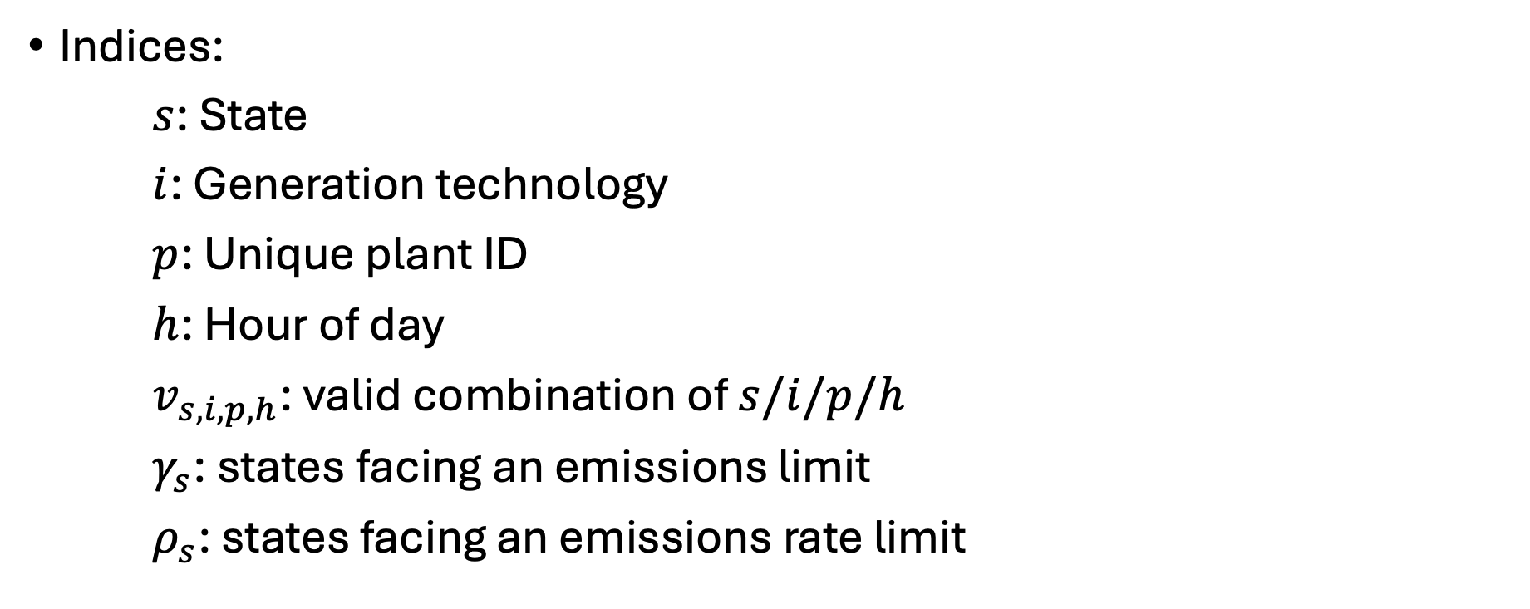
Electricity “dispatch” problem
Indices:
$s$: State
$i$: Generation technology
$p$: Unique plant ID
$h$: Hour of day
$v_{s,i,p,h}$: valid combination of $s/i/p/h$
$γ_{s}$: states facing an emissions limit
$ρ_{s}$: states facing an emissions rate limit

Slide 7
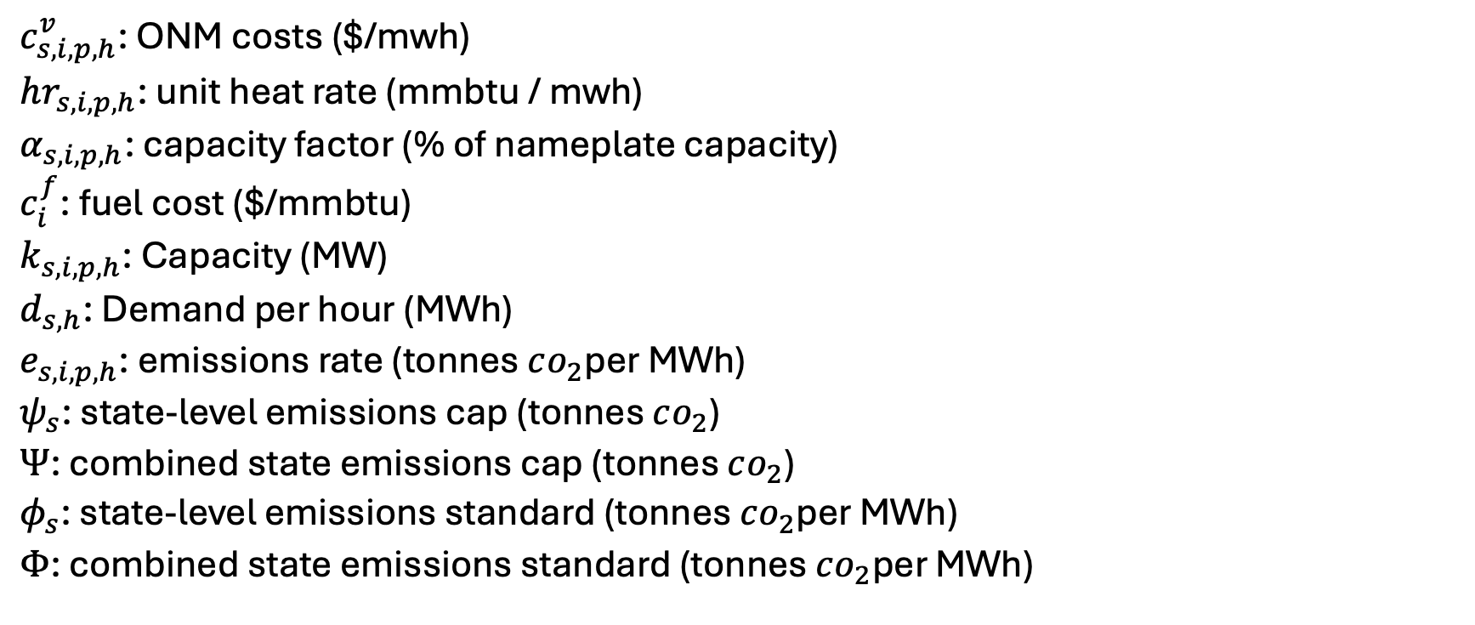
Parameters
$c_{s,i,p,h}^{v}$: ONM costs ($/mwh)
$hr_{s,i,p,h}$: unit heat rate (mmbtu / mwh)
$α_{s,i,p,h}$: capacity factor (% of nameplate capacity)
$c_{i}^{f}$: fuel cost ($/mmbtu)
$k_{s,i,p,h}$: Capacity (MW)
$d_{s,h}$: Demand per hour (MWh)
$e_{s,i,p,h}$: emissions rate (tonnes $co_{2}$per MWh)
$ψ_{s}$: state-level emissions cap (tonnes $co_{2}$)
$Ψ$: combined state emissions cap (tonnes $co_{2}$)
$φ_{s}$: state-level emissions standard (tonnes $co_{2}$per MWh)
$Φ$: combined state emissions standard (tonnes $co_{2}$per MWh)

Slide 8
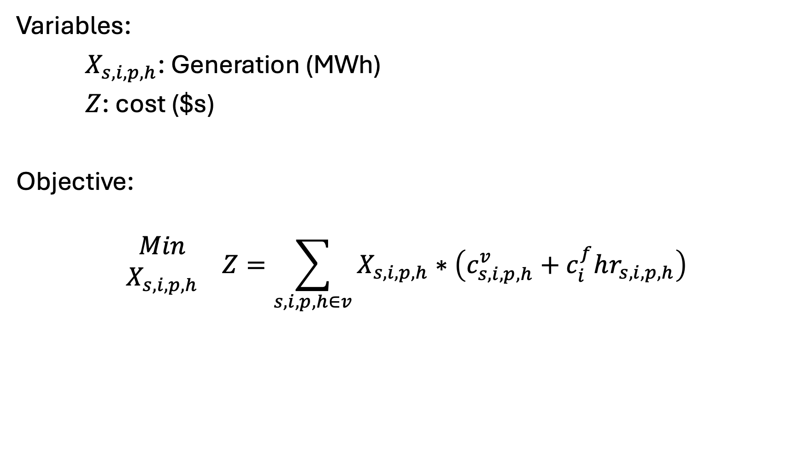
Variables, Objective
Variables:
$X_{s,i,p,h}$: Generation (MWh)
$Z$: cost ($s)
Objective:
$$\begin{matrix}Min \\ X_{s,i,p,h}\end{matrix} Z=\sum_{s,i,p,h∈v}{X_{s,i,p,h}}∗\left(c_{s,i,p,h}^{v}+c_{i}^{f}hr_{s,i,p,h}\right)$$

Slide 9
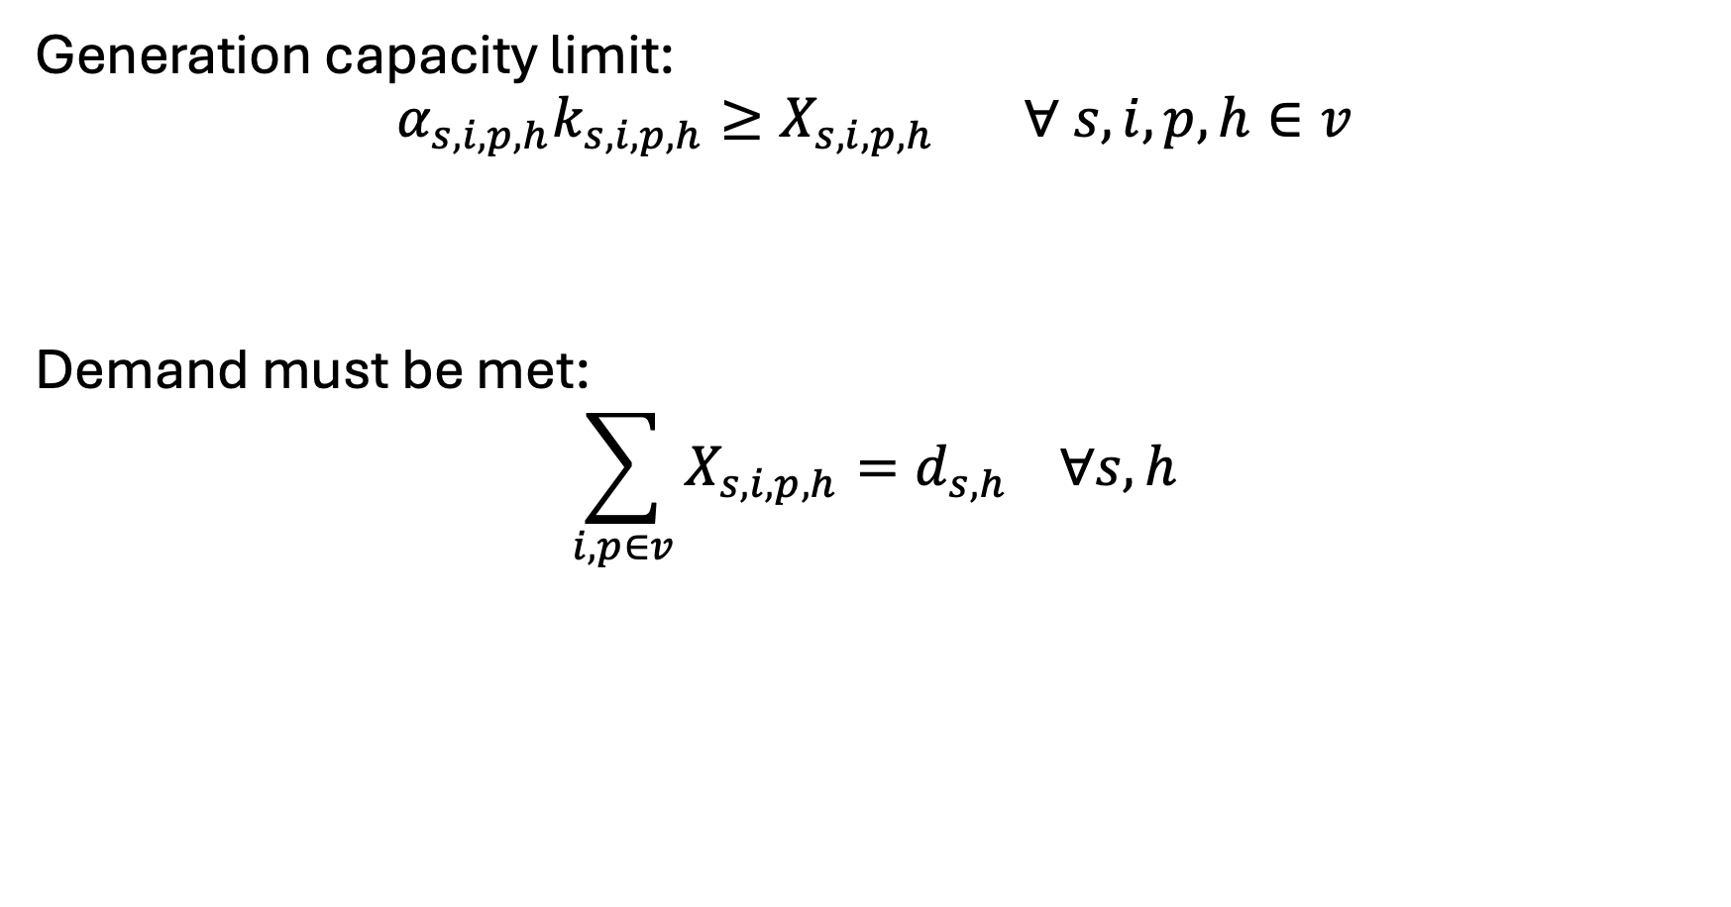
Constraints - basics
Generation capacity limit:
$$α_{s,i,p,h}k_{s,i,p,h}≥X_{s,i,p,h} ∀ s,i,p,h∈v$$
Demand must be met:
$$\sum_{i,p∈v}{X_{s,i,p,h}}=d_{s,h} ∀s,h$$

Slide 10
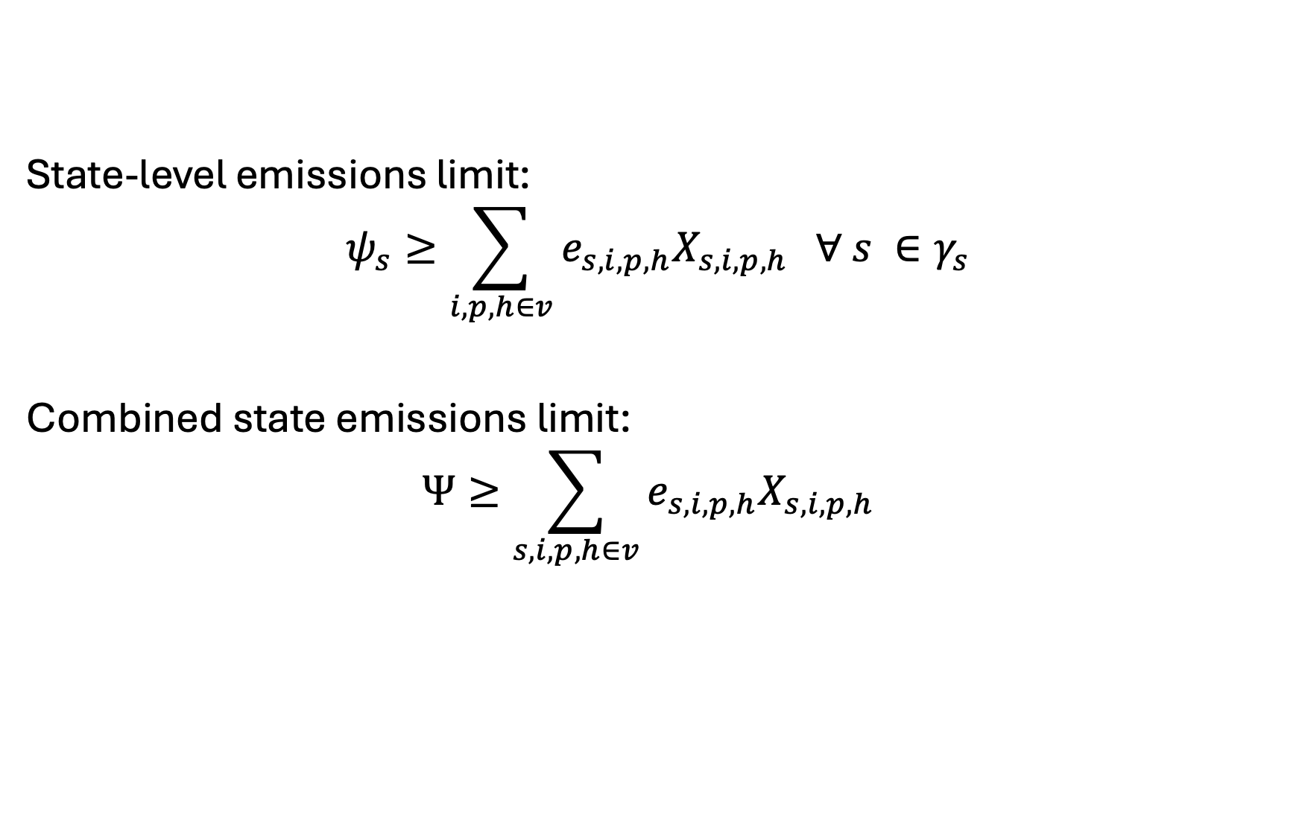
Constraints – Mass-based Policies
State-level emissions limit:
$$ψ_{s}≥\sum_{i,p,h∈v}{e_{s,i,p,h}X_{s,i,p,h}} ∀ s ∈γ_{s}$$
Combined state emissions limit:
$$Ψ≥\sum_{s,i,p,h∈v}{e_{s,i,p,h}X_{s,i,p,h}}$$

Slide 11
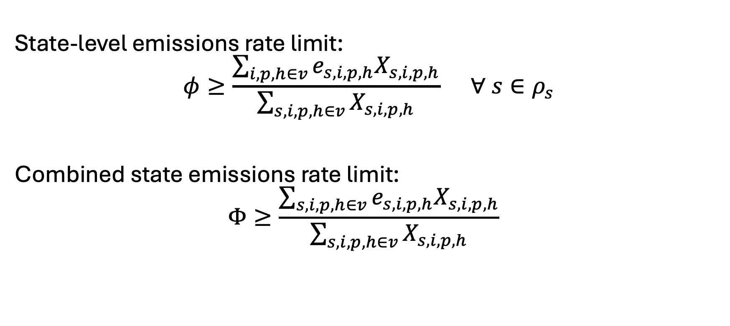
Constraints – Rate-based Policies
State-level emissions rate limit:
$$φ≥\frac{\sum_{i,p,h∈v}{e_{s,i,p,h}X_{s,i,p,h}}}{\sum_{s,i,p,h∈v}{X_{s,i,p,h}}} ∀ s∈ρ_{s}$$
Combined state emissions rate limit:
$$Φ≥\frac{\sum_{s,i,p,h∈v}{e_{s,i,p,h}X_{s,i,p,h}}}{\sum_{s,i,p,h∈v}{X_{s,i,p,h}}}$$

Slide 12

Constraints – “unit commitment”
Similar to before…
Lower bound:
$$X_{s,i,p,h}≥\left(1−δ_{i}\right)X_{s,i,p,h^{′}} ∀ s,i,p,h,h^{′}∈v$$
Upper bound:
$$X_{s,i,p,h}≤\left(1+δ_{i}\right)X_{s,i,p,h^{′}} ∀ s,i,p,h,h^{′}∈v$$

Slide 13

Meme [II]

