Slide 1
EBGN645: First Day

Slide 2

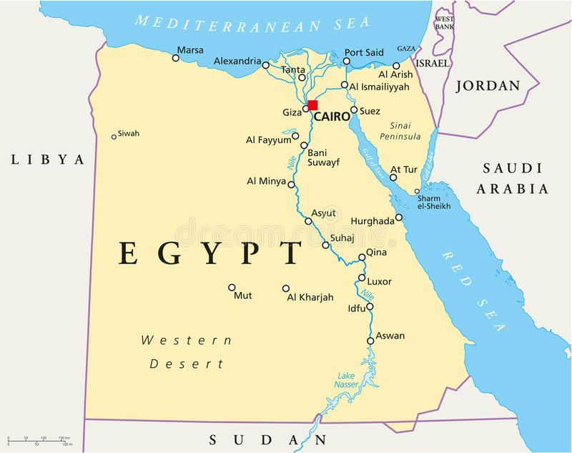
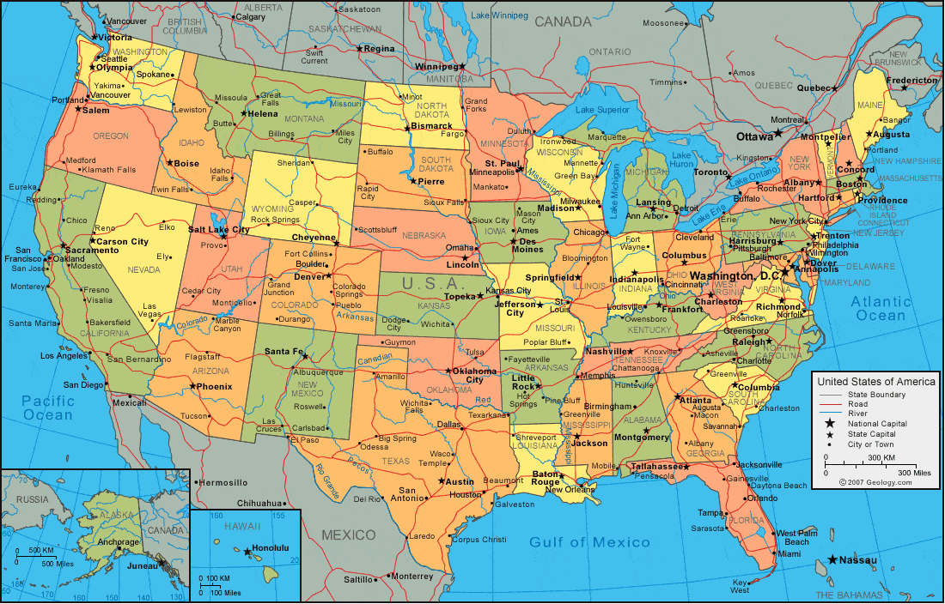





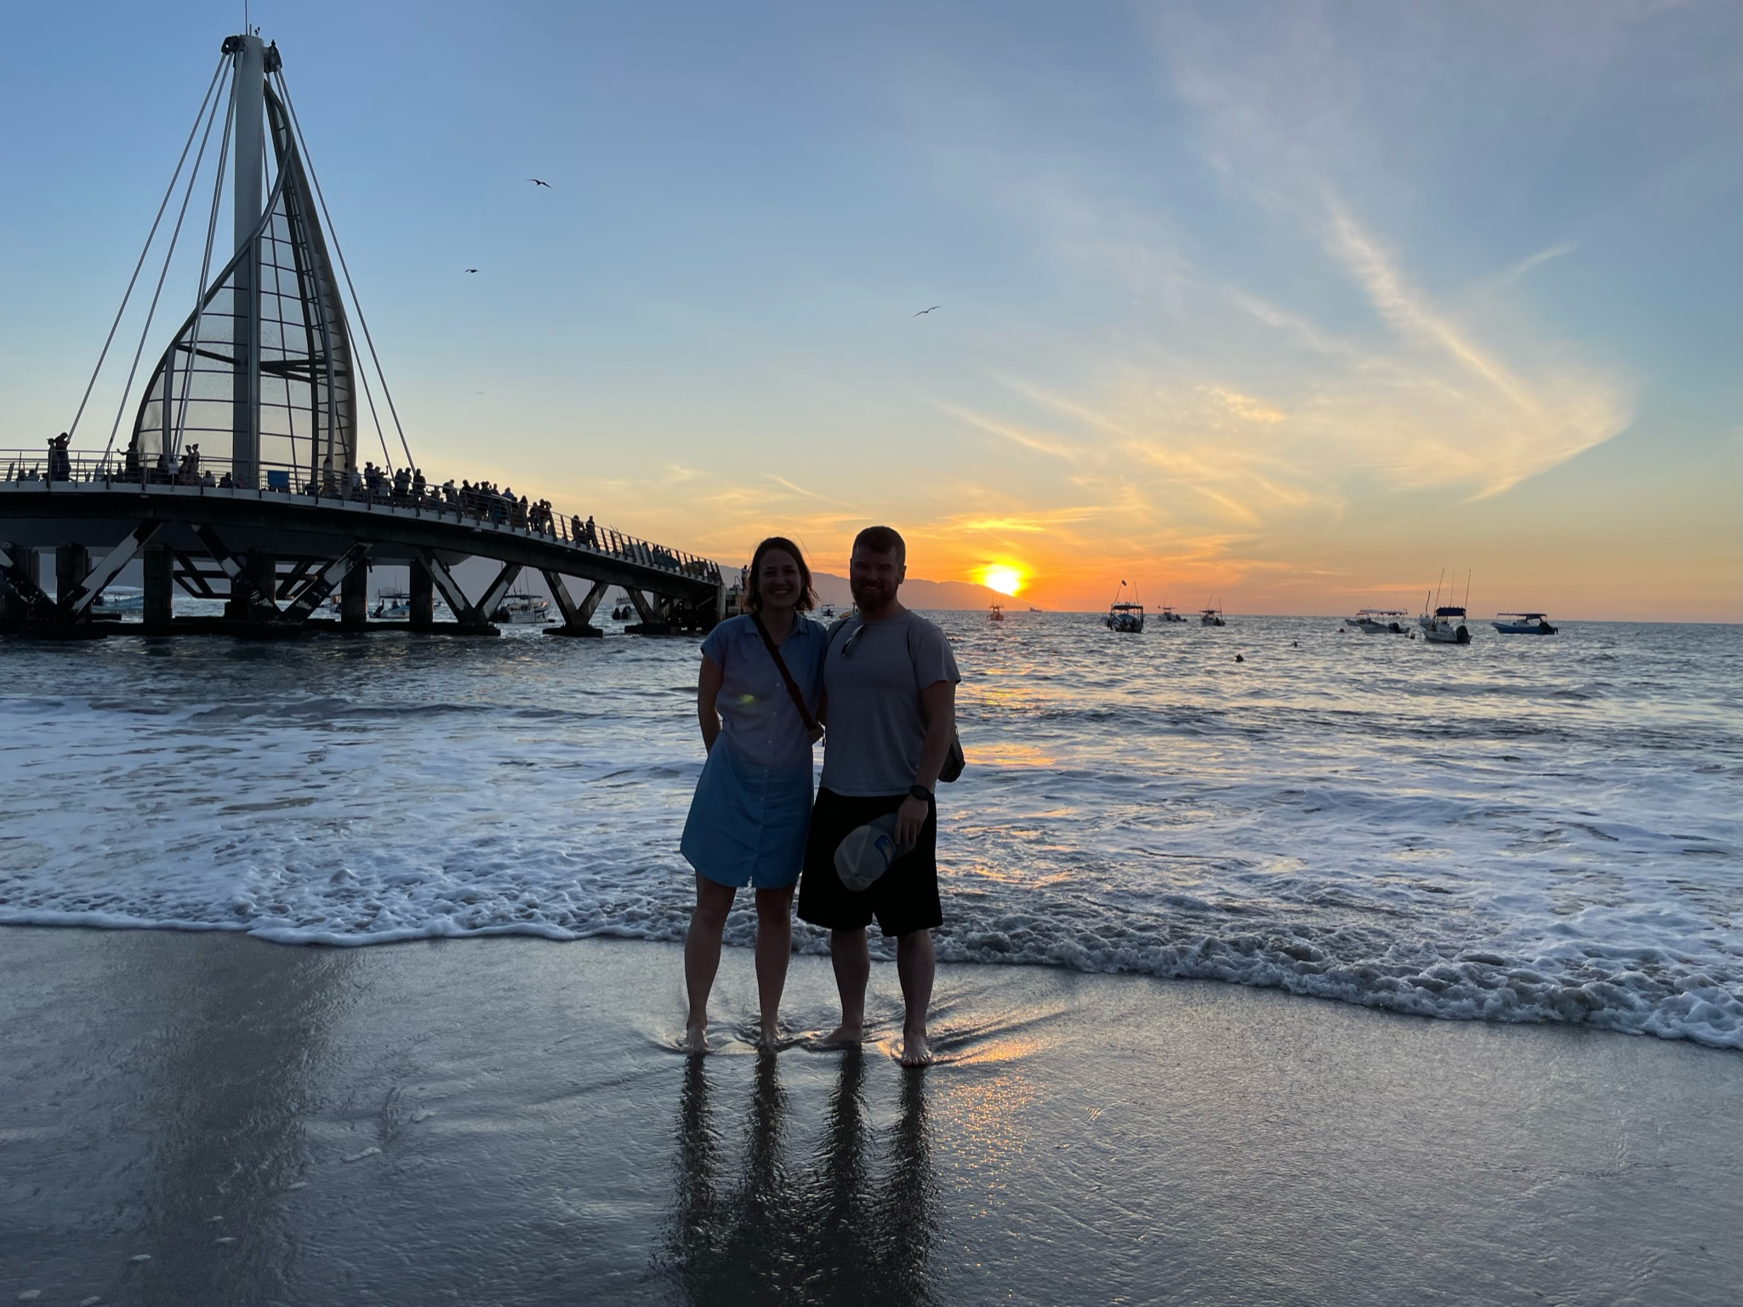

My Background
Notes:
North Dakota State College of Science (2004-2006)
North Dakota State University (2006-2010)
University of Maine (2010-2012)
Oak Ridge National Laboratory (2012-2017)
Colorado School of Mines (2013-2017)
Critical Materials Institute
Payne Institute for Earth Resources
National Renewable Energy Laboratory (2016-Present)
Colorado School of Mines (2019-Present)

Slide 3
Previous projects
Lead developer on Regional Energy Deployment System (ReEDS)
Lead re-development in ~2017
Open-sourcing effort, R&D100 award in ~2020
Flexible temporal and spatial resolution
Lead on hydrogen and carbon capture and storage (CCS) modeling
Lead on Inflation Reduction Act (IRA) policy analysis
Comparison of economic welfare and air quality impacts
45v, 45q now 45x, 48c
ReEDS-USREP
Lead developer on Fuels and Industry Integrated Optimization (FINITO)
Steel, cement, ammonia, aluminum, hydrogen, glass, food processing …
Liquid and gaseous fuel supply

Slide 4
Current projects
Emissions leakage of incremental electricity load (with EMTEC, NREL)
Equity of the energy transition (with MIT, NREL // CMU)
United Nation’s Biennial Transparency Report (with EPA)
Material use in electricity with market responsiveness (with CMI)
With NREL:
Industry and fuel supply modeling/forecasting
Evaluation of off-grid hydrogen (and steel) facilities
Ongoing policy analysis for IRA and 111
All sorts of modeling/programming things…

Slide 5
Teaching philosophy
Nothing needs to be overly/intentionally difficult or stressful - We should look forward to and enjoy our time together
You should learn the core concepts well – “5-year takeaways”
Goal should be an intuitive understanding of the material
ie – why is this important? when will I ever use this?
Mutual respect
Teacher and students
Among students

Slide 6
Recording
Classes will be recorded
Recording will only be available to students who miss due to an excused absence
They will not be made available outside of the class roster

Slide 7
Punishments for…
Anything that creates an unsafe learning environment
Discrimination, bigotry, threats, violence, …
Academic misconduct (cheating)
I take these very seriously --
You will be punished to the full extent of university policy

Slide 8
Purpose of this course
Main goals:
Exposure to and knowledge of various modeling techniques
Using software as a vehicle for those techniques to solve problems in economics and engineering
Secondary goals:
Application of knowledge/skills to the real world
Modeling a topic of interest via the final project

Slide 9
Topics covered
Programming
GitHub
Command line tools
Mainly using GAMS - Other languages: Python, Julia as examples
Linear programs <- HW1
Non-linear programs
Duality
Mixed complementarity problems <- HW2
Model linkages – iterative and co-optimized
Computable General Equilibrium models
Mathematical Programs with Equilibrium Constraints (MPECs) - HW3
Equilibrium Programs with Equilibrium Constraints (EPECs)

Slide 10
Grading
Course grade determined by:
Homework x3: 50%
Presentation: 15%
Final projects: 35%
Late homework will not be accepted – the due date/time will be clearly printed on the assignment
I reserve the right to curve any/all work – Students will never be negatively impacted by grade adjustments

Slide 11
Your final project
Broken into stages.. (dates subject to change)
2-page proposal due September 25th
Draft of paper due November 13th
Final paper due December 12th
Drafts, final papers, and presentations that do not clearly state a research question (or statement) will be heavily penalized

Slide 12
Coding
This class will move fast in the beginning
All code be made available through the GitHub repository
Anyone can learn to code – it is a language
I will not write your code for you

Slide 13
Scheduling
Most of you have similar schedules
Do not want to overlap with other exams or project due dates
Will try to work around schedules to make sure we don’t overlap
See google sheet to list out any problem dates
I will be out October 20th and 23rd for INFORMS

Slide 14
Absences, delays
Should any personal issues arise that requires you to miss extended periods of class, please reach out ASAP
Homework extensions or special accommodations for the final project will require at least 72 hours notice and will be evaluated on a case-by-case basis

Slide 15
Disabilities, counseling
Will always do my best to accommodate any disability
Should any personal issue arise, Mines has a great counseling center
Avoid burn-out

Slide 16
Advice for the program/life
A degree is just a piece of paper if you’re just jumping through the hoops
Goals should be to..
Acquire skills and knowledge that make you more valuable/employable
Become well-rounded in the space of minerals and/or energy
Pursue your passion
Talk to people, network, go to events
Get to know people’s research
Create a work life balance
Whatever you do, try

Slide 17
Your first assignments – will also send an email
Add any date conflicts to the google sheet
Download/install the most recent version of GAMS
Add license to GAMS
Create a git account
Download/install the most recent versions of GitHub and GitHub Desktop
Download/install Visual Studio Code as well as the GAMS extension
If you’ve never done so before, open your command prompt or terminal and type in a command:
For windows: dir
For linux/mac: ls

Slide 18
Questions?

