Slide 1
EBGN645: Day 2

Slide 2
Questions [I]
Why bash/command prompt and not python?
Normally will script operations – e.g. creation of files/directories, pre- and post-processing of results, model runs, …
Can do this in either python or bash/dos… e.g. in bash:
mkdir my_dir
and in python:
os.mkdir(“my_dir”)
.. This amounts to personal preference
For routine things (“unscripted development”) it’s much faster just to do these things via dos/bash
Helpful to know bash when on non-GUI machines

Slide 3
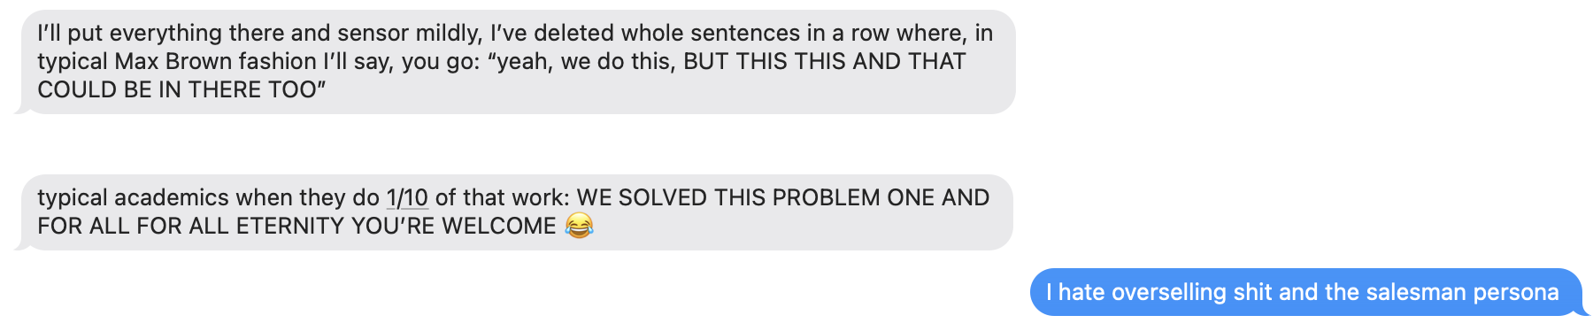
Questions [II]
What did you mean by call ‘BS’ ?

Slide 4
Questions [III] – Final Project
Conflicting schedules for project dates between online syllabus and here - Sorry for this
Due dates (also updated in syllabus on canvas)
2-page proposal due September 25th
Draft of paper due November 13th
Final paper due December 12th
Don’t hesitate to share ideas
I won’t discourage you from doing something big but better to take on a reasonable amount of work

Slide 5
Questions [IV] – Model relationships
“How do all these model types relate and
why are we going in this order?”
CGE
MCP
LP
NLP
MPECS
EPECS
MPECS
EPECS
LP

Slide 6
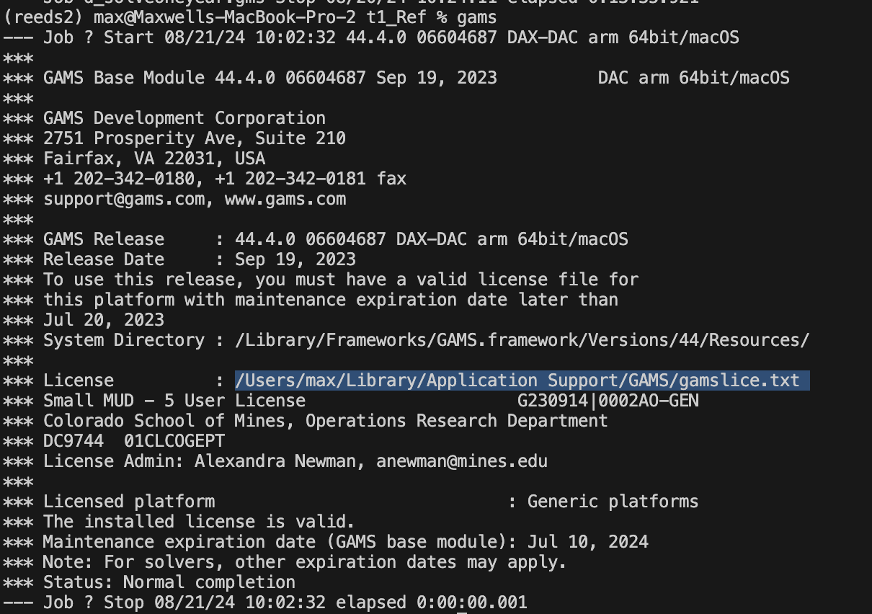
Questions [V] – GAMS license
Run ‘gams’ from dos/bash (command prompt or terminal), check license line from output, replace the file indicated with the version sent via email
Other option: copy the gams license text, open gams studio, go to help -> GAMS licensing .. It will ask if you want to replace the license

Slide 7
Questions [VI] – OS Choice
”Why do you use a Mac?”
A1: Because other people pay for my computers :0)
A2: Linux/unix running under the hood.. Anything I do on this machine can (usually) transfer to HPC – no longer the case with WSL

Slide 8
An update from a former student…

Slide 9
Some unsolicited career advice
Always look for opportunities…
Even when you’re at your dream job, options bring leverage
Nobody ever wants to give you more money
Keep improving, demonstrating value, staying competitive
Cliché but.. when starting out, make mistakes on someone else’s dime

Slide 10
Agenda for today
GitHub
Creating a class repo
Committing a file
Creating a branch
Merging changes
Resolving merge conflicts
Writing out models: Ripley’s restaurant (math and code)

Slide 11
Git terms
repository/”repo”: a collection of files saved on a server
branch: a version of the code you are working on
commit: save code to your branch on your local machine
push: save code to the repository
pull: update local code from the repository
merge: combine the code/files from one branch into another
merge conflict: code that was updated on both branches
and git doesn’t know which to choose

Slide 12
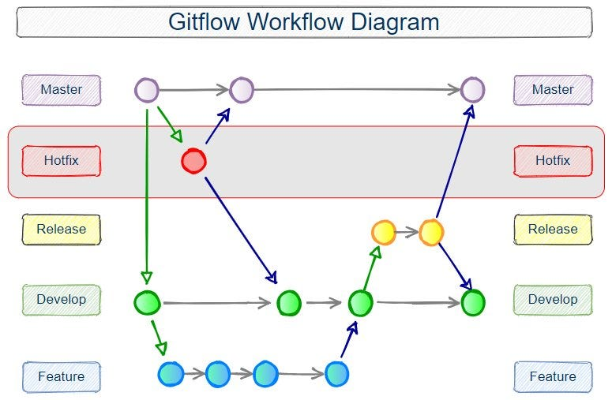
Git diagram

Slide 13
GitHub Desktop Example
Commands for git are pretty simple
GitHub Desktop more friendly for beginners

Slide 14
Ripley’s restaurant – A very simple model
Ripley works 40 hours per week making hamburgers, hot dogs, and french fries. The net revenue and time to make for each of the items is in the table below.
What is Ripley’s profit-maximizing production choice?
Item | Revenue | Cost | Hours
Hamburger | 1.5 | 0.75 | 0.5
Hot dog | 0.75 | 0.1 | 0.2
French fries | 0.25 | 0.05 | 0.1

Slide 15
Ripley’s restaurant
Warning.. The images I’m about to show are disturbing

Slide 16
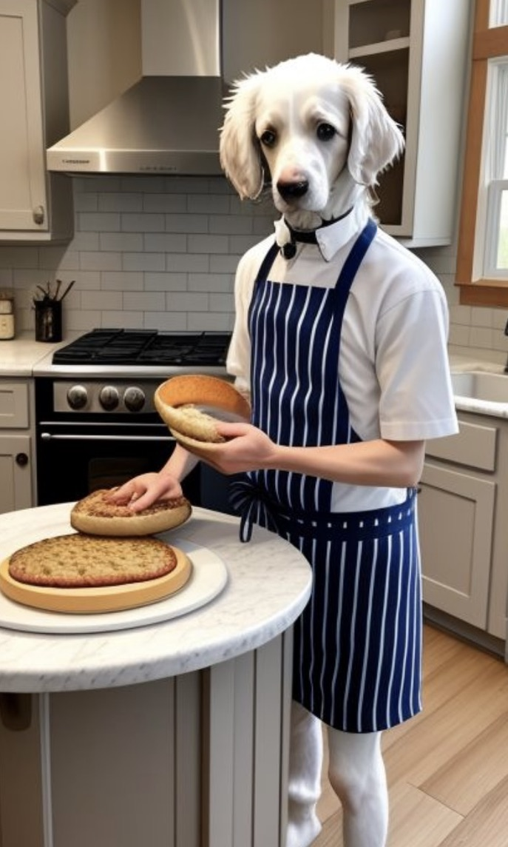
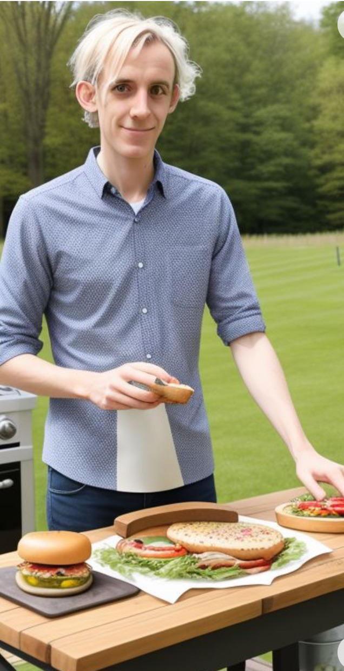
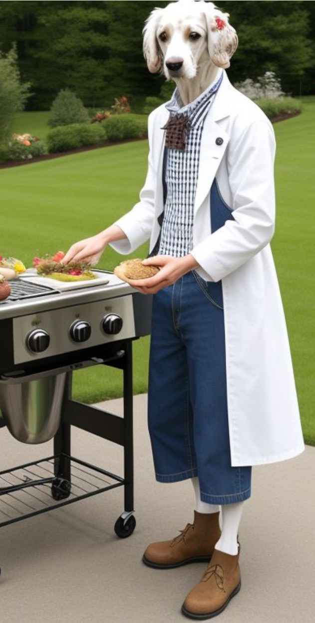
Ripley’s restaurant – visualized by AI

Slide 17
Writing a model
Always go in this order:
Sets/indices
Parameters
Variables
Objective function
Constraints
See explanation/examples in INFORMS (Grievel et al.) or CCS papers

Slide 18
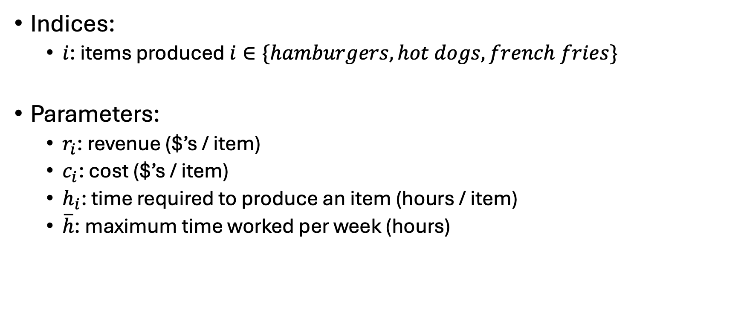
Ripley’s restaurant
Indices:
$i$: items produced $i∈\{hamburgers, hot dogs, french fries\}$
Parameters:
$r_{i}$: revenue ($’s / item)
$c_{i}$: cost ($’s / item)
$h_{i}$: time required to produce an item (hours / item)
$\overline{h}$: maximum time worked per week (hours)
Item | Revenue | Cost | Hours
Hamburger | 1.5 | 0.75 | 0.5
Hot dog | 0.75 | 0.1 | 0.2
French fries | 0.25 | 0.05 | 0.1

Slide 19
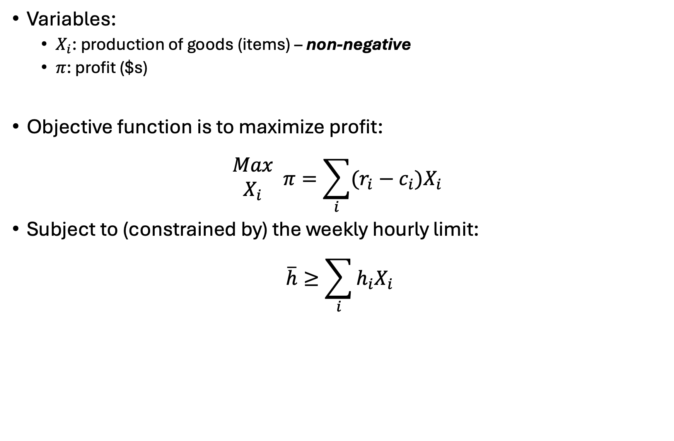
Ripley’s restaurant
Variables:
$X_{i}$: production of goods (items) – non-negative
$π$: profit ($s)
Objective function is to maximize profit:
$$\begin{matrix}Max \\ X_{i}\end{matrix} π=\sum_{i}{(r_{i}−c_{i})X_{i}}$$
Subject to (constrained by) the weekly hourly limit:
$$\overline{h}≥\sum_{i}{h_{i}X_{i}}$$

Slide 20
Ripley’s restaurant
Let’s code this up in GAMS…

Slide 21
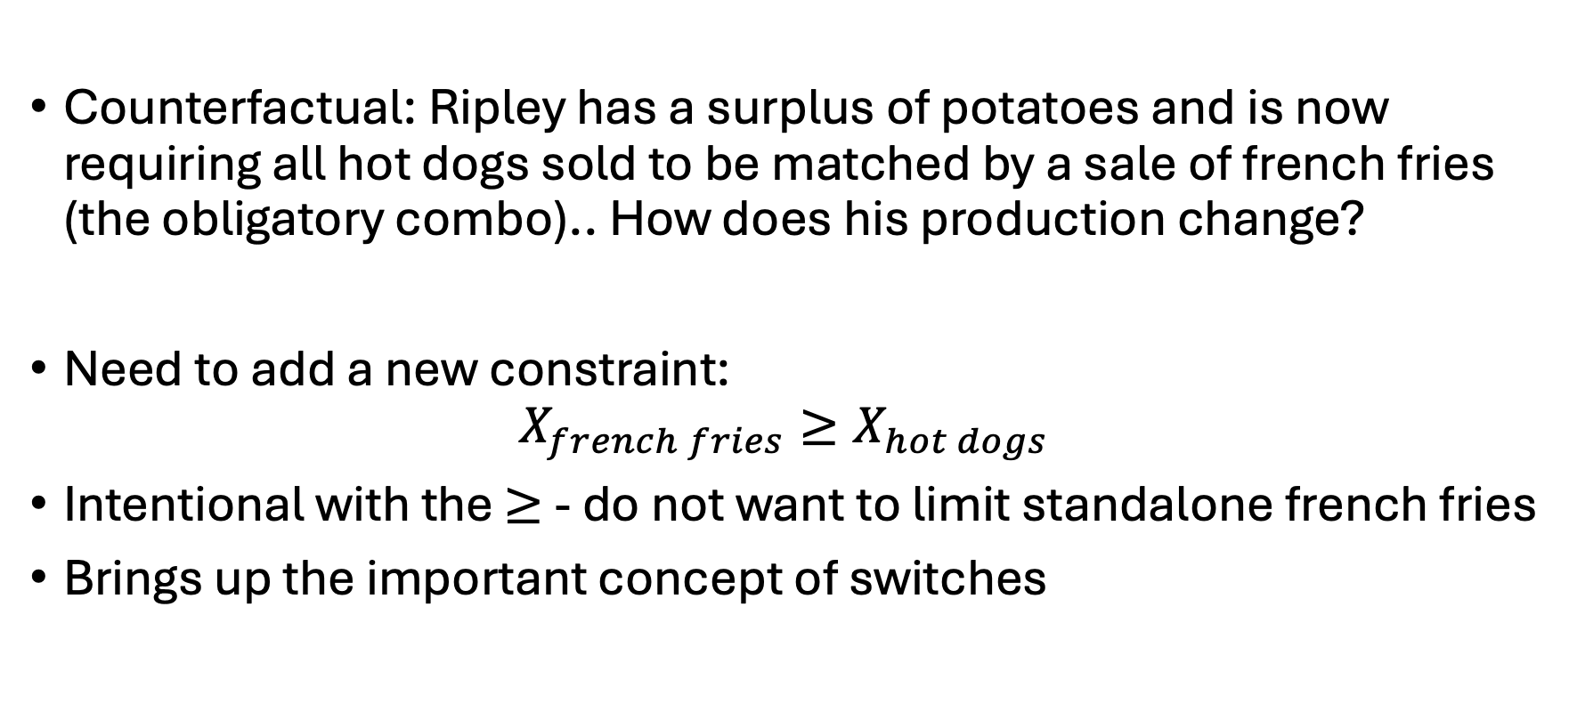
Ripley’s restaurant
Counterfactual: Ripley has a surplus of potatoes and is now requiring all hot dogs sold to be matched by a sale of french fries (the obligatory combo).. How does his production change?
Need to add a new constraint:
$$X_{french fries}≥X_{hot dogs}$$
Intentional with the $≥$ - do not want to limit standalone french fries
Brings up the important concept of switches

Slide 22
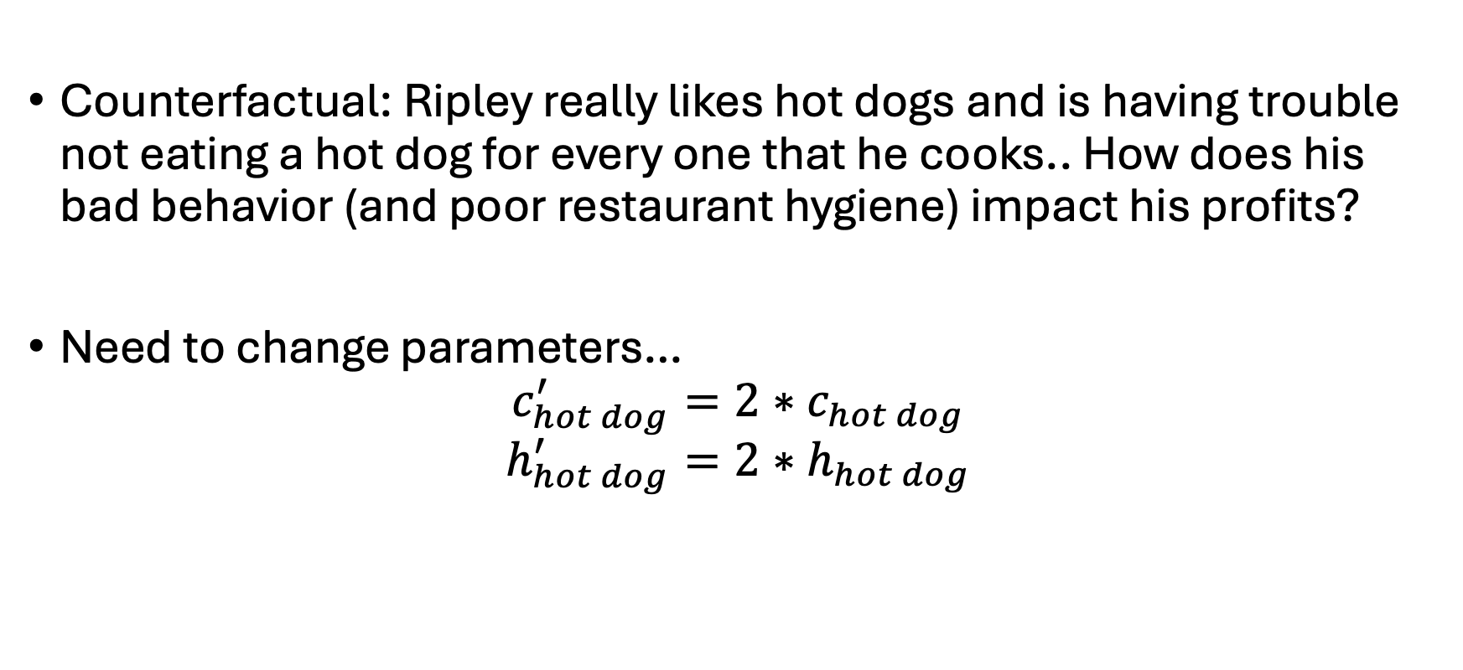
Ripley’s restaurant
Counterfactual: Ripley really likes hot dogs and is having trouble not eating a hot dog for every one that he cooks.. How does his bad behavior (and poor restaurant hygiene) impact his profits?
Need to change parameters…
$$c_{hot dog}^{′}=2∗c_{hot dog}$$
$$h_{hot dog}^{′}=2∗h_{hot dog}$$

Slide 23
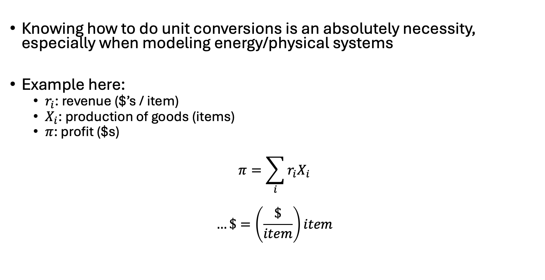
Notes on unit conversions
Knowing how to do unit conversions is an absolutely necessity, especially when modeling energy/physical systems
Example here:
$r_{i}$: revenue ($’s / item)
$X_{i}$: production of goods (items)
$π$: profit ($s)
$$π=\sum_{i}{{r_{i}X}_{i}}$$
$$…\$=\left(\frac{\$}{item}\right)item$$

