Slide 1
EBGN645: Day 3

Slide 2
Questions
Can I get an overview of the current US energy landscape?
How do computers work?
Why can’t I call GAMS from the command prompt/terminal?
Can you talk slower?

Slide 3
Agenda
Reviewing GitHub
Practicing GAMS
Another simple example
Introducing time
(slightly) less simple example, introduction of conditionals
Restarts/saves

Slide 4

But first… a meme

Slide 5
What is GitHub?
GitHub is a web-based platform that allows developers to create, store, manage, and share their code. It uses Git, an open-source version control software, to let multiple people make changes to code at the same time. GitHub is often called a "social coding platform" because it encourages teams to work together to build and edit their site content

Slide 6
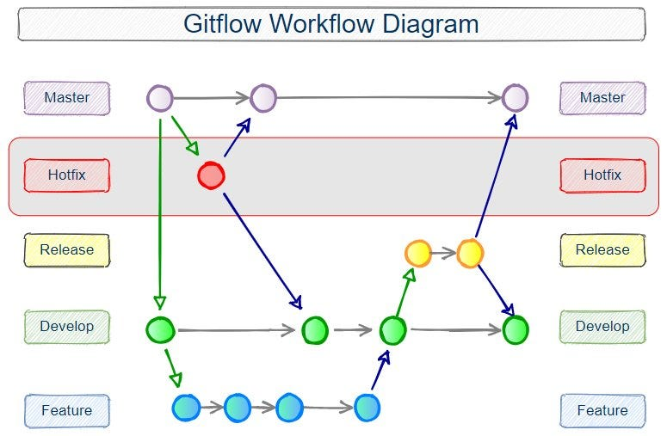
Git diagram
Main

Slide 7

Example 2: Ursula’s Utility
Ursula love’s eating pizza and beer. She is at Woody’s and is trying to decide what combination would maximize her utility/happiness. She has $20 in her pocket and forgot her wallet (luckily she’s a regular and they don’t ID her). Each piece of pizza costs $2 and gives her 2 utils of satisfaction while each beer costs $4 and gives her 5 utils of satisfaction. What is Ursula’s utility-maximizing set of consumption choices?
Also – what major utility assumption are we violating?

Slide 8
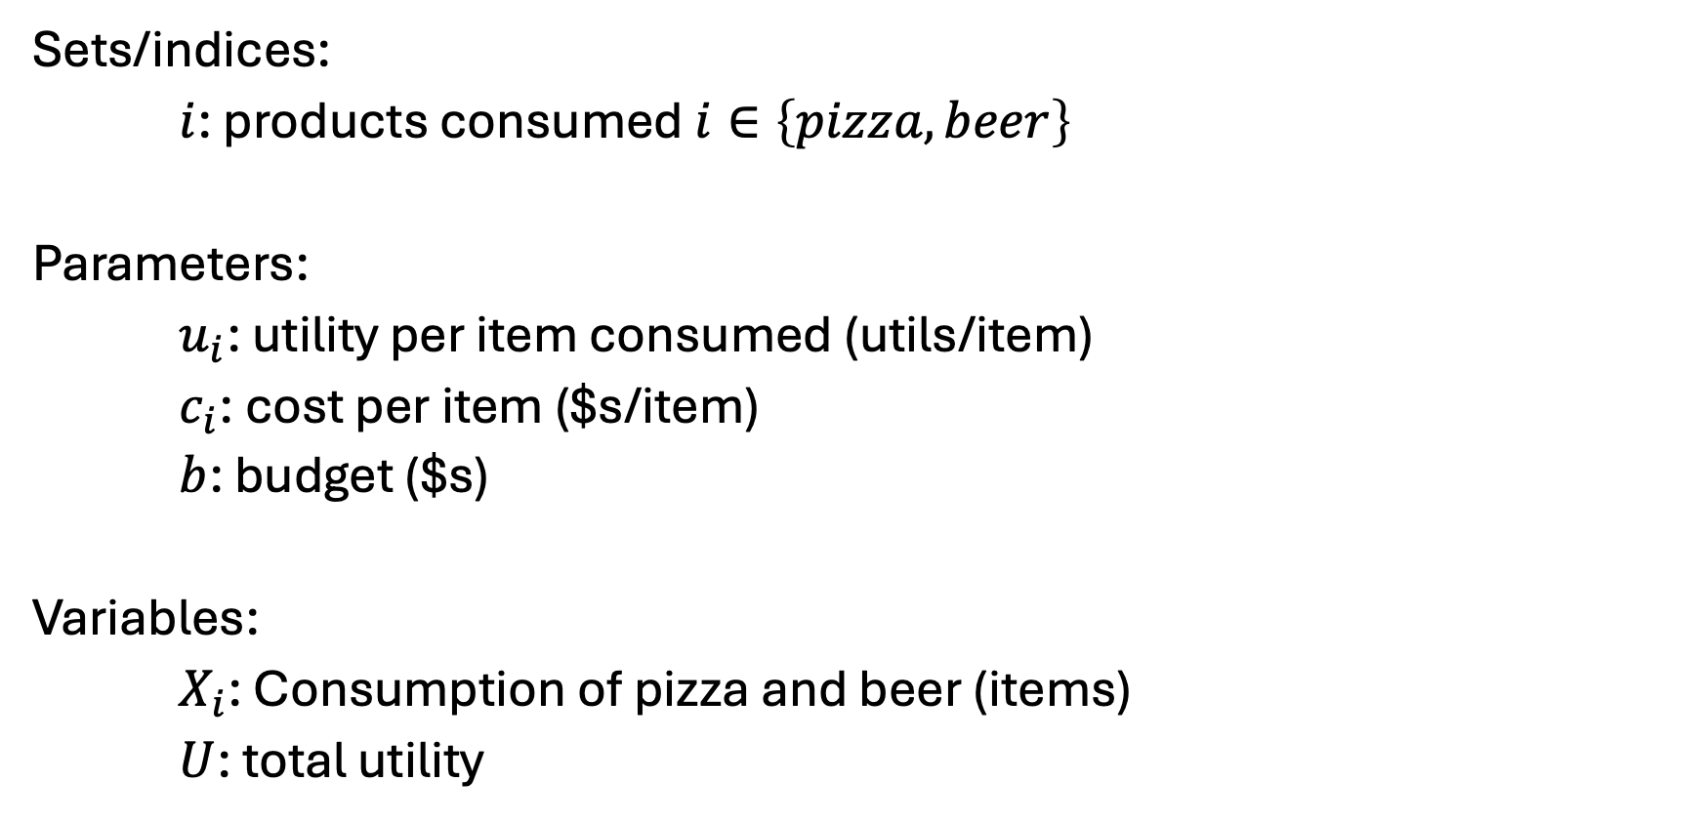
Ursula’s Utility [I] – Sets, parameters, variables
Sets/indices:
$i$: products consumed $i∈\left\{pizza, beer\right\}$
Parameters:
$u_{i}$: utility per item consumed (utils/item)
$c_{i}$: cost per item ($s/item)
$b$: budget ($s)
Variables:
$X_{i}$: Consumption of pizza and beer (items)
$U$: total utility

Slide 9
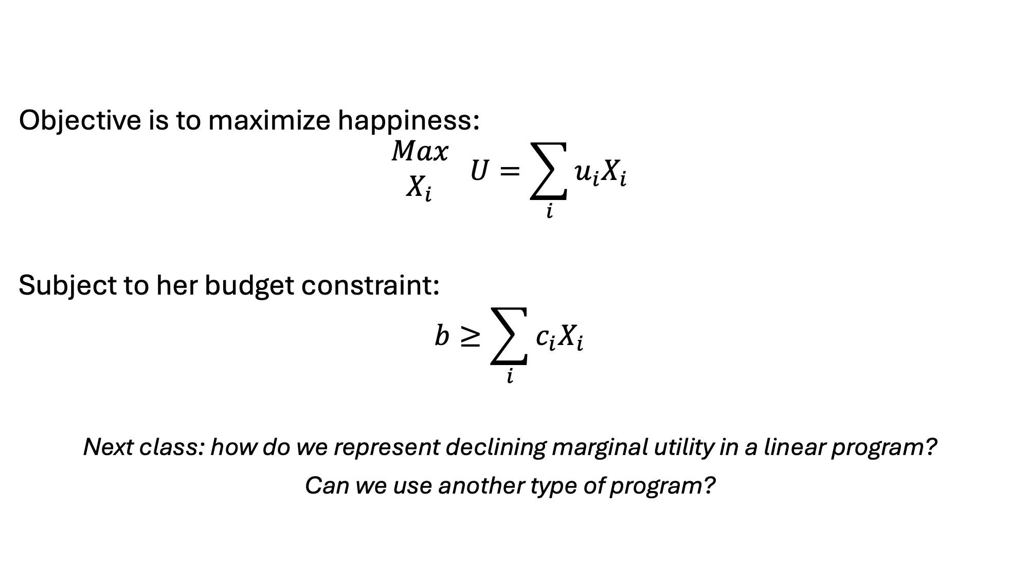
Ursula’s Utility [II] – Objective and constraints
Objective is to maximize happiness:
$$\begin{matrix}Max \\ X_{i}\end{matrix} U=\sum_{i}{u_{i}X_{i}}$$
Subject to her budget constraint:
$$b≥\sum_{i}{c_{i}X_{i}}$$
Next class: how do we represent declining marginal utility in a linear program?
Can we use another type of program?

Slide 10

Example 3: Franz Forestry
Franz owns land that produces lumber. Franz makes $100 net profit for every tree cut down. There is an initial stand of 100 trees and the trees grow at 1%* per year. Franz has a discount rate of 2%*. What is Franz profit-maximizing harvesting behavior?
*: Varied in counterfactuals

Slide 11

Franz Forestry [I] – sets and parameters
Set/Indices:
$t$: years, $t∈\{0,1,2,…T\}$
$t^{0}$: first year
$T$: last year
Parameters:
$p$: sale price ($/tree)
$g$: annual growth rate for trees (%) – $g≥1$
$s^{0}$: initial stock of trees (trees)
$r$: discount rate (%)
$δ_{t}$: discount factor (unitless)
$$δ_{t}=\frac{1}{{\left(1+r\right)}^{t}}$$

Slide 12
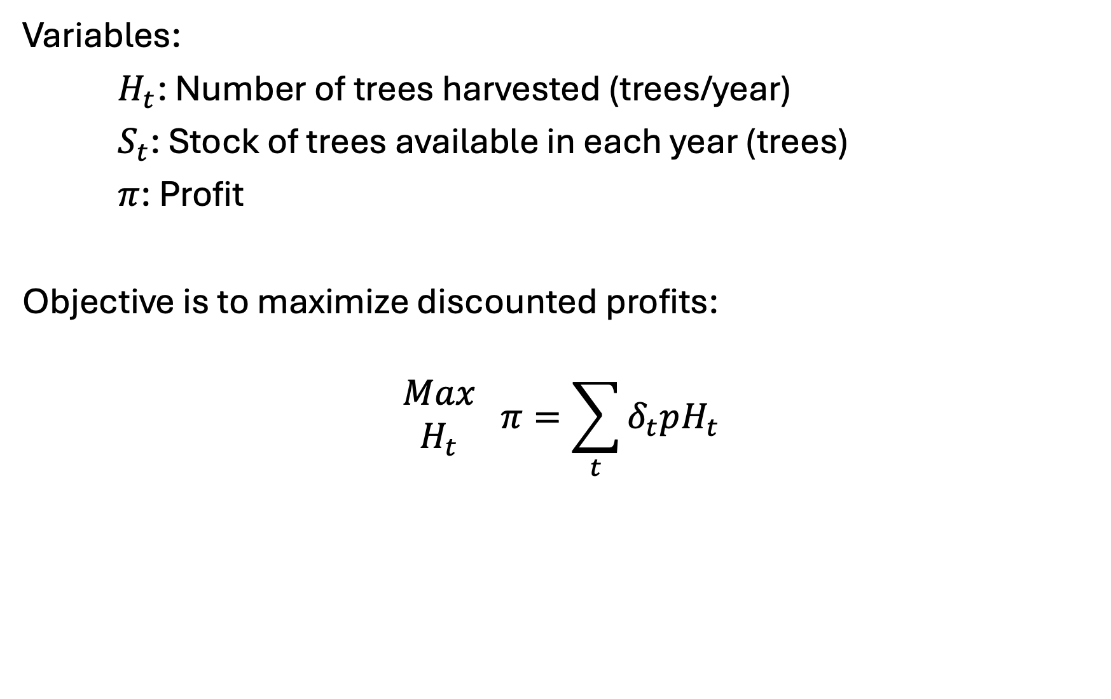
Franz Forestry [II] – variables and objective
Variables:
$H_{t}$: Number of trees harvested (trees/year)
$S_{t}$: Stock of trees available in each year (trees)
$π$: Profit
Objective is to maximize discounted profits:
$$\begin{matrix}Max \\ H_{t}\end{matrix} π=\sum_{t}{δ_{t}pH_{t}}$$

Slide 13
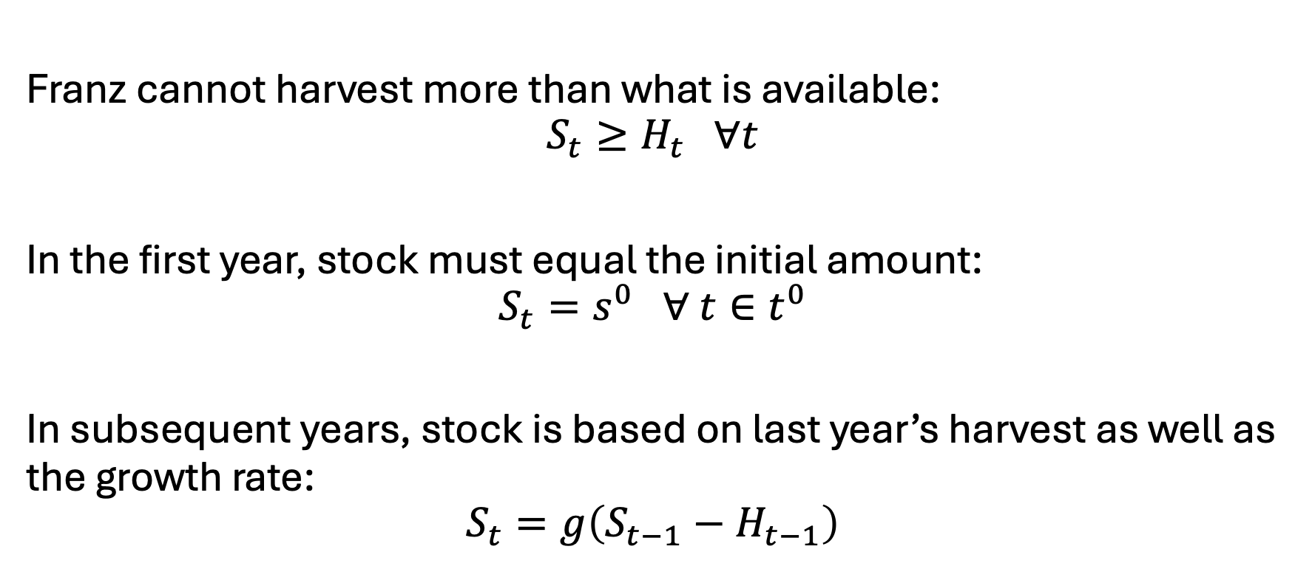
Franz Forestry [III] - constraints
Franz cannot harvest more than what is available:
$$S_{t}≥H_{t} ∀t$$
In the first year, stock must equal the initial amount:
$$S_{t}=s^{0} ∀ t∈t^{0}$$
In subsequent years, stock is based on last year’s harvest as well as the growth rate:
$$S_{t}=g\left(S_{t−1}−H_{t−1}\right)$$

Slide 14
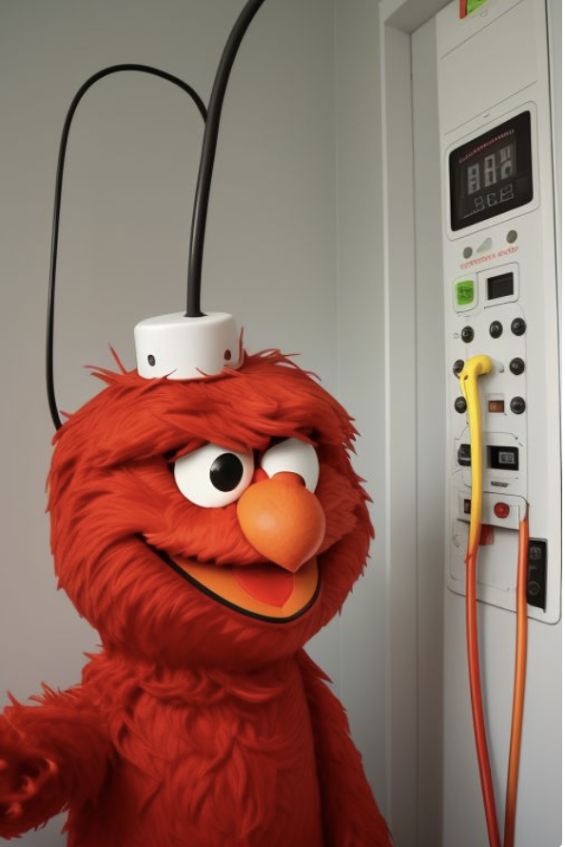
Example 4: Elmo’s Electricity
Elmo runs a small electricity utility. He has three electricity facilities: coal, gas, and wind. Each technology has its own cost and capacity. He must meet the hourly demand of his small town. What is Elmo’s cost-minimizing set of operational decisions?

Slide 15
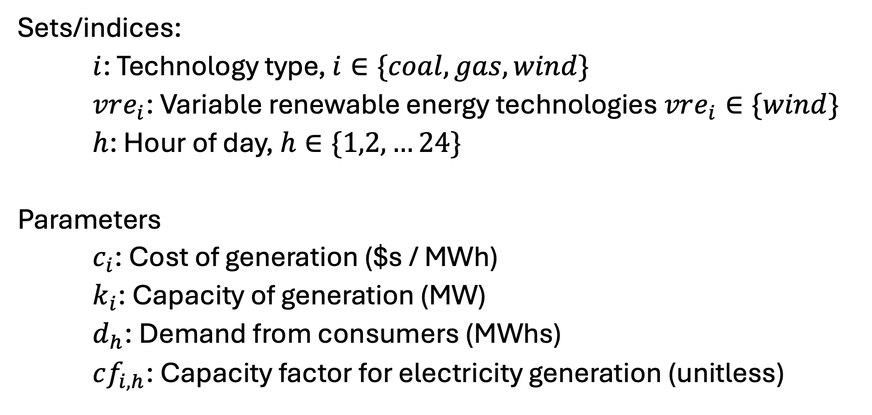
Elmo’s Electricity [I] – Sets and parameters
Sets/indices:
$i$: Technology type, $i∈\{coal, gas, wind\}$
$vre_{i}$: Variable renewable energy technologies $vre_{i}∈\{wind\}$
$h$: Hour of day, $h∈\{1,2,…24\}$
Parameters
$c_{i}$: Cost of generation ($s / MWh)
$k_{i}$: Capacity of generation (MW)
$d_{h}$: Demand from consumers (MWhs)
$cf_{i,h}$: Capacity factor for electricity generation (unitless)

Slide 16
Elmo’s electricity [II] - data
See spreadsheet - EBGN645_Data_Day3.xlsx

Slide 17
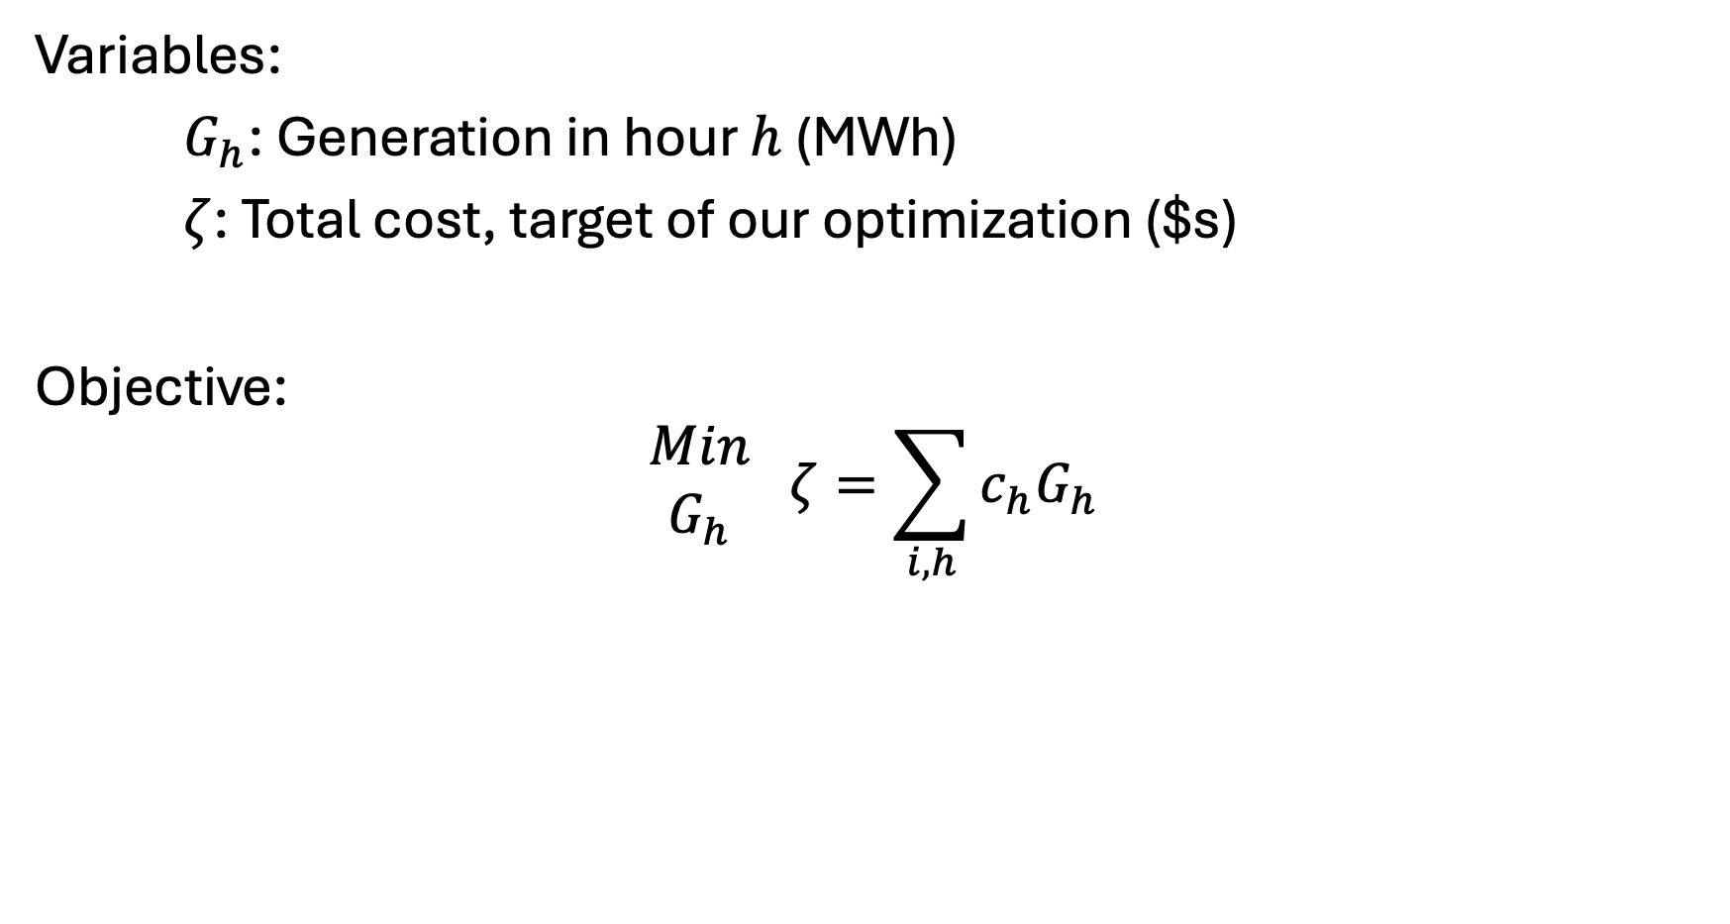
Elmo’s Electricity [III] – Variables and objective
Variables:
$G_{h}$: Generation in hour $h$ (MWh)
$ζ$: Total cost, target of our optimization ($s)
Objective:
$$\begin{matrix}Min \\ G_{h}\end{matrix} ζ=\sum_{i,h}{c_{h}G_{h}}$$

Slide 18
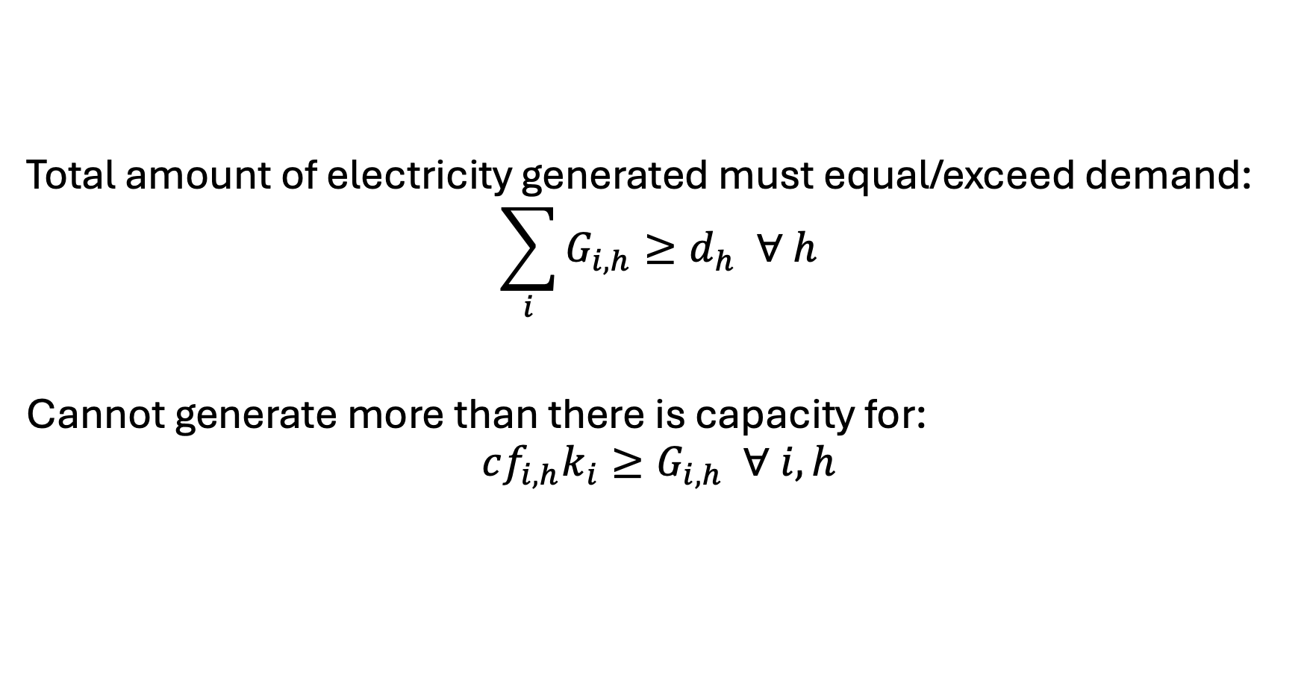
Elmo’s Electricity [IV] - Constraints
Total amount of electricity generated must equal/exceed demand:
$$\sum_{i}{G_{i,h}}≥d_{h} ∀ h$$
Cannot generate more than there is capacity for:
$$cf_{i,h}k_{i}≥G_{i,h} ∀ i,h$$

