Slide 1
EBGN645: Day 4

Slide 2
Questions
What is the purpose of the three programs we installed:
Git/GitHub Desktop, GAMS, VS Code
.. and how do they relate?
Recordings/file sharing

Slide 3
More unsolicited career advice
Negotiate – especially when first starting out
- Relative growth base
- Better opportunities
More flexibility in bigger companies, usually dealing with HR
If pay is non-negotiable, go for other benefits (e.g. PTO)
Three general areas:
Academia (less stress, less pay sometimes)
Government (medium stress, medium pay)
Industry (higher stress, higher pay)

Slide 4
Agenda
Reviewing GitHub
Practicing GAMS
Introducing time
(slightly) less simple example, introduction of conditionals
Restarts/saves
Debugging

Slide 5

Example 3: Franz Forestry
Franz owns land that produces lumber. Franz makes $100 net profit for every tree cut down. There is an initial stand of 100 trees and the trees grow at 1%* per year. Franz has a discount rate of 2%*. What is Franz profit-maximizing harvesting behavior?
*: Varied in counterfactuals

Slide 6

Franz Forestry [I] – sets and parameters
Set/Indices:
$t$: years, $t∈\{0,1,2,…T\}$
$t^{0}$: first year
$T$: last year
Parameters:
$p$: sale price ($/tree)
$g$: annual growth rate for trees (%) – $g≥1$
$s^{0}$: initial stock of trees (trees)
$r$: discount rate (%)
$δ_{t}$: discount factor (unitless)
$$δ_{t}=\frac{1}{{\left(1+r\right)}^{t}}$$

Slide 7
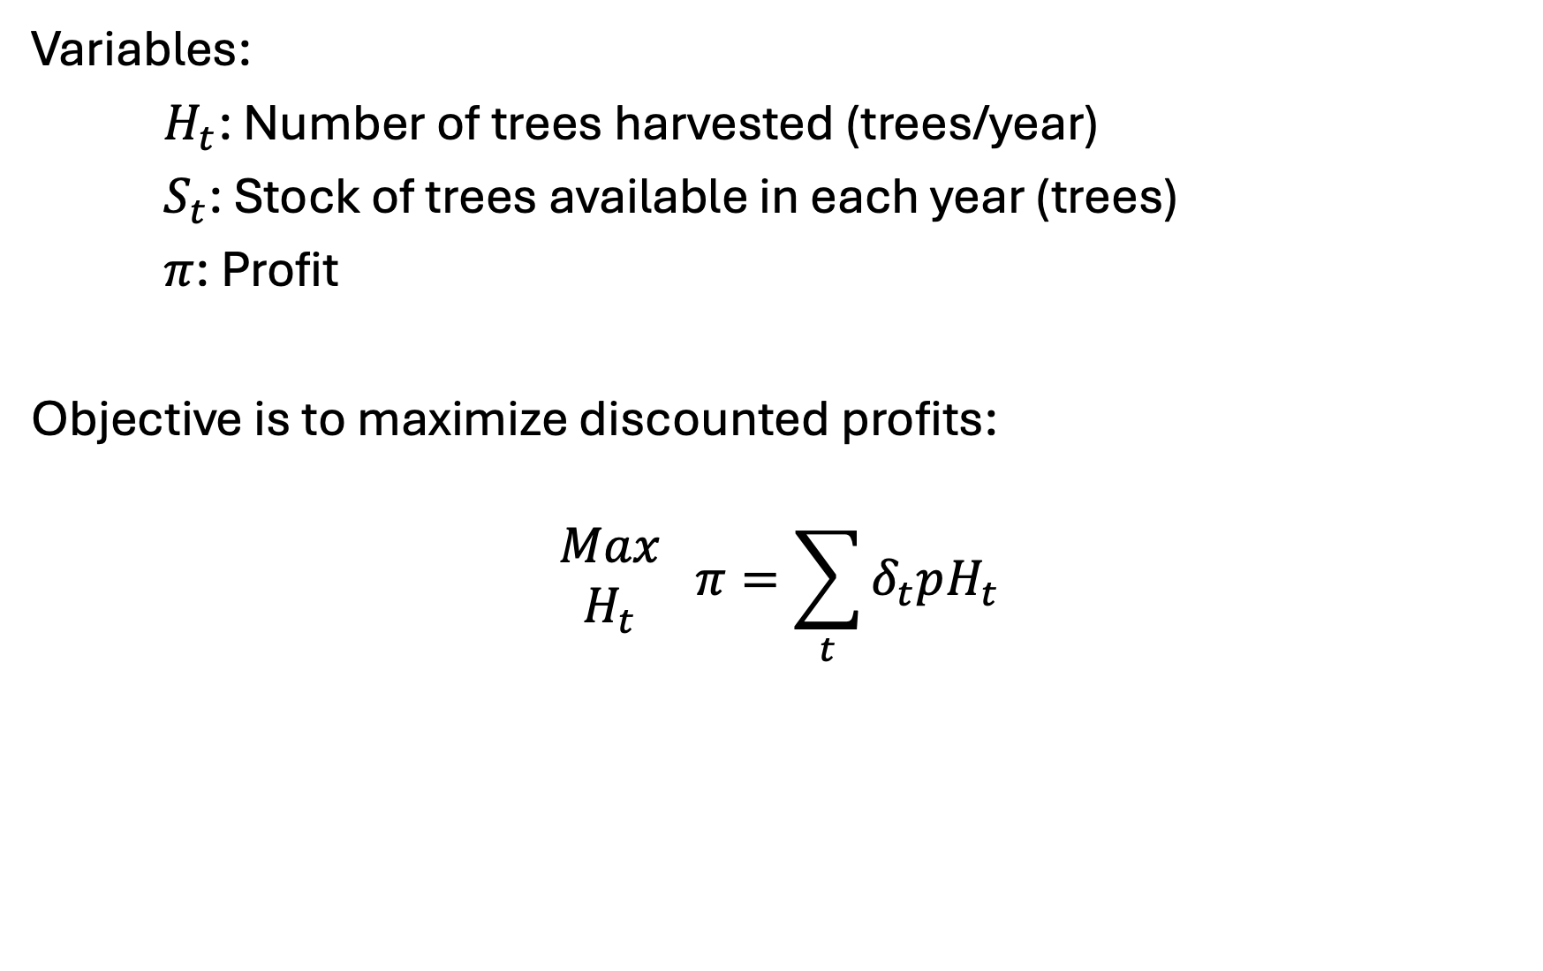
Franz Forestry [II] – variables and objective
Variables:
$H_{t}$: Number of trees harvested (trees/year)
$S_{t}$: Stock of trees available in each year (trees)
$π$: Profit
Objective is to maximize discounted profits:
$$\begin{matrix}Max \\ H_{t}\end{matrix} π=\sum_{t}{δ_{t}pH_{t}}$$

Slide 8
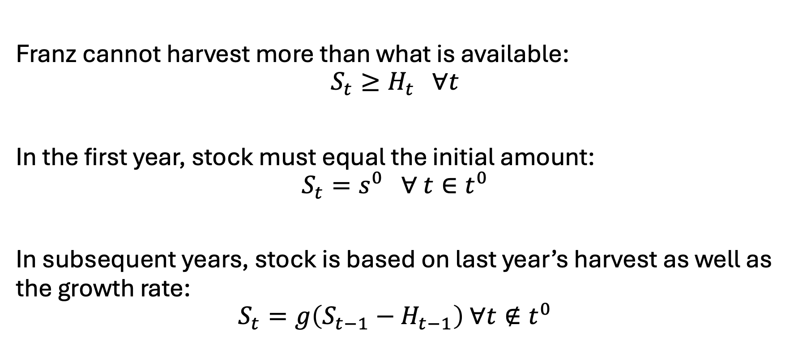
Franz Forestry [III] - constraints
Franz cannot harvest more than what is available:
$$S_{t}≥H_{t} ∀t$$
In the first year, stock must equal the initial amount:
$$S_{t}=s^{0} ∀ t∈t^{0}$$
In subsequent years, stock is based on last year’s harvest as well as the growth rate:
$$S_{t}=g\left(S_{t−1}−H_{t−1}\right) ∀t∉t^{0}$$

