Slide 1
EBGN645: Day 16
Lagrangians, duality, complementarity problems

Slide 2
Some notes
Class next week is cancelled
Will be sending around sign-up sheet for presentations this week
Homework 2 assigned

Slide 3
HW2 – Q1 (model and code)
Write out the indices, parameters, variables, objective function (if applicable), and constraints for your project
Make sure to explain the logic behind the objective function and constraints – I will not interpret your intended logic and will penalize any model descriptions not containing explanatory text
Code the model in the language of your choice – if needed, make heroic assumptions when/where necessary

Slide 4
HW2 – Q2 (data)
List out (at least two) data sources that are necessary for your project and describe how you will use them in 2-3 sentences each. Present at least one figure or table summarizing the data.
In addition, explain and document any assumptions necessary for your model – e.g. “I will assume that the elasticity of demand is -0.5, consistent with Brown et al. (2024)”

Slide 5
Agenda
Lagrangian derivation and explanation
Primal/dual formulation
… leading us to the world of MCP’s

Slide 6
The Lagrangian
Useful tool in optimization – converts a constrained problem into an unconstrained problem
Versatile – used in all fields
Very important to gain the intuition behind the Lagrangian multipliers
Will also be important to understand as we move towards duality

Slide 7
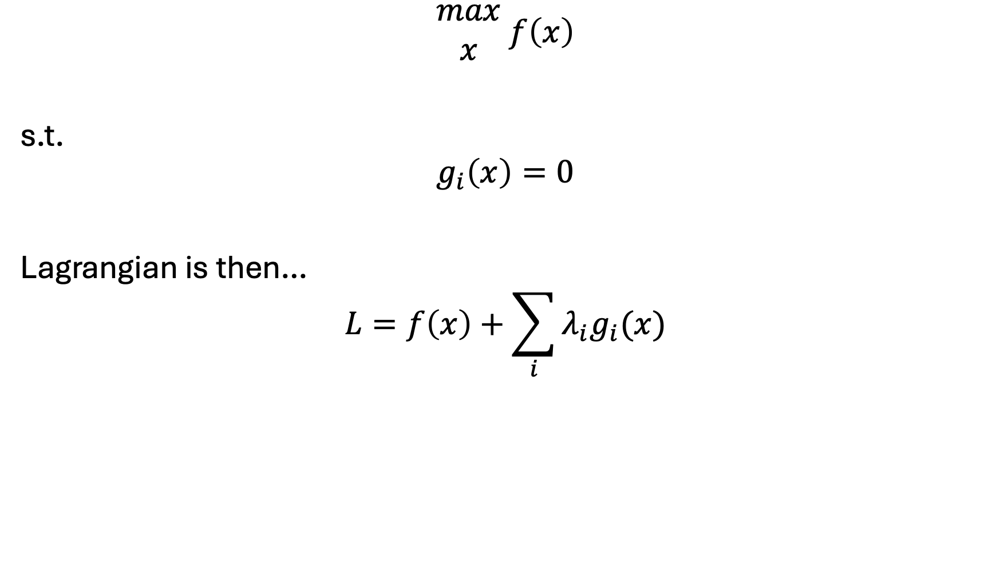
Simple setup for the Lagrangian…
$$\begin{matrix}max \\ x\end{matrix} f\left(x\right)$$
s.t.
$$g_{i}\left(x\right)=0$$
Lagrangian is then…
$$L=f\left(x\right)+\sum_{i}{λ_{i}g_{i}(x)}$$

Slide 8
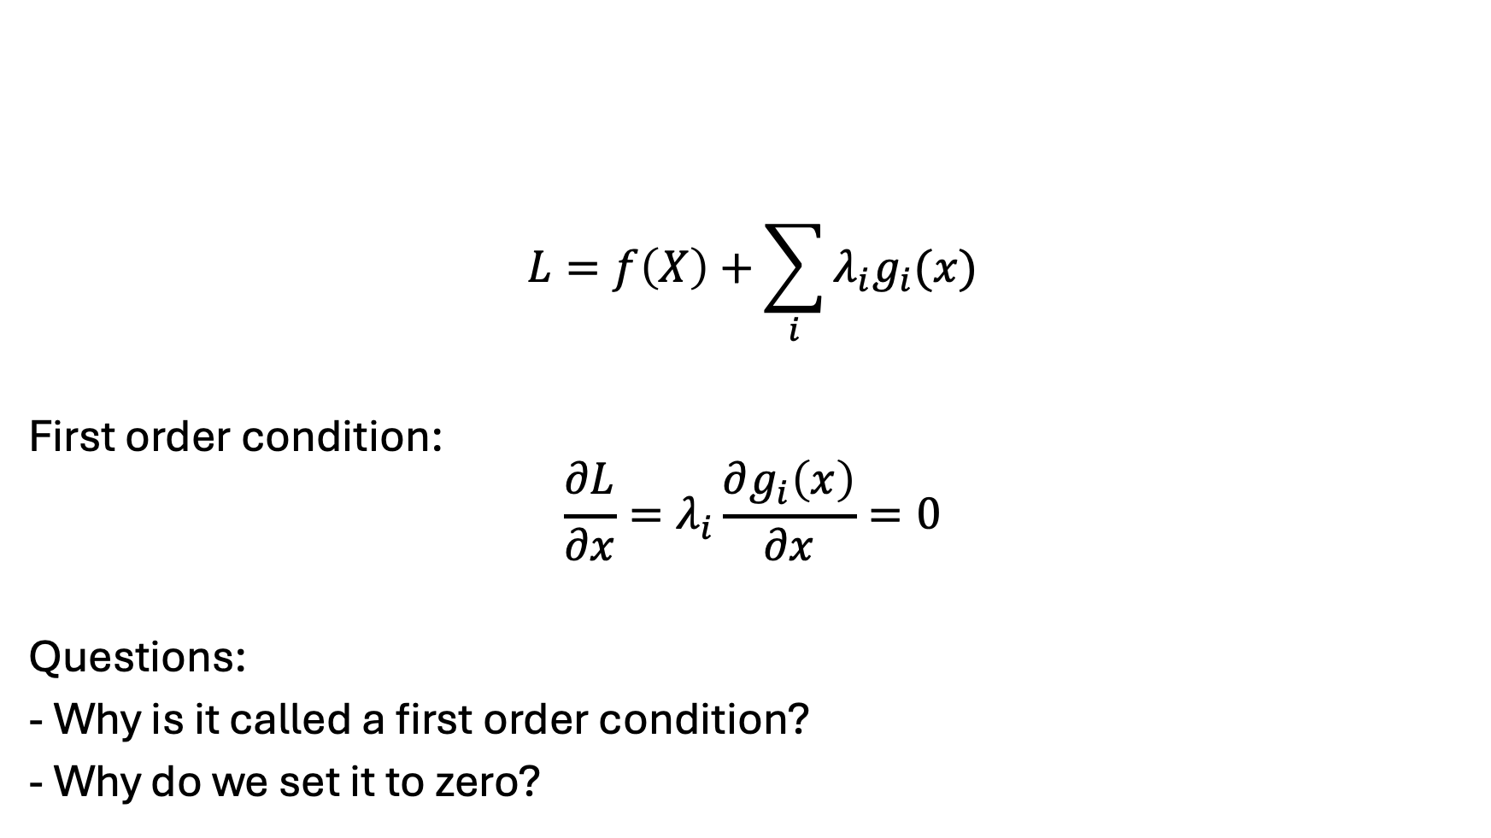
Conditions for optimality…
$$L=f\left(X\right)+\sum_{i}{λ_{i}g_{i}(x)}$$
First order condition:
$$\frac{∂L}{∂x}=λ_{i}\frac{∂g_{i}\left(x\right)}{∂x}=0$$
Questions:
- Why is it called a first order condition?
- Why do we set it to zero?
Notes:
Local extrema
Balancing of objective function and constraints

Slide 9

Units of shadow value
$$\frac{∂L}{∂x}=λ_{i}\frac{∂g_{i}\left(x\right)}{∂x}=0$$
Implies:
$$λ_{i}=\frac{\frac{∂L}{∂x}}{\frac{∂g_{i}\left(x\right)}{∂x}}$$
Change in the objective function value
Change in the limit implied by the constraint

Slide 10
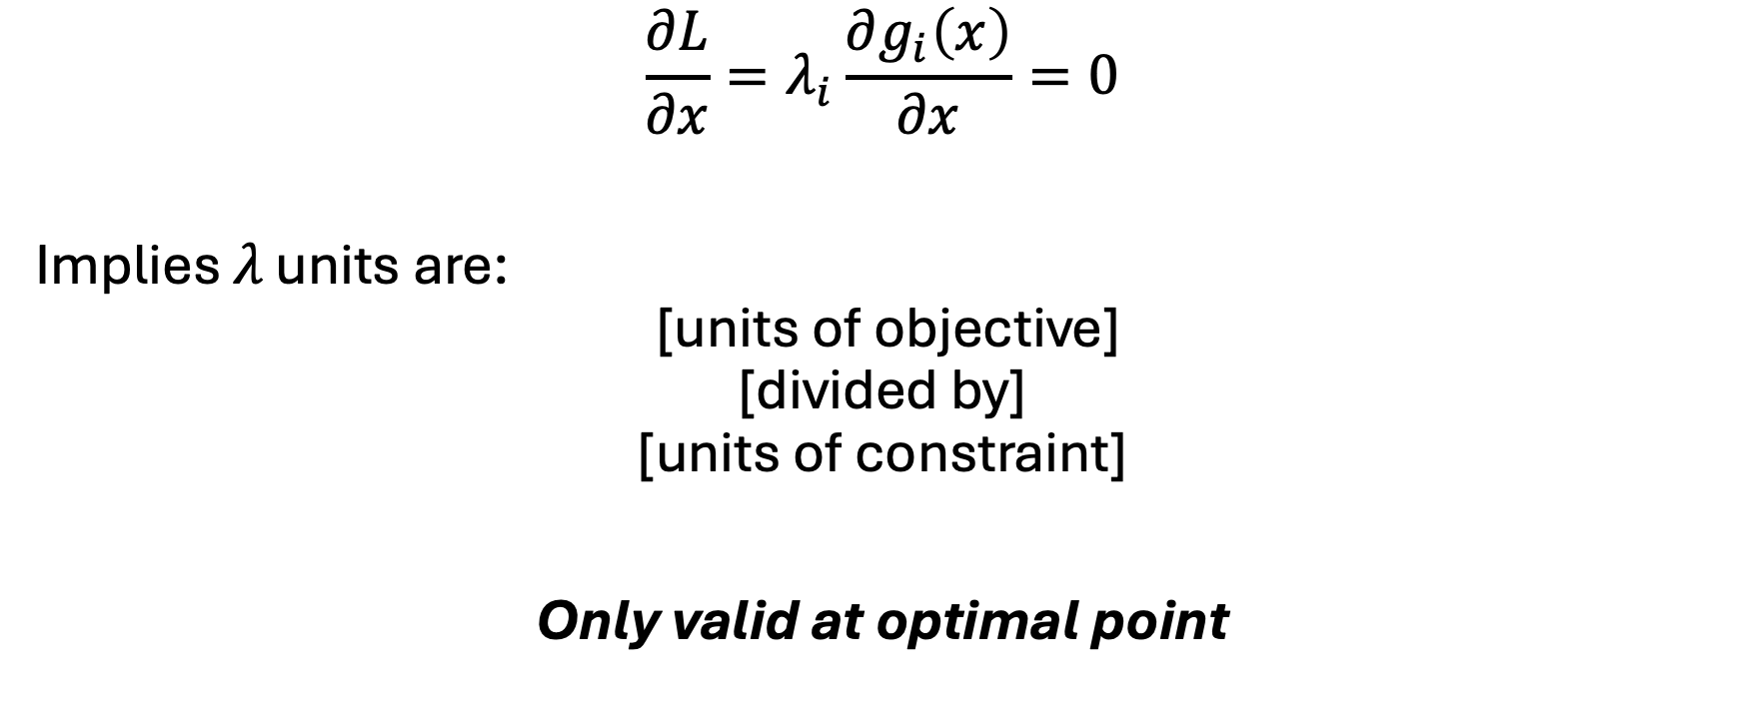
Units of shadow value
$$\frac{∂L}{∂x}=λ_{i}\frac{∂g_{i}\left(x\right)}{∂x}=0$$
Implies $λ \text{units} \text{are}\text{:}$
$$\text{ [}\text{units} \text{of} \text{objective}\text{]}$$
$$\text{[}\text{divided} \text{by}\text{]}$$
$$\text{[}\text{units} \text{of} \text{constraint}\text{]}$$
Only valid at optimal point

Slide 11


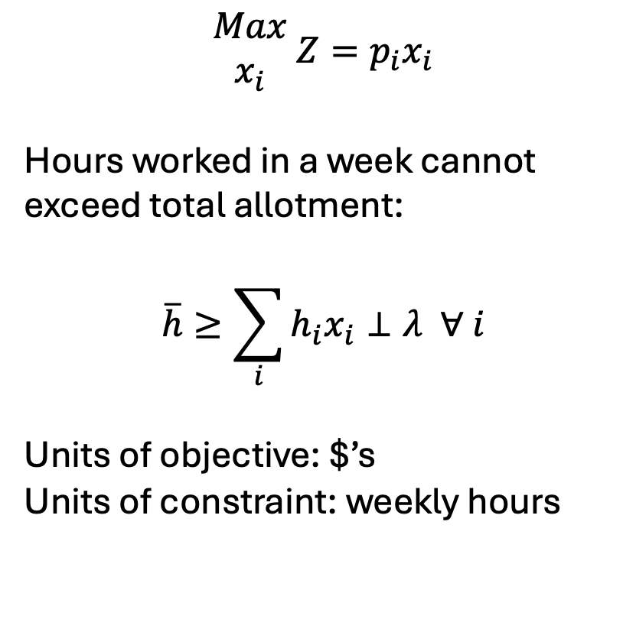
Example translation of $λ$
Indices
$i$: product sold
Parameters:
$p_{i}$: net revenue ($ / product)
$h_{i}$: hours per product
$\overline{h}$: weekly hourly limit
Variables:
$Z$: Total profit ($s)
$x_{i}$: production of $i$ (product)
$$\begin{matrix}Max \\ x_{i}\end{matrix} {Z=p}_{i}x_{i}$$
Hours worked in a week cannot exceed total allotment:
$$\overline{h}≥\sum_{i}{h_{i}x_{i}}⊥λ ∀ i$$
Units of objective: $’s
Units of constraint: weekly hours
$λ$ thus represents the change in total profits given a change in the weekly hours
“What is the change in profits with increasing my total hours worked by 1 hour?”

Slide 12
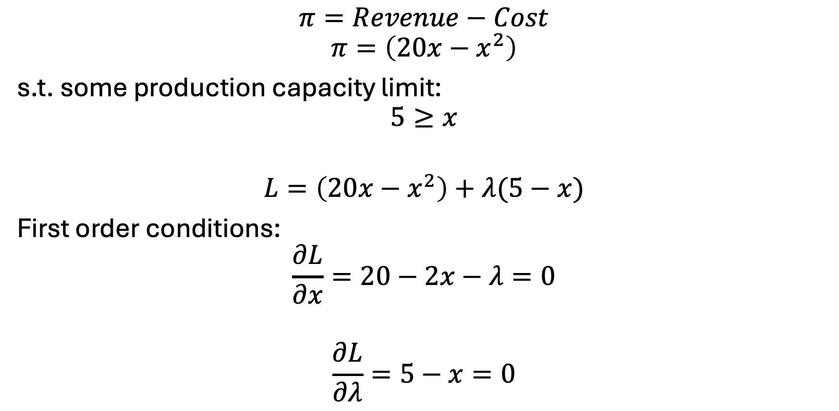
A simple example
$$π=Revenue−Cost$$
$$π=\left(20x−x^{2}\right)$$
s.t. some production capacity limit:
$$5≥x$$
$$L=\left(20x−x^{2}\right)+λ(5−x)$$
First order conditions:
$$\frac{∂L}{∂x}=20−2x−λ=0$$
$$\frac{∂L}{∂λ}=5−x=0$$

Slide 13
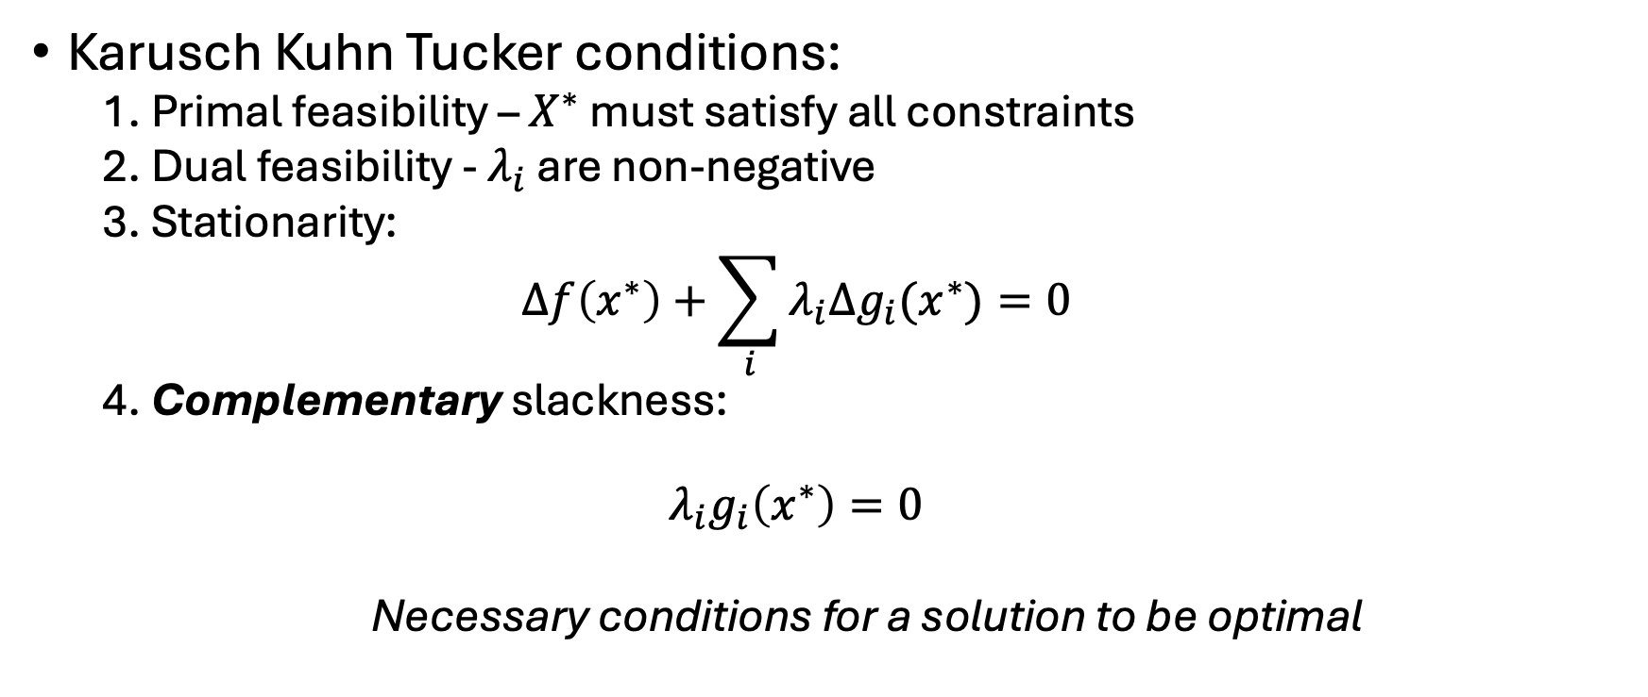
Summary of KKT conditions
Karusch Kuhn Tucker conditions:
1. Primal feasibility – $X^{∗}$ must satisfy all constraints
2. Dual feasibility - $λ_{i}$ are non-negative
3. Stationarity:
$$Δf\left(x^{∗}\right)+\sum_{i}{λ_{i}Δg_{i}(x^{∗})}=0$$
4. Complementary slackness:
$$λ_{i}g_{i}\left(x^{∗}\right)=0$$
Necessary conditions for a solution to be optimal

Slide 14
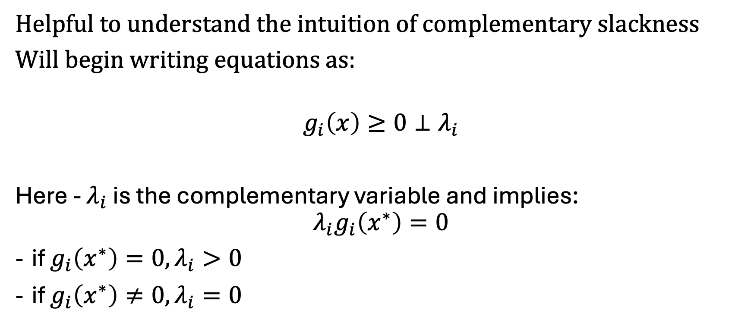
A new way to write constraints…
Helpful to understand the intuition of complementary slackness
Will begin writing equations as:
$$g_{i}\left(x\right)≥0⊥λ_{i}$$
Here - $λ_{i}$ is the complementary variable and implies:
$$λ_{i}g_{i}\left(x^{∗}\right)=0$$
if $g_{i}\left(x^{∗}\right)=0, λ_{i}>0$
if $g_{i}\left(x^{∗}\right)≠0, λ_{i}=0$

Slide 15
Duality introduction
Always two types of problems:
Primal: your original optimization problem
Dual: an equivalent problem
Why do we care?
Complementarity problems remove the objective function(s) entirely
Rely on casting the problem in both primal and dual forms
I like to think of this as simultaneously representing both the physical (primal) and market (dual) problems

Slide 16
Duality – another perspective
Can think of the primal problem as the way in which we allocate resources – then the dual problem is how to allocate costs and/or values to those resources
Thus – dual can be thought of as the ‘worth’ of the constraints
Often call the dual constraints "zero profit conditions”

Slide 17

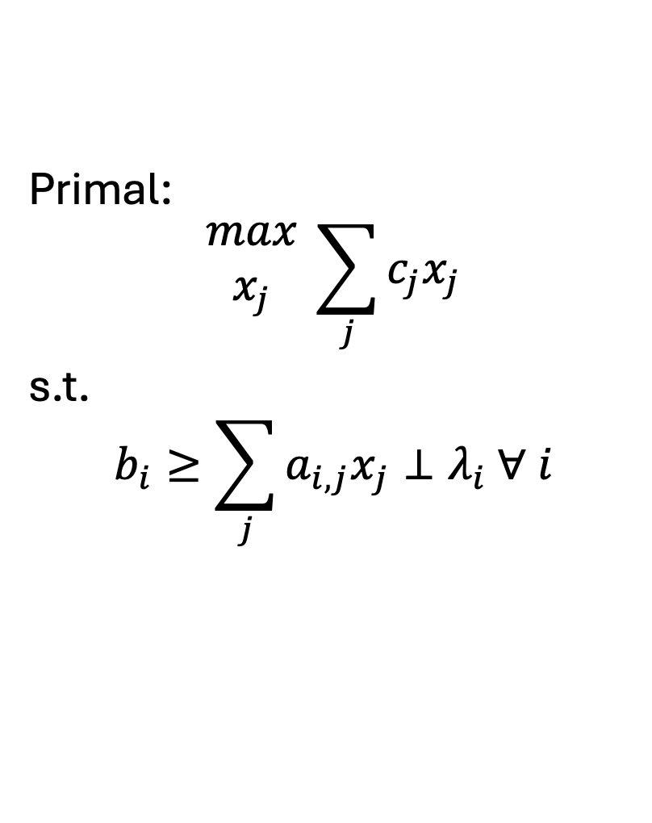
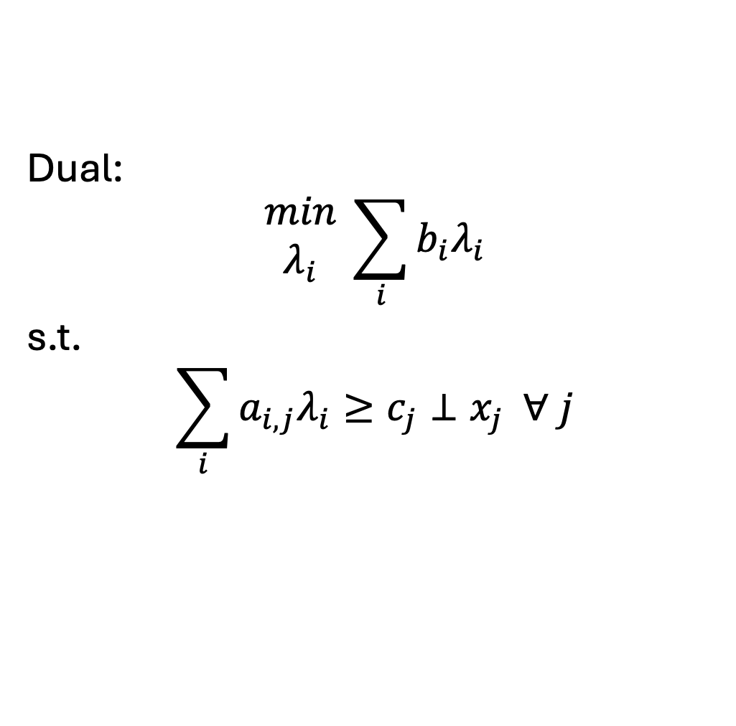
Formulating the dual..
$i$: # constraints
$j$: # variables
Primal:
$$\begin{matrix}max \\ x_{j}\end{matrix} \sum_{j}{c_{j}x_{j}}$$
s.t.
$$b_{i}≥\sum_{j}{a_{i,j}x_{j}}⊥λ_{i} ∀ i$$
Dual:
$$\begin{matrix}min \\ λ_{i}\end{matrix} \sum_{i}{b_{i}λ_{i}}$$
s.t.
$$\sum_{i}{a_{i,j}λ_{i}}≥c_{j}⊥x_{j} ∀ j$$

Slide 18
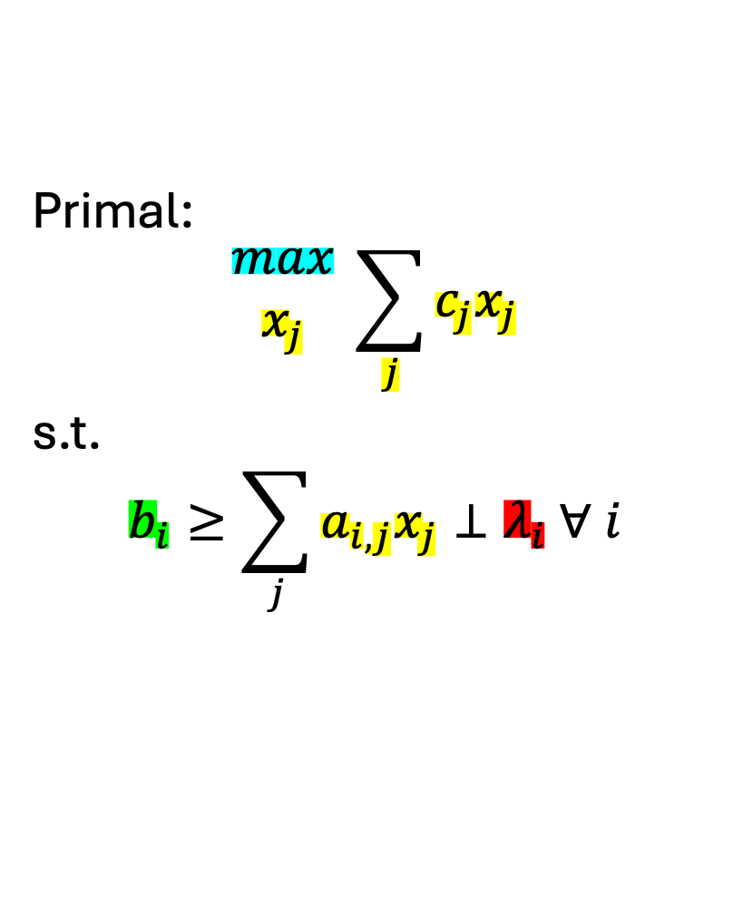
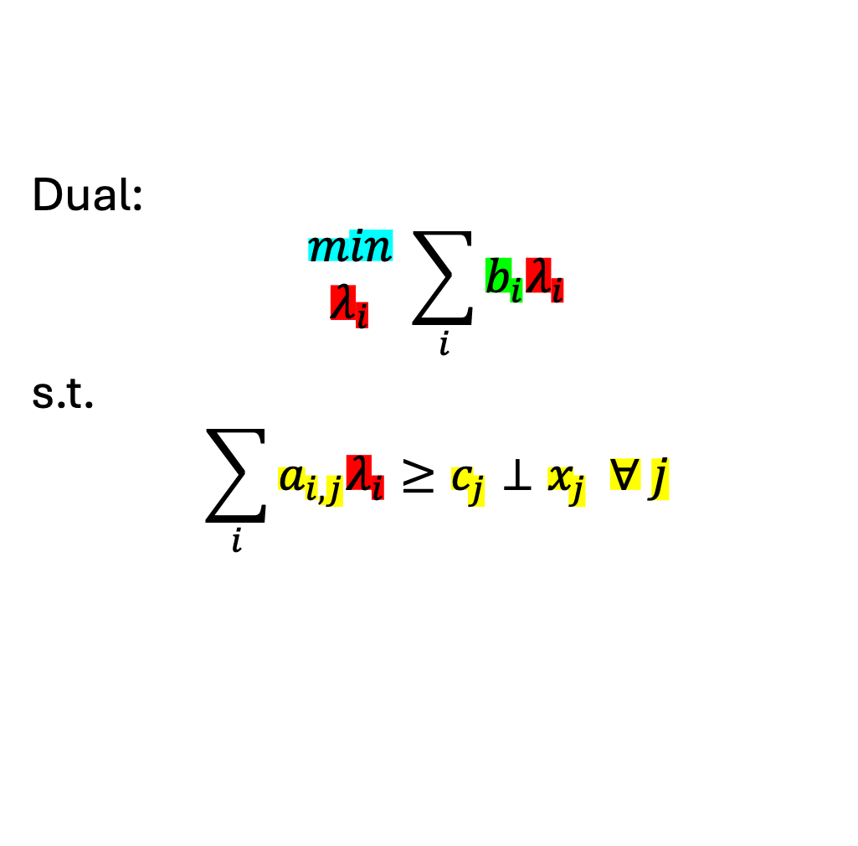
Formulating the dual..
$i$: # constraints
$j$: # variables
Primal:
$$\begin{matrix}max \\ x_{j}\end{matrix} \sum_{j}{c_{j}x_{j}}$$
s.t.
$$b_{i}≥\sum_{j}{a_{i,j}x_{j}}⊥λ_{i} ∀ i$$
Dual:
$$\begin{matrix}min \\ λ_{i}\end{matrix} \sum_{i}{b_{i}λ_{i}}$$
s.t.
$$\sum_{i}{a_{i,j}λ_{i}}≥c_{j}⊥x_{j} ∀ j$$

Slide 19
Indices of the shadow value variable will always match the dimensions of its primal constraint – this also implies conditionals on the primal constraint indices need to be applied to the dual variable

Slide 20
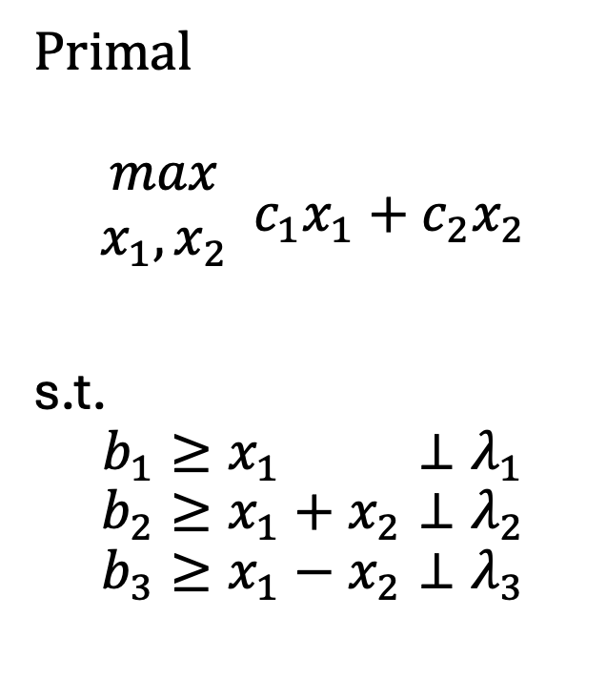
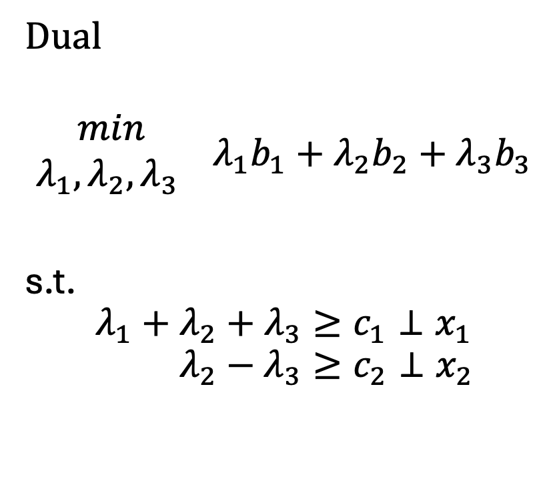
A very simple example
Primal
$$\begin{matrix}max \\ x_{1},x_{2}\end{matrix} c_{1}x_{1}+c_{2}x_{2}$$
s.t.
$$b_{1}≥x_{1} ⊥λ_{1}$$
$$b_{2}≥x_{1}+x_{2}⊥λ_{2}$$
$$b_{3}≥x_{1}−x_{2}⊥λ_{3}$$
Dual
$$\begin{matrix}min \\ λ_{1},λ_{2},λ_{3} \end{matrix} λ_{1}b_{1}+λ_{2}b_{2}+λ_{3}b_{3}$$
s.t.
$${λ_{1}+λ_{2}+λ_{3}≥c}_{1}⊥x_{1}$$
$$λ_{2}−λ_{3}≥c_{2}⊥x_{2}$$
1 | 1 | 1
0 | 1 | -1
1 | 0
1 | 1
1 | -1

Slide 21
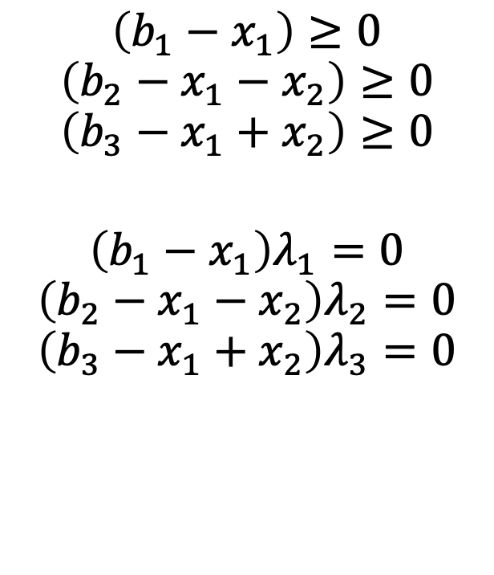

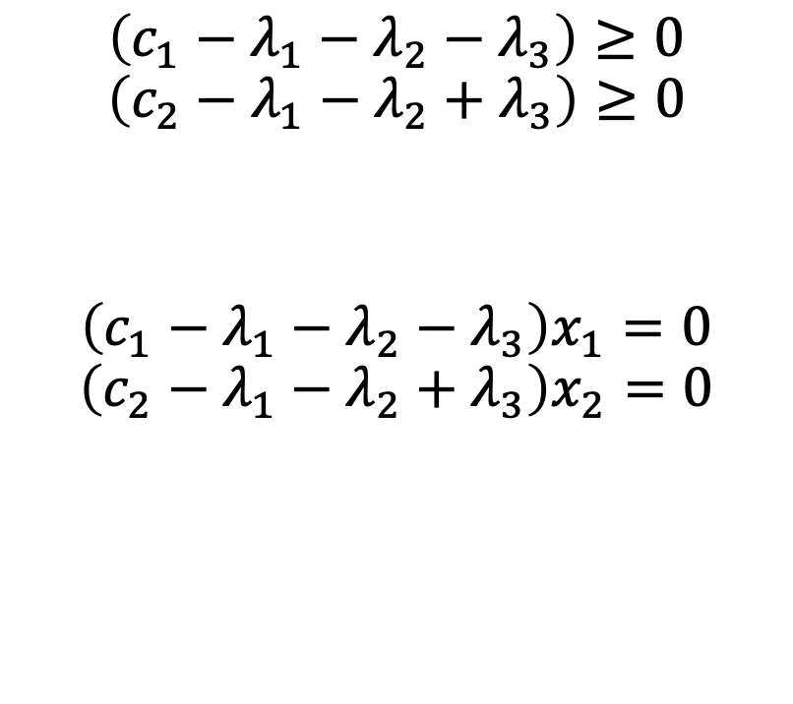
Complementarity conditions
$$\left(b_{1}−x_{1}\right)≥0$$
$$\left(b_{2}−x_{1}−x_{2}\right)≥0$$
$$\left(b_{3}−x_{1}+x_{2}\right)≥0$$
$$\left(b_{1}−x_{1}\right)λ_{1}=0$$
$$\left(b_{2}−x_{1}−x_{2}\right)λ_{2}=0$$
$$\left(b_{3}−x_{1}+x_{2}\right)λ_{3}=0$$
$$\left(c_{1}−λ_{1}−λ_{2}−λ_{3}\right)≥0$$
$$\left(c_{2}−λ_{1}−λ_{2}+λ_{3}\right)≥0$$
$$\left(c_{1}−λ_{1}−λ_{2}−λ_{3}\right)x_{1}=0$$
$$\left(c_{2}−λ_{1}−λ_{2}+λ_{3}\right)x_{2}=0$$
$$x_{1},x_{2}≥0$$
$$λ_{1},λ_{2},λ_{3}≥0$$

Slide 22

He’s back

Slide 23
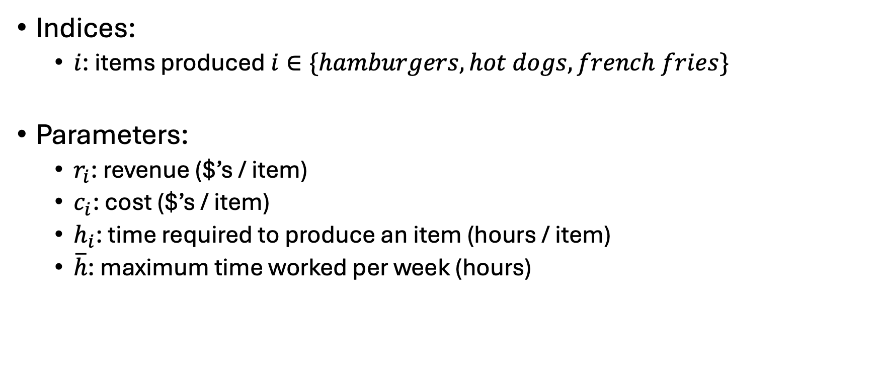
Ripley’s restaurant
Indices:
$i$: items produced $i∈\{hamburgers, hot dogs, french fries\}$
Parameters:
$r_{i}$: revenue ($’s / item)
$c_{i}$: cost ($’s / item)
$h_{i}$: time required to produce an item (hours / item)
$\overline{h}$: maximum time worked per week (hours)
Item | Revenue | Cost | Hours
Hamburger | 1.5 | 0.75 | 0.5
Hot dog | 0.75 | 0.1 | 0.2
French fries | 0.25 | 0.05 | 0.1

Slide 24
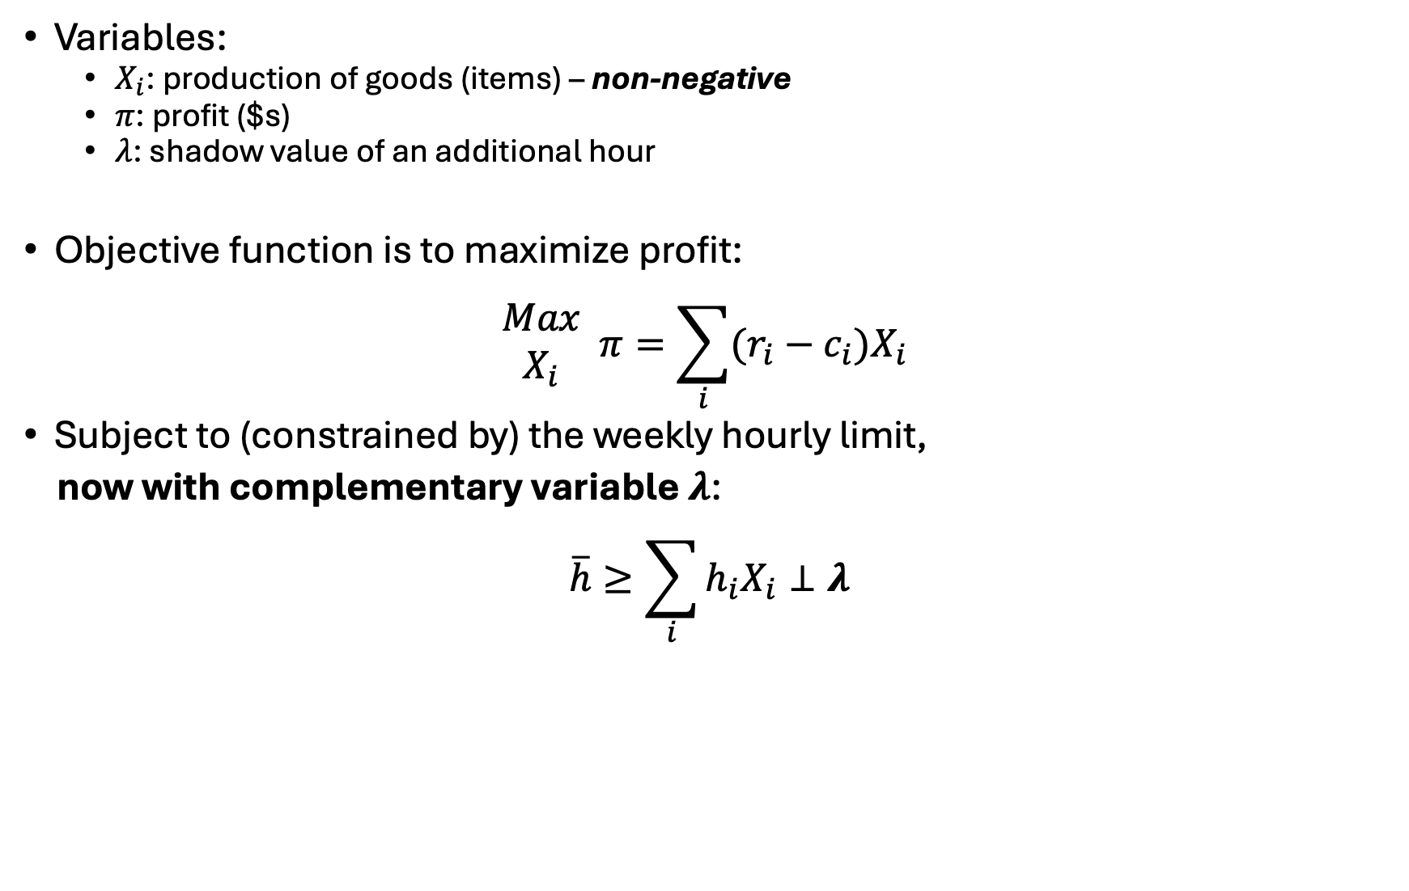
Ripley’s restaurant
Variables:
$X_{i}$: production of goods (items) – non-negative
$π$: profit ($s)
$λ$: shadow value of an additional hour
Objective function is to maximize profit:
$$\begin{matrix}Max \\ X_{i}\end{matrix} π=\sum_{i}{(r_{i}−c_{i})X_{i}}$$
Subject to (constrained by) the weekly hourly limit,
now with complementary variable $λ$:
$$\overline{h}≥\sum_{i}{h_{i}X_{i}}⊥λ$$

Slide 25
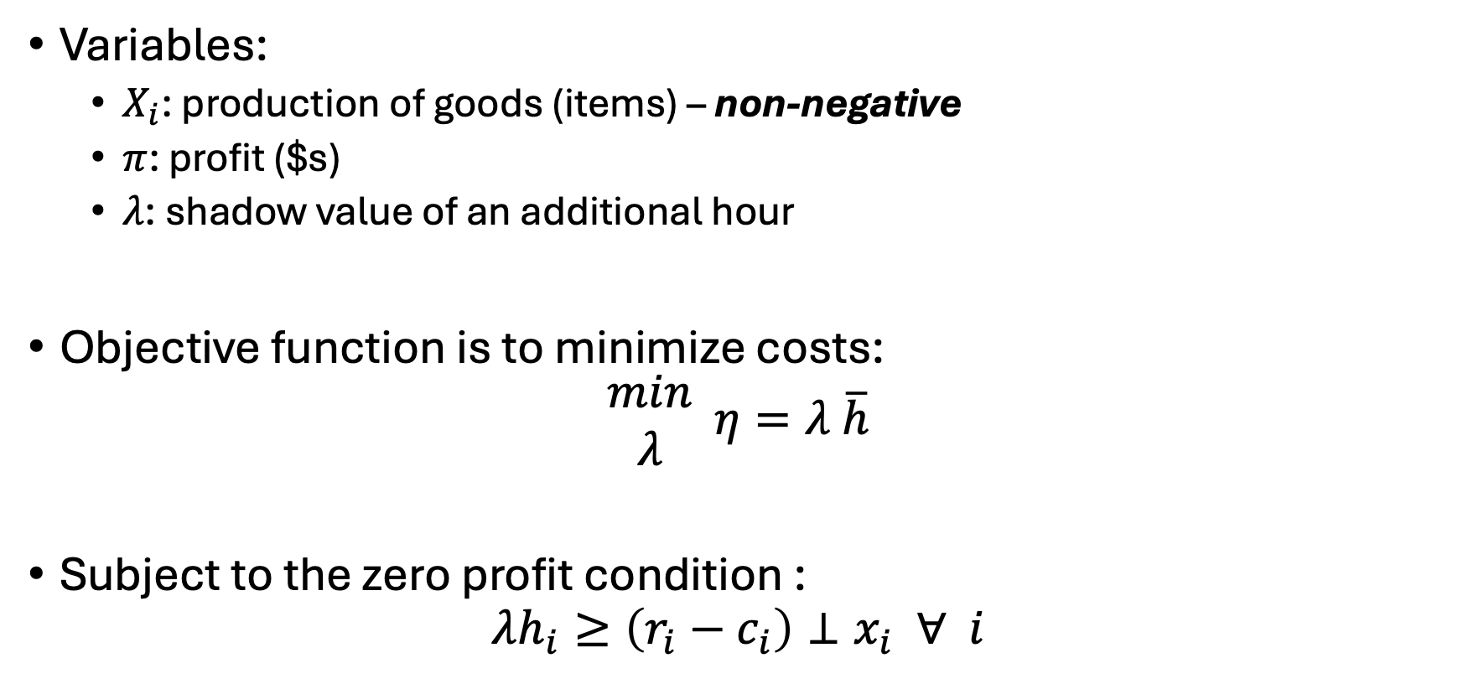
Ripley’s restaurant – the dual
Variables:
$X_{i}$: production of goods (items) – non-negative
$π$: profit ($s)
$λ$: shadow value of an additional hour
Objective function is to minimize costs:
$$\begin{matrix}min \\ λ\end{matrix} η=λ \overline{h}$$
Subject to the zero profit condition :
$$λh_{i}≥\left(r_{i}−c_{i}\right)⊥x_{i} ∀ i$$

Slide 26

Let’s code this up in GAMS
How do we know if our dual formulation is correct?
$$Z^{primal}=Z^{dual}$$
$$\frac{∂Z^{primal}}{∂\overline{h}}=λ$$
(sometimes $..=−λ$)

Slide 27
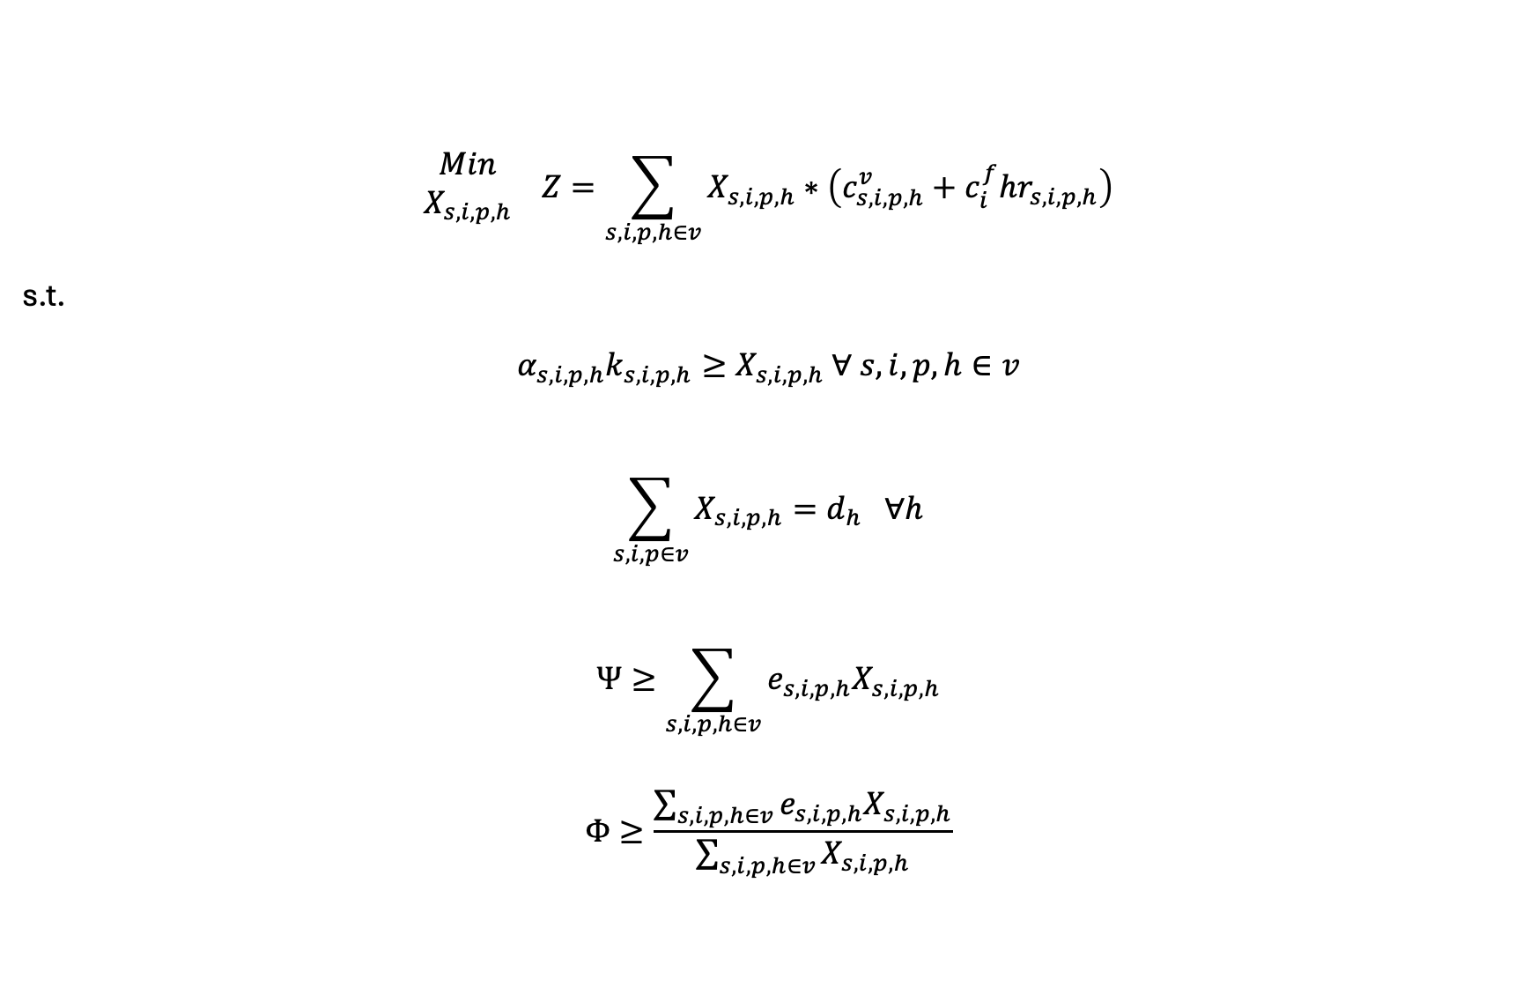
What about our simple electricity model?
$$\begin{matrix}Min \\ X_{s,i,p,h}\end{matrix} Z=\sum_{s,i,p,h∈v}{X_{s,i,p,h}}∗\left(c_{s,i,p,h}^{v}+c_{i}^{f}hr_{s,i,p,h}\right)$$
s.t.
$$α_{s,i,p,h}k_{s,i,p,h}≥X_{s,i,p,h} ∀ s,i,p,h∈v$$
$$\sum_{s,i,p∈v}{X_{s,i,p,h}}=d_{h} ∀h$$
$$Ψ≥\sum_{s,i,p,h∈v}{e_{s,i,p,h}X_{s,i,p,h}}$$
$$Φ≥\frac{\sum_{s,i,p,h∈v}{e_{s,i,p,h}X_{s,i,p,h}}}{\sum_{s,i,p,h∈v}{X_{s,i,p,h}}}$$

Slide 28
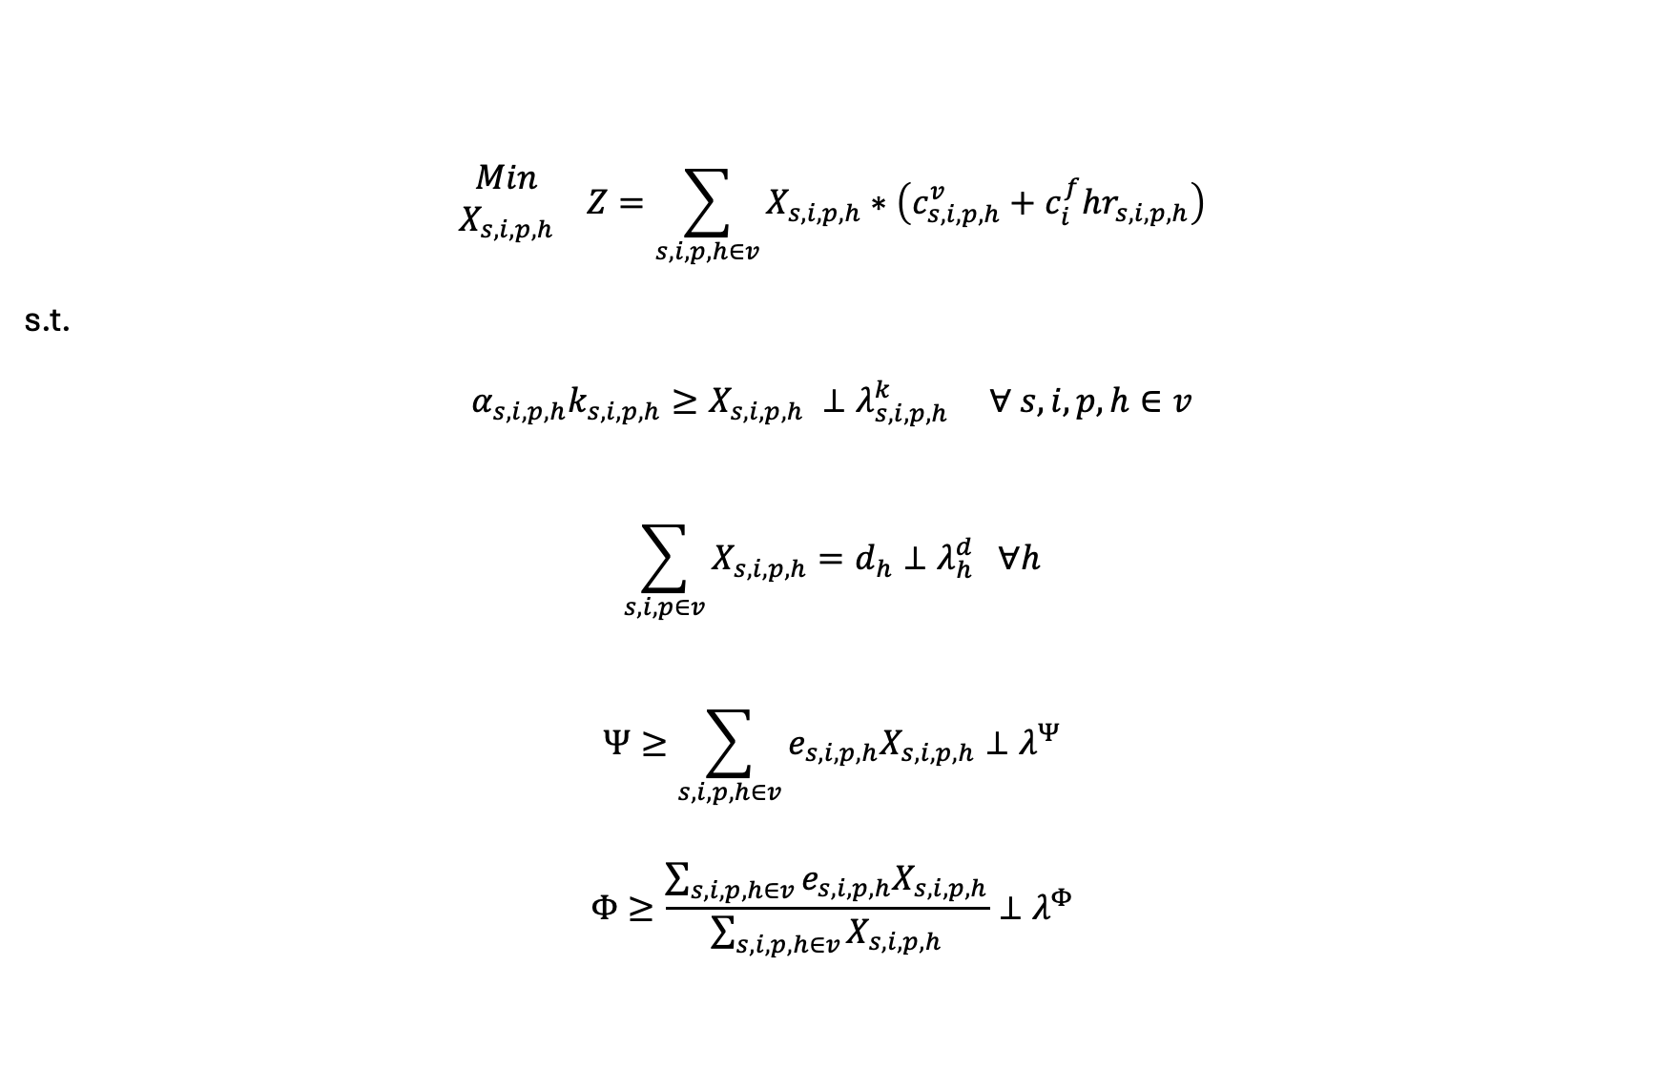
Let’s interpret these shadow values…
$$\begin{matrix}Min \\ X_{s,i,p,h}\end{matrix} Z=\sum_{s,i,p,h∈v}{X_{s,i,p,h}}∗\left(c_{s,i,p,h}^{v}+c_{i}^{f}hr_{s,i,p,h}\right)$$
s.t.
$$α_{s,i,p,h}k_{s,i,p,h}≥X_{s,i,p,h} ⊥λ_{s,i,p,h}^{k} ∀ s,i,p,h∈v$$
$$\sum_{s,i,p∈v}{X_{s,i,p,h}}=d_{h}⊥λ_{h}^{d} ∀h$$
$$Ψ≥\sum_{s,i,p,h∈v}{e_{s,i,p,h}X_{s,i,p,h}}⊥λ^{Ψ}$$
$$Φ≥\frac{\sum_{s,i,p,h∈v}{e_{s,i,p,h}X_{s,i,p,h}}}{\sum_{s,i,p,h∈v}{X_{s,i,p,h}}}⊥λ^{Φ}$$

Slide 29

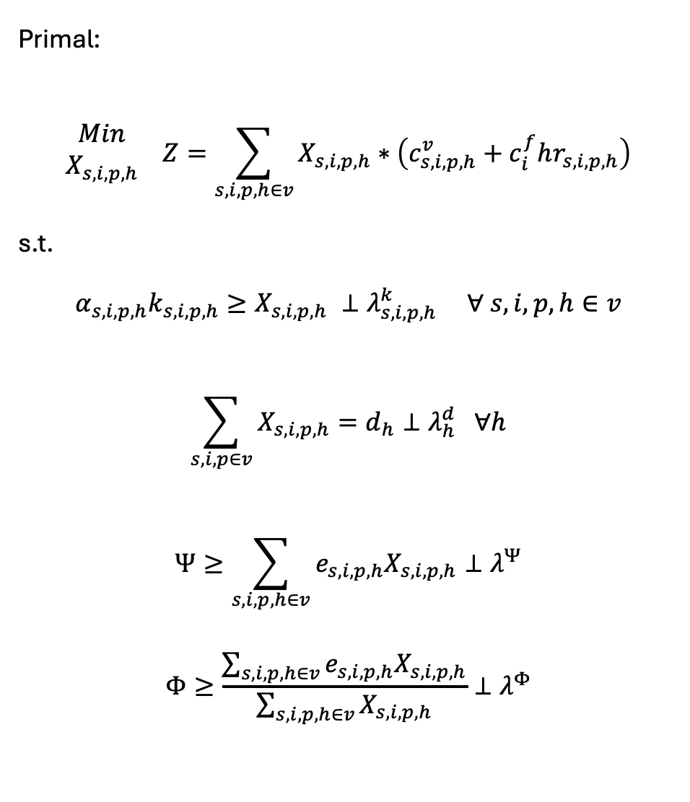
Primal:
$$\begin{matrix}Min \\ X_{s,i,p,h}\end{matrix} Z=\sum_{s,i,p,h∈v}{X_{s,i,p,h}}∗\left(c_{s,i,p,h}^{v}+c_{i}^{f}hr_{s,i,p,h}\right)$$
s.t.
$$α_{s,i,p,h}k_{s,i,p,h}≥X_{s,i,p,h} ⊥λ_{s,i,p,h}^{k} ∀ s,i,p,h∈v$$
$$\sum_{s,i,p∈v}{X_{s,i,p,h}}=d_{h}⊥λ_{h}^{d} ∀h$$
$$Ψ≥\sum_{s,i,p,h∈v}{e_{s,i,p,h}X_{s,i,p,h}}⊥λ^{Ψ}$$
$$Φ≥\frac{\sum_{s,i,p,h∈v}{e_{s,i,p,h}X_{s,i,p,h}}}{\sum_{s,i,p,h∈v}{X_{s,i,p,h}}}⊥λ^{Φ}$$
Dual:
$$\begin{matrix}Max \\ λ_{s,i,p,h}^{k},λ_{h}^{d},λ^{Ψ},λ^{Φ}\end{matrix} η=\sum_{h}{λ_{h}^{d}d_{h}}$$
$$−\sum_{s,i,p,h∈v}{λ_{s,i,p,h}^{k}α_{s,i,p,h}k_{s,i,p,h}}$$
$$−λ^{Ψ}Ψ−λ^{Φ}Φ$$
s.t.
$${ c}_{s,i,p,h}^{v}+c_{i}^{f}hr_{s,i,p,h}+λ_{s,i,p,h}^{k}$$
$$+ e_{s, i,p,h}λ^{Ψ}+λ^{Φ}\left(e_{s,i,p,h}−Ψ\right)$$
$$≥λ_{h}^{d}⊥X_{s, i,p,h} ∀ s,i,p,h∈v$$

Slide 30
Complementarity Problems
Complementarity problems start with the primal and dual constraints and remove the objective functions
Specific types but -almost- always referred to in practice as Mixed Complementarity Problems (MCPs).. All types:
Linear Complementarity Problems (LCPs)
Non-linear Complementarity Problems (NLCPs)
Both non-linear and linear complementarity problems are mixed (MCPs)
Also: integer, others..

Slide 31
Complementarity conditions
$$\left(b_{1}−x_{1}\right)≥0$$
$$\left(b_{2}−x_{1}−x_{2}\right)≥0$$
$$\left(b_{3}−x_{1}+x_{2}\right)≥0$$
$$\left(b_{1}−x_{1}\right)λ_{1}=0$$
$$\left(b_{2}−x_{1}−x_{2}\right)λ_{2}=0$$
$$\left(b_{3}−x_{1}+x_{2}\right)λ_{3}=0$$
$$\left(c_{1}−λ_{1}−λ_{2}−λ_{3}\right)≥0$$
$$\left(c_{2}−λ_{1}−λ_{2}+λ_{3}\right)≥0$$
$$\left(c_{1}−λ_{1}−λ_{2}−λ_{3}\right)x_{1}=0$$
$$\left(c_{2}−λ_{1}−λ_{2}+λ_{3}\right)x_{2}=0$$
$$x_{1},x_{2}≥0$$
$$λ_{1},λ_{2},λ_{3}≥0$$

Slide 32

A good book..

