Slide 1
EBGN645: Day 18
The Lagrangian, duality, and complementarity problems

Slide 2
HW2
Due Wednesday

Slide 3
Note: Project scheduling is live
You do not need final results – you should plan to discuss:
What is your research question?
Why is this research important?
How did you formulate your model?
What are the important assumptions/data?
What are your (anticipated/final) results?
What conclusions can you (hope to) draw from the work?
If you had unlimited time/money/energy, what would this project look like?
Presentations should be ~10-12 minutes

Slide 4
Agenda
Review of…
Lagrangian derivation and explanation
Primal/dual formulation
Leading us to the world of MCP’s
Simple example using Ripley’s restaurant
More complicated with electricity dispatch
Optional – can present INFORMS slides

Slide 5
The Lagrangian
Useful tool in optimization – converts a constrained problem into an unconstrained problem
Versatile – used in all fields
Very important to gain the intuition behind the Lagrangian multipliers
Will also be important to understand as we move towards duality

Slide 6
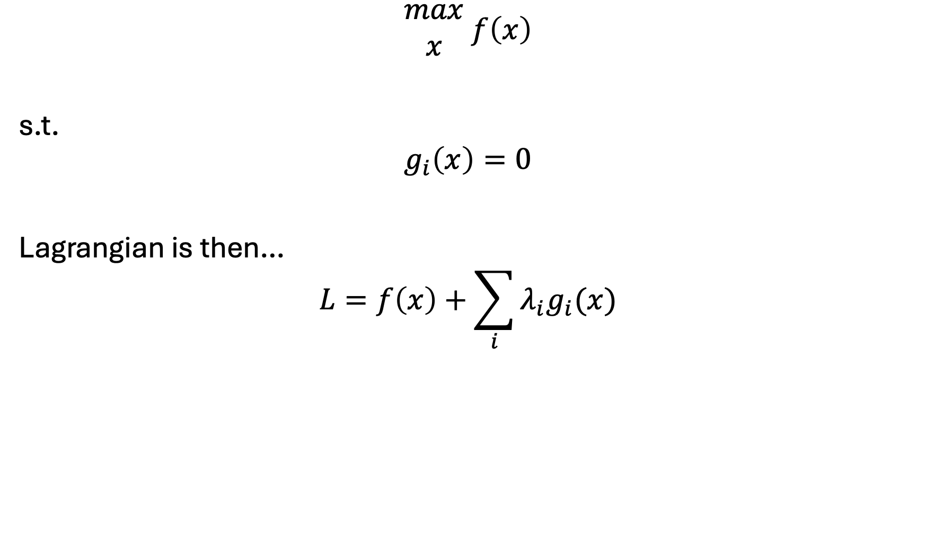
Simple setup for the Lagrangian…
$$\begin{matrix}max \\ x\end{matrix} f\left(x\right)$$
s.t.
$$g_{i}\left(x\right)=0$$
Lagrangian is then…
$$L=f\left(x\right)+\sum_{i}{λ_{i}g_{i}(x)}$$

Slide 7
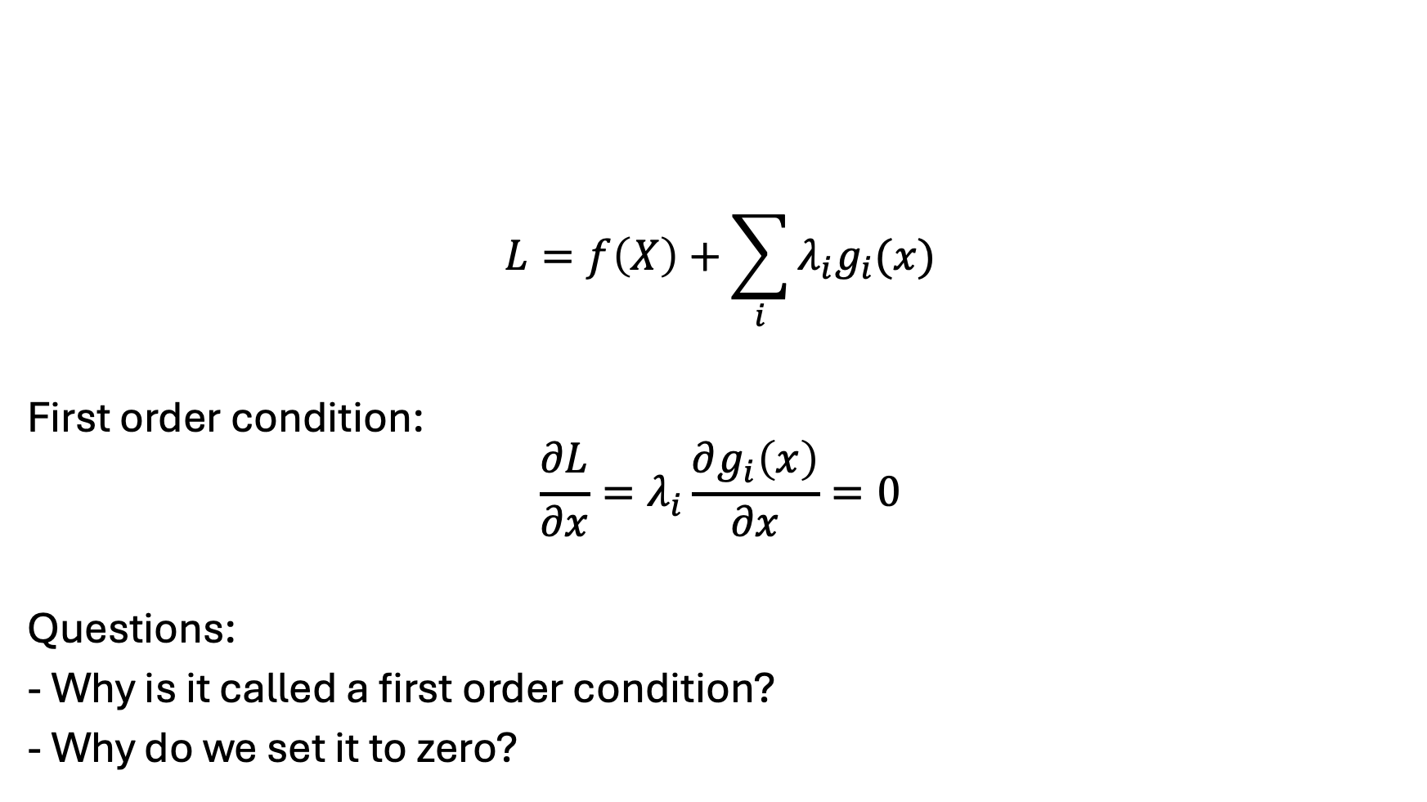
Conditions for optimality…
$$L=f\left(X\right)+\sum_{i}{λ_{i}g_{i}(x)}$$
First order condition:
$$\frac{∂L}{∂x}=λ_{i}\frac{∂g_{i}\left(x\right)}{∂x}=0$$
Questions:
- Why is it called a first order condition?
- Why do we set it to zero?
Notes:
Local extrema
Balancing of objective function and constraints

Slide 8

Units of shadow value
$$\frac{∂L}{∂x}=f^{′}\left(x\right)+λ_{i}\frac{∂g_{i}\left(x\right)}{∂x}=0$$
Implies:
$$λ_{i}=\frac{\frac{∂L}{∂x}}{\frac{∂g_{i}\left(x\right)}{∂x}}$$
Change in the objective function value
Change in the limit implied by the constraint

Slide 9
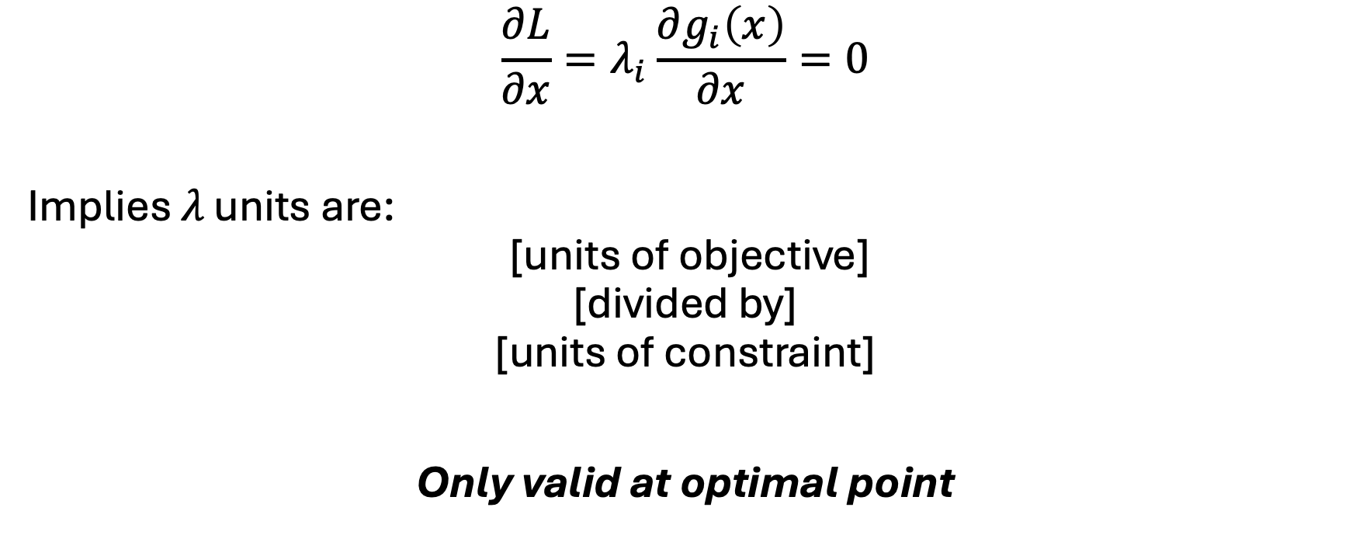
Units of shadow value
$$\frac{∂L}{∂x}=λ_{i}\frac{∂g_{i}\left(x\right)}{∂x}=0$$
Implies $λ \text{units} \text{are}\text{:}$
$$\text{ [}\text{units} \text{of} \text{objective}\text{]}$$
$$\text{[}\text{divided} \text{by}\text{]}$$
$$\text{[}\text{units} \text{of} \text{constraint}\text{]}$$
Only valid at optimal point

Slide 10


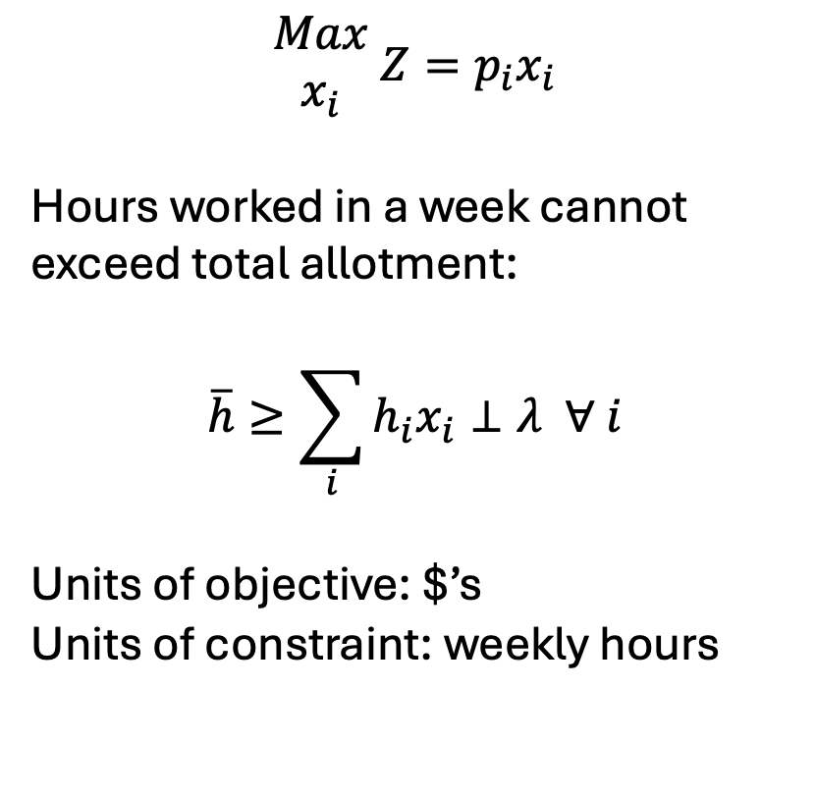
Example translation of $λ$
Indices
$i$: product sold
Parameters:
$p_{i}$: net revenue ($ / product)
$h_{i}$: hours per product
$\overline{h}$: weekly hourly limit
Variables:
$Z$: Total profit ($s)
$x_{i}$: production of $i$ (product)
$$\begin{matrix}Max \\ x_{i}\end{matrix} {Z=p}_{i}x_{i}$$
Hours worked in a week cannot exceed total allotment:
$$\overline{h}≥\sum_{i}{h_{i}x_{i}}⊥λ ∀ i$$
Units of objective: $’s
Units of constraint: weekly hours
$λ$ thus represents the change in total profits given a change in the weekly hours
“What is the change in profits with increasing my total hours worked by 1 hour?”

Slide 11
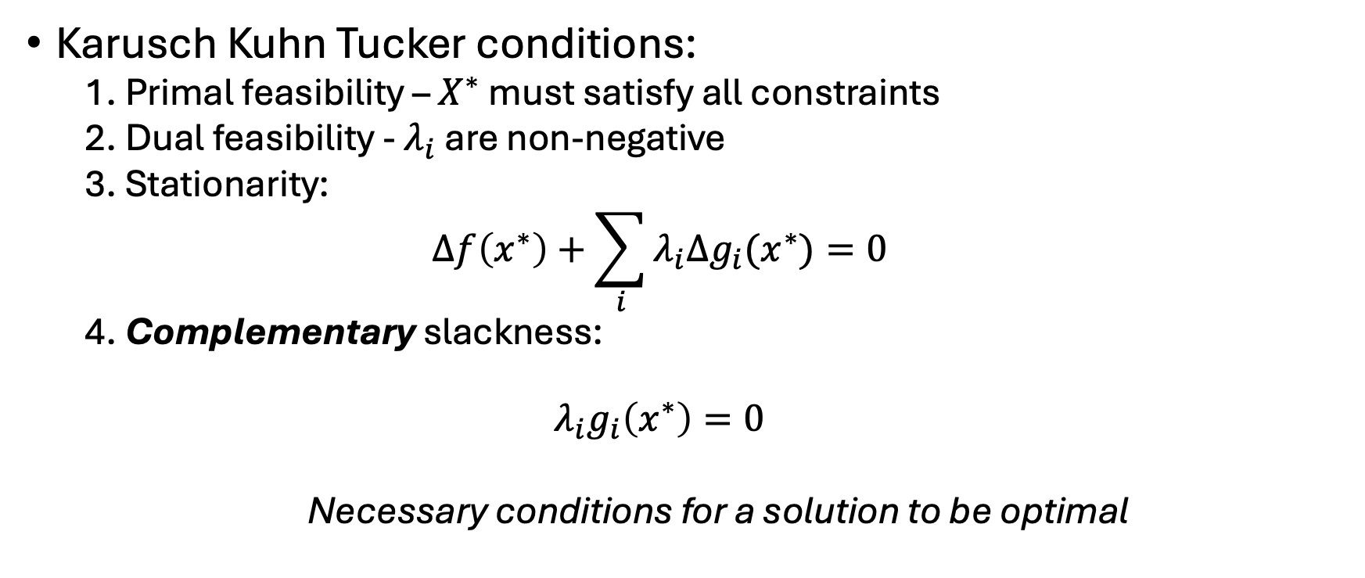
Summary of KKT conditions
Karusch Kuhn Tucker conditions:
1. Primal feasibility – $X^{∗}$ must satisfy all constraints
2. Dual feasibility - $λ_{i}$ are non-negative
3. Stationarity:
$$Δf\left(x^{∗}\right)+\sum_{i}{λ_{i}Δg_{i}(x^{∗})}=0$$
4. Complementary slackness:
$$λ_{i}g_{i}\left(x^{∗}\right)=0$$
Necessary conditions for a solution to be optimal

Slide 12
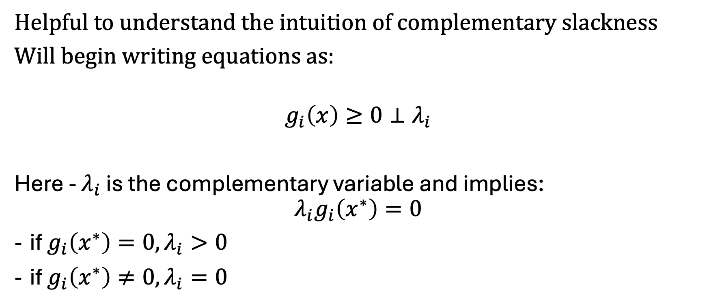
A new way to write constraints…
Helpful to understand the intuition of complementary slackness
Will begin writing equations as:
$$g_{i}\left(x\right)≥0⊥λ_{i}$$
Here - $λ_{i}$ is the complementary variable and implies:
$$λ_{i}g_{i}\left(x^{∗}\right)=0$$
if $g_{i}\left(x^{∗}\right)=0, λ_{i}>0$
if $g_{i}\left(x^{∗}\right)≠0, λ_{i}=0$

Slide 13
Duality introduction
Always two types of problems:
Primal: your original optimization problem
Dual: an equivalent problem
Why do we care?
Complementarity problems remove the objective function(s) entirely
Rely on casting the problem in both primal and dual forms
I like to think of this as simultaneously representing both the physical (primal) and market (dual) problems

Slide 14
Duality – another perspective
Can think of the primal problem as the way in which we allocate resources – then the dual problem is how to allocate costs and/or values to those resources
Thus – dual can be thought of as the ‘worth’ of the constraints
Often call the dual constraints "zero profit conditions”

Slide 15

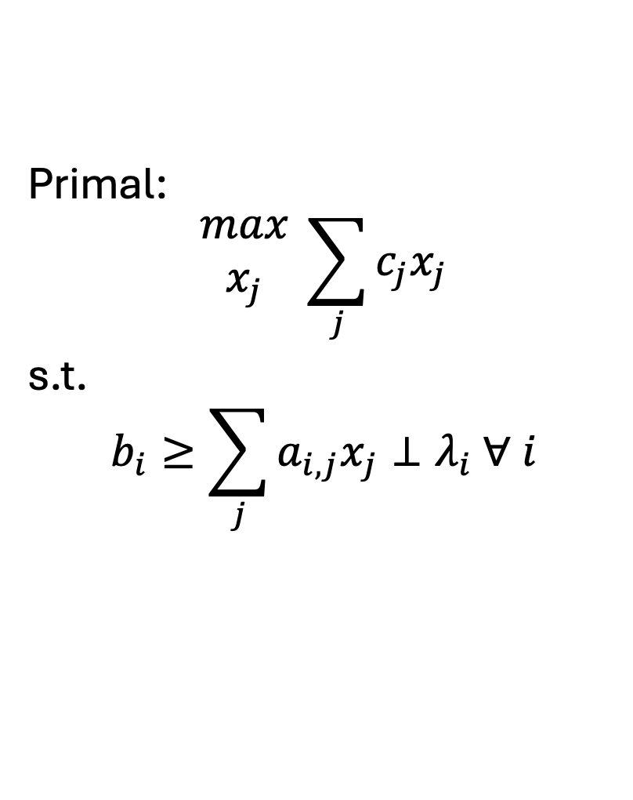
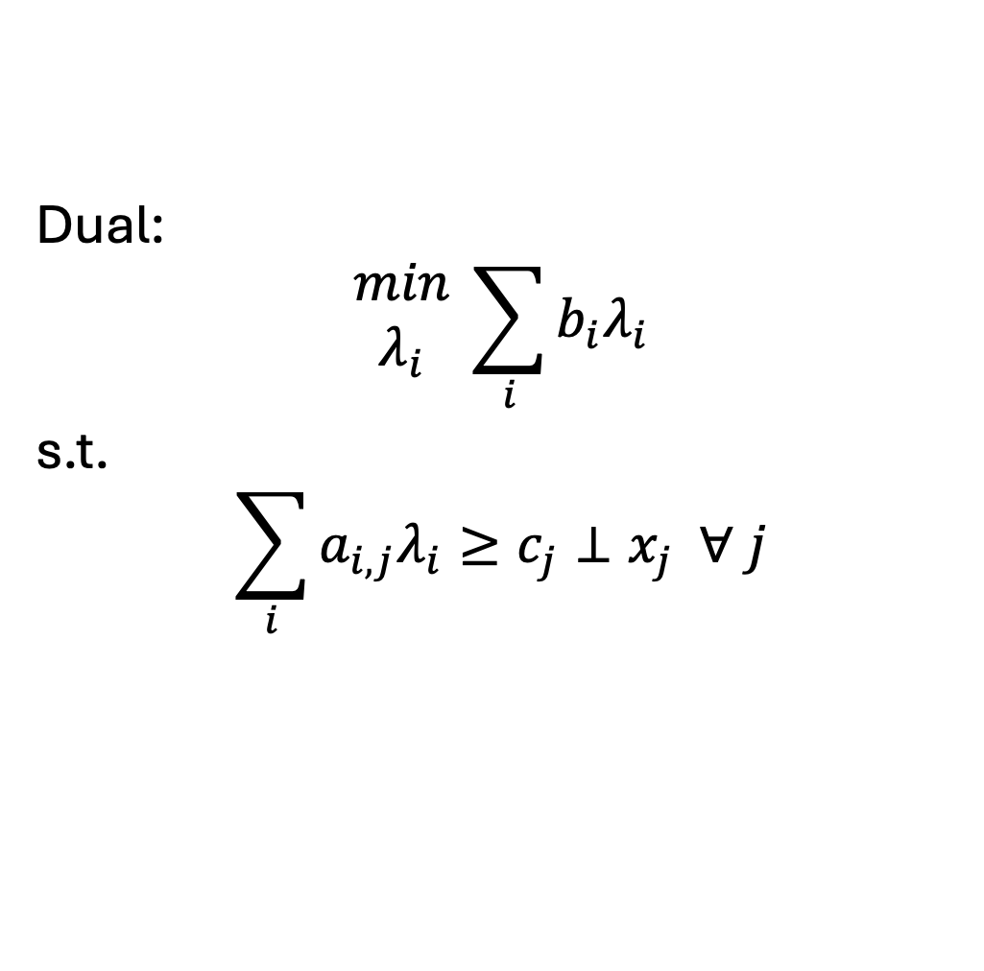
Formulating the dual..
$i$: # constraints
$j$: # variables
Primal:
$$\begin{matrix}max \\ x_{j}\end{matrix} \sum_{j}{c_{j}x_{j}}$$
s.t.
$$b_{i}≥\sum_{j}{a_{i,j}x_{j}}⊥λ_{i} ∀ i$$
Dual:
$$\begin{matrix}min \\ λ_{i}\end{matrix} \sum_{i}{b_{i}λ_{i}}$$
s.t.
$$\sum_{i}{a_{i,j}λ_{i}}≥c_{j}⊥x_{j} ∀ j$$

Slide 16
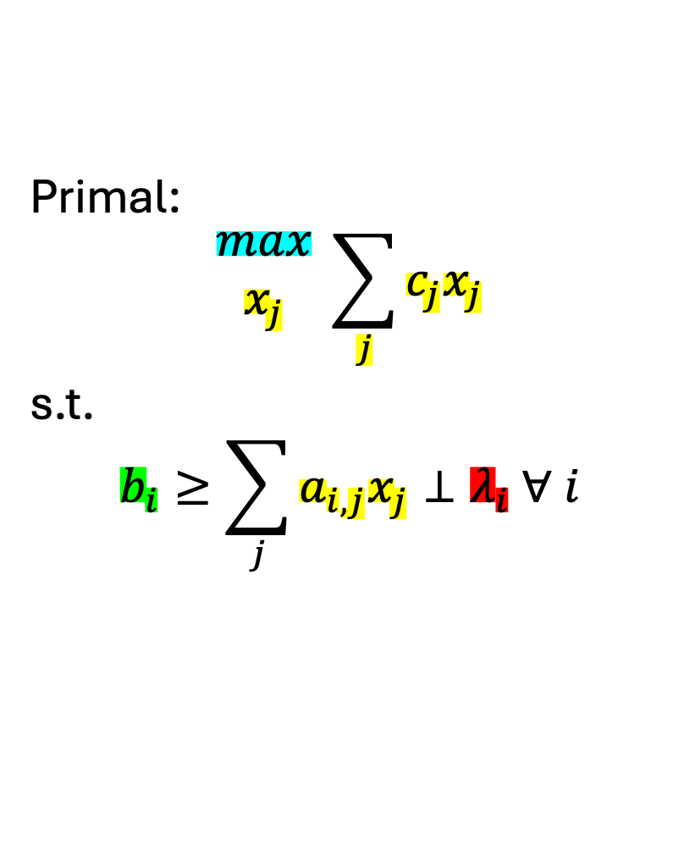
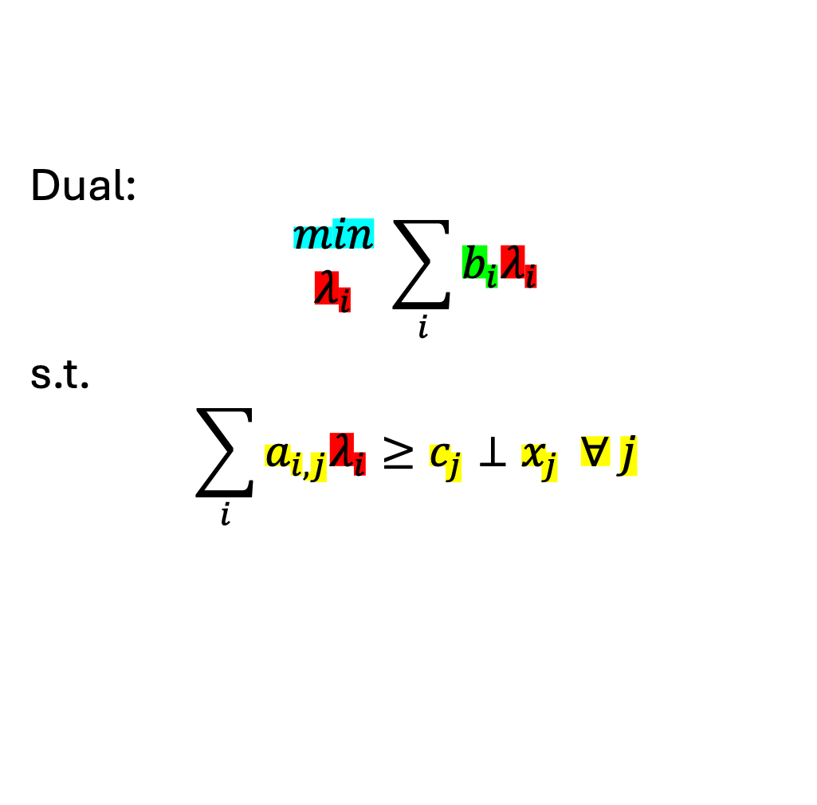
Formulating the dual..
$i$: # constraints
$j$: # variables
Primal:
$$\begin{matrix}max \\ x_{j}\end{matrix} \sum_{j}{c_{j}x_{j}}$$
s.t.
$$b_{i}≥\sum_{j}{a_{i,j}x_{j}}⊥λ_{i} ∀ i$$
Dual:
$$\begin{matrix}min \\ λ_{i}\end{matrix} \sum_{i}{b_{i}λ_{i}}$$
s.t.
$$\sum_{i}{a_{i,j}λ_{i}}≥c_{j}⊥x_{j} ∀ j$$

Slide 17
Indices of the shadow value variable will always match the dimensions of its primal constraint – this also implies conditionals on the primal constraint indices need to be applied to the dual variable

Slide 18
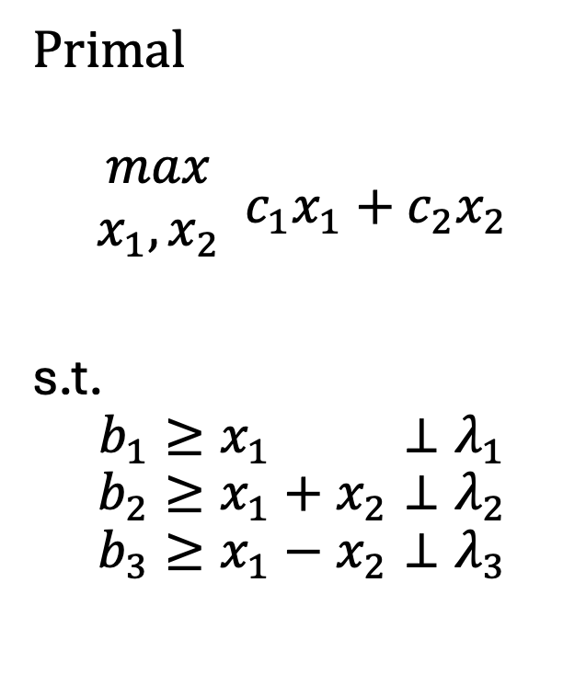
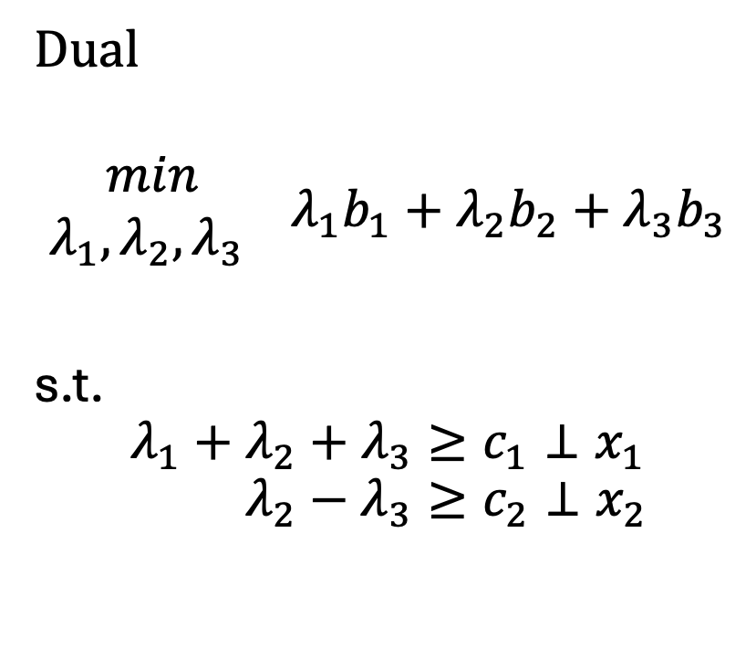
A very simple example
Primal
$$\begin{matrix}max \\ x_{1},x_{2}\end{matrix} c_{1}x_{1}+c_{2}x_{2}$$
s.t.
$$b_{1}≥x_{1} ⊥λ_{1}$$
$$b_{2}≥x_{1}+x_{2}⊥λ_{2}$$
$$b_{3}≥x_{1}−x_{2}⊥λ_{3}$$
Dual
$$\begin{matrix}min \\ λ_{1},λ_{2},λ_{3} \end{matrix} λ_{1}b_{1}+λ_{2}b_{2}+λ_{3}b_{3}$$
s.t.
$${λ_{1}+λ_{2}+λ_{3}≥c}_{1}⊥x_{1}$$
$$λ_{2}−λ_{3}≥c_{2}⊥x_{2}$$
1 | 1 | 1
0 | 1 | -1
1 | 0
1 | 1
1 | -1

Slide 19
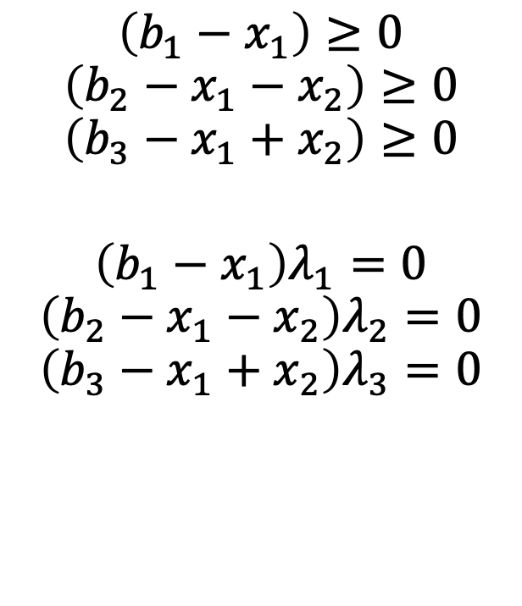

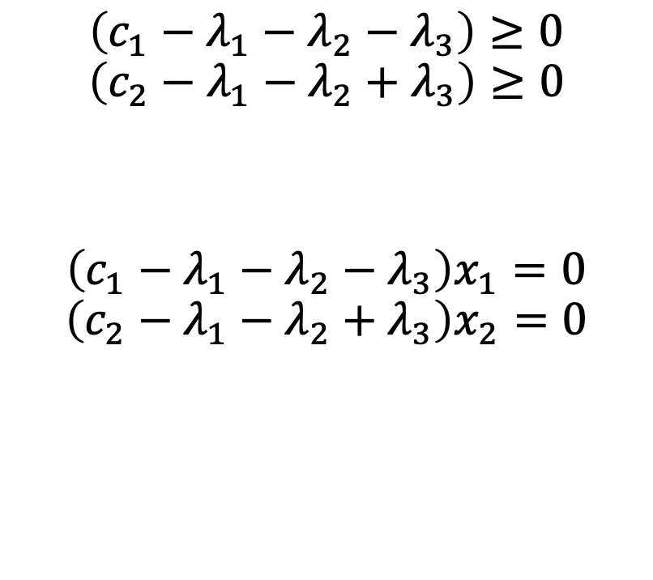
Complementarity conditions
$$\left(b_{1}−x_{1}\right)≥0$$
$$\left(b_{2}−x_{1}−x_{2}\right)≥0$$
$$\left(b_{3}−x_{1}+x_{2}\right)≥0$$
$$\left(b_{1}−x_{1}\right)λ_{1}=0$$
$$\left(b_{2}−x_{1}−x_{2}\right)λ_{2}=0$$
$$\left(b_{3}−x_{1}+x_{2}\right)λ_{3}=0$$
$$\left(c_{1}−λ_{1}−λ_{2}−λ_{3}\right)≥0$$
$$\left(c_{2}−λ_{1}−λ_{2}+λ_{3}\right)≥0$$
$$\left(c_{1}−λ_{1}−λ_{2}−λ_{3}\right)x_{1}=0$$
$$\left(c_{2}−λ_{1}−λ_{2}+λ_{3}\right)x_{2}=0$$
$$x_{1},x_{2}≥0$$
$$λ_{1},λ_{2},λ_{3}≥0$$

Slide 20
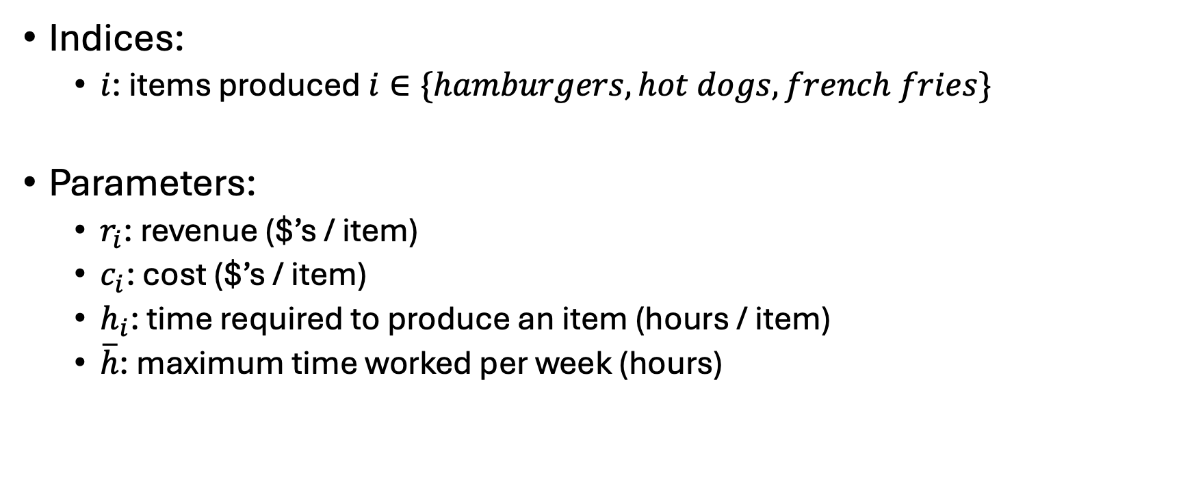
Ripley’s restaurant
Indices:
$i$: items produced $i∈\{hamburgers, hot dogs, french fries\}$
Parameters:
$r_{i}$: revenue ($’s / item)
$c_{i}$: cost ($’s / item)
$h_{i}$: time required to produce an item (hours / item)
$\overline{h}$: maximum time worked per week (hours)
Item | Revenue | Cost | Hours
Hamburger | 1.5 | 0.75 | 0.5
Hot dog | 0.75 | 0.1 | 0.2
French fries | 0.25 | 0.05 | 0.1

Slide 21
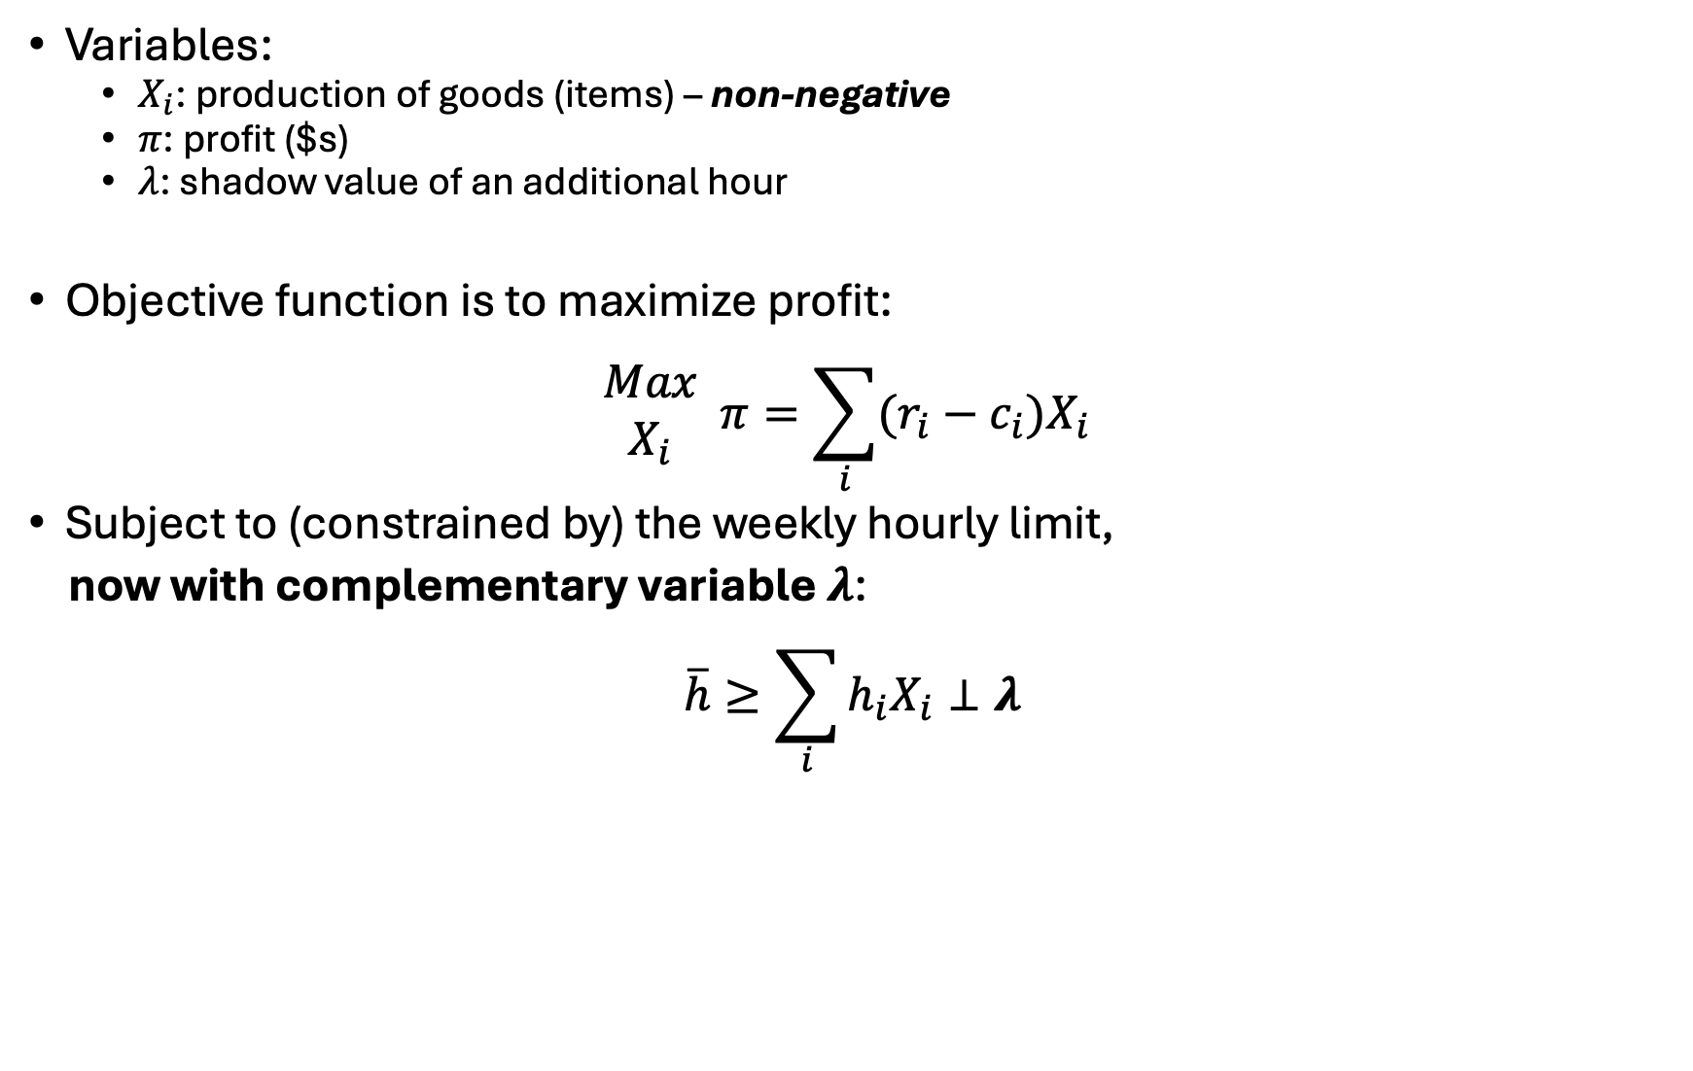
Ripley’s restaurant
Variables:
$X_{i}$: production of goods (items) – non-negative
$π$: profit ($s)
$λ$: shadow value of an additional hour
Objective function is to maximize profit:
$$\begin{matrix}Max \\ X_{i}\end{matrix} π=\sum_{i}{(r_{i}−c_{i})X_{i}}$$
Subject to (constrained by) the weekly hourly limit,
now with complementary variable $λ$:
$$\overline{h}≥\sum_{i}{h_{i}X_{i}}⊥λ$$

Slide 22
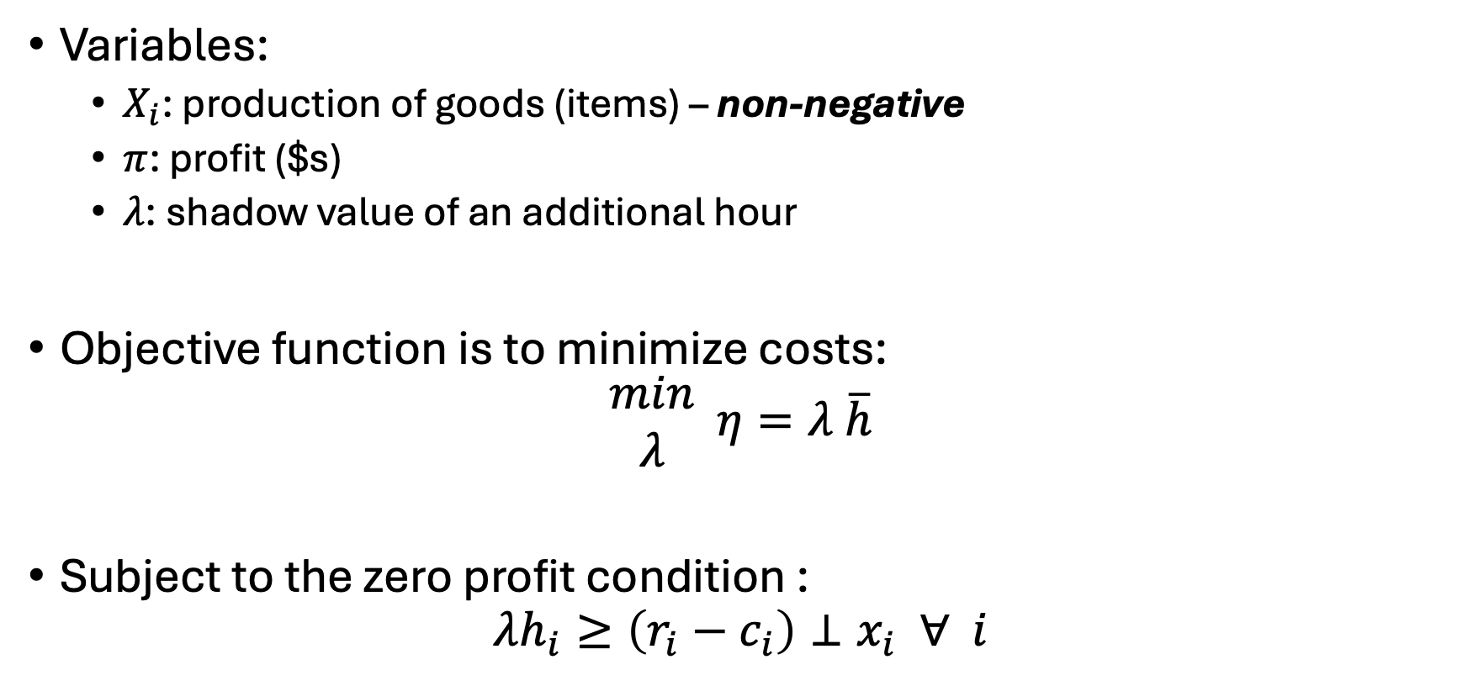
Ripley’s restaurant – the dual
Variables:
$X_{i}$: production of goods (items) – non-negative
$π$: profit ($s)
$λ$: shadow value of an additional hour
Objective function is to minimize costs:
$$\begin{matrix}min \\ λ\end{matrix} η=λ \overline{h}$$
Subject to the zero profit condition :
$$λh_{i}≥\left(r_{i}−c_{i}\right)⊥x_{i} ∀ i$$

Slide 23
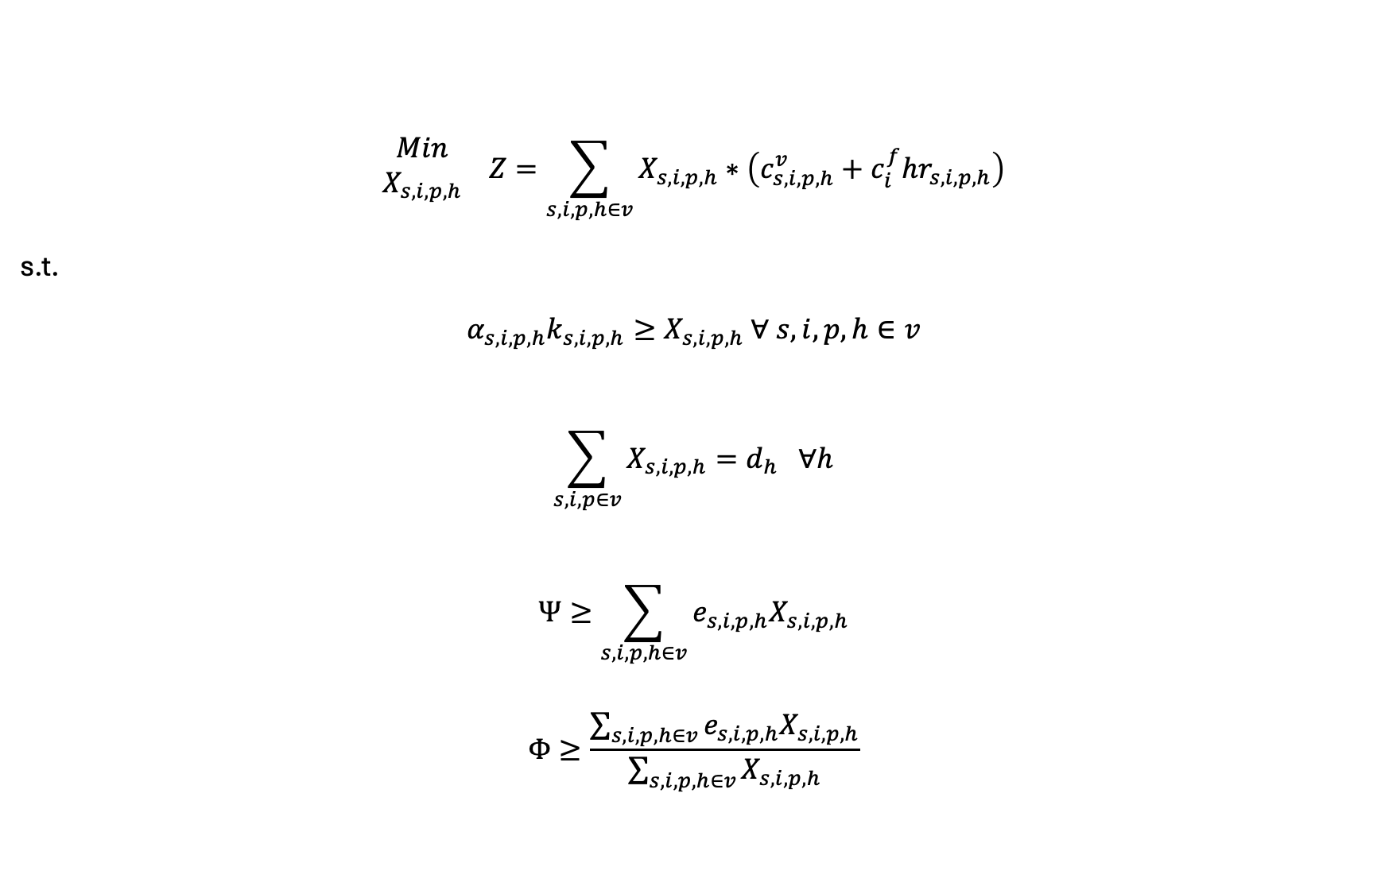
What about our simple electricity model?
$$\begin{matrix}Min \\ X_{s,i,p,h}\end{matrix} Z=\sum_{s,i,p,h∈v}{X_{s,i,p,h}}∗\left(c_{s,i,p,h}^{v}+c_{i}^{f}hr_{s,i,p,h}\right)$$
s.t.
$$α_{s,i,p,h}k_{s,i,p,h}≥X_{s,i,p,h} ∀ s,i,p,h∈v$$
$$\sum_{s,i,p∈v}{X_{s,i,p,h}}=d_{h} ∀h$$
$$Ψ≥\sum_{s,i,p,h∈v}{e_{s,i,p,h}X_{s,i,p,h}}$$
$$Φ≥\frac{\sum_{s,i,p,h∈v}{e_{s,i,p,h}X_{s,i,p,h}}}{\sum_{s,i,p,h∈v}{X_{s,i,p,h}}}$$

Slide 24

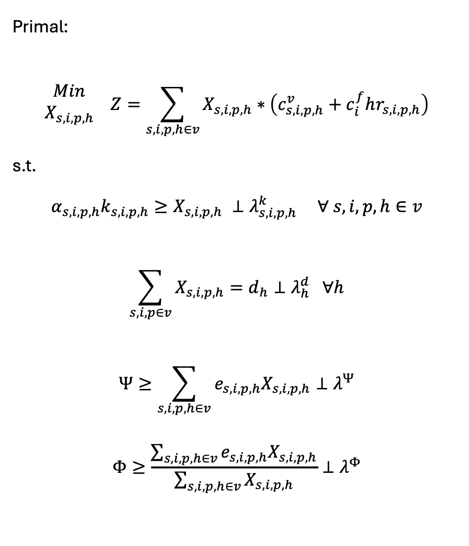
Primal:
$$\begin{matrix}Min \\ X_{s,i,p,h}\end{matrix} Z=\sum_{s,i,p,h∈v}{X_{s,i,p,h}}∗\left(c_{s,i,p,h}^{v}+c_{i}^{f}hr_{s,i,p,h}\right)$$
s.t.
$$α_{s,i,p,h}k_{s,i,p,h}≥X_{s,i,p,h} ⊥λ_{s,i,p,h}^{k} ∀ s,i,p,h∈v$$
$$\sum_{s,i,p∈v}{X_{s,i,p,h}}=d_{h}⊥λ_{h}^{d} ∀h$$
$$Ψ≥\sum_{s,i,p,h∈v}{e_{s,i,p,h}X_{s,i,p,h}}⊥λ^{Ψ}$$
$$Φ≥\frac{\sum_{s,i,p,h∈v}{e_{s,i,p,h}X_{s,i,p,h}}}{\sum_{s,i,p,h∈v}{X_{s,i,p,h}}}⊥λ^{Φ}$$
Dual:
$$\begin{matrix}Max \\ λ_{s,i,p,h}^{k},λ_{h}^{d},λ^{Ψ},λ^{Φ}\end{matrix} η=\sum_{h}{λ_{h}^{d}d_{h}}$$
$$−\sum_{s,i,p,h∈v}{λ_{s,i,p,h}^{k}α_{s,i,p,h}k_{s,i,p,h}}$$
$$−λ^{Ψ}Ψ−λ^{Φ}Φ$$
s.t.
$${ c}_{s,i,p,h}^{v}+c_{i}^{f}hr_{s,i,p,h}+λ_{s,i,p,h}^{k}$$
$$+ e_{s, i,p,h}λ^{Ψ}+λ^{Φ}\left(e_{s,i,p,h}−Ψ\right)$$
$$≥λ_{h}^{d}⊥X_{s, i,p,h} ∀ s,i,p,h∈v$$

Slide 25
Complementarity Problems
Complementarity problems start with the primal and dual constraints and remove the objective functions
Specific types but -almost- always referred to in practice as Mixed Complementarity Problems (MCPs).. All types:
Linear Complementarity Problems (LCPs)
Non-linear Complementarity Problems (NLCPs)
Both non-linear and linear complementarity problems are mixed (MCPs)
Also: integer, others..

Slide 26

A good book..

Slide 27
Steps to creating an MCP from an existing LP/NLP
Write out initial problem
Derive complementarity conditions (dual w/o objective)
Set up problem as: [primal constraints] & [dual constraints]
Solve your initial problem
Assign level values to both primal variables and dual variables
Dual variable values set as marginal off the respective constraints
Alternatively, could solve both the primal and dual problem
Set iteration limit for MCP problem to zero
Make sure we have a zero residual

Slide 28
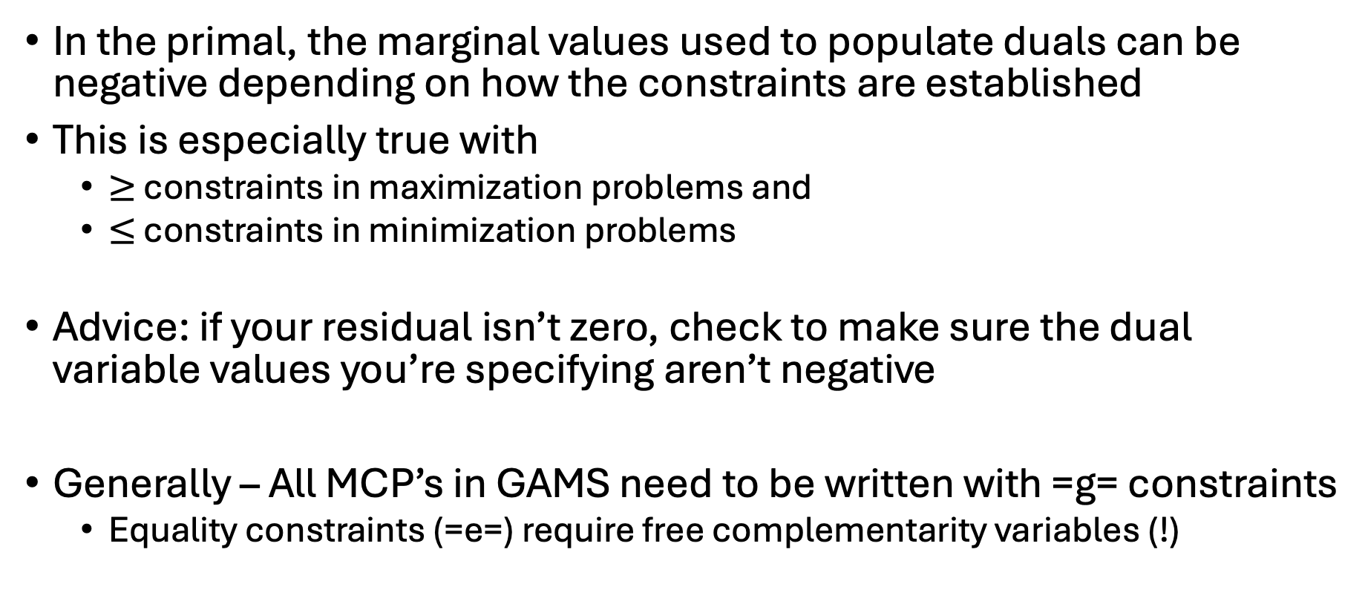
Dual signs
In the primal, the marginal values used to populate duals can be negative depending on how the constraints are established
This is especially true with
$≥$ constraints in maximization problems and
$≤$ constraints in minimization problems
Advice: if your residual isn’t zero, check to make sure the dual variable values you’re specifying aren’t negative
Generally – All MCP’s in GAMS need to be written with =g= constraints
Equality constraints (=e=) require free complementarity variables (!)

Slide 29
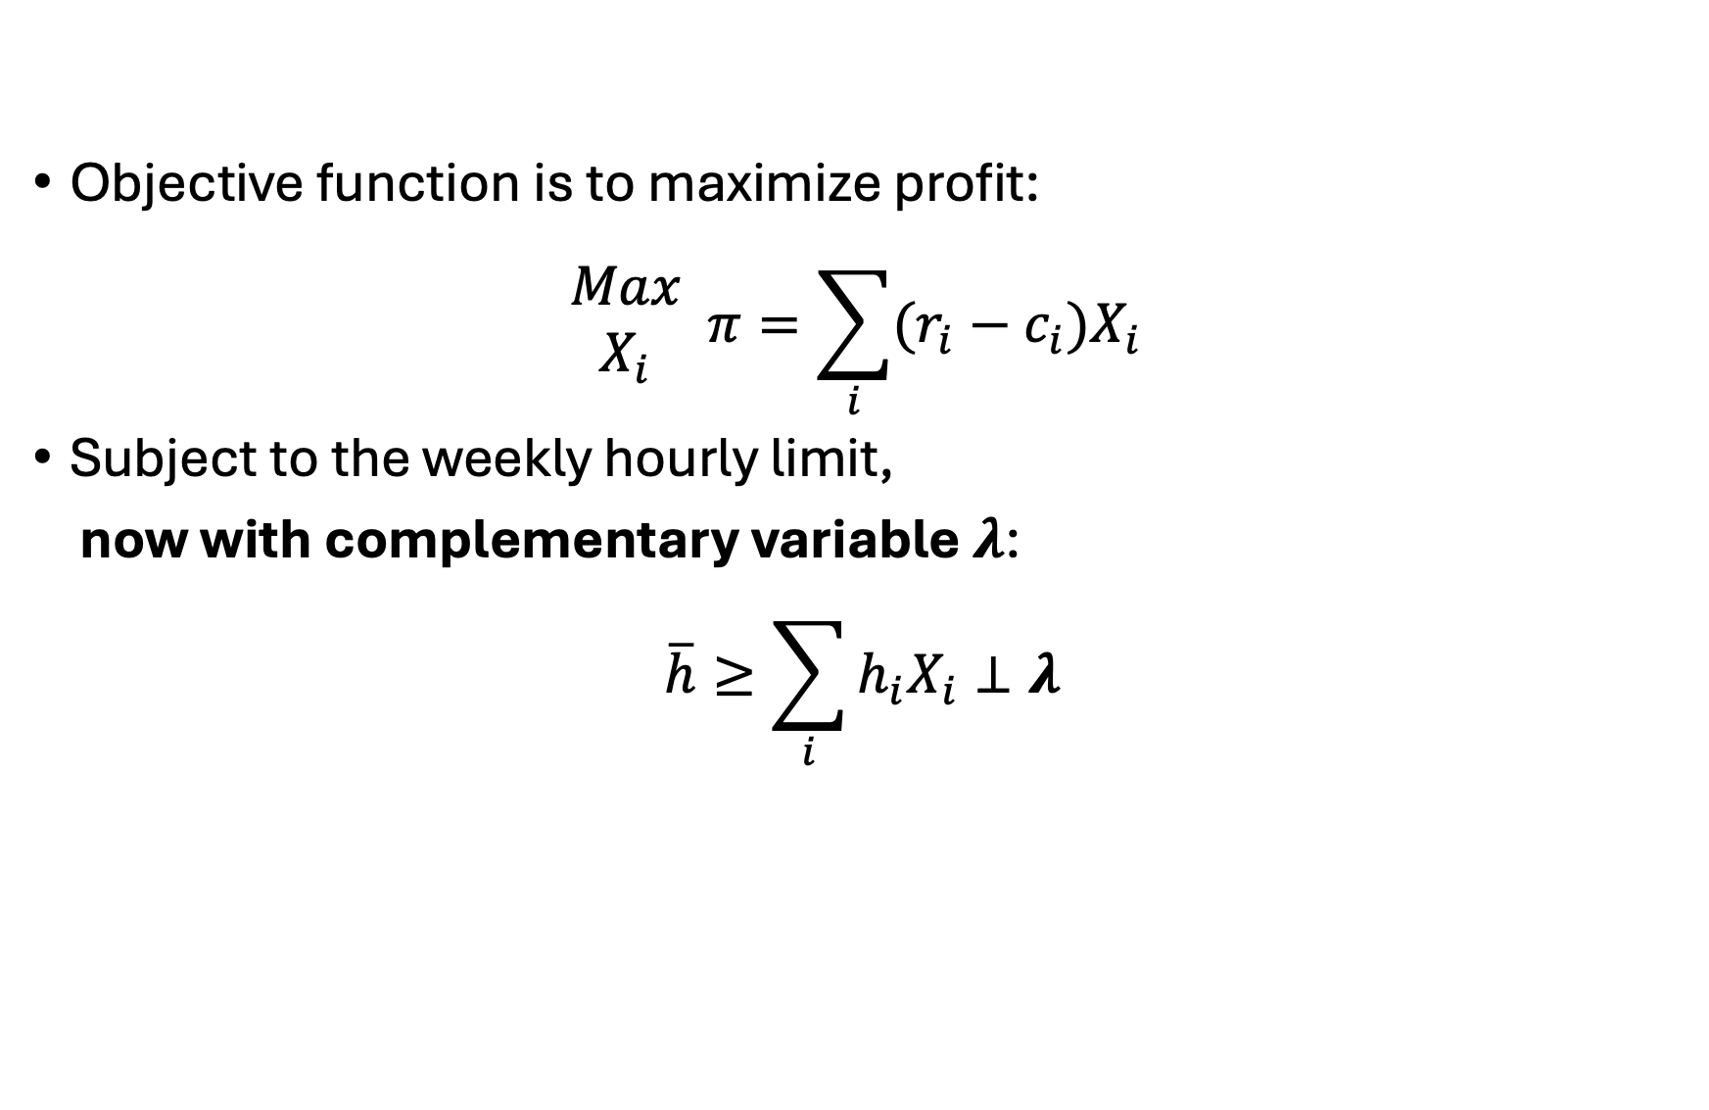
Write out initial problem
Objective function is to maximize profit:
$$\begin{matrix}Max \\ X_{i}\end{matrix} π=\sum_{i}{(r_{i}−c_{i})X_{i}}$$
Subject to the weekly hourly limit,
now with complementary variable $λ$:
$$\overline{h}≥\sum_{i}{h_{i}X_{i}}⊥λ$$

Slide 30
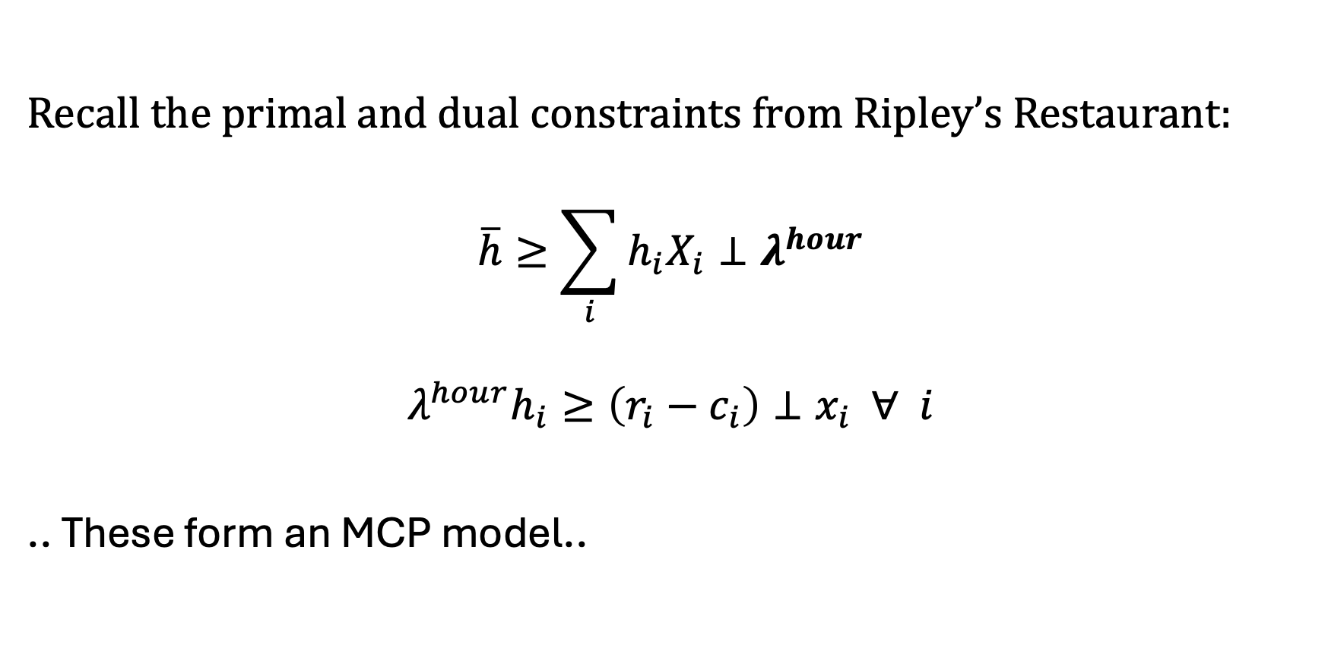
Derive complementarity conditions
Recall the primal and dual constraints from Ripley’s Restaurant:
$$\overline{h}≥\sum_{i}{h_{i}X_{i}}⊥λ^{hour}$$
$$λ^{hour}h_{i}≥\left(r_{i}−c_{i}\right)⊥x_{i} ∀ i$$
.. These form an MCP model..

Slide 31
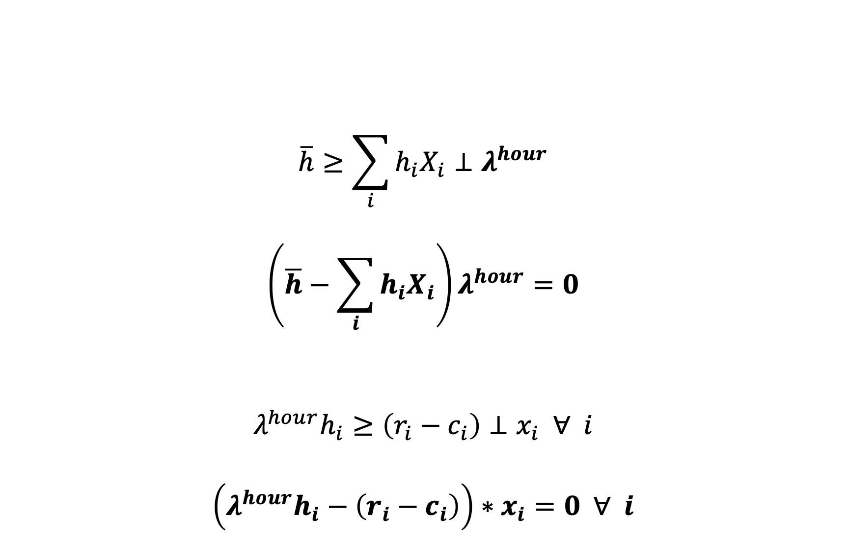
(Full) Complementarity Conditions
$$\overline{h}≥\sum_{i}{h_{i}X_{i}}⊥λ^{hour}$$
$$\left(\overline{h}−\sum_{i}{h_{i}X_{i}}\right)λ^{hour}=0$$
$$λ^{hour}h_{i}≥\left(r_{i}−c_{i}\right)⊥x_{i} ∀ i$$
$$\left(λ^{hour}h_{i}−\left(r_{i}−c_{i}\right)\right)∗x_{i}=0 ∀ i$$
These are generated by GAMS!

Slide 32
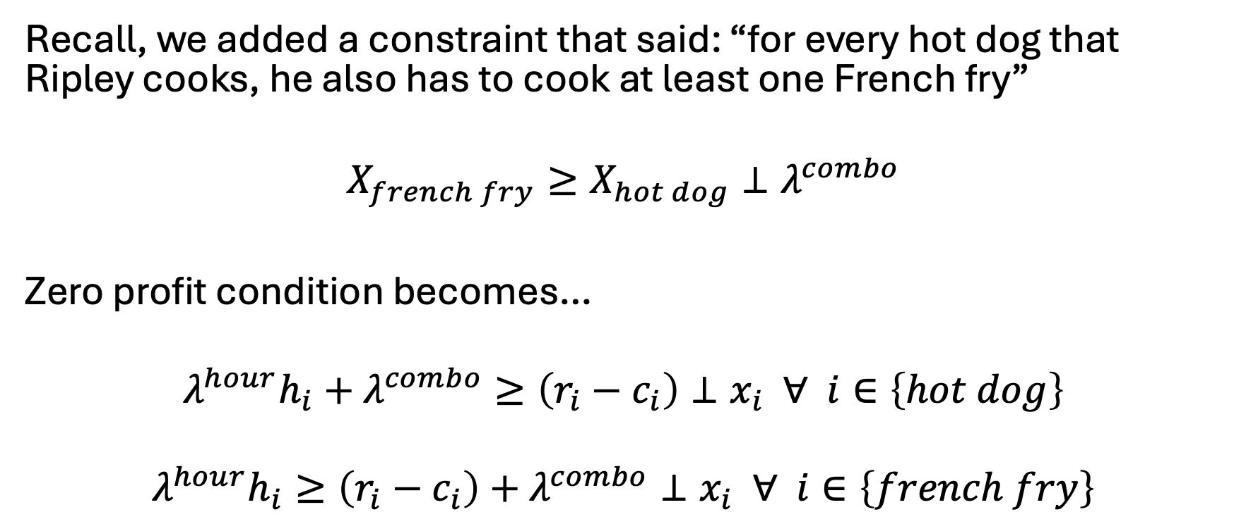
Let’s add the combo constraint…
Recall, we added a constraint that said: “for every hot dog that Ripley cooks, he also has to cook at least one French fry”
$$X_{french fry}≥X_{hot dog}⊥λ^{combo}$$
Zero profit condition becomes…
$$λ^{hour}h_{i}+λ^{combo}≥\left(r_{i}−c_{i}\right)⊥x_{i} ∀ i∈\left\{hot dog\right\}$$
$$λ^{hour}h_{i}≥\left(r_{i}−c_{i}\right)+λ^{combo}⊥x_{i} ∀ i∈\left\{french fry\right\}$$

Slide 33
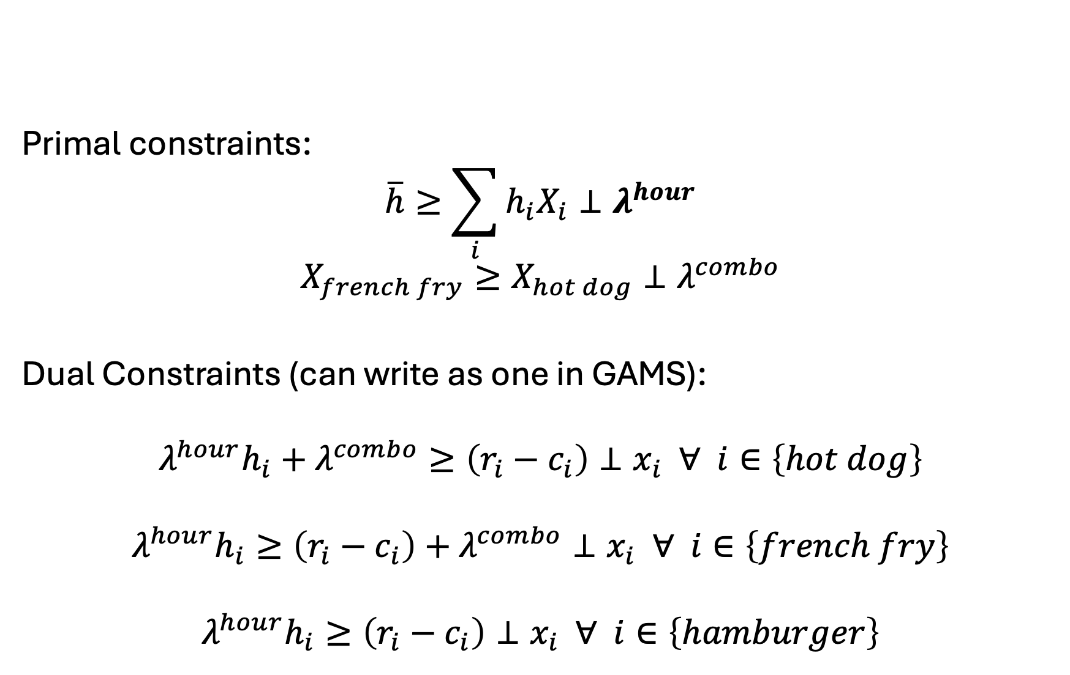
Set up problem as: [primal constraints] & [dual constraints]
Primal constraints:
$$\overline{h}≥\sum_{i}{h_{i}X_{i}}⊥λ^{hour}$$
$$X_{french fry}≥X_{hot dog}⊥λ^{combo}$$
Dual Constraints (can write as one in GAMS):
$$λ^{hour}h_{i}+λ^{combo}≥\left(r_{i}−c_{i}\right)⊥x_{i} ∀ i∈\left\{hot dog\right\}$$
$$λ^{hour}h_{i}≥\left(r_{i}−c_{i}\right)+λ^{combo}⊥x_{i} ∀ i∈\left\{french fry\right\}$$
$$λ^{hour}h_{i}≥\left(r_{i}−c_{i}\right)⊥x_{i} ∀ i∈\left\{hamburger\right\}$$

Slide 34
Now in GAMS, need to:
Solve your initial problem
Assign level values to both primal variables and dual variables
Dual variable values set as marginal off the respective constraints
Alternatively, could solve both the primal and dual problem
Set iteration limit for MCP problem to zero
Make sure we have a zero residual

Slide 35
Now let’s do the electricity example
Write out initial problem
Derive complementarity conditions (dual w/o objective)
Set up problem as: [primal constraints] & [dual constraints]
Solve your initial problem
Assign level values to both primal variables and dual variables
Dual variable values set as marginal off the respective constraints
Alternatively, could solve both the primal and dual problem
Set iteration limit for MCP problem to zero
Make sure we have a zero residual

Slide 36
Primal:
$$\begin{matrix}Min \\ X_{s,i,p,h}\end{matrix} Z=\sum_{s,i,p,h∈v}{X_{s,i,p,h}}∗\left(c_{s,i,p,h}^{v}+c_{i}^{f}hr_{s,i,p,h}\right)$$
s.t.
$$α_{s,i,p,h}k_{s,i,p,h}≥X_{s,i,p,h} ⊥λ_{s,i,p,h}^{k} ∀ s,i,p,h∈v$$
$$\sum_{s,i,p∈v}{X_{s,i,p,h}}=d_{h}⊥λ_{h}^{d} ∀h$$
$$Ψ≥\sum_{s,i,p,h∈v}{e_{s,i,p,h}X_{s,i,p,h}}⊥λ^{Ψ}$$
$$Φ≥\frac{\sum_{s,i,p,h∈v}{e_{s,i,p,h}X_{s,i,p,h}}}{\sum_{s,i,p,h∈v}{X_{s,i,p,h}}}⊥λ^{Φ}$$
Dual:
$$\begin{matrix}Max \\ λ_{s,i,p,h}^{k},λ_{h}^{d},λ^{Ψ},λ^{Φ}\end{matrix} η=\sum_{h}{λ_{h}^{d}d_{h}}$$
$$−\sum_{s,i,p,h∈v}{λ_{s,i,p,h}^{k}α_{s,i,p,h}k_{s,i,p,h}}$$
$$−λ^{Ψ}Ψ−λ^{Φ}Φ$$
s.t.
$${ c}_{s,i,p,h}^{v}+c_{i}^{f}hr_{s,i,p,h}+λ_{s,i,p,h}^{k}$$
$$+ e_{s, i,p,h}λ^{Ψ}+λ^{Φ}\left(e_{s,i,p,h}−Ψ\right)$$
$$≥λ_{h}^{d}⊥X_{s, i,p,h} ∀ s,i,p,h∈v$$

Slide 37
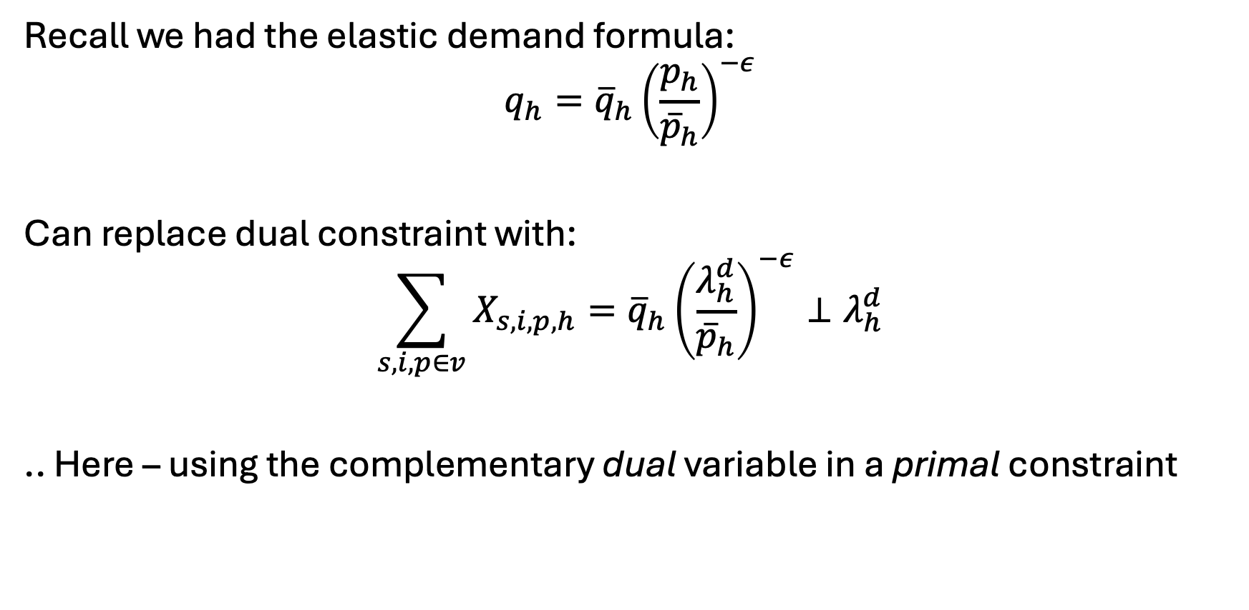
What about elastic demand?
Recall we had the elastic demand formula:
$$q_{h}={\overline{q}}_{h}{\left(\frac{p_{h}}{{\overline{p}}_{h}}\right)}^{−ε}$$
Can replace dual constraint with:
$$\sum_{s,i,p∈v}{X_{s,i,p,h}}={\overline{q}}_{h}{\left(\frac{λ_{h}^{d}}{{\overline{p}}_{h}}\right)}^{−ε}⊥λ_{h}^{d}$$
.. Here – using the complementary dual variable in a primal constraint

