Slide 1
EBGN645: Day 19
Complementarity problems

Slide 2
Note: Project scheduling is live
You do not need final results – you should plan to discuss:
What is your research question?
Why is this research important?
How did you formulate your model?
What are the important assumptions/data?
What are your (anticipated/final) results?
What conclusions can you (hope to) draw from the work?
If you had unlimited time/money/energy, what would this project look like?
Presentations should be ~10-12 minutes

Slide 3
Next week
Brady Cowiestoll will be visiting to talk on her work in energy modeling, how it fits into a private sector enterprise (NextEra), as well as opportunities for students
Aiming for one more guest speaker

Slide 4
Agenda
Review of MCP’s
Applications:
Simple example using Ripley’s restaurant
More complicated with electricity dispatch
Oligopolistic competition

Slide 5
Complementarity Problems
Complementarity problems (today) start with the primal and dual constraints and remove the objective functions
More generally: equilibrium problems
Specific types but -almost- always referred to in practice as Mixed Complementarity Problems (MCPs).. All types:
Linear Complementarity Problems (LCPs)
Non-linear Complementarity Problems (NLCPs)
Both non-linear and linear complementarity problems are mixed (MCPs)
Also: integer, others..

Slide 6
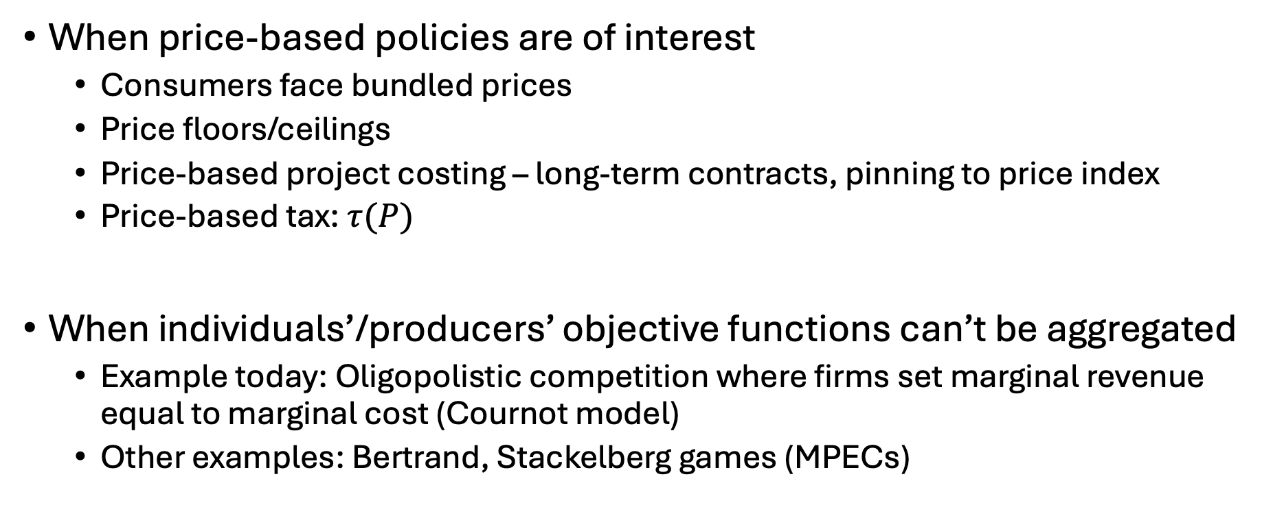
When should we use MCPs?
When price-based policies are of interest
Consumers face bundled prices
Price floors/ceilings
Price-based project costing – long-term contracts, pinning to price index
Price-based tax: $τ(P)$
When individuals’/producers’ objective functions can’t be aggregated
Example today: Oligopolistic competition where firms set marginal revenue equal to marginal cost (Cournot model)
Other examples: Bertrand, Stackelberg games (MPECs)

Slide 7
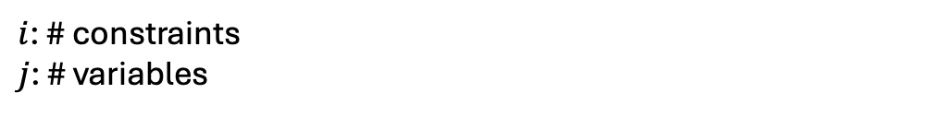
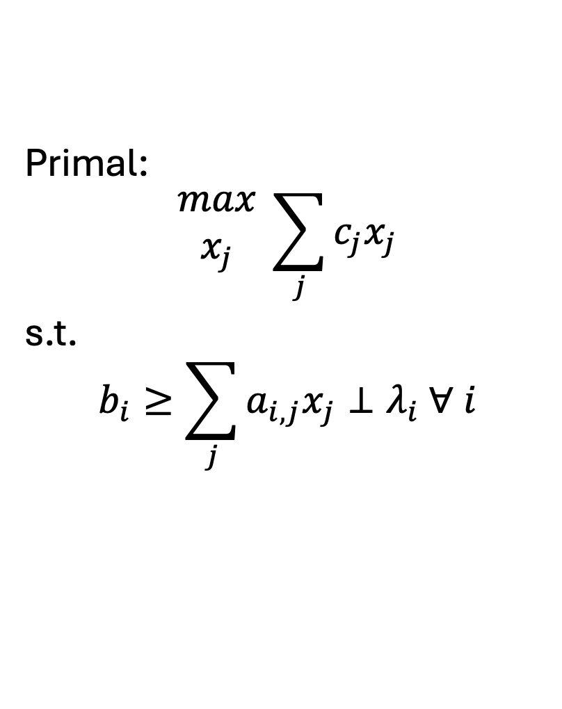
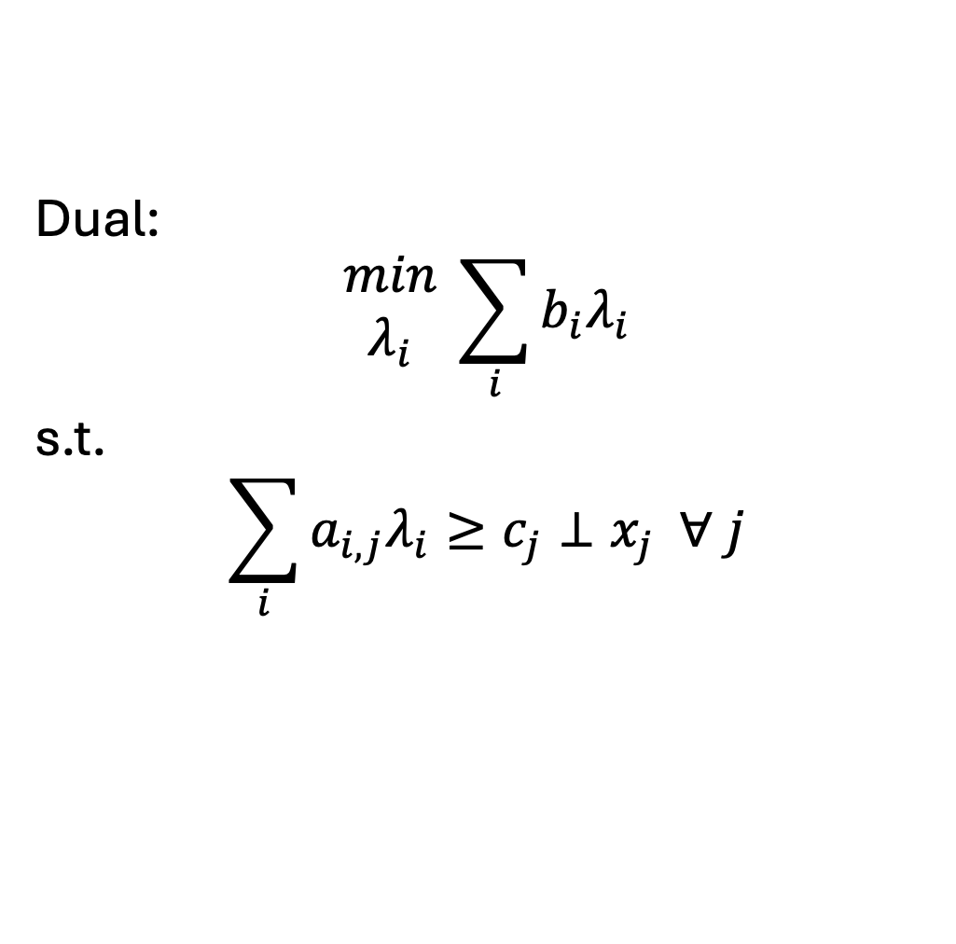
Formulating the dual..
$i$: # constraints
$j$: # variables
Primal:
$$\begin{matrix}max \\ x_{j}\end{matrix} \sum_{j}{c_{j}x_{j}}$$
s.t.
$$b_{i}≥\sum_{j}{a_{i,j}x_{j}}⊥λ_{i} ∀ i$$
Dual:
$$\begin{matrix}min \\ λ_{i}\end{matrix} \sum_{i}{b_{i}λ_{i}}$$
s.t.
$$\sum_{i}{a_{i,j}λ_{i}}≥c_{j}⊥x_{j} ∀ j$$

Slide 8
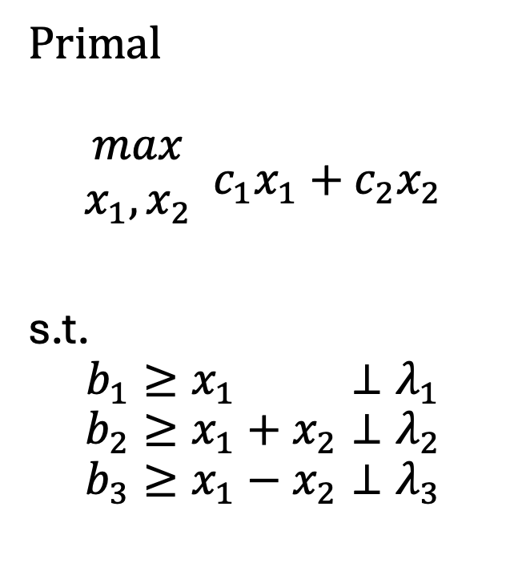
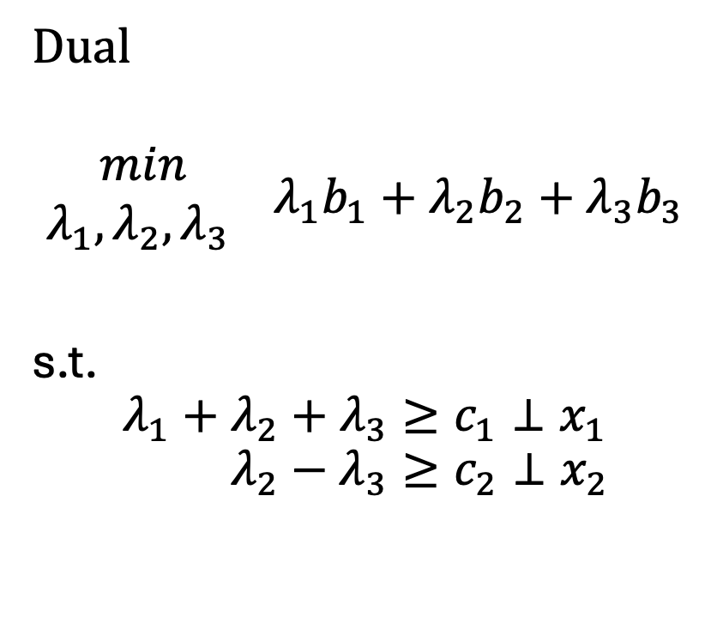
A very simple example
Primal
$$\begin{matrix}max \\ x_{1},x_{2}\end{matrix} c_{1}x_{1}+c_{2}x_{2}$$
s.t.
$$b_{1}≥x_{1} ⊥λ_{1}$$
$$b_{2}≥x_{1}+x_{2}⊥λ_{2}$$
$$b_{3}≥x_{1}−x_{2}⊥λ_{3}$$
Dual
$$\begin{matrix}min \\ λ_{1},λ_{2},λ_{3} \end{matrix} λ_{1}b_{1}+λ_{2}b_{2}+λ_{3}b_{3}$$
s.t.
$${λ_{1}+λ_{2}+λ_{3}≥c}_{1}⊥x_{1}$$
$$λ_{2}−λ_{3}≥c_{2}⊥x_{2}$$
1 | 1 | 1
0 | 1 | -1
1 | 0
1 | 1
1 | -1

Slide 9
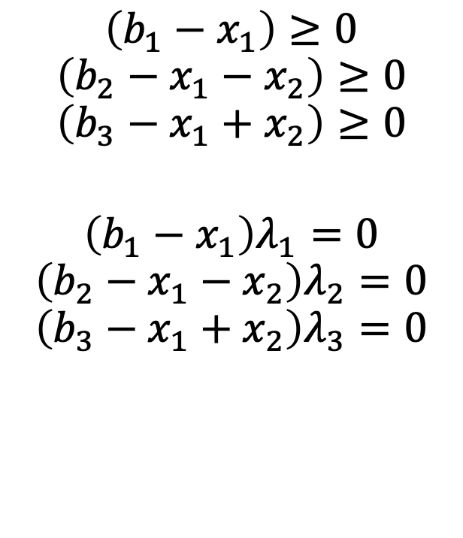

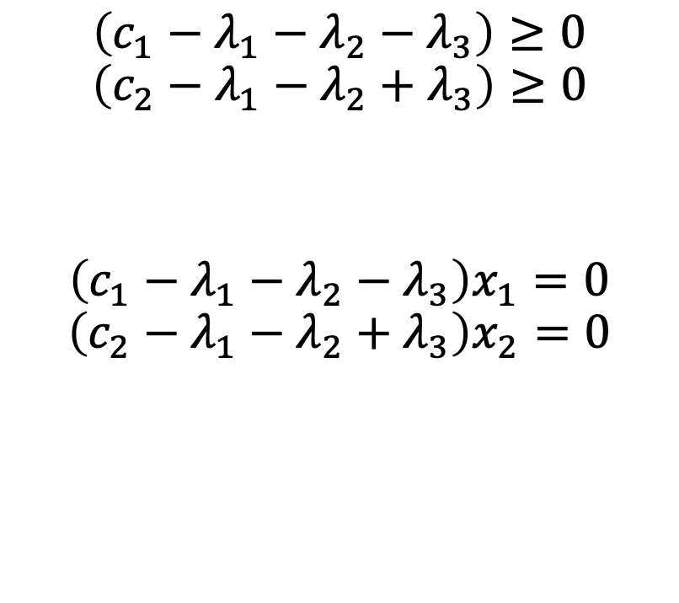
Complementarity conditions
$$\left(b_{1}−x_{1}\right)≥0$$
$$\left(b_{2}−x_{1}−x_{2}\right)≥0$$
$$\left(b_{3}−x_{1}+x_{2}\right)≥0$$
$$\left(b_{1}−x_{1}\right)λ_{1}=0$$
$$\left(b_{2}−x_{1}−x_{2}\right)λ_{2}=0$$
$$\left(b_{3}−x_{1}+x_{2}\right)λ_{3}=0$$
$$\left(c_{1}−λ_{1}−λ_{2}−λ_{3}\right)≥0$$
$$\left(c_{2}−λ_{1}−λ_{2}+λ_{3}\right)≥0$$
$$\left(c_{1}−λ_{1}−λ_{2}−λ_{3}\right)x_{1}=0$$
$$\left(c_{2}−λ_{1}−λ_{2}+λ_{3}\right)x_{2}=0$$
$$x_{1},x_{2}≥0$$
$$λ_{1},λ_{2},λ_{3}≥0$$

Slide 10
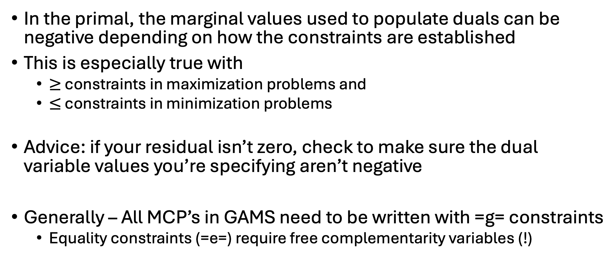
Caveat: Dual signs
In the primal, the marginal values used to populate duals can be negative depending on how the constraints are established
This is especially true with
$≥$ constraints in maximization problems and
$≤$ constraints in minimization problems
Advice: if your residual isn’t zero, check to make sure the dual variable values you’re specifying aren’t negative
Generally – All MCP’s in GAMS need to be written with =g= constraints
Equality constraints (=e=) require free complementarity variables (!)

Slide 11
Steps to creating an MCP from an existing LP/NLP
Write out initial problem
Derive complementarity conditions (dual w/o objective)
Set up problem as: [primal constraints] & [dual constraints]
Solve your initial problem
Assign level values to both primal variables and dual variables
Dual variable values set as marginal off the respective constraints
Alternatively, could solve both the primal and dual problem
Set iteration limit for MCP problem to zero
Make sure we have a zero residual

Slide 12
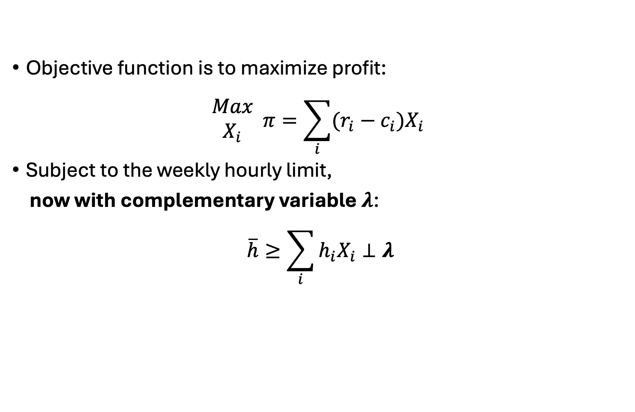
Write out initial problem
Objective function is to maximize profit:
$$\begin{matrix}Max \\ X_{i}\end{matrix} π=\sum_{i}{(r_{i}−c_{i})X_{i}}$$
Subject to the weekly hourly limit,
now with complementary variable $λ$:
$$\overline{h}≥\sum_{i}{h_{i}X_{i}}⊥λ$$

Slide 13
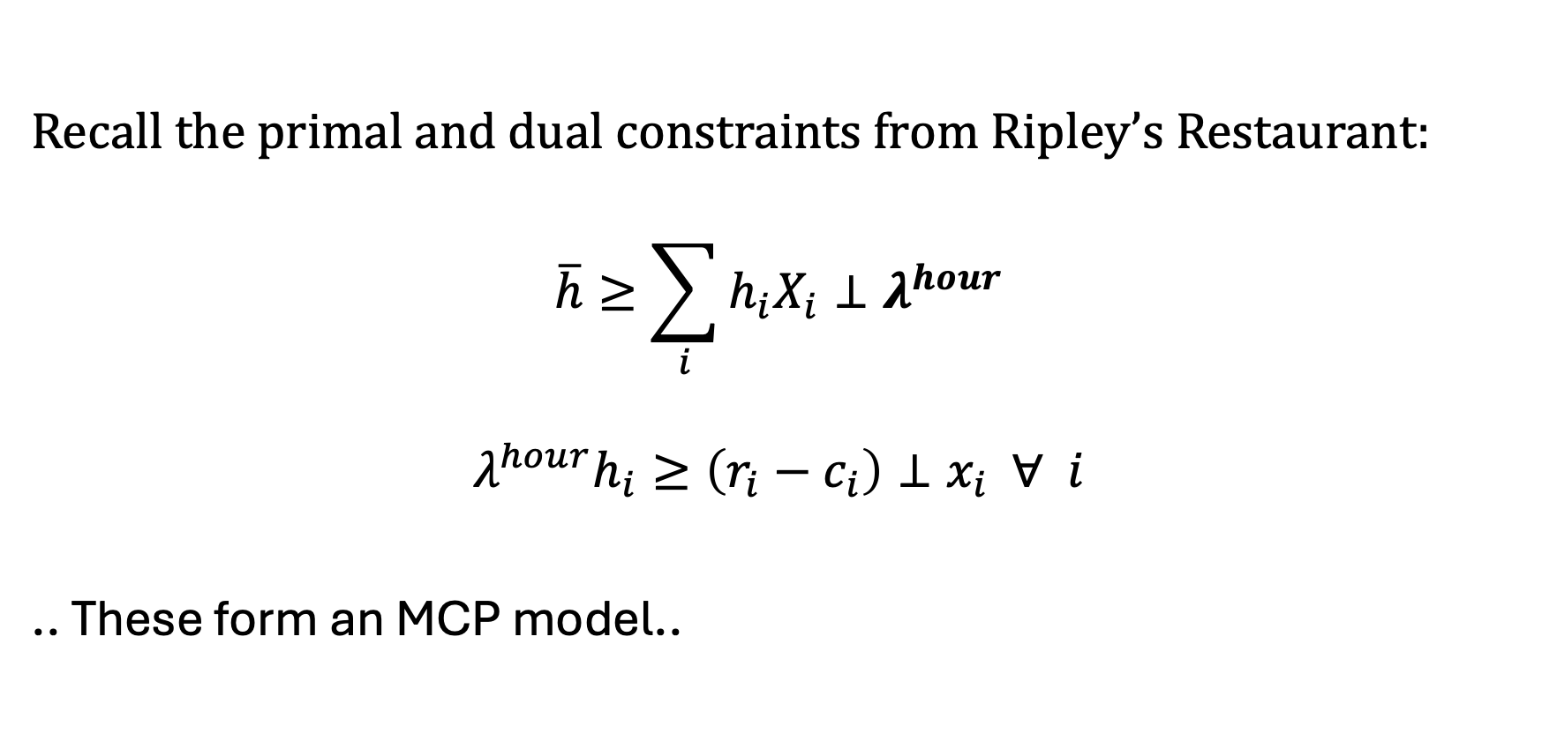
Derive complementarity conditions
Recall the primal and dual constraints from Ripley’s Restaurant:
$$\overline{h}≥\sum_{i}{h_{i}X_{i}}⊥λ^{hour}$$
$$λ^{hour}h_{i}≥\left(r_{i}−c_{i}\right)⊥x_{i} ∀ i$$
.. These form an MCP model..

Slide 14
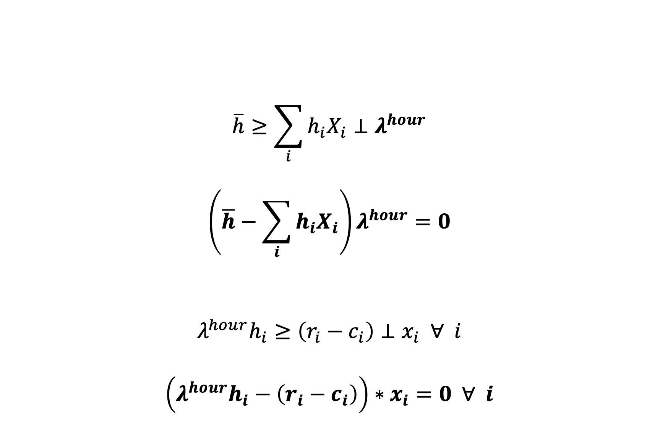
(Full) Complementarity Conditions
$$\overline{h}≥\sum_{i}{h_{i}X_{i}}⊥λ^{hour}$$
$$\left(\overline{h}−\sum_{i}{h_{i}X_{i}}\right)λ^{hour}=0$$
$$λ^{hour}h_{i}≥\left(r_{i}−c_{i}\right)⊥x_{i} ∀ i$$
$$\left(λ^{hour}h_{i}−\left(r_{i}−c_{i}\right)\right)∗x_{i}=0 ∀ i$$
These are generated by GAMS!

Slide 15
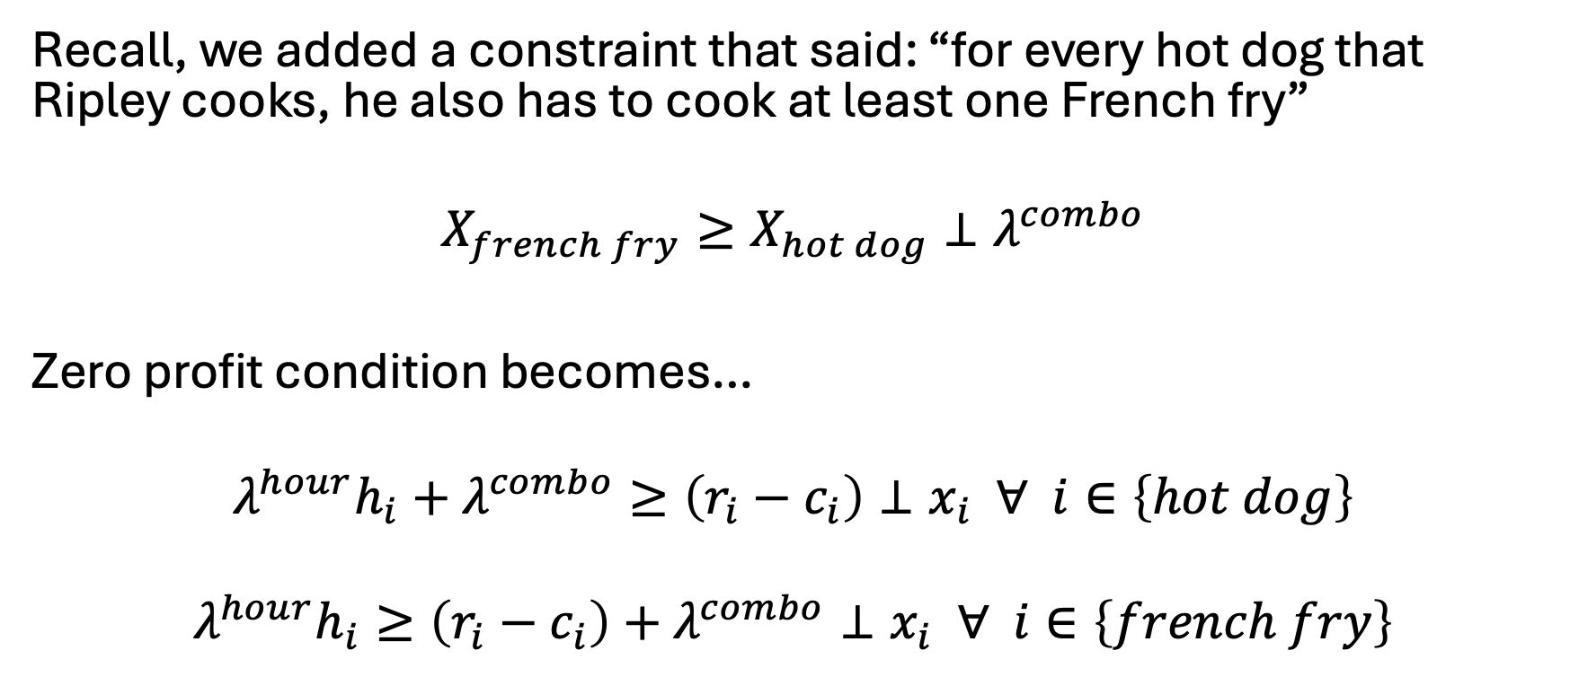
Let’s add the combo constraint…
Recall, we added a constraint that said: “for every hot dog that Ripley cooks, he also has to cook at least one French fry”
$$X_{french fry}≥X_{hot dog}⊥λ^{combo}$$
Zero profit condition becomes…
$$λ^{hour}h_{i}+λ^{combo}≥\left(r_{i}−c_{i}\right)⊥x_{i} ∀ i∈\left\{hot dog\right\}$$
$$λ^{hour}h_{i}≥\left(r_{i}−c_{i}\right)+λ^{combo}⊥x_{i} ∀ i∈\left\{french fry\right\}$$

Slide 16
Indices of the shadow value variable will always match the dimensions of its primal constraint – this also implies conditionals on the primal constraint indices need to be applied to the dual variable

Slide 17
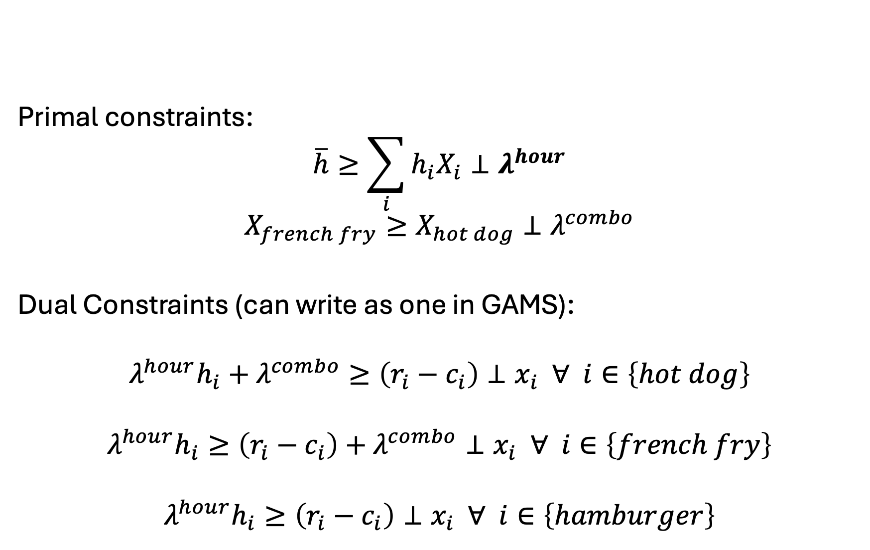
Set up problem as: [primal constraints] & [dual constraints]
Primal constraints:
$$\overline{h}≥\sum_{i}{h_{i}X_{i}}⊥λ^{hour}$$
$$X_{french fry}≥X_{hot dog}⊥λ^{combo}$$
Dual Constraints (can write as one in GAMS):
$$λ^{hour}h_{i}+λ^{combo}≥\left(r_{i}−c_{i}\right)⊥x_{i} ∀ i∈\left\{hot dog\right\}$$
$$λ^{hour}h_{i}≥\left(r_{i}−c_{i}\right)+λ^{combo}⊥x_{i} ∀ i∈\left\{french fry\right\}$$
$$λ^{hour}h_{i}≥\left(r_{i}−c_{i}\right)⊥x_{i} ∀ i∈\left\{hamburger\right\}$$

Slide 18
Now in GAMS, need to:
Solve your initial problem
Assign level values to both primal variables and dual variables
Dual variable values set as marginal off the respective constraints
Alternatively, could solve both the primal and dual problem
Set iteration limit for MCP problem to zero
Make sure we have a zero residual

Slide 19
Now let’s do the electricity example
Write out initial problem
Derive complementarity conditions (dual w/o objective)
Set up problem as: [primal constraints] & [dual constraints]
Solve your initial problem
Assign level values to both primal variables and dual variables
Dual variable values set as marginal off the respective constraints
Alternatively, could solve both the primal and dual problem
Set iteration limit for MCP problem to zero
Make sure we have a zero residual

Slide 20

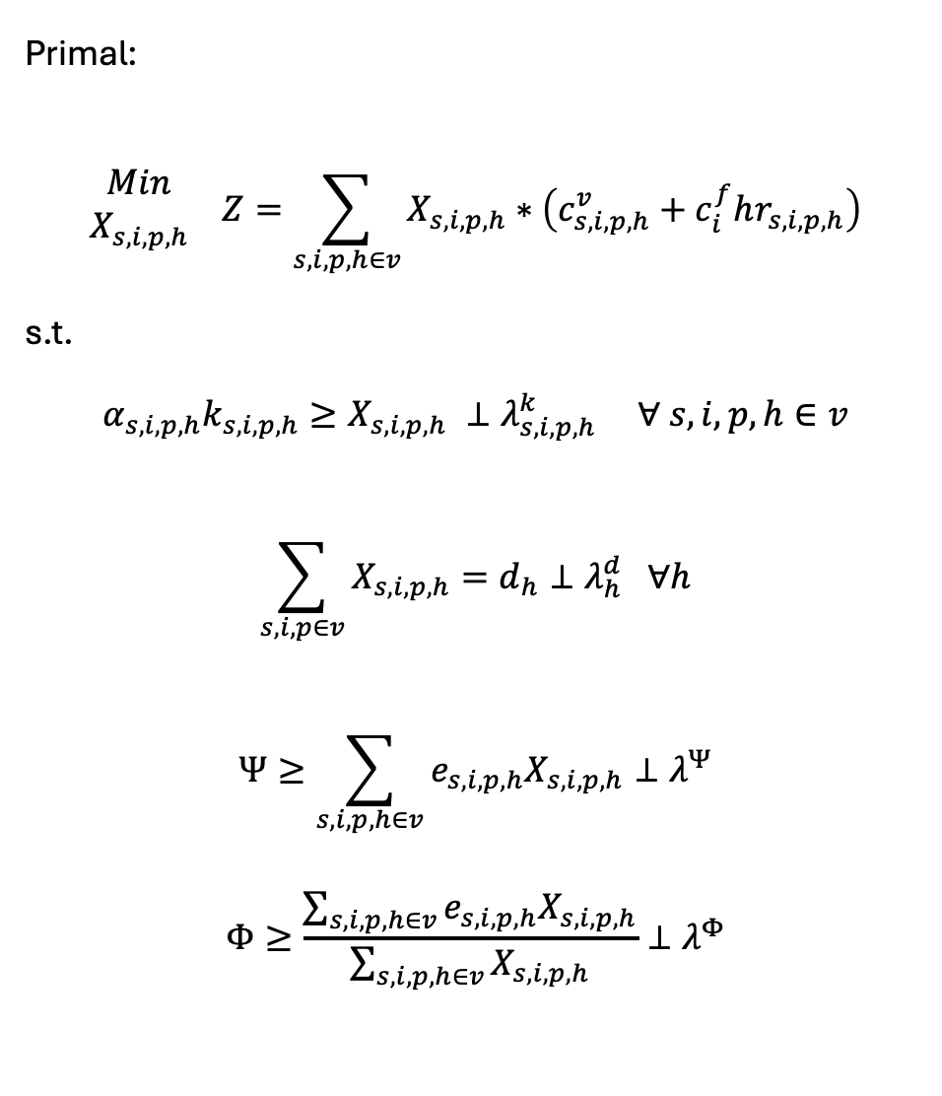
Primal:
$$\begin{matrix}Min \\ X_{s,i,p,h}\end{matrix} Z=\sum_{s,i,p,h∈v}{X_{s,i,p,h}}∗\left(c_{s,i,p,h}^{v}+c_{i}^{f}hr_{s,i,p,h}\right)$$
s.t.
$$α_{s,i,p,h}k_{s,i,p,h}≥X_{s,i,p,h} ⊥λ_{s,i,p,h}^{k} ∀ s,i,p,h∈v$$
$$\sum_{s,i,p∈v}{X_{s,i,p,h}}=d_{h}⊥λ_{h}^{d} ∀h$$
$$Ψ≥\sum_{s,i,p,h∈v}{e_{s,i,p,h}X_{s,i,p,h}}⊥λ^{Ψ}$$
$$Φ≥\frac{\sum_{s,i,p,h∈v}{e_{s,i,p,h}X_{s,i,p,h}}}{\sum_{s,i,p,h∈v}{X_{s,i,p,h}}}⊥λ^{Φ}$$
Dual:
$$\begin{matrix}Max \\ λ_{s,i,p,h}^{k},λ_{h}^{d},λ^{Ψ},λ^{Φ}\end{matrix} η=\sum_{h}{λ_{h}^{d}d_{h}}$$
$$−\sum_{s,i,p,h∈v}{λ_{s,i,p,h}^{k}α_{s,i,p,h}k_{s,i,p,h}}$$
$$−λ^{Ψ}Ψ−λ^{Φ}Φ$$
s.t.
$${ c}_{s,i,p,h}^{v}+c_{i}^{f}hr_{s,i,p,h}+λ_{s,i,p,h}^{k}$$
$$+ e_{s, i,p,h}λ^{Ψ}+λ^{Φ}\left(e_{s,i,p,h}−Ψ\right)$$
$$≥λ_{h}^{d}⊥X_{s, i,p,h} ∀ s,i,p,h∈v$$

Slide 21
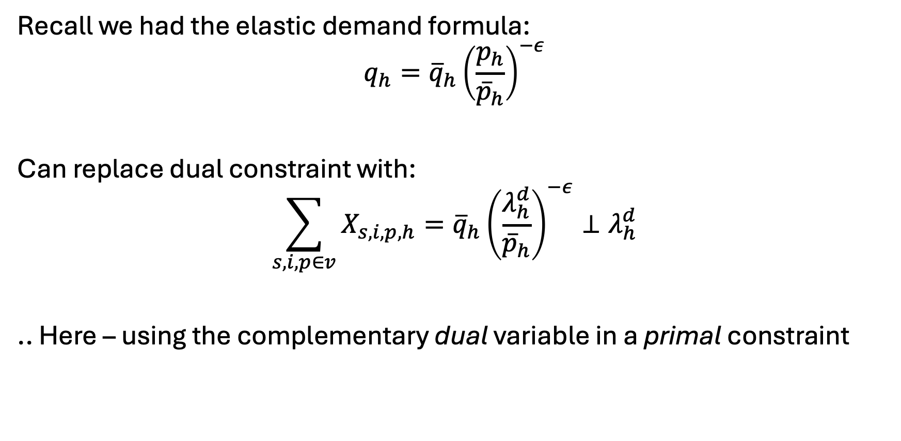
What about elastic demand?
Recall we had the elastic demand formula:
$$q_{h}={\overline{q}}_{h}{\left(\frac{p_{h}}{{\overline{p}}_{h}}\right)}^{−ε}$$
Can replace dual constraint with:
$$\sum_{s,i,p∈v}{X_{s,i,p,h}}={\overline{q}}_{h}{\left(\frac{λ_{h}^{d}}{{\overline{p}}_{h}}\right)}^{−ε}⊥λ_{h}^{d}$$
.. Here – using the complementary dual variable in a primal constraint

Slide 22
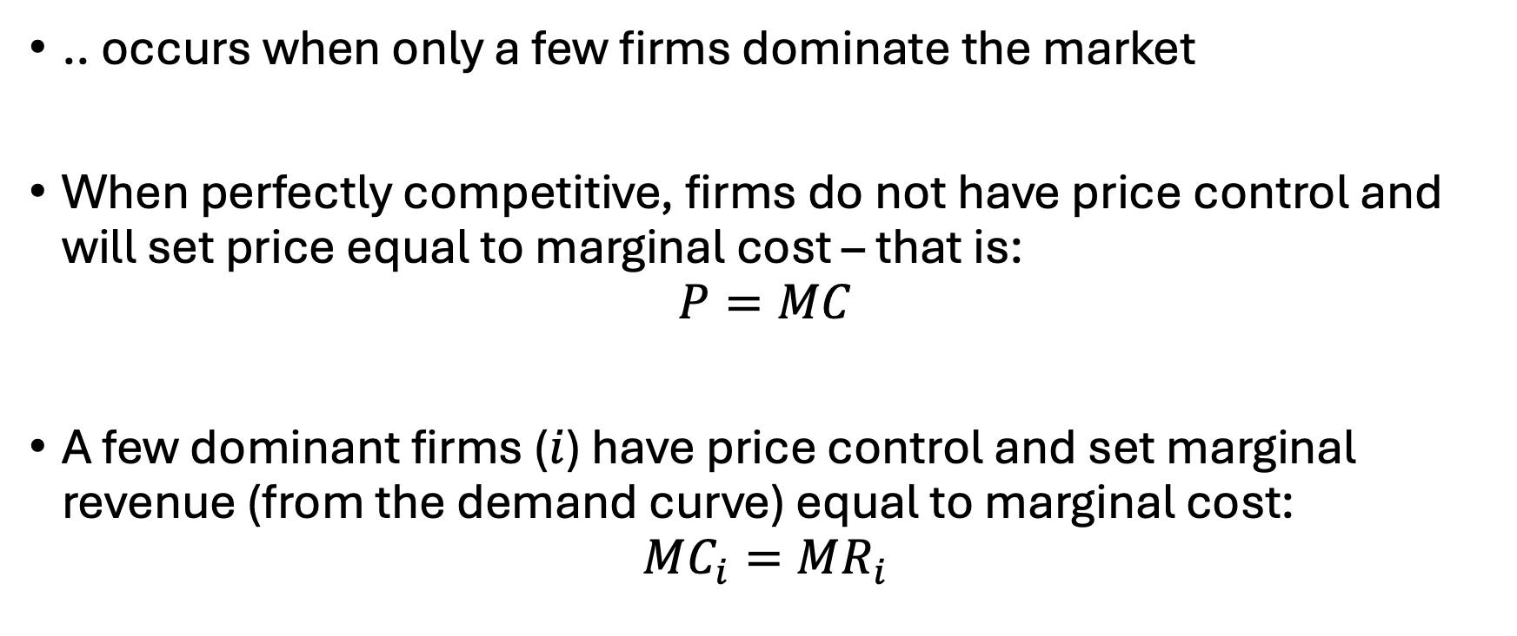
Oligopolistic Competition
.. occurs when only a few firms dominate the market
When perfectly competitive, firms do not have price control and will set price equal to marginal cost – that is:
$$P=MC$$
A few dominant firms ($i$) have price control and set marginal revenue (from the demand curve) equal to marginal cost:
$$MC_{i}=MR_{i}$$

Slide 23
Oligopolistic Competition
No longer…
maximizing social surplus as was done with supply and demand curves
able to aggregate objective functions as each firm is self-interested
Another perspective: Each firm is interacting in a shared market but acting individually in their own, profit-maximizing way
… thus can’t simply sumand maximize profits

Slide 24
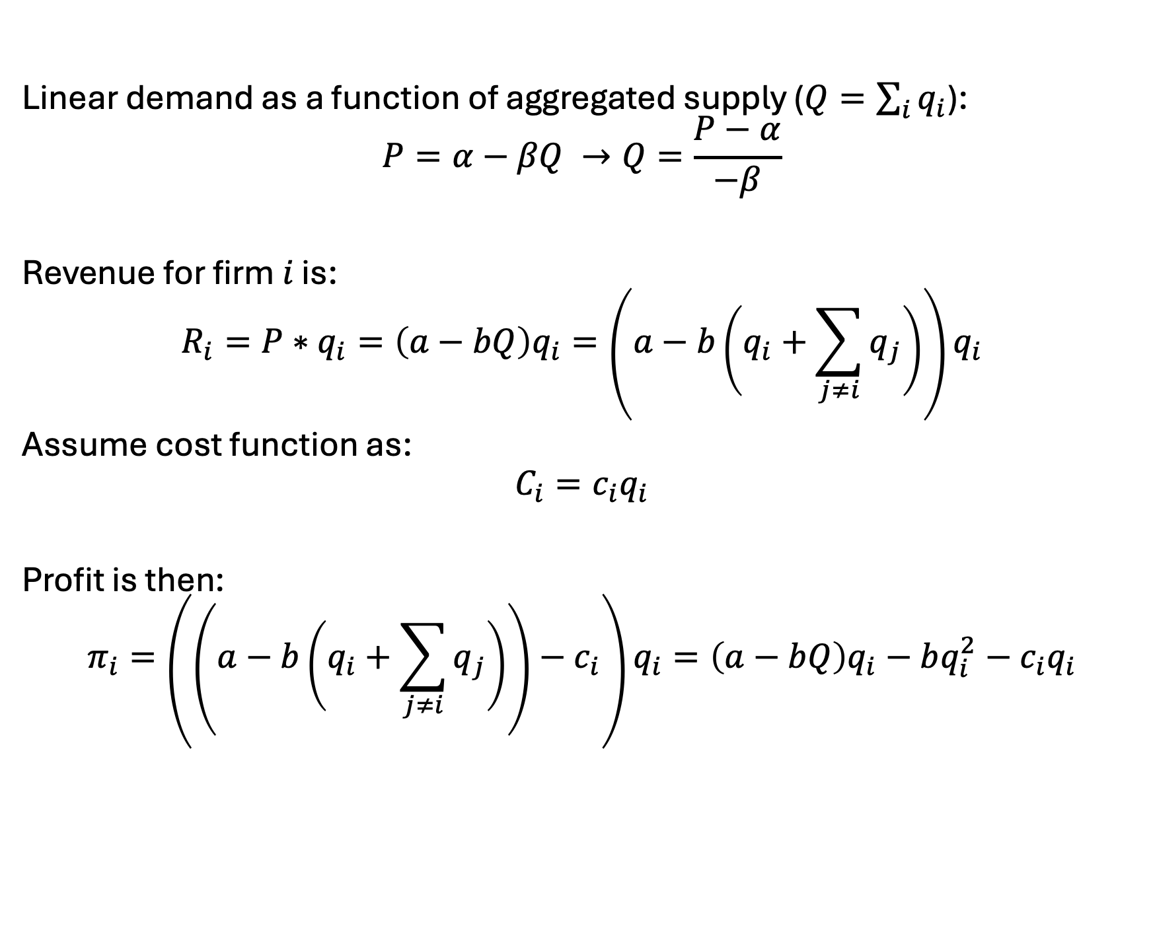
Cournot model derivation
Linear demand as a function of aggregated supply ($Q=\sum_{i}{q_{i}}$):
$$P=α−βQ →Q=\frac{P−α}{−β}$$
Revenue for firm $i$ is:
$$R_{i}=P∗q_{i}=\left(a−bQ\right)q_{i}=\left(a−b\left(q_{i}+\sum_{j≠i}{q_{j}}\right)\right)q_{i}$$
Assume cost function as:
$$C_{i}=c_{i}q_{i}$$
Profit is then:
$$π_{i}=\left(\left(a−b\left(q_{i}+\sum_{j≠i}{q_{j}}\right)\right)−c_{i}\right)q_{i}=\left(a−bQ\right)q_{i}−bq_{i}^{2}−c_{i}q_{i}$$

Slide 25
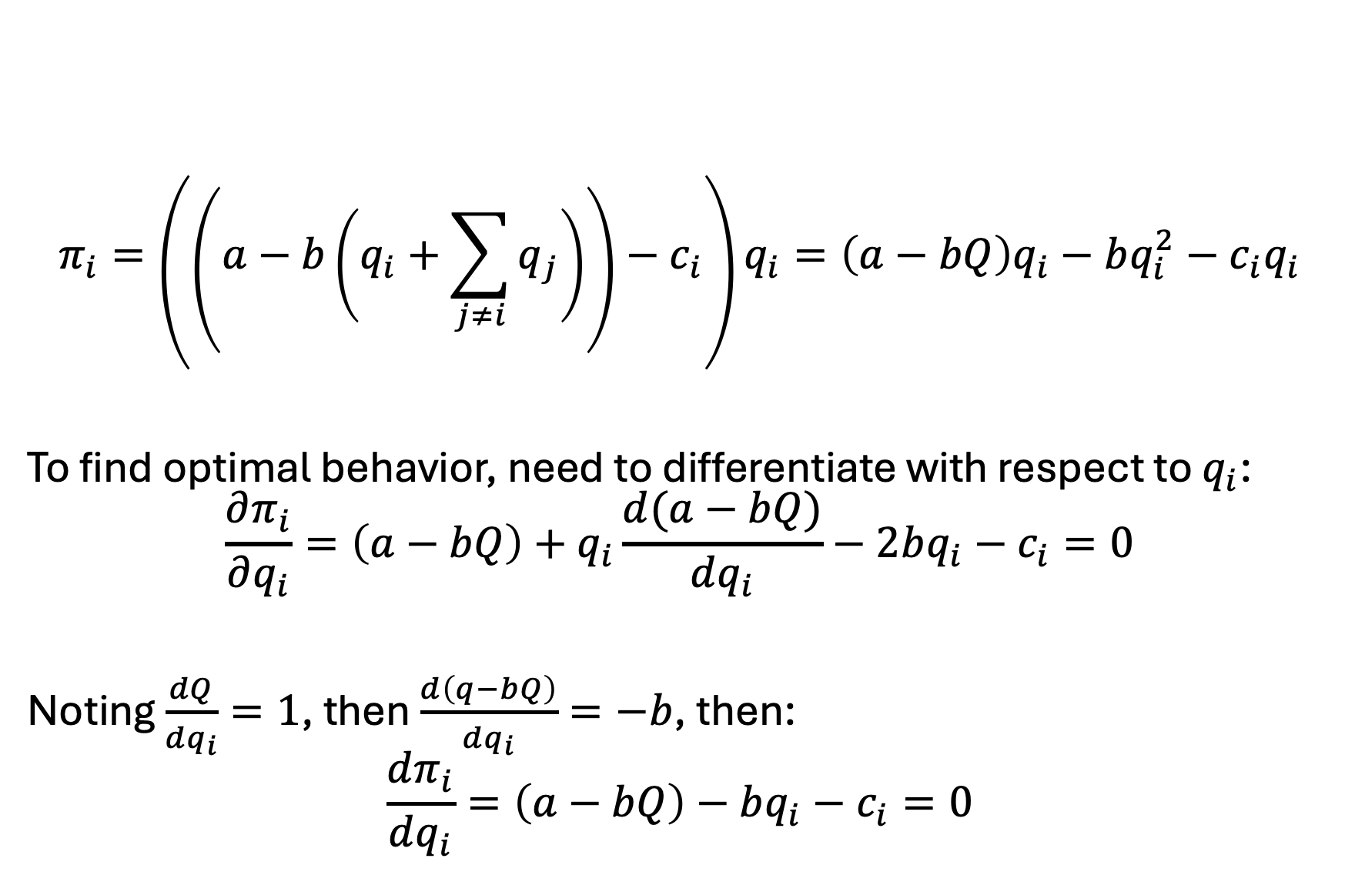
Cournot model derivation
$$π_{i}=\left(\left(a−b\left(q_{i}+\sum_{j≠i}{q_{j}}\right)\right)−c_{i}\right)q_{i}=\left(a−bQ\right)q_{i}−bq_{i}^{2}−c_{i}q_{i}$$
To find optimal behavior, need to differentiate with respect to $q_{i}$:
$$\frac{∂π_{i}}{∂q_{i}}=\left(a−bQ\right)+q_{i}\frac{d(a−bQ)}{dq_{i}}−2bq_{i}−c_{i}=0$$
Noting $\frac{dQ}{dq_{i}}=1$, then $\frac{d\left(q−bQ\right)}{dq_{i}}=−b$, then:
$$\frac{dπ_{i}}{dq_{i}}=\left(a−bQ\right)−bq_{i}−c_{i}=0$$

Slide 26

Cournot model derivation
$$\frac{dπ_{i}}{dq_{i}}=\left(a−bQ\right)−bq_{i}−c_{i}=0$$
Implies (a) $MR_{i}=MC_{i}$ and (b):
$$q_{i}^{∗}=\frac{a−c_{i}−bQ}{b}$$

Slide 27
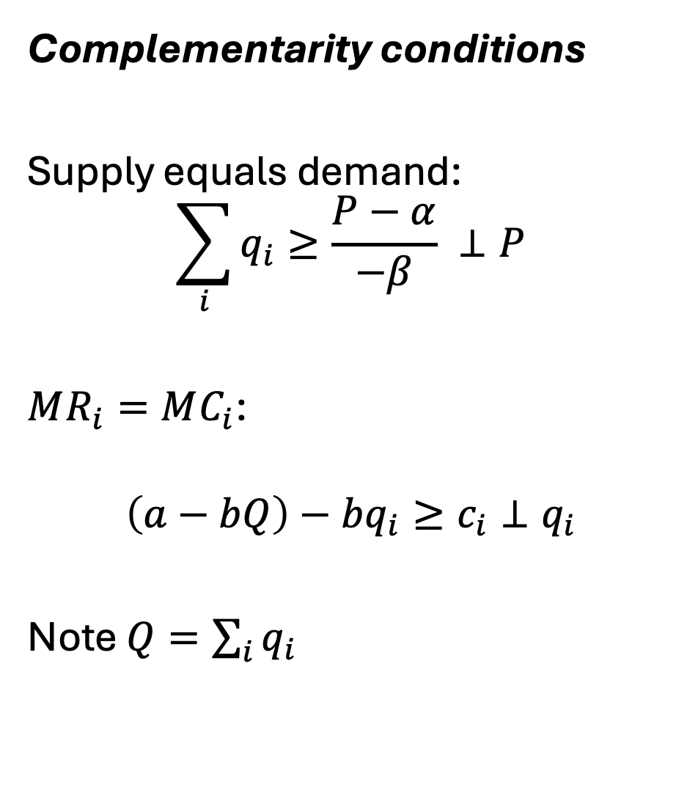
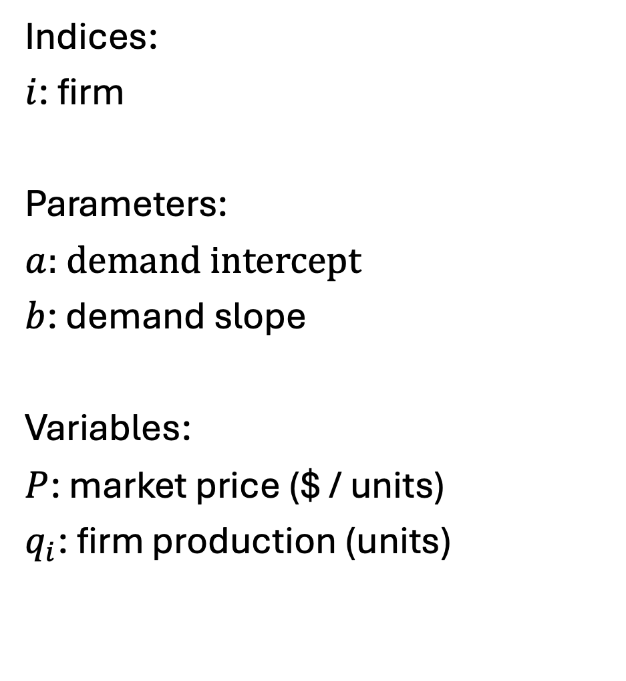
Cournot model as an MCP (linear)
Indices:
$i$: firm
Parameters:
$a$: demand intercept
$b$: demand slope
Variables:
$P$: market price ($ / units)
$q_{i}$: firm production (units)
Complementarity conditions
Supply equals demand:
$$\sum_{i}{q_{i}}≥\frac{P−α}{−β} ⊥P$$
$MR_{i}=MC_{i}$:
$$\left(a−bQ\right)−bq_{i}≥c_{i}⊥q_{i}$$
Note $Q=\sum_{i}{q_{i}}$

Slide 28
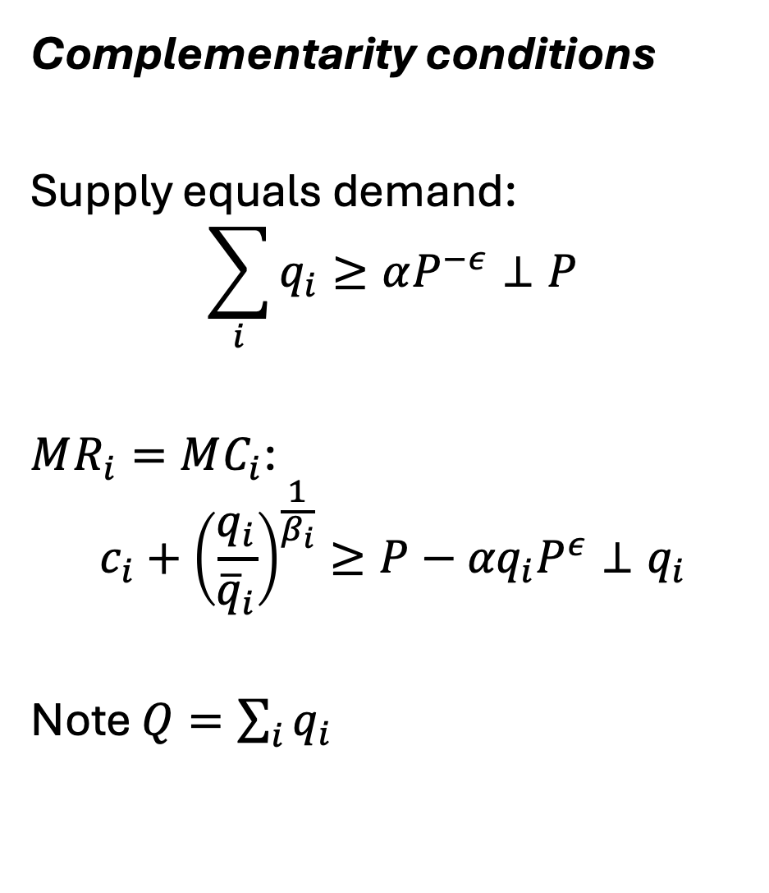
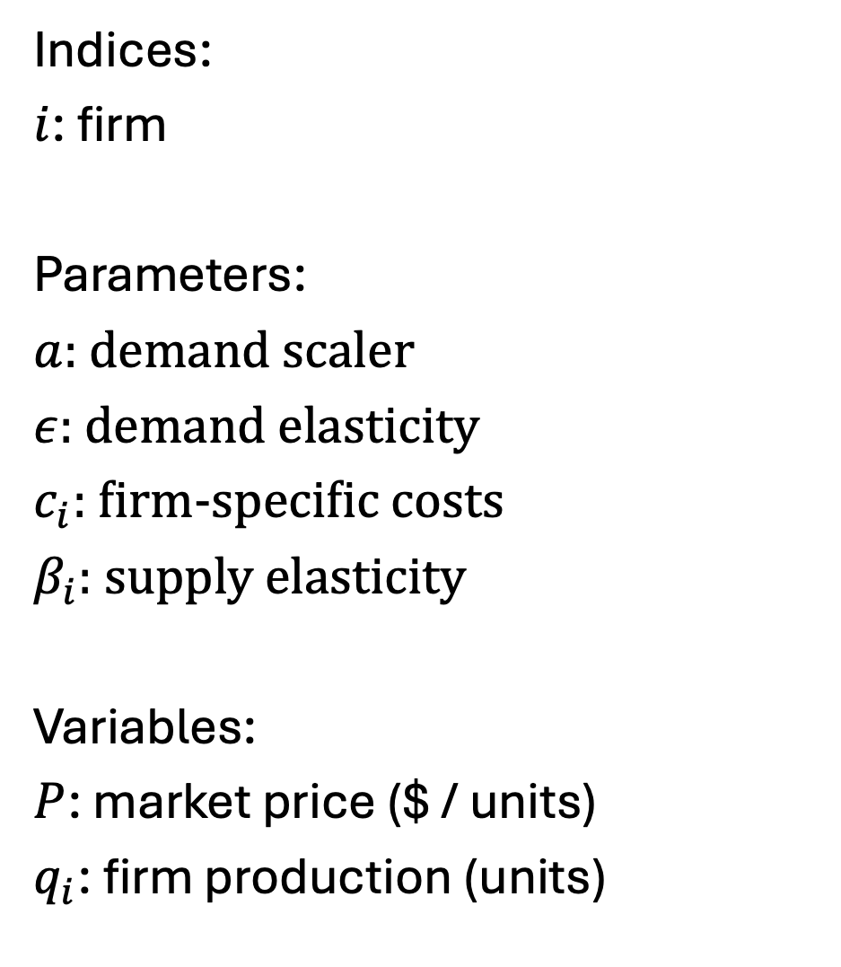
Cournot model as an MCP – from Murphy et al. 1982
Indices:
$i$: firm
Parameters:
$a$: demand scaler
$ε$: demand elasticity
$c_{i}$: firm-specific costs
$β_{i}$: supply elasticity
Variables:
$P$: market price ($ / units)
$q_{i}$: firm production (units)
Complementarity conditions
Supply equals demand:
$$\sum_{i}{q_{i}}≥αP^{−ε}⊥P$$
$MR_{i}=MC_{i}$:
$$c_{i}+{\left(\frac{q_{i}}{{\overline{q}}_{i}}\right)}^{\frac{1}{β_{i}}}≥P−{αq}_{i}P^{ε}⊥q_{i}$$
Note $Q=\sum_{i}{q_{i}}$

Slide 29

Note on deriving MC curves
Original function:
$$f_{i}=c_{i}∗q_{i}+\frac{β_{i}}{β_{i}+1 }\frac{q^{β_{i}+1}}{{\overline{q}}_{i}^{\frac{1}{β_{i}}}β}$$
Implies:
$$\frac{df_{i}}{dq_{i}}=c_{i}+{\left(\frac{q_{i}}{{\overline{q}}_{i}}\right)}^{\frac{1}{β_{i}}}$$
From the wild west times of functional forms…

Slide 30
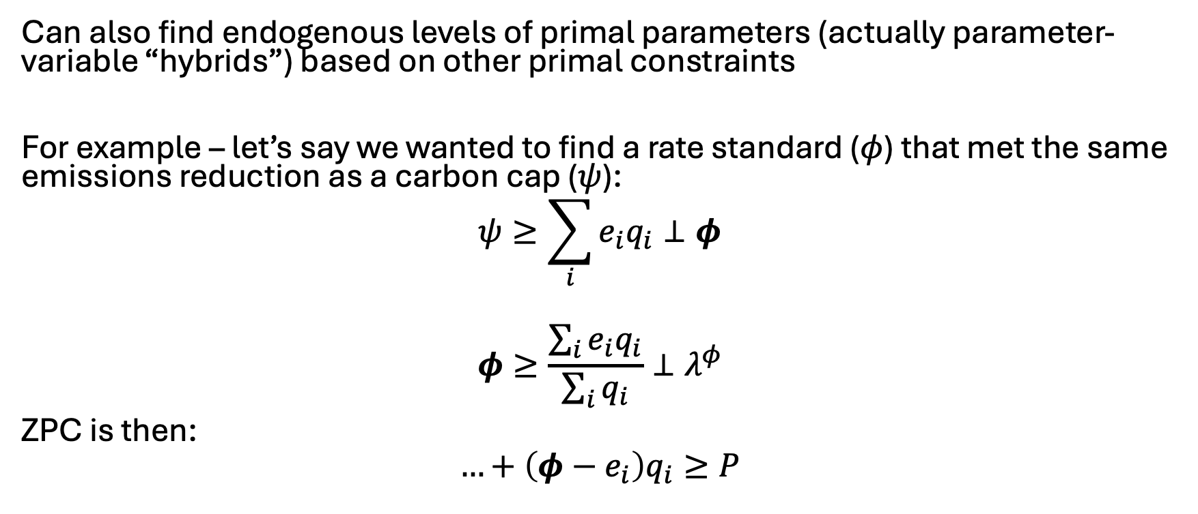
An MCP ‘hack’
Can also find endogenous levels of primal parameters (actually parameter-variable “hybrids”) based on other primal constraints
For example – let’s say we wanted to find a rate standard ($φ$) that met the same emissions reduction as a carbon cap ($ψ$):
$$ψ≥\sum_{i}{e_{i}q_{i}}⊥φ$$
$$φ≥\frac{\sum_{i}{e_{i}q_{i}}}{\sum_{i}{q_{i}}}⊥λ^{φ}$$
ZPC is then:
$$…+\left(φ−e_{i}\right)q_{i}≥P$$

Slide 31
Next up…
CGE models (~1 week)
MPECs/EPECs (~1 week)
Know presentations are taking a lot of time.. If can’t get to these in class, will send around recordings for those interested

