Slide 1
EBGN645: Day 13

Slide 2
Some notes
(short) homework will be assigned October 14th, Due October 28th
Topics:
Adding linearized demand
Non-linear utility optimization (covering this next week)
Your project
Class on Monday November 25th is optional
Several students already planning to be gone
Can take requests on anything you might find interesting

Slide 3
Agenda
Starting with NLPs today
Review of why we need NLPs
Multiple variables
Non-monotonic relationships (economies of scale)
Examples:
Calibrated market models of social surplus maximization
Utility maximization of multiple goods
Ramsey model

Slide 4
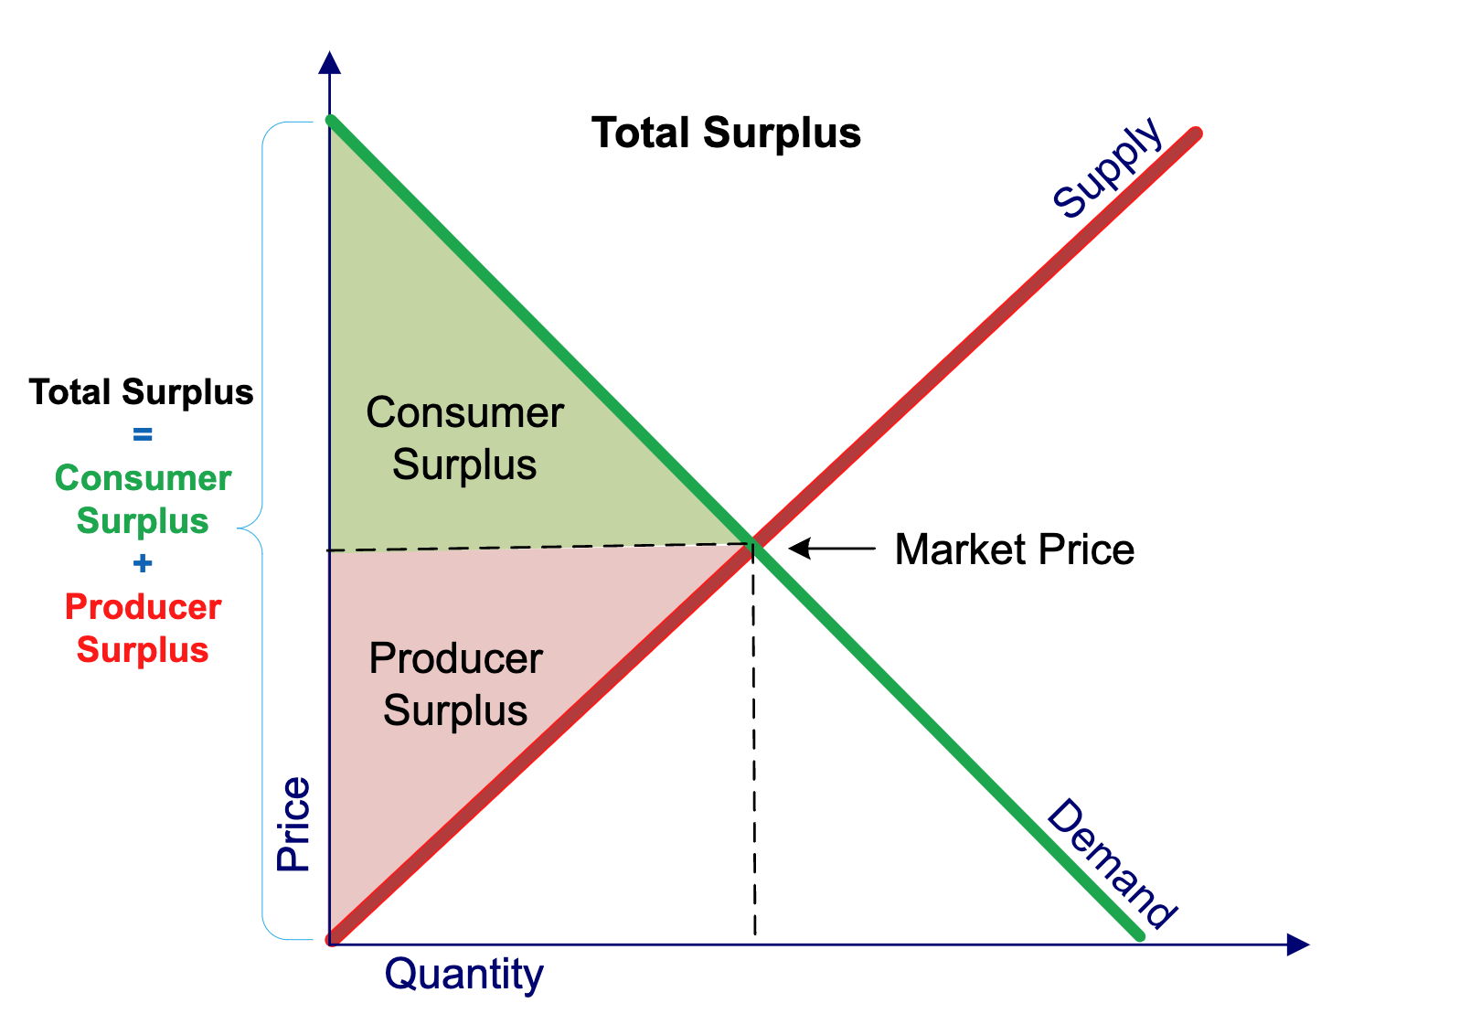
Partial equilibrium - social surplus maximization

Slide 5

Calibrated market models
Let’s set up a simple supply/demand model:
$$Q_{d}=Q_{s}$$
$$Q_{d}=a−bP$$
$$Q_{s}=c+dP$$
(all parameters/variables are positive)

Slide 6
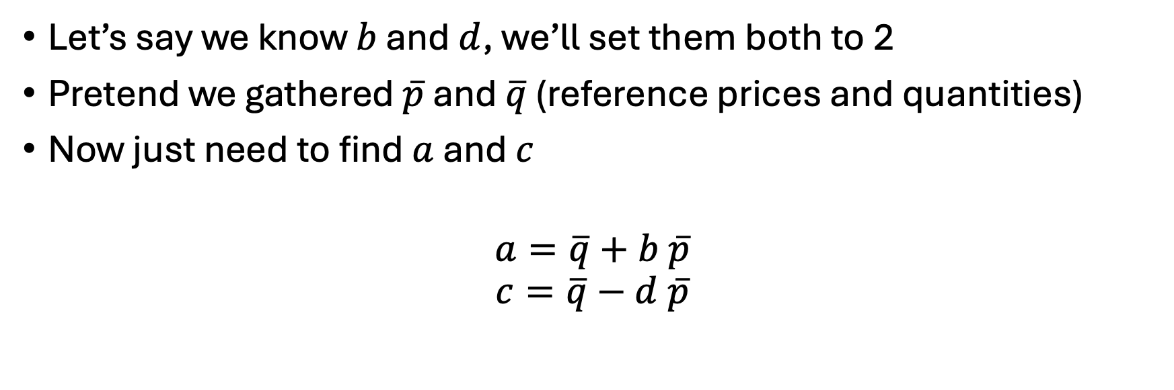
How to set the parameters?
Let’s say we know $b$ and $d$, we’ll set them both to 2
Pretend we gathered $\overline{p}$ and $\overline{q}$ (reference prices and quantities)
Now just need to find $a$ and $c$
$$a=\overline{q}+b \overline{p}$$
$$c=\overline{q}−d \overline{p}$$

Slide 7

However..
These are demand/supply functions.. Need inverse demand/supply functions
$$P=(a−Q_{d})/b$$
$$P=(Q_{s}−c)/d$$

Slide 8

Calibrated market models
$$P=(a−Q_{d})/b$$
$$P=(Q_{s}−c)/d$$
Let’s label…
$$a^{′}=\frac{a}{b}, b^{′}=\left(\frac{1}{b}\right), c^{′}=−\frac{c}{d},d^{′}=\left(\frac{1}{d}\right)$$
Can rewrite as:
$$P=a^{′}−b^{′}Q_{d}$$
$$P=c^{′}+d^{′}Q_{s}$$

Slide 9
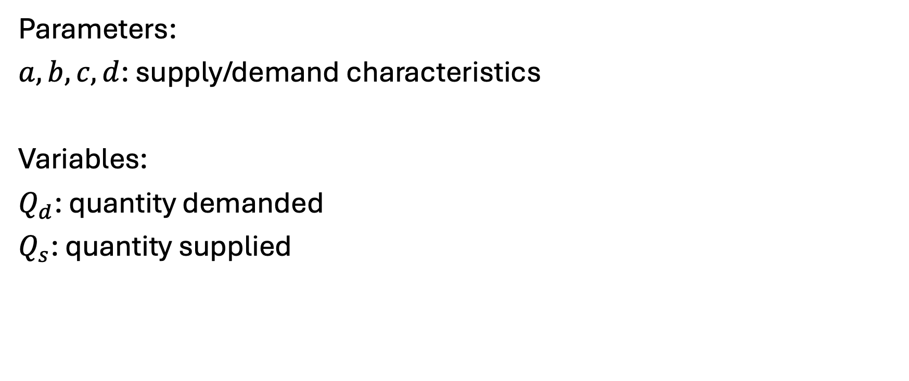
Model – indices (none), parameters, variables
Parameters:
$a,b,c,d$: supply/demand characteristics
Variables:
$Q_{d}$: quantity demanded
$Q_{s}$: quantity supplied

Slide 10
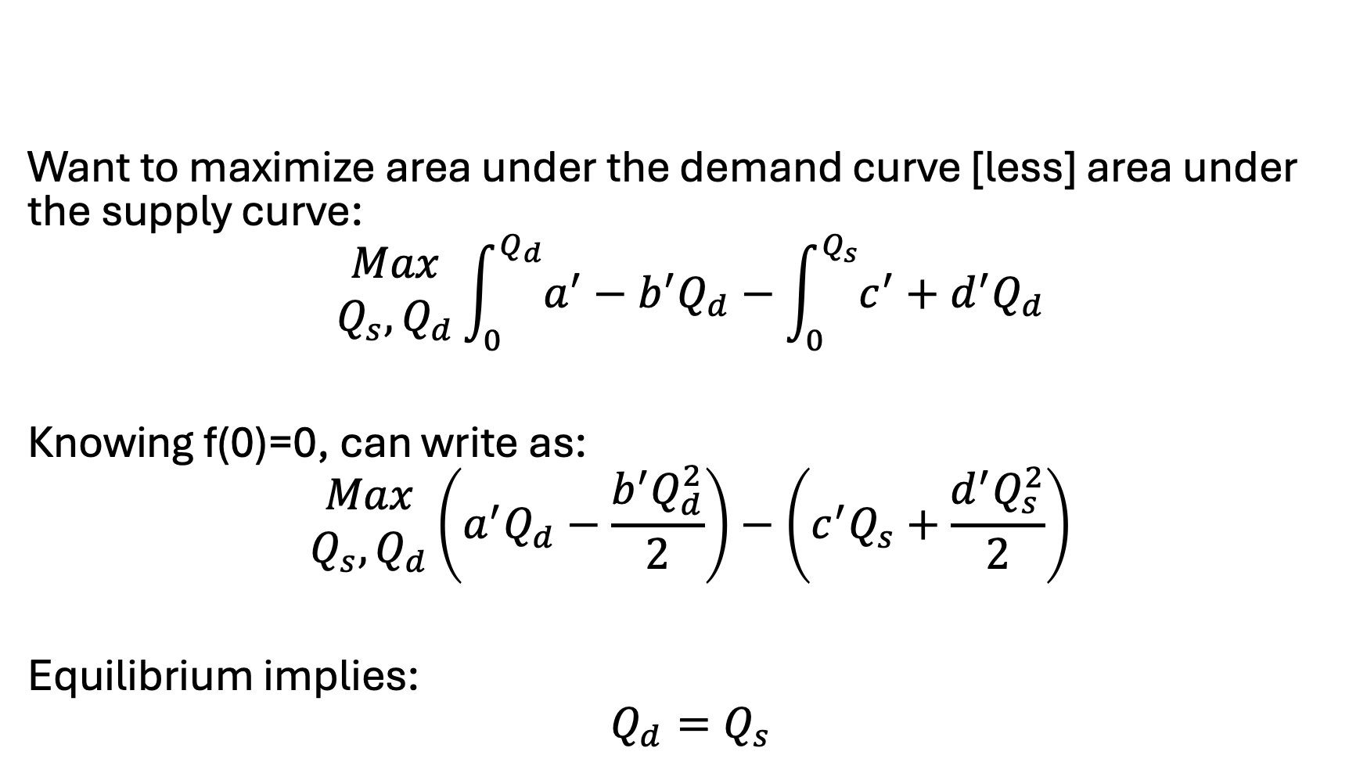
Model – objective function
Want to maximize area under the demand curve [less] area under the supply curve:
$$\begin{matrix}Max \\ Q_{s}, Q_{d}\end{matrix}\int_{0}^{Q_{d}}{a^{′}−b^{′}Q_{d}}−\int_{0}^{Q_{s}}{c^{′}+d^{′}Q_{d}}$$
Knowing f(0)=0, can write as:
$$\begin{matrix}Max \\ Q_{s}, Q_{d}\end{matrix}\left(a^{′}Q_{d}−\frac{b^{′}Q_{d}^{2}}{2}\right)−\left(c^{′}Q_{s}+\frac{d^{′}Q_{s}^{2}}{2}\right)$$
Equilibrium implies:
$$Q_{d}=Q_{s}$$

Slide 11

Let’s put this simple model in GAMS…
Assuming: $\overline{p}=\overline{q}=1$
Assuming: $b=c=0.5$

Slide 12
Why could we linearize demand before?
Biggest takeaway: we only had one variable that was providing value (cost) to the model in our model
That is, we were only consuming electricity and it was the only thing providing value of consumption
No way to stay linear if two variables are interacting and providing value or cost to the model, examples:
Pizza and beer
Capital and labor
Shifting of demand across time
When there are tradeoffs or benefits to the interaction of different variables in the model, cannot stay linear

Slide 13
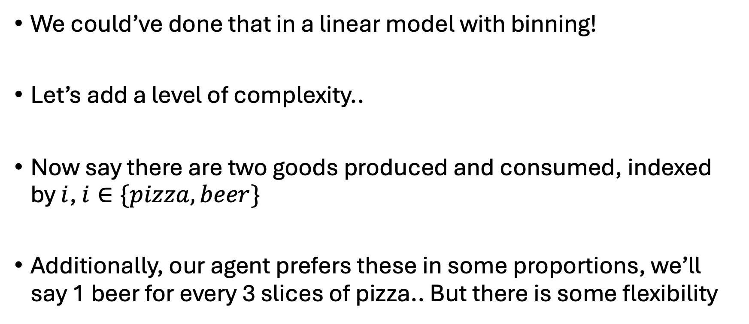
Easy enough… let’s expand
We could’ve done that in a linear model with binning!
Let’s add a level of complexity..
Now say there are two goods produced and consumed, indexed by $i$, $i∈\{pizza, beer\}$
Additionally, our agent prefers these in some proportions, we’ll say 1 beer for every 3 slices of pizza.. But there is some flexibility

Slide 14
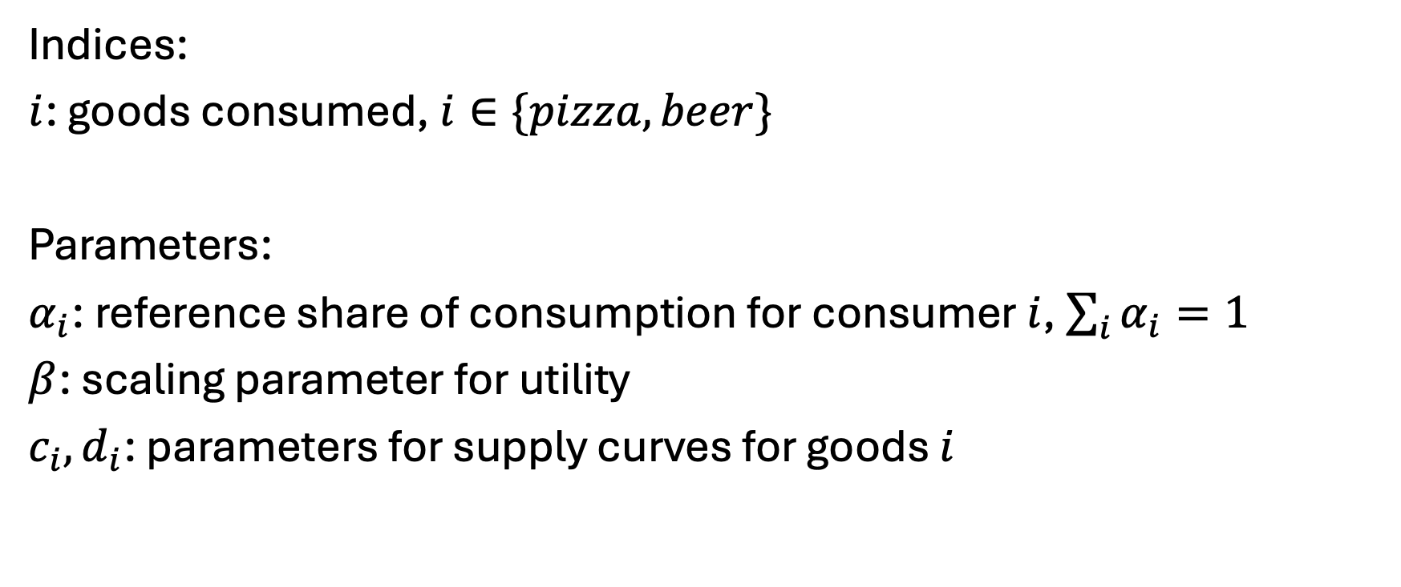
New model…
Indices:
$i$: goods consumed, $i∈\{pizza, beer\}$
Parameters:
$α_{i}$: reference share of consumption for consumer $i$, $\sum_{i}{α_{i}=1}$
$β$: scaling parameter for utility
$c_{i},d_{i}$: parameters for supply curves for goods $i$

Slide 15
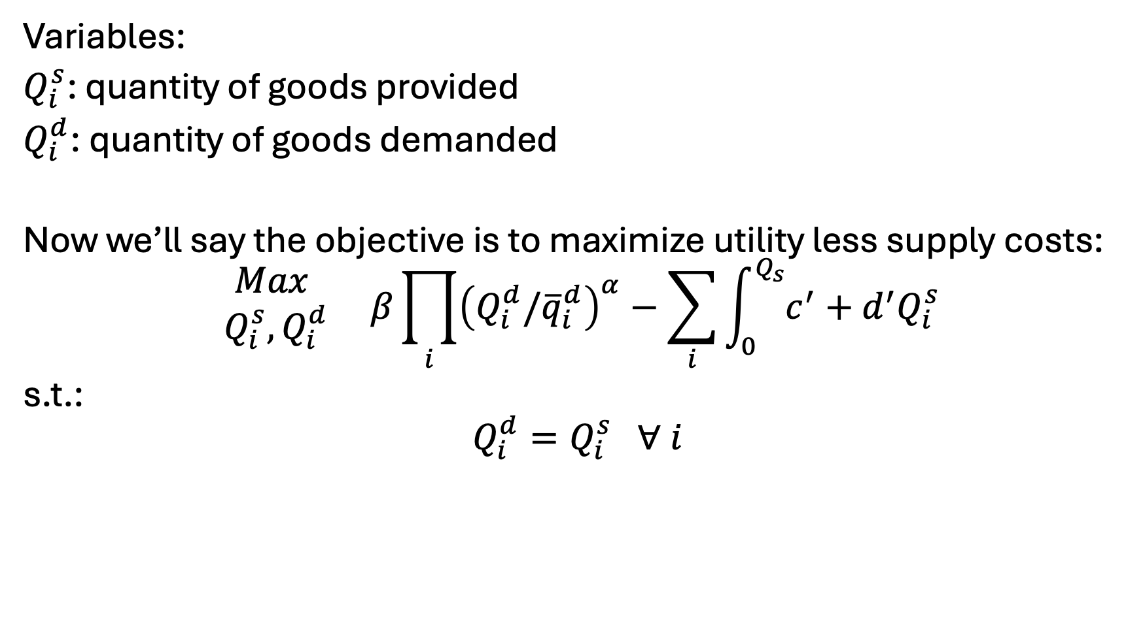
New model: Variables, Objective, Constraints
Variables:
$Q_{i}^{s}$: quantity of goods provided
$Q_{i}^{d}$: quantity of goods demanded
Now we’ll say the objective is to maximize utility less supply costs:
$$\begin{matrix}Max \\ Q_{i}^{s},Q_{i}^{d}\end{matrix} β\prod_{i}{{\left(Q_{i}^{d}/{\overline{q}}_{i}^{d}\right)}^{α}}−\sum_{i}{\int_{0}^{Q_{s}}{c^{′}+d^{′}Q_{i}^{s}}}$$
s.t.:
$$Q_{i}^{d}=Q_{i}^{s} ∀ i$$

Slide 16
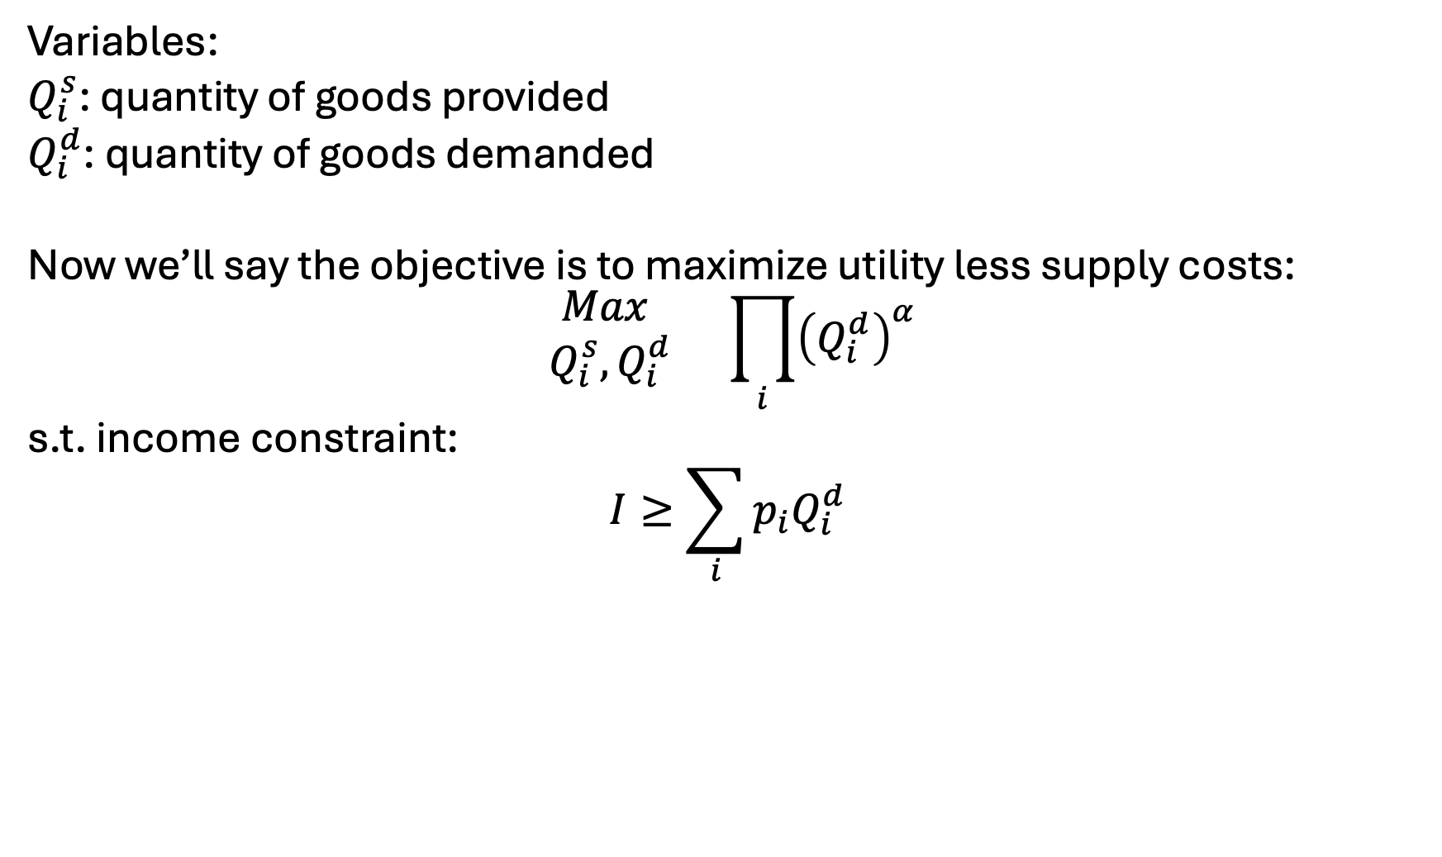
Alternatively can express with fixed prices…
Variables:
$Q_{i}^{s}$: quantity of goods provided
$Q_{i}^{d}$: quantity of goods demanded
Now we’ll say the objective is to maximize utility less supply costs:
$$\begin{matrix}Max \\ Q_{i}^{s},Q_{i}^{d}\end{matrix} \prod_{i}{{\left(Q_{i}^{d}\right)}^{α}}$$
s.t. income constraint:
$$I≥\sum_{i}{p_{i}Q_{i}^{d}}$$

Slide 17

Calibration in the alternative setup…
Need to only set $α_{i}$
Can determine relative weighting such that:
$$α_{i}=\frac{{\overline{q}}_{i}{\overline{p}}_{i}}{\sum_{i}{{\overline{q}}_{i}{\overline{p}}_{i} }}$$

Slide 18
Points of these exercises..
You can flexibly represent the consumption and production of goods in simplified setups
Ties it back to all our econ models – utility maximization, profit maximization, …
Presents a strong need for calibration and calibrated functional forms

Slide 19
Ramsey model – main points
(simple) economic growth model based on labor growth, capital accumulation, investment
Target of optimization is utility
Two variables define output: capital and labor
Concept of the steady state
Barr-Manne terminal investment condition

Slide 20
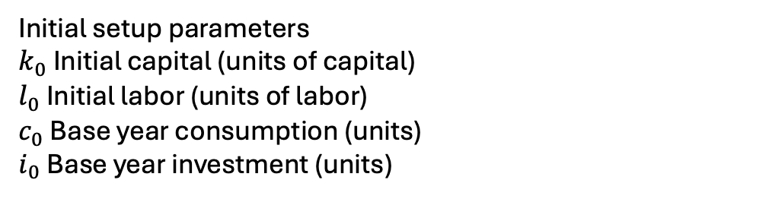

The Ramsey model – indices, parameters
Indices
$t$: time
$t_{0}$: initial period
$t_{T}$: final period
Parameters:
$β_{t}$: utility discount parameter
$g$ Labor growth rate in efficiency units (% / yr)
$δ$ Capital depreciation rate (% / yr)
$α$ Capital value share
$η$ Inverse intertemporal elasticity
$ρ$ Calibrated marginal product of capital
$a$ Cobb Douglas scale parameter;
Initial setup parameters
$k_{0}$ Initial capital (units of capital)
$l_{0}$ Initial labor (units of labor)
$c_{0}$ Base year consumption (units)
$i_{0}$ Base year investment (units)

Slide 21
Lets translate some of those parameters…

Slide 22
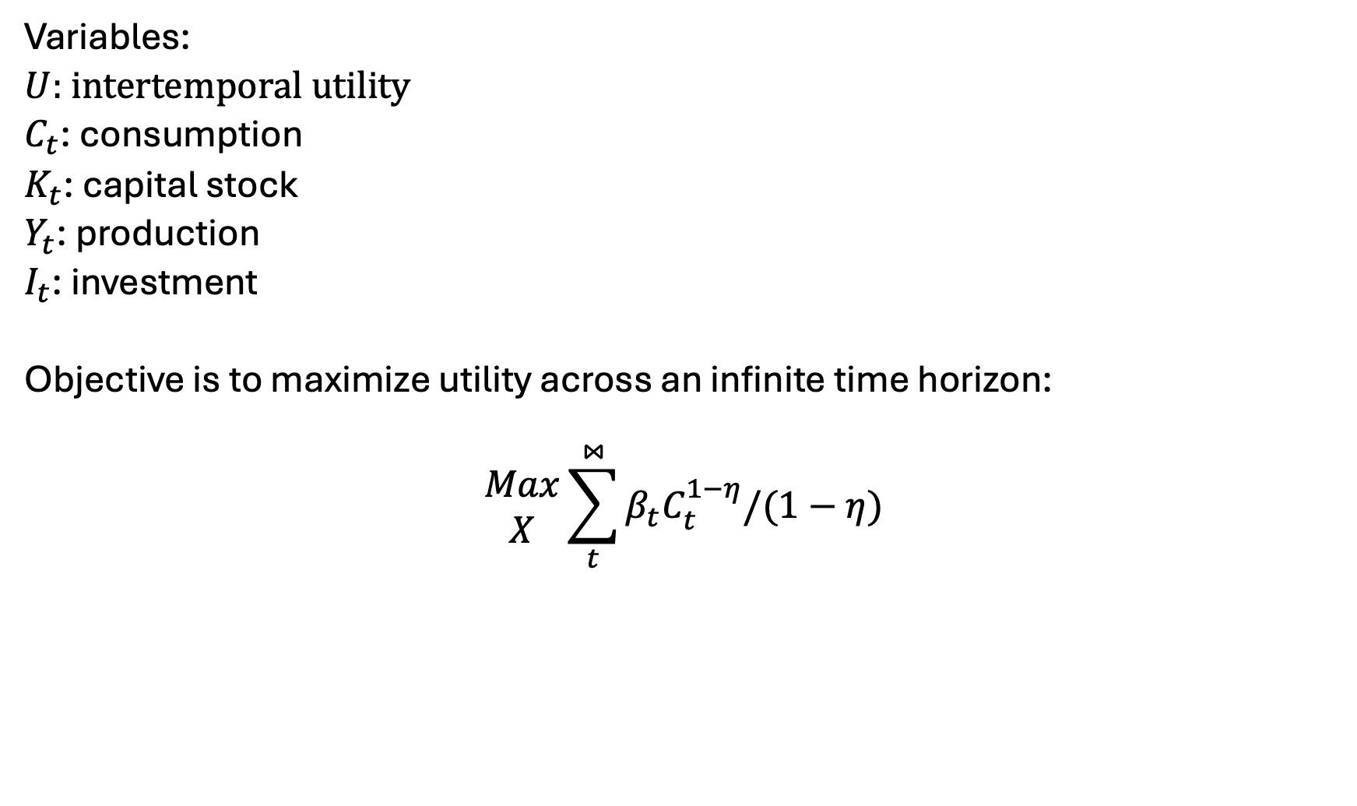
The Ramsey Model – Variables, Objective function
Variables:
$U$: intertemporal utility
$C_{t}$: consumption
$K_{t}$: capital stock
$Y_{t}$: production
$I_{t}$: investment
Objective is to maximize utility across an infinite time horizon:
$$\begin{matrix}Max \\ X\end{matrix}\sum_{t}^{⋈}{β_{t}C_{t}^{1−η}/(1−η)}$$

Slide 23
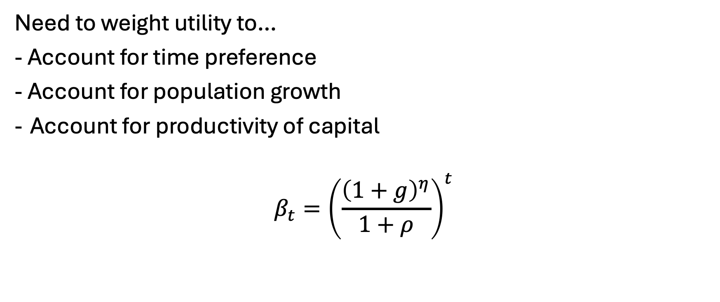
Setting the utility discount factor…
Need to weight utility to…
- Account for time preference
- Account for population growth
Account for productivity of capital
$$β_{t}={\left(\frac{{\left(1+g\right)}^{η}}{1+ρ}\right)}^{t}$$

Slide 24
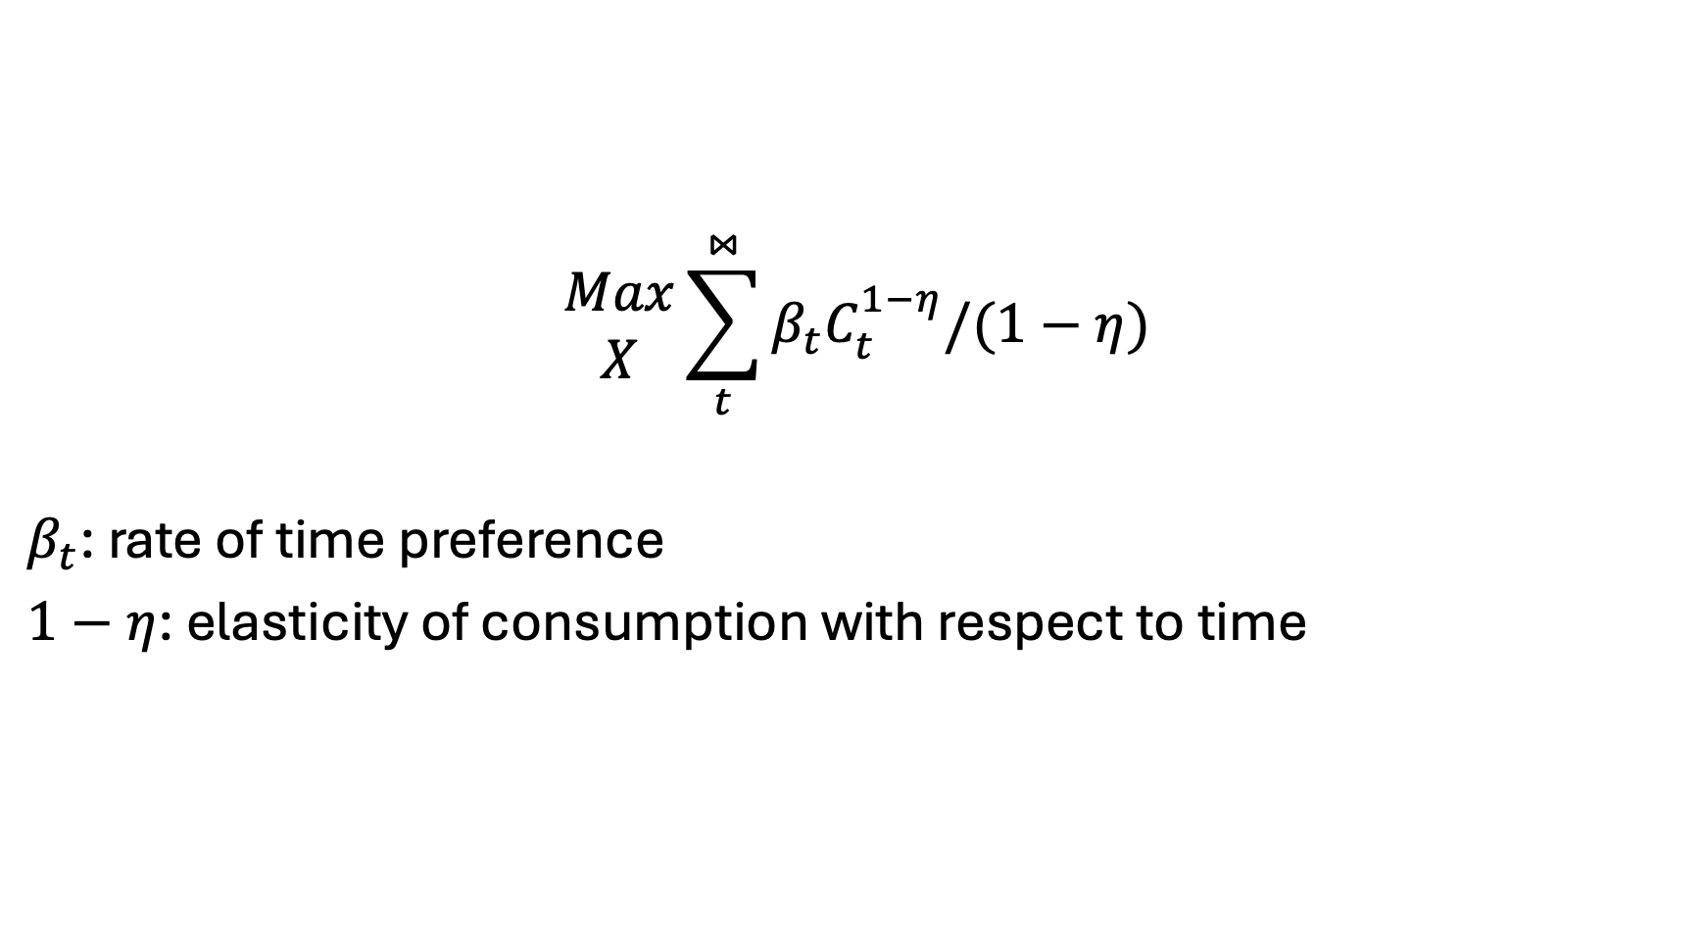
The Model – objective function breakdown
$$\begin{matrix}Max \\ X\end{matrix}\sum_{t}^{⋈}{β_{t}C_{t}^{1−η}/(1−η)}$$
$β_{t}$: rate of time preference
$1−η$: elasticity of consumption with respect to time

Slide 25
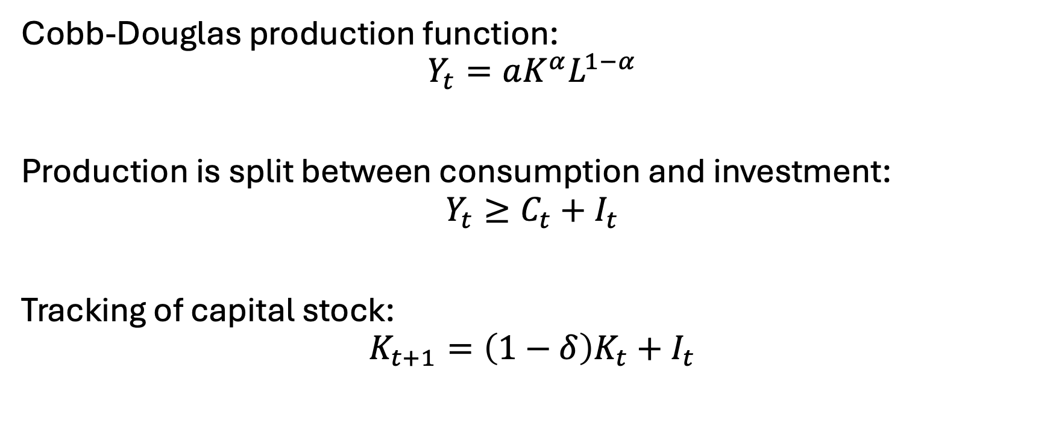
Constraints
Cobb-Douglas production function:
$$Y_{t}=aK^{α}L^{1−α}$$
Production is split between consumption and investment:
$$Y_{t}≥C_{t}+I_{t}$$
Tracking of capital stock:
$$K_{t+1}=\left(1−δ\right)K_{t}+I_{t}$$

Slide 26
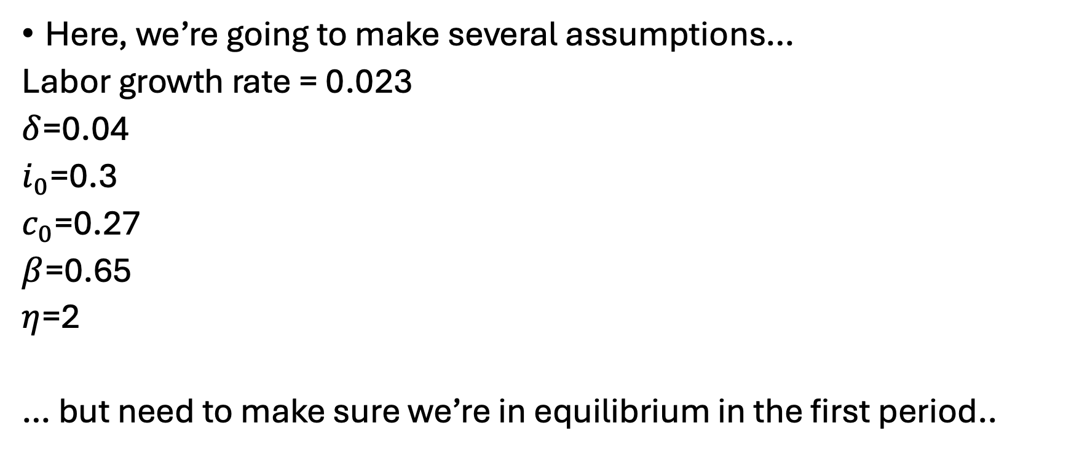
Calibration
Here, we’re going to make several assumptions…
Labor growth rate = 0.023
$δ$=0.04
$i_{0}$=0.3
$c_{0}$=0.27
$β$=0.65
$η$=2
… but need to make sure we’re in equilibrium in the first period..

Slide 27

Initial capital/labor calibration
Investment must cover depreciation plus population growth. Given the investment rate, we can back out the initial capital stock level. Knowing investment must cover initial capital stock’s expected growth rate and depreciation in the first period:
$$k_{0}\left(g+δ\right)=i_{0}$$
Can thus back out calibrated initial capital level:
$$k_{0}=\frac{i_{0}}{g+δ}$$
Labor supply is it’s share in production [times] initial production:
$$l_{0}=\left(1−α\right)∗(c_{0}+i_{0})$$
(exogenously-defined) labor grows at the labor growth rate:
$$l_{t}=l_{0}∗{\left(1+g\right)}^{t}$$

Slide 28
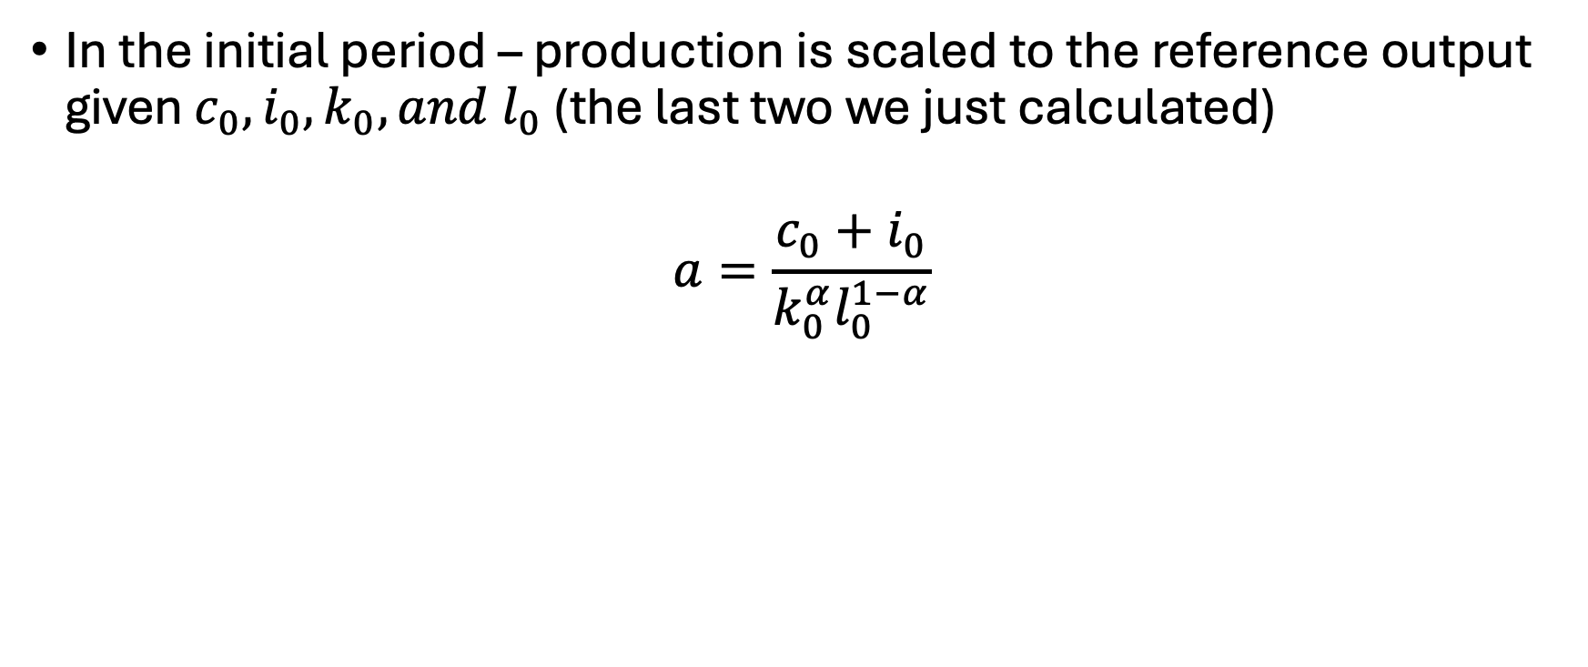
Calibrating the production scale parameter
In the initial period – production is scaled to the reference output given $c_{0}, i_{0},k_{0}, and l_{0}$ (the last two we just calculated)
$$a=\frac{c_{0}+i_{0}}{k_{0}^{α}l_{0}^{1−α}}$$

Slide 29
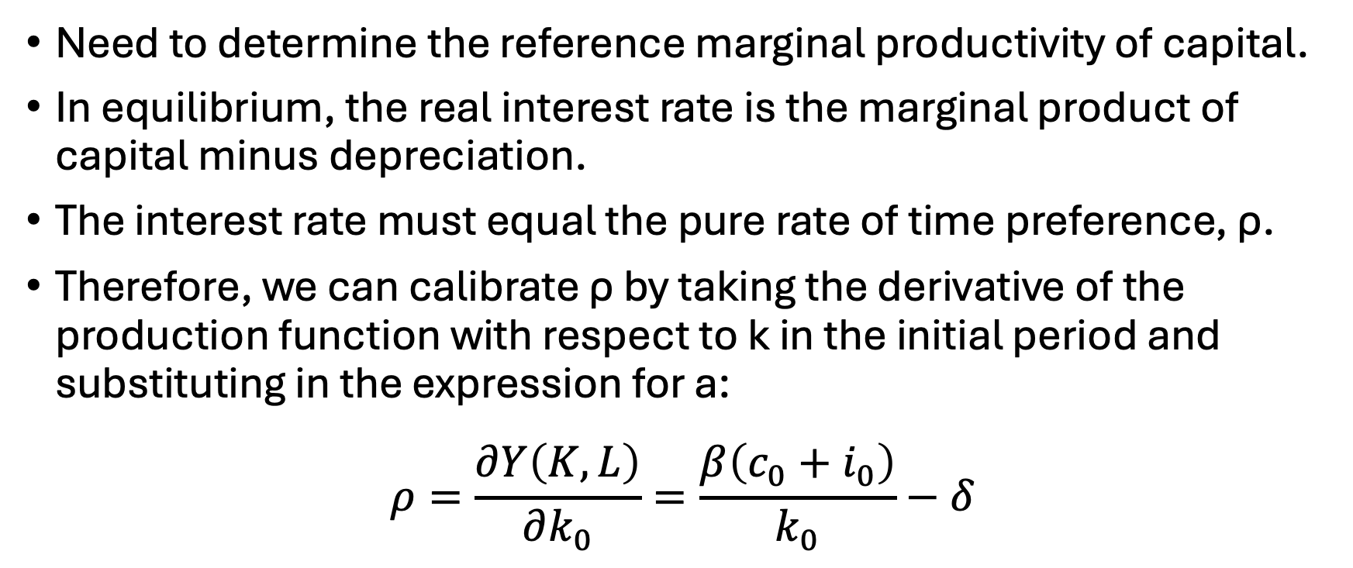
Calibrating the capital productivity
Need to determine the reference marginal productivity of capital.
In equilibrium, the real interest rate is the marginal product of capital minus depreciation.
The interest rate must equal the pure rate of time preference, ρ.
Therefore, we can calibrate ρ by taking the derivative of the production function with respect to k in the initial period and substituting in the expression for a:
$$ρ=\frac{∂Y\left(K,L\right)}{∂k_{0}}=\frac{β\left(c_{0}+i_{0}\right)}{k_{0}}−δ$$

Slide 30
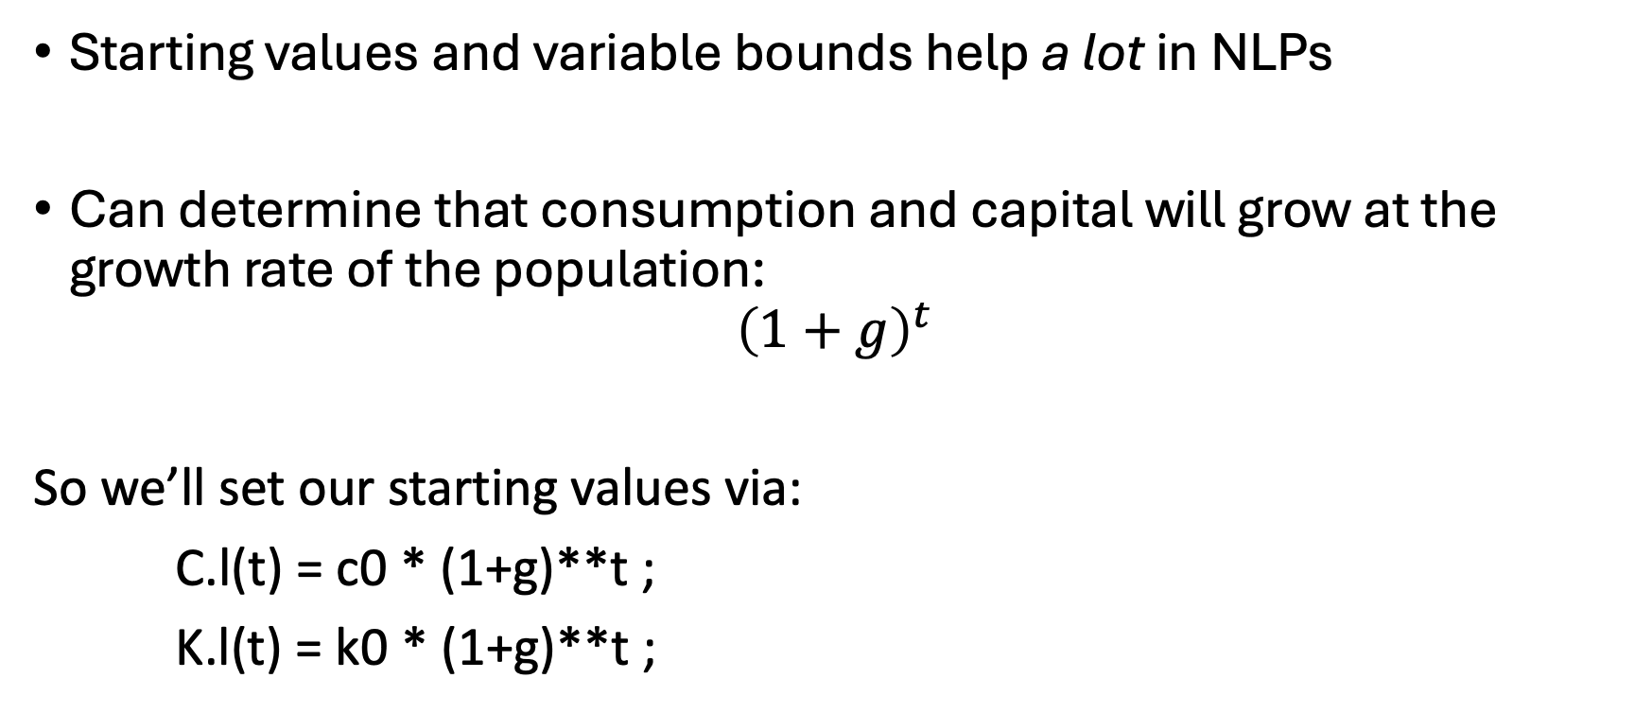
Some more notes…
Starting values and variable bounds help a lot in NLPs
Can determine that consumption and capital will grow at the growth rate of the population:
$${\left(1+g\right)}^{t}$$
So we’ll set our starting values via:
C.l(t) = c0 * (1+g)**t ;
K.l(t) = k0 * (1+g)**t ;

Slide 31
Some more notes..
Bounds on variables are needed to avoid mathematical problems
e.g. We don’t want consumption to be zero
C.lo(t) = 0.01 * C.l(t) ;
K.lo(t) = 0.01 * K.l(t) ;
Fix first period capital
K.fx(t)$tfirst(t) = k0 ;

Slide 32
Let’s build the base model…

Slide 33
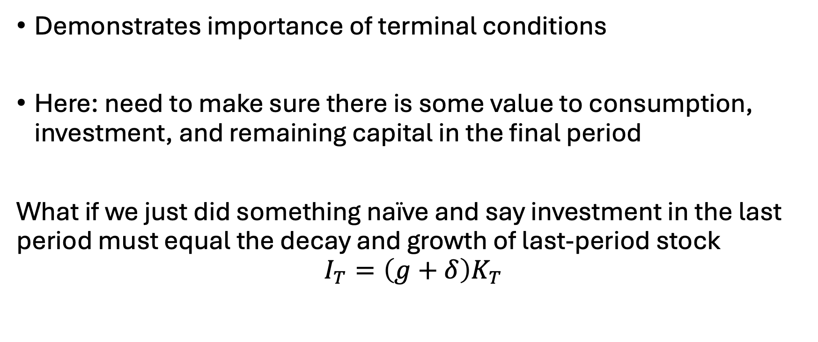
That’s weird…
Demonstrates importance of terminal conditions
Here: need to make sure there is some value to consumption, investment, and remaining capital in the final period
What if we just did something naïve and say investment in the last period must equal the decay and growth of last-period stock
$$I_{T}=\left(g+δ\right)K_{T}$$

Slide 34
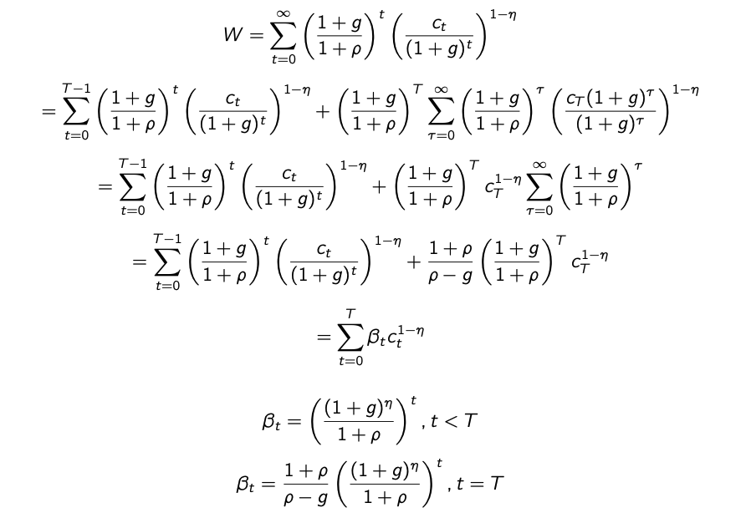
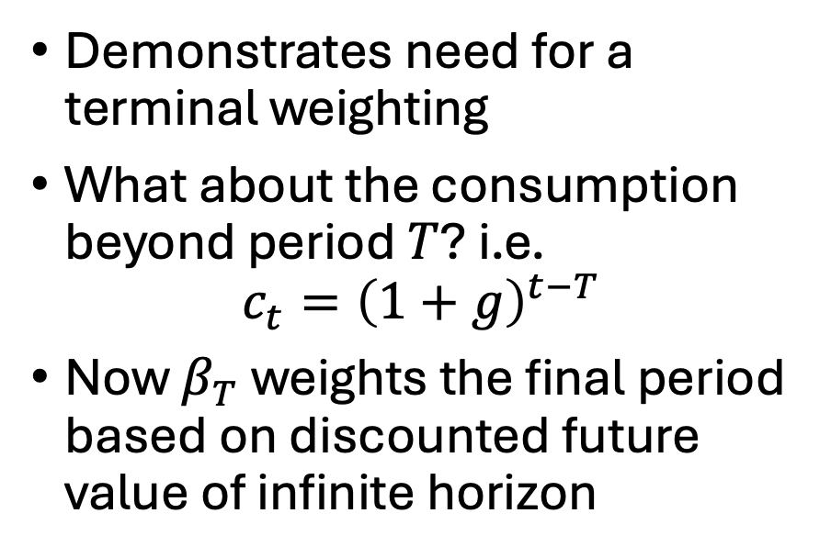
Plotting investment over time…
Demonstrates need for a terminal weighting
What about the consumption beyond period $T$? i.e.
$$c_{t}={\left(1+g\right)}^{t−T}$$
Now $β_{T}$ weights the final period based on discounted future value of infinite horizon

