Slide 1
EBGN645: Day 15

Slide 2
Some notes
Class on week of October 21st is cancelled – will send around recording
Need to figure out presentations schedule

Slide 3
Questions
Better explanation of applying NLP models

Slide 4
Agenda
Reviewing NLPs
Review of why we need NLPs
Multiple variables
Non-monotonic relationships (economies of scale)
Examples:
Calibrated market models of social surplus maximization
Utility maximization of multiple goods
Ramsey model

Slide 5
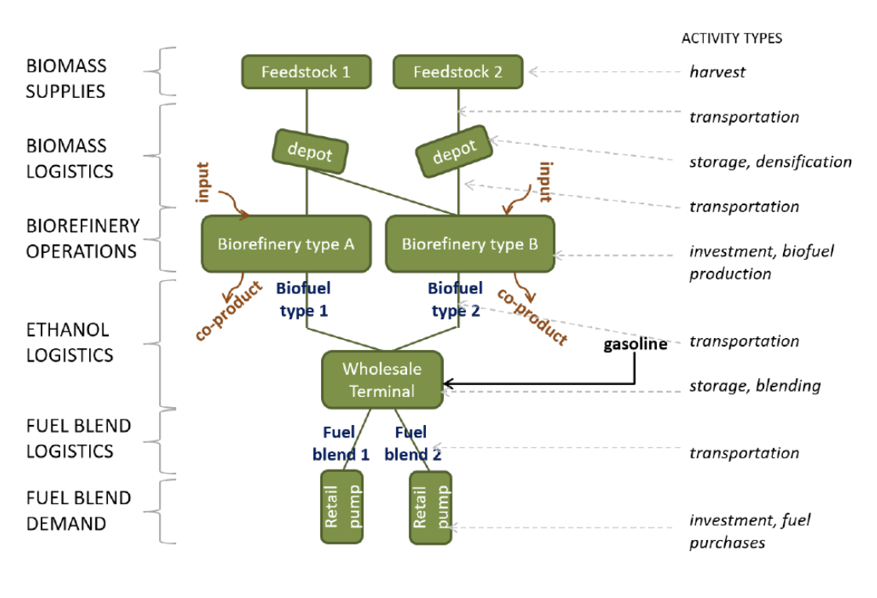
Market models – Example [I]

Slide 6
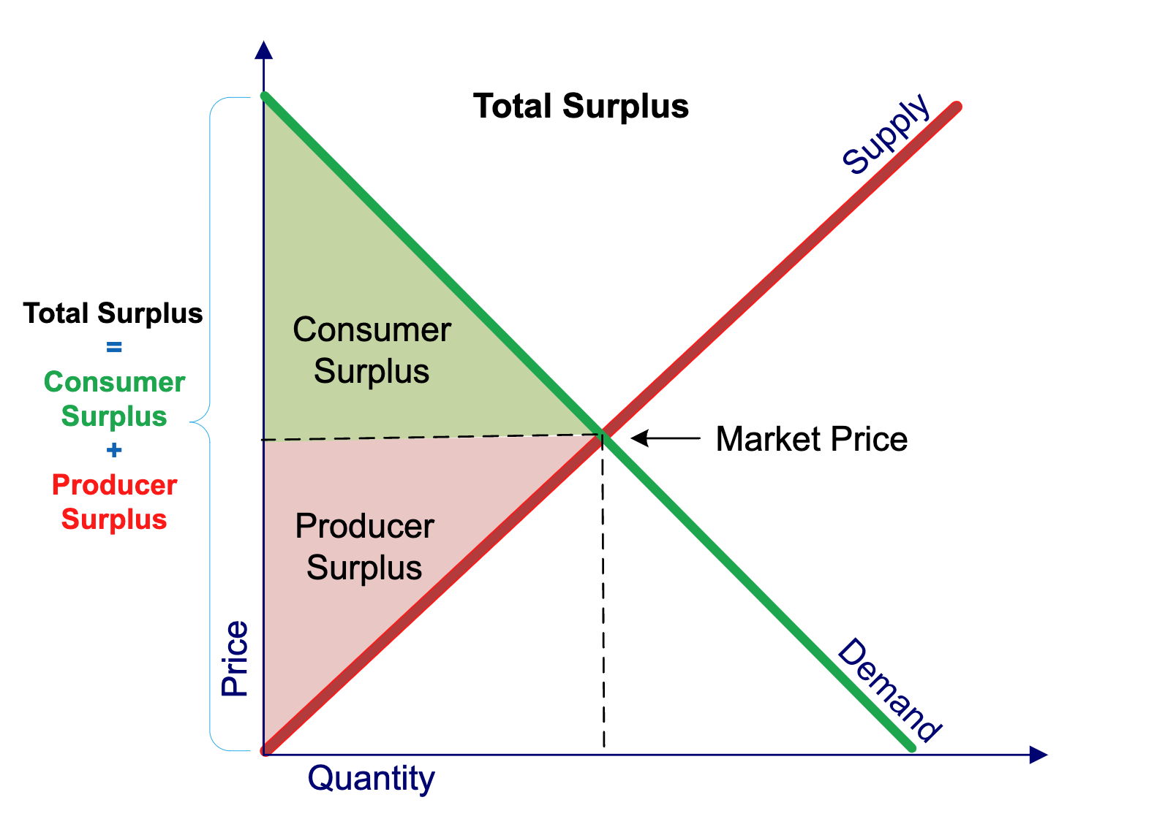
Partial equilibrium - social surplus maximization

Slide 7
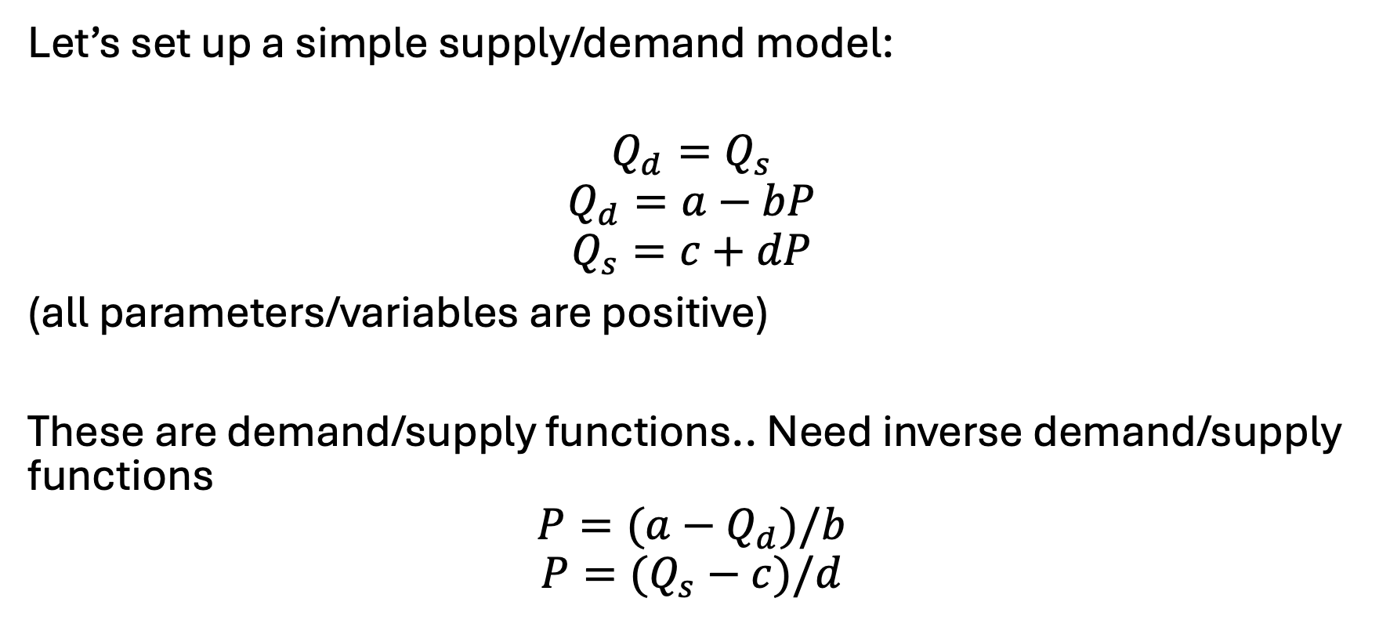
Calibrated market models
Let’s set up a simple supply/demand model:
$$Q_{d}=Q_{s}$$
$$Q_{d}=a−bP$$
$$Q_{s}=c+dP$$
(all parameters/variables are positive)
These are demand/supply functions.. Need inverse demand/supply functions
$$P=(a−Q_{d})/b$$
$$P=(Q_{s}−c)/d$$

Slide 8


Calibrated market models
$$Q_{d}=Q_{s}$$
$$Q_{d}=a−bP$$
$$Q_{s}=c+dP$$
$$P=(a−Q_{d})/b$$
$$P=(Q_{s}−c)/d$$
Let’s label…
$$a^{′}=\frac{a}{b}, b^{′}=\left(\frac{1}{b}\right), c^{′}=−\frac{c}{d},d^{′}=\left(\frac{1}{d}\right)$$
Can rewrite as:
$$P=a^{′}−b^{′}Q_{d}$$
$$P=c^{′}+d^{′}Q_{s}$$

Slide 9
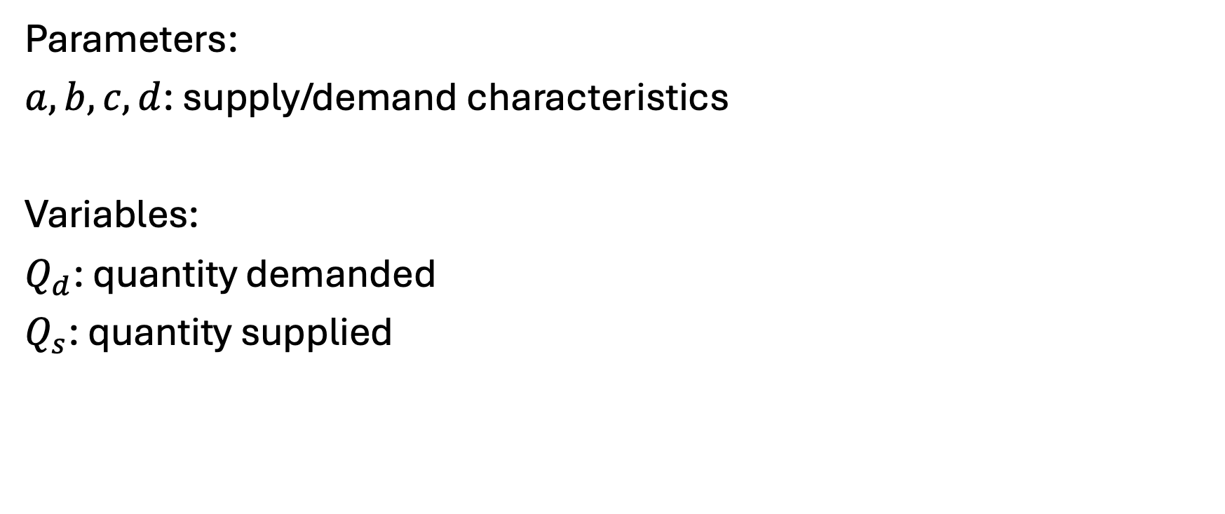
Model – indices (none), parameters, variables
Parameters:
$a,b,c,d$: supply/demand characteristics
Variables:
$Q_{d}$: quantity demanded
$Q_{s}$: quantity supplied

Slide 10
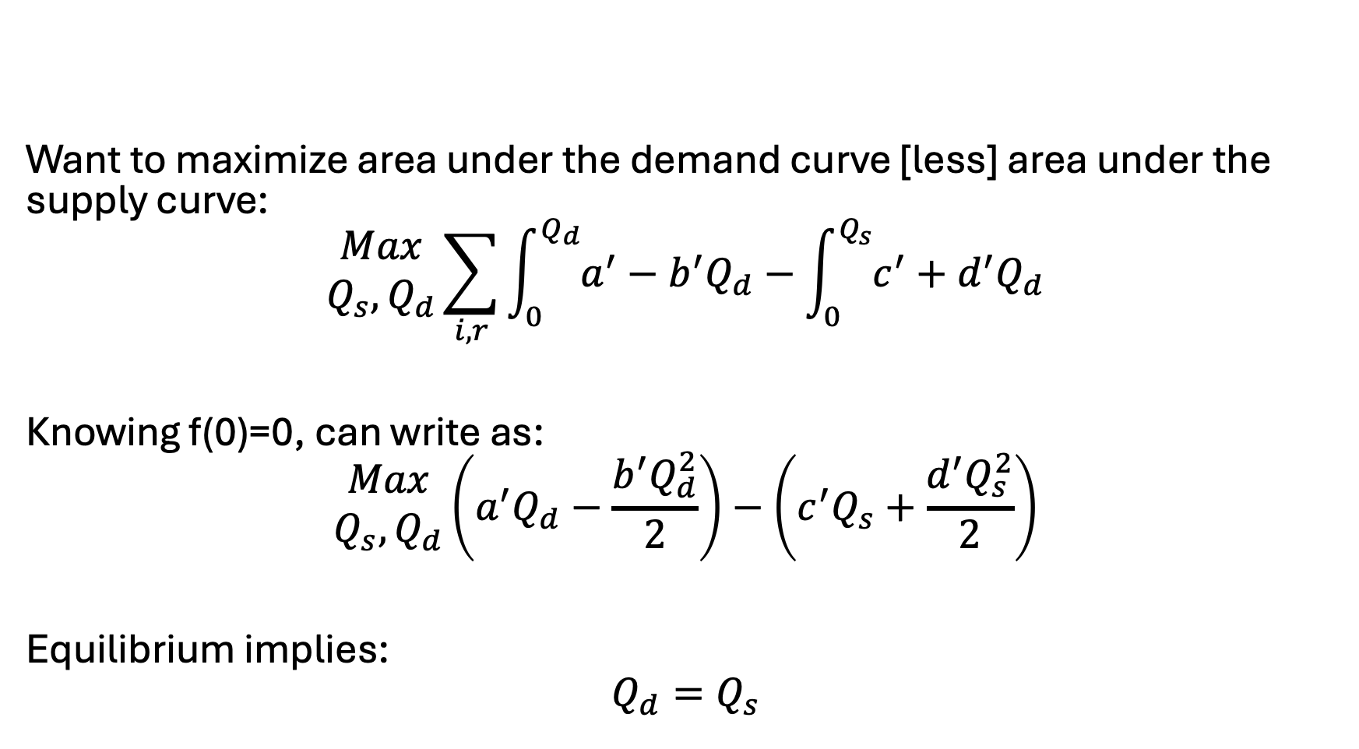
Model – objective function
Want to maximize area under the demand curve [less] area under the supply curve:
$$\begin{matrix}Max \\ Q_{s}, Q_{d}\end{matrix}\sum_{i,r}{\int_{0}^{Q_{d}}{a^{′}−b^{′}Q_{d}}}−\int_{0}^{Q_{s}}{c^{′}+d^{′}Q_{d}}$$
Knowing f(0)=0, can write as:
$$\begin{matrix}Max \\ Q_{s}, Q_{d}\end{matrix}\left(a^{′}Q_{d}−\frac{b^{′}Q_{d}^{2}}{2}\right)−\left(c^{′}Q_{s}+\frac{d^{′}Q_{s}^{2}}{2}\right)$$
Equilibrium implies:
$$Q_{d}=Q_{s}$$

Slide 11

Let’s put this simple model in GAMS…
Assuming: $\overline{p}=\overline{q}=1$
Assuming: $b=d=0.5$

Slide 12
Why could we linearize demand before?
Biggest takeaway: we only had one variable that was providing value (cost) to in our model
That is, we were only consuming electricity, it was the only thing providing value/benefit to consumption, and it did not compete with other goods
No (easy) way to stay linear if two variables are interacting and providing value or cost to the model, examples:
Pizza and beer
Capital and labor
Shifting of demand across time
When there are tradeoffs or benefits to the interaction of different variables in the model, cannot stay linear

Slide 13
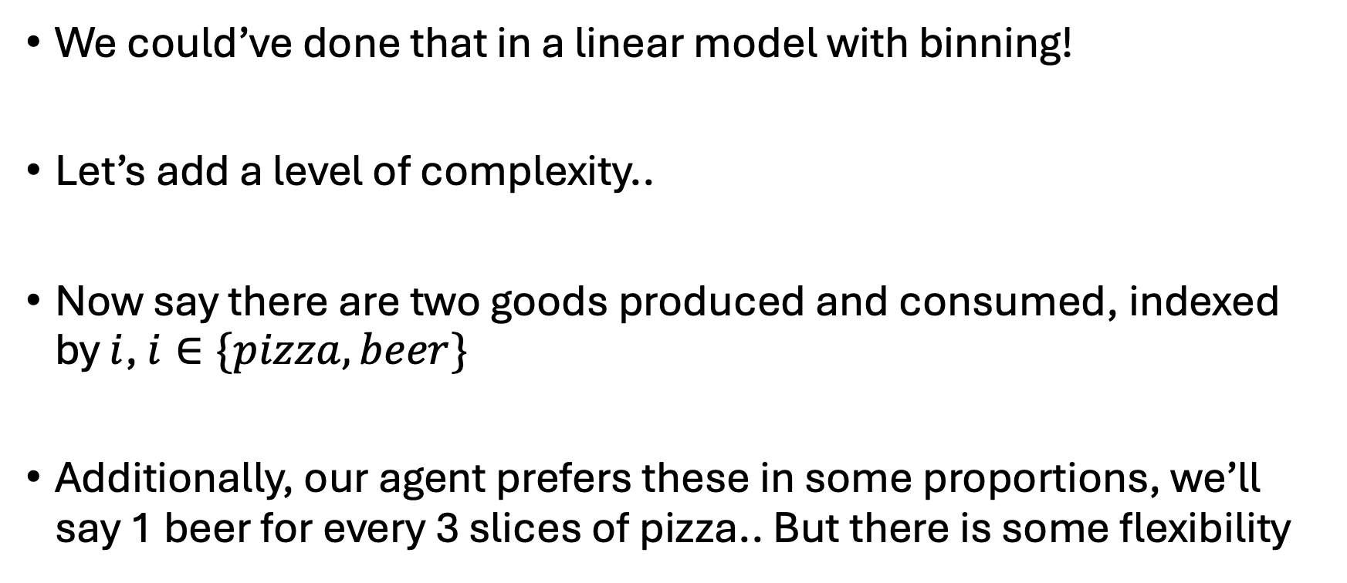
Easy enough… let’s expand
We could’ve done that in a linear model with binning!
Let’s add a level of complexity..
Now say there are two goods produced and consumed, indexed by $i$, $i∈\{pizza, beer\}$
Additionally, our agent prefers these in some proportions, we’ll say 1 beer for every 3 slices of pizza.. But there is some flexibility

Slide 14
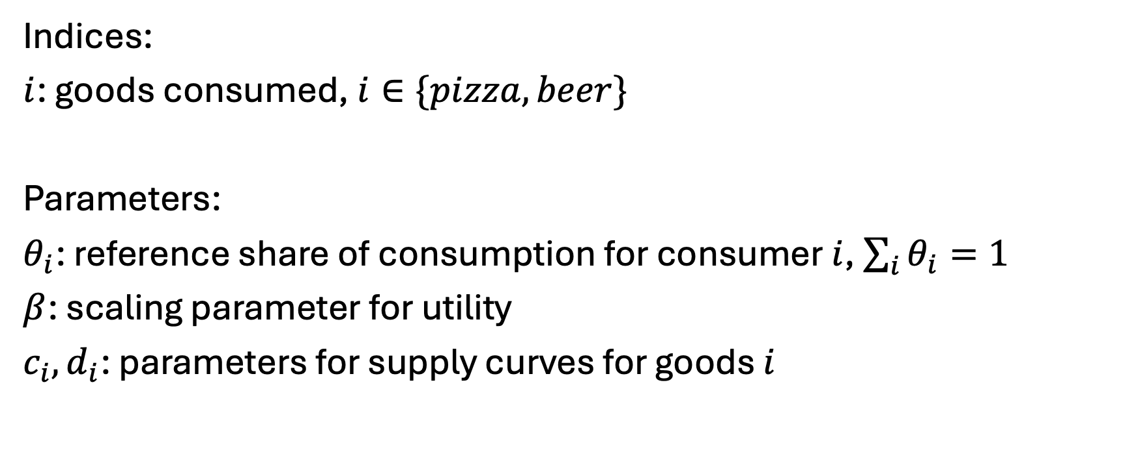
New model…
Indices:
$i$: goods consumed, $i∈\{pizza, beer\}$
Parameters:
$θ_{i}$: reference share of consumption for consumer $i$, $\sum_{i}{θ_{i}=1}$
$β$: scaling parameter for utility
$c_{i},d_{i}$: parameters for supply curves for goods $i$

Slide 15
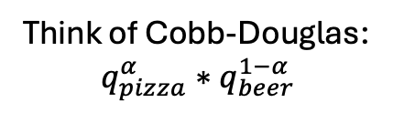
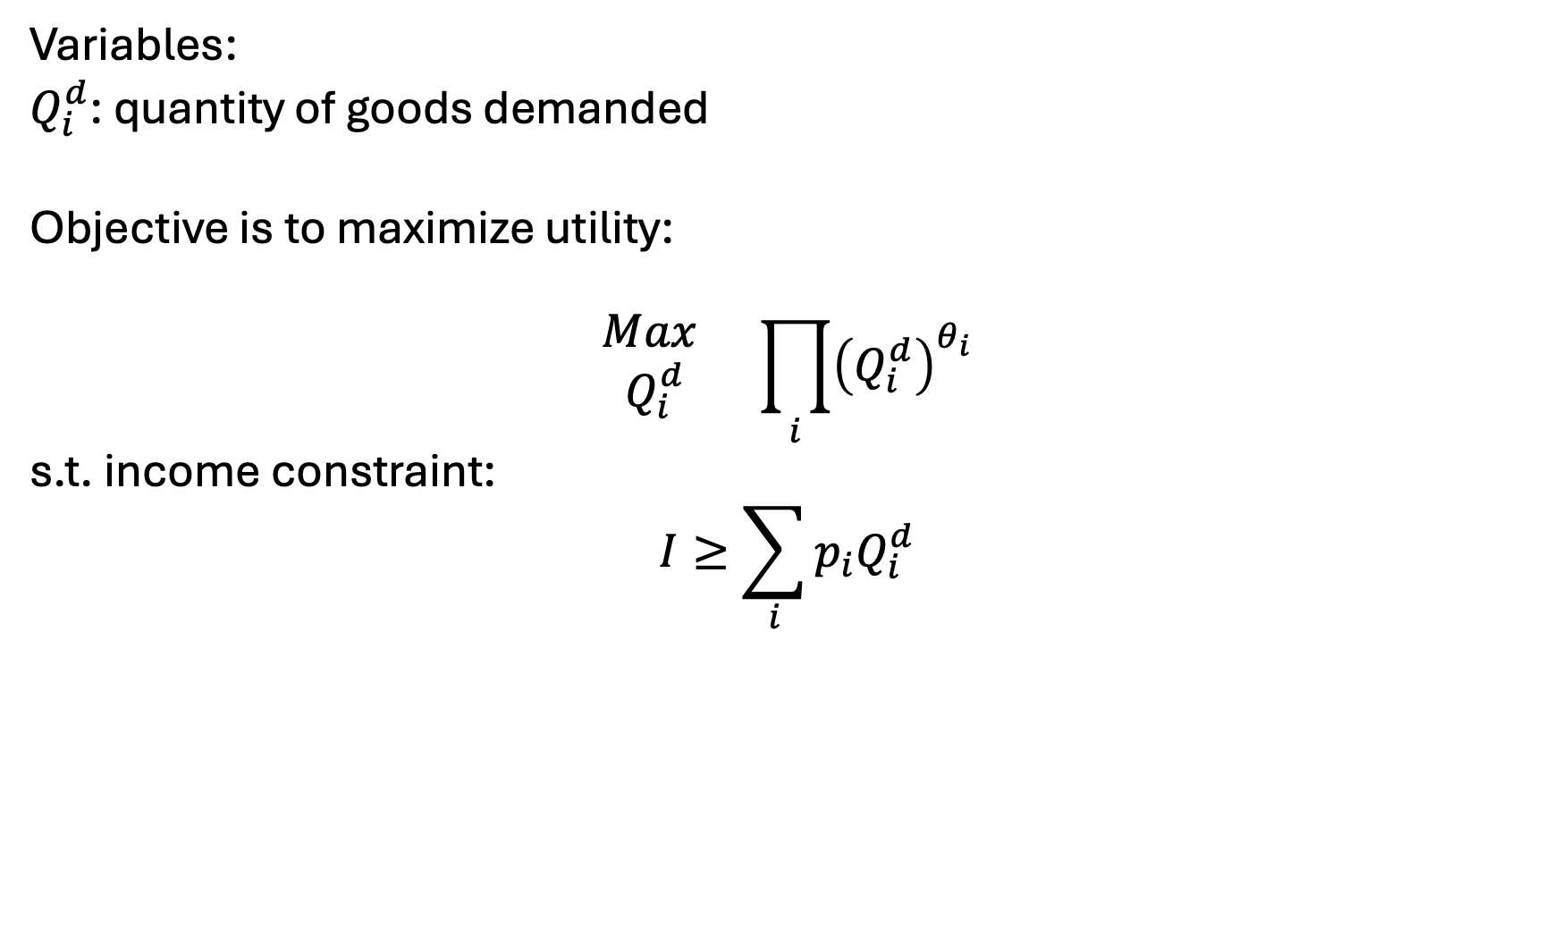
New model: Simple version
Variables:
$Q_{i}^{d}$: quantity of goods demanded
Objective is to maximize utility:
$$\begin{matrix}Max \\ Q_{i}^{d}\end{matrix} \prod_{i}{{\left(Q_{i}^{d}\right)}^{θ_{i}}}$$
s.t. income constraint:
$$I≥\sum_{i}{p_{i}Q_{i}^{d}}$$
Think of Cobb-Douglas:
$$q_{pizza}^{α}∗q_{beer}^{1−α}$$
Can add simple taxes/subsidies

Slide 16
Simple counterfactuals
What if Woody’s raises it’s pizza price by 10%?
What if our agent makes 50% more money?

Slide 17
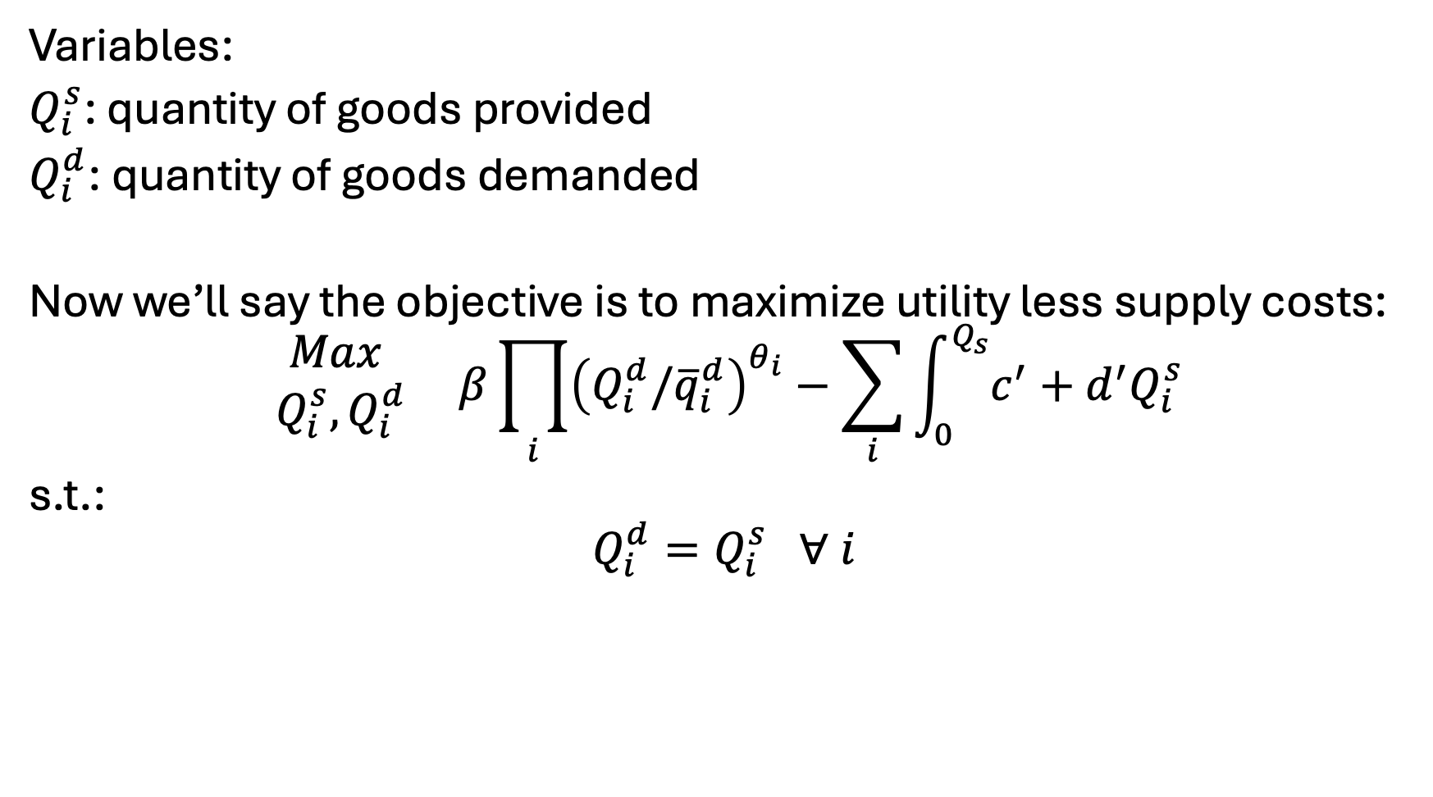
New model: Variables, Objective, Constraints
Variables:
$Q_{i}^{s}$: quantity of goods provided
$Q_{i}^{d}$: quantity of goods demanded
Now we’ll say the objective is to maximize utility less supply costs:
$$\begin{matrix}Max \\ Q_{i}^{s},Q_{i}^{d}\end{matrix} β\prod_{i}{{\left(Q_{i}^{d}/{\overline{q}}_{i}^{d}\right)}^{θ_{i}}}−\sum_{i}{\int_{0}^{Q_{s}}{c^{′}+d^{′}Q_{i}^{s}}}$$
s.t.:
$$Q_{i}^{d}=Q_{i}^{s} ∀ i$$

Slide 18

Calibration in the alternative setup…
Need to only set $θ_{i}$
Can determine relative weighting such that:
$$θ_{i}=\frac{{\overline{q}}_{i}{\overline{p}}_{i}}{\sum_{i}{{\overline{q}}_{i}{\overline{p}}_{i} }}$$

Slide 19
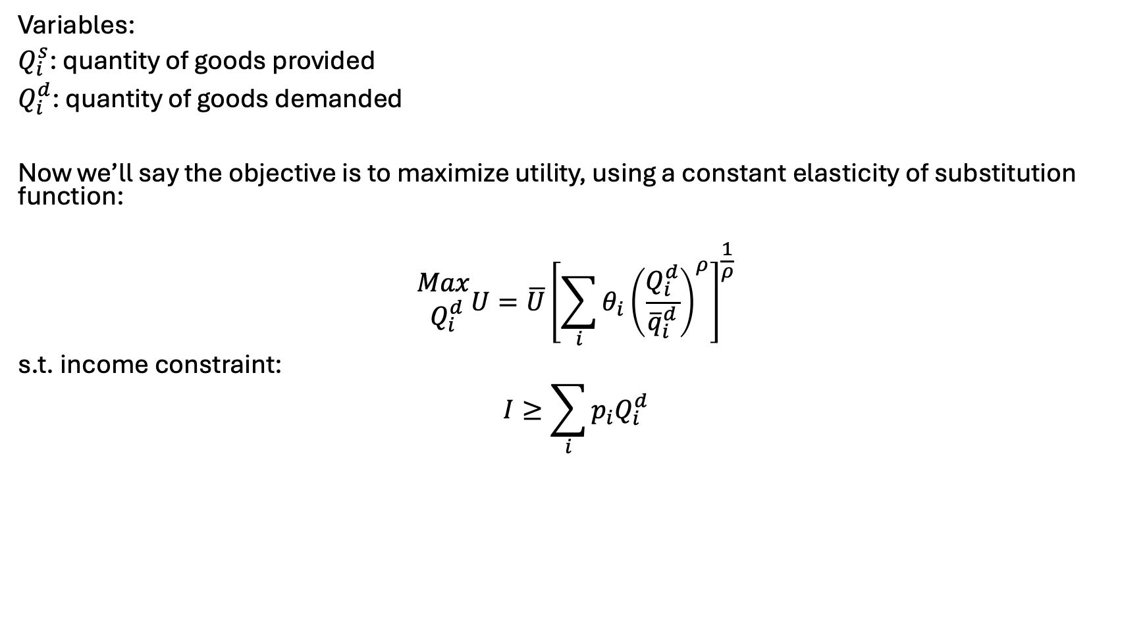
Another functional form.. Calibrated constant elasticity of substitution
Variables:
$Q_{i}^{s}$: quantity of goods provided
$Q_{i}^{d}$: quantity of goods demanded
Now we’ll say the objective is to maximize utility, using a constant elasticity of substitution function:
$$\begin{matrix}Max \\ Q_{i}^{d}\end{matrix}U=\overline{U}{\left[\sum_{i}{θ_{i}{\left(\frac{Q_{i}^{d}}{{\overline{q}}_{i}^{d}}\right)}^{ρ}}\right]}^{\frac{1}{ρ}}$$
s.t. income constraint:
$$I≥\sum_{i}{p_{i}Q_{i}^{d}}$$

Slide 20

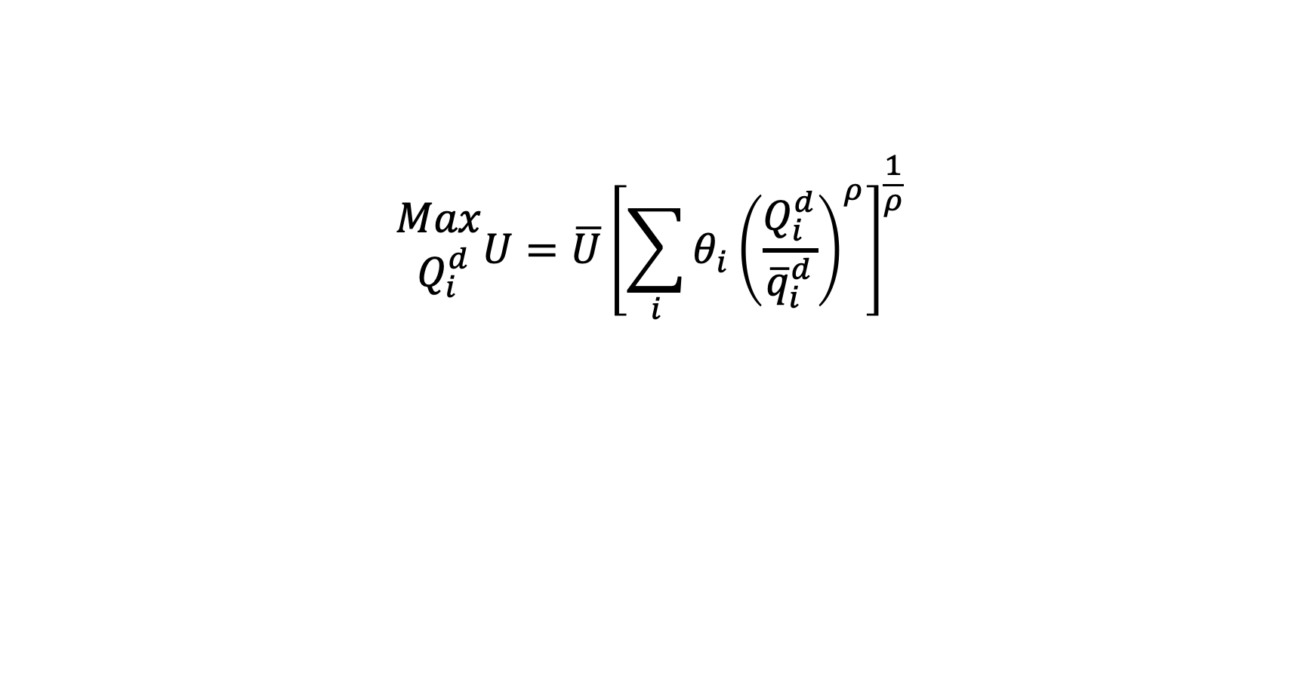



Another functional form.. Calibrated constant elasticity of substitution
$$\begin{matrix}Max \\ Q_{i}^{d}\end{matrix}U=\overline{U}{\left[\sum_{i}{θ_{i}{\left(\frac{Q_{i}^{d}}{{\overline{q}}_{i}^{d}}\right)}^{ρ}}\right]}^{\frac{1}{ρ}}$$
$$U$$
$$ρ$$
$$q_{1}$$
$$q_{2}$$

Slide 21
Points of these exercises..
You can flexibly represent the consumption and production of goods in simplified setups
Ties it back to all our econ models – utility maximization, profit maximization, …
Presents a strong need for calibration and calibrated functional forms

Slide 22
Choosing parameters and functional forms
Easy to find P/Q pairs, search literature for elasticity values
Examples with TRACT, BioTrans, REE model, FINITO, …
Need for the final/calibrated P to match up to sum of costs
Especially true for supply chain and engineering models
Can solve with inelastic demand to disentangle price
Usually pulling values through a system
Note – we still do not have explicit and simultaneous price/quantity control
For econ proofs/theories – you will need to spend time justifying assumptions implied in form choice
E.g. homogeneity, homotheticity, substitutability, …
https://windc.wisc.edu/downloads/summercourse_2021/thursday/ces.pdf
https://www2.econ.iastate.edu/classes/econ501/Hallam/documents/FunctionalForms.pdf

Slide 23
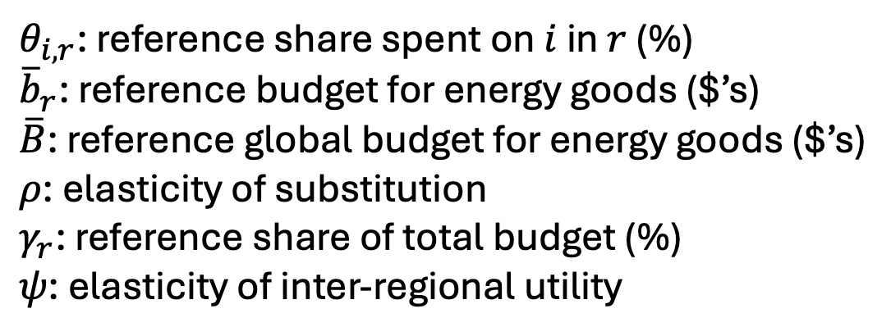
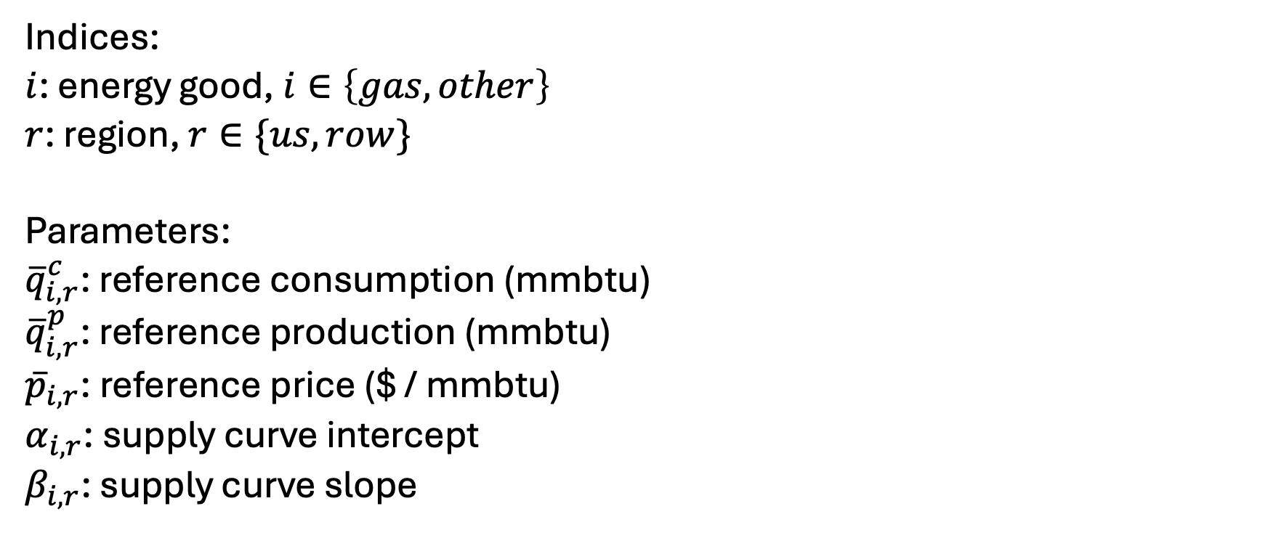
A global gas/energy model…
Indices:
$i$: energy good, $i∈\left\{gas,other\right\}$
$r$: region, $r∈\{us, row\}$
Parameters:
${\overline{q}}_{i,r}^{c}$: reference consumption (mmbtu)
${\overline{q}}_{i,r}^{p}$: reference production (mmbtu)
${\overline{p}}_{i,r}$: reference price ($ / mmbtu)
$α_{i,r}$: supply curve intercept
$β_{i,r}$: supply curve slope
$θ_{i,r}$: reference share spent on $i$ in $r$ (%)
${\overline{b}}_{r}$: reference budget for energy goods ($’s)
$\overline{B}$: reference global budget for energy goods ($’s)
$ρ$: elasticity of substitution
$γ_{r}$: reference share of total budget (%)
$ψ$: elasticity of inter-regional utility

Slide 24
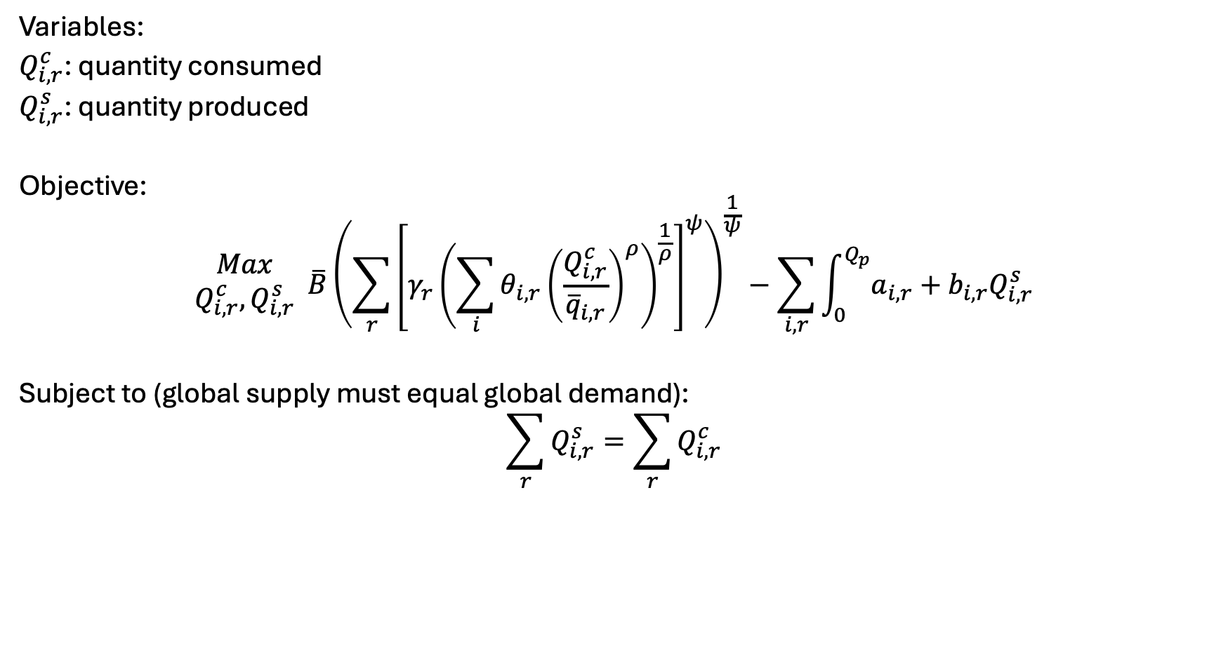
Variables, objective, constraints
Variables:
$Q_{i,r}^{c}$: quantity consumed
$Q_{i,r}^{s}$: quantity produced
Objective:
$$\begin{matrix}Max \\ Q_{i,r}^{c},Q_{i,r}^{s}\end{matrix} \overline{B}{\left({\sum_{r}{\left[γ_{r}{\left(\sum_{i}{θ_{i,r}}{\left(\frac{Q_{i,r}^{c}}{{\overline{q}}_{i,r}}\right)}^{ρ}\right)}^{\frac{1}{ρ}}\right]}}^{ψ}\right)}^{\frac{1}{ψ}}−\sum_{i,r}{\int_{0}^{Q_{p}}{a_{i,r}+b_{i,r}Q_{i,r}^{s}}}$$
Subject to (global supply must equal global demand):
$$\sum_{r}{Q_{i,r}^{s}}=\sum_{r}{Q_{i,r}^{c}}$$

Slide 25









$$U$$
$$ψ$$
$$U_{r1}$$
$$U_{r2}$$
$$ρ$$
$$ρ$$
$$q_{1}$$
$$q_{2}$$
$$q_{1}$$
$$q_{2}$$

Slide 26
Ramsey model – main points
(simple) economic growth model based on labor growth, capital accumulation, investment
Target of optimization is intertemporal utility
Two variables define output: capital and labor
Concept of the steady state
Barr-Manne terminal investment condition

Slide 27
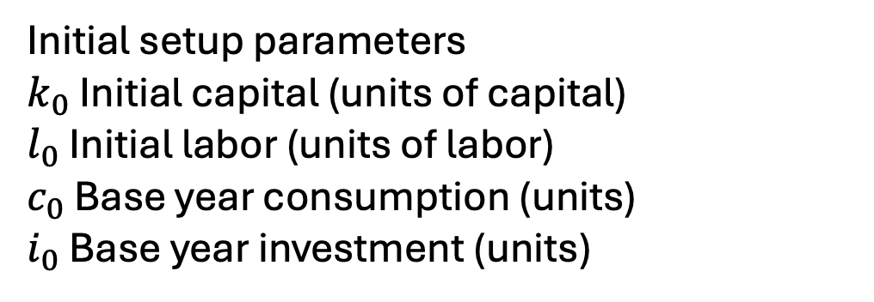
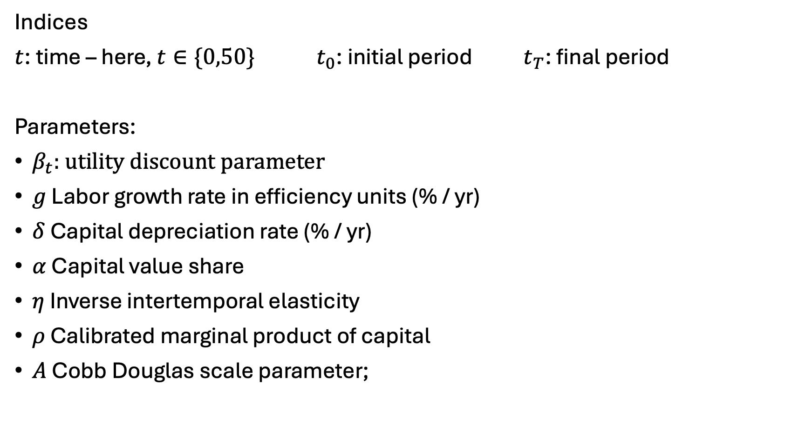
The Ramsey model – indices, parameters
Indices
$t$: time – here, $t∈\{0,50\}{ t}_{0}$: initial period$t_{T}$: final period
Parameters:
$β_{t}$: utility discount parameter
$g$ Labor growth rate in efficiency units (% / yr)
$δ$ Capital depreciation rate (% / yr)
$α$ Capital value share
$η$ Inverse intertemporal elasticity
$ρ$ Calibrated marginal product of capital
$A$ Cobb Douglas scale parameter;
Initial setup parameters
$k_{0}$ Initial capital (units of capital)
$l_{0}$ Initial labor (units of labor)
$c_{0}$ Base year consumption (units)
$i_{0}$ Base year investment (units)

Slide 28
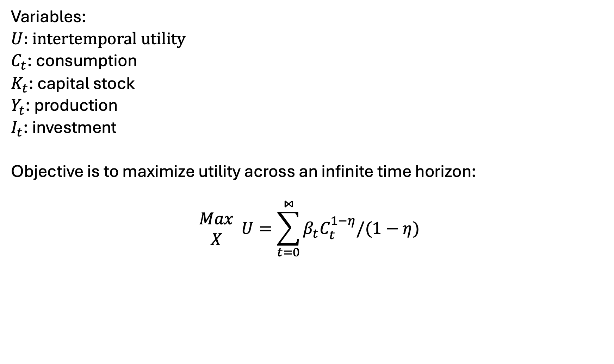
The Ramsey Model – Variables, Objective function
Variables:
$U$: intertemporal utility
$C_{t}$: consumption
$K_{t}$: capital stock
$Y_{t}$: production
$I_{t}$: investment
Objective is to maximize utility across an infinite time horizon:
$$\begin{matrix}Max \\ X\end{matrix} U=\sum_{t=0}^{⋈}{β_{t}C_{t}^{1−η}/(1−η)}$$

Slide 29
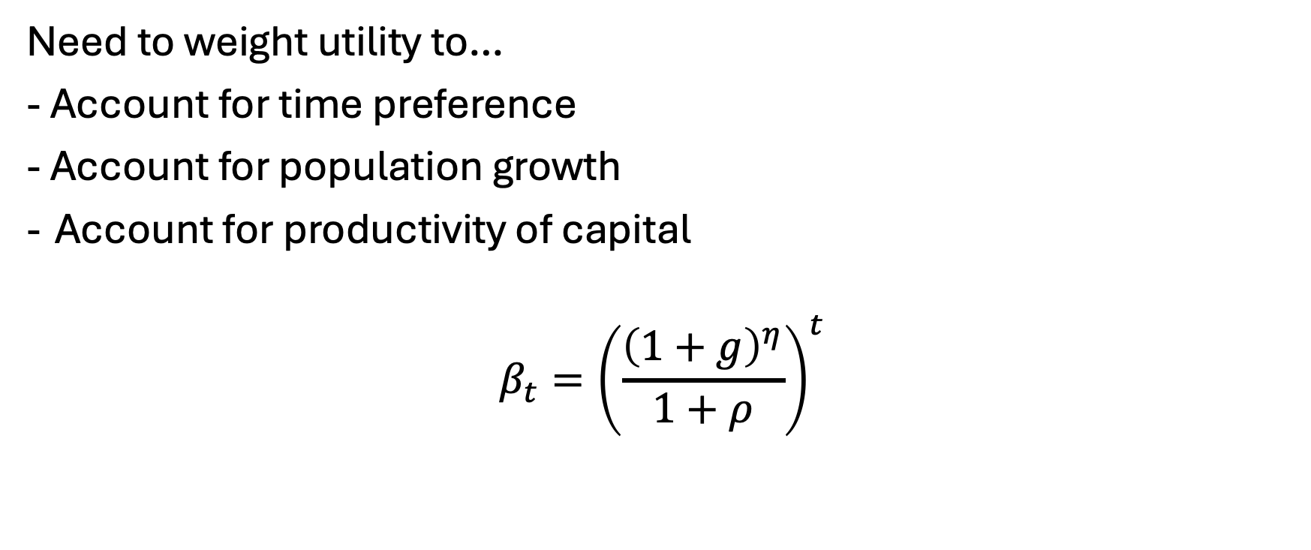
Setting the utility discount factor…
Need to weight utility to…
- Account for time preference
- Account for population growth
Account for productivity of capital
$$β_{t}={\left(\frac{{\left(1+g\right)}^{η}}{1+ρ}\right)}^{t}$$

Slide 30
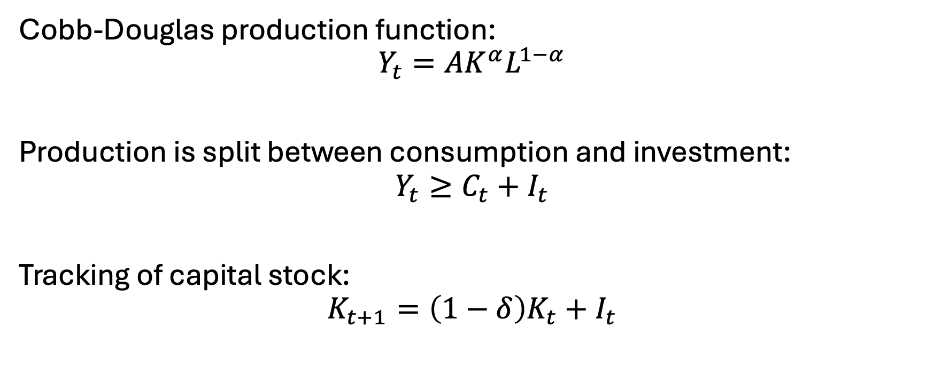
Constraints
Cobb-Douglas production function:
$$Y_{t}=AK^{α}L^{1−α}$$
Production is split between consumption and investment:
$$Y_{t}≥C_{t}+I_{t}$$
Tracking of capital stock:
$$K_{t+1}=\left(1−δ\right)K_{t}+I_{t}$$

Slide 31
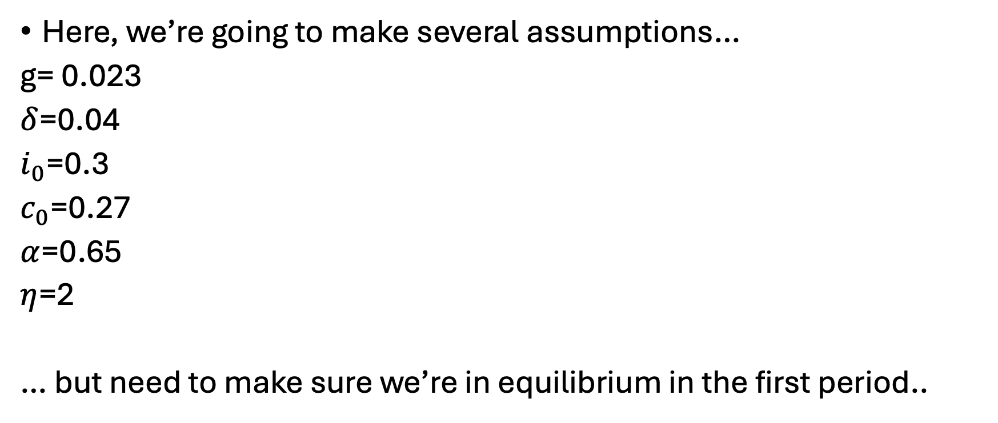
Calibration
Here, we’re going to make several assumptions…
g= 0.023
$δ$=0.04
$i_{0}$=0.3
$c_{0}$=0.27
$α$=0.65
$η$=2
… but need to make sure we’re in equilibrium in the first period..

Slide 32

Initial capital/labor calibration
Investment must cover depreciation plus population growth. Given the investment rate, we can back out the initial capital stock level. Knowing investment must cover initial capital stock’s expected growth rate and depreciation in the first period:
$$k_{0}\left(g+δ\right)=i_{0}$$
Can thus back out calibrated initial capital level:
$$k_{0}=\frac{i_{0}}{g+δ}$$
Labor supply is it’s share in production [times] initial production:
$$l_{0}=\left(1−α\right)∗(c_{0}+i_{0})$$
(exogenously-defined) labor grows at the labor growth rate:
$$l_{t}=l_{0}∗{\left(1+g\right)}^{t}$$

Slide 33
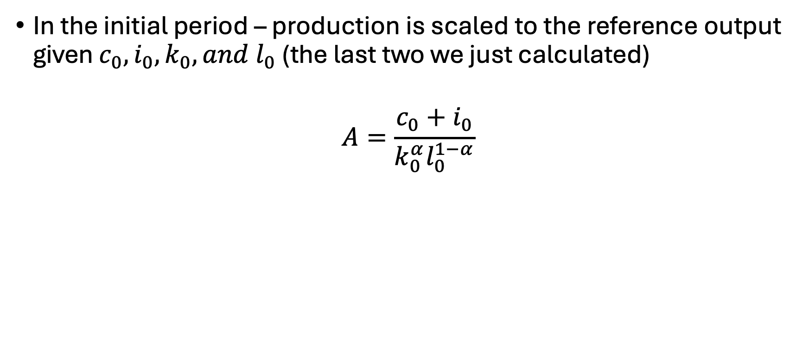
Calibrating the production scale parameter
In the initial period – production is scaled to the reference output given $c_{0}, i_{0},k_{0}, and l_{0}$ (the last two we just calculated)
$$A=\frac{c_{0}+i_{0}}{k_{0}^{α}l_{0}^{1−α}}$$

Slide 34
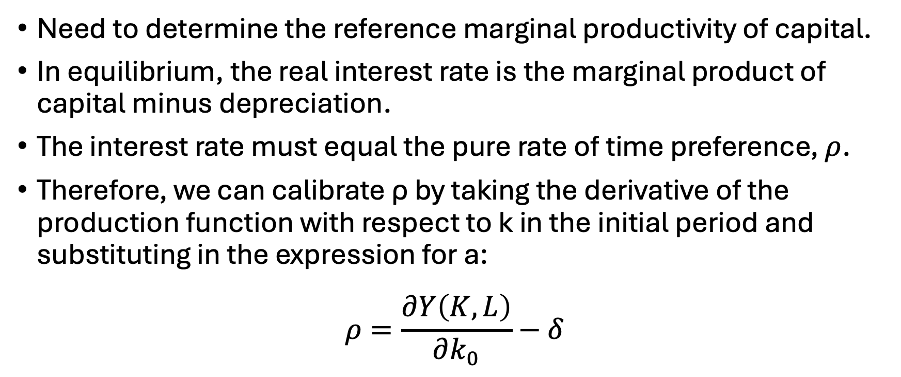
Calibrating capital productivity [I]
Need to determine the reference marginal productivity of capital.
In equilibrium, the real interest rate is the marginal product of capital minus depreciation.
The interest rate must equal the pure rate of time preference, $ρ$.
Therefore, we can calibrate ρ by taking the derivative of the production function with respect to k in the initial period and substituting in the expression for a:
$$ρ=\frac{∂Y\left(K,L\right)}{∂k_{0}}−δ$$
Notes:
The marginal product of capital for our Cobb-Douglas production fn is:
d y0 / d k0 = a * b * k0**(b-1) * l0**(1-b)
a = (c0+i0) / k0**b * l0**(1-b)
So d y0 / d k0 = (c0+i0) / k0**b * l0**(1-b) * b * k0**(b-1) * l0**(1-b)
Which simplifies to: b*(c0+i0)/k0. Therefore, we can calculate rho as:

Slide 35

Calibrating capital productivity [II]
$$ρ=\frac{∂Y\left(K,L\right)}{∂k_{0}}−δ=Aβk_{0}^{α−1}l_{0}^{1−α}−δ$$
We know:
$$A=\frac{c_{0}+i_{0}}{k_{0}^{α}l_{0}^{1−α}}$$
$$∴ρ=\frac{β\left(c_{0}+i_{0}\right)}{k_{0}}−δ$$
Notes:
The marginal product of capital for our Cobb-Douglas production fn is:
d y0 / d k0 = a * b * k0**(b-1) * l0**(1-b)
a = (c0+i0) / k0**b * l0**(1-b)
So d y0 / d k0 = (c0+i0) / k0**b * l0**(1-b) * b * k0**(b-1) * l0**(1-b)
Which simplifies to: b*(c0+i0)/k0. Therefore, we can calculate rho as:

Slide 36
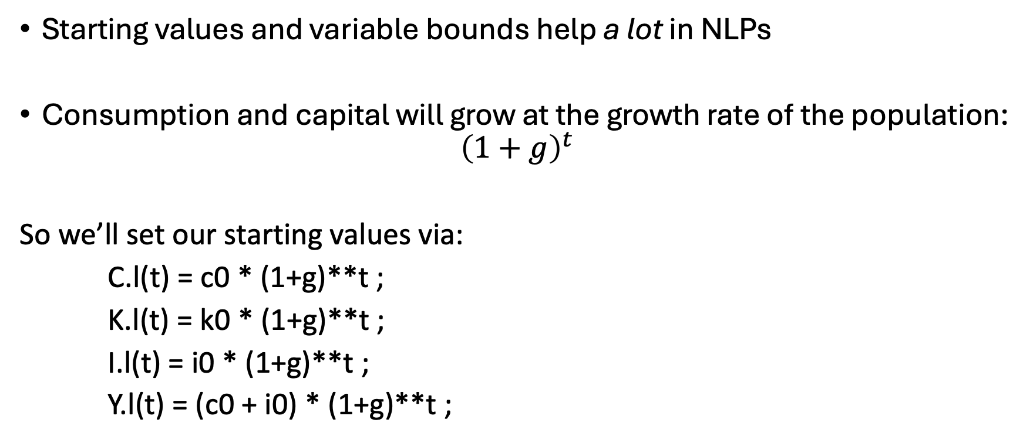
Some more notes…
Starting values and variable bounds help a lot in NLPs
Consumption and capital will grow at the growth rate of the population:
$${\left(1+g\right)}^{t}$$
So we’ll set our starting values via:
C.l(t) = c0 * (1+g)**t ;
K.l(t) = k0 * (1+g)**t ;
I.l(t) = i0 * (1+g)**t ;
Y.l(t) = (c0 + i0) * (1+g)**t ;

Slide 37
Some more notes..
Bounds on variables are needed to avoid mathematical problems
e.g. We don’t want consumption to be zero
C.lo(t) = 0.01 * C.l(t) ;
K.lo(t) = 0.01 * K.l(t) ;
Fix first period capital
K.fx(t)$tfirst(t) = k0 ;

Slide 38
Let’s build the base model…

Slide 39
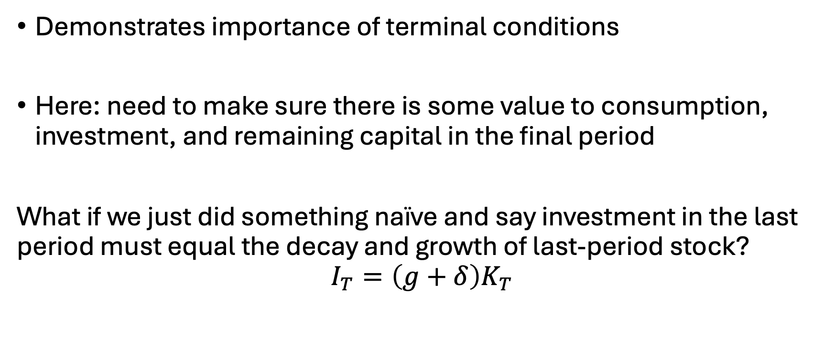
That’s weird…
Demonstrates importance of terminal conditions
Here: need to make sure there is some value to consumption, investment, and remaining capital in the final period
What if we just did something naïve and say investment in the last period must equal the decay and growth of last-period stock?
$$I_{T}=\left(g+δ\right)K_{T}$$

Slide 40
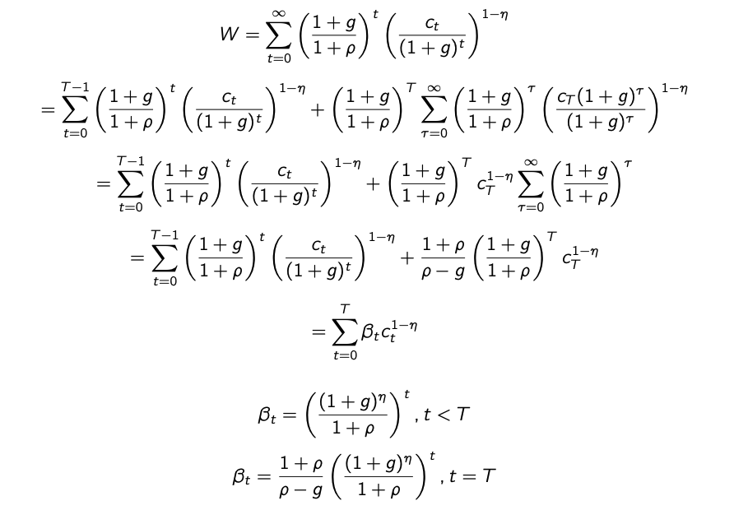
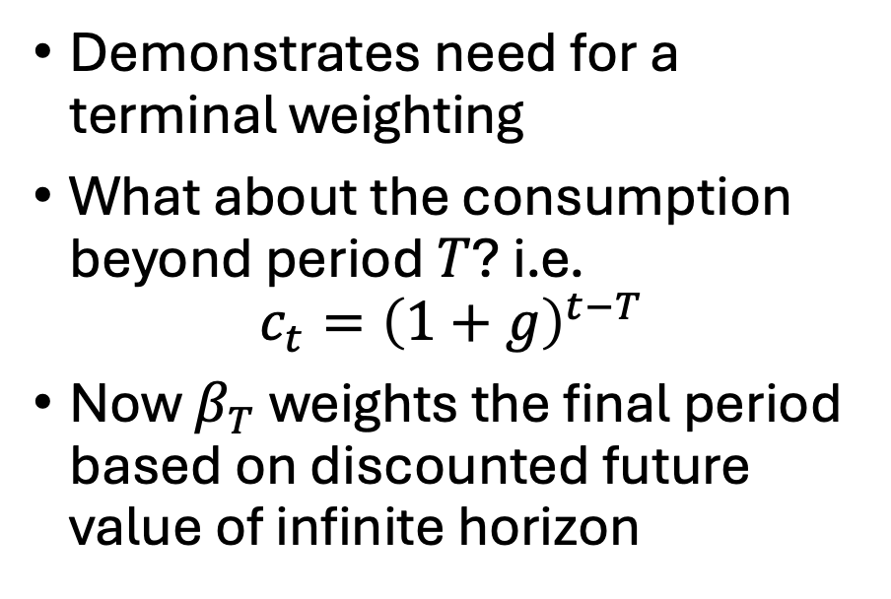
Plotting investment over time…
Demonstrates need for a terminal weighting
What about the consumption beyond period $T$? i.e.
$$c_{t}={\left(1+g\right)}^{t−T}$$
Now $β_{T}$ weights the final period based on discounted future value of infinite horizon

