Slide 1
EBGN645: Day 10

Slide 2
Notes
Wednesday
Presentation from
Jared Woollacott
Tuesday 10am-2pm (with lunch break)
Extra office hours next week
Wednesday
Homework 1b due
Today: Need to leave at noon

Slide 3
Scheduling notes
No class 10/27-29 (INFORMS)
Potentially optional: 11/10
Possibly 11/12

Slide 4

Questions
The question nobody asked:
“What watch are you wearing today?”
A: 1977 King Quartz 4823-8120
Short history on Seiko

Slide 5
Bigger picture
Homework 1 together
Resource models
Hotelling (review)
Fisheries management (Gordon-Schaeffer)
Forestry management (Faustmann)
CO-WY electricity ‘dispatch’
Non-linear, calibrated market models
US petroleum, backstop techs
Review of duality -> MCP models
Game theory models
Stackelberg
Cournot
Ramsey model
CGE models
MPECs/EPECs
Presentations

Slide 6
Homework – Question 1
Q1 (25 points): Benny’s bakery
Benny makes rolls, croissants, and bread loafs. The price, cost, and time for each is in the table below. Benny only has 40 hours to work in a week.
(5 points) Write out the indices, parameters, variables, objective function, and constraints for this problem. Make sure to indicate units on your parameters and variables.
(5 points) Counterfactual: Benny now requires a roll to be sold with every croissant. Rolls can still be sold individually. Write out the math for this constraint.
(15 points) Write the problem in GAMS solving the reference and counterfactual case. Be sure to use a switch to enable the counterfactual. Report on the optimal values of production in both the reference and counterfactual scenarios, including total profits.
Product | Revenue ($/item) | Cost ($/item) | Time (hours/item)
Roll | 2.25 | 1.5 | 1.5
Croissant | 5.5 | 2 | 2.25
Bread | 10 | 5 | 5

Slide 7

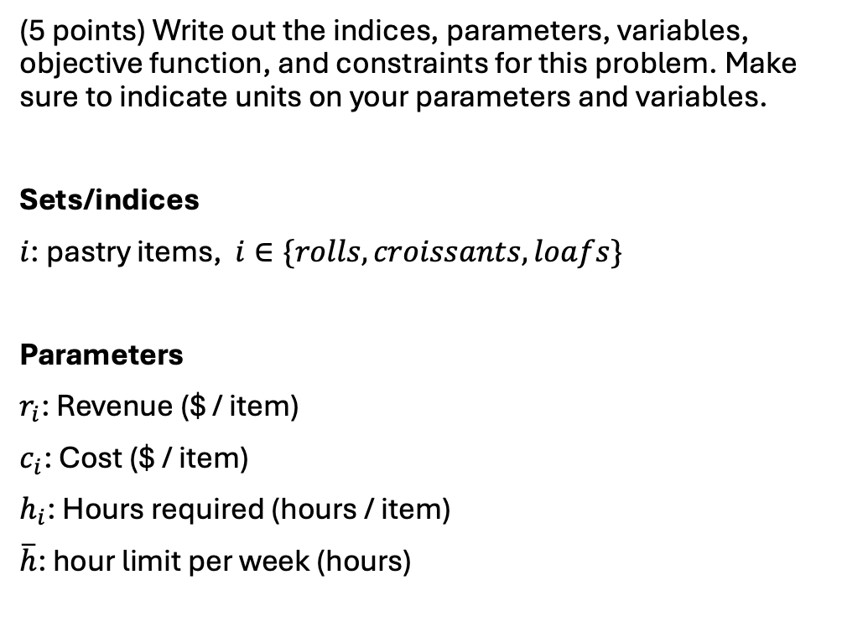
Q1a
(5 points) Write out the indices, parameters, variables, objective function, and constraints for this problem. Make sure to indicate units on your parameters and variables.
Sets/indices
$i$: pastry items, $i∈\{rolls, croissants, loafs\}$
Parameters
$r_{i}$: Revenue ($ / item)
$c_{i}$: Cost ($ / item)
$h_{i}$: Hours required (hours / item)
$\overline{h}$: hour limit per week (hours)

Slide 8
Q1a
(5 points) Write out the indices, parameters, variables, objective function, and constraints for this problem. Make sure to indicate units on your parameters and variables.
Variables
$X_{i}$: amount produced (items)
$π$: profit ($s)
Objective function – maximize profit
$$\begin{matrix}Max \\ X_{i}\end{matrix}π=\sum_{i}{\left(r_{i}−c_{i}\right)X_{i}}$$

Slide 9
Q1a
(5 points) Write out the indices, parameters, variables, objective function, and constraints for this problem. Make sure to indicate units on your parameters and variables.
Constraints:
$$\overline{h}≥\sum_{i}{h_{i}X_{i}}$$

Slide 10
Q1b
Counterfactual: Benny now requires a roll to be sold with every croissant. Rolls can still be sold individually. Write out the math for this constraint.
Constraints:
$$X_{i}≥X_{i^{′}} ∀ i∈\left\{roll\right\},i^{′}∈\left\{croissant\right\}$$

Slide 11
Q1c
Write the problem in GAMS solving the reference and counterfactual case. Be sure to use a switch to enable the counterfactual. Report on the optimal values of production in both the reference and counterfactual scenarios, including total profits.
Started via bennys_bakery.gms…

Slide 12
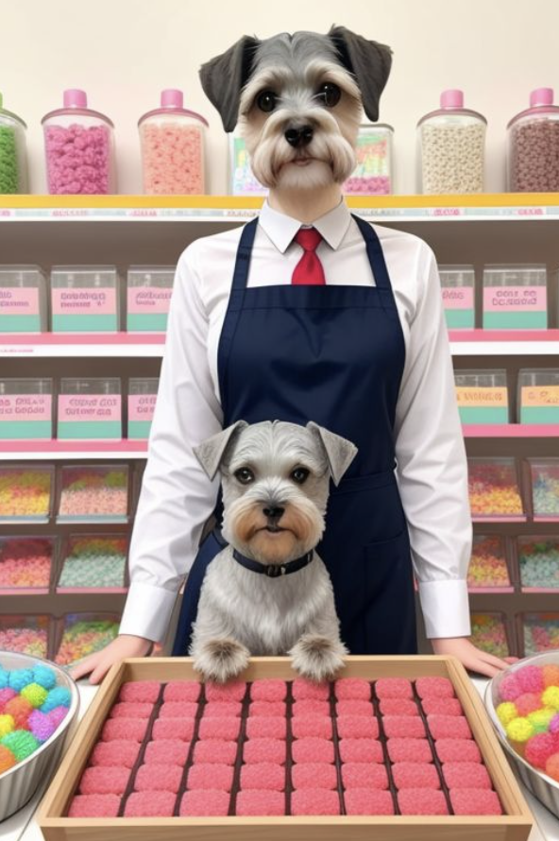
June’s Jellybeans
June has a jellybean factory with two machines, X1 and X2, that produce yellow, blue, green, orange, and purple jellybeans. The net revenue for each type of jellybean are in the table below. Assume each machine can produce 100 jellybeans per hour and can only run 40 hours per week.
Color | Yellow | Blue | Green | Orange | Purple
Net Revenue ($/bean) | 1 | 1.05 | 1.07 | 0.95 | 0.9

Slide 13


Slide 14
Q1a – indices, parameters, variables, objective, constraints
Sets:
$i$: Machines, $i∈\{X1, X2\}$
$j$: Jellybeans, $j∈\{y,b,g,o,p\}$
$v_{i,j}$: valid combination of $i$ and $j$
Parameters:
$r_{j}$: revenue ($ / jellybean)
$h$: production rate (jellybeans / hour)
$\overline{h}$: maximum hours per week (hours, 40)

Slide 15
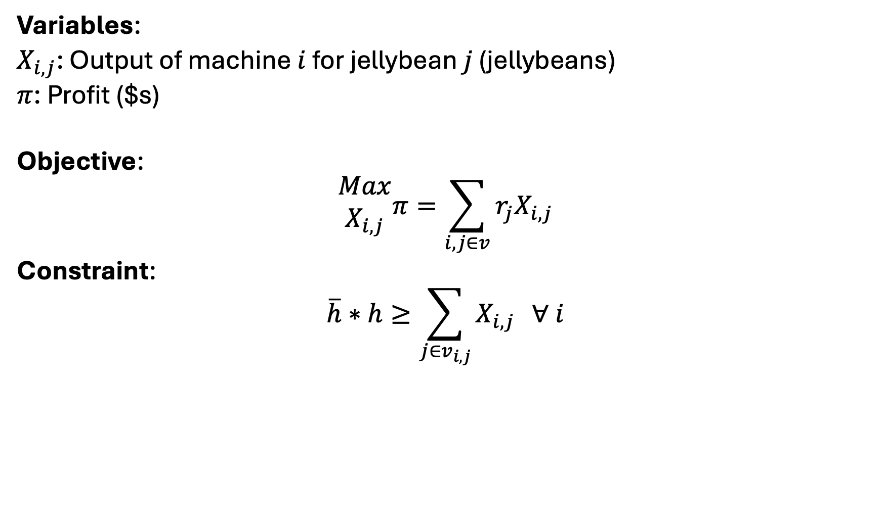
Q1a – indices, parameters, variables, objective, constraints
Variables:
$X_{i,j}$: Output of machine $i$ for jellybean $j$ (jellybeans)
$π$: Profit ($s)
Objective:
$$\begin{matrix}Max \\ X_{i,j}\end{matrix}π=\sum_{i,j∈v}{{r_{j}X}_{i,j}}$$
Constraint:
$$\overline{h}∗h≥\sum_{j∈v_{i,j}}{X_{i,j}} ∀ i$$

Slide 16
Q2b – write the model in GAMS
Starting with [repo]/HW1/junes_jellybeans.gms

Slide 17
Q2c – Maximum deviation
Now, June must produce jellybeans in nearly equal amounts. For all jellybean colors, there can only be 5% deviation across all production amounts relative to other colors. For example, if June produces 100 green jellybeans, she has to produce between 95 and 105 orange jellybeans. If she produces 105 orange jellybeans, she has to produce between (0.95 * 105 =) 99.75 and (1.05 * 105 =) 110.25 yellow jellybeans.

Slide 18
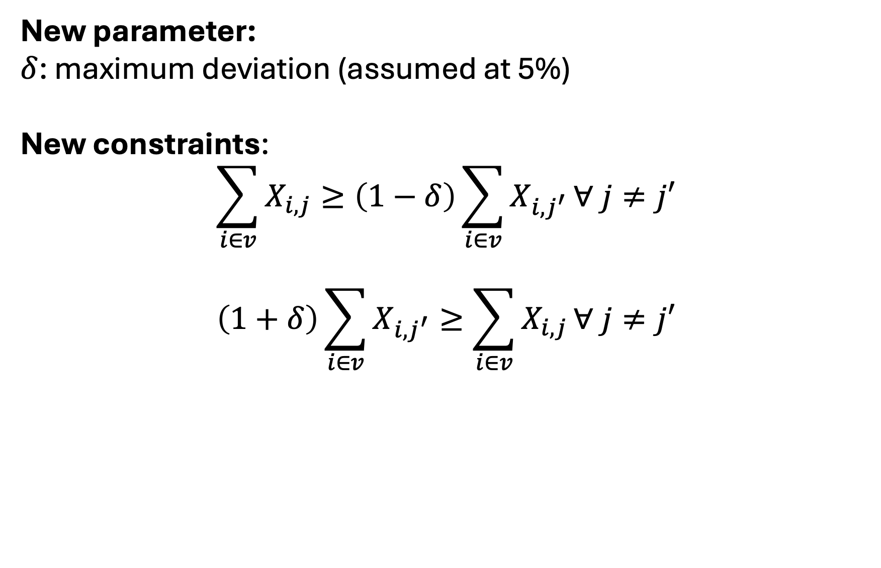
Q2c – Maximum deviation
New parameter:
$δ$: maximum deviation (assumed at 5%)
New constraints:
$$\sum_{i∈v}{X_{i,j}}≥\left(1−δ\right)\sum_{i∈v}{X_{i,j^{′}}}∀ j≠j′$$
$$\left(1+δ\right)\sum_{i∈v}{X_{i,j^{′}}}≥\sum_{i∈v}{X_{i,j}}∀ j≠j′$$

Slide 19
Q2d – Conditional on production
Now, in addition to part b, the first machine only produces yellow, blue, and green jellybeans. The second machine only produces yellow, orange, and purple jellybeans.
How does June’s production profile and profits change with this restriction?
How to do this? Adjust the $v_{i,j}$ set

Slide 20
Now… Models of resource management
Non-renewable resource management via Hotelling (review)
Renewable resource management
Fisheries
Forestry
Why? They’re classic econ examples and fun/easy to code in GAMS

Slide 21
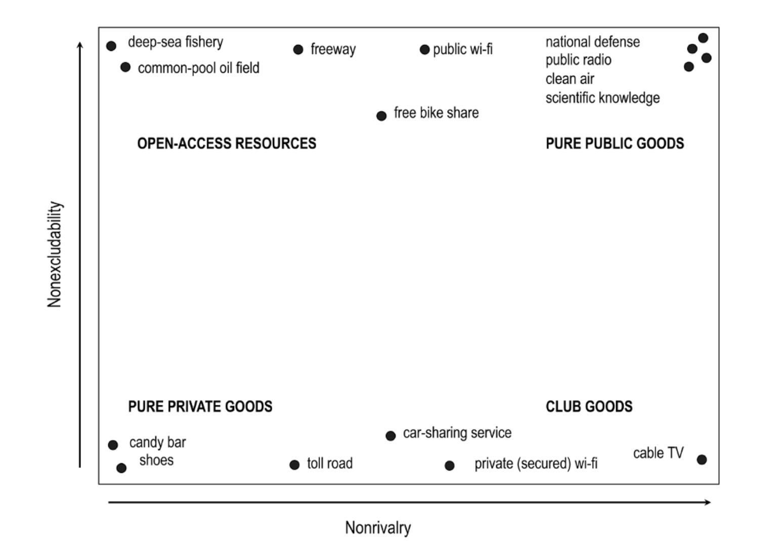
OARs and PPGs
Main focus is now on…
Private goods
Privately-owned mine, an oil-field, ..
Personal farm
Open access resources
Common-pool oil field
Fisheries
Groundwater
Forests
Require different management strategies

Slide 22
Three models for resources management
Hotelling model (non-renewable resources)
How resource owners decide extraction rates
Main point: price of resource should rise at the rate of interest
Policy relevance: how do subsidies and regulation alter extraction paths?
Gordon-Schaefer model (for Fisheries Management)
Models relationships between fishing effort, stocks, and sustainable harvest levels
Main point: Maximum Sustainable Yield determines largest harvest w/o depleting fish stocks
Policy relevance: quotas, property rights
Faustmann model (for Forestry management)

Slide 23
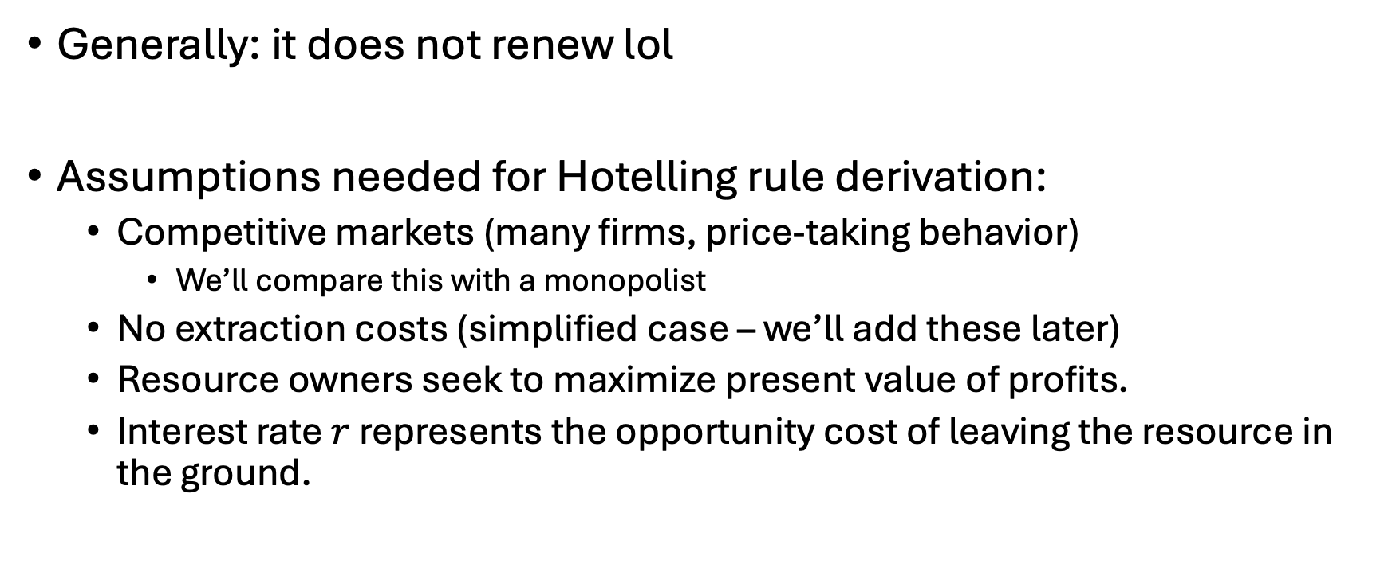
Characteristics of non-renewable resources
Generally: it does not renew lol
Assumptions needed for Hotelling rule derivation:
Competitive markets (many firms, price-taking behavior)
We’ll compare this with a monopolist
No extraction costs (simplified case – we’ll add these later)
Resource owners seek to maximize present value of profits.
Interest rate $r$ represents the opportunity cost of leaving the resource in the ground.

Slide 24
Prompt
If you owned an exhaustible resource (oil field, or coal mine, or lithium mine, or natural gas well, …), how would you choose when to extract and how much?

Slide 25
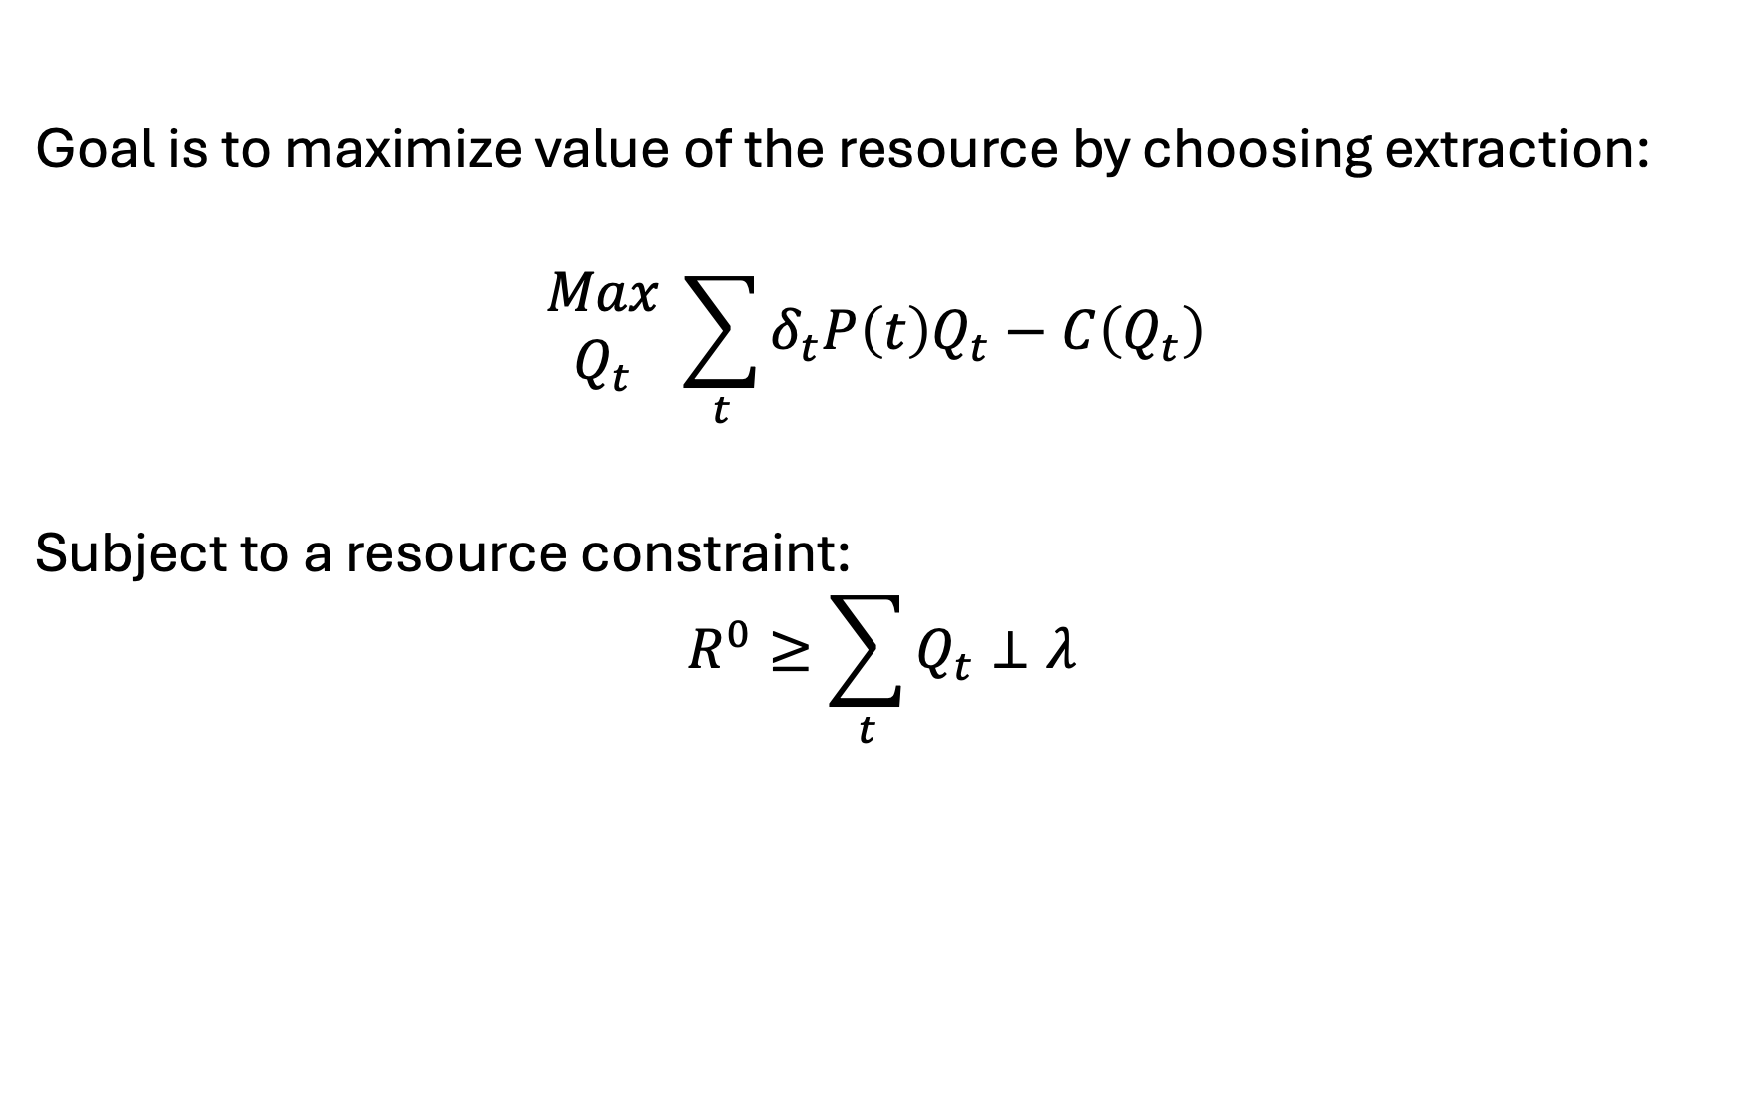
Review of Hotelling’s model
Goal is to maximize value of the resource by choosing extraction:
$$\begin{matrix}Max \\ Q_{t}\end{matrix} \sum_{t}{δ_{t}P\left(t\right)Q_{t}−C\left(Q_{t}\right) }$$
Subject to a resource constraint:
$$R^{0}≥\sum_{t}{Q_{t}}⊥λ$$

Slide 26
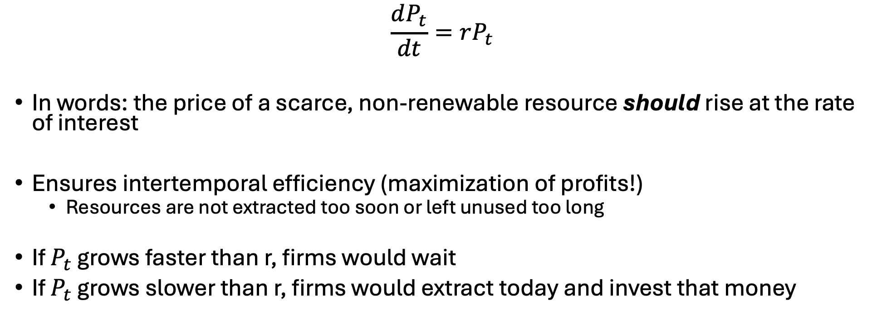
Importance of Hotelling’s rule
$$\frac{dP_{t}}{dt}=rP_{t}$$
In words: the price of a scarce, non-renewable resource should rise at the rate of interest
Ensures intertemporal efficiency (maximization of profits!)
Resources are not extracted too soon or left unused too long
If $P_{t}$ grows faster than r, firms would wait
If $P_{t}$ grows slower than r, firms would extract today and invest that money

Slide 27
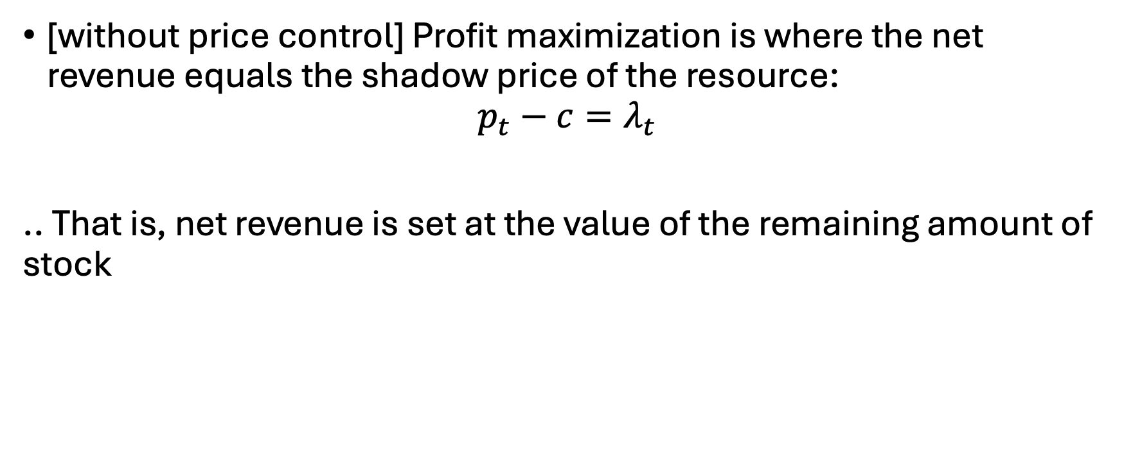
Another important rule
[without price control] Profit maximization is where the net revenue equals the shadow price of the resource:
$$p_{t}−c=λ_{t}$$
.. That is, net revenue is set at the value of the remaining amount of stock

Slide 28
New Prompt
If you were the only one that owned an exhaustible resource (oil field, or coal mine, or lithium mine, or natural gas well, …), how would you choose when to extract and how much?

Slide 29
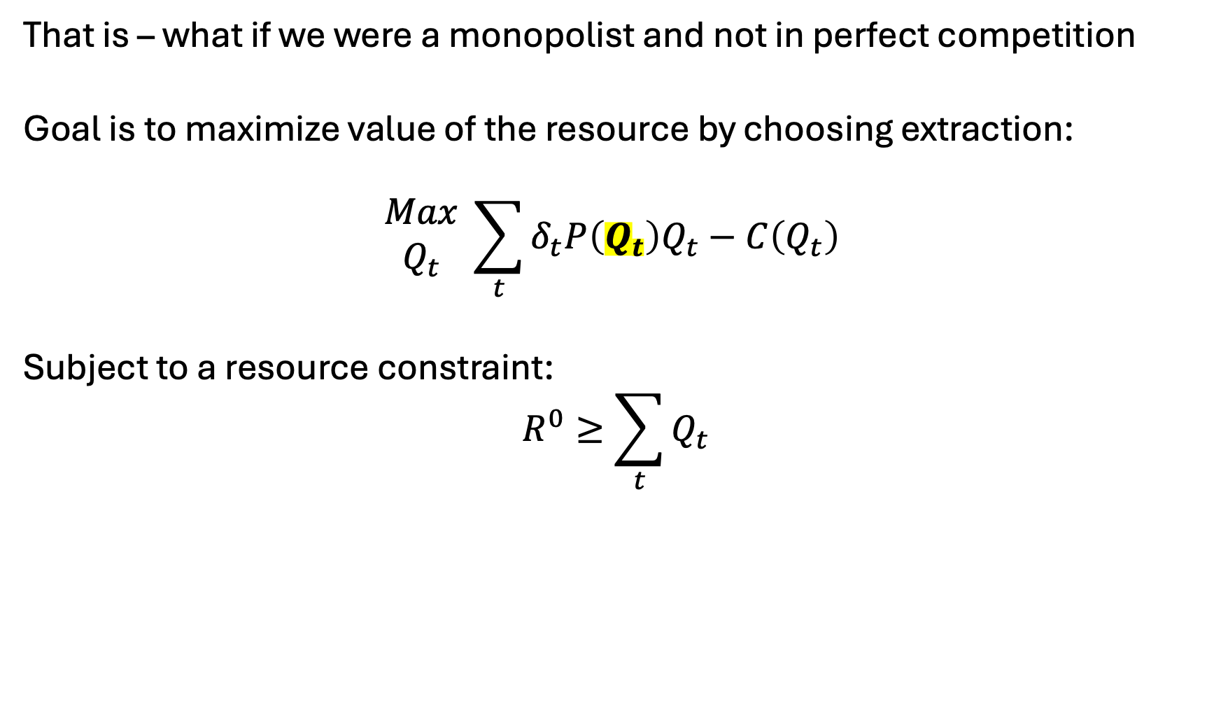
Now – what if we had price control?
That is – what if we were a monopolist and not in perfect competition
Goal is to maximize value of the resource by choosing extraction:
$$\begin{matrix}Max \\ Q_{t}\end{matrix} \sum_{t}{δ_{t}P\left(Q_{t}\right)Q_{t}−C\left(Q_{t}\right) }$$
Subject to a resource constraint:
$$R^{0}≥\sum_{t}{Q_{t}}$$

Slide 30
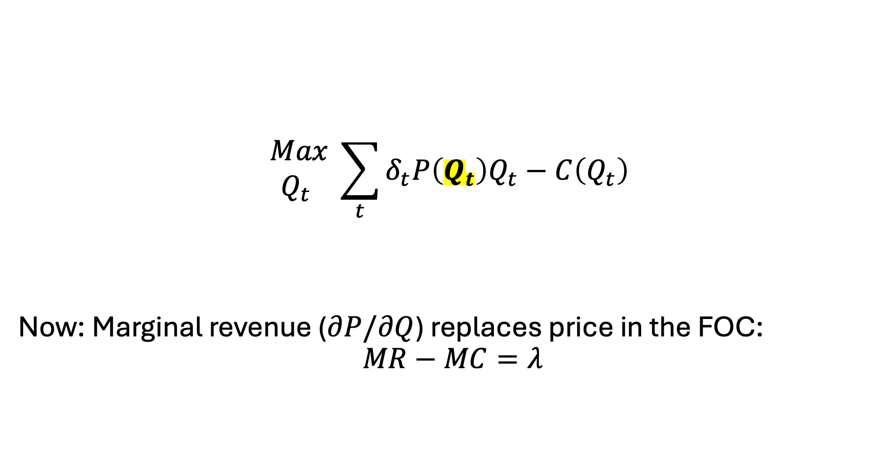
Monopolistic Resource Extraction
$$\begin{matrix}Max \\ Q_{t} \end{matrix} \sum_{t}{δ_{t}P\left(Q_{t}\right)Q_{t}−C\left(Q_{t}\right) }$$
Now: Marginal revenue ($∂P/∂Q$) replaces price in the FOC:
$$MR−MC=λ$$

Slide 31

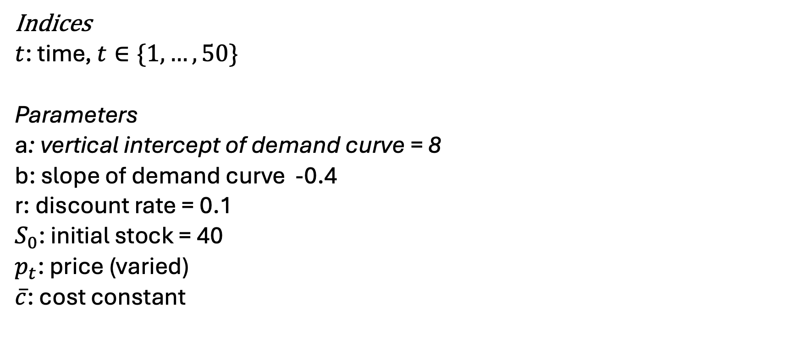
Let’s code up the models in GAMS
Variables
$q_{t}$: quantity extracted at time t
$p_{t}$: price at time t
$λ$: marginal cost
$π$: profit
Indices
$t$: time, $t∈\{1,…,50\}$
Parameters
a: vertical intercept of demand curve = 8
b: slope of demand curve -0.4
r: discount rate = 0.1
$S_{0}$: initial stock = 40
$p_{t}$: price (varied)
$\overline{c}$: cost constant

Slide 32
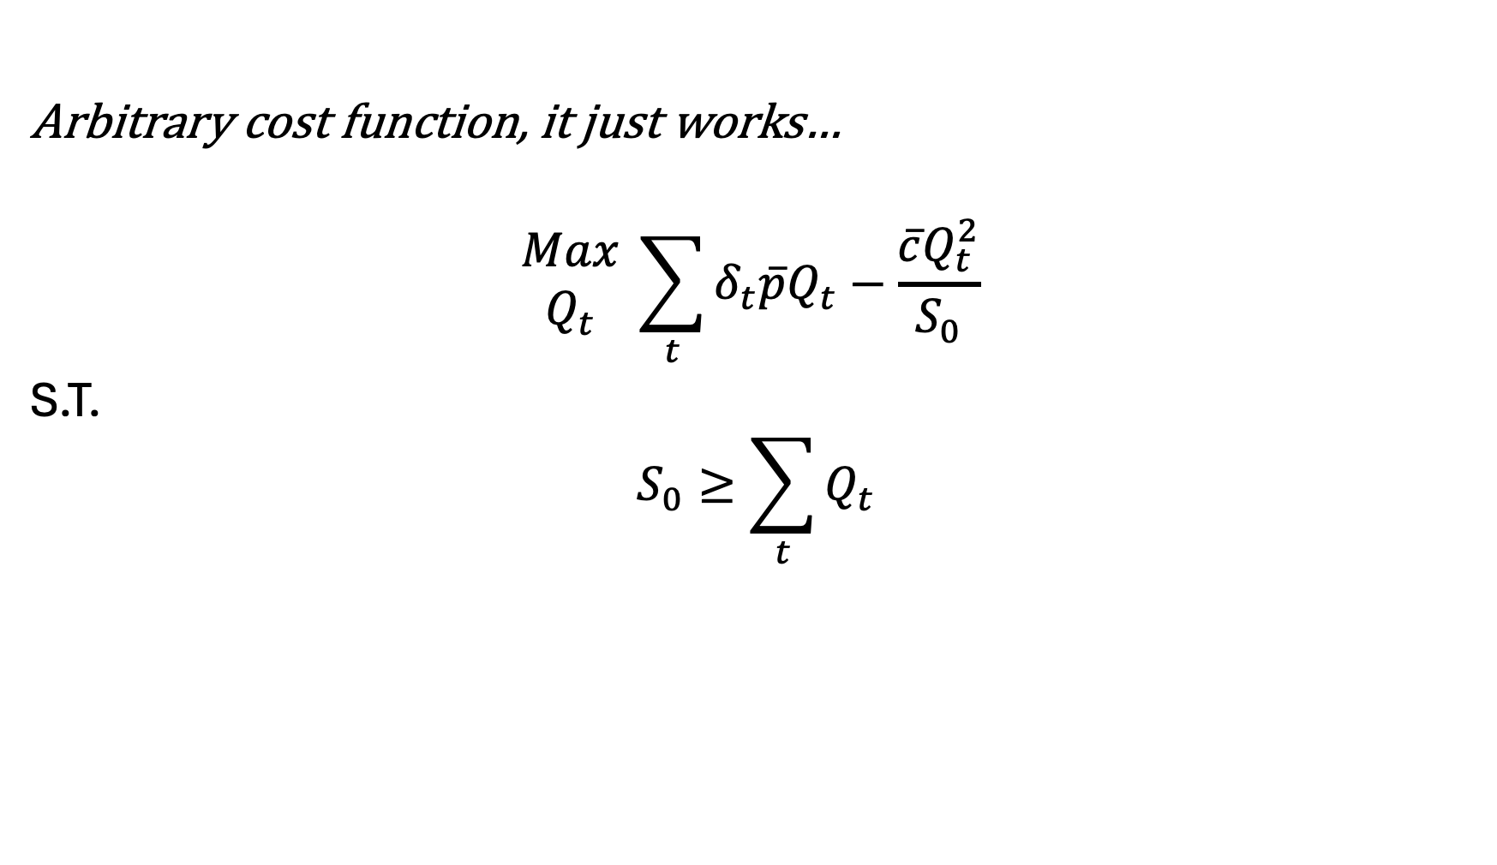
GAMS model - PC
Arbitrary cost function, it just works…
$$\begin{matrix}Max \\ Q_{t}\end{matrix} \sum_{t}{δ_{t}\overline{p}Q_{t}−\frac{\overline{c}Q_{t}^{2}}{S_{0}} }$$
S.T.
$$S_{0}≥\sum_{t}{Q_{t}}$$

Slide 33
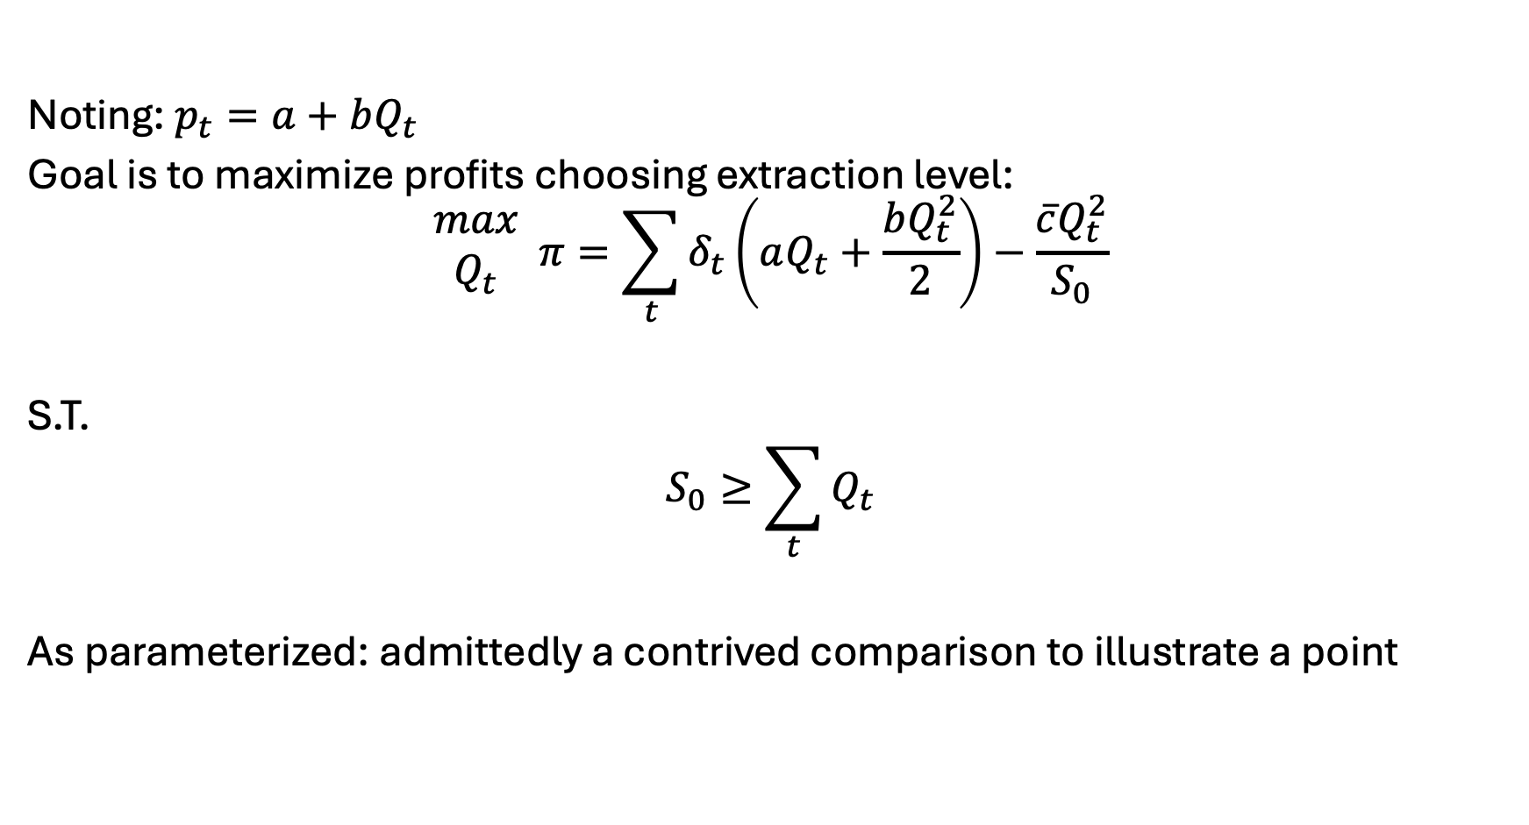
GAMS model - monopolist, continued
Noting: $p_{t}=a+bQ_{t}$
Goal is to maximize profits choosing extraction level:
$$\begin{matrix}max \\ Q_{t}\end{matrix} π=\sum_{t}{δ_{t}\left(aQ_{t}+\frac{bQ_{t}^{2}}{2}\right)}−\frac{\overline{c}Q_{t}^{2}}{S_{0}}$$
S.T.
$$S_{0}≥\sum_{t}{Q_{t}}$$
As parameterized: admittedly a contrived comparison to illustrate a point

Slide 34
Bigger picture of Hotelling and non-renewable resource extraction
Aspect | PC | Monopoly
Price Path | Rises at r | Rises slower than r
Extraction | Faster | Slower
Initial Price | Lower | Higher
Resource lifetime | Shorter | Longer
Extraction | Complete | May not fully exhaust resource

Slide 35

Meme break

Slide 36
Short discussion
Modelers, myself included, love to make things complicated
The biggest, bestest, most detailed model ever
Economists, however, try to draw broader and more generalizable conclusions from modeling efforts
e.g. named Lemmas (Shephard’s), rules (Hotelling), models (Gordon-Schaeffer, Faustman), methods (the Lagrangian), …
Have seen many high-quality econ articles with really poor modeling (esp as it relates to electricity)
Economists also love perverse policy incentives

Slide 37
Now – renewable resources
How does your management strategy change if
the resource regenerates over time?
For fisheries, the population is ‘constantly’ multiplying
Overharvest and they die out
Underharvest and you’re leaving money on the table
- For forestry, it starts anew with each harvest

Slide 38

Specific to fisheries
What level of fish stock is sustainable?
We do not want to overharvest and decimate stock
We do not want to underharvest and leave money/food in the water
Goal: manage the growth of a renewable resource to maximize profit

Slide 39
Some terms we need to know…
Harvest: extraction of the renewable resource
Maximum sustainable yield (MSY): The maximum harvest we can continuously/indefinitely take without system collapse
Exponential growth: monotonically increasing rate of change
Logistic growth: think of an s-shapes curve
Carrying capacity: the natural limit to to an environment’s stock

Slide 40
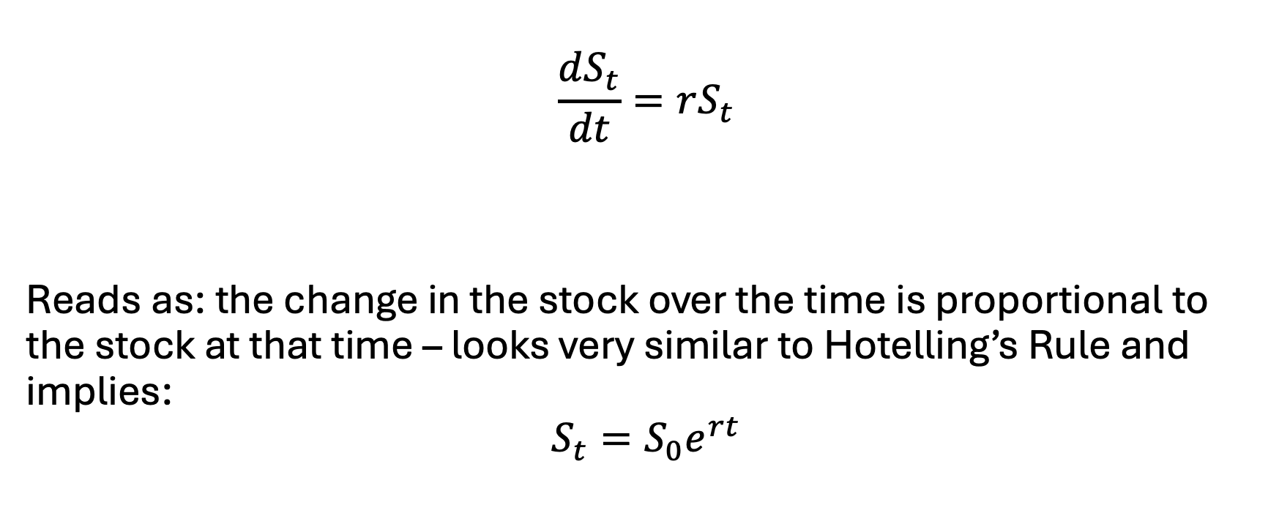
The exponential growth function
$$\frac{dS_{t}}{dt}=rS_{t}$$
Reads as: the change in the stock over the time is proportional to the stock at that time – looks very similar to Hotelling’s Rule and implies:
$$S_{t}=S_{0}e^{rt}$$

Slide 41

Exponential growth not realistic though
Limits to…
Food
Space
Environmental quality
Productivity of the resource

Slide 42

Exponential growth not realistic though
Previous, not realistic:
$$\frac{dS_{t}}{dt}=rS_{t}$$
Thus, we introduce carrying capacity:
$$\frac{dS_{t}}{dt}={rS}_{t}\left(1−\frac{S_{t}}{K}\right)$$

Slide 43
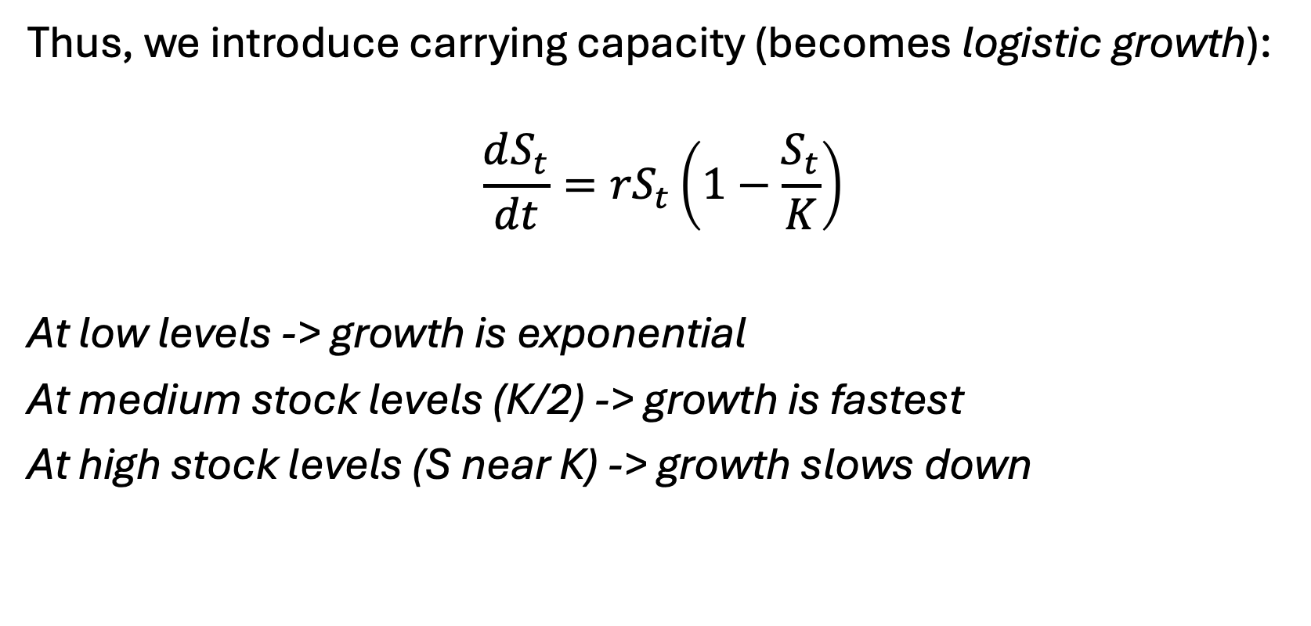
Exponential growth not realistic though
Thus, we introduce carrying capacity (becomes logistic growth):
$$\frac{dS_{t}}{dt}={rS}_{t}\left(1−\frac{S_{t}}{K}\right)$$
At low levels -> growth is exponential
At medium stock levels (K/2) -> growth is fastest
At high stock levels (S near K) -> growth slows down

Slide 44
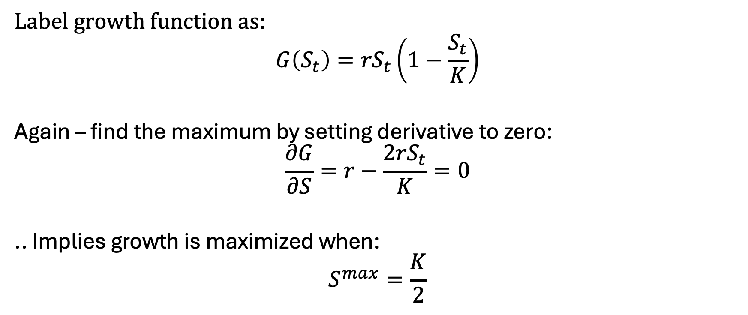
Logistic growth and Maximum Sustainable Yield
Label growth function as:
$$G\left(S_{t}\right)={rS}_{t}\left(1−\frac{S_{t}}{K}\right)$$
Again – find the maximum by setting derivative to zero:
$$\frac{∂G}{∂S}=r−\frac{2{rS}_{t}}{K}=0$$
.. Implies growth is maximized when:
$$S^{max}=\frac{K}{2}$$

Slide 45

Logistic growth and Maximum Sustainable Yield
Label growth function as:
$$G\left(S_{t}\right)={rS}_{t}\left(1−\frac{S_{t}}{K}\right)$$
$$S^{max}=\frac{K}{2}$$
$$G\left(S^{max}\right)=\frac{rK}{2}\left(1−\frac{K/2}{K}\right)=\frac{rK}{4}=MSY$$

Slide 46
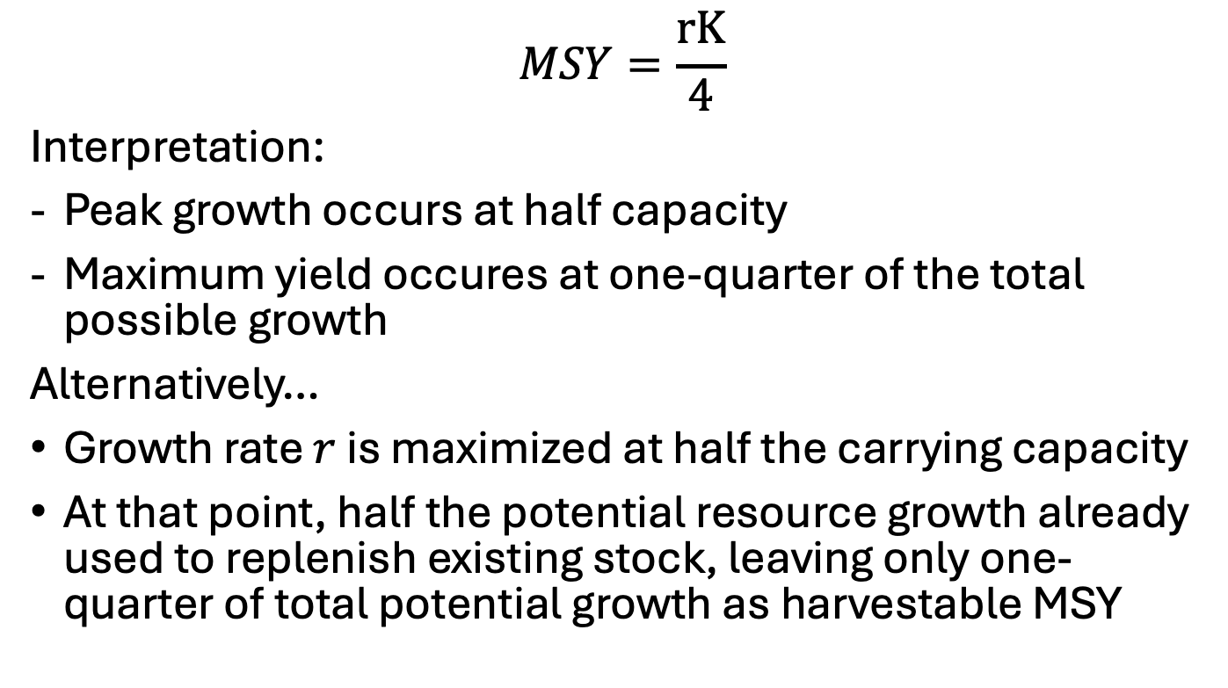
MSY Logic
$$MSY=\frac{rK}{4}$$
Interpretation:
Peak growth occurs at half capacity
Maximum yield occures at one-quarter of the total possible growth
Alternatively…
Growth rate $r$ is maximized at half the carrying capacity
At that point, half the potential resource growth already used to replenish existing stock, leaving only one-quarter of total potential growth as harvestable MSY

Slide 47
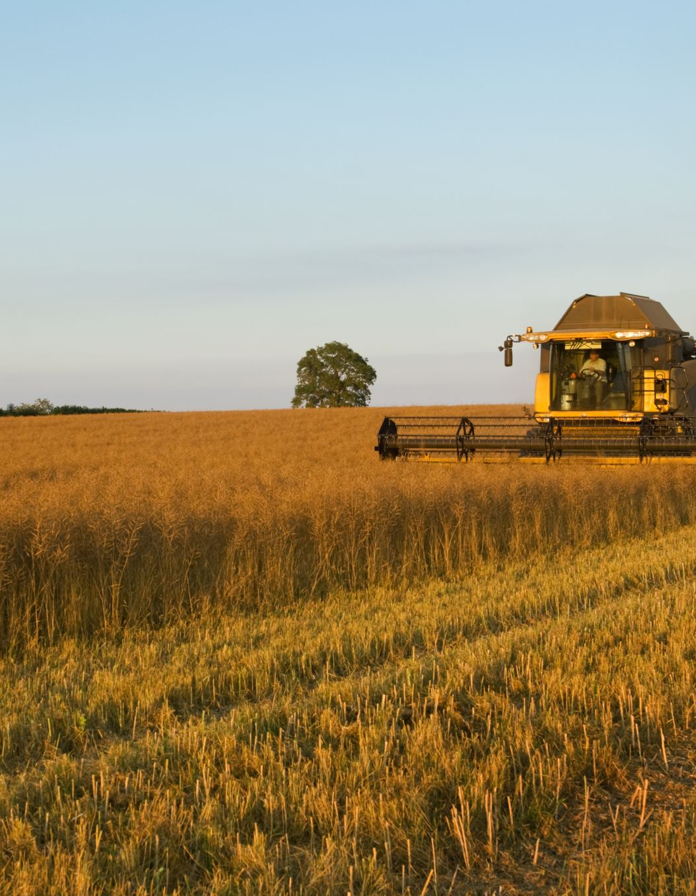

Now – what if we add harvesting?
$$\frac{dS_{t}}{dt}={rS}_{t}\left(1−\frac{S_{t}}{K}\right)−H_{t}$$
… Let’s define harvest as the product of..
- A catching coefficient ($α$)
- The current stock ($S_{t}$)
- And some effort level ($E_{t}$)
Such that:
$$H_{t}=αS_{t}E_{t}$$

Slide 48
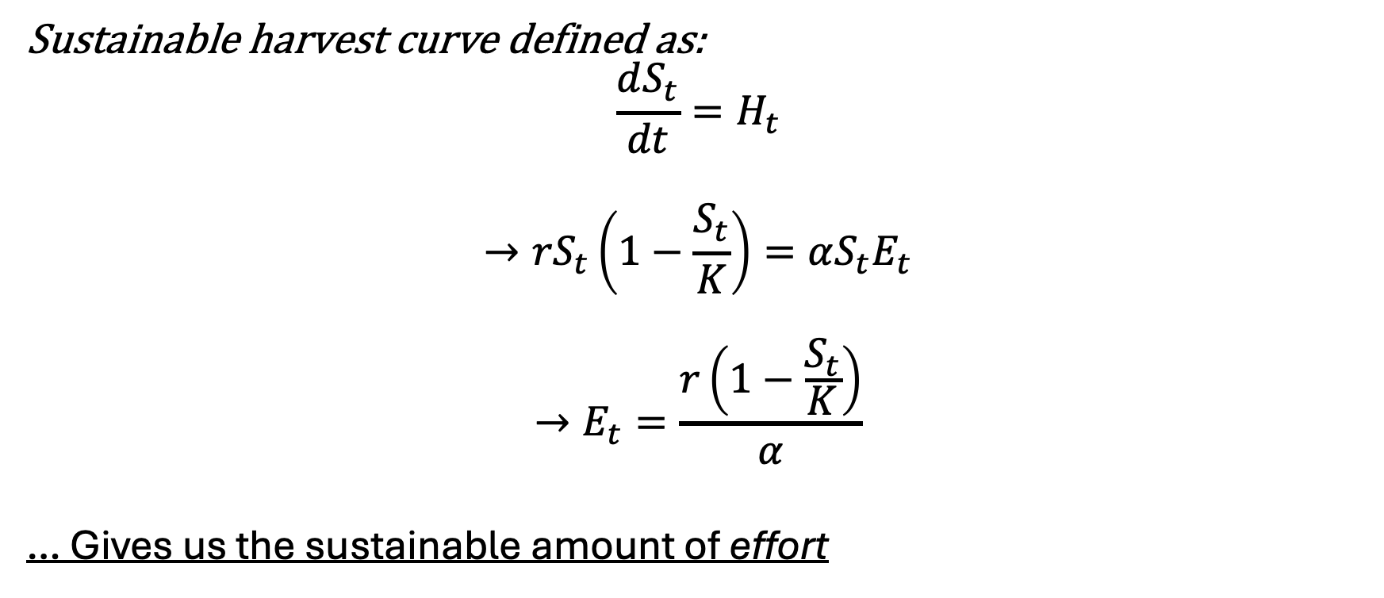
What if we don’t want the stock to change?
Sustainable harvest curve defined as:
$$\frac{dS_{t}}{dt}=H_{t}$$
$$→{rS}_{t}\left(1−\frac{S_{t}}{K}\right)=αS_{t}E_{t}$$
$$→E_{t}=\frac{r\left(1−\frac{S_{t}}{K}\right)}{α}$$
… Gives us the sustainable amount of effort

Slide 49
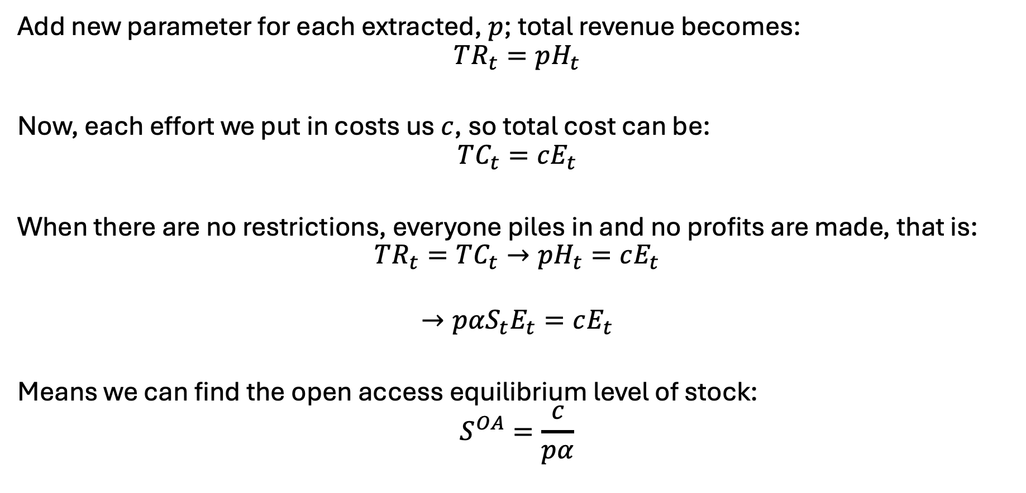
Let’s bring money into this..
Add new parameter for each extracted, $p$; total revenue becomes:
$$TR_{t}=pH_{t}$$
Now, each effort we put in costs us $c$, so total cost can be:
$$TC_{t}=cE_{t}$$
When there are no restrictions, everyone piles in and no profits are made, that is:
$$TR_{t}=TC_{t}→pH_{t}=cE_{t}$$
$$→pαS_{t}E_{t}=cE_{t}$$
Means we can find the open access equilibrium level of stock:
$$S^{OA}=\frac{c}{pα}$$

Slide 50

Evaluating OA level of effort
Recall
$$E_{t}=\frac{r\left(1−\frac{S_{t}}{K}\right)}{α}$$
Replacing $S_{t}$ with $S^{OA}$..
$$E_{t}=\frac{r\left(1−\frac{S^{OA}}{K}\right)}{α}$$

Slide 51
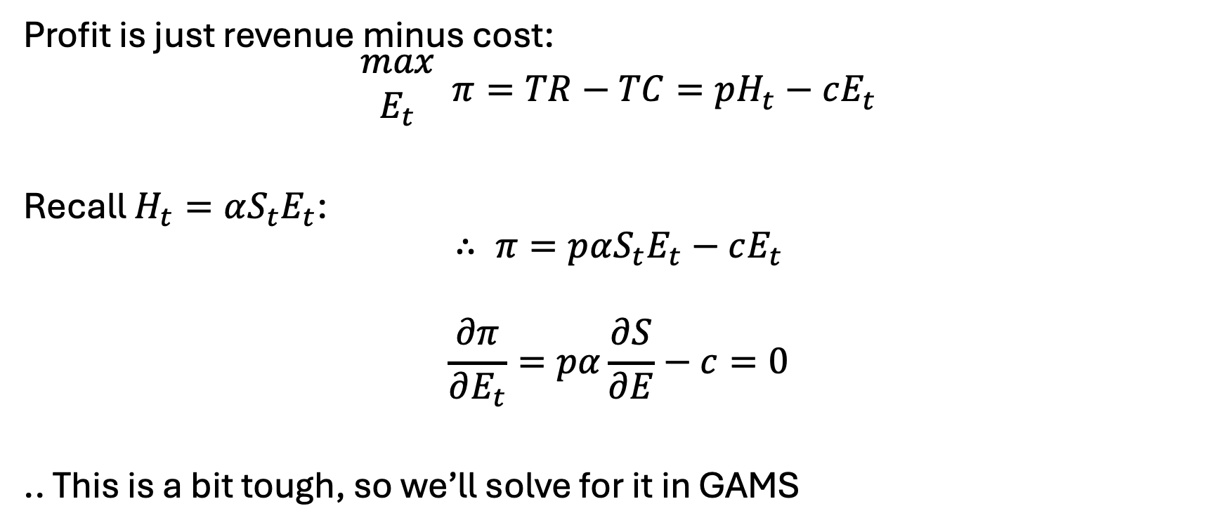

But we care about profit… that $π$ in the sky
Profit is just revenue minus cost:
$$\begin{matrix}max \\ E_{t}\end{matrix} π=TR−TC=pH_{t}−cE_{t}$$
Recall $H_{t}=αS_{t}E_{t}$:
$$∴ π=pαS_{t}E_{t}−cE_{t}$$
$$\frac{∂π}{∂E_{t}}=pα\frac{∂S}{∂E}−c=0$$
.. This is a bit tough, so we’ll solve for it in GAMS

Slide 52

Important note here
We could optimize with and without price control (same way we did with Hotelling)..
but we already know the optimality conditions
Thus: we can explore how different conditions impact those optimal decisions
We call this an analytical model.. basically, exploring the solution space

Slide 53
In GAMS..
Specify..
r=0.5
k=3500
50 time periods
… then can solve analytically (we know the optimality conditions)
See: fishy.gms

Slide 54

What if we change $α$?
… could be likened to a new technology – more efficient capture!

Slide 55
Commonly-proposed policies
Individual transfer quotas – basically like a cap and trade for fish
Taxes on effort or harvest – align private and social costs
Protected areas / sanctuaries
Equipment restrictions

Slide 56
Policies in practice [I]
Individual transfer quotas
How they work – set a limit on total harvest/effort:
$$H^{∗}=qE^{∗}X^{∗}$$
Examples:
New Zealand Hoki fishery – success, raised profits
Iceland Cod Fishery – failure
Giant corporations bought out small fishers
Low enforcement

Slide 57
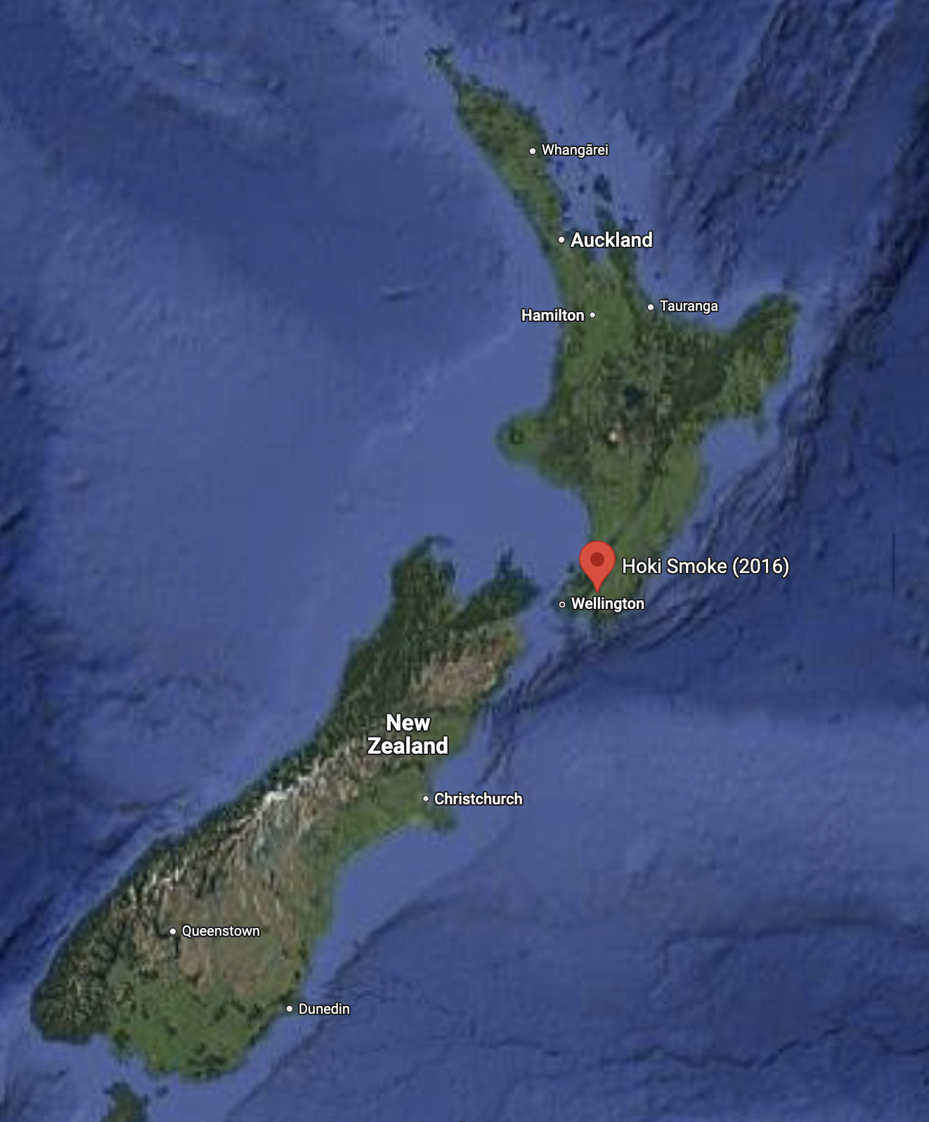
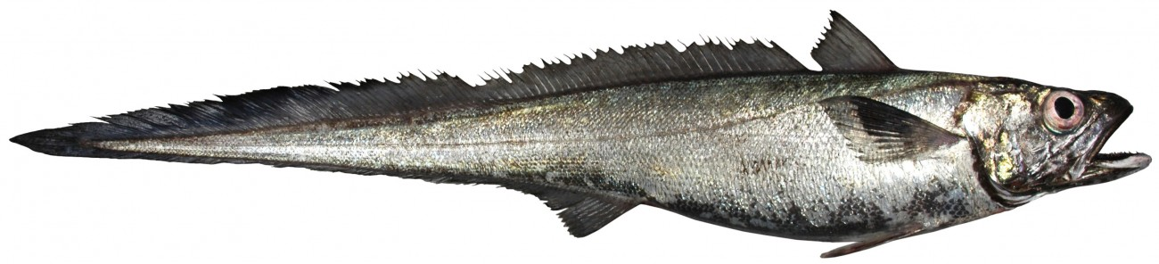
New Zealand Hoki Fishery Management
Fishery management strategy started in 1986
Works on a system of ITQ’s that limit the Total Allowable Commercial Catch (TACC)
Total number of TACCs set at 10% of total estimated stock
Resulted in 36% increase in total profits per unit of cost input

Slide 58
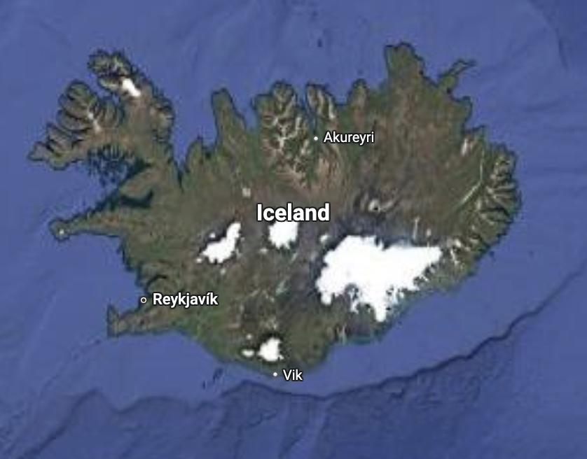

Iceland Cod Fishery
ITQ system started in 1984
Allowed for grandfathering in of substantial fishing quotas
Several rights were sold to large corporations who overfished with little punitive recompense
Cod industry plagued by constant declines and surges in stock

Slide 59
ITQs in practice
Individual transfer quotas can succeed or fail
Failures a result of:
Overfishing (obviously), itself being a result of..
Low enforcement
Consolidation
Lacking monitoring and updates to quotas
Several other examples ..

Slide 60
Policies in practice [II]
Effort tax
How they work – simple tax on effort:
$TC=\left(c+τ\right)E$
Examples:
Denmark effort taxes on heavy fishing days
Indonesia –
Weak enforcement and tax evasion in remote areas
Fishers shifted to illegal methods

Slide 61
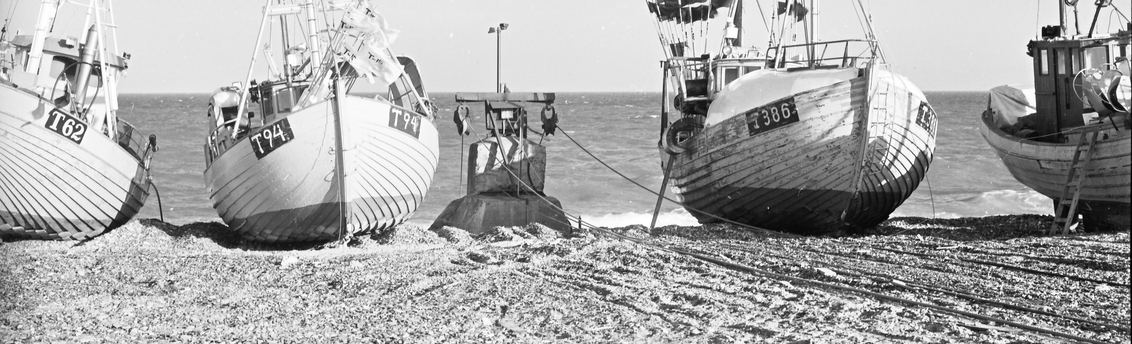
Denmark’s effort tax
One of the first major attempts at fisheries regulation for a big industry (Denmark is 5th largest fish exporter in the world)
Tax based on fishing pressure – directly tied to horsepower, equipment, …
Wasn’t based on catch equipment… problem?
Criticized for taxing inputs, not outputs
Eventually switched to an ITQ

Slide 62
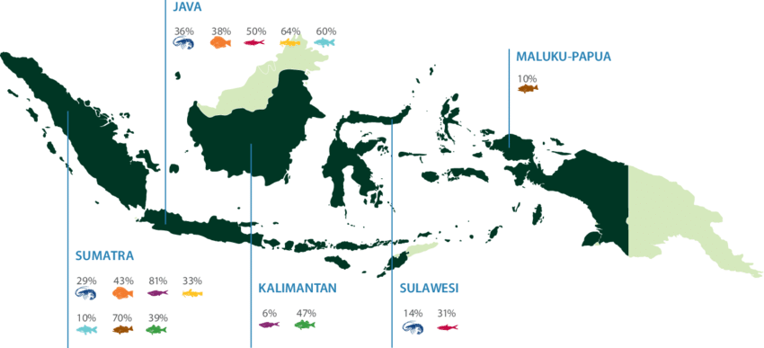
Indonesia’s effort tax
Similar to Denmark in that it imposed a tax based on boat characteristics
Had an exception for boats under a certain size
Led to industry fragmentation
When prices of fish skyrocketed in mid-2000’s, tax was too small
In 2023, switched to ITQ
Still – low enforcement
Community outrage

Slide 63
Effort taxes in practice
Two examples, both failed – why?
Difficult to enforce
Difficult to parameterize a one-size-fits-all solution
Workaround for catch equipment with the Denmark tax
Cut-off in size in the Indonesian system
Both examples ultimately switched to ITQ
Perhaps most importantly - community and company opposition

Slide 64

Policies in practice [III]
Marine Protected Areas
How they work:
Examples:
Great Barrier Reef, Australia
Philippines coral reefs - fail
Rules ignored, fines were not high enough
Community-opposed (loss of livelihood, not enough information)

Slide 65
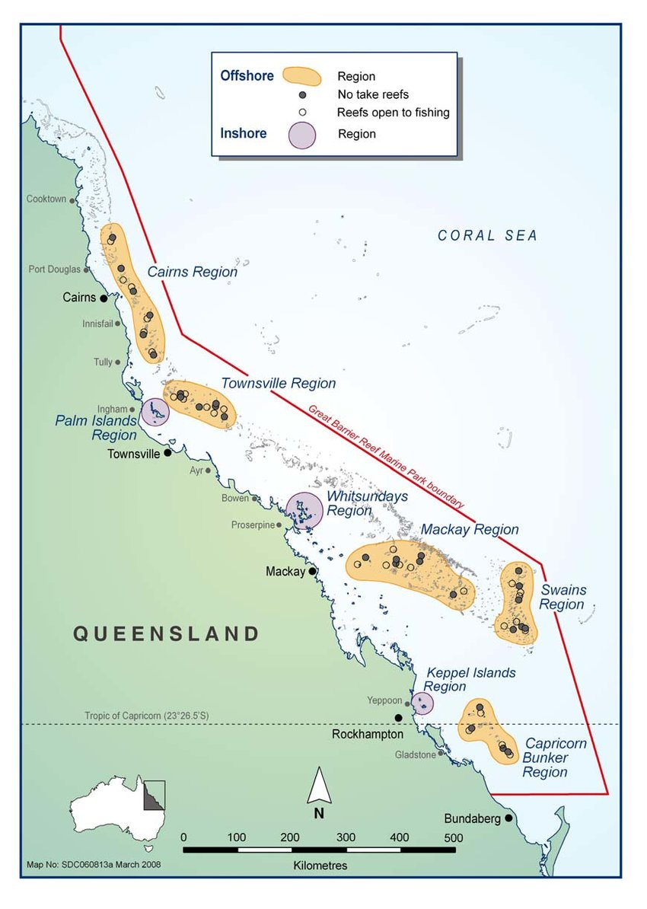
Great Barrier Reef Marine Park
Started in 1975 but ‘zone’ approach introduced in 2004
Basically – enforced no fishing rules in several regions along the reef
Included permitting for fishing
Benefits neighbors

Slide 66

Philippines
Failed:
Nobody cared
Weak fines
Despised

Slide 67
Marine Protected Areas in Practice
Great Barrier Reef vs Philippines
GBR: Strong enforcement, community involvement
Philippines: Weak fines, fragmented enforcement, community hatred
Very tough to enforce

Slide 68
Takeaways from fisheries
Class example of over-exploitation (tragedy of the commons) of a common pool resource
Free entry leads to overharvesting
Profit maximization results in a greater stock being kept
Policies instruments helpful in management
Need heavy fines, local involvement/participation
Demonstrably beneficial to fishers in the long run

Slide 69
Prompt
Imagine you own a plot of land
You plant trees today and want to eventually cut them down to sell
When should you harvest those trees?
... Knowing you’re going to replant and not sell the land

Slide 70
Pause
What did the forest say when it got overharvested?
Why is the forester also a good programmer?
Why did the professor bring a tree to class?

Slide 71
Pause
What did the forest say when it got overharvested?
“I’m stumped”
Why is the forester also a good programmer?
Because they knew how to log their changes
Why did the professor bring a tree to class?
For some rooted discussion

Slide 72
Forestry
Now not talking about stock we’re talking about rotation
Still harvesting but once we do, the ‘stock’ resets (for now)
Intuition:
Trees grow in volume/value over time, but also tie up resources (land)
Harvesting too early: missed value from growth
Harvesting too late: delays profits (we want money now)
Enter the Faustmann Model

Slide 73
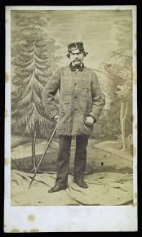
Martin Faustmann
Born 1822, Died 1876
Spotty college record
Quickly became chief forester of Dudenhofen (Black Forest)
Known for incorporating time into the consideration of forest harvests:
“If a patient forester chooses to let their stand grow for an additional decade, they might receive a much larger timber sale revenue, but at the cost of delaying the next rotation: after harvesting, they are left with bare land, while their impatient colleague now has 10-year-old-trees.”

Slide 74
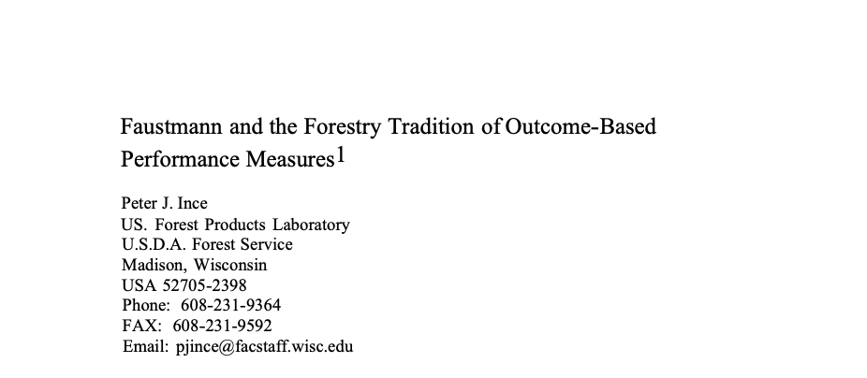

The Faustmann Model
Used widely in forestry and resource management
Actually used by companies and governments (more on this later)
Fundamentally: How you choose a rotation period to maximize the value of land when it can be harvest, replanted, and used forever on a T-year cycle?

Slide 75
Main difference with Faustmann and others
In this sense – our choice variable is the optimal ‘timing’ of when to harvest, it is not some harvest amount
That is – we are choosing the length of time between the planting period and harvesting that maximizes our long-run (to infinity!) profits

Slide 76
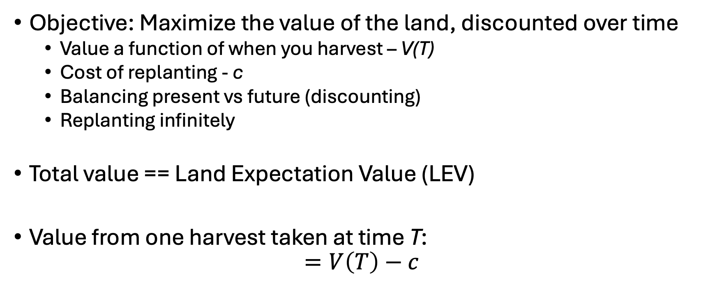
The Faustmann Model
Objective: Maximize the value of the land, discounted over time
Value a function of when you harvest – V(T)
Cost of replanting - c
Balancing present vs future (discounting)
Replanting infinitely
Total value == Land Expectation Value (LEV)
Value from one harvest taken at time T:
$$=V\left(T\right)−c$$

Slide 77
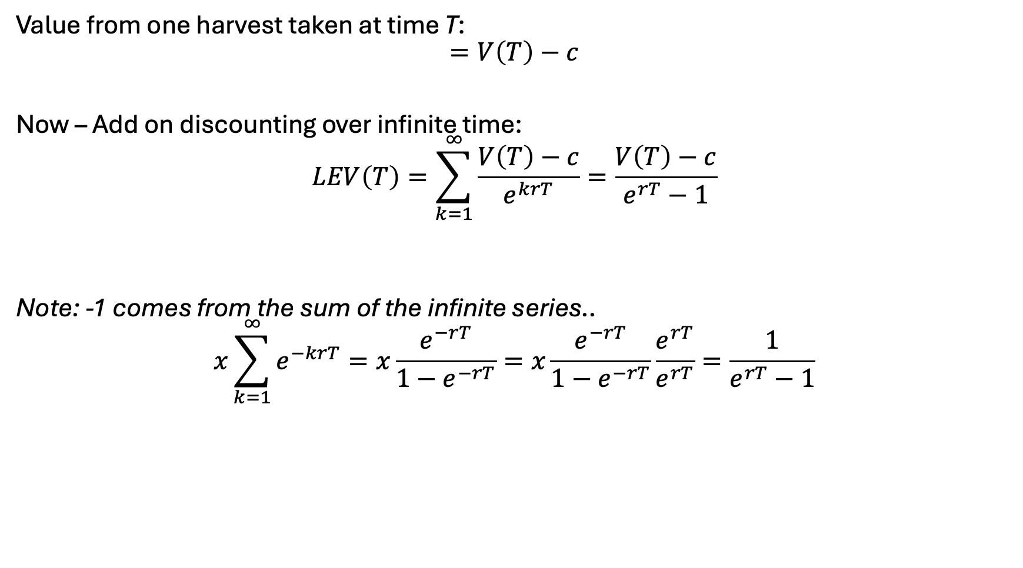
The Faustmann Model [II]
Value from one harvest taken at time T:
$$=V\left(T\right)−c$$
Now – Add on discounting over infinite time:
$$LEV\left(T\right)=\sum_{k=1}^{∞}{\frac{V\left(T\right)−c}{e^{krT}}}=\frac{V\left(T\right)−c}{e^{rT}−1}$$
Note: -1 comes from the sum of the infinite series..
$$x\sum_{k=1}^{∞}{e^{−krT}}=x\frac{e^{−rT}}{1−e^{−rT}}=x\frac{e^{−rT}}{1−e^{−rT}}\frac{e^{rT}}{e^{rT}}=\frac{1}{e^{rT}−1}$$

Slide 78
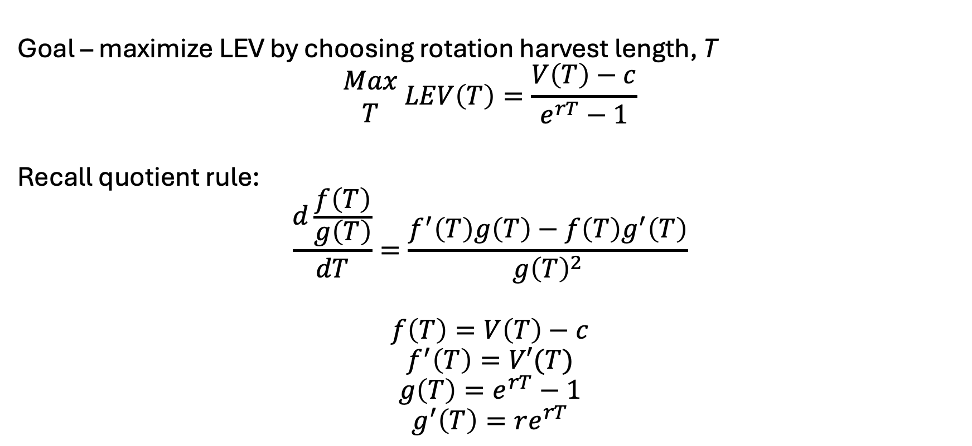
The Faustmann Model [II]
Goal – maximize LEV by choosing rotation harvest length, T
$$\begin{matrix}Max \\ T\end{matrix} LEV\left(T\right)=\frac{V\left(T\right)−c}{e^{rT}−1}$$
Recall quotient rule:
$$\frac{d\frac{f\left(T\right)}{g\left(T\right)}}{dT}=\frac{f^{′}\left(T\right)g\left(T\right)−f\left(T\right)g^{′}\left(T\right)}{g{\left(T\right)}^{2}}$$
$$f\left(T\right)=V\left(T\right)−c$$
$$f^{′}\left(T\right)=V′(T)$$
$$g\left(T\right)=e^{rT}−1$$
$$g^{′}\left(T\right)=re^{rT}$$

Slide 79

The Faustmann Model [III]
First order condition, set to zero:
$$\frac{dLEV}{dT}=\frac{V^{′}\left(T\right)\left(e^{rT}−1\right)−re^{rT}\left(V\left(T\right)−c\right)}{{\left(e^{rT}−1\right)}^{2}}=0$$
Implies:
$$V^{′}\left(T\right)\left(e^{rT}−1\right)=re^{rT}(V\left(T\right)−c)$$
Opportunity cost of capital tied up in the stand,
including delayed profits
Marginal increase in time value [x] Perpetuity factor

Slide 80
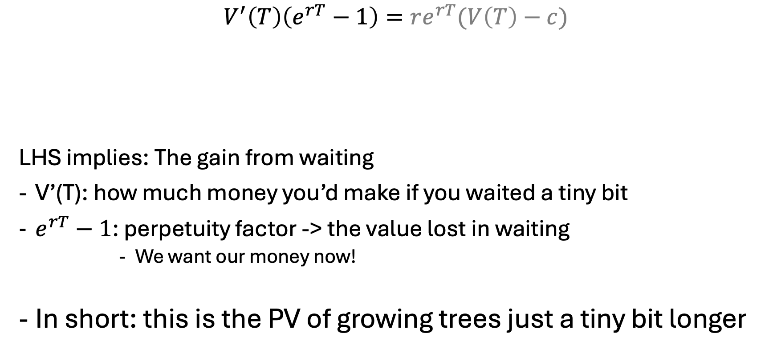
The Faustmann Equation [I]
$$V^{′}\left(T\right)\left(e^{rT}−1\right)=re^{rT}(V\left(T\right)−c)$$
LHS implies: The gain from waiting
V’(T): how much money you’d make if you waited a tiny bit
$e^{rT}−1$: perpetuity factor -> the value lost in waiting
We want our money now!
In short: this is the PV of growing trees just a tiny bit longer
Opportunity cost of capital tied up in the stand,
including delayed profits
Marginal increase in time value [x] Perpetuity factor

Slide 81
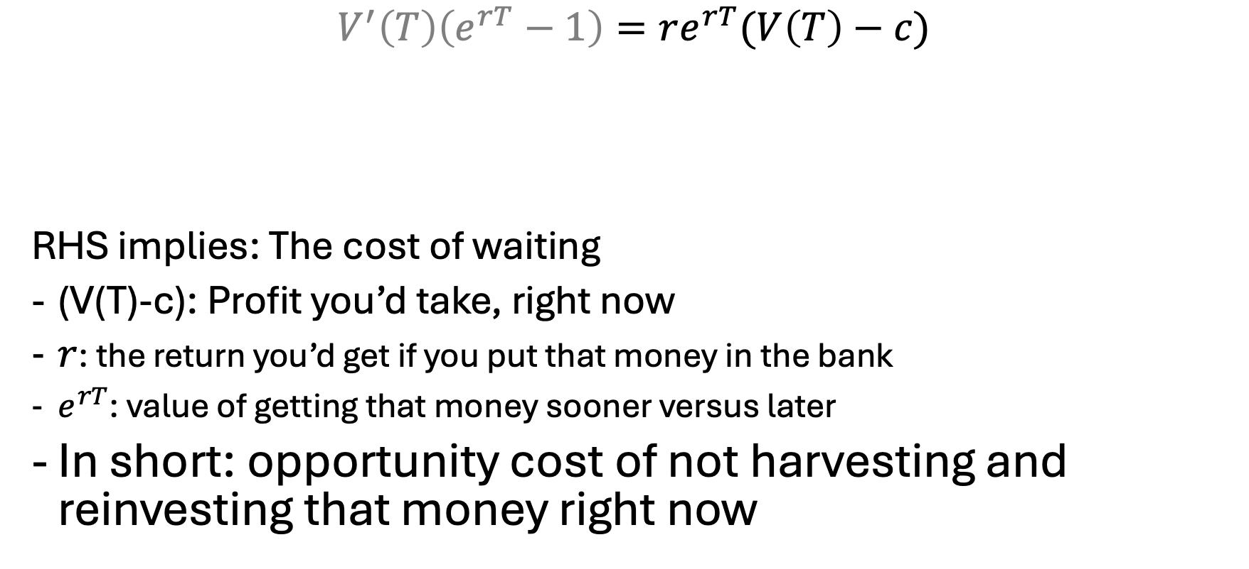
The Faustmann Equation [II]
$$V^{′}\left(T\right)\left(e^{rT}−1\right)=re^{rT}(V\left(T\right)−c)$$
RHS implies: The cost of waiting
(V(T)-c): Profit you’d take, right now
$r$: the return you’d get if you put that money in the bank
$e^{rT}$: value of getting that money sooner versus later
In short: opportunity cost of not harvesting and reinvesting that money right now
Opportunity cost of capital tied up in the stand,
including delayed profits
Marginal increase in time value [x] Perpetuity factor

Slide 82
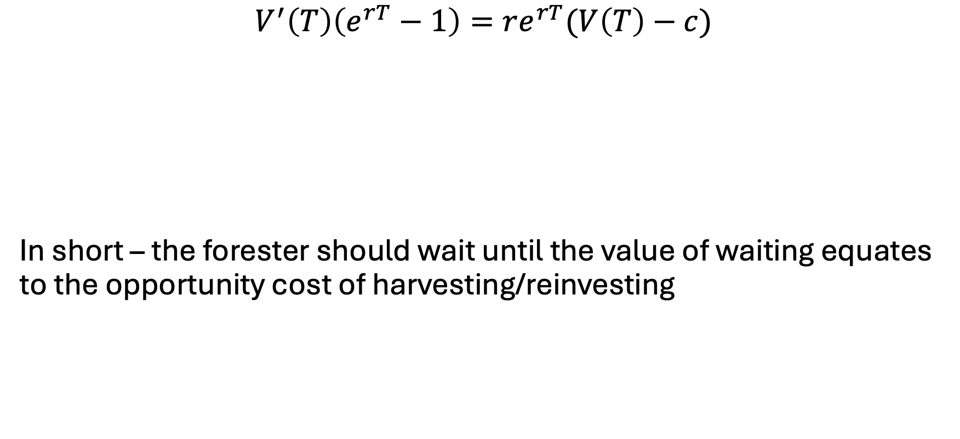
The Faustmann Equation [III]
$$V^{′}\left(T\right)\left(e^{rT}−1\right)=re^{rT}(V\left(T\right)−c)$$
In short – the forester should wait until the value of waiting equates to the opportunity cost of harvesting/reinvesting
opportunity cost of not harvesting and reinvesting that money (right now)
PV of growing trees just a tiny bit longer (waiting)

Slide 83
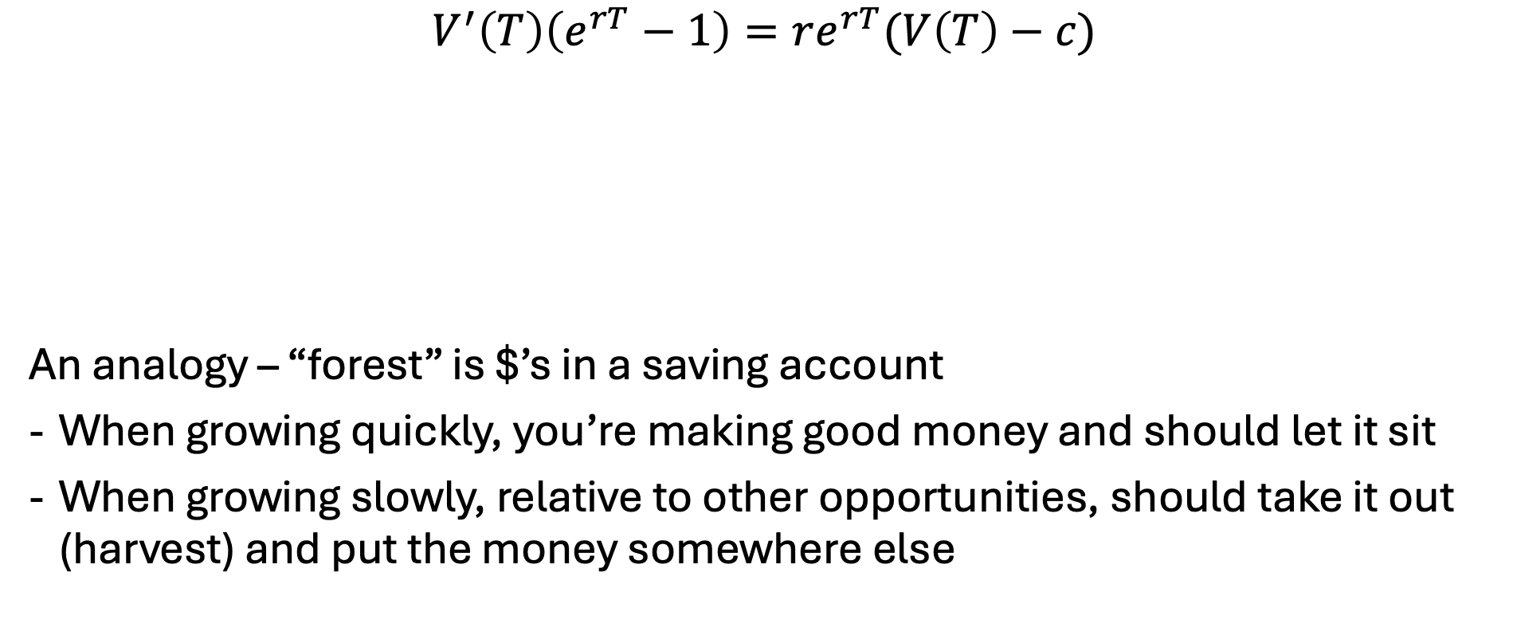
The Faustmann Equation [III]
$$V^{′}\left(T\right)\left(e^{rT}−1\right)=re^{rT}(V\left(T\right)−c)$$
An analogy – “forest” is $’s in a saving account
When growing quickly, you’re making good money and should let it sit
When growing slowly, relative to other opportunities, should take it out (harvest) and put the money somewhere else
opportunity cost of not harvesting and reinvesting that money (right now)
PV of growing trees just a tiny bit longer (waiting)

Slide 84


The full Faustmann model…
Variables
Z – present value of profit
T – rotation period (years)
Objective:
$$\begin{matrix}Max \\ T\end{matrix} \frac{p\overline{s}{\left(1+f\right)}^{T}−c}{e^{rT}−1}$$
Parameters
p: price = 1000
r: discount rate = 0.1
c: replanting cost = 500
f: growth rate = 0.08
$\overline{s}$: initial stand = 100

Slide 85
Faustmann in practice
https://demonstrations.wolfram.com/FaustmannsRuleOfOptimalRotation
GAMS model – faustmann.gms

Slide 86


Faustmann in practice [I]
Several large timber companies (Weyerhaeuser, Rayonier) use Faustmann for their even-aged plantations
Model used to..
Determine optimal rotation ages (equipment planning)
Evaluate land value and ‘silvicultural’ intervention
Consider how market prices/trends impact land value
Include stochastic extensions for pests/drought/…

Slide 87


Faustmann in practice [II]
Aspect | Finland | Sweden
State forest agency | Metsähallitus | Sveaskog + Skogsstyrelsen
Private ownership share | ~60% private | ~80% private
Use of Faustmann | Directly for state rotation planning and LEV mapping | Strategic planning and private advising
Biodiversity integration | Hartman-style extensions common | Multi-objective optimization more common
Modeling platforms | SIMO, Heureka | PlanWise, Heureka
Discount rate differences | Lower for state/public forest objectives | More market-based in private land models

Slide 88

Faustmann in Practice [III]
Extension of Faustman = Hartman
Includes ecological/environmental services
Used by REDD+
Reducing Emissions from Deforestation and Forest Degradation
Discussed previously – provides carbon offset credits
Pays countries/landowners not to deforest
Equivalent to CRP but for forests

Slide 89
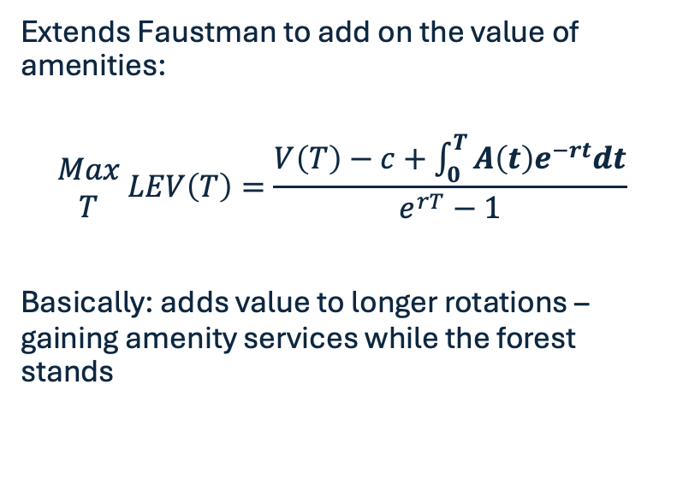
Brief on Hartman Model
Feature | Faustmann | Hartman
Maximizes | Timber value | Timber + amenity value
Rotation age | Usually shorter | Often longer
Ecological services | Ignored | Included explicitly
Relevant to | Industrial timberland | Multi-use or public forests
Extends Faustman to add on the value of amenities:
$$\begin{matrix}Max \\ T\end{matrix} LEV\left(T\right)=\frac{V\left(T\right)−c+\int_{0}^{T}{A\left(t\right)e^{−rt}dt}}{e^{rT}−1}$$
Basically: adds value to longer rotations – gaining amenity services while the forest stands

Slide 90

Richard Hartman
Genuinely.. Tough to find more info on him
Forestry paper cited 1000+ times

Slide 91
Faustmann in Practice [IV]
(In US and Canada) Need to assign value to land for..
Property taxes
Sales
Resource investments
Faustmann answers: what is the value of this land today given the potential to harvest in X years?
When considering..
Timber prices
Growth curves from yield tables
Planning/management costs
Interest rate (4-6% for public)

Slide 92
Relationship to Hotelling
Hotelling -> once you’ve extracted, there is no going back
Market structure makes for an interesting comparison
Faustmann -> restarts the cycle
Thus, land value and replacement cost must be accounted for

Slide 93
Do we see any problems with Faustmann?

Slide 94
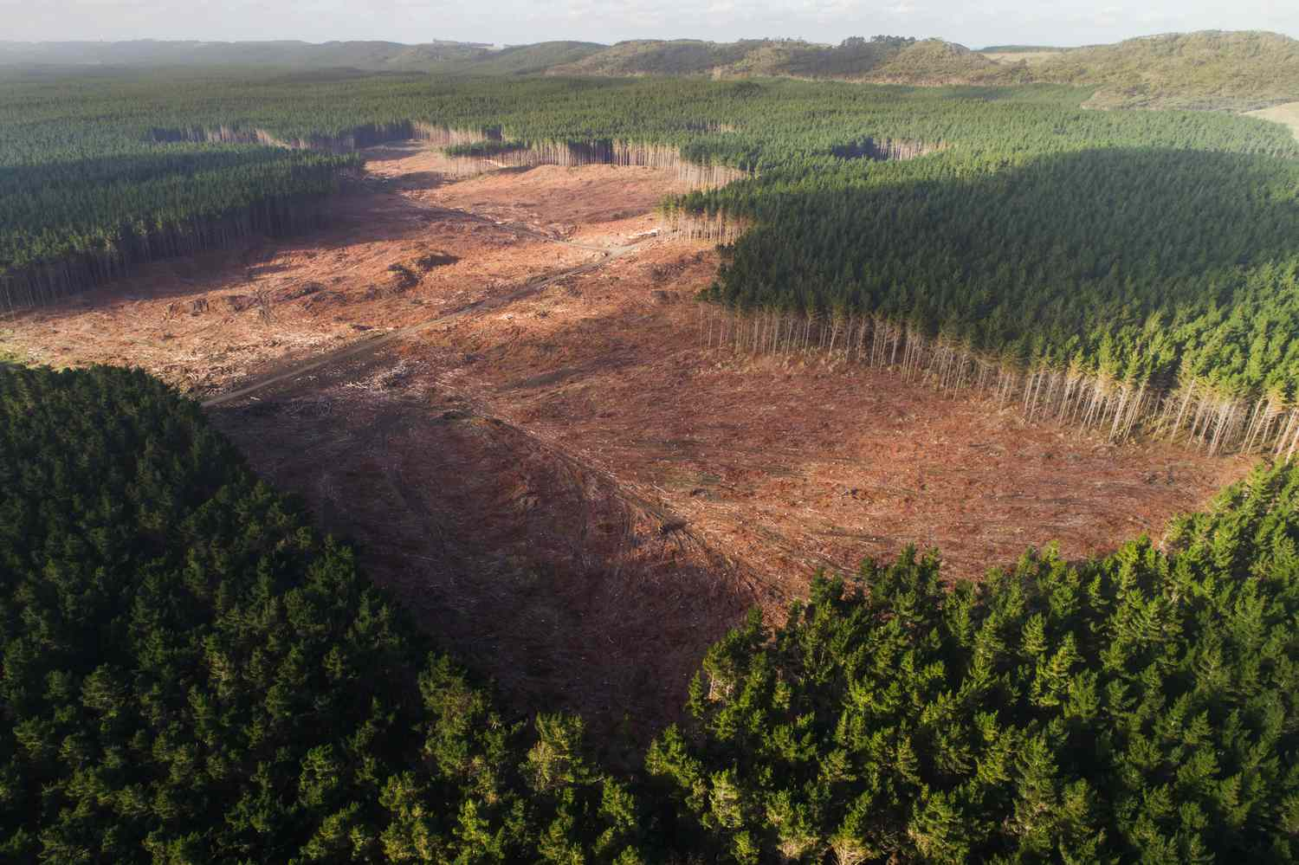
Pros/cons of Faustmann
Pros:
Easy/intuitive
Focus on PV
Easily-expandable
Cons:
Even-aged, clear-cutting
Ignores ecological services
Perfect foresight
Super simple

Slide 95
Enter a new challenger – Managed forests
It doesn’t always make sense to just clear-cut a forest
Similar to fisheries – we can harvest some trees when the time is right but wait for others to mature and become more valuable
Thus, need to introduce the idea that we want to optimize via choosing a quantity to harvest, not a harvest period

Slide 96
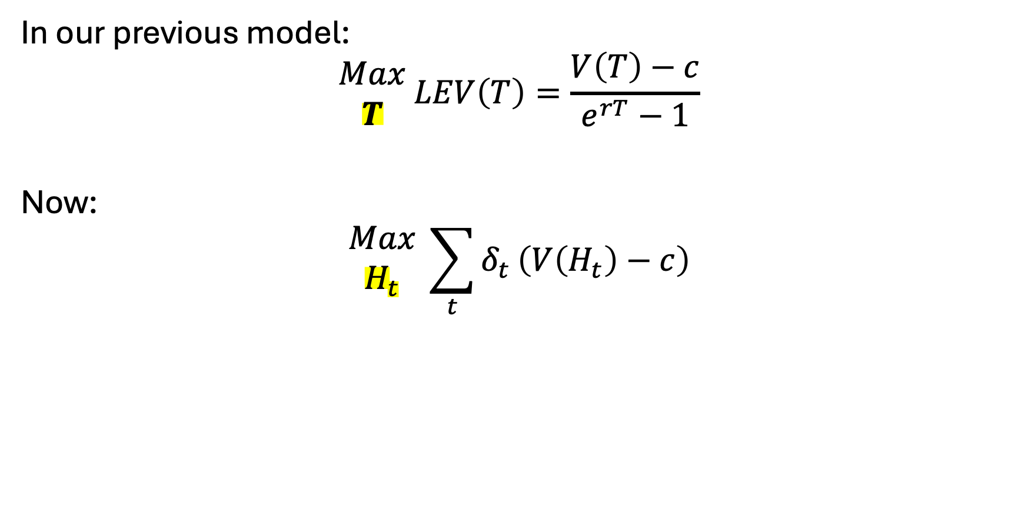
Subtle difference
In our previous model:
$$\begin{matrix}Max \\ T\end{matrix} LEV\left(T\right)=\frac{V\left(T\right)−c}{e^{rT}−1}$$
Now:
$$\begin{matrix}Max \\ H_{t}\end{matrix} \sum_{t}{δ_{t}}\left(V\left(H_{t}\right)−c\right)$$

Slide 97
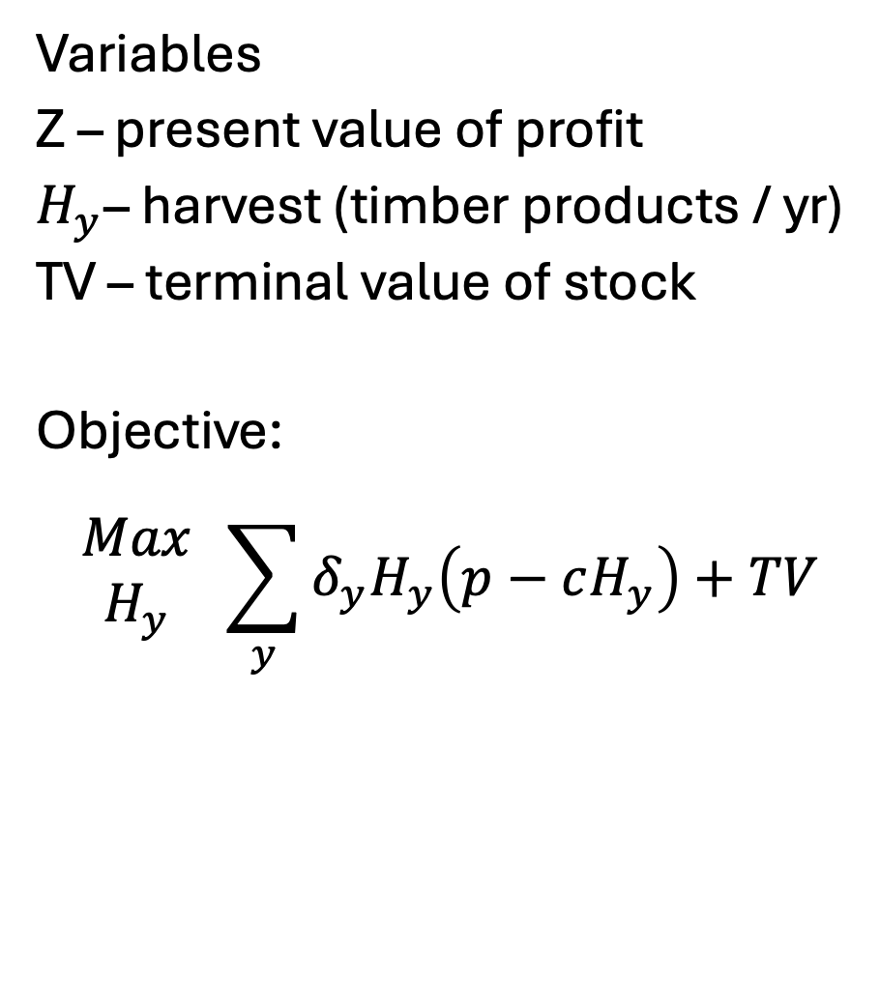

The full managed model
Variables
Z – present value of profit
$H_{y}$– harvest (timber products / yr)
TV – terminal value of stock
Objective:
$$\begin{matrix}Max \\ H_{y}\end{matrix} \sum_{y}{δ_{y}H_{y}\left(p−cH_{y}\right)+TV}$$
Index
y: year ($y∈\{1,..,100\}$)
Parameters
p: price = 1000
r: discount rate = 0.1
c: replanting cost = 500
f: growth rate = 0.08
$\overline{s}$: initial stand = 100

Slide 98

The full managed model
$$\begin{matrix}Max \\ H_{y}\end{matrix} \sum_{y}{δ_{y}H_{y}\left(p−cH_{y}\right)+TV}$$
S.T….
$$TV=\left(p−\frac{cS_{Y}}{20}\right)S_{Y} ∀ Y∈\{100\}$$
$$S_{y}=\left(S_{y−1}−H_{y−1}\right)\left(1+f\right)$$
$$S_{y}≥H_{y}$$

Slide 99
To the GAMS model!
And Tableau!

