Slide 1
EBGN645: Day 10

Slide 2
Notes
Today
Presentation from
Jared Woollacott
Tuesday (10/14) 10am-2pm
Extra office hours next week
Wednesday (10/22)
Homework 1b due
Today: Need to leave at noon

Slide 3
Scheduling notes
No class 10/27-29 (INFORMS)
Potentially optional: 11/10
Possibly 11/12

Slide 4
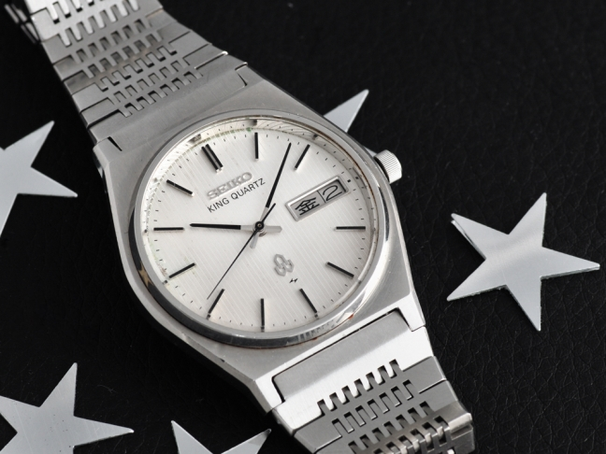
Questions
The question nobody asked:
“What watch are you wearing today?”
A: 1977 King Quartz 4823-8120
Short history on Seiko

Slide 5
Bigger picture
Homework 1 together
Resource models
Hotelling (review)
Fisheries management (Gordon-Schaeffer)
Forestry management (Faustmann)
CO-WY electricity ‘dispatch’
Non-linear, calibrated market models
US petroleum, backstop techs
Review of duality -> MCP models
Game theory models
Stackelberg
Cournot
Ramsey model
CGE models
MPECs/EPECs
Presentations

Slide 6
Bigger picture of Hotelling and non-renewable resource extraction
Aspect | PC | Monopoly
Price Path | Rises at r | Rises slower than r
Extraction | Faster | Slower
Initial Price | Lower | Higher
Resource lifetime | Shorter | Longer
Extraction | Complete | May not fully exhaust resource

Slide 7
Short discussion
Modelers, myself included, love to make things complicated
The biggest, bestest, most detailed model ever
Economists, however, try to draw broader and more generalizable conclusions from modeling efforts
e.g. named Lemmas (Shephard’s), rules (Hotelling), models (Gordon-Schaeffer, Faustman), methods (the Lagrangian), …
Have seen many high-quality econ articles with really poor modeling (esp as it relates to electricity)
Economists also love perverse policy incentives

Slide 8
Now – renewable resources
How does your management strategy change if
the resource regenerates over time?
For fisheries, the population is ‘constantly’ multiplying
Overharvest and they die out
Underharvest and you’re leaving money on the table
- For forestry, it starts anew with each harvest

Slide 9

Specific to fisheries
What level of fish stock is sustainable?
We do not want to overharvest and decimate stock
We do not want to underharvest and leave money/food in the water
Goal: manage the growth of a renewable resource to maximize profit

Slide 10
Some terms we need to know…
Harvest: extraction of the renewable resource
Maximum sustainable yield (MSY): The maximum harvest we can continuously/indefinitely take without system collapse
Exponential growth: monotonically increasing rate of change
Logistic growth: think of an s-shapes curve
Carrying capacity: the natural limit to to an environment’s stock

Slide 11
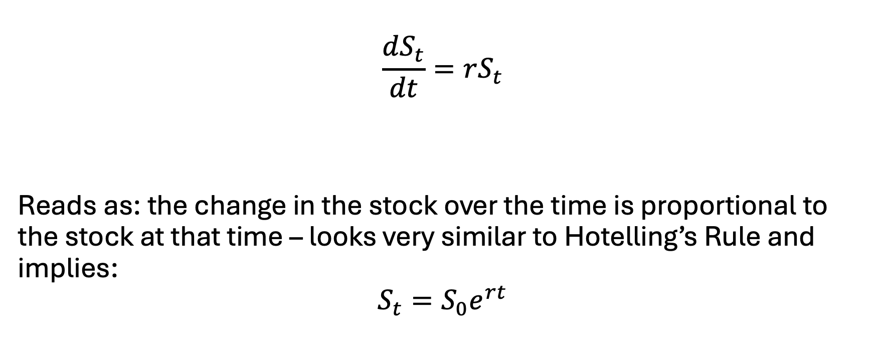
The exponential growth function
$$\frac{dS_{t}}{dt}=rS_{t}$$
Reads as: the change in the stock over the time is proportional to the stock at that time – looks very similar to Hotelling’s Rule and implies:
$$S_{t}=S_{0}e^{rt}$$

Slide 12

Exponential growth not realistic though
Limits to…
Food
Space
Environmental quality
Productivity of the resource

Slide 13

Exponential growth not realistic though
Previous, not realistic:
$$\frac{dS_{t}}{dt}=rS_{t}$$
Thus, we introduce carrying capacity:
$$\frac{dS_{t}}{dt}={rS}_{t}\left(1−\frac{S_{t}}{K}\right)$$

Slide 14
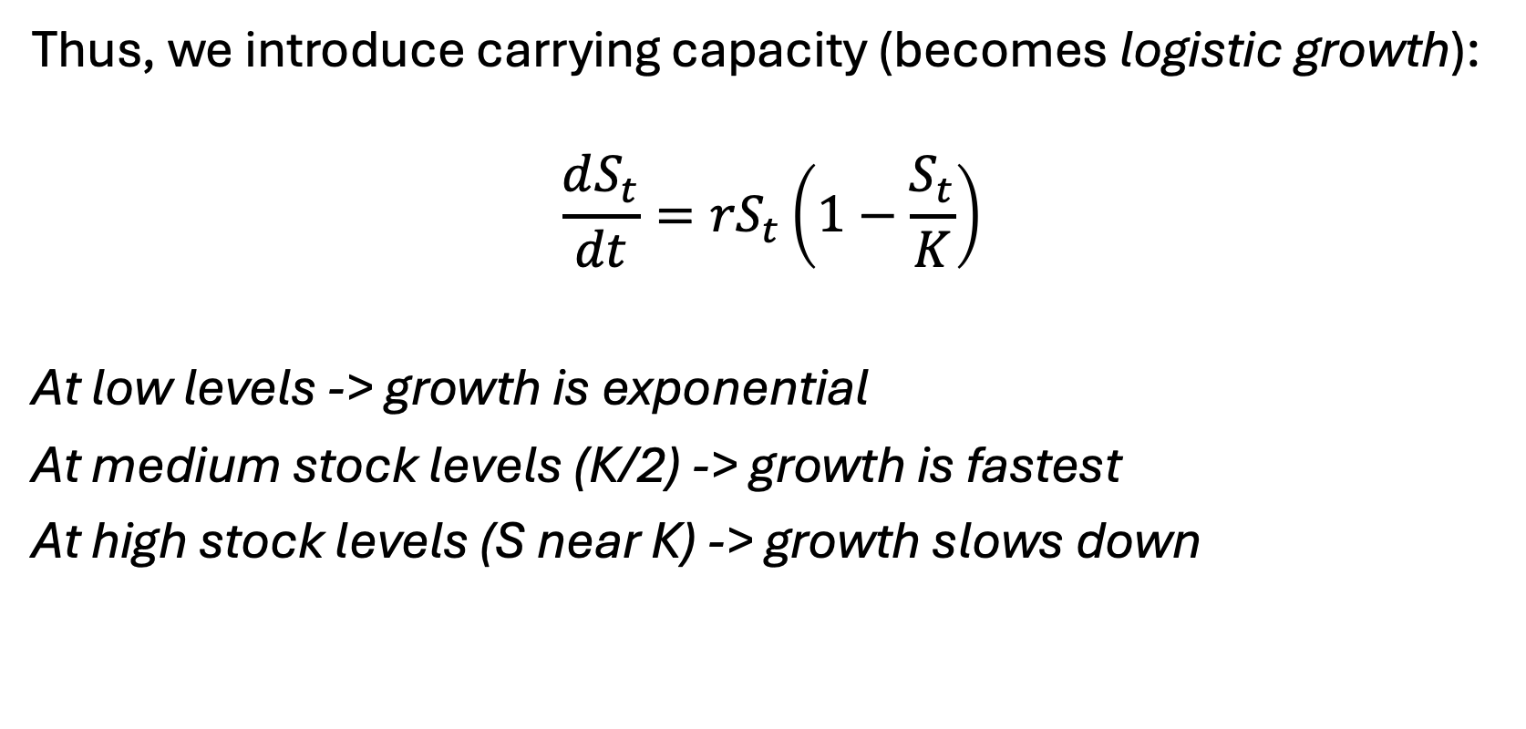
Exponential growth not realistic though
Thus, we introduce carrying capacity (becomes logistic growth):
$$\frac{dS_{t}}{dt}={rS}_{t}\left(1−\frac{S_{t}}{K}\right)$$
At low levels -> growth is exponential
At medium stock levels (K/2) -> growth is fastest
At high stock levels (S near K) -> growth slows down

Slide 15
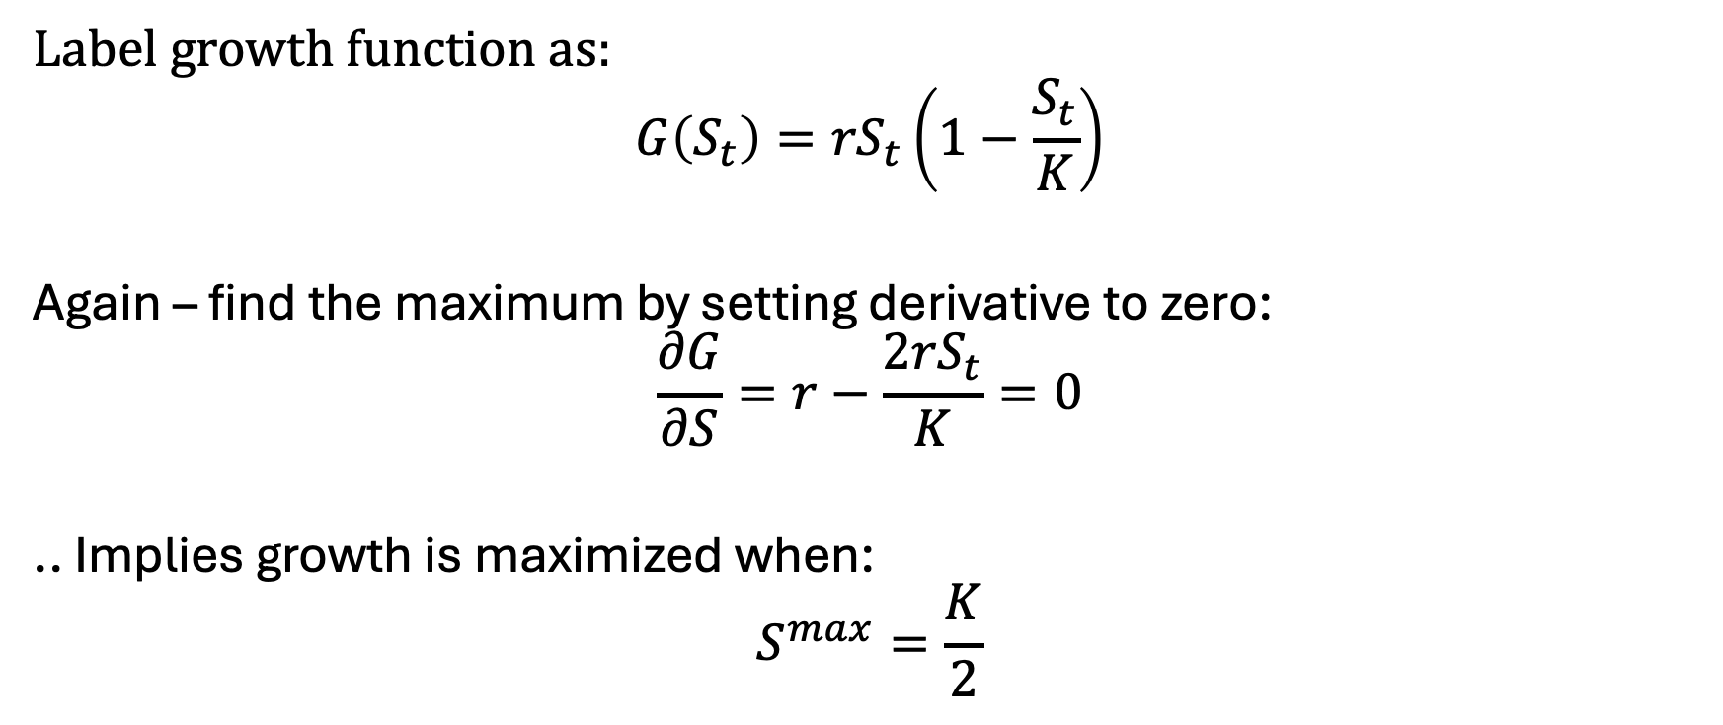
Logistic growth and Maximum Sustainable Yield
Label growth function as:
$$G\left(S_{t}\right)={rS}_{t}\left(1−\frac{S_{t}}{K}\right)$$
Again – find the maximum by setting derivative to zero:
$$\frac{∂G}{∂S}=r−\frac{2{rS}_{t}}{K}=0$$
.. Implies growth is maximized when:
$$S^{max}=\frac{K}{2}$$

Slide 16

Logistic growth and Maximum Sustainable Yield
Label growth function as:
$$G\left(S_{t}\right)={rS}_{t}\left(1−\frac{S_{t}}{K}\right)$$
$$S^{max}=\frac{K}{2}$$
$$G\left(S^{max}\right)=\frac{rK}{2}\left(1−\frac{K/2}{K}\right)=\frac{rK}{4}=MSY$$

Slide 17
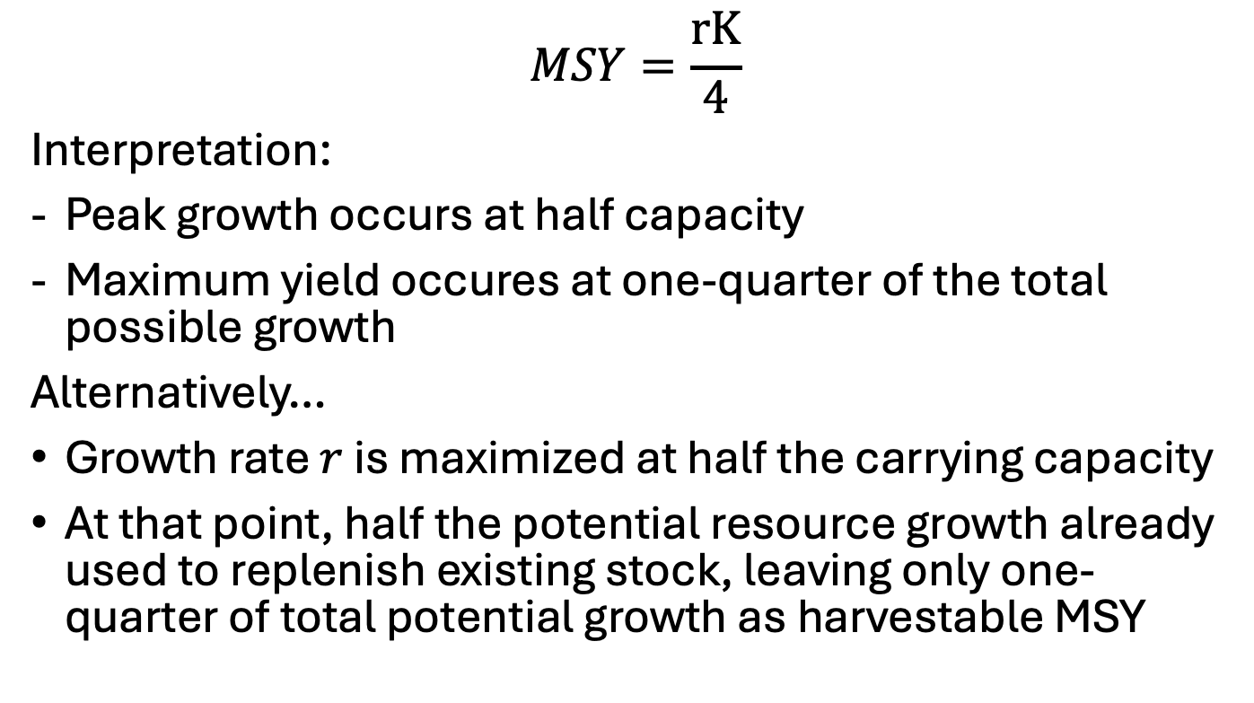
MSY Logic
$$MSY=\frac{rK}{4}$$
Interpretation:
Peak growth occurs at half capacity
Maximum yield occures at one-quarter of the total possible growth
Alternatively…
Growth rate $r$ is maximized at half the carrying capacity
At that point, half the potential resource growth already used to replenish existing stock, leaving only one-quarter of total potential growth as harvestable MSY

Slide 18
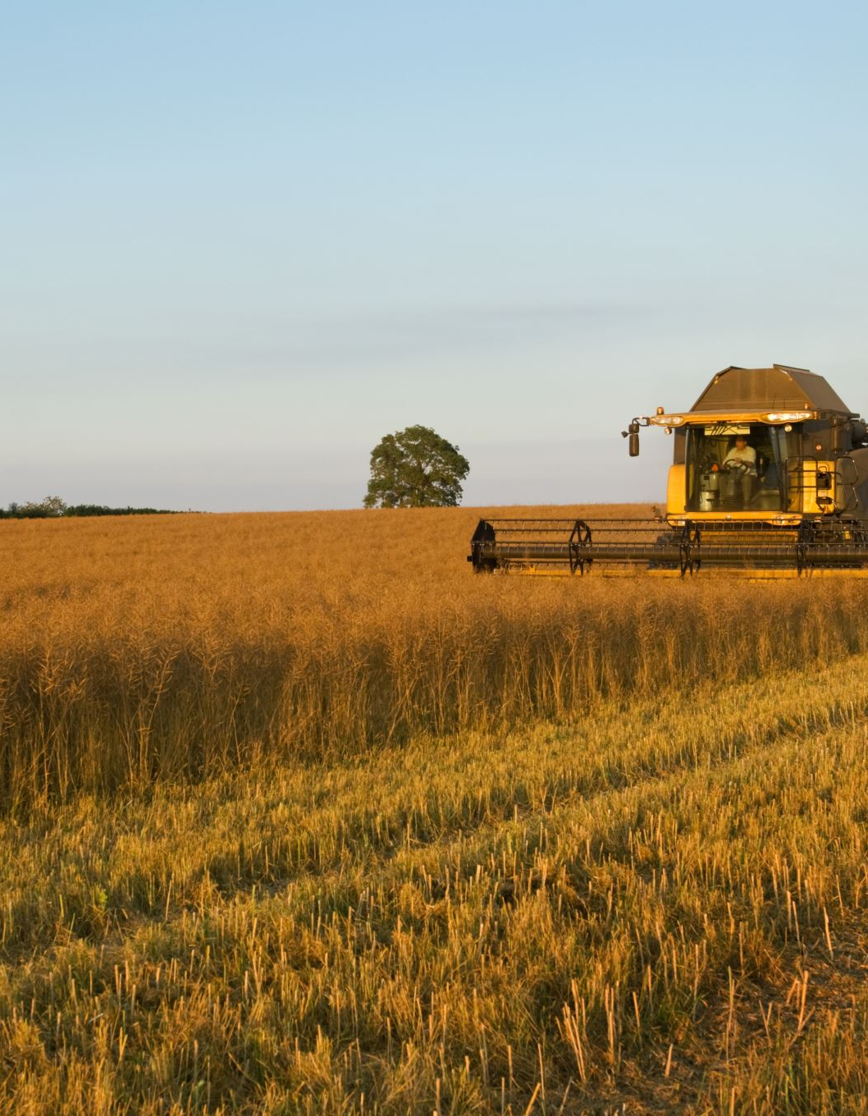

Now – what if we add harvesting?
$$\frac{dS_{t}}{dt}={rS}_{t}\left(1−\frac{S_{t}}{K}\right)−H_{t}$$
… Let’s define harvest as the product of..
- A catching coefficient ($α$)
- The current stock ($S_{t}$)
- And some effort level ($E_{t}$)
Such that:
$$H_{t}=αS_{t}E_{t}$$

Slide 19
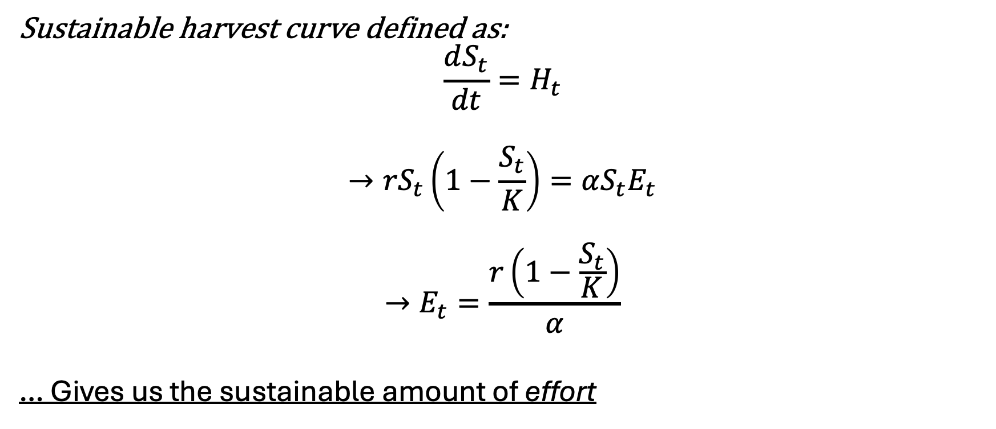
What if we don’t want the stock to change?
Sustainable harvest curve defined as:
$$\frac{dS_{t}}{dt}=H_{t}$$
$$→{rS}_{t}\left(1−\frac{S_{t}}{K}\right)=αS_{t}E_{t}$$
$$→E_{t}=\frac{r\left(1−\frac{S_{t}}{K}\right)}{α}$$
… Gives us the sustainable amount of effort

Slide 20
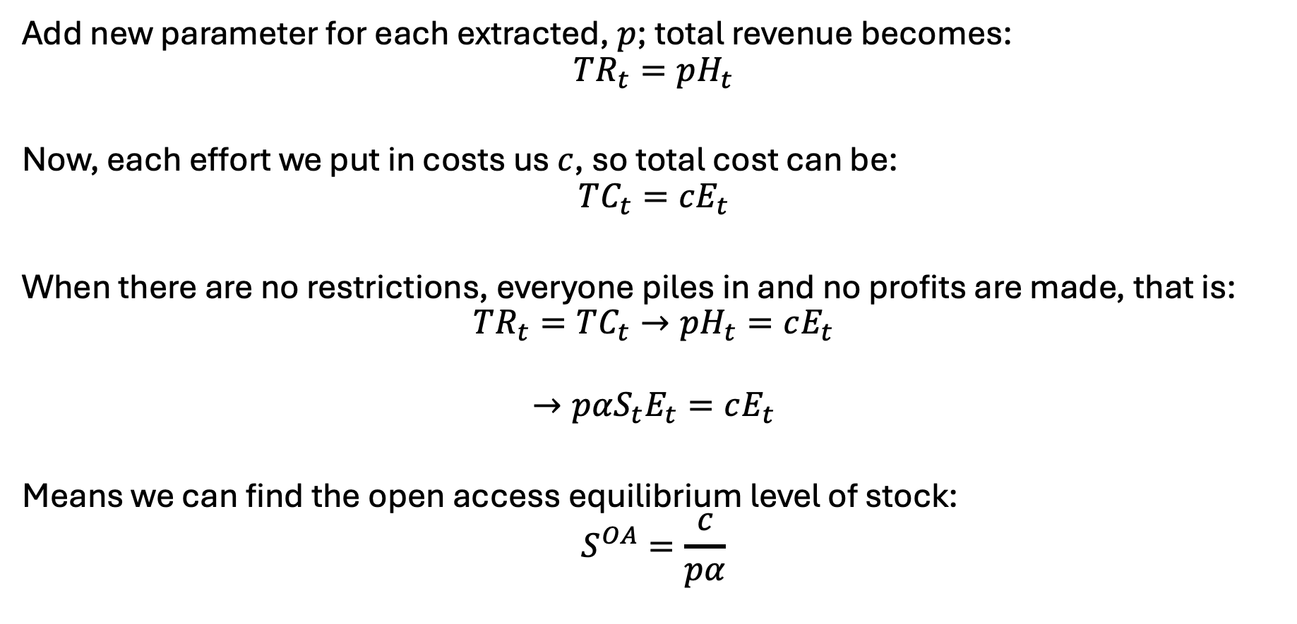
Let’s bring money into this..
Add new parameter for each extracted, $p$; total revenue becomes:
$$TR_{t}=pH_{t}$$
Now, each effort we put in costs us $c$, so total cost can be:
$$TC_{t}=cE_{t}$$
When there are no restrictions, everyone piles in and no profits are made, that is:
$$TR_{t}=TC_{t}→pH_{t}=cE_{t}$$
$$→pαS_{t}E_{t}=cE_{t}$$
Means we can find the open access equilibrium level of stock:
$$S^{OA}=\frac{c}{pα}$$

Slide 21

Evaluating OA level of effort
Recall
$$E_{t}=\frac{r\left(1−\frac{S_{t}}{K}\right)}{α}$$
Replacing $S_{t}$ with $S^{OA}$..
$$E_{t}=\frac{r\left(1−\frac{S^{OA}}{K}\right)}{α}$$

Slide 22
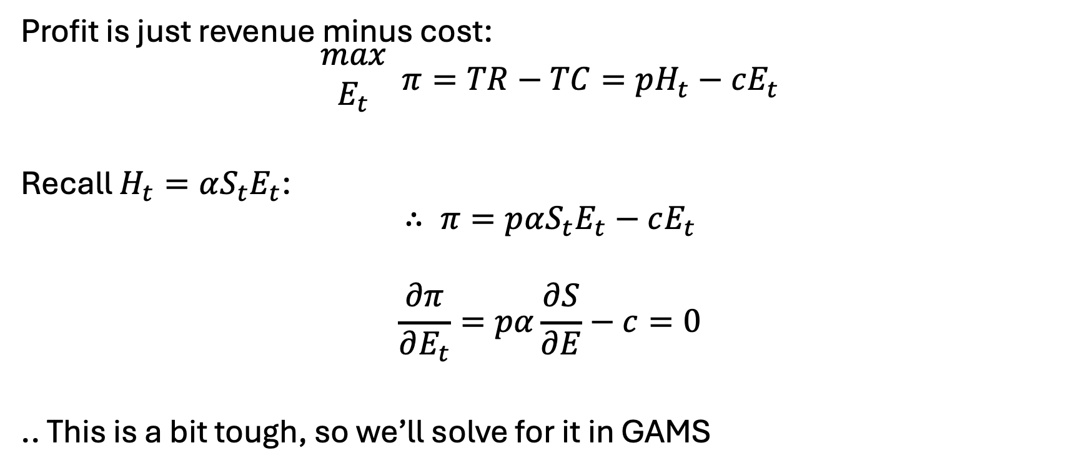

But we care about profit… that $π$ in the sky
Profit is just revenue minus cost:
$$\begin{matrix}max \\ E_{t}\end{matrix} π=TR−TC=pH_{t}−cE_{t}$$
Recall $H_{t}=αS_{t}E_{t}$:
$$∴ π=pαS_{t}E_{t}−cE_{t}$$
$$\frac{∂π}{∂E_{t}}=pα\frac{∂S}{∂E}−c=0$$
.. This is a bit tough, so we’ll solve for it in GAMS

Slide 23

Important note here
We could optimize with and without price control (same way we did with Hotelling)..
but we already know the optimality conditions
Thus: we can explore how different conditions impact those optimal decisions
We call this an analytical model.. basically, exploring the solution space

Slide 24
In GAMS..
Specify..
r=0.5
k=3500
50 time periods
… then can solve analytically (we know the optimality conditions)
See: fishy.gms

Slide 25

What if we change $α$?
… could be likened to a new technology – more efficient capture!

Slide 26
Commonly-proposed policies
Individual transfer quotas – basically like a cap and trade for fish
Taxes on effort or harvest – align private and social costs
Protected areas / sanctuaries
Equipment restrictions

Slide 27
Policies in practice [I]
Individual transfer quotas
How they work – set a limit on total harvest/effort:
$$H^{∗}=qE^{∗}X^{∗}$$
Examples:
New Zealand Hoki fishery – success, raised profits
Iceland Cod Fishery – failure
Giant corporations bought out small fishers
Low enforcement

Slide 28
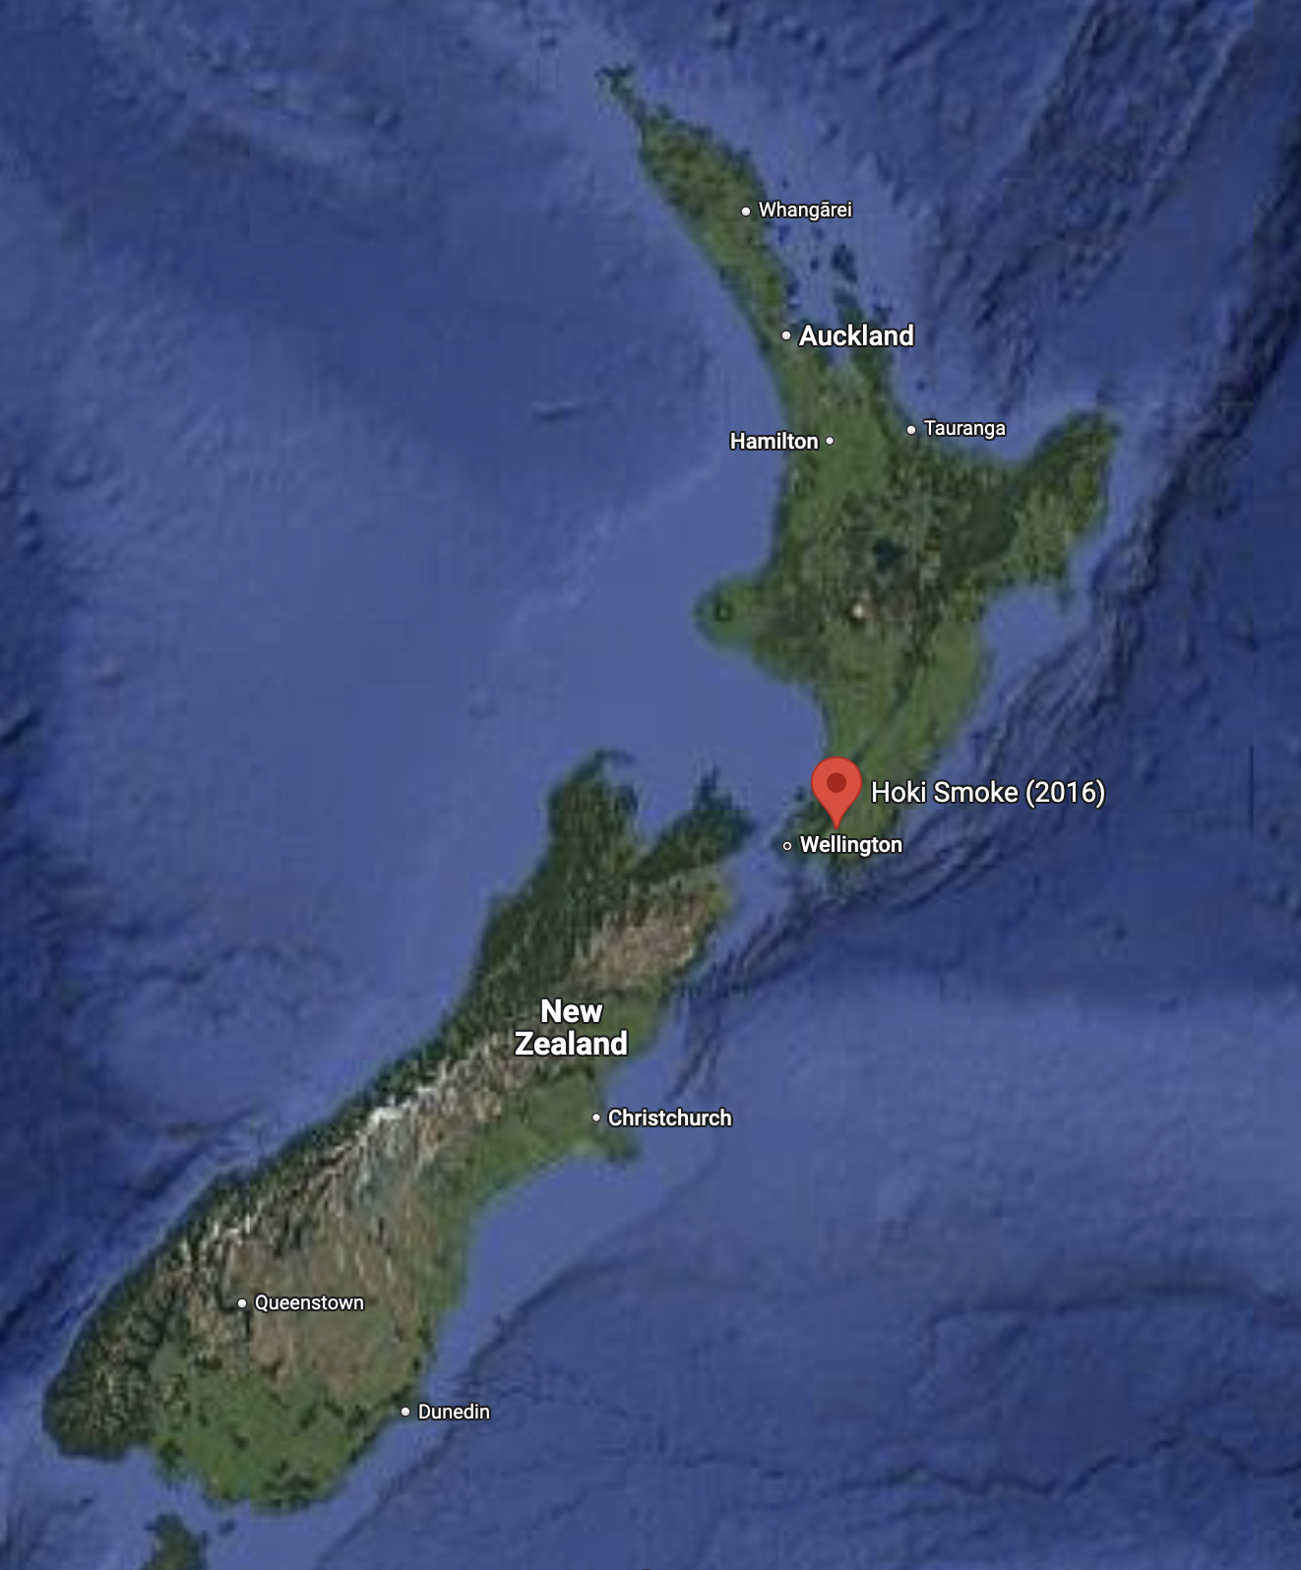
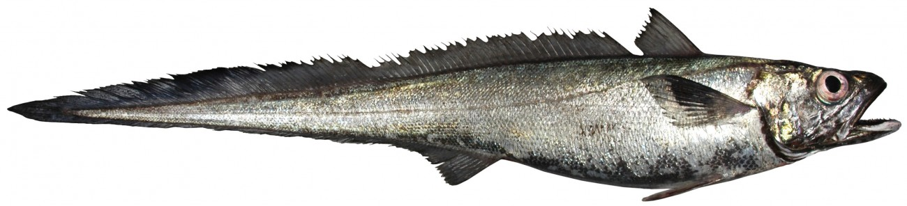
New Zealand Hoki Fishery Management
Fishery management strategy started in 1986
Works on a system of ITQ’s that limit the Total Allowable Commercial Catch (TACC)
Total number of TACCs set at 10% of total estimated stock
Resulted in 36% increase in total profits per unit of cost input

Slide 29
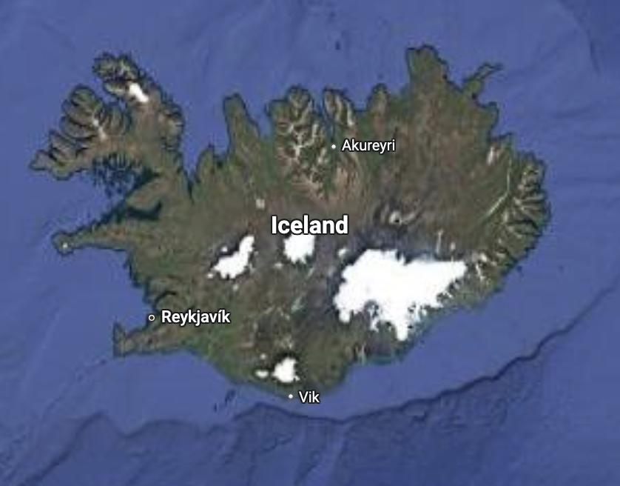
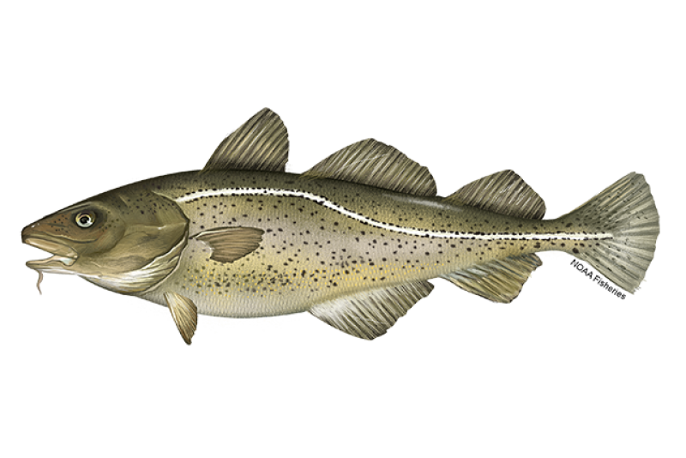
Iceland Cod Fishery
ITQ system started in 1984
Allowed for grandfathering in of substantial fishing quotas
Several rights were sold to large corporations who overfished with little punitive recompense
Cod industry plagued by constant declines and surges in stock

Slide 30
ITQs in practice
Individual transfer quotas can succeed or fail
Failures a result of:
Overfishing (obviously), itself being a result of..
Low enforcement
Consolidation
Lacking monitoring and updates to quotas
Several other examples ..

Slide 31
Policies in practice [II]
Effort tax
How they work – simple tax on effort:
$TC=\left(c+τ\right)E$
Examples:
Denmark effort taxes on heavy fishing days
Indonesia –
Weak enforcement and tax evasion in remote areas
Fishers shifted to illegal methods

Slide 32
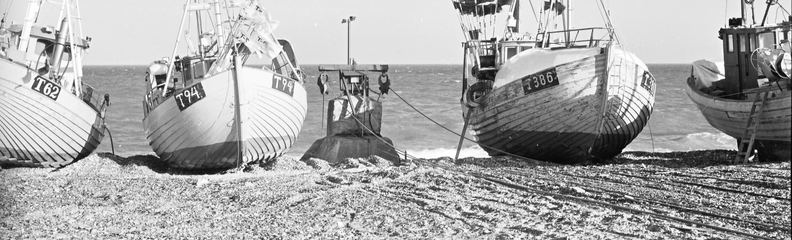
Denmark’s effort tax
One of the first major attempts at fisheries regulation for a big industry (Denmark is 5th largest fish exporter in the world)
Tax based on fishing pressure – directly tied to horsepower, equipment, …
Wasn’t based on catch equipment… problem?
Criticized for taxing inputs, not outputs
Eventually switched to an ITQ

Slide 33
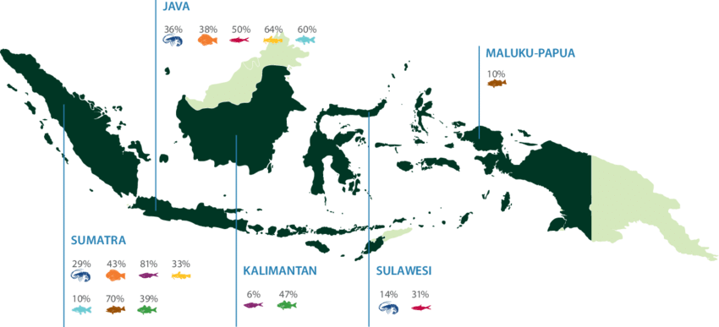
Indonesia’s effort tax
Similar to Denmark in that it imposed a tax based on boat characteristics
Had an exception for boats under a certain size
Led to industry fragmentation
When prices of fish skyrocketed in mid-2000’s, tax was too small
In 2023, switched to ITQ
Still – low enforcement
Community outrage

Slide 34
Effort taxes in practice
Two examples, both failed – why?
Difficult to enforce
Difficult to parameterize a one-size-fits-all solution
Workaround for catch equipment with the Denmark tax
Cut-off in size in the Indonesian system
Both examples ultimately switched to ITQ
Perhaps most importantly - community and company opposition

Slide 35

Policies in practice [III]
Marine Protected Areas
How they work:
Examples:
Great Barrier Reef, Australia
Philippines coral reefs - fail
Rules ignored, fines were not high enough
Community-opposed (loss of livelihood, not enough information)

Slide 36
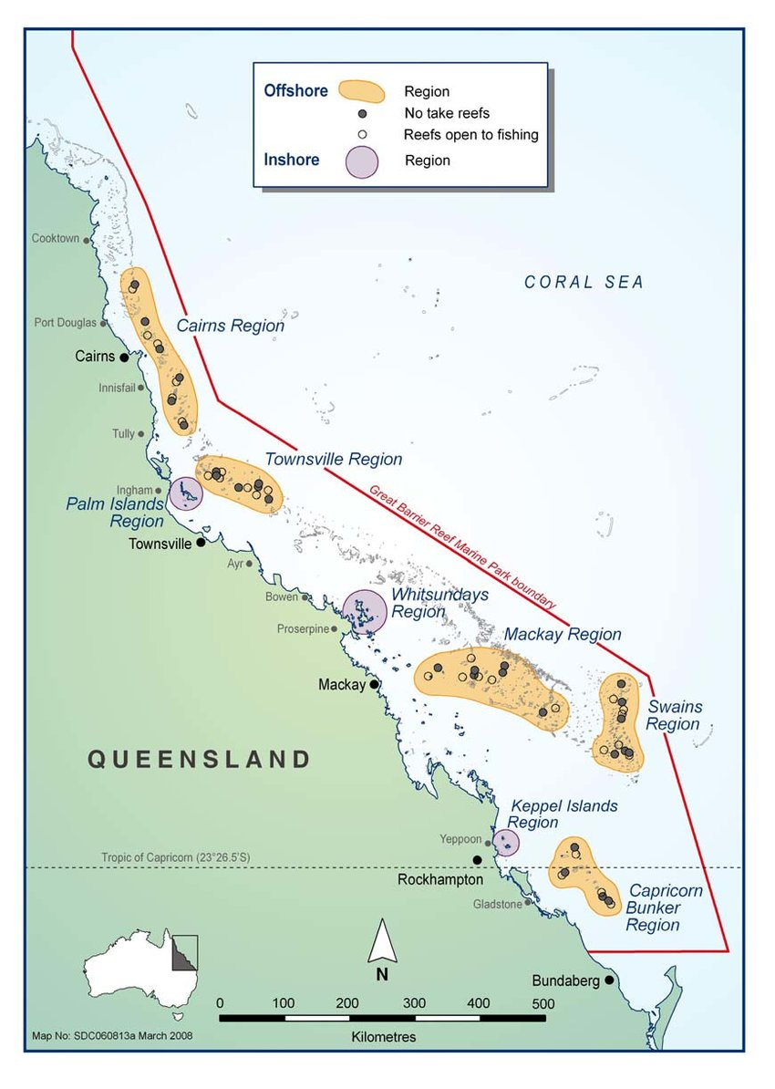
Great Barrier Reef Marine Park
Started in 1975 but ‘zone’ approach introduced in 2004
Basically – enforced no fishing rules in several regions along the reef
Included permitting for fishing
Benefits neighbors

Slide 37
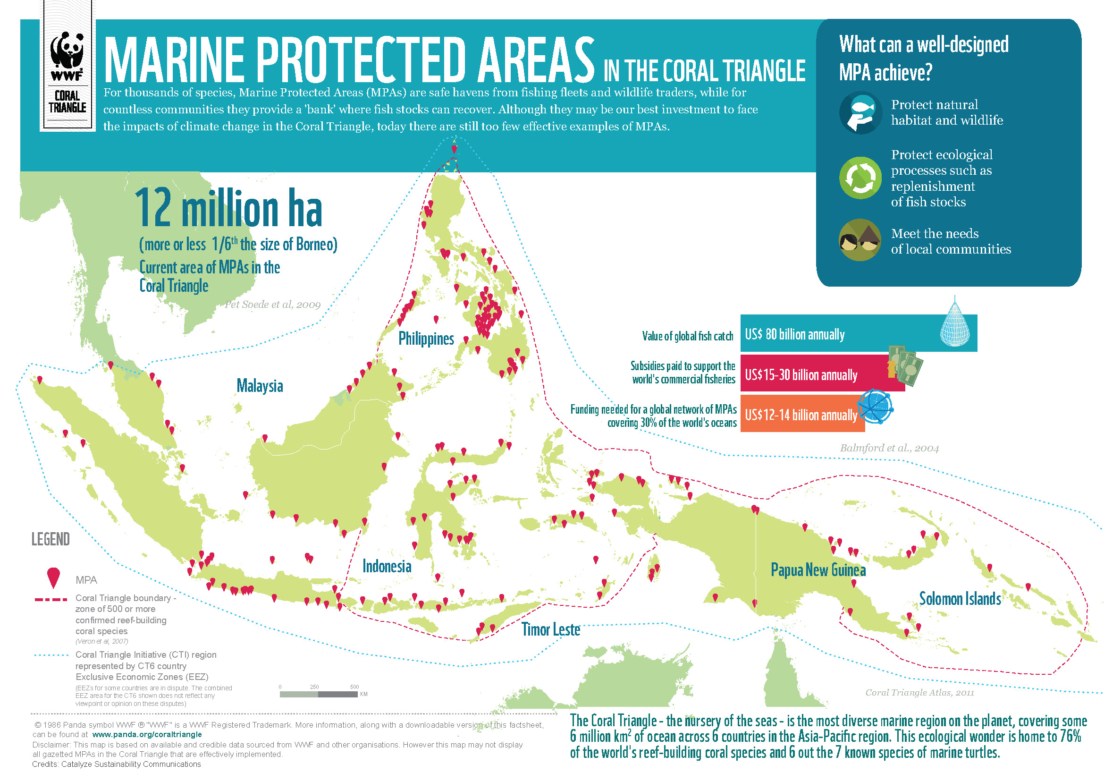
Philippines
Failed:
Nobody cared
Weak fines
Despised

Slide 38
Marine Protected Areas in Practice
Great Barrier Reef vs Philippines
GBR: Strong enforcement, community involvement
Philippines: Weak fines, fragmented enforcement, community hatred
Very tough to enforce

Slide 39
Takeaways from fisheries
Class example of over-exploitation (tragedy of the commons) of a common pool resource
Free entry leads to overharvesting
Profit maximization results in a greater stock being kept
Policies instruments helpful in management
Need heavy fines, local involvement/participation
Demonstrably beneficial to fishers in the long run

Slide 40
Prompt
Imagine you own a plot of land
You plant trees today and want to eventually cut them down to sell
When should you harvest those trees?
... Knowing you’re going to replant and not sell the land

Slide 41
Pause
What did the forest say when it got overharvested?
Why is the forester also a good programmer?
Why did the professor bring a tree to class?

Slide 42
Pause
What did the forest say when it got overharvested?
“I’m stumped”
Why is the forester also a good programmer?
Because they knew how to log their changes
Why did the professor bring a tree to class?
For some rooted discussion

Slide 43
Forestry
Now not talking about stock we’re talking about rotation
Still harvesting but once we do, the ‘stock’ resets (for now)
Intuition:
Trees grow in volume/value over time, but also tie up resources (land)
Harvesting too early: missed value from growth
Harvesting too late: delays profits (we want money now)
Enter the Faustmann Model

Slide 44
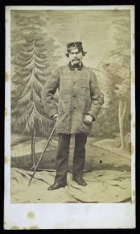
Martin Faustmann
Born 1822, Died 1876
Spotty college record
Quickly became chief forester of Dudenhofen (Black Forest)
Known for incorporating time into the consideration of forest harvests:
“If a patient forester chooses to let their stand grow for an additional decade, they might receive a much larger timber sale revenue, but at the cost of delaying the next rotation: after harvesting, they are left with bare land, while their impatient colleague now has 10-year-old-trees.”

Slide 45
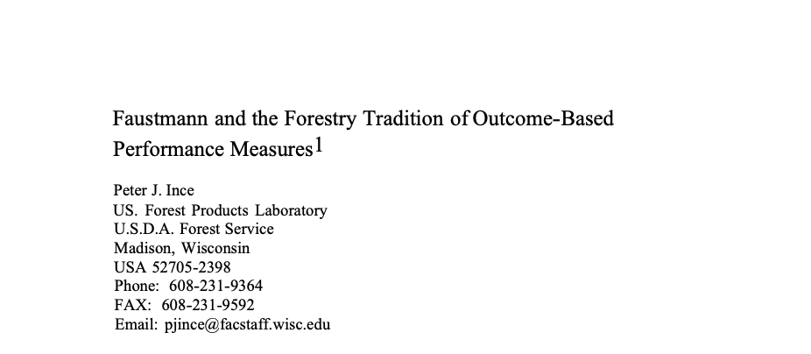

The Faustmann Model
Used widely in forestry and resource management
Actually used by companies and governments (more on this later)
Fundamentally: How you choose a rotation period to maximize the value of land when it can be harvest, replanted, and used forever on a T-year cycle?

Slide 46
Main difference with Faustmann and others
In this sense – our choice variable is the optimal ‘timing’ of when to harvest, it is not some harvest amount
That is – we are choosing the length of time between the planting period and harvesting that maximizes our long-run (to infinity!) profits

Slide 47
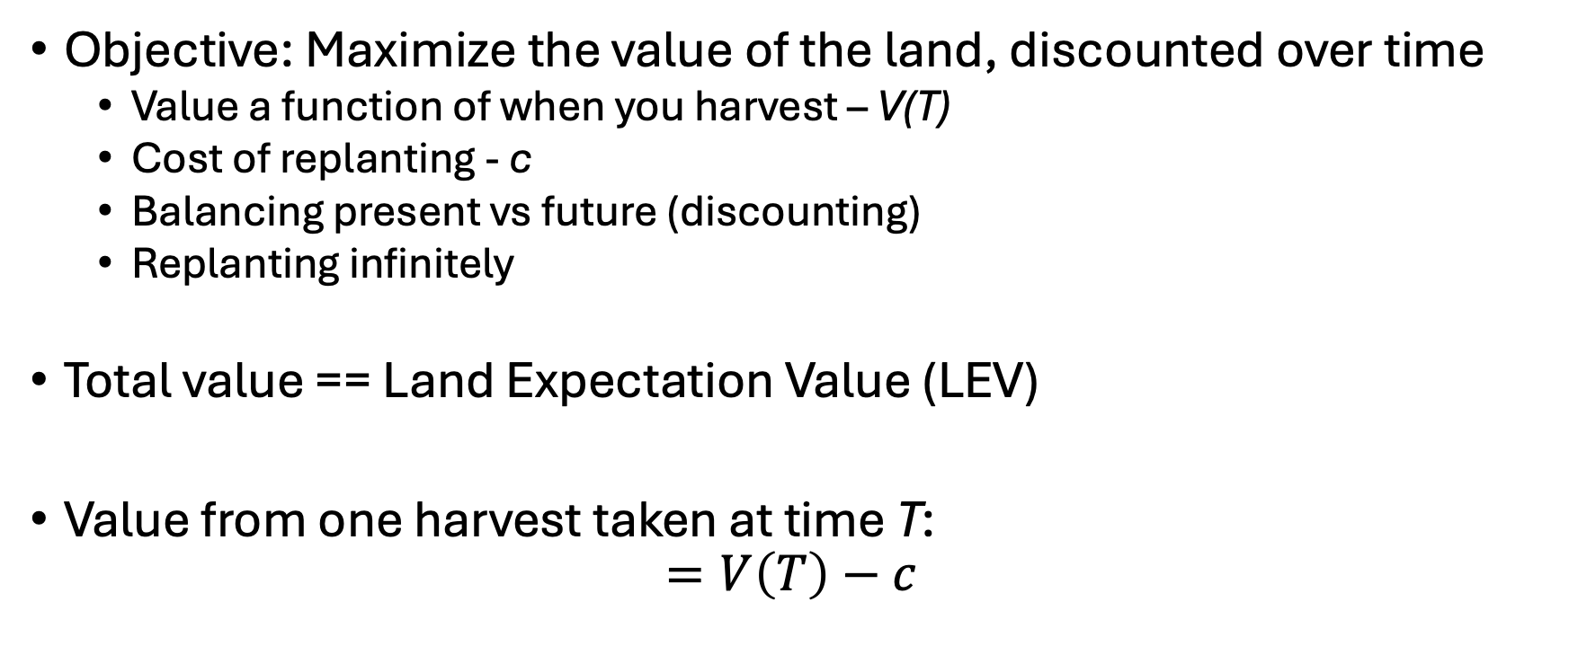
The Faustmann Model
Objective: Maximize the value of the land, discounted over time
Value a function of when you harvest – V(T)
Cost of replanting - c
Balancing present vs future (discounting)
Replanting infinitely
Total value == Land Expectation Value (LEV)
Value from one harvest taken at time T:
$$=V\left(T\right)−c$$

Slide 48
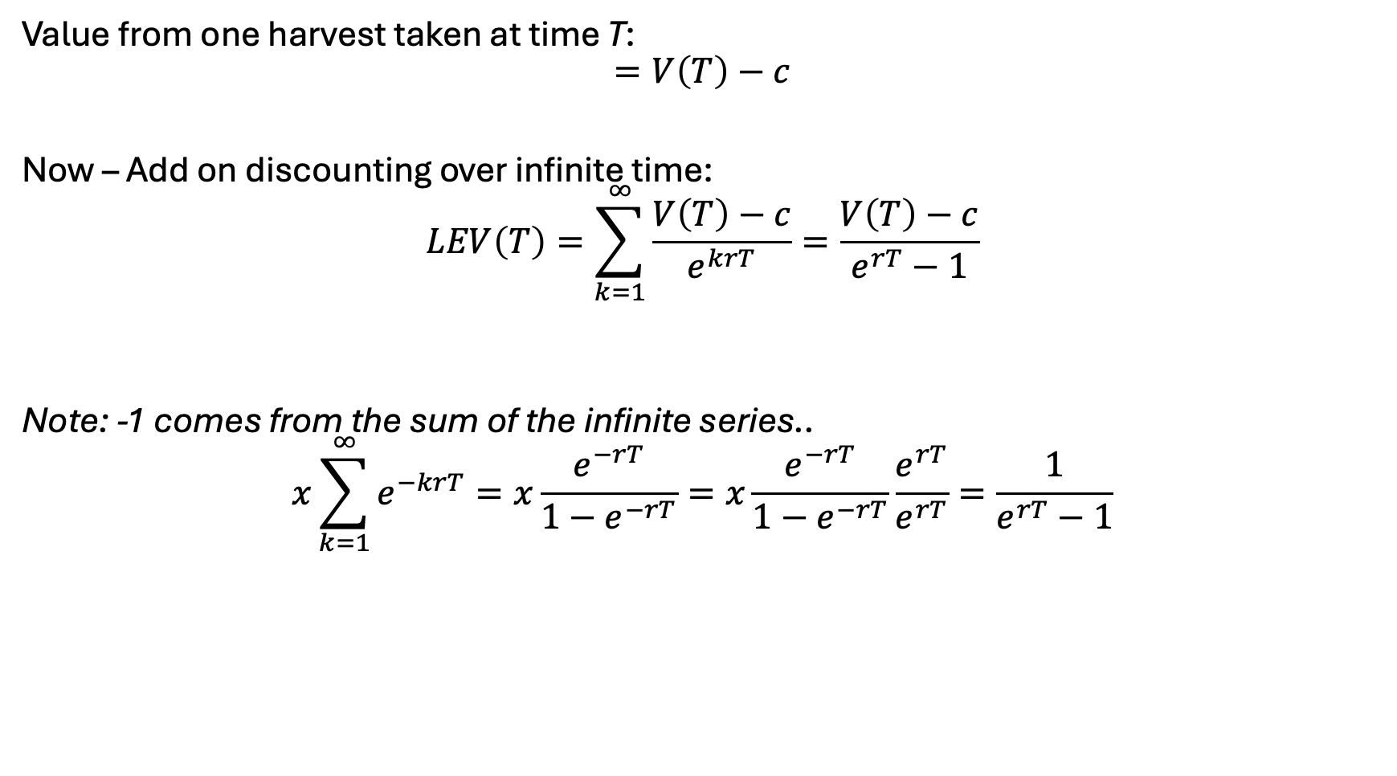
The Faustmann Model [II]
Value from one harvest taken at time T:
$$=V\left(T\right)−c$$
Now – Add on discounting over infinite time:
$$LEV\left(T\right)=\sum_{k=1}^{∞}{\frac{V\left(T\right)−c}{e^{krT}}}=\frac{V\left(T\right)−c}{e^{rT}−1}$$
Note: -1 comes from the sum of the infinite series..
$$x\sum_{k=1}^{∞}{e^{−krT}}=x\frac{e^{−rT}}{1−e^{−rT}}=x\frac{e^{−rT}}{1−e^{−rT}}\frac{e^{rT}}{e^{rT}}=\frac{1}{e^{rT}−1}$$

Slide 49
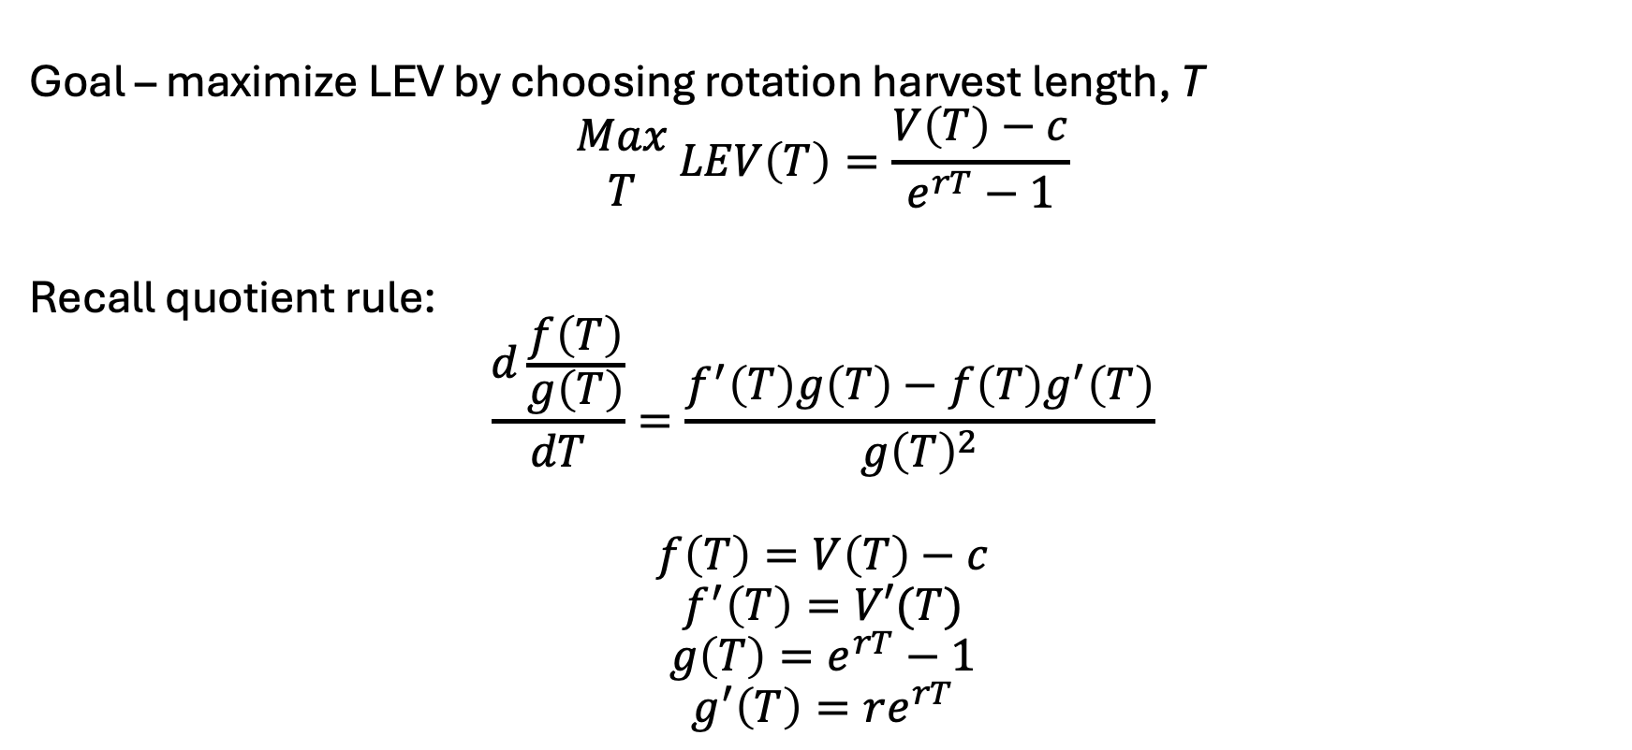
The Faustmann Model [II]
Goal – maximize LEV by choosing rotation harvest length, T
$$\begin{matrix}Max \\ T\end{matrix} LEV\left(T\right)=\frac{V\left(T\right)−c}{e^{rT}−1}$$
Recall quotient rule:
$$\frac{d\frac{f\left(T\right)}{g\left(T\right)}}{dT}=\frac{f^{′}\left(T\right)g\left(T\right)−f\left(T\right)g^{′}\left(T\right)}{g{\left(T\right)}^{2}}$$
$$f\left(T\right)=V\left(T\right)−c$$
$$f^{′}\left(T\right)=V′(T)$$
$$g\left(T\right)=e^{rT}−1$$
$$g^{′}\left(T\right)=re^{rT}$$

Slide 50

The Faustmann Model [III]
First order condition, set to zero:
$$\frac{dLEV}{dT}=\frac{V^{′}\left(T\right)\left(e^{rT}−1\right)−re^{rT}\left(V\left(T\right)−c\right)}{{\left(e^{rT}−1\right)}^{2}}=0$$
Implies:
$$V^{′}\left(T\right)\left(e^{rT}−1\right)=re^{rT}(V\left(T\right)−c)$$
Opportunity cost of capital tied up in the stand,
including delayed profits
Marginal increase in time value [x] Perpetuity factor

Slide 51
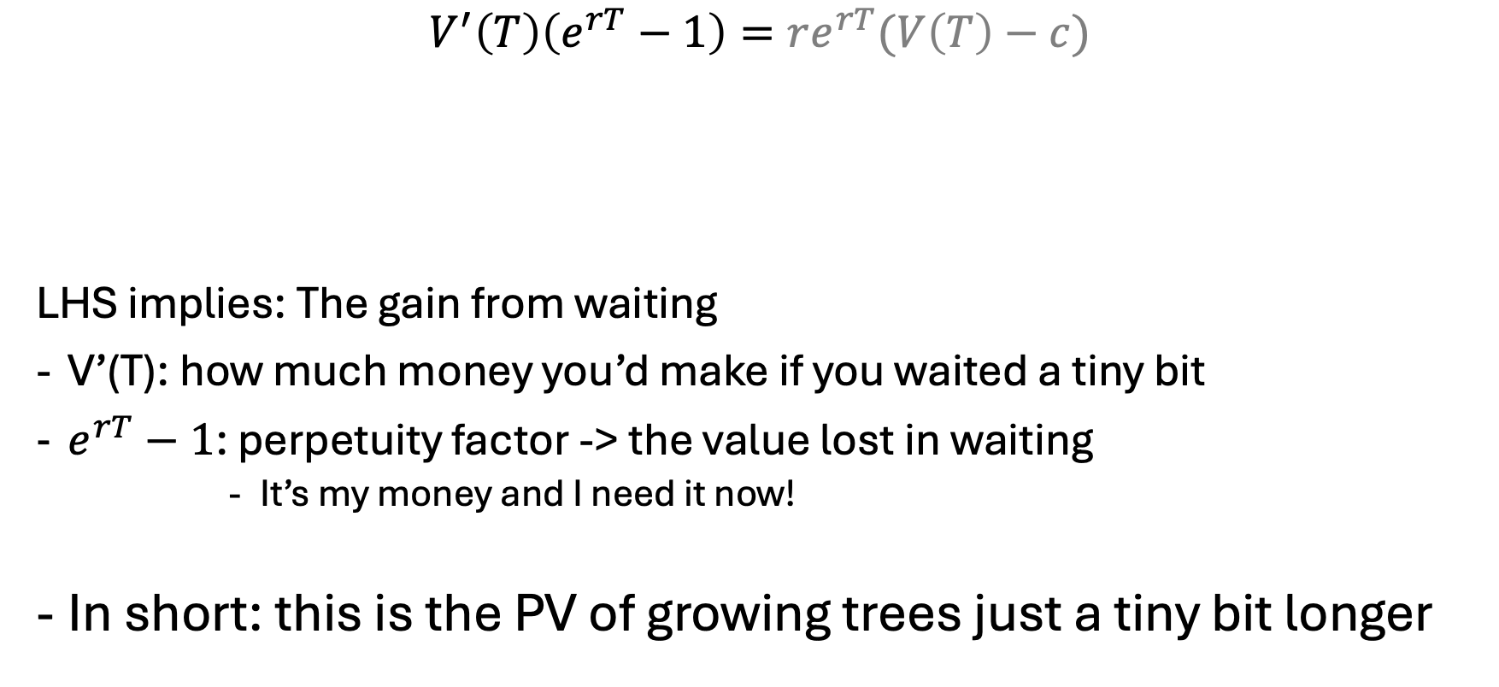
The Faustmann Equation [I]
$$V^{′}\left(T\right)\left(e^{rT}−1\right)=re^{rT}(V\left(T\right)−c)$$
LHS implies: The gain from waiting
V’(T): how much money you’d make if you waited a tiny bit
$e^{rT}−1$: perpetuity factor -> the value lost in waiting
It’s my money and I need it now!
In short: this is the PV of growing trees just a tiny bit longer
Opportunity cost of capital tied up in the stand,
including delayed profits
Marginal increase in time value [x] Perpetuity factor
Notes:
https://youtu.be/7jY_ZP6gQiQ

Slide 52
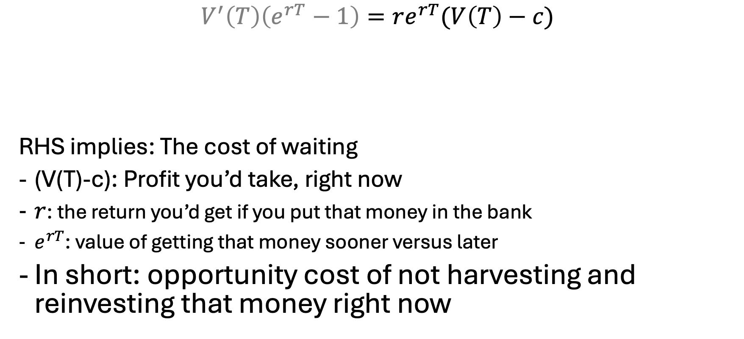
The Faustmann Equation [II]
$$V^{′}\left(T\right)\left(e^{rT}−1\right)=re^{rT}(V\left(T\right)−c)$$
RHS implies: The cost of waiting
(V(T)-c): Profit you’d take, right now
$r$: the return you’d get if you put that money in the bank
$e^{rT}$: value of getting that money sooner versus later
In short: opportunity cost of not harvesting and reinvesting that money right now
Opportunity cost of capital tied up in the stand,
including delayed profits
Marginal increase in time value [x] Perpetuity factor

Slide 53
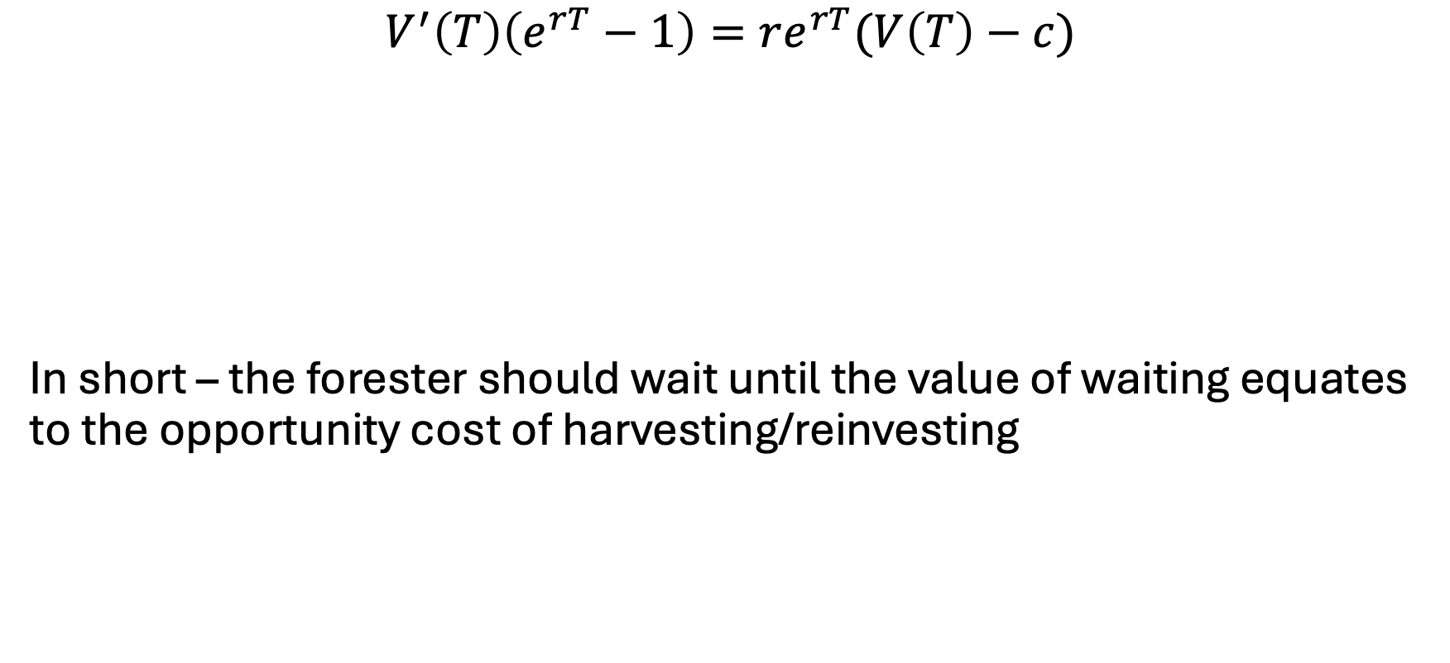
The Faustmann Equation [III]
$$V^{′}\left(T\right)\left(e^{rT}−1\right)=re^{rT}(V\left(T\right)−c)$$
In short – the forester should wait until the value of waiting equates to the opportunity cost of harvesting/reinvesting
opportunity cost of not harvesting and reinvesting that money (right now)
PV of growing trees just a tiny bit longer (waiting)

Slide 54
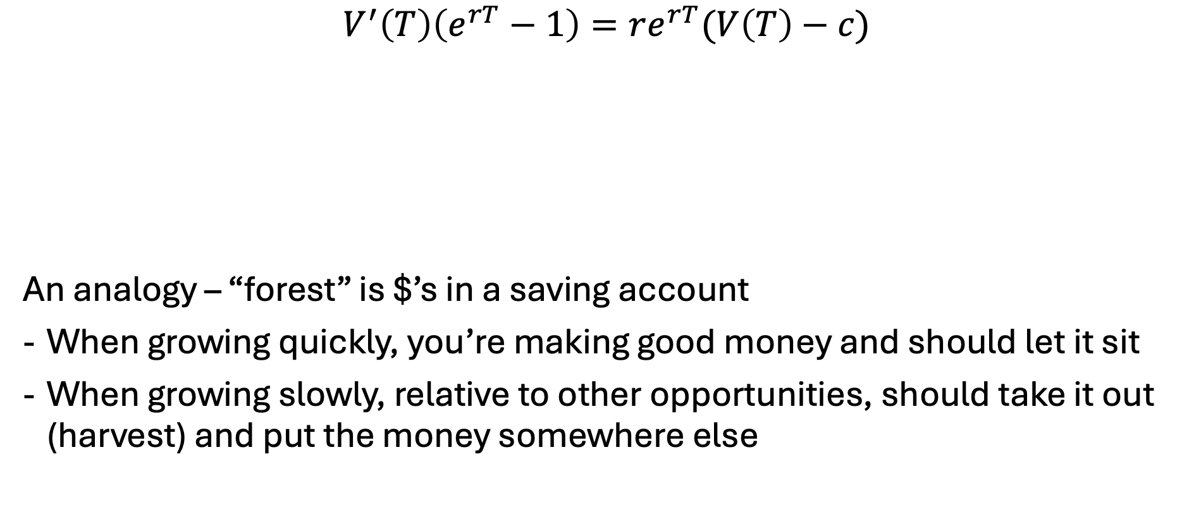
The Faustmann Equation [III]
$$V^{′}\left(T\right)\left(e^{rT}−1\right)=re^{rT}(V\left(T\right)−c)$$
An analogy – “forest” is $’s in a saving account
When growing quickly, you’re making good money and should let it sit
When growing slowly, relative to other opportunities, should take it out (harvest) and put the money somewhere else
opportunity cost of not harvesting and reinvesting that money (right now)
PV of growing trees just a tiny bit longer (waiting)

Slide 55


The full Faustmann model…
Variables
Z – present value of profit
T – rotation period (years)
Objective:
$$\begin{matrix}Max \\ T\end{matrix} \frac{p\overline{s}{\left(1+f\right)}^{T}−c}{e^{rT}−1}$$
Parameters
p: price = 1000
r: discount rate = 0.1
c: replanting cost = 500
f: growth rate = 0.08
$\overline{s}$: initial stand = 100

Slide 56
Faustmann in practice
https://demonstrations.wolfram.com/FaustmannsRuleOfOptimalRotation
GAMS model – faustmann.gms

Slide 57


Faustmann in practice [I]
Several large timber companies (Weyerhaeuser, Rayonier) use Faustmann for their even-aged plantations
Model used to..
Determine optimal rotation ages (equipment planning)
Evaluate land value and ‘silvicultural’ intervention
Consider how market prices/trends impact land value
Include stochastic extensions for pests/drought/…

Slide 58


Faustmann in practice [II]
Aspect | Finland | Sweden
State forest agency | Metsähallitus | Sveaskog + Skogsstyrelsen
Private ownership share | ~60% private | ~80% private
Use of Faustmann | Directly for state rotation planning and LEV mapping | Strategic planning and private advising
Biodiversity integration | Hartman-style extensions common | Multi-objective optimization more common
Modeling platforms | SIMO, Heureka | PlanWise, Heureka
Discount rate differences | Lower for state/public forest objectives | More market-based in private land models

Slide 59
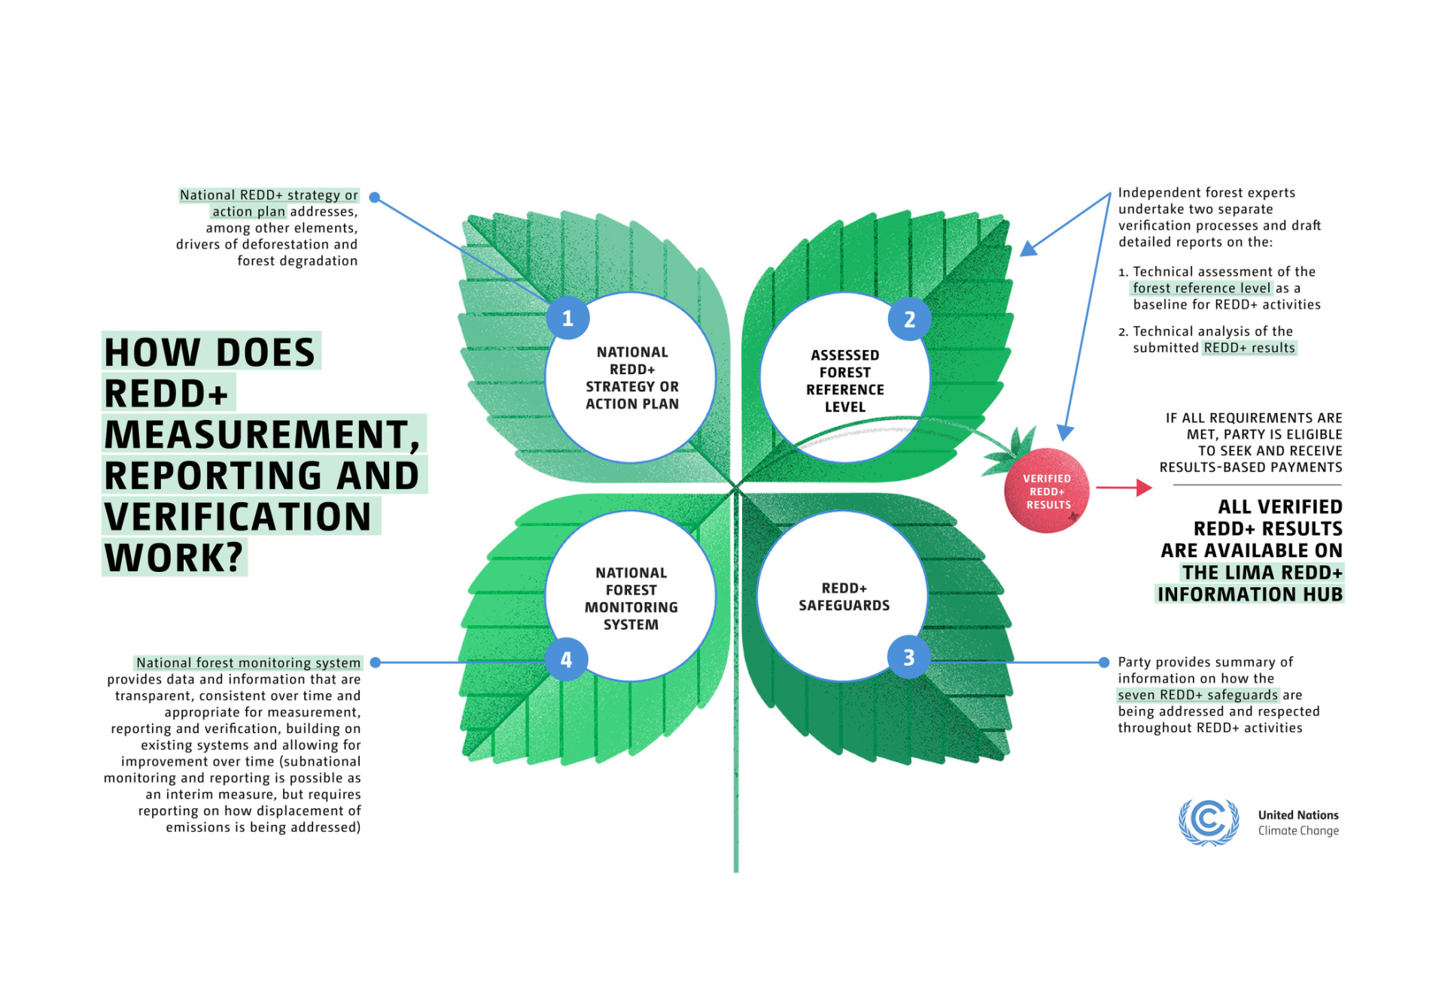
Faustmann in Practice [III]
Extension of Faustman = Hartman
Includes ecological/environmental services
Used by REDD+
Reducing Emissions from Deforestation and Forest Degradation
Discussed previously – provides carbon offset credits
Pays countries/landowners not to deforest
Equivalent to CRP but for forests

Slide 60
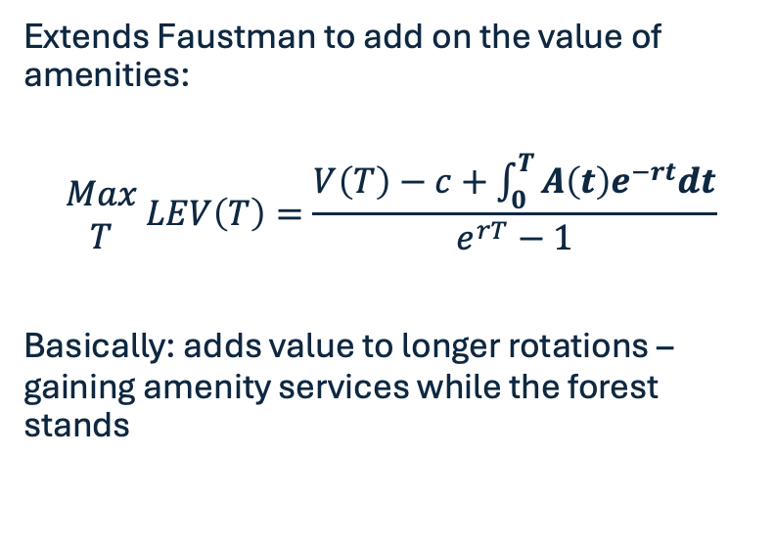
Brief on Hartman Model
Feature | Faustmann | Hartman
Maximizes | Timber value | Timber + amenity value
Rotation age | Usually shorter | Often longer
Ecological services | Ignored | Included explicitly
Relevant to | Industrial timberland | Multi-use or public forests
Extends Faustman to add on the value of amenities:
$$\begin{matrix}Max \\ T\end{matrix} LEV\left(T\right)=\frac{V\left(T\right)−c+\int_{0}^{T}{A\left(t\right)e^{−rt}dt}}{e^{rT}−1}$$
Basically: adds value to longer rotations – gaining amenity services while the forest stands

Slide 61
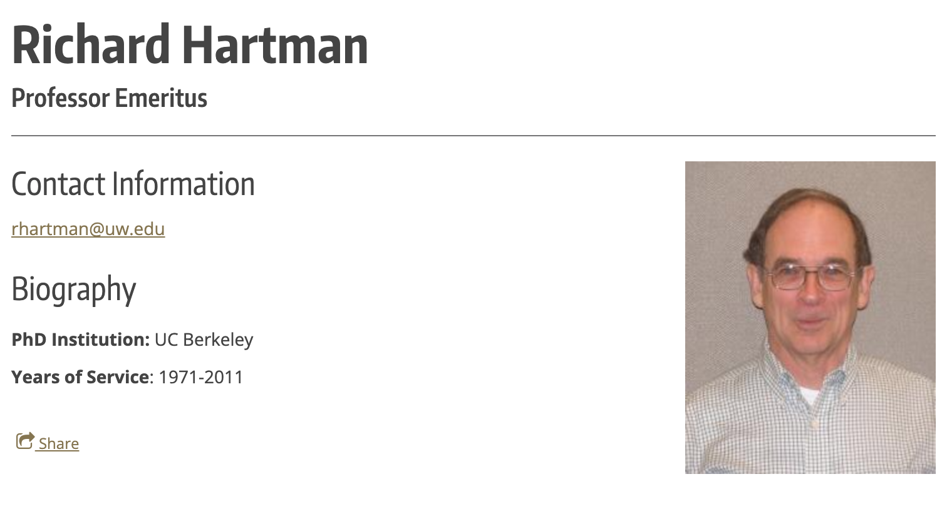
Richard Hartman
Genuinely.. Tough to find more info on him
Forestry paper cited 1000+ times

Slide 62
Faustmann in Practice [IV]
(In US and Canada) Need to assign value to land for..
Property taxes
Sales
Resource investments
Faustmann answers: what is the value of this land today given the potential to harvest in X years?
When considering..
Timber prices
Growth curves from yield tables
Planning/management costs
Interest rate (4-6% for public)

Slide 63
Relationship to Hotelling
Hotelling -> once you’ve extracted, there is no going back
Market structure makes for an interesting comparison
Faustmann -> restarts the cycle
Thus, land value and replacement cost must be accounted for

Slide 64
Do we see any problems with Faustmann?

Slide 65
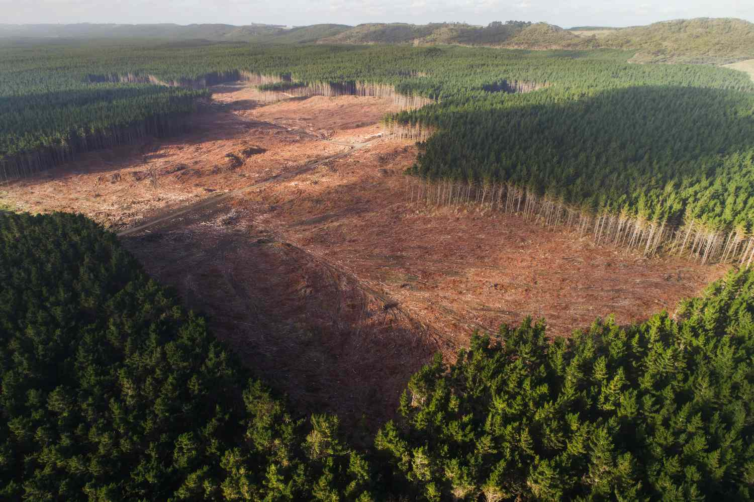
Pros/cons of Faustmann
Pros:
Easy/intuitive
Focus on PV
Easily-expandable
Cons:
Even-aged, clear-cutting
Ignores ecological services
Perfect foresight
Super simple

Slide 66
Enter a new challenger – Managed forests
It doesn’t always make sense to just clear-cut a forest
Similar to fisheries – we can harvest some trees when the time is right but wait for others to mature and become more valuable
Thus, need to introduce the idea that we want to optimize via choosing a quantity to harvest, not a harvest period

Slide 67
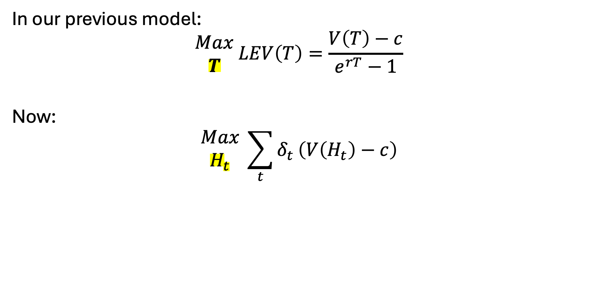
Subtle difference
In our previous model:
$$\begin{matrix}Max \\ T\end{matrix} LEV\left(T\right)=\frac{V\left(T\right)−c}{e^{rT}−1}$$
Now:
$$\begin{matrix}Max \\ H_{t}\end{matrix} \sum_{t}{δ_{t}}\left(V\left(H_{t}\right)−c\right)$$

Slide 68
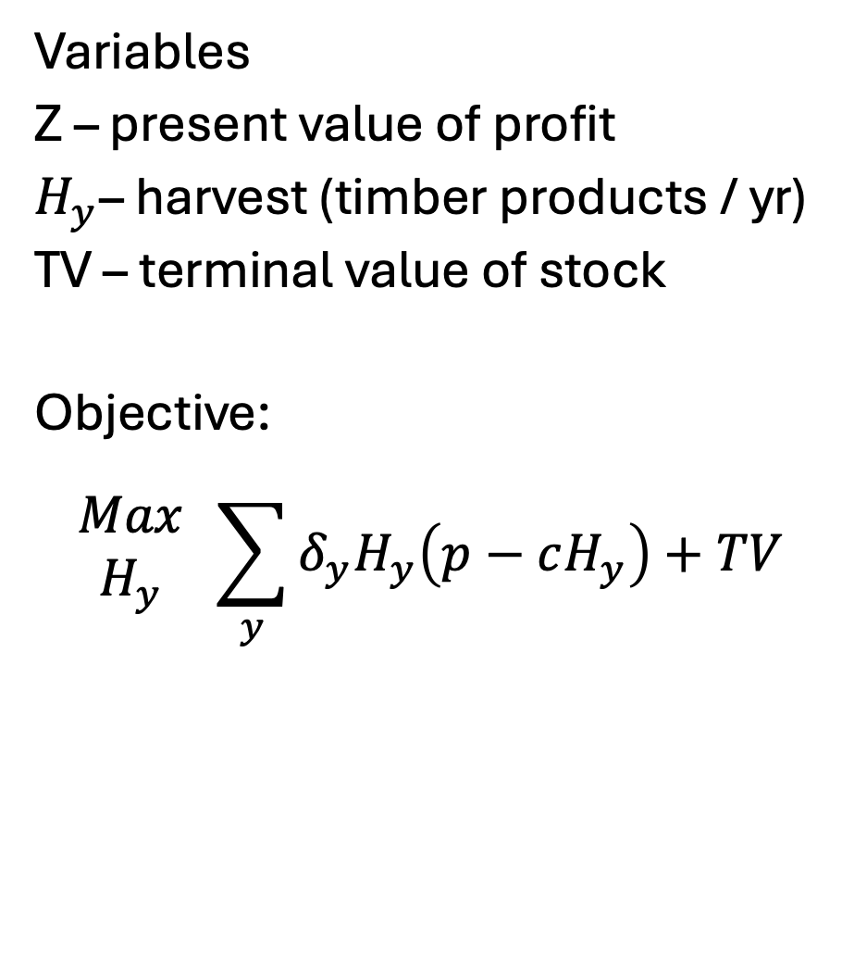

The full managed model
Variables
Z – present value of profit
$H_{y}$– harvest (timber products / yr)
TV – terminal value of stock
Objective:
$$\begin{matrix}Max \\ H_{y}\end{matrix} \sum_{y}{δ_{y}H_{y}\left(p−cH_{y}\right)+TV}$$
Index
y: year ($y∈\{1,..,100\}$)
Parameters
p: price = 1000
r: discount rate = 0.1
c: replanting cost = 500
f: growth rate = 0.08
$\overline{s}$: initial stand = 100

Slide 69
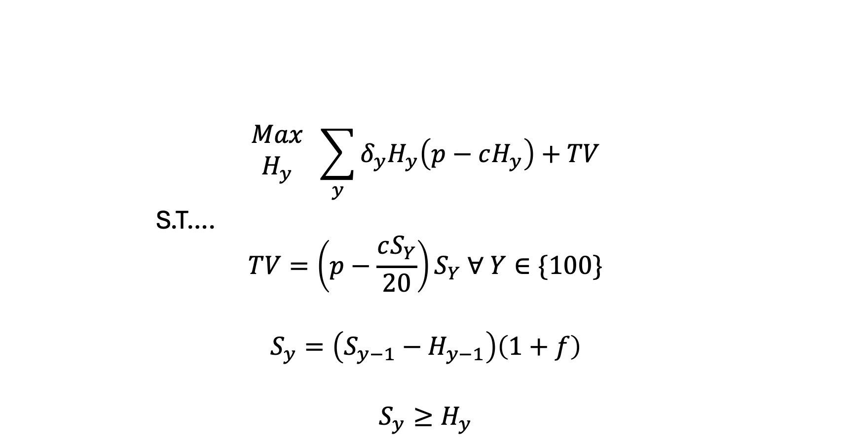
The full managed model
$$\begin{matrix}Max \\ H_{y}\end{matrix} \sum_{y}{δ_{y}H_{y}\left(p−cH_{y}\right)+TV}$$
S.T….
$$TV=\left(p−\frac{cS_{Y}}{20}\right)S_{Y} ∀ Y∈\{100\}$$
$$S_{y}=\left(S_{y−1}−H_{y−1}\right)\left(1+f\right)$$
$$S_{y}≥H_{y}$$

Slide 70
To the GAMS model!
And Tableau!

