Slide 1
EBGN645: Day 13

Slide 2
Notes
My phone volume is on today
No class 10/20 – Fall Break
No class 10/27-29
Will record at least one lecture (or two shorter ones)
Potentially cancelled: 11/10-12 (will email Sunday PM)
Good luck on your time series midterm

Slide 3

Meme [I]
eq_forcex(i)$[not val(i)].. X(i) =e= 0 ;

Slide 4
Bigger picture
Homework 1 together
Resource models
Hotelling (review)
Fisheries management (Gordon-Schaeffer)
Forestry management (Faustmann)
CO-WY electricity ‘dispatch’
Non-linear, calibrated market models
US petroleum, backstop techs
Review of duality -> MCP models
Game theory models
Stackelberg
Cournot
Ramsey model
CGE models
MPECs/EPECs
Presentations

Slide 5
Agenda today
Shorter class – know you’re all excited for your time series midterm
Brief review of resource models and then managed forests
On to electricity ‘dispatch’

Slide 6
Takeaways from fisheries
Classic example of over-exploitation (tragedy of the commons) of a common pool resource
Free entry leads to overharvesting
Profit maximization results in…
a greater stock being kept
thus a greater replenishment rate
Policies instruments helpful in management
Need heavy fines, local involvement/participation
Demonstrably beneficial to fishers in the long run

Slide 7
Forestry
Now not talking about stock we’re talking about rotation
Still harvesting but once we do, the ‘stock’ resets (for now)
Intuition:
Trees grow in volume/value over time, but also tie up resources (land)
Harvesting too early: missed value from growth
Harvesting too late: delays profits (we want money now)
Enter the Faustmann Model

Slide 8
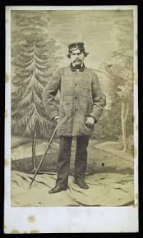
Martin Faustmann
Born 1822, Died 1876
Spotty college record
Quickly became chief forester of Dudenhofen (Black Forest)
Known for incorporating time into the consideration of forest harvests:
“If a patient forester chooses to let their stand grow for an additional decade, they might receive a much larger timber sale revenue, but at the cost of delaying the next rotation: after harvesting, they are left with bare land, while their impatient colleague now has 10-year-old-trees.”

Slide 9
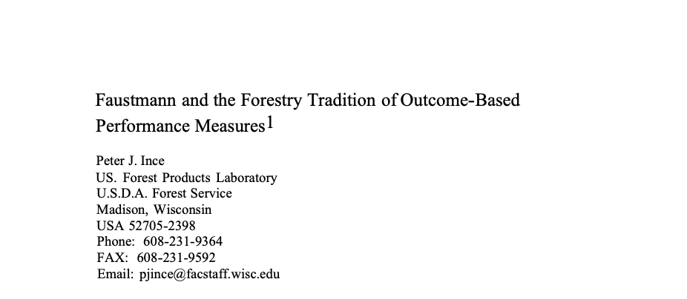

The Faustmann Model
Used widely in forestry and resource management
Actually used by companies and governments (more on this later)
Fundamentally: How do you choose a rotation period to maximize the value of land when it can be harvested, replanted, and used forever on a T-year cycle?

Slide 10
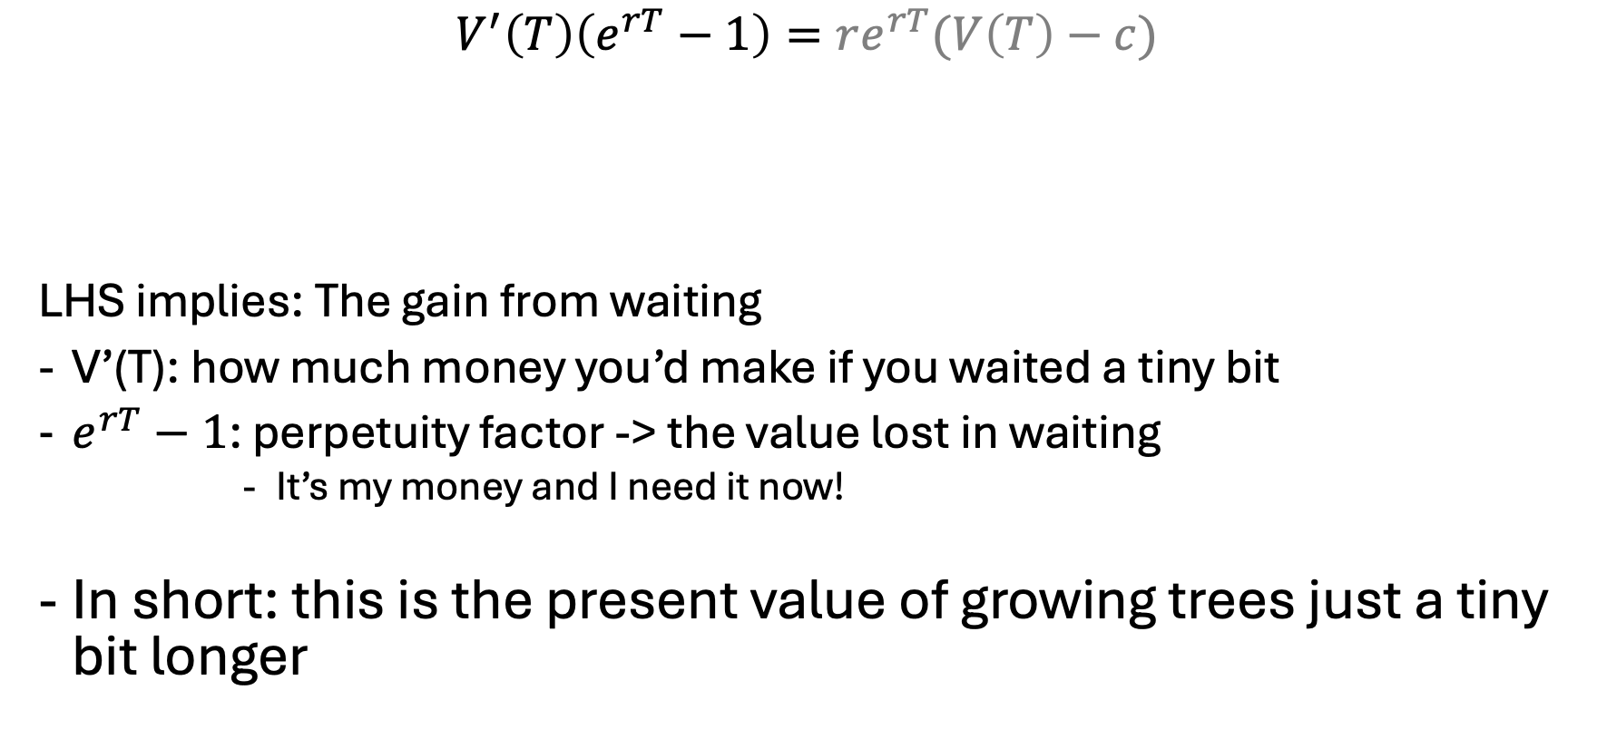
The Faustmann Equation [I]
$$V^{′}\left(T\right)\left(e^{rT}−1\right)=re^{rT}(V\left(T\right)−c)$$
LHS implies: The gain from waiting
V’(T): how much money you’d make if you waited a tiny bit
$e^{rT}−1$: perpetuity factor -> the value lost in waiting
It’s my money and I need it now!
In short: this is the present value of growing trees just a tiny bit longer
Opportunity cost of capital tied up in the stand,
including delayed profits
Marginal increase in time value [x] Perpetuity factor
Notes:
https://youtu.be/7jY_ZP6gQiQ

Slide 11
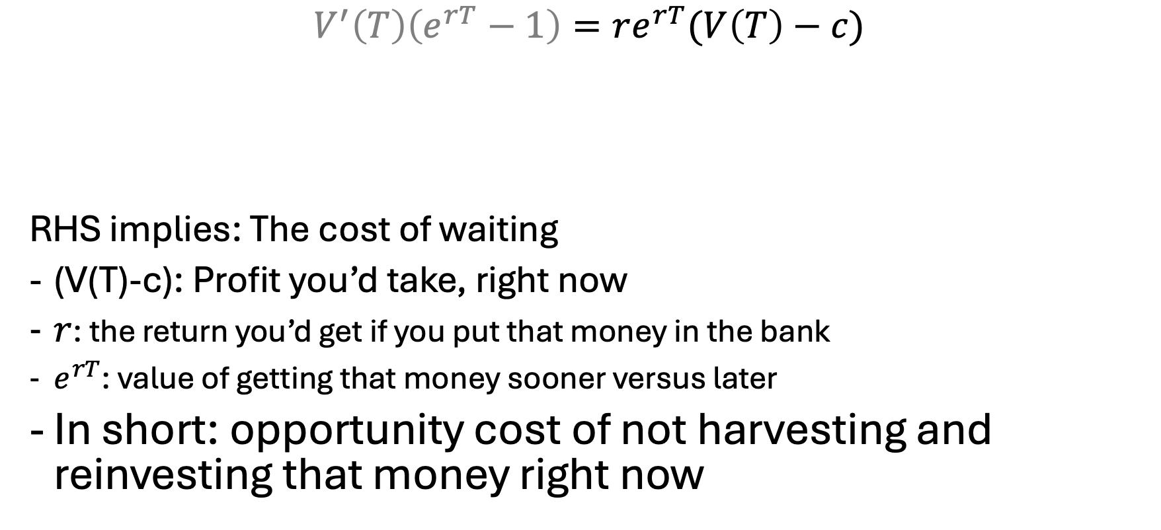
The Faustmann Equation [II]
$$V^{′}\left(T\right)\left(e^{rT}−1\right)=re^{rT}(V\left(T\right)−c)$$
RHS implies: The cost of waiting
(V(T)-c): Profit you’d take, right now
$r$: the return you’d get if you put that money in the bank
$e^{rT}$: value of getting that money sooner versus later
In short: opportunity cost of not harvesting and reinvesting that money right now
Opportunity cost of capital tied up in the stand,
including delayed profits
Marginal increase in time value [x] Perpetuity factor

Slide 12
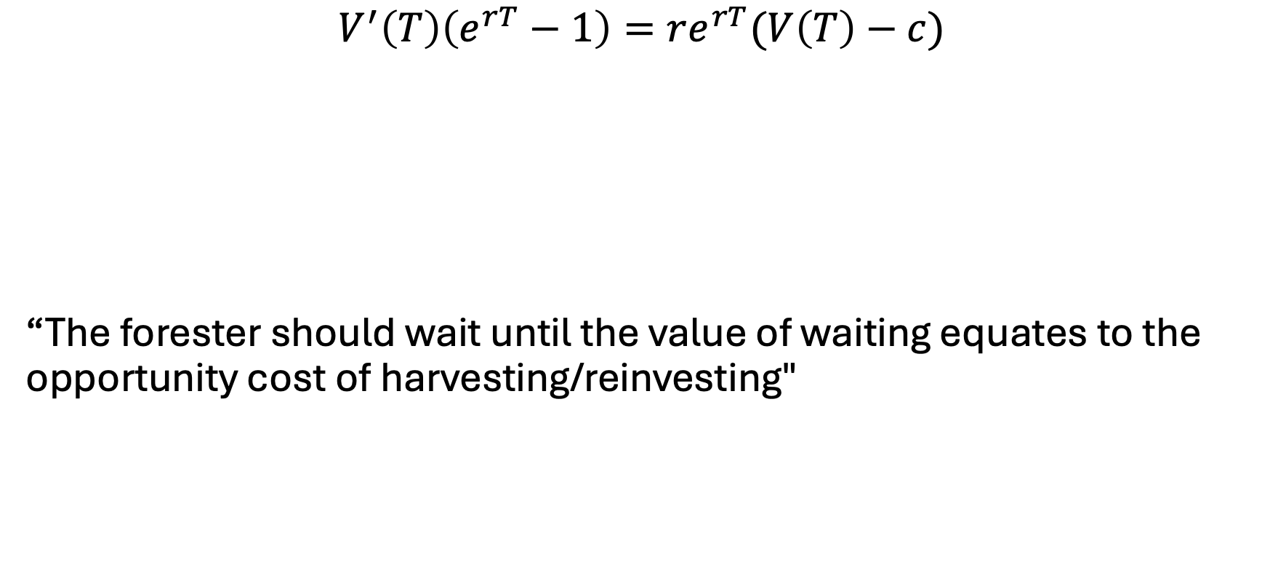
The Faustmann Equation [III]
$$V^{′}\left(T\right)\left(e^{rT}−1\right)=re^{rT}(V\left(T\right)−c)$$
“The forester should wait until the value of waiting equates to the opportunity cost of harvesting/reinvesting"
Value of harvesting (more appropriately opportunity cost of not harvesting) and reinvesting that money - JG Wentwroth
PV of growing trees just a tiny bit longer (waiting)

Slide 13
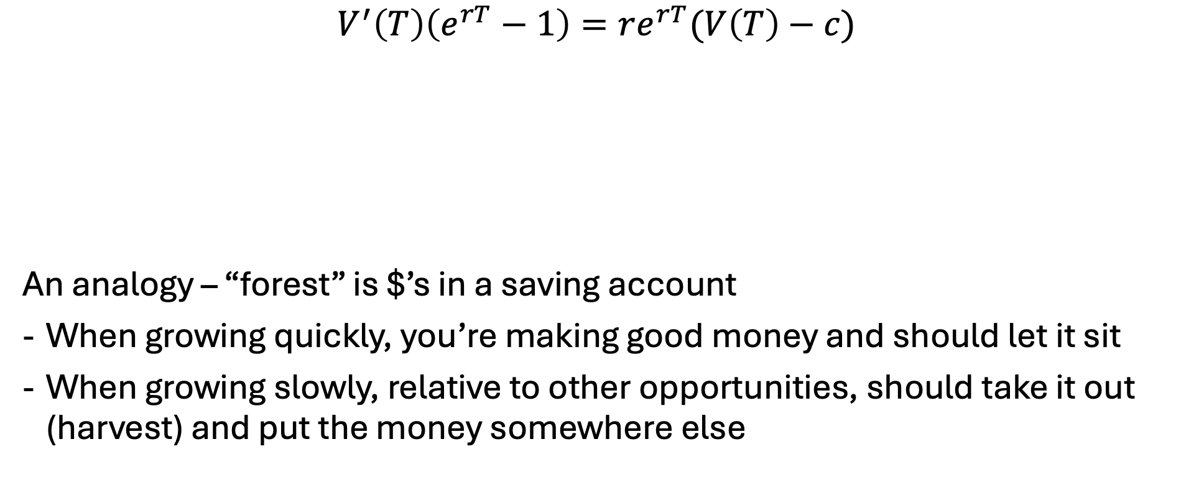
The Faustmann Equation [III]
$$V^{′}\left(T\right)\left(e^{rT}−1\right)=re^{rT}(V\left(T\right)−c)$$
An analogy – “forest” is $’s in a saving account
When growing quickly, you’re making good money and should let it sit
When growing slowly, relative to other opportunities, should take it out (harvest) and put the money somewhere else
opportunity cost of not harvesting and reinvesting that money (right now)
PV of growing trees just a tiny bit longer (waiting)

Slide 14


The full Faustmann model…
Variables
Z – present value of profit
T – rotation period (years)
Objective:
$$\begin{matrix}Max \\ T\end{matrix} π=\frac{p\overline{s}{\left(1+f\right)}^{T}−c}{e^{rT}−1}$$
Parameters
p: price = 1000
r: discount rate = 0.1
c: replanting cost = 500
f: growth rate = 0.08
$\overline{s}$: initial stand = 100

Slide 15
Do we see any problems with Faustmann?

Slide 16
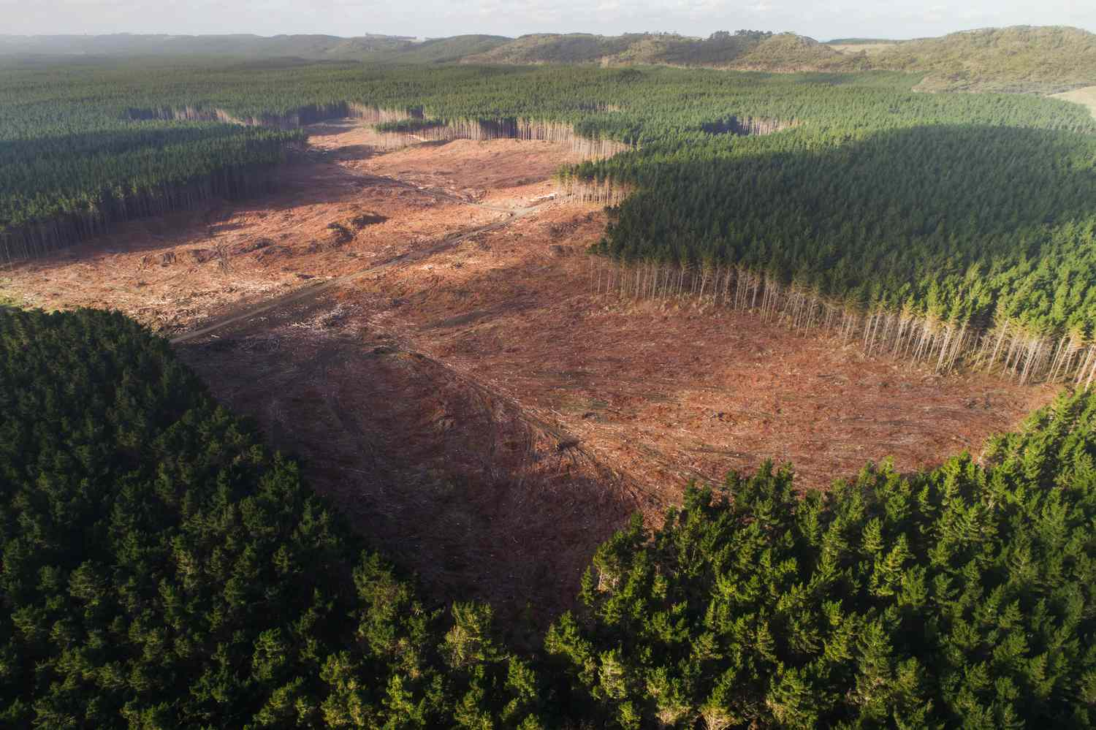
Pros/cons of Faustmann
Pros:
Easy/intuitive
Focus on PV
Easily-expandable
Cons:
Even-aged, clear-cutting
Ignores ecological services
Perfect foresight
Super simple

Slide 17
Enter a new challenger – Managed forests
It doesn’t always make sense to just clear-cut a forest
Similar to fisheries – we can harvest some trees when the time is right but wait for others to mature and become more valuable
Thus, need to introduce the idea that we want to optimize via choosing a quantity to harvest, not a harvest period

Slide 18
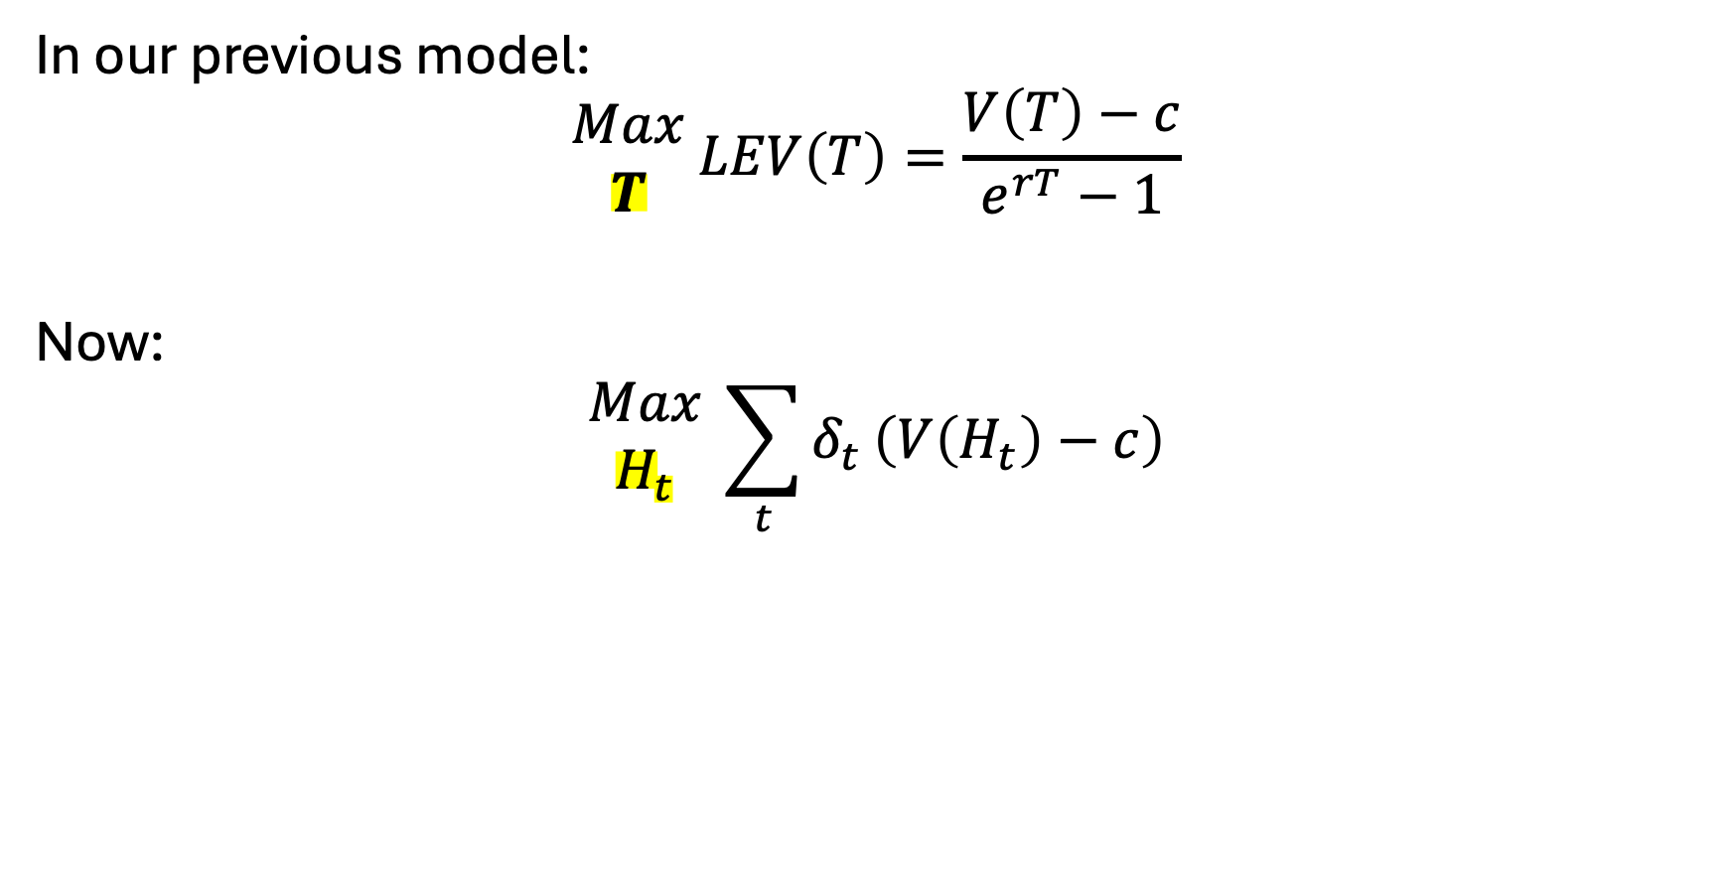
Subtle difference
In our previous model:
$$\begin{matrix}Max \\ T\end{matrix} LEV\left(T\right)=\frac{V\left(T\right)−c}{e^{rT}−1}$$
Now:
$$\begin{matrix}Max \\ H_{t}\end{matrix} \sum_{t}{δ_{t}}\left(V\left(H_{t}\right)−c\right)$$

Slide 19
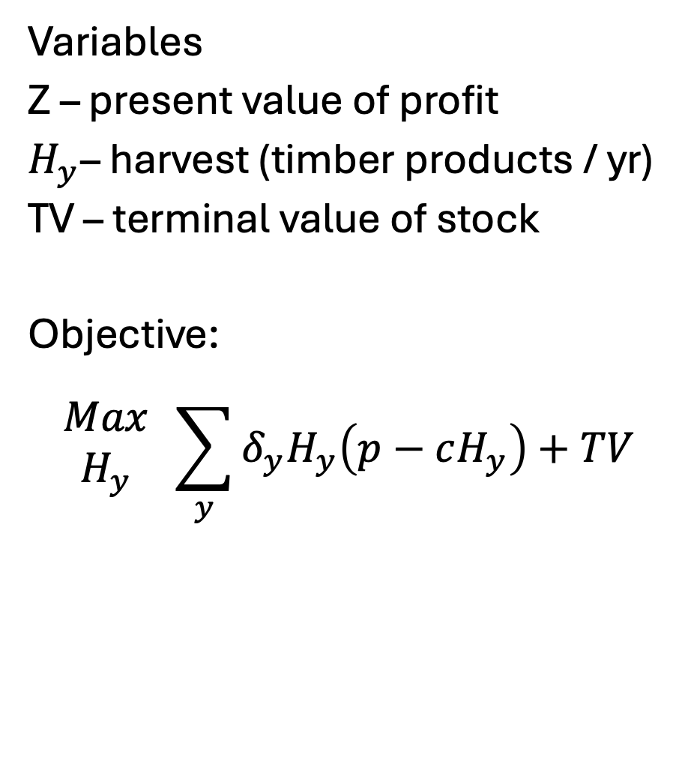

The full managed model
Variables
Z – present value of profit
$H_{y}$– harvest (timber products / yr)
TV – terminal value of stock
Objective:
$$\begin{matrix}Max \\ H_{y}\end{matrix} \sum_{y}{δ_{y}H_{y}\left(p−cH_{y}\right)+TV}$$
Index
y: year ($y∈\{1,..,100\}$)
Parameters
p: price = 1000
r: discount rate = 0.1
c: replanting cost = 500
f: growth rate = 0.08
$\overline{s}$: initial stand = 100

Slide 20
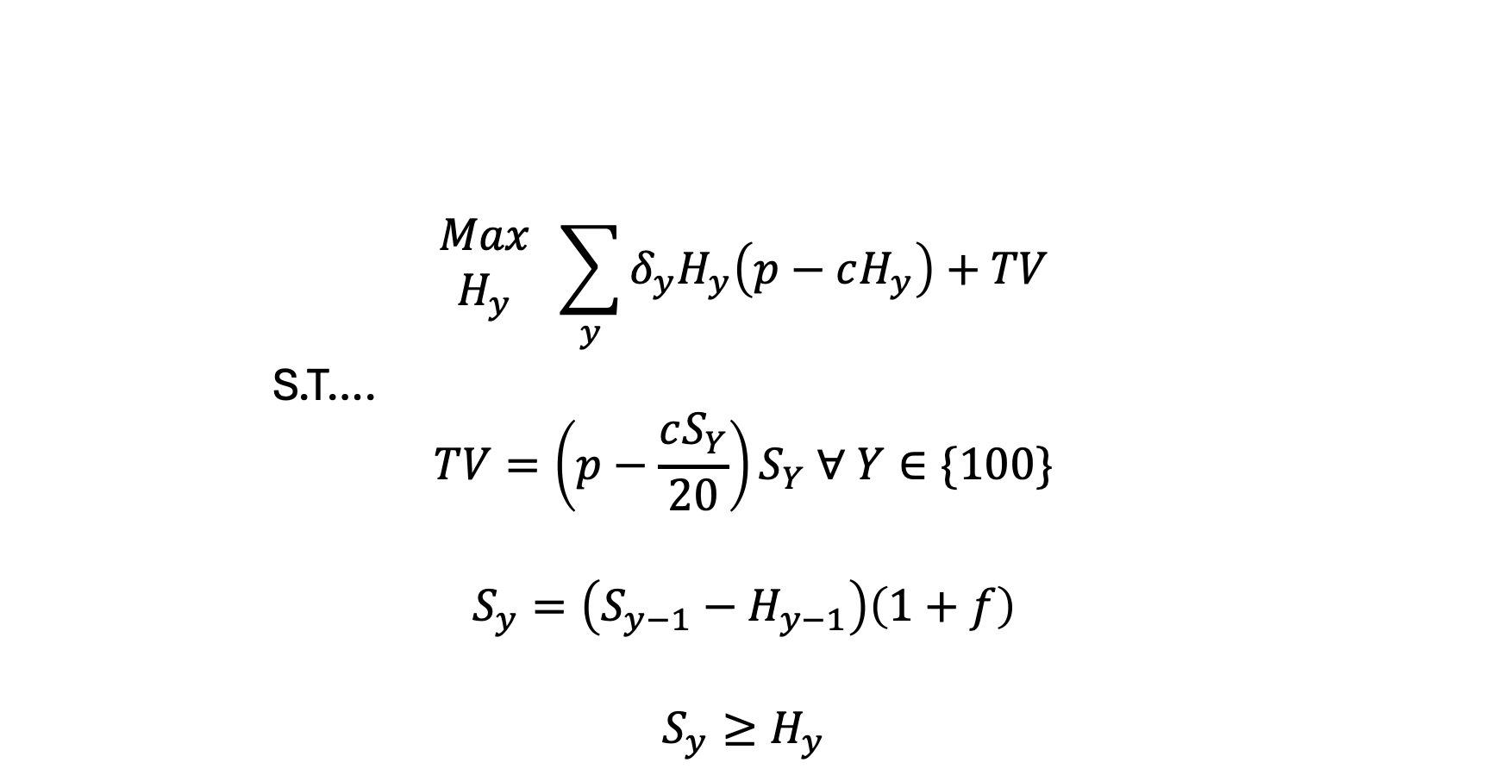
The full managed model
$$\begin{matrix}Max \\ H_{y}\end{matrix} \sum_{y}{δ_{y}H_{y}\left(p−cH_{y}\right)+TV}$$
S.T….
$$TV=\left(p−\frac{cS_{Y}}{20}\right)S_{Y} ∀ Y∈\{100\}$$
$$S_{y}=\left(S_{y−1}−H_{y−1}\right)\left(1+f\right)$$
$$S_{y}≥H_{y}$$
Source: I made it up

Slide 21
To the GAMS model!
And Tableau!

Slide 22

Meme [II]

Slide 23
Now: Electricity ’dispatch’
Not so much a ‘dispatch’ model – ignoring a lot of electricity-related considerations
Transmission
Basic physics
Unit commitment
… so many other things
Purpose is to:
Reinforce sparse matrix construction
Evaluate policy design
Interpretation of shadow values
Provide a foundation for converting an LP into an MCP
Incorporate demand elasticity via both piecewise linear and MCP methods

Slide 24
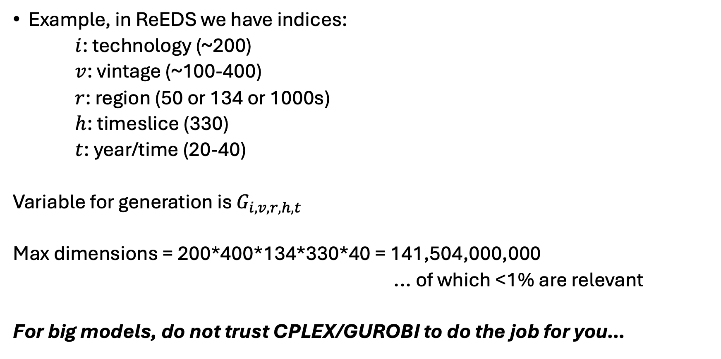
Why conditionals?
Example, in ReEDS we have indices:
$i$: technology (~200)
$v$: vintage (~100-400)
$r$: region (50 or 134 or 1000s)
$h$: timeslice (330)
$t$: year/time (20-40)
Variable for generation is $G_{i,v,r,h,t}$
Max dimensions = 200*400*134*330*40 = 141,504,000,000
... of which <1% are relevant
For big models, do not trust CPLEX/GUROBI to do the job for you…

Slide 25
More specifically: sparse matrix construction
Put simply: We do not want to burden the model with irrelevant constraints or decision variables
In GAMS, reducing equation population via…
eq_caplim(i,v,r,h,t)$valid_generation(i,v,r,h,t)..
and reducing variable consideration via:
… + sum{(i,v,r,h,t)$valid_generation(i,v,r,h,t), GEN(i,v,r,h,t) }

Slide 26
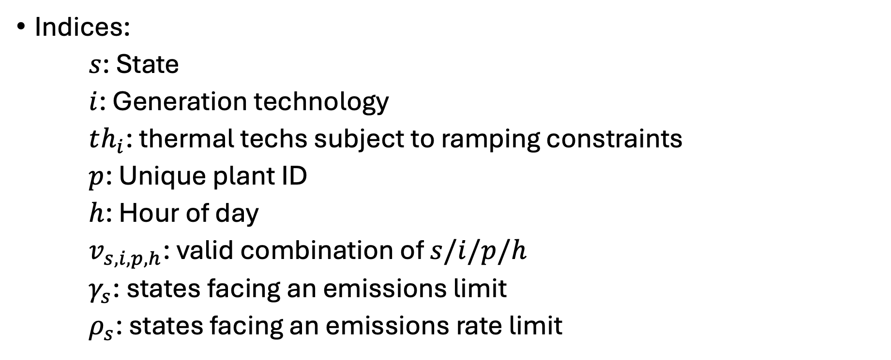
Electricity “dispatch” problem
Indices:
$s$: State
$i$: Generation technology
$th_{i}$: thermal techs subject to ramping constraints
$p$: Unique plant ID
$h$: Hour of day
$v_{s,i,p,h}$: valid combination of $s/i/p/h$
$γ_{s}$: states facing an emissions limit
$ρ_{s}$: states facing an emissions rate limit

Slide 27
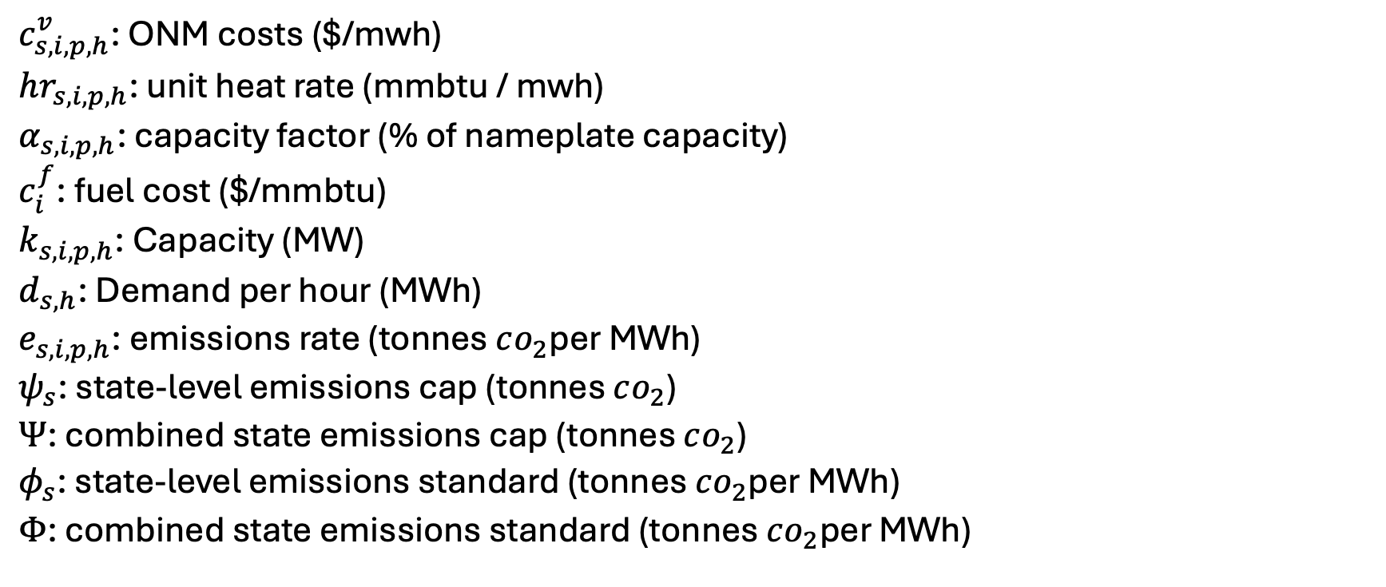
Parameters
$c_{s,i,p,h}^{v}$: ONM costs ($/mwh)
$hr_{s,i,p,h}$: unit heat rate (mmbtu / mwh)
$α_{s,i,p,h}$: capacity factor (% of nameplate capacity)
$c_{i}^{f}$: fuel cost ($/mmbtu)
$k_{s,i,p,h}$: Capacity (MW)
$d_{s,h}$: Demand per hour (MWh)
$e_{s,i,p,h}$: emissions rate (tonnes $co_{2}$per MWh)
$ψ_{s}$: state-level emissions cap (tonnes $co_{2}$)
$Ψ$: combined state emissions cap (tonnes $co_{2}$)
$φ_{s}$: state-level emissions standard (tonnes $co_{2}$per MWh)
$Φ$: combined state emissions standard (tonnes $co_{2}$per MWh)

Slide 28
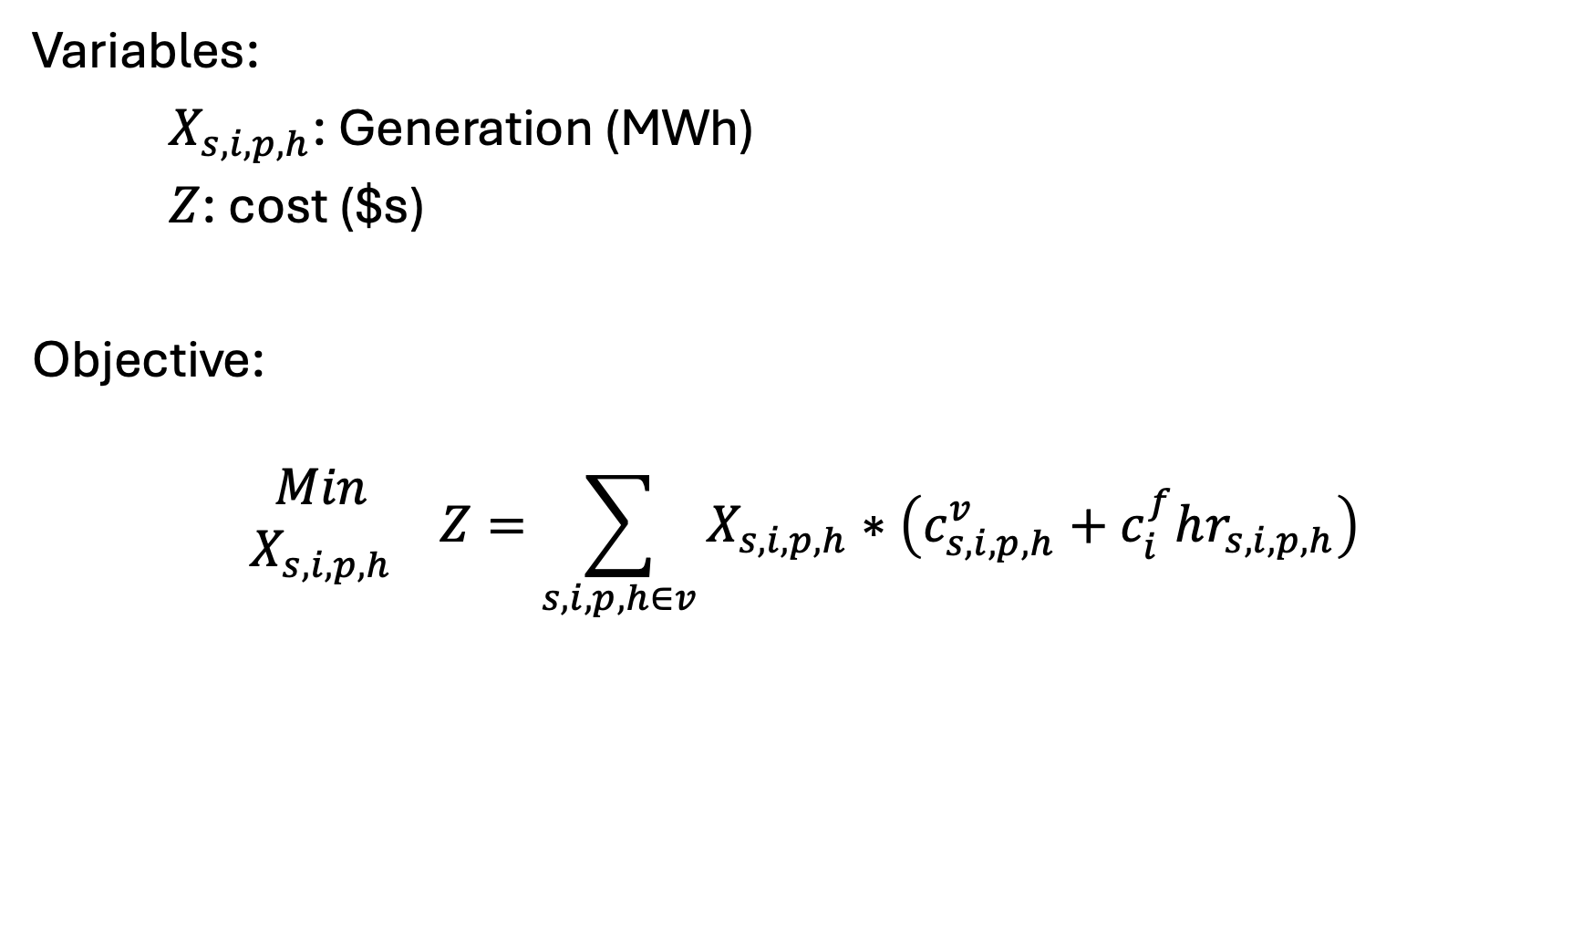
Variables, Objective
Variables:
$X_{s,i,p,h}$: Generation (MWh)
$Z$: cost ($s)
Objective:
$$\begin{matrix}Min \\ X_{s,i,p,h}\end{matrix} Z=\sum_{s,i,p,h∈v}{X_{s,i,p,h}}∗\left(c_{s,i,p,h}^{v}+c_{i}^{f}hr_{s,i,p,h}\right)$$

Slide 29
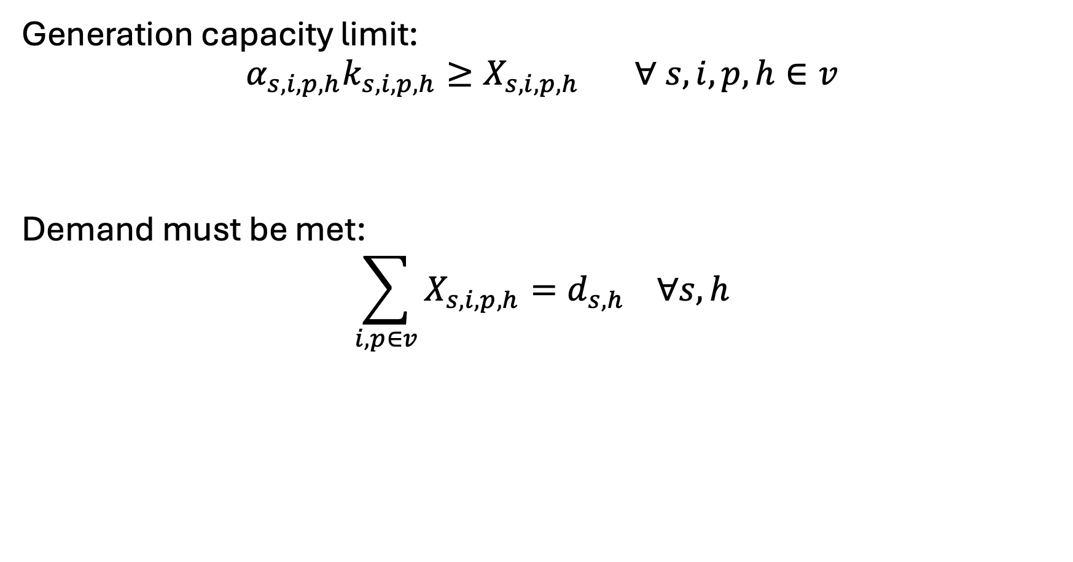
Constraints - basics
Generation capacity limit:
$$α_{s,i,p,h}k_{s,i,p,h}≥X_{s,i,p,h} ∀ s,i,p,h∈v$$
Demand must be met:
$$\sum_{i,p∈v}{X_{s,i,p,h}}=d_{s,h} ∀s,h$$

Slide 30
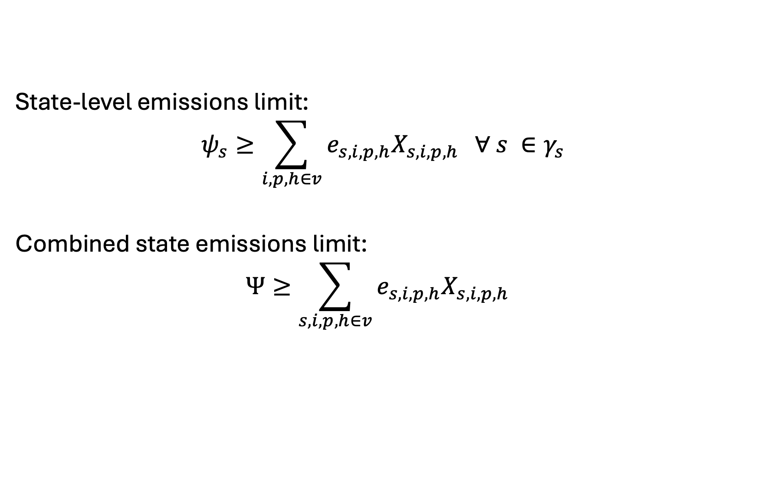
Constraints – Mass-based Policies
State-level emissions limit:
$$ψ_{s}≥\sum_{i,p,h∈v}{e_{s,i,p,h}X_{s,i,p,h}} ∀ s ∈γ_{s}$$
Combined state emissions limit:
$$Ψ≥\sum_{s,i,p,h∈v}{e_{s,i,p,h}X_{s,i,p,h}}$$

Slide 31
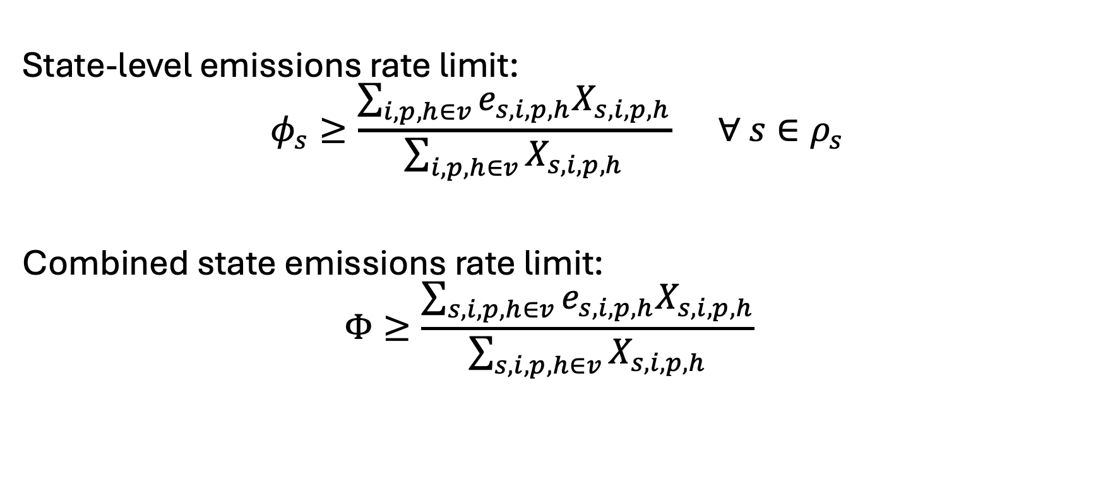
Constraints – Rate-based Policies
State-level emissions rate limit:
$$φ_{s}≥\frac{\sum_{i,p,h∈v}{e_{s,i,p,h}X_{s,i,p,h}}}{\sum_{i,p,h∈v}{X_{s,i,p,h}}} ∀ s∈ρ_{s}$$
Combined state emissions rate limit:
$$Φ≥\frac{\sum_{s,i,p,h∈v}{e_{s,i,p,h}X_{s,i,p,h}}}{\sum_{s,i,p,h∈v}{X_{s,i,p,h}}}$$

Slide 32
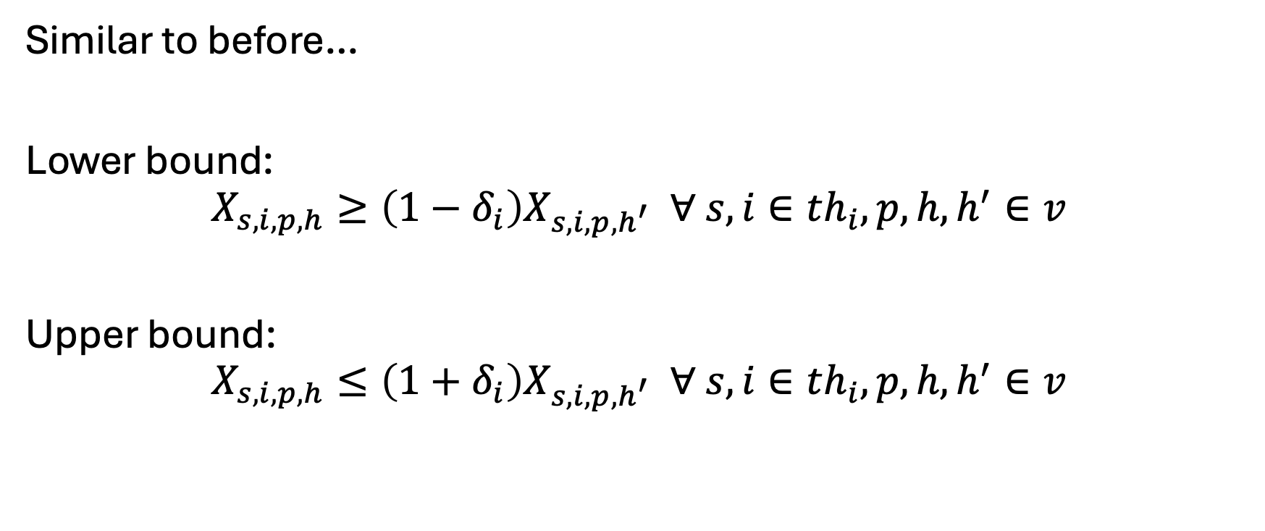
Constraints – “unit commitment”
Similar to before…
Lower bound:
$$X_{s,i,p,h}≥\left(1−δ_{i}\right)X_{s,i,p,h^{′}} ∀ s,i∈th_{i},p,h,h^{′}∈v$$
Upper bound:
$$X_{s,i,p,h}≤\left(1+δ_{i}\right)X_{s,i,p,h^{′}} ∀ s,i∈th_{i},p,h,h^{′}∈v$$

Slide 33

Meme [III]

