Slide 1
EBGN645: Day 14

Slide 2
Notes
No class 10/27-29
Will record (at least) one lecture
Potentially cancelled: 11/10-12 (will email Sunday PM)
HW1b due today (now)

Slide 3

Discussion time
Can tell many of you are struggling.. I don’t want that
How can I help?
What would be most useful?
What questions can I answer now? … in future classes?
Any useful examples?
What would you like to get out of the rest of this course?

Slide 4
Bigger picture
Homework 1 together
Resource models
Hotelling (review)
Fisheries management (Gordon-Schaeffer)
Forestry management (Faustmann)
CO-WY electricity ‘dispatch’
Non-linear, calibrated market models
US petroleum, backstop techs
Review of duality -> MCP models
Game theory models
Stackelberg
Cournot
Ramsey model
CGE models
MPECs/EPECs
Presentations

Slide 5
Agenda – next few classes (aka this slide deck)
Brief review of electricity dispatch Lagrangian and interpretation
Coding up that model
Rambling on investment and terminal conditions
Moving into discussion on NLP market models
Basics
Utility maximization (pizza/beer)
Actual example using US data
Competition between EVs and petroleum
Imports/exports
Ramsey model

Slide 6

Meme [I]

Slide 7
Now: Electricity ’dispatch’
Not so much a ‘dispatch’ model – ignoring a lot of electricity-related considerations
Transmission
Basic physics
Unit commitment
… so many other things
Purpose is to:
Reinforce sparse matrix construction
Evaluate policy design
Interpretation of shadow values
Provide a foundation for converting an LP into an MCP
Incorporate demand elasticity via both piecewise linear and MCP methods

Slide 8
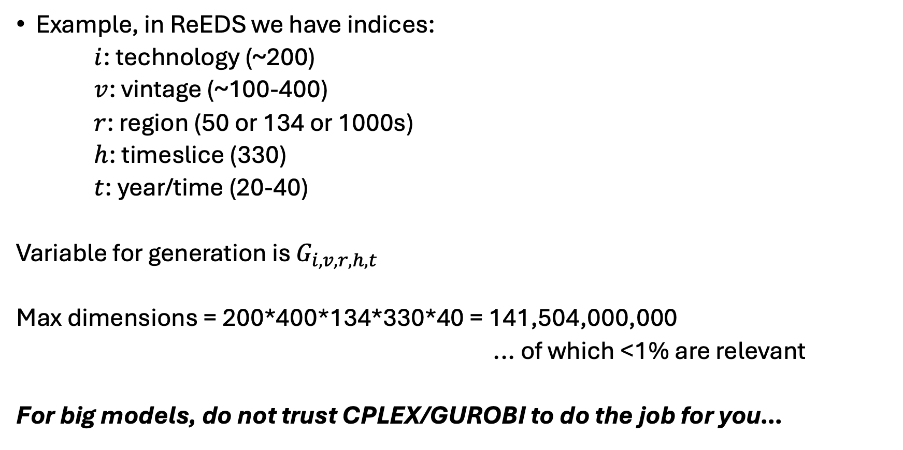
Why conditionals?
Example, in ReEDS we have indices:
$i$: technology (~200)
$v$: vintage (~100-400)
$r$: region (50 or 134 or 1000s)
$h$: timeslice (330)
$t$: year/time (20-40)
Variable for generation is $G_{i,v,r,h,t}$
Max dimensions = 200*400*134*330*40 = 141,504,000,000
... of which <1% are relevant
For big models, do not trust CPLEX/GUROBI to do the job for you…

Slide 9
More specifically: sparse matrix construction
Put simply: We do not want to burden the model with irrelevant constraints or decision variables
In GAMS, reducing equation population via…
eq_caplim(i,v,r,h,t)$valid_generation(i,v,r,h,t)..
and reducing variable consideration via:
… + sum{(i,v,r,h,t)$valid_generation(i,v,r,h,t), GEN(i,v,r,h,t) }

Slide 10
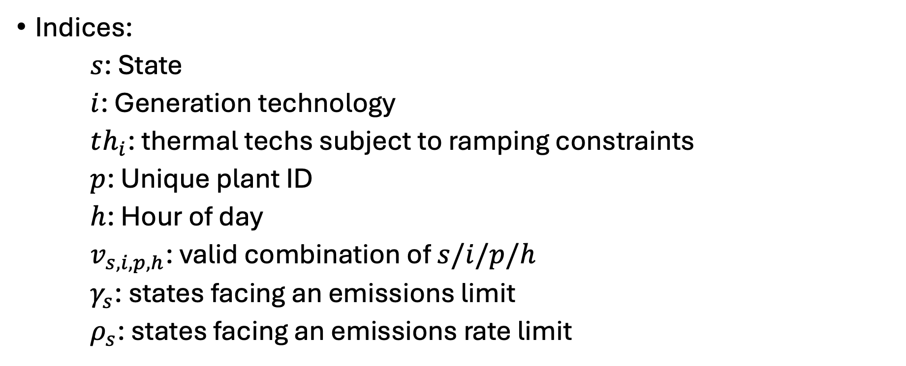
Electricity “dispatch” problem
Indices:
$s$: State
$i$: Generation technology
$th_{i}$: thermal techs subject to ramping constraints
$p$: Unique plant ID
$h$: Hour of day
$v_{s,i,p,h}$: valid combination of $s/i/p/h$
$γ_{s}$: states facing an emissions limit
$ρ_{s}$: states facing an emissions rate limit

Slide 11
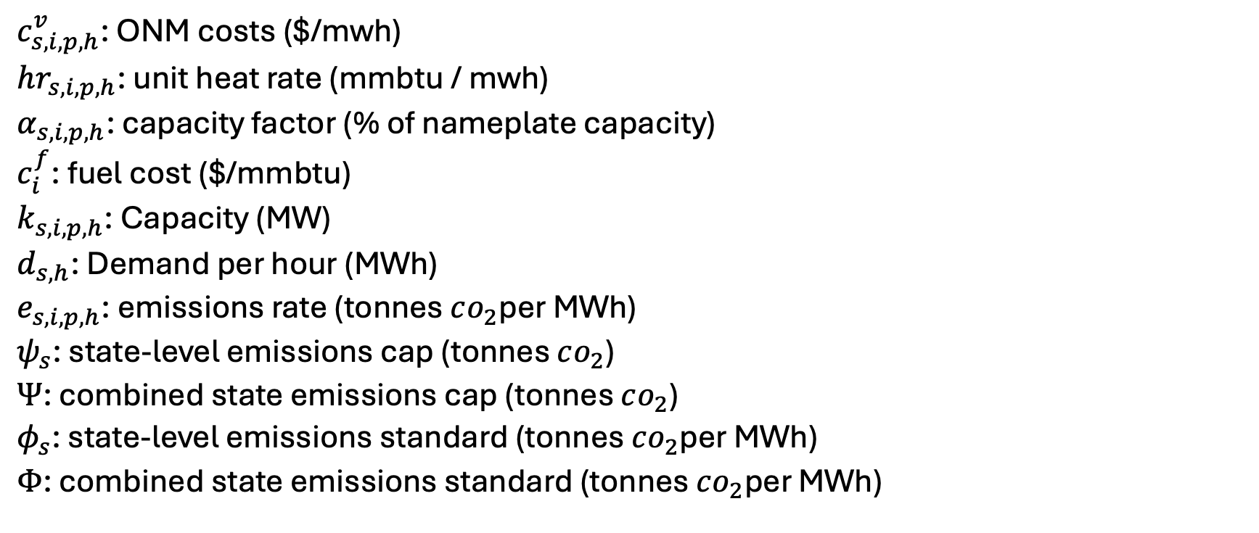
Parameters
$c_{s,i,p,h}^{v}$: ONM costs ($/mwh)
$hr_{s,i,p,h}$: unit heat rate (mmbtu / mwh)
$α_{s,i,p,h}$: capacity factor (% of nameplate capacity)
$c_{i}^{f}$: fuel cost ($/mmbtu)
$k_{s,i,p,h}$: Capacity (MW)
$d_{s,h}$: Demand per hour (MWh)
$e_{s,i,p,h}$: emissions rate (tonnes $co_{2}$per MWh)
$ψ_{s}$: state-level emissions cap (tonnes $co_{2}$)
$Ψ$: combined state emissions cap (tonnes $co_{2}$)
$φ_{s}$: state-level emissions standard (tonnes $co_{2}$per MWh)
$Φ$: combined state emissions standard (tonnes $co_{2}$per MWh)

Slide 12
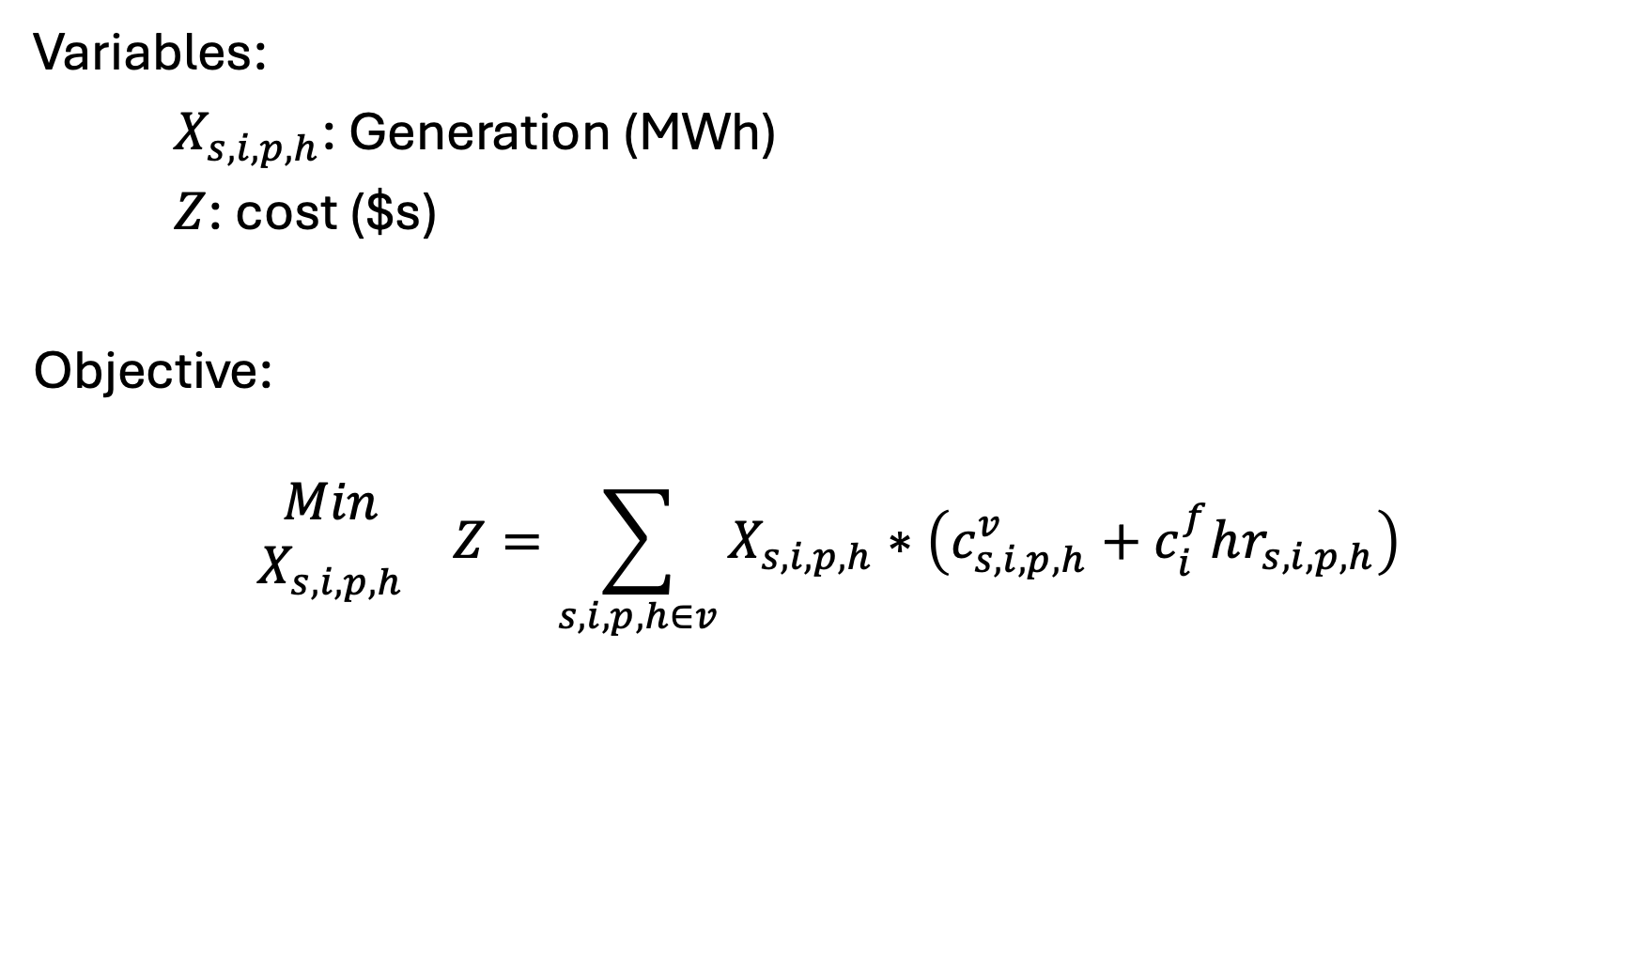
Variables, Objective
Variables:
$X_{s,i,p,h}$: Generation (MWh)
$Z$: cost ($s)
Objective:
$$\begin{matrix}Min \\ X_{s,i,p,h}\end{matrix} Z=\sum_{s,i,p,h∈v}{X_{s,i,p,h}}∗\left(c_{s,i,p,h}^{v}+c_{i}^{f}hr_{s,i,p,h}\right)$$

Slide 13
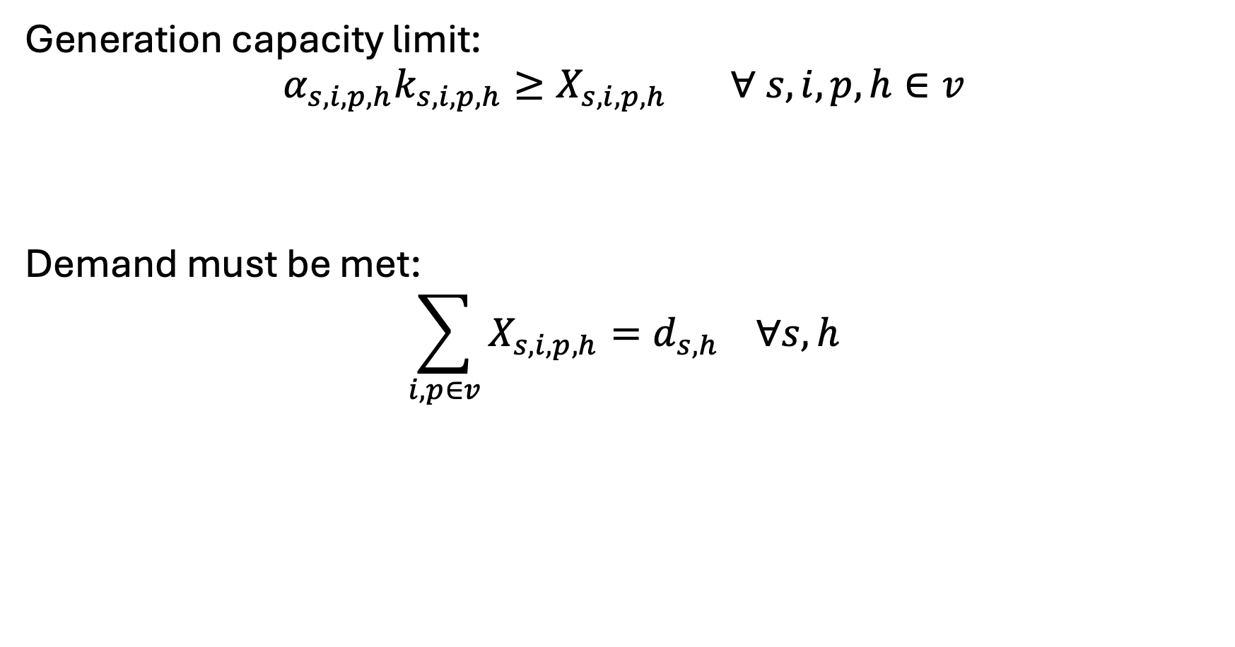
Constraints - basics
Generation capacity limit:
$$α_{s,i,p,h}k_{s,i,p,h}≥X_{s,i,p,h} ∀ s,i,p,h∈v$$
Demand must be met:
$$\sum_{i,p∈v}{X_{s,i,p,h}}=d_{s,h} ∀s,h$$

Slide 14
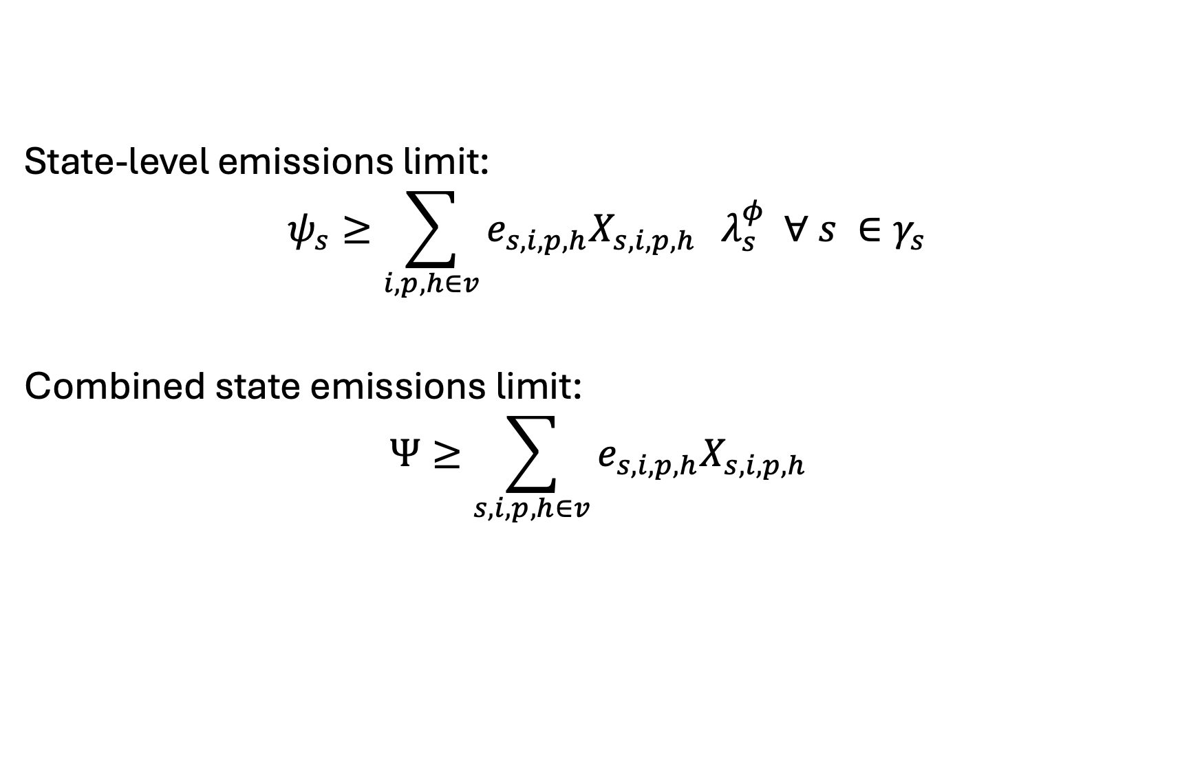
Constraints – Mass-based Policies
State-level emissions limit:
$$ψ_{s}≥\sum_{i,p,h∈v}{e_{s,i,p,h}X_{s,i,p,h}} λ_{s}^{φ} ∀ s ∈γ_{s}$$
Combined state emissions limit:
$$Ψ≥\sum_{s,i,p,h∈v}{e_{s,i,p,h}X_{s,i,p,h}}$$

Slide 15
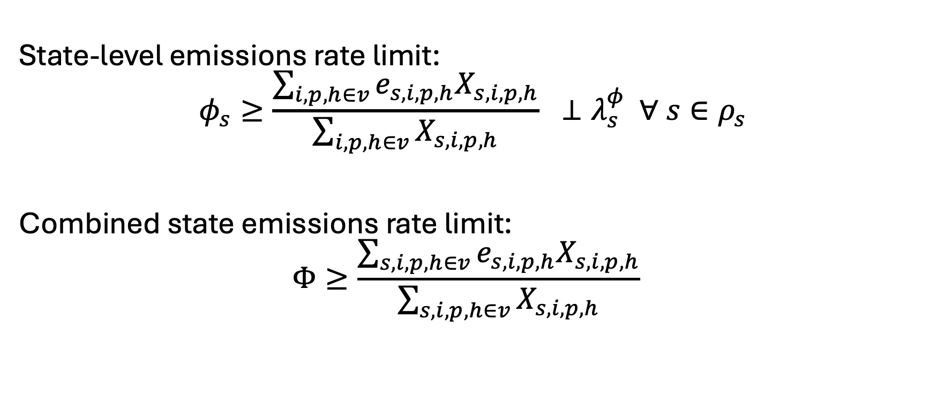
Constraints – Rate-based Policies
State-level emissions rate limit:
$$φ_{s}≥\frac{\sum_{i,p,h∈v}{e_{s,i,p,h}X_{s,i,p,h}}}{\sum_{i,p,h∈v}{X_{s,i,p,h}}} ⊥λ_{s}^{φ} ∀ s∈ρ_{s}$$
Combined state emissions rate limit:
$$Φ≥\frac{\sum_{s,i,p,h∈v}{e_{s,i,p,h}X_{s,i,p,h}}}{\sum_{s,i,p,h∈v}{X_{s,i,p,h}}}$$

Slide 16
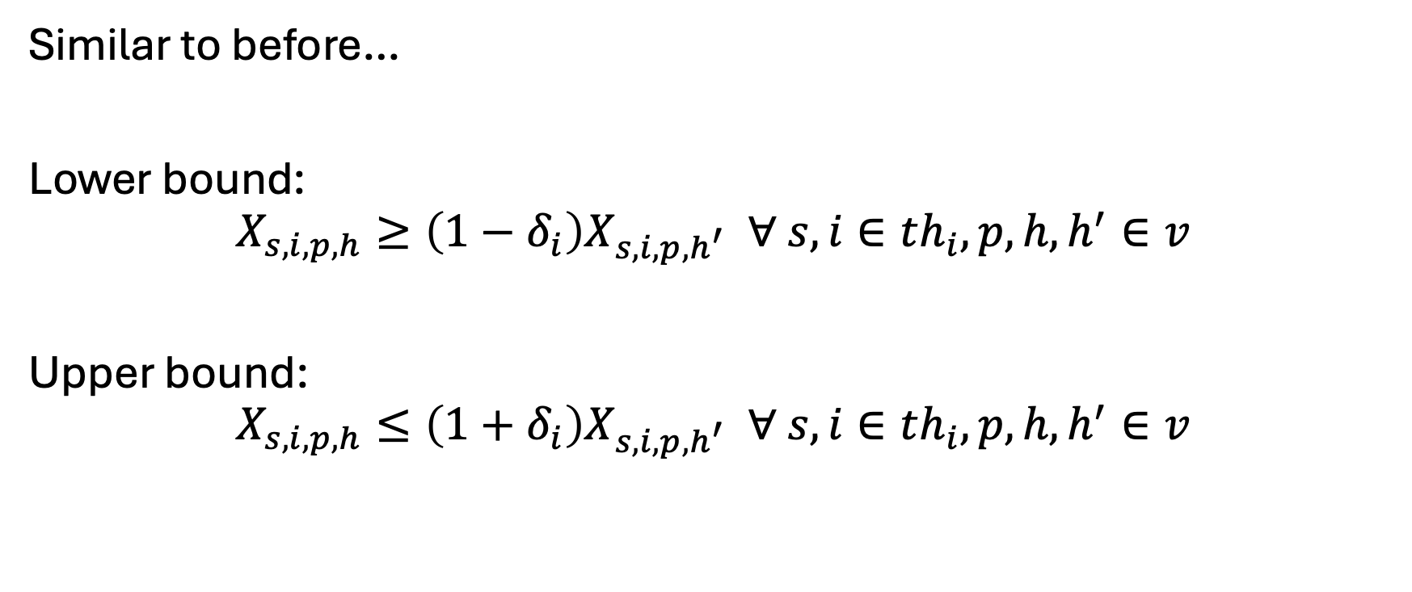
Constraints – “unit commitment”
Similar to before…
Lower bound:
$$X_{s,i,p,h}≥\left(1−δ_{i}\right)X_{s,i,p,h^{′}} ∀ s,i∈th_{i},p,h,h^{′}∈v$$
Upper bound:
$$X_{s,i,p,h}≤\left(1+δ_{i}\right)X_{s,i,p,h^{′}} ∀ s,i∈th_{i},p,h,h^{′}∈v$$

Slide 17
Let’s code this up in GAMS…
Notes to self…
Add on linear demand based on reference/endogenous price
Sparse matrix construction:
Intentionally miss a conditional
Running policies for:
Mass-based limit
Rate-based limit
Traded mass-based limit
Traded rate-based limit
… with and w/o endogenous demand

Slide 18

Meme [III]

Slide 19
Investment – overview/ramblings
Big decision: myopic vs intertemporal
Myopic: no foresight
‘Window’ : limited foresight
Intertemporal: full foresight
Can write as a general setup that allows for all three
Choice will determine how you calculate the discount/present value factor (PVF) and distinguishing between capital (k) and operations (v)
Alternatively, can represent as annualized cash flow/balance

Slide 20
Investment – terminal conditions
Terminal conditions: what happens when time ends
For myopic, need to weight by a certain number of years. For example, I’m choosing investment now and looking for a payback in the next X years
For intertemporal/window, four options:
Do nothing – a lot of models do this (but it is wrong)
Weight the last year(s) similar to a myopic solve - easy
Solve to T+X years, cut solution to T – also wrong, but convenient
Salvage value of investment – complicated (sometimes)
Barr-Manne terminal investment condition..
Basically: make enough investment in the terminal period to sustain the near future
Difficult when you have many technologies
Covered more in the Ramsey model

Slide 21
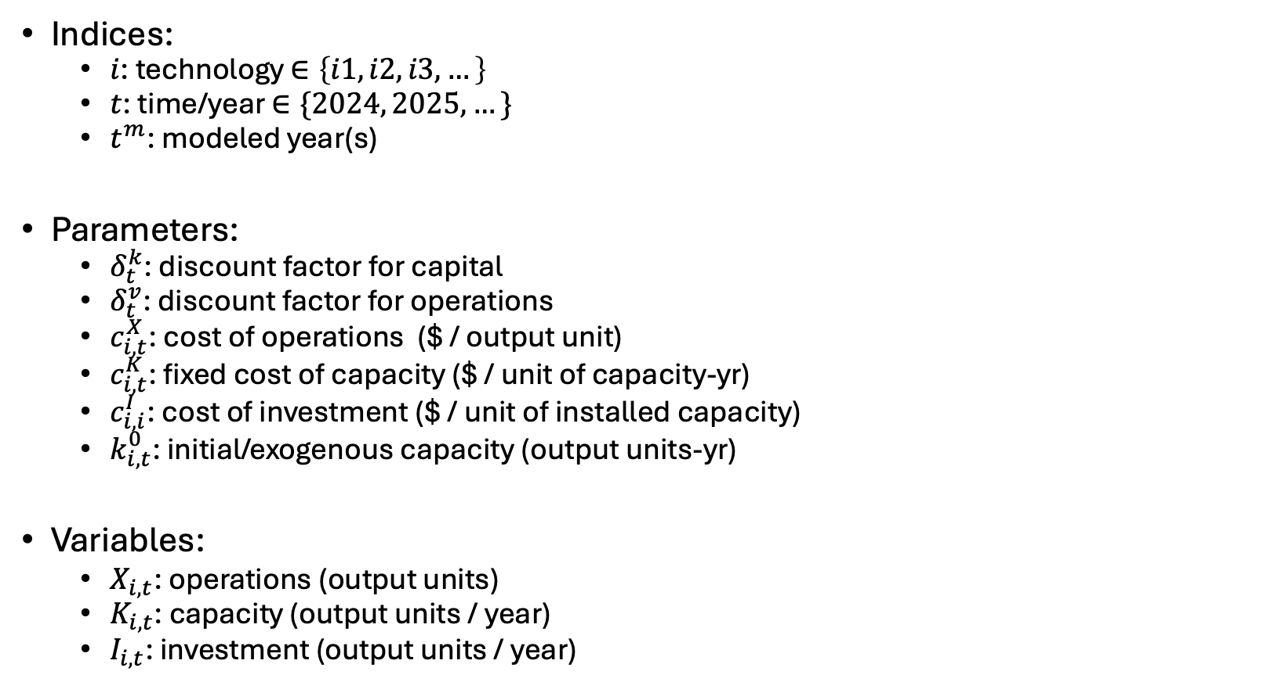
General investment model
Indices:
$i$: technology $∈\left\{i1,i2,i3,…\right\}$
$t$: time/year $∈\{2024, 2025, …\}$
$t^{m}$: modeled year(s)
Parameters:
$δ_{t}^{k}$: discount factor for capital
$δ_{t}^{v}$: discount factor for operations
$c_{i,t}^{X}$: cost of operations ($ / output unit)
$c_{i,t}^{K}$: fixed cost of capacity ($ / unit of capacity-yr)
$c_{i,i}^{I}$: cost of investment ($ / unit of installed capacity)
$k_{i,t}^{0}$: initial/exogenous capacity (output units-yr)
Variables:
$X_{i,t}$: operations (output units)
$K_{i,t}$: capacity (output units / year)
$I_{i,t}$: investment (output units / year)

Slide 22
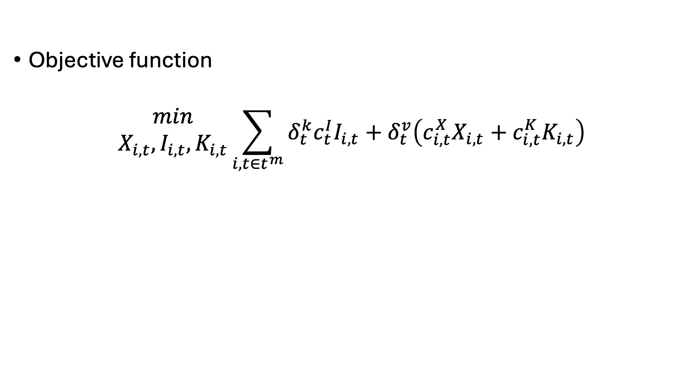
General investment concept
Objective function
$$\begin{matrix}min \\ X_{i,t},I_{i,t},K_{i,t}\end{matrix}\sum_{i,t∈t^{m}}{δ_{t}^{k}c_{t}^{I}I_{i,t}+δ_{t}^{v}\left(c_{i,t}^{X}X_{i,t}+c_{i,t}^{K}K_{i,t}\right)}$$
Investment Costs
Operational Costs
Modeled years – makes it easy to change temporal resolution!

Slide 23
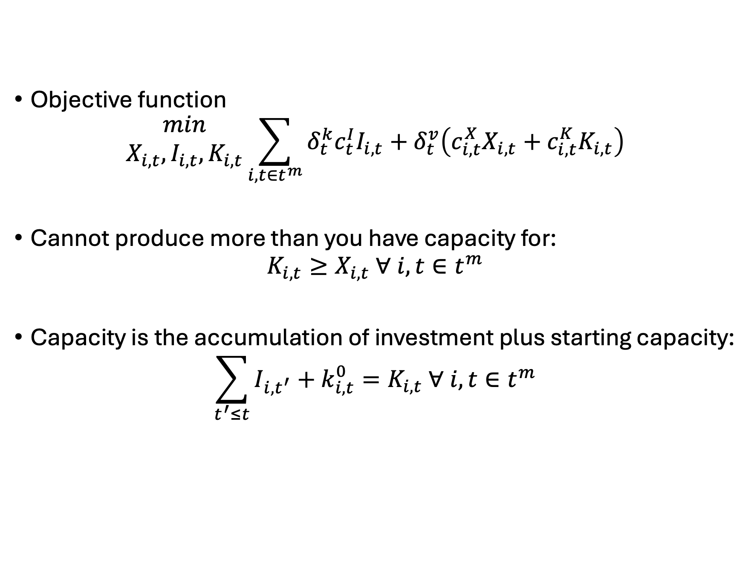
General investment concept
Objective function
$$\begin{matrix}min \\ X_{i,t},I_{i,t},K_{i,t}\end{matrix}\sum_{i,t∈t^{m}}{δ_{t}^{k}c_{t}^{I}I_{i,t}+δ_{t}^{v}\left(c_{i,t}^{X}X_{i,t}+c_{i,t}^{K}K_{i,t}\right)}$$
Cannot produce more than you have capacity for:
$$K_{i,t}≥X_{i,t} ∀ i,t∈t^{m}$$
Capacity is the accumulation of investment plus starting capacity:
$$\sum_{t^{′}≤t}{I_{i,t^{′}}}+k_{i,t}^{0}=K_{i,t} ∀ i,t∈t^{m}$$

Slide 24
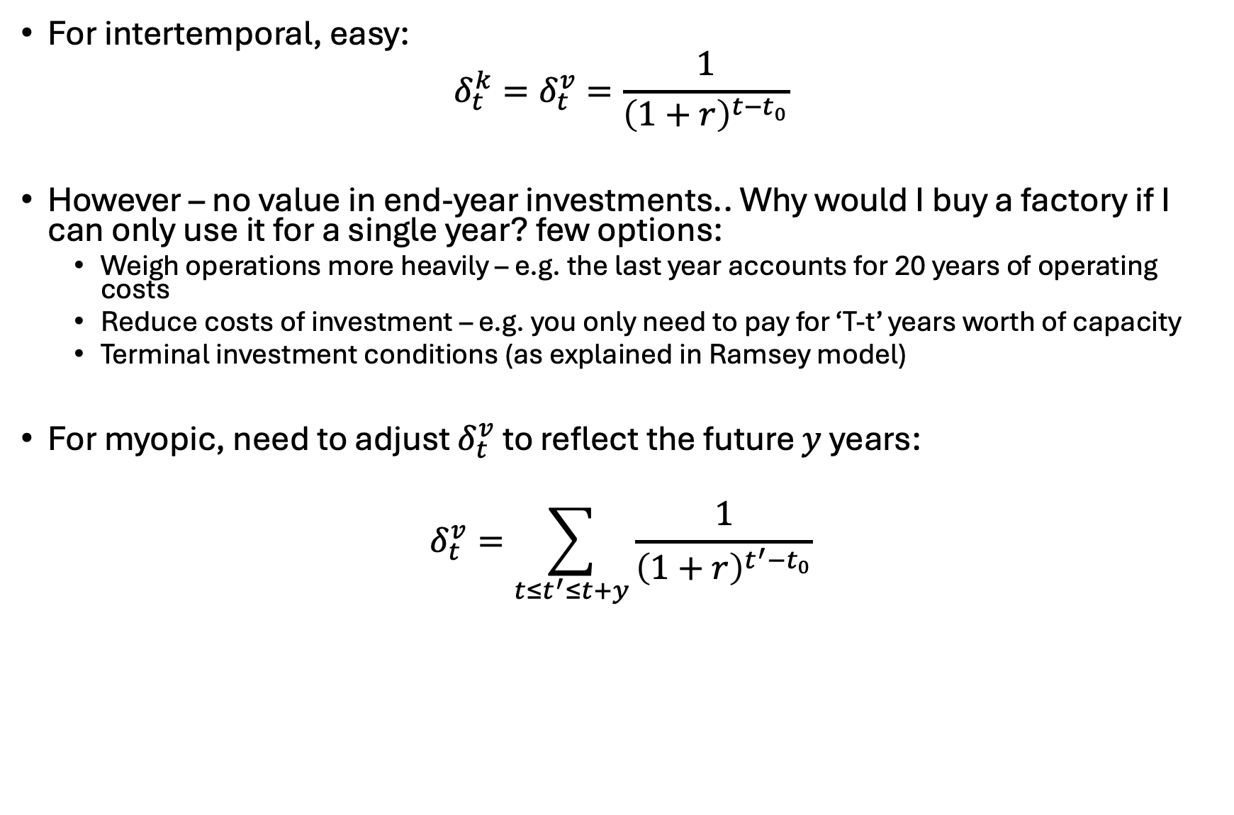

Setting $δ_{t}^{k}$ and $δ_{t}^{v}$
For intertemporal, easy:
$$δ_{t}^{k}=δ_{t}^{v}=\frac{1}{{\left(1+r\right)}^{t−t_{0}}}$$
However – no value in end-year investments.. Why would I buy a factory if I can only use it for a single year? few options:
Weigh operations more heavily – e.g. the last year accounts for 20 years of operating costs
Reduce costs of investment – e.g. you only need to pay for ‘T-t’ years worth of capacity
Terminal investment conditions (as explained in Ramsey model)
For myopic, need to adjust $δ_{t}^{v}$ to reflect the future $y$ years:
$$δ_{t}^{v}=\sum_{t≤t^{′}≤t+y}{\frac{1}{{\left(1+r\right)}^{t^{′}−t_{0}}}}$$

Slide 25
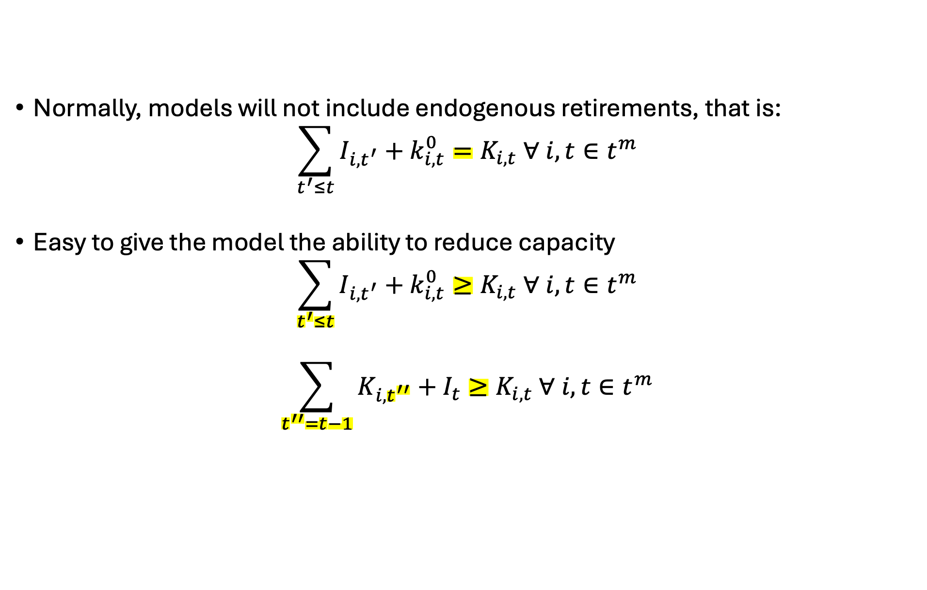
Ramblings on endogenous retirements
Normally, models will not include endogenous retirements, that is:
$$\sum_{t^{′}≤t}{I_{i,t^{′}}}+k_{i,t}^{0}=K_{i,t} ∀ i,t∈t^{m}$$
Easy to give the model the ability to reduce capacity
$$\sum_{t^{′}≤t}{I_{i,t^{′}}}+k_{i,t}^{0}≥K_{i,t} ∀ i,t∈t^{m}$$
$$\sum_{t^{′′}=t−1}{K_{i,t^{′′}}}+I_{t}≥K_{i,t} ∀ i,t∈t^{m}$$
Contemporaneous
Investment!

Slide 26
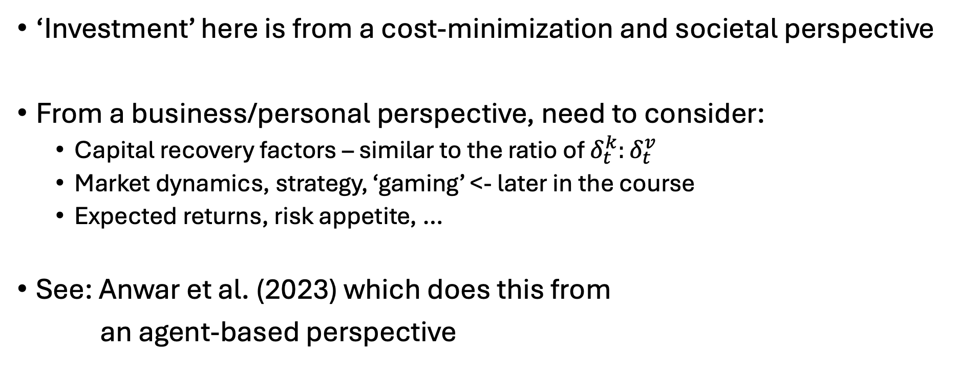
Ramblings on investment
‘Investment’ here is from a cost-minimization and societal perspective
From a business/personal perspective, need to consider:
Capital recovery factors – similar to the ratio of $δ_{t}^{k}:δ_{t}^{v}$
Market dynamics, strategy, ‘gaming’ <- later in the course
Expected returns, risk appetite, …
See: Anwar et al. (2023) which does this from
an agent-based perspective

Slide 27
Agenda - NLPs
Reviewing NLPs
Review of why we need NLPs
Multiple variables
Non-monotonic relationships (economies of scale)
Examples:
Calibrated market models of social surplus maximization
Utility maximization of multiple goods
Ramsey model

Slide 28
Market models
Going to ramble on my experiences here…
University of Maine – first real research project
Oak Ridge National Laboratory
Rare earth market model
FINITO – fossil fuel supply curves
All of these used calibrated functions from market data

Slide 29
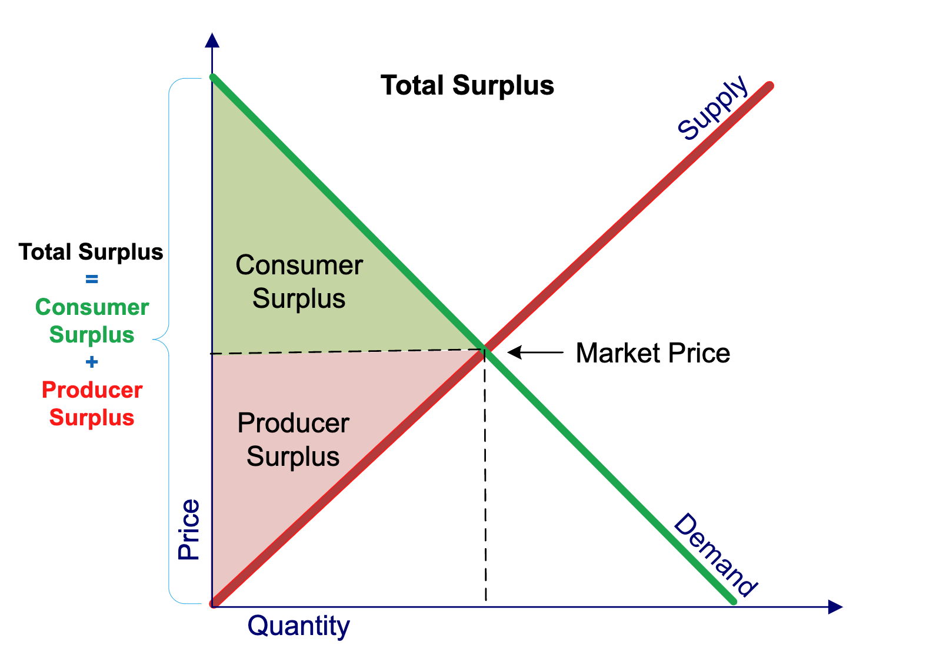
Partial equilibrium - social surplus maximization

Slide 30


Market models
Let’s set up a simple supply/demand model:
$$Q_{d}=Q_{s}$$
$$Q_{d}=a−bP$$
$$Q_{s}=c+dP$$

Slide 31


Market models
Let’s set up a simple supply/demand model:
$$Q_{d}=Q_{s}$$
$$Q_{d}=a−bP$$
$$Q_{s}=c+dP$$

Slide 32
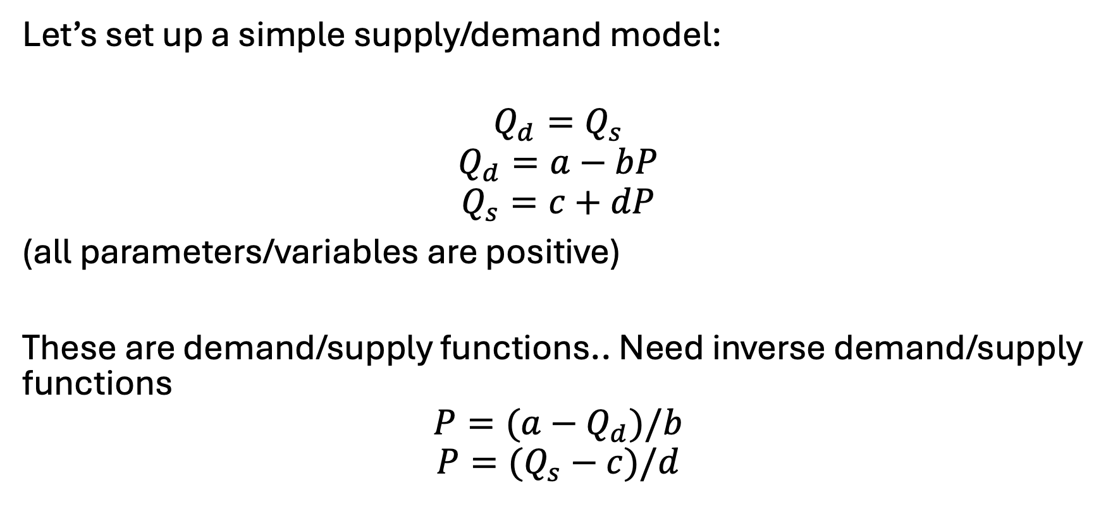
Calibrated market models
Let’s set up a simple supply/demand model:
$$Q_{d}=Q_{s}$$
$$Q_{d}=a−bP$$
$$Q_{s}=c+dP$$
(all parameters/variables are positive)
These are demand/supply functions.. Need inverse demand/supply functions
$$P=(a−Q_{d})/b$$
$$P=(Q_{s}−c)/d$$

Slide 33


Calibrated market models
$$Q_{d}=Q_{s}$$
$$Q_{d}=a−bP$$
$$Q_{s}=c+dP$$
$$P=(a−Q_{d})/b$$
$$P=(Q_{s}−c)/d$$
Let’s label…
$$a^{′}=\frac{a}{b}, b^{′}=\left(\frac{1}{b}\right), c^{′}=−\frac{c}{d},d^{′}=\left(\frac{1}{d}\right)$$
Can rewrite as:
$$P=a^{′}−b^{′}Q_{d}$$
$$P=c^{′}+d^{′}Q_{s}$$

Slide 34
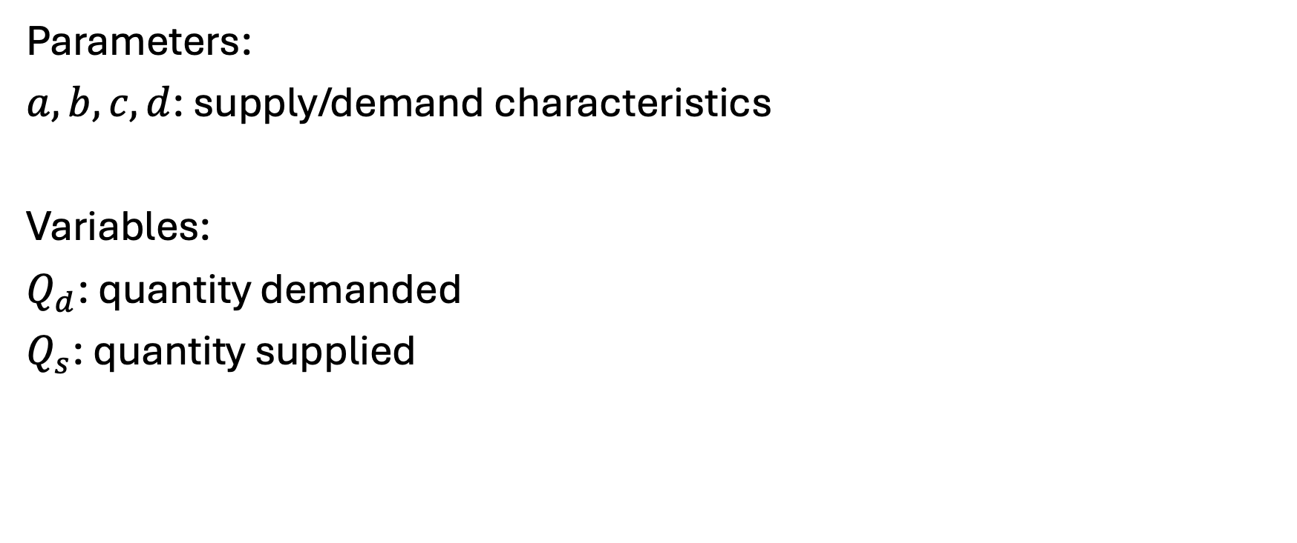
Model – indices (none), parameters, variables
Parameters:
$a,b,c,d$: supply/demand characteristics
Variables:
$Q_{d}$: quantity demanded
$Q_{s}$: quantity supplied

Slide 35
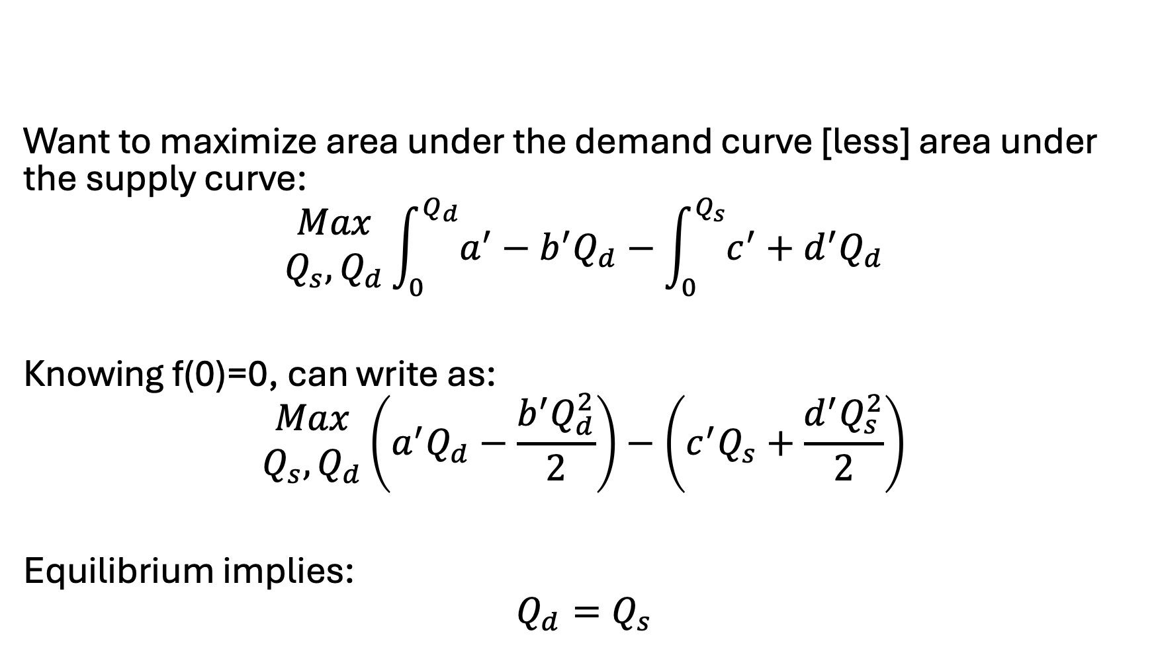
Model – objective function
Want to maximize area under the demand curve [less] area under the supply curve:
$$\begin{matrix}Max \\ Q_{s}, Q_{d}\end{matrix}\int_{0}^{Q_{d}}{a^{′}−b^{′}Q_{d}}−\int_{0}^{Q_{s}}{c^{′}+d^{′}Q_{d}}$$
Knowing f(0)=0, can write as:
$$\begin{matrix}Max \\ Q_{s}, Q_{d}\end{matrix}\left(a^{′}Q_{d}−\frac{b^{′}Q_{d}^{2}}{2}\right)−\left(c^{′}Q_{s}+\frac{d^{′}Q_{s}^{2}}{2}\right)$$
Equilibrium implies:
$$Q_{d}=Q_{s}$$

Slide 36

Let’s put this simple model in GAMS…
Assuming: $\overline{p}=\overline{q}=1$
Assuming: $b=d=0.5$

Slide 37
Why could we linearize demand before?
Biggest takeaway: we only had one variable that was providing value (cost) to in our model
That is, we were only consuming electricity, it was the only thing providing value/benefit to consumption, and it did not compete with other goods
No (easy) way to stay linear if two variables are interacting and providing value or cost to the model, examples:
Pizza and beer
Capital and labor
Shifting of demand across time
When there are tradeoffs or benefits to the interaction of different variables in the model, cannot stay linear

Slide 38
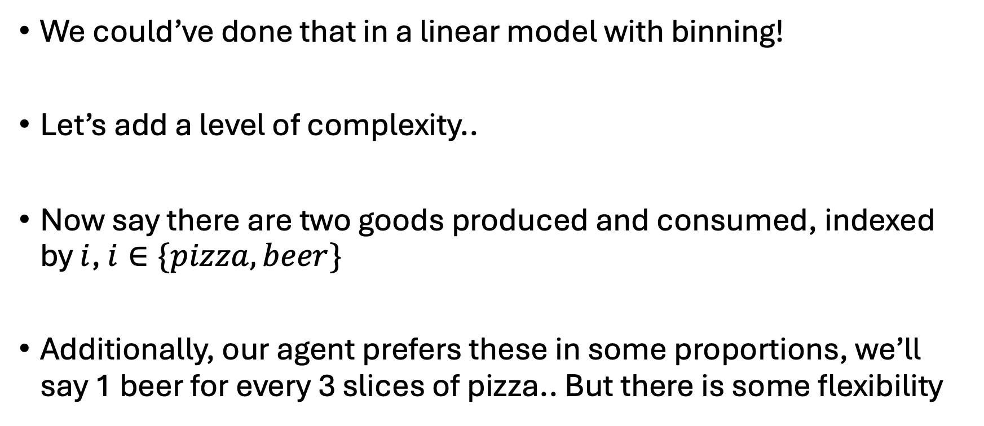
Easy enough… let’s expand
We could’ve done that in a linear model with binning!
Let’s add a level of complexity..
Now say there are two goods produced and consumed, indexed by $i$, $i∈\{pizza, beer\}$
Additionally, our agent prefers these in some proportions, we’ll say 1 beer for every 3 slices of pizza.. But there is some flexibility

Slide 39
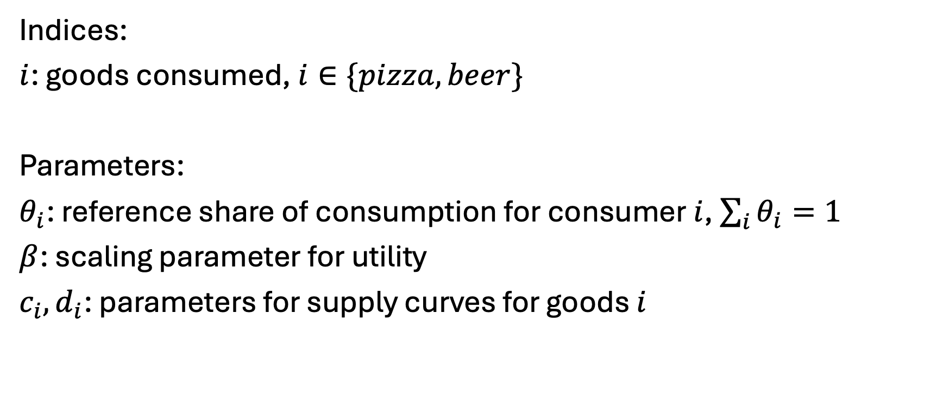
New model…
Indices:
$i$: goods consumed, $i∈\{pizza, beer\}$
Parameters:
$θ_{i}$: reference share of consumption for consumer $i$, $\sum_{i}{θ_{i}=1}$
$β$: scaling parameter for utility
$c_{i},d_{i}$: parameters for supply curves for goods $i$

Slide 40
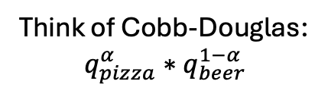
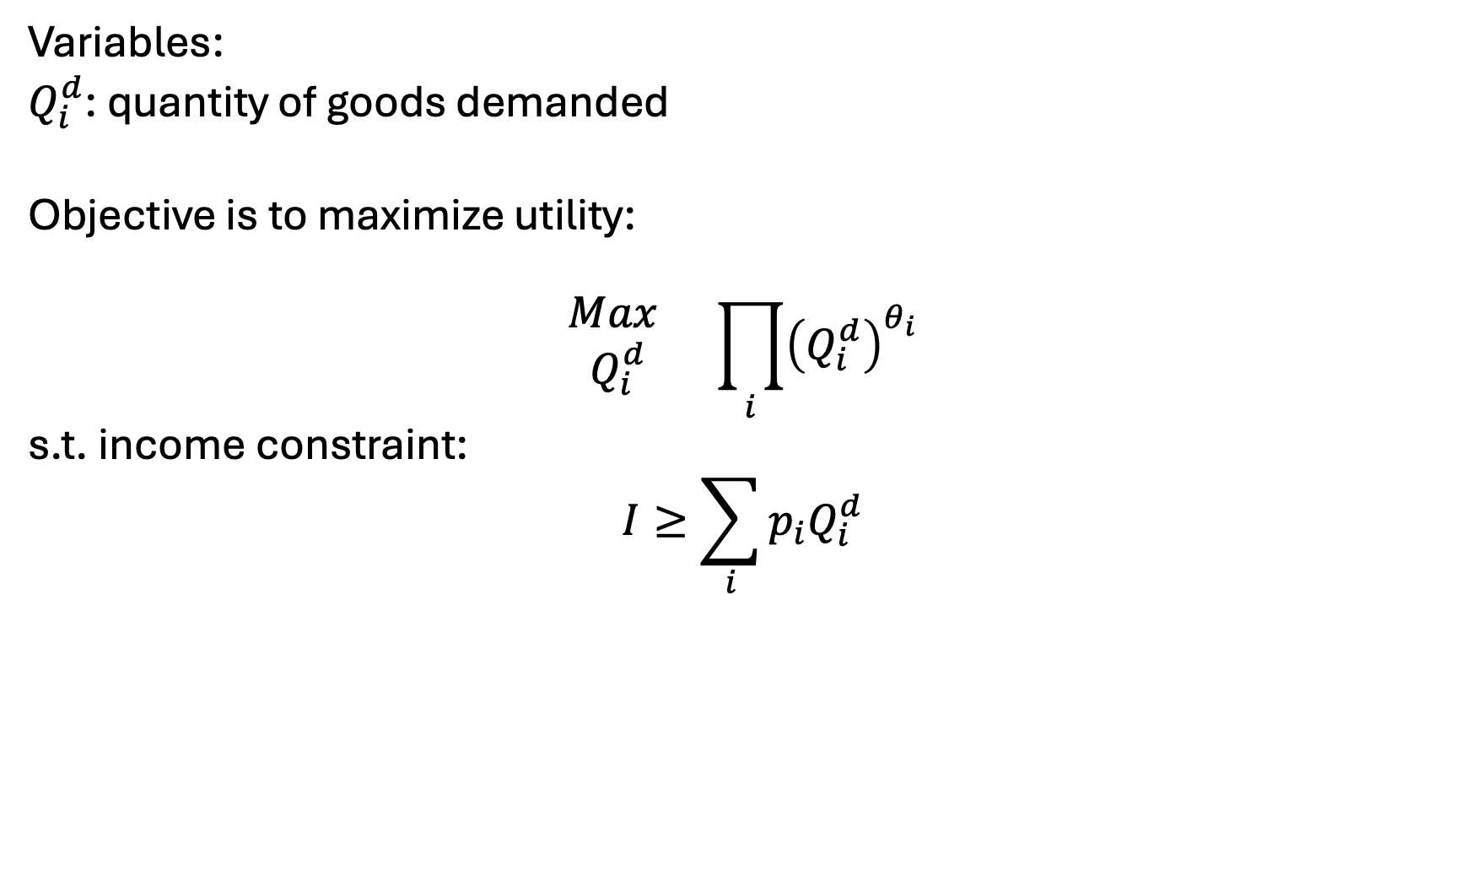
New model: Simple version
Variables:
$Q_{i}^{d}$: quantity of goods demanded
Objective is to maximize utility:
$$\begin{matrix}Max \\ Q_{i}^{d}\end{matrix} \prod_{i}{{\left(Q_{i}^{d}\right)}^{θ_{i}}}$$
s.t. income constraint:
$$I≥\sum_{i}{p_{i}Q_{i}^{d}}$$
Think of Cobb-Douglas:
$$q_{pizza}^{α}∗q_{beer}^{1−α}$$
Can add simple taxes/subsidies

Slide 41
Simple counterfactuals
What if Woody’s raises it’s pizza price by 10%?
What if our agent makes 50% more money?

Slide 42
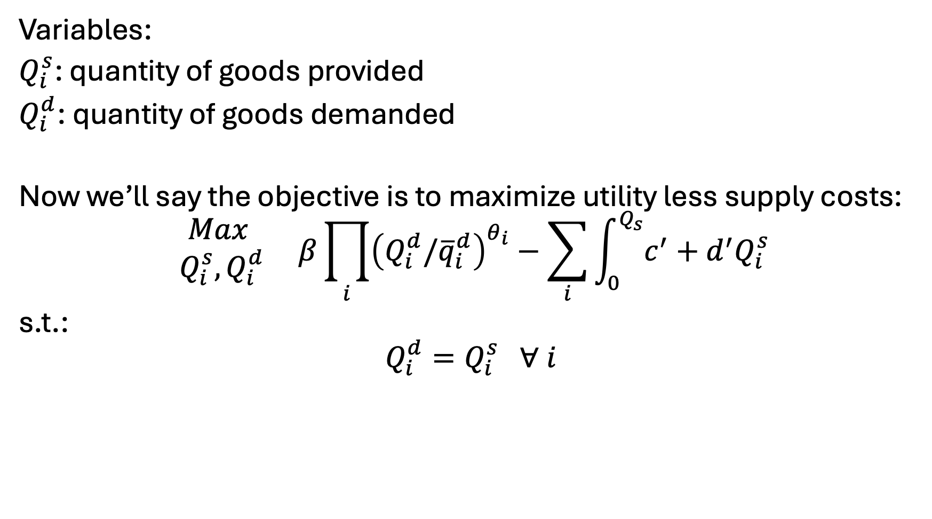
New model: Variables, Objective, Constraints
Variables:
$Q_{i}^{s}$: quantity of goods provided
$Q_{i}^{d}$: quantity of goods demanded
Now we’ll say the objective is to maximize utility less supply costs:
$$\begin{matrix}Max \\ Q_{i}^{s},Q_{i}^{d}\end{matrix} β\prod_{i}{{\left(Q_{i}^{d}/{\overline{q}}_{i}^{d}\right)}^{θ_{i}}}−\sum_{i}{\int_{0}^{Q_{s}}{c^{′}+d^{′}Q_{i}^{s}}}$$
s.t.:
$$Q_{i}^{d}=Q_{i}^{s} ∀ i$$

Slide 43
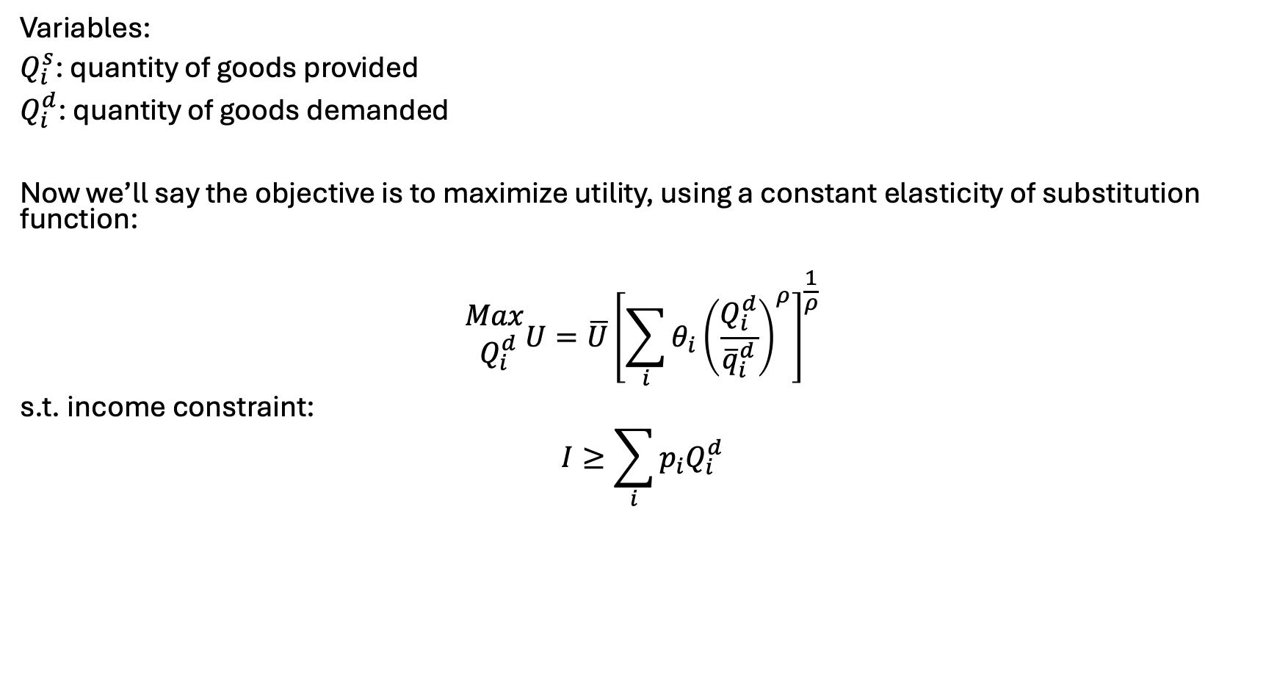
Another functional form.. Calibrated constant elasticity of substitution
Variables:
$Q_{i}^{s}$: quantity of goods provided
$Q_{i}^{d}$: quantity of goods demanded
Now we’ll say the objective is to maximize utility, using a constant elasticity of substitution function:
$$\begin{matrix}Max \\ Q_{i}^{d}\end{matrix}U=\overline{U}{\left[\sum_{i}{θ_{i}{\left(\frac{Q_{i}^{d}}{{\overline{q}}_{i}^{d}}\right)}^{ρ}}\right]}^{\frac{1}{ρ}}$$
s.t. income constraint:
$$I≥\sum_{i}{p_{i}Q_{i}^{d}}$$

Slide 44

Calibration in the alternative setup…
Need to only set $θ_{i}$
Can determine relative weighting such that:
$$θ_{i}=\frac{{\overline{q}}_{i}{\overline{p}}_{i}}{\sum_{i}{{\overline{q}}_{i}{\overline{p}}_{i} }}$$

Slide 45
Let’s do a real-world example..
Comparison of electricity versus petroleum demands in the US light duty transport sector
Not doing supply (yet) – will add on exports etc

Slide 46
Points of these exercises..
You can flexibly represent the consumption and production of goods in simplified setups
Ties it back to all our econ models – utility maximization, profit maximization, …
Presents a strong need for calibration and calibrated functional forms

Slide 47
Choosing parameters and functional forms
Easy to find P/Q pairs, search literature for elasticity values
Examples with TRACT, BioTrans, REE model, FINITO, …
Need for the final/calibrated P to match up to sum of costs
Especially true for supply chain and engineering models
Can solve with inelastic demand to disentangle price
Usually pulling values through a system
Note – we still do not have explicit and simultaneous price/quantity control
For econ proofs/theories – you will need to spend time justifying assumptions implied in form choice
E.g. homogeneity, homotheticity, substitutability, …
https://windc.wisc.edu/downloads/summercourse_2021/thursday/ces.pdf
https://www2.econ.iastate.edu/classes/econ501/Hallam/documents/FunctionalForms.pdf

Slide 48

Ramsey model – main points
(simple) economic growth model based on labor growth, capital accumulation, investment
Target of optimization is intertemporal utility
Two variables define output: capital and labor
Concept of the steady state
Barr-Manne terminal investment condition

Slide 49
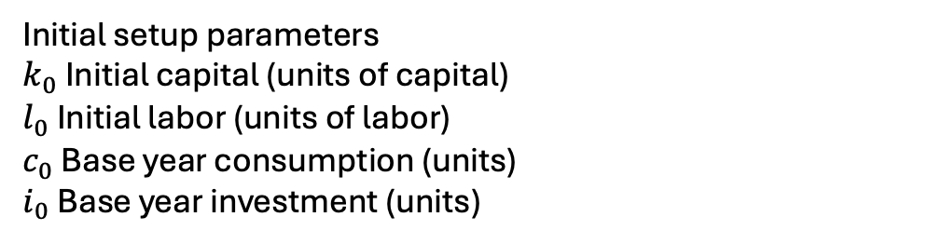

The Ramsey model – indices, parameters
Indices
$t$: time
$t_{0}$: initial period
$t_{T}$: final period
Parameters:
$β_{t}$: utility discount parameter
$g$ Labor growth rate in efficiency units (% / yr)
$δ$ Capital depreciation rate (% / yr)
$α$ Capital value share
$η$ Inverse intertemporal elasticity
$ρ$ Calibrated marginal product of capital
$a$ Cobb Douglas scale parameter;
Initial setup parameters
$k_{0}$ Initial capital (units of capital)
$l_{0}$ Initial labor (units of labor)
$c_{0}$ Base year consumption (units)
$i_{0}$ Base year investment (units)

Slide 50
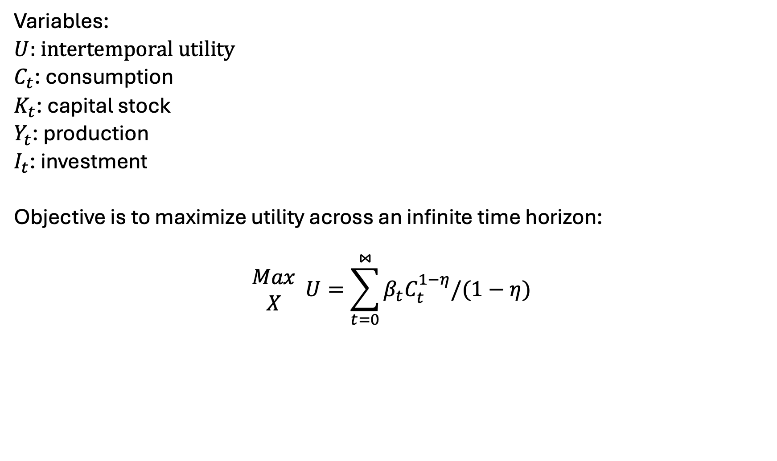
The Ramsey Model – Variables, Objective function
Variables:
$U$: intertemporal utility
$C_{t}$: consumption
$K_{t}$: capital stock
$Y_{t}$: production
$I_{t}$: investment
Objective is to maximize utility across an infinite time horizon:
$$\begin{matrix}Max \\ X\end{matrix} U=\sum_{t=0}^{⋈}{β_{t}C_{t}^{1−η}/(1−η)}$$

Slide 51
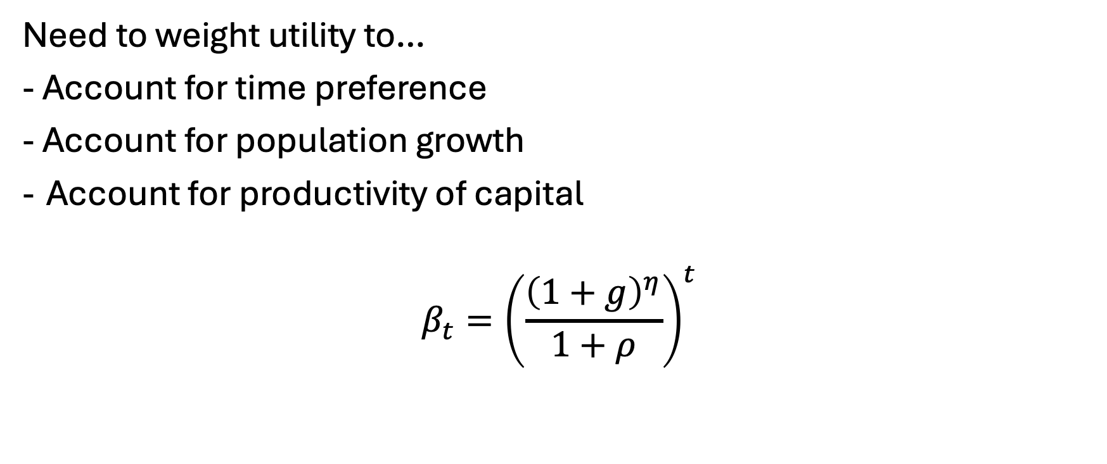
Setting the utility discount factor…
Need to weight utility to…
- Account for time preference
- Account for population growth
Account for productivity of capital
$$β_{t}={\left(\frac{{\left(1+g\right)}^{η}}{1+ρ}\right)}^{t}$$

Slide 52
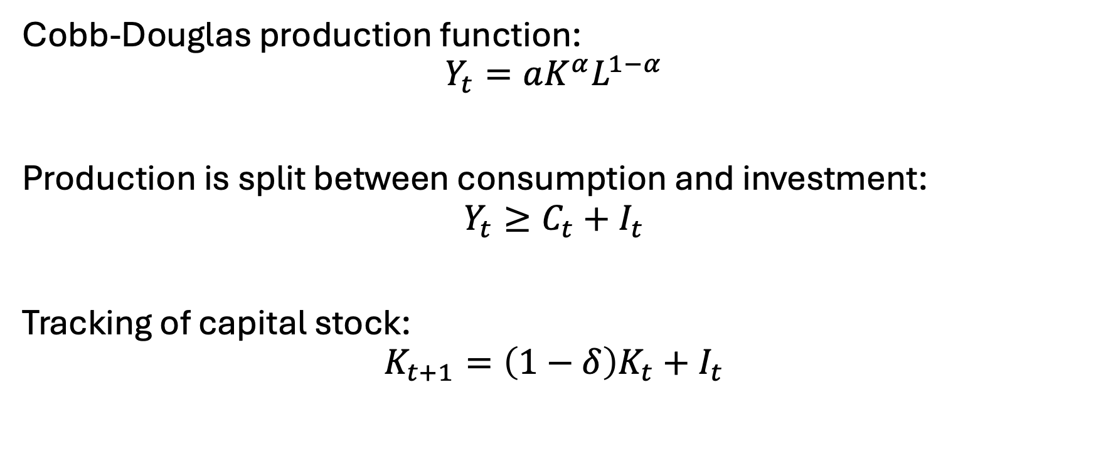
Constraints
Cobb-Douglas production function:
$$Y_{t}=aK^{α}L^{1−α}$$
Production is split between consumption and investment:
$$Y_{t}≥C_{t}+I_{t}$$
Tracking of capital stock:
$$K_{t+1}=\left(1−δ\right)K_{t}+I_{t}$$

Slide 53
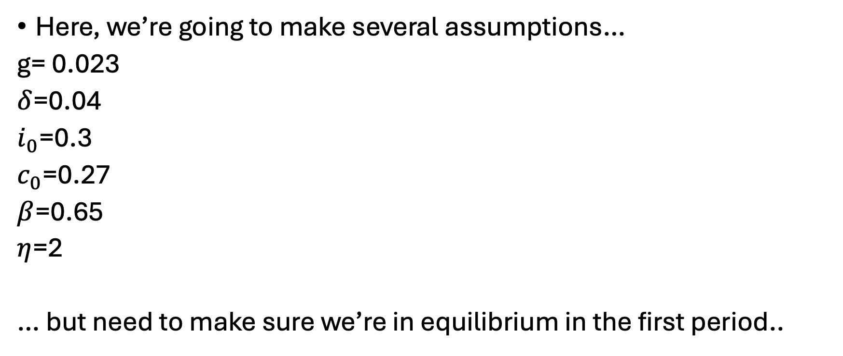
Calibration
Here, we’re going to make several assumptions…
g= 0.023
$δ$=0.04
$i_{0}$=0.3
$c_{0}$=0.27
$β$=0.65
$η$=2
… but need to make sure we’re in equilibrium in the first period..

Slide 54

Initial capital/labor calibration
Investment must cover depreciation plus population growth. Given the investment rate, we can back out the initial capital stock level. Knowing investment must cover initial capital stock’s expected growth rate and depreciation in the first period:
$$k_{0}\left(g+δ\right)=i_{0}$$
Can thus back out calibrated initial capital level:
$$k_{0}=\frac{i_{0}}{g+δ}$$
Labor supply is it’s share in production [times] initial production:
$$l_{0}=\left(1−α\right)∗(c_{0}+i_{0})$$
(exogenously-defined) labor grows at the labor growth rate:
$$l_{t}=l_{0}∗{\left(1+g\right)}^{t}$$

Slide 55
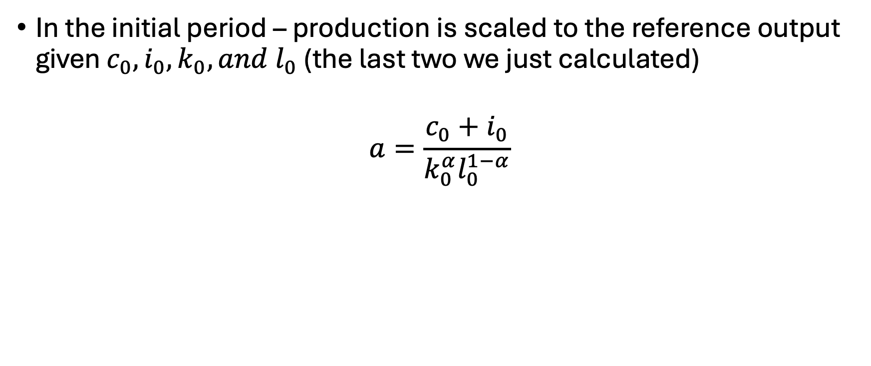
Calibrating the production scale parameter
In the initial period – production is scaled to the reference output given $c_{0}, i_{0},k_{0}, and l_{0}$ (the last two we just calculated)
$$a=\frac{c_{0}+i_{0}}{k_{0}^{α}l_{0}^{1−α}}$$

Slide 56
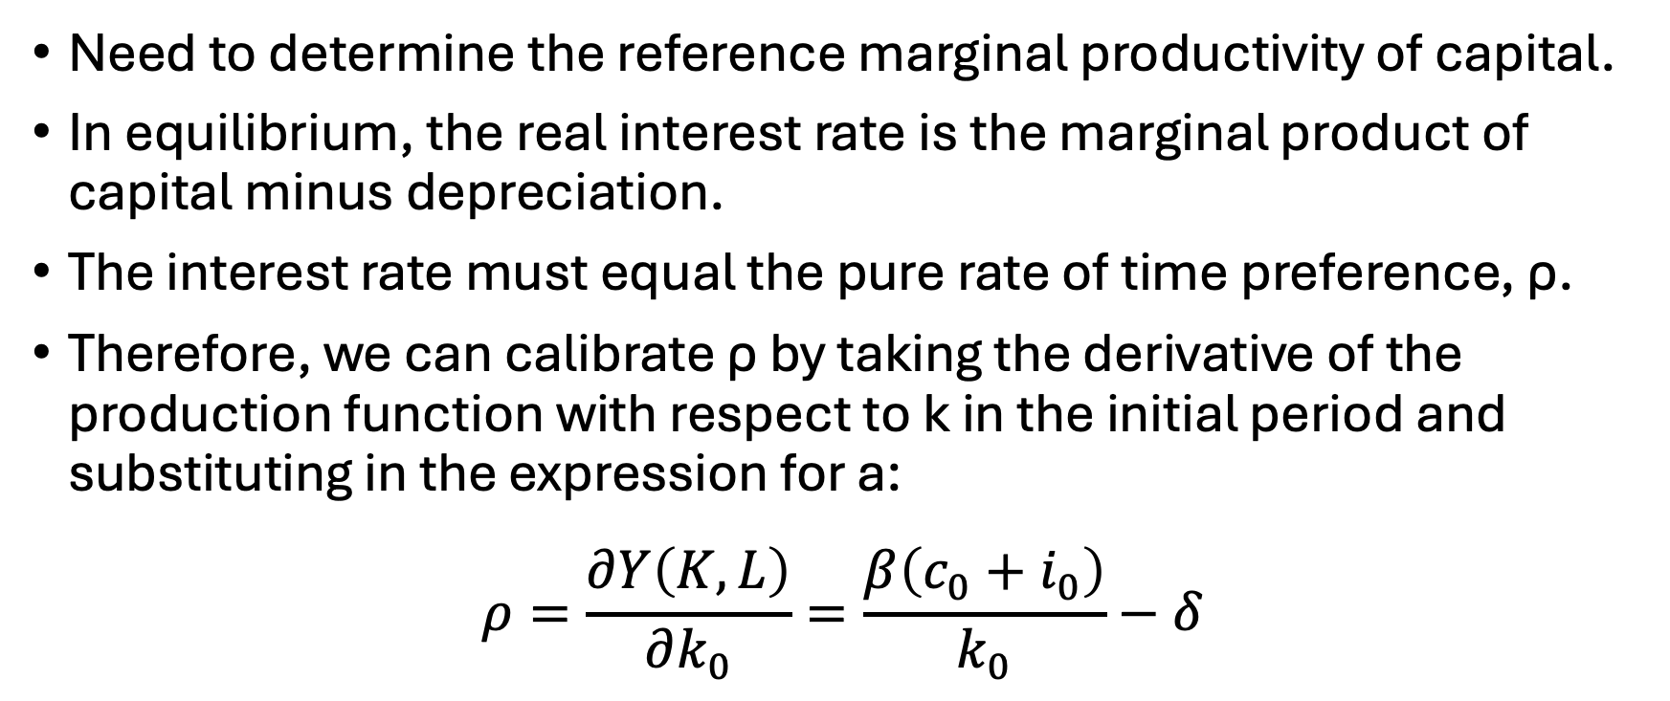
Calibrating the capital productivity
Need to determine the reference marginal productivity of capital.
In equilibrium, the real interest rate is the marginal product of capital minus depreciation.
The interest rate must equal the pure rate of time preference, ρ.
Therefore, we can calibrate ρ by taking the derivative of the production function with respect to k in the initial period and substituting in the expression for a:
$$ρ=\frac{∂Y\left(K,L\right)}{∂k_{0}}=\frac{β\left(c_{0}+i_{0}\right)}{k_{0}}−δ$$

Slide 57
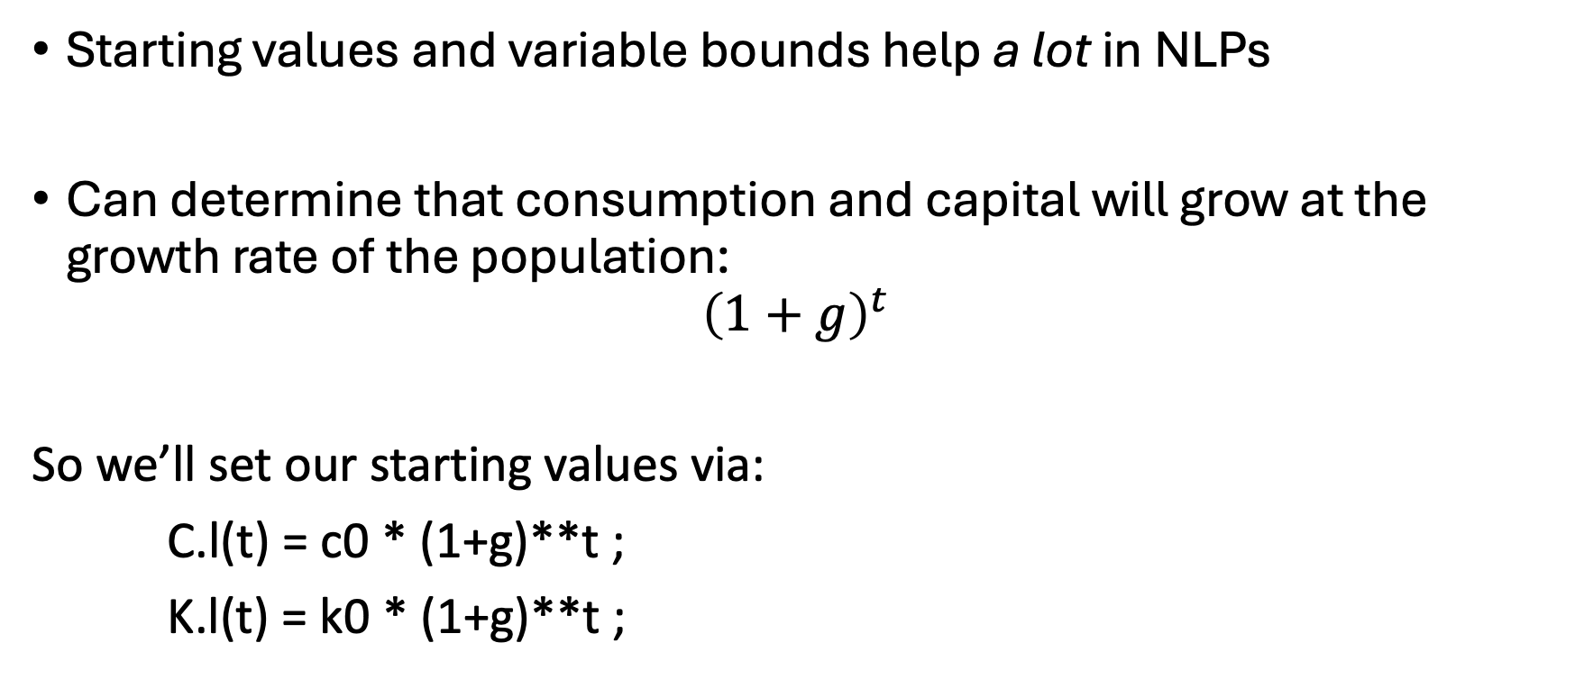
Some more notes…
Starting values and variable bounds help a lot in NLPs
Can determine that consumption and capital will grow at the growth rate of the population:
$${\left(1+g\right)}^{t}$$
So we’ll set our starting values via:
C.l(t) = c0 * (1+g)**t ;
K.l(t) = k0 * (1+g)**t ;

Slide 58
Some more notes..
Bounds on variables are needed to avoid mathematical problems
e.g. We don’t want consumption to be zero
C.lo(t) = 0.01 * C.l(t) ;
K.lo(t) = 0.01 * K.l(t) ;
Fix first period capital
K.fx(t)$tfirst(t) = k0 ;

Slide 59
Let’s build the base model…

Slide 60
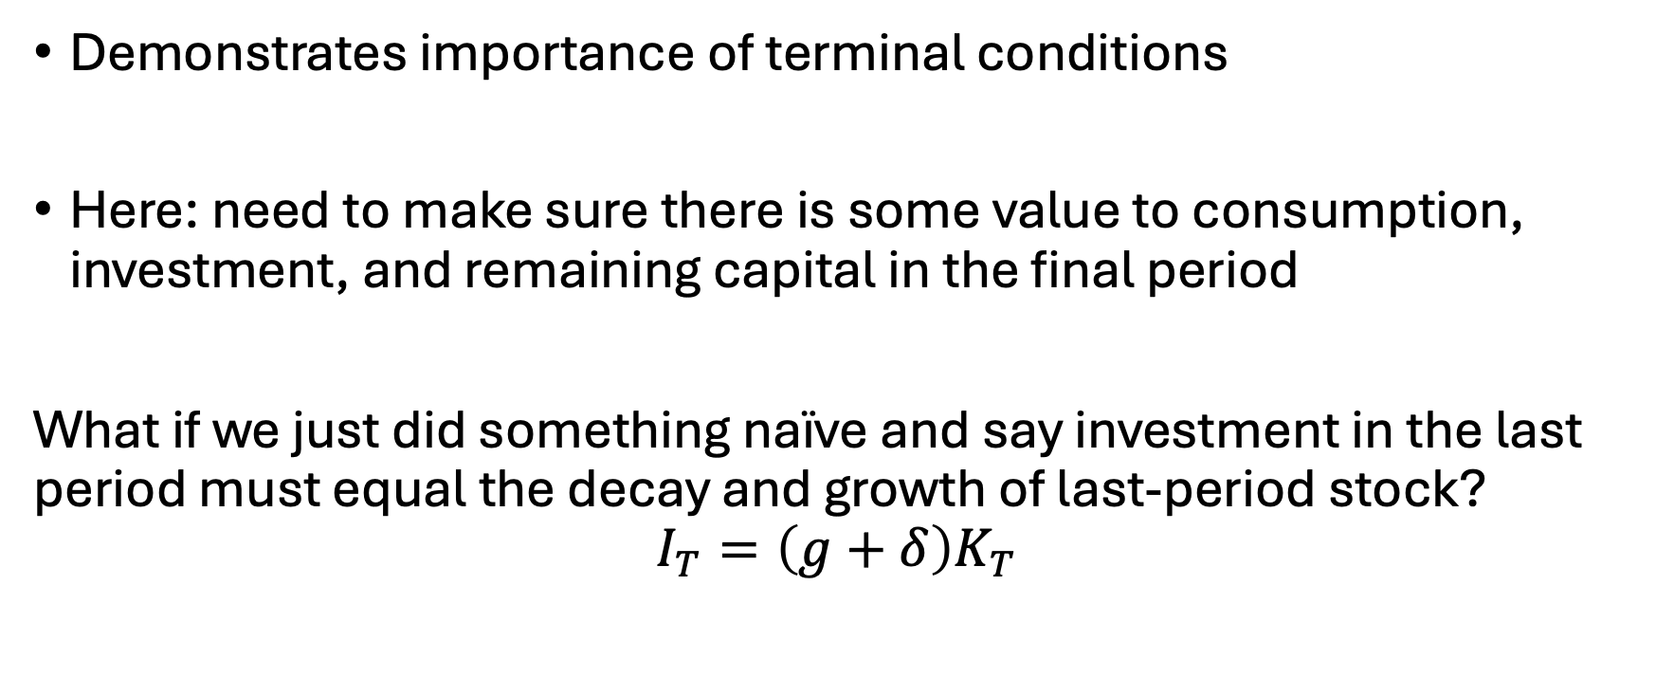
That’s weird…
Demonstrates importance of terminal conditions
Here: need to make sure there is some value to consumption, investment, and remaining capital in the final period
What if we just did something naïve and say investment in the last period must equal the decay and growth of last-period stock?
$$I_{T}=\left(g+δ\right)K_{T}$$

Slide 61
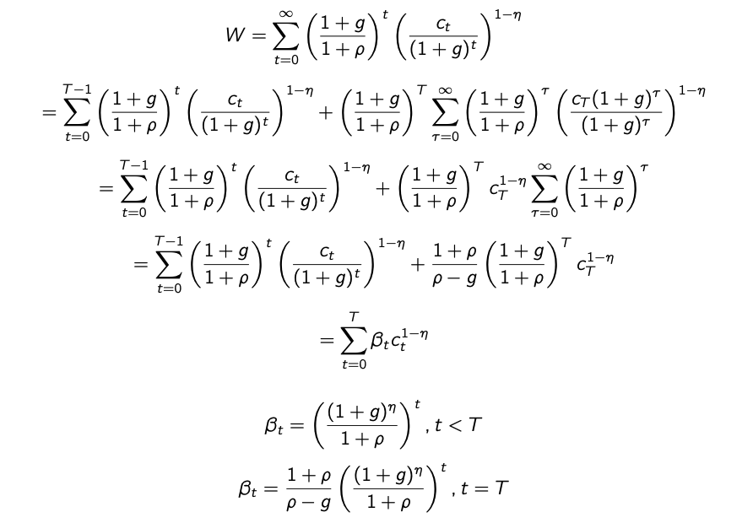
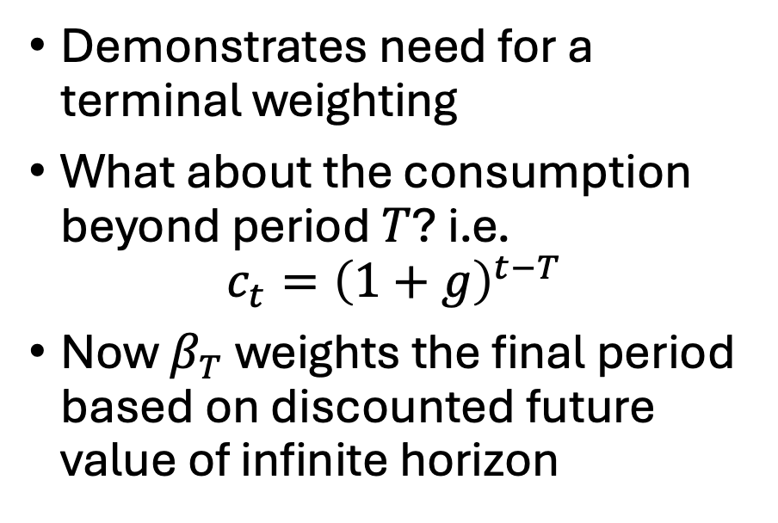
Plotting investment over time…
Demonstrates need for a terminal weighting
What about the consumption beyond period $T$? i.e.
$$c_{t}={\left(1+g\right)}^{t−T}$$
Now $β_{T}$ weights the final period based on discounted future value of infinite horizon

