Slide 1
EBGN645 Electricity wrap up, Utility and market models (now with bespoke memes)

Slide 2

Another discussion
Anything I can do better?
What would be most helpful moving forward?
More homework?
Guided help?

Slide 3

The question nobody asked…
What watch are you wearing today?
Answer: Mr. Jones Watches - Sun and Moon Miyamoto

Slide 4
Notes
Classes 11/10 and 11/12
I will email Sunday and Tuesday night
Still: optional -but- watch the recording
Sign-up sheet for presentations:
https://docs.google.com/spreadsheets/d/1eRkK5JlFJ86rkI5_e_Zcm9km8ex4nRKUB69_8BENvr4/edit?usp=sharing
Need to leave at 11:55 today

Slide 5

Student questions
How do I get this dataset into GAMS!?
One example
Also helped several others with errors, issues, design, simple examples, …
Seriously: reach out with project questions.
In-person or via email

Slide 6
Agenda – next few classes (aka this slide deck)
Brief review of electricity dispatch Lagrangian and interpretation
Coding up that model
Plotting results, adding elasticity, comparing
Rambling on investment and terminal conditions
Moving into discussion on NLP market models
Basics
Utility maximization (pizza/beer)
Supply competition (gas/oth)
Ramsey model - tentative
Then: Converting models to MCPs

Slide 7
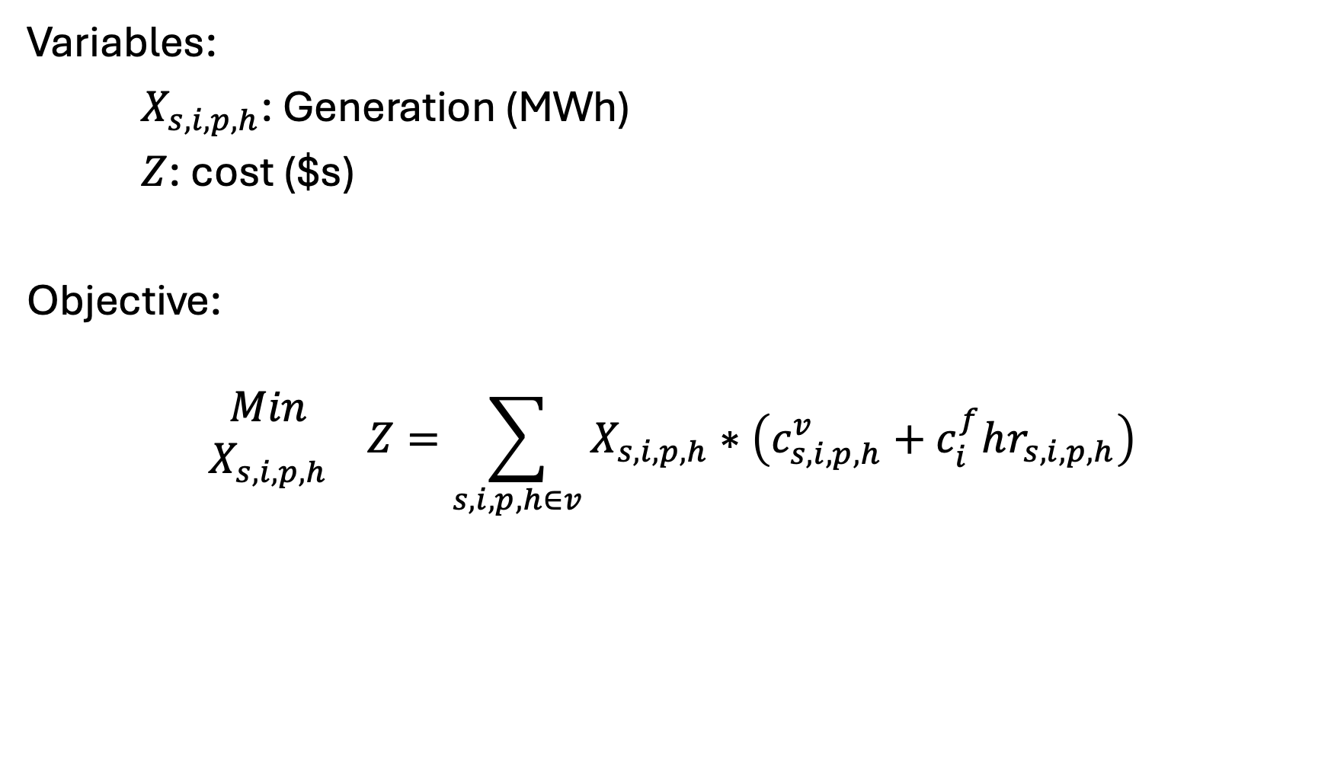
Variables, Objective
Variables:
$X_{s,i,p,h}$: Generation (MWh)
$Z$: cost ($s)
Objective:
$$\begin{matrix}Min \\ X_{s,i,p,h}\end{matrix} Z=\sum_{s,i,p,h∈v}{X_{s,i,p,h}}∗\left(c_{s,i,p,h}^{v}+c_{i}^{f}hr_{s,i,p,h}\right)$$

Slide 8
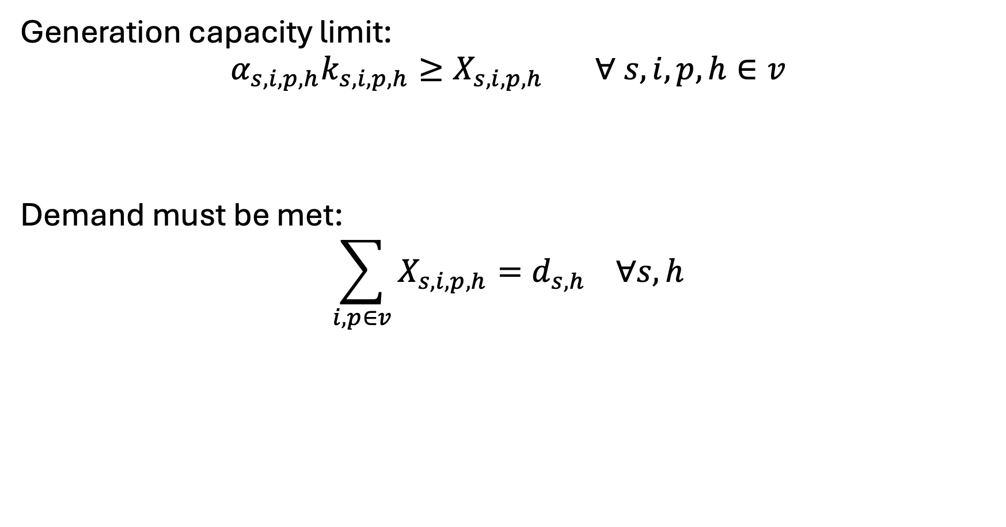
Constraints - basics
Generation capacity limit:
$$α_{s,i,p,h}k_{s,i,p,h}≥X_{s,i,p,h} ∀ s,i,p,h∈v$$
Demand must be met:
$$\sum_{i,p∈v}{X_{s,i,p,h}}=d_{s,h} ∀s,h$$

Slide 9
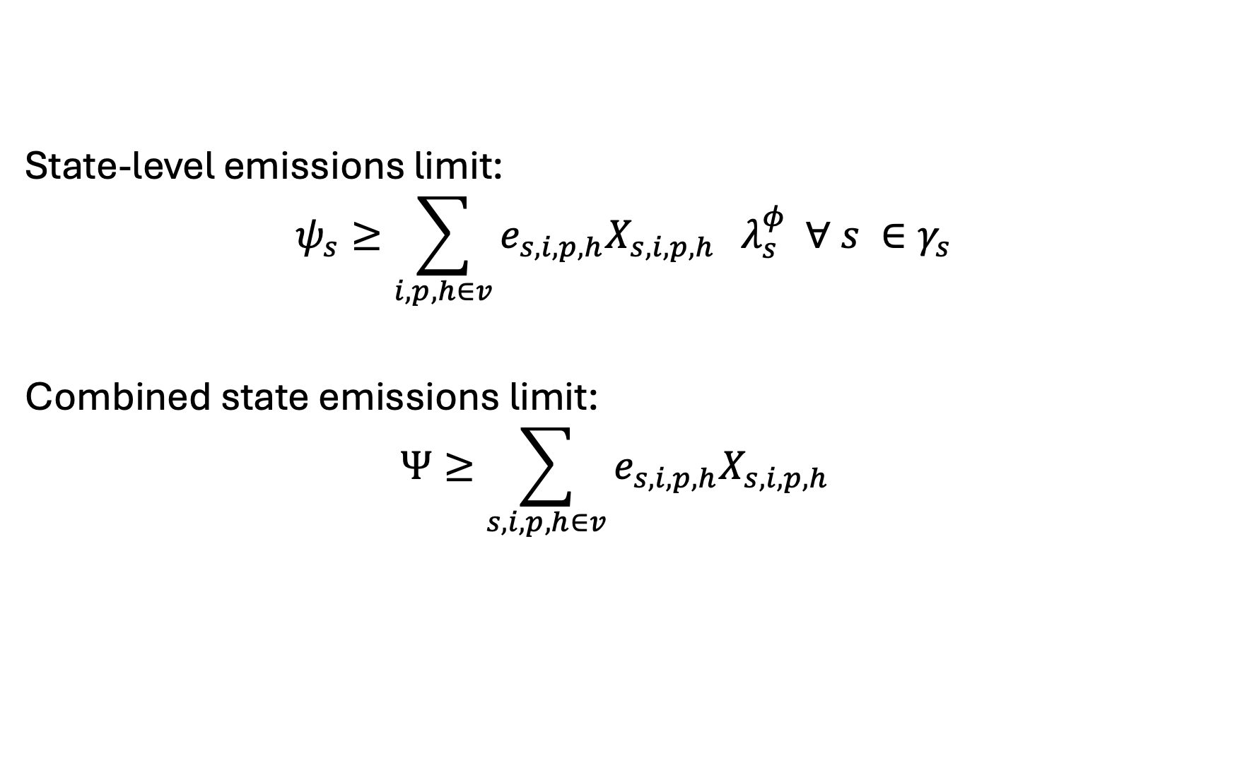
Constraints – Mass-based Policies
State-level emissions limit:
$$ψ_{s}≥\sum_{i,p,h∈v}{e_{s,i,p,h}X_{s,i,p,h}} λ_{s}^{φ} ∀ s ∈γ_{s}$$
Combined state emissions limit:
$$Ψ≥\sum_{s,i,p,h∈v}{e_{s,i,p,h}X_{s,i,p,h}}$$

Slide 10
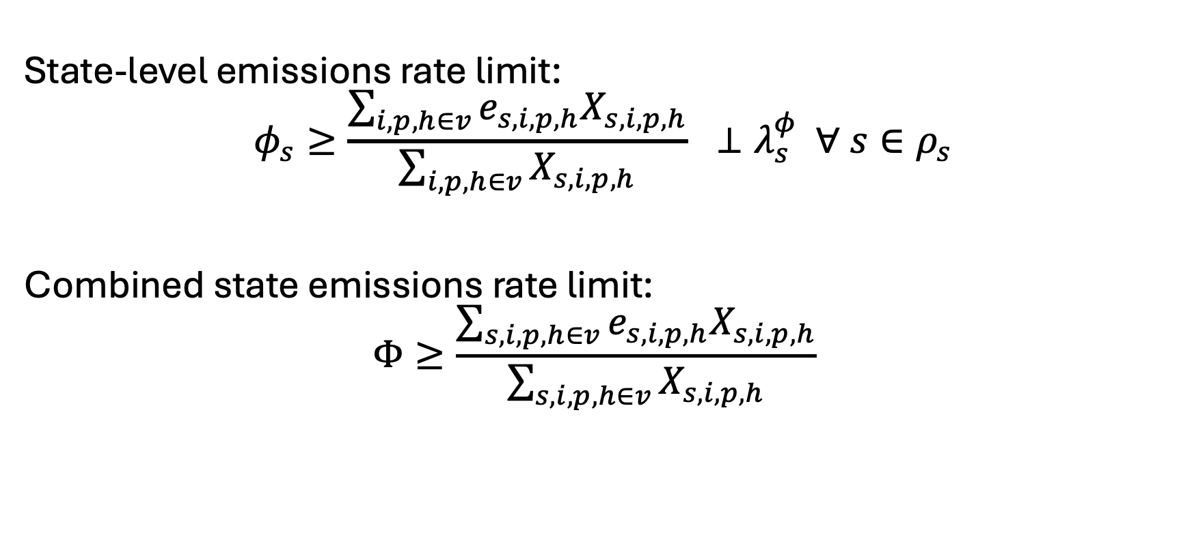
Constraints – Rate-based Policies
State-level emissions rate limit:
$$φ_{s}≥\frac{\sum_{i,p,h∈v}{e_{s,i,p,h}X_{s,i,p,h}}}{\sum_{i,p,h∈v}{X_{s,i,p,h}}} ⊥λ_{s}^{φ} ∀ s∈ρ_{s}$$
Combined state emissions rate limit:
$$Φ≥\frac{\sum_{s,i,p,h∈v}{e_{s,i,p,h}X_{s,i,p,h}}}{\sum_{s,i,p,h∈v}{X_{s,i,p,h}}}$$

Slide 11
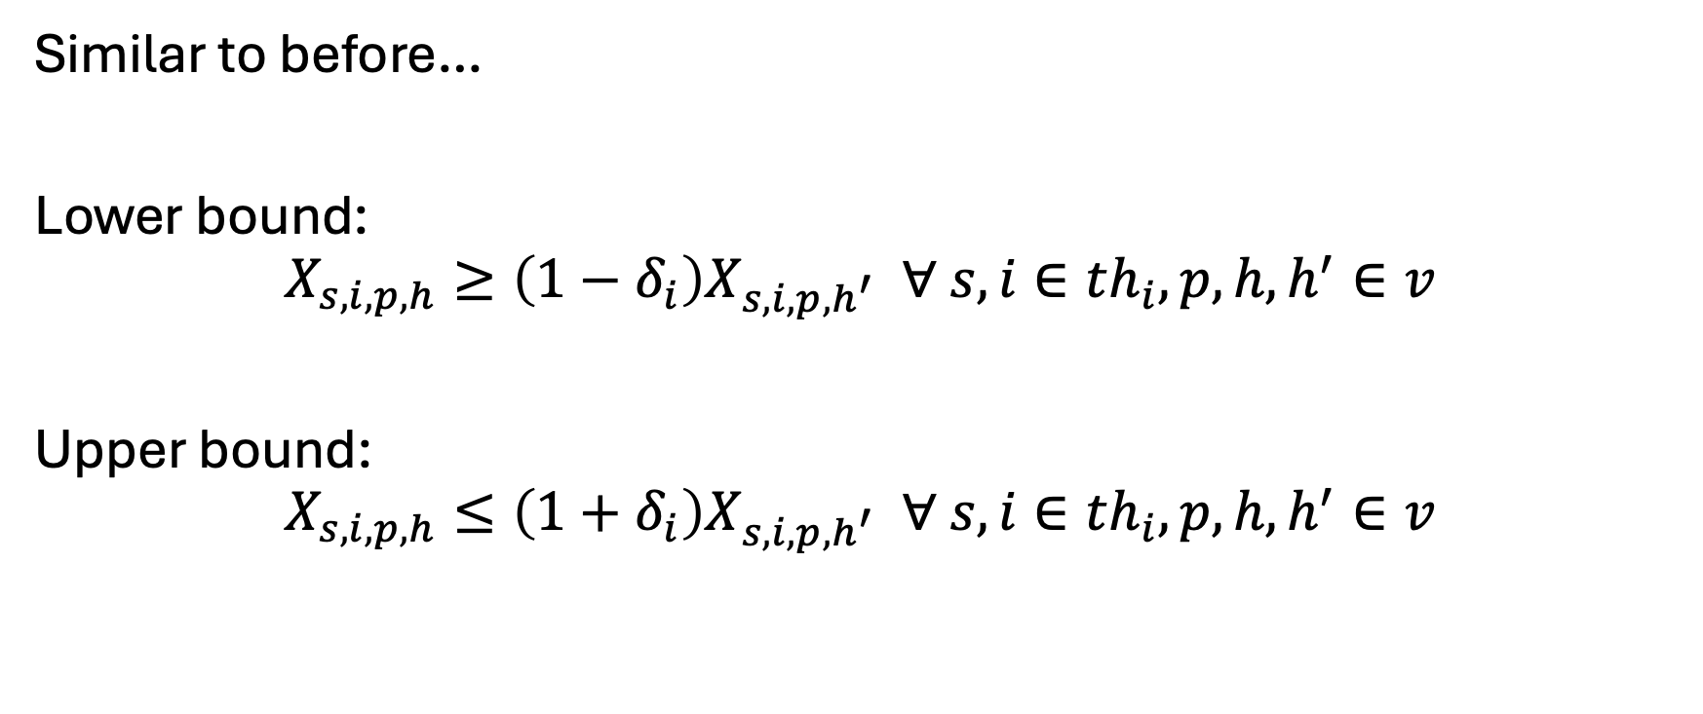
Constraints – “unit commitment”
Similar to before…
Lower bound:
$$X_{s,i,p,h}≥\left(1−δ_{i}\right)X_{s,i,p,h^{′}} ∀ s,i∈th_{i},p,h,h^{′}∈v$$
Upper bound:
$$X_{s,i,p,h}≤\left(1+δ_{i}\right)X_{s,i,p,h^{′}} ∀ s,i∈th_{i},p,h,h^{′}∈v$$

Slide 12
Let’s code this up in GAMS…
Notes to self…
Add on linear demand based on reference/endogenous price
Sparse matrix construction:
Intentionally miss a conditional
Running policies for:
Mass-based limit
Rate-based limit
Traded mass-based limit
Traded rate-based limit
… with and w/o endogenous demand

Slide 13

Meme break

Slide 14
Investment – overview/ramblings
Big decision: myopic vs intertemporal
Myopic: no foresight
‘Window’ : limited foresight
Intertemporal: full foresight
Can write as a general setup that allows for all three
Choice will determine how you calculate the discount/present value factor (PVF) and distinguishing between capital (k) and operations (v)
Alternatively, can represent as annualized cash flow/balance

Slide 15
Investment – terminal conditions
Terminal conditions: what happens when time ends
For myopic, need to weight by a certain number of years. For example, I’m choosing investment now and looking for a payback in the next X years
For intertemporal/window, four options:
Do nothing – a lot of models do this (but it is wrong)
Weight the last year(s) similar to a myopic solve - easy
Solve to T+X years, cut solution to T – also wrong, but convenient
Salvage value of investment – complicated (sometimes)
Barr-Manne terminal investment condition..
Basically: make enough investment in the terminal period to sustain the near future
Difficult when you have many technologies
Covered more in the Ramsey model

Slide 16
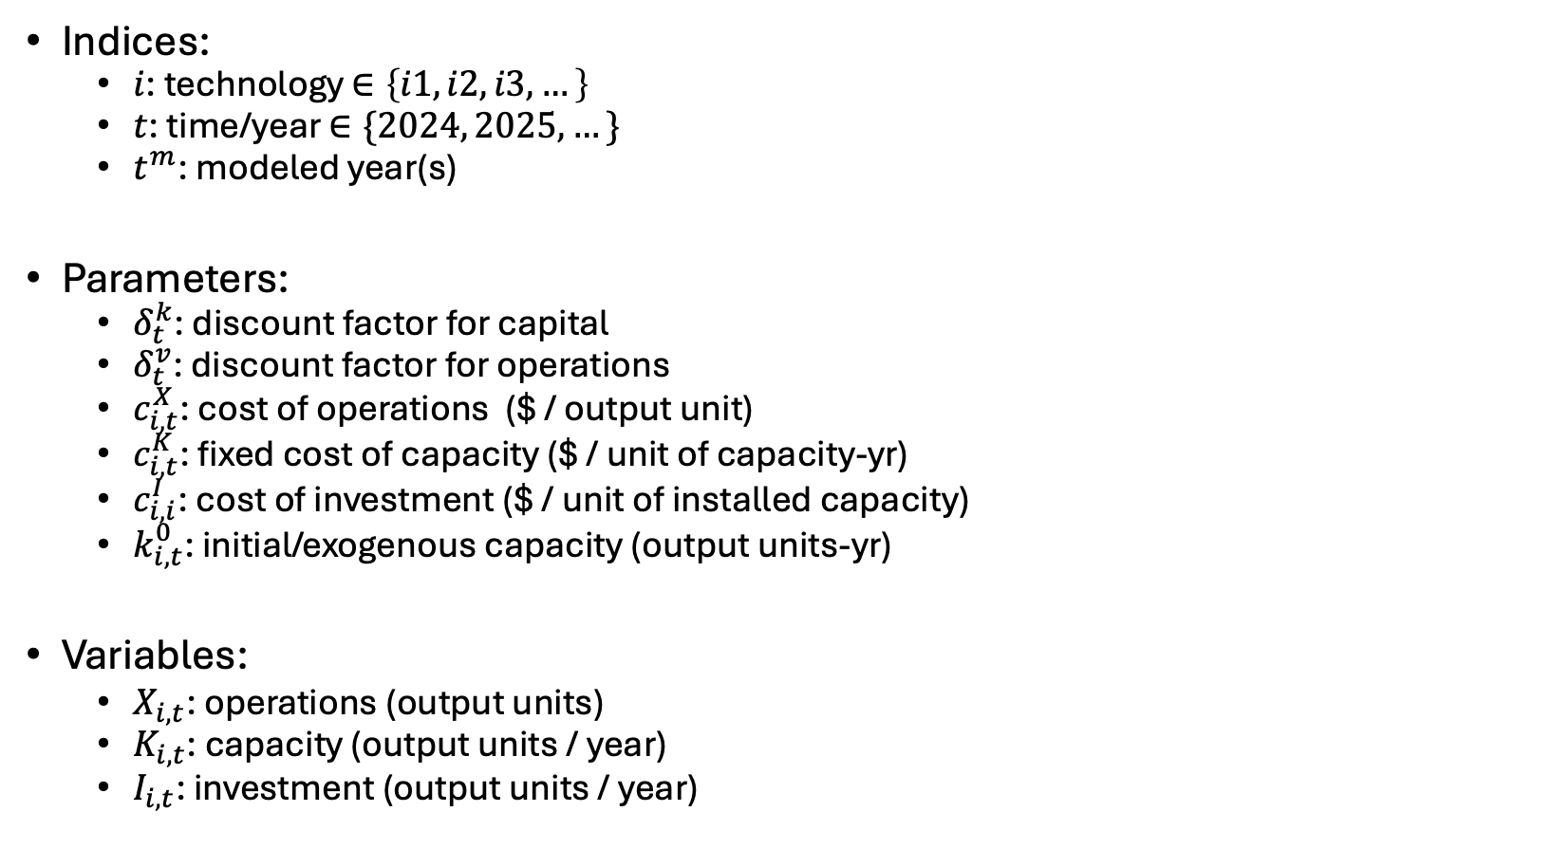
General investment model
Indices:
$i$: technology $∈\left\{i1,i2,i3,…\right\}$
$t$: time/year $∈\{2024, 2025, …\}$
$t^{m}$: modeled year(s)
Parameters:
$δ_{t}^{k}$: discount factor for capital
$δ_{t}^{v}$: discount factor for operations
$c_{i,t}^{X}$: cost of operations ($ / output unit)
$c_{i,t}^{K}$: fixed cost of capacity ($ / unit of capacity-yr)
$c_{i,i}^{I}$: cost of investment ($ / unit of installed capacity)
$k_{i,t}^{0}$: initial/exogenous capacity (output units-yr)
Variables:
$X_{i,t}$: operations (output units)
$K_{i,t}$: capacity (output units / year)
$I_{i,t}$: investment (output units / year)

Slide 17
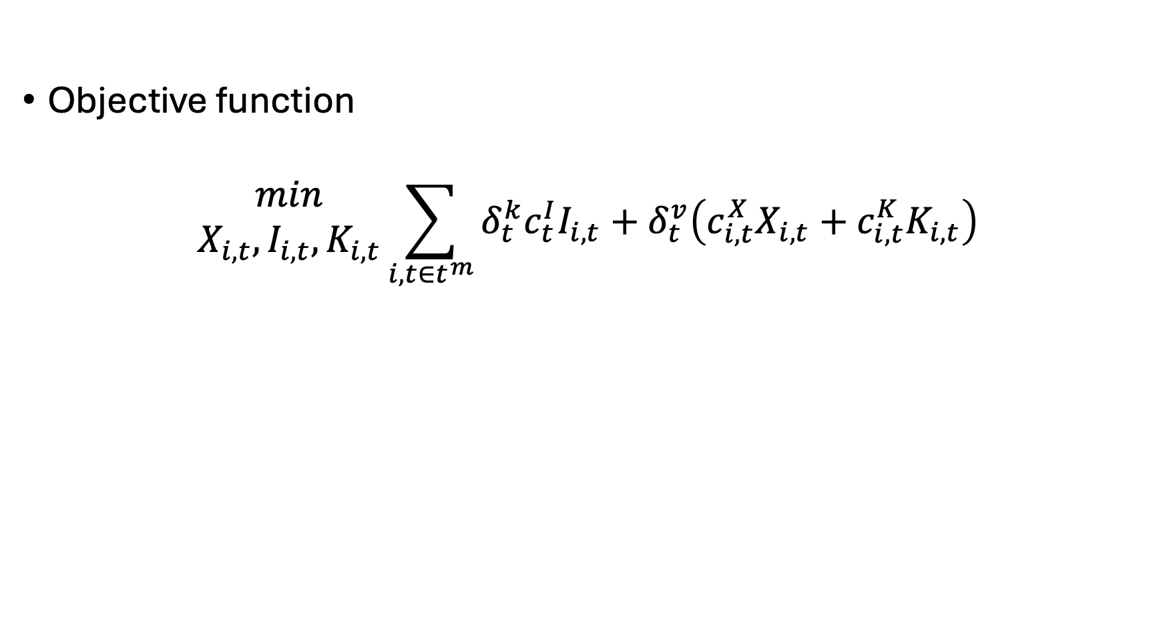
General investment concept
Objective function
$$\begin{matrix}min \\ X_{i,t},I_{i,t},K_{i,t}\end{matrix}\sum_{i,t∈t^{m}}{δ_{t}^{k}c_{t}^{I}I_{i,t}+δ_{t}^{v}\left(c_{i,t}^{X}X_{i,t}+c_{i,t}^{K}K_{i,t}\right)}$$
Investment Costs
Operational Costs
Modeled years – makes it easy to change temporal resolution!

Slide 18
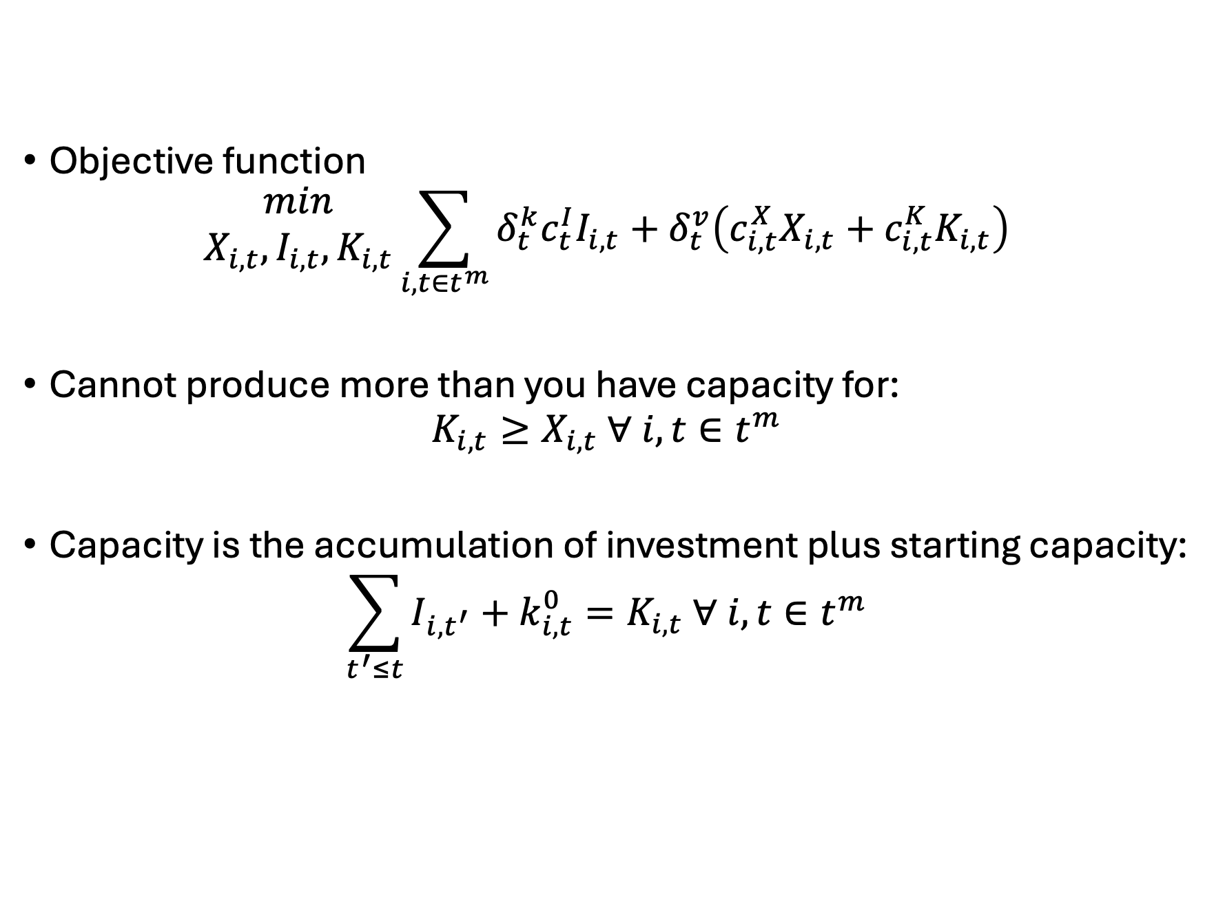
General investment concept
Objective function
$$\begin{matrix}min \\ X_{i,t},I_{i,t},K_{i,t}\end{matrix}\sum_{i,t∈t^{m}}{δ_{t}^{k}c_{t}^{I}I_{i,t}+δ_{t}^{v}\left(c_{i,t}^{X}X_{i,t}+c_{i,t}^{K}K_{i,t}\right)}$$
Cannot produce more than you have capacity for:
$$K_{i,t}≥X_{i,t} ∀ i,t∈t^{m}$$
Capacity is the accumulation of investment plus starting capacity:
$$\sum_{t^{′}≤t}{I_{i,t^{′}}}+k_{i,t}^{0}=K_{i,t} ∀ i,t∈t^{m}$$

Slide 19
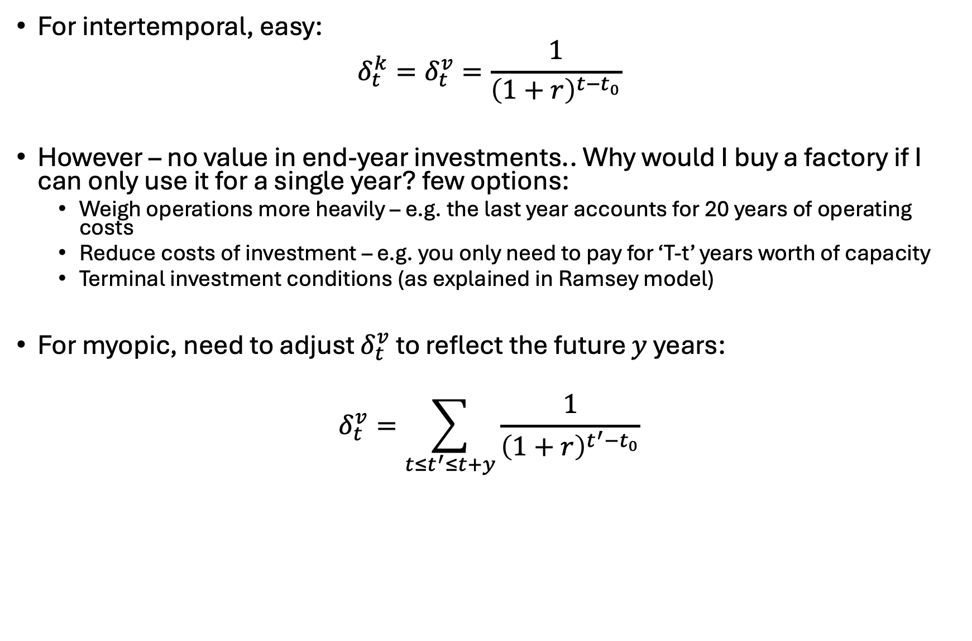

Setting $δ_{t}^{k}$ and $δ_{t}^{v}$
For intertemporal, easy:
$$δ_{t}^{k}=δ_{t}^{v}=\frac{1}{{\left(1+r\right)}^{t−t_{0}}}$$
However – no value in end-year investments.. Why would I buy a factory if I can only use it for a single year? few options:
Weigh operations more heavily – e.g. the last year accounts for 20 years of operating costs
Reduce costs of investment – e.g. you only need to pay for ‘T-t’ years worth of capacity
Terminal investment conditions (as explained in Ramsey model)
For myopic, need to adjust $δ_{t}^{v}$ to reflect the future $y$ years:
$$δ_{t}^{v}=\sum_{t≤t^{′}≤t+y}{\frac{1}{{\left(1+r\right)}^{t^{′}−t_{0}}}}$$

Slide 20
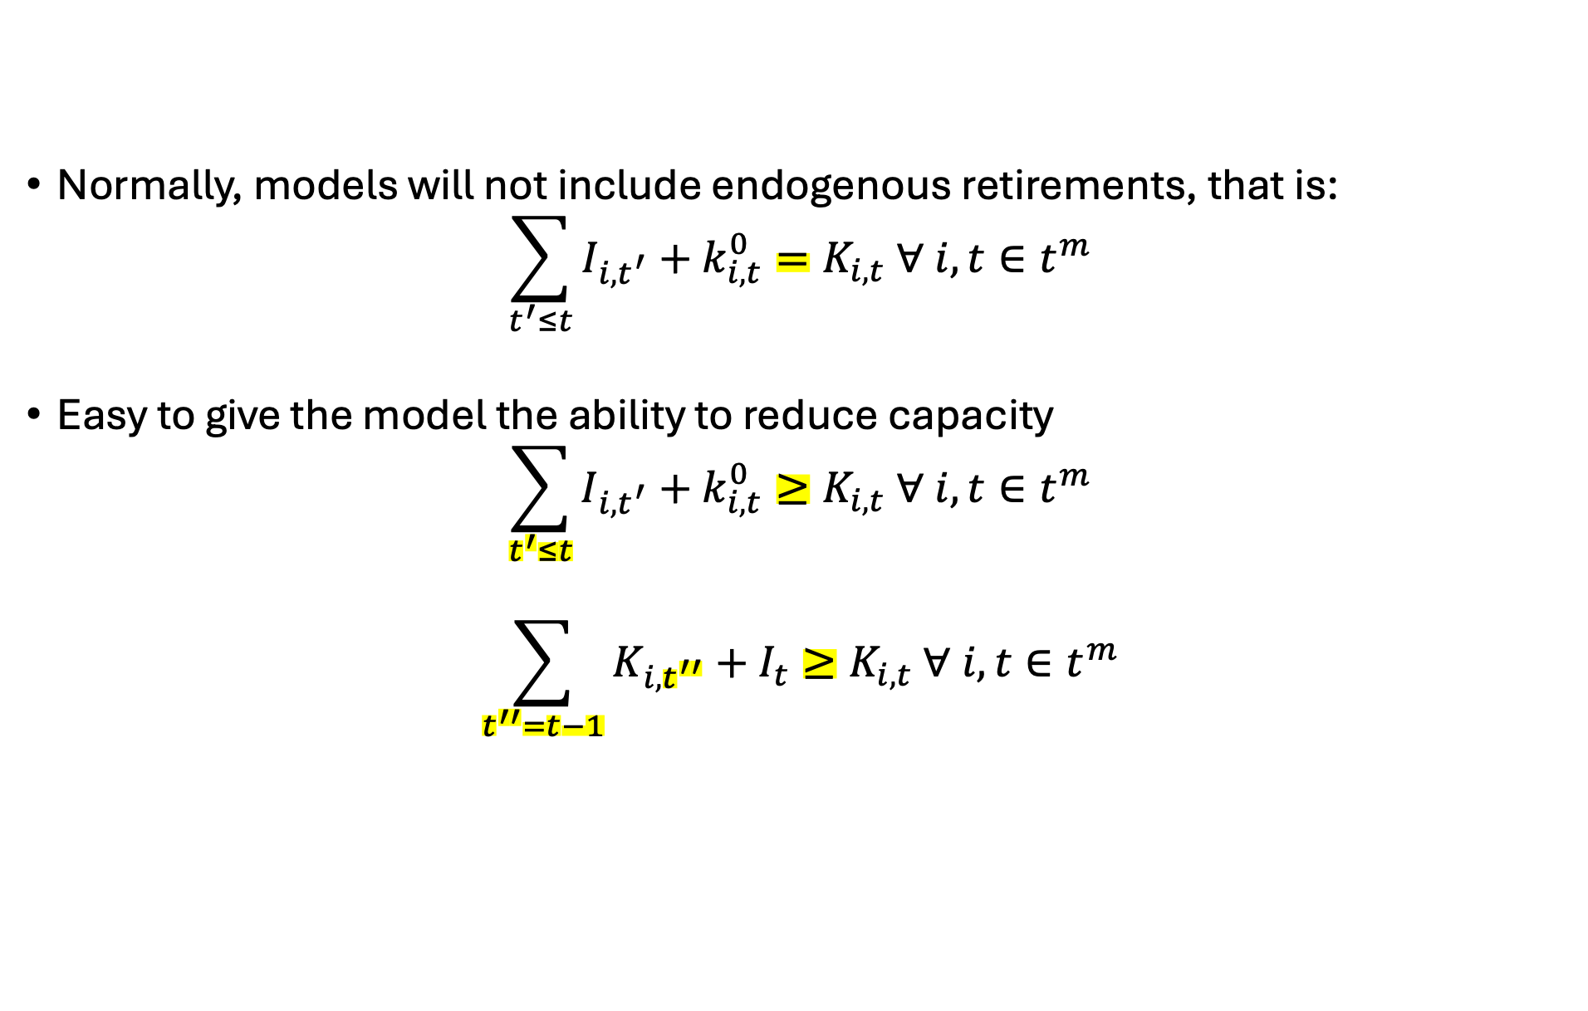
Ramblings on endogenous retirements
Normally, models will not include endogenous retirements, that is:
$$\sum_{t^{′}≤t}{I_{i,t^{′}}}+k_{i,t}^{0}=K_{i,t} ∀ i,t∈t^{m}$$
Easy to give the model the ability to reduce capacity
$$\sum_{t^{′}≤t}{I_{i,t^{′}}}+k_{i,t}^{0}≥K_{i,t} ∀ i,t∈t^{m}$$
$$\sum_{t^{′′}=t−1}{K_{i,t^{′′}}}+I_{t}≥K_{i,t} ∀ i,t∈t^{m}$$
Contemporaneous
Investment!

Slide 21
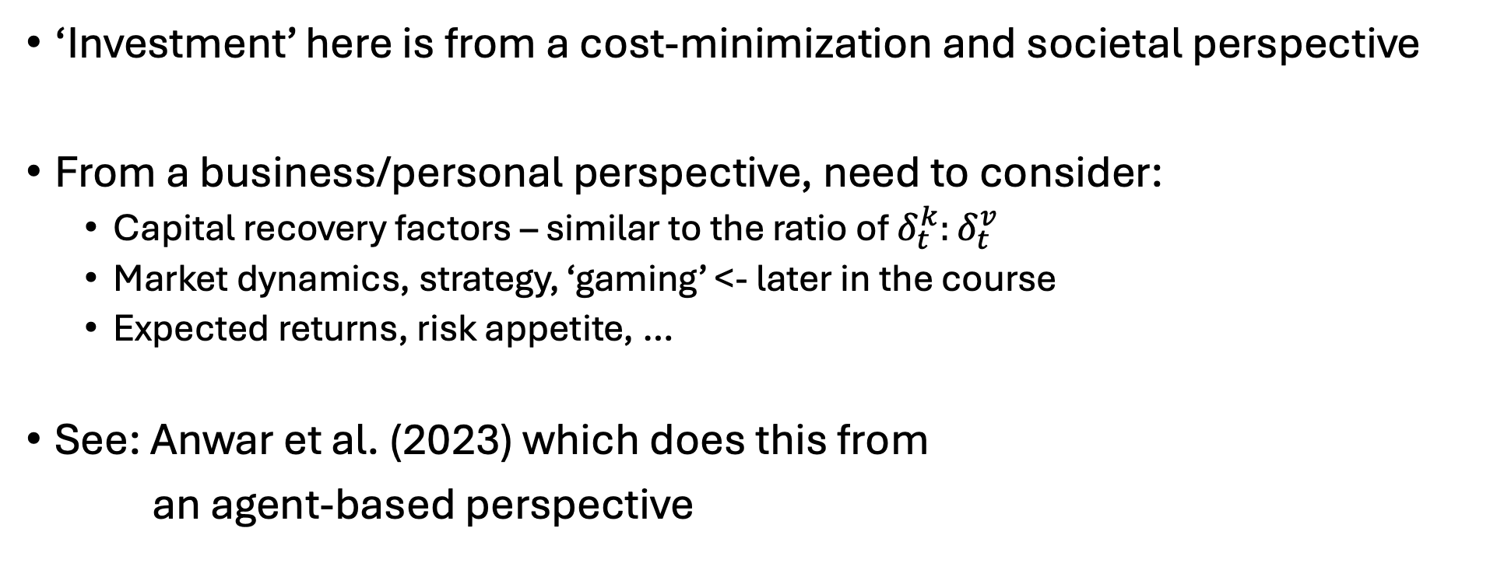
Ramblings on investment
‘Investment’ here is from a cost-minimization and societal perspective
From a business/personal perspective, need to consider:
Capital recovery factors – similar to the ratio of $δ_{t}^{k}:δ_{t}^{v}$
Market dynamics, strategy, ‘gaming’ <- later in the course
Expected returns, risk appetite, …
See: Anwar et al. (2023) which does this from
an agent-based perspective

Slide 22
Agenda - NLPs
Reviewing NLPs
Review of why we need NLPs
Multiple variables
Non-monotonic relationships (economies of scale)
Examples:
Models of social surplus maximization
Utility maximization of multiple goods
Ramsey model

Slide 23
Market models
Going to ramble on my experiences here…
University of Maine – first real research project
Oak Ridge National Laboratory
Rare earth market model
FINITO – fossil fuel supply curves
All of these used calibrated functions from market data

Slide 24
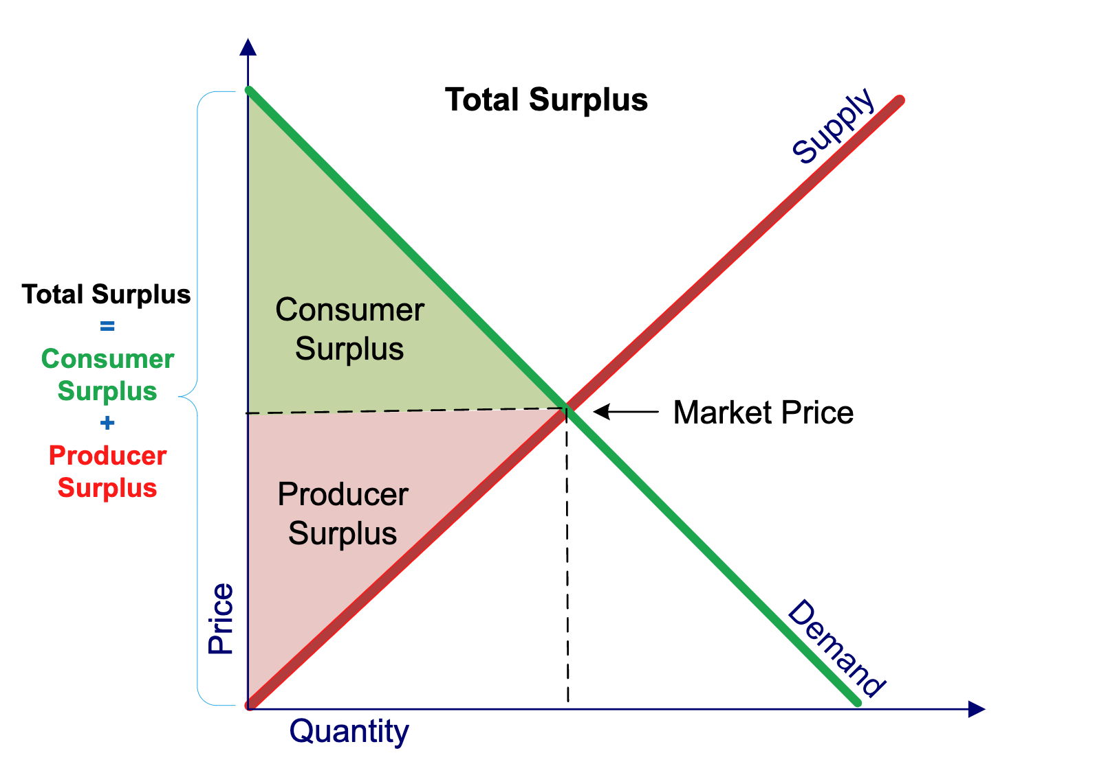
Partial equilibrium - social surplus maximization

Slide 25


Market models
Let’s set up a simple supply/demand model:
$$Q_{d}=Q_{s}$$
$$Q_{d}=a−bP$$
$$Q_{s}=c+dP$$

Slide 26
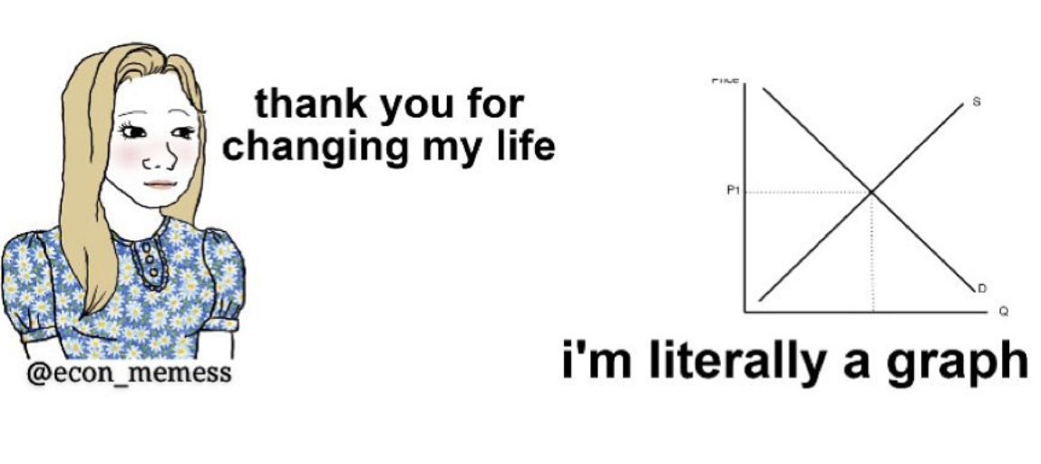

Market models
Let’s set up a simple supply/demand model:
$$Q_{d}=Q_{s}$$
$$Q_{d}=a−bP$$
$$Q_{s}=c+dP$$

Slide 27
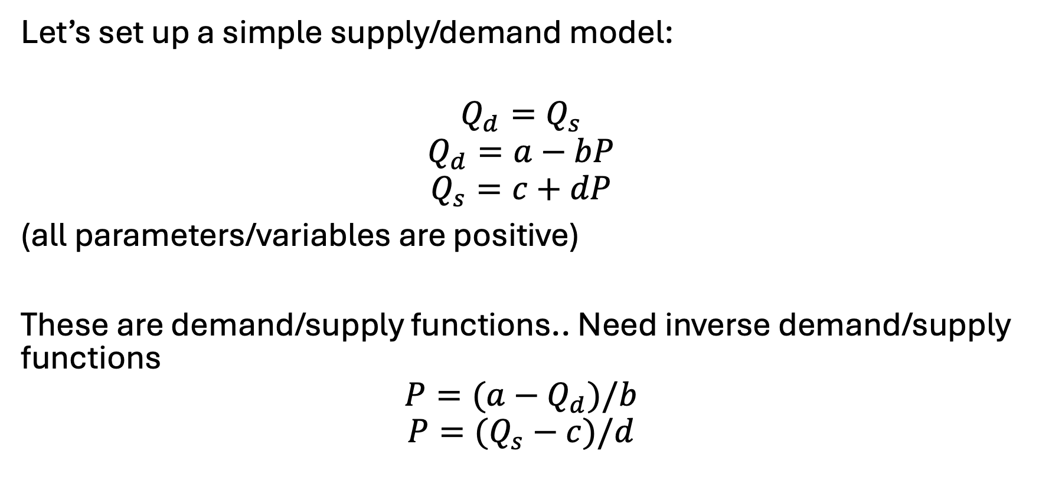
Calibrated market models
Let’s set up a simple supply/demand model:
$$Q_{d}=Q_{s}$$
$$Q_{d}=a−bP$$
$$Q_{s}=c+dP$$
(all parameters/variables are positive)
These are demand/supply functions.. Need inverse demand/supply functions
$$P=(a−Q_{d})/b$$
$$P=(Q_{s}−c)/d$$

Slide 28


Calibrated market models
$$Q_{d}=Q_{s}$$
$$Q_{d}=a−bP$$
$$Q_{s}=c+dP$$
$$P=(a−Q_{d})/b$$
$$P=(Q_{s}−c)/d$$
Let’s label…
$$a^{′}=\frac{a}{b}, b^{′}=\left(\frac{1}{b}\right), c^{′}=−\frac{c}{d},d^{′}=\left(\frac{1}{d}\right)$$
Can rewrite as:
$$P=a^{′}−b^{′}Q_{d}$$
$$P=c^{′}+d^{′}Q_{s}$$

Slide 29
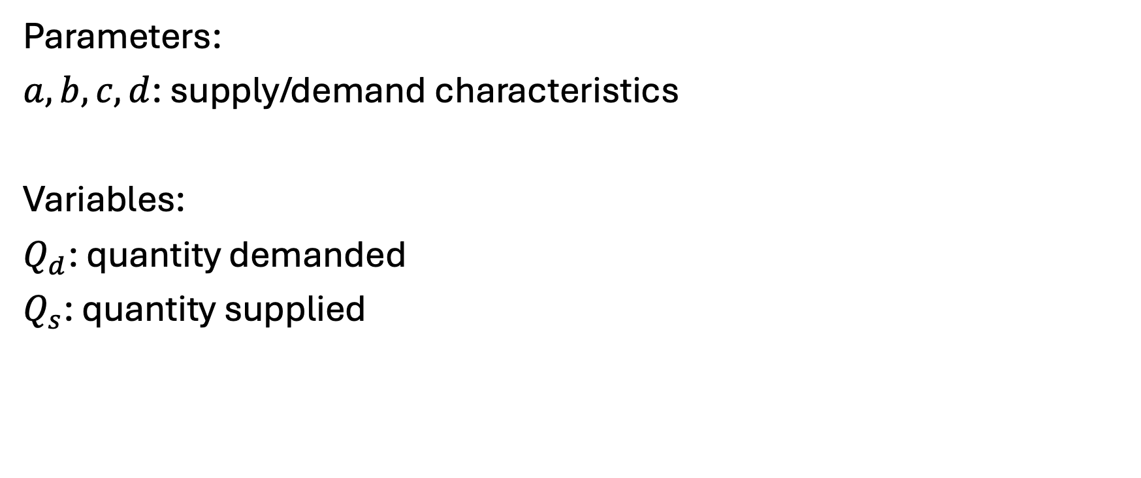
Model – indices (none), parameters, variables
Parameters:
$a,b,c,d$: supply/demand characteristics
Variables:
$Q_{d}$: quantity demanded
$Q_{s}$: quantity supplied

Slide 30
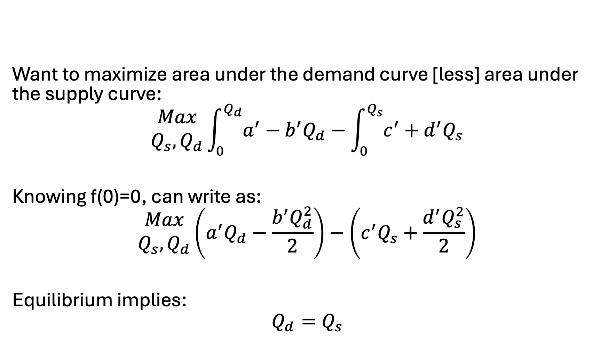
Model – objective function
Want to maximize area under the demand curve [less] area under the supply curve:
$$\begin{matrix}Max \\ Q_{s}, Q_{d}\end{matrix}\int_{0}^{Q_{d}}{a^{′}−b^{′}Q_{d}}−\int_{0}^{Q_{s}}{c^{′}+d^{′}Q_{s}}$$
Knowing f(0)=0, can write as:
$$\begin{matrix}Max \\ Q_{s}, Q_{d}\end{matrix}\left(a^{′}Q_{d}−\frac{b^{′}Q_{d}^{2}}{2}\right)−\left(c^{′}Q_{s}+\frac{d^{′}Q_{s}^{2}}{2}\right)$$
Equilibrium implies:
$$Q_{d}=Q_{s}$$

Slide 31

Let’s put this simple model in GAMS…
Assuming: $\overline{p}=\overline{q}=1$
Assuming: $b=d=0.5$

Slide 32
Why could we linearize demand before?
Biggest takeaway: we only had one variable that was providing value (cost) to in our model
That is, we were only consuming electricity, it was the only thing providing value/benefit to consumption, and it did not compete with other goods
No (easy) way to stay linear if two variables are interacting and providing value or cost to the model, examples:
Pizza and beer
Capital and labor
Shifting of demand across time
When there are tradeoffs or benefits to the interaction of different variables in the model, cannot stay linear

Slide 33
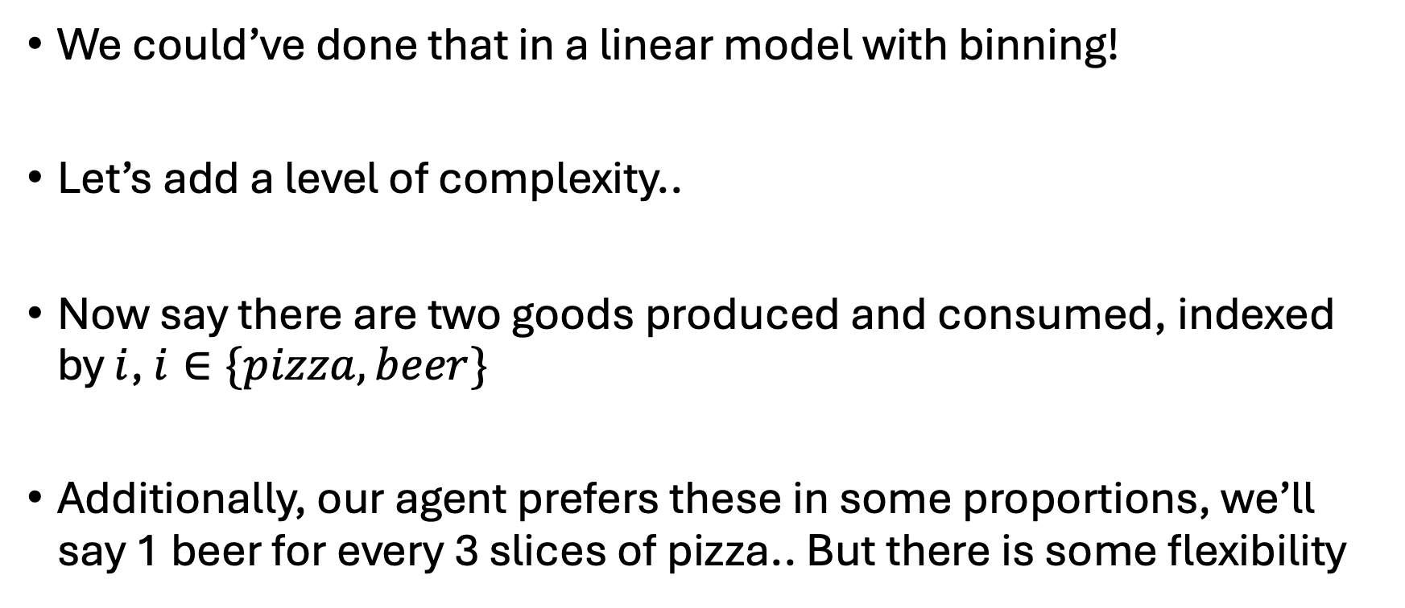
Easy enough… let’s expand
We could’ve done that in a linear model with binning!
Let’s add a level of complexity..
Now say there are two goods produced and consumed, indexed by $i$, $i∈\{pizza, beer\}$
Additionally, our agent prefers these in some proportions, we’ll say 1 beer for every 3 slices of pizza.. But there is some flexibility

Slide 34
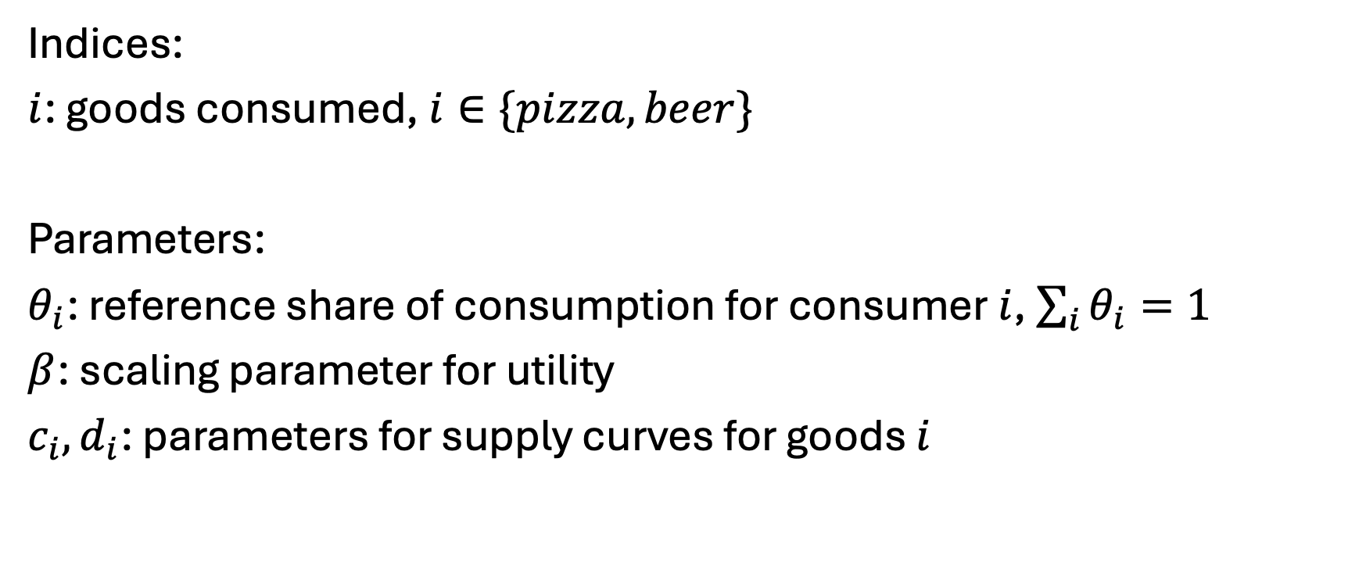
New model…
Indices:
$i$: goods consumed, $i∈\{pizza, beer\}$
Parameters:
$θ_{i}$: reference share of consumption for consumer $i$, $\sum_{i}{θ_{i}=1}$
$β$: scaling parameter for utility
$c_{i},d_{i}$: parameters for supply curves for goods $i$

Slide 35
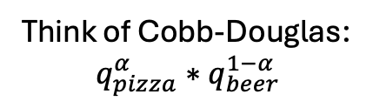
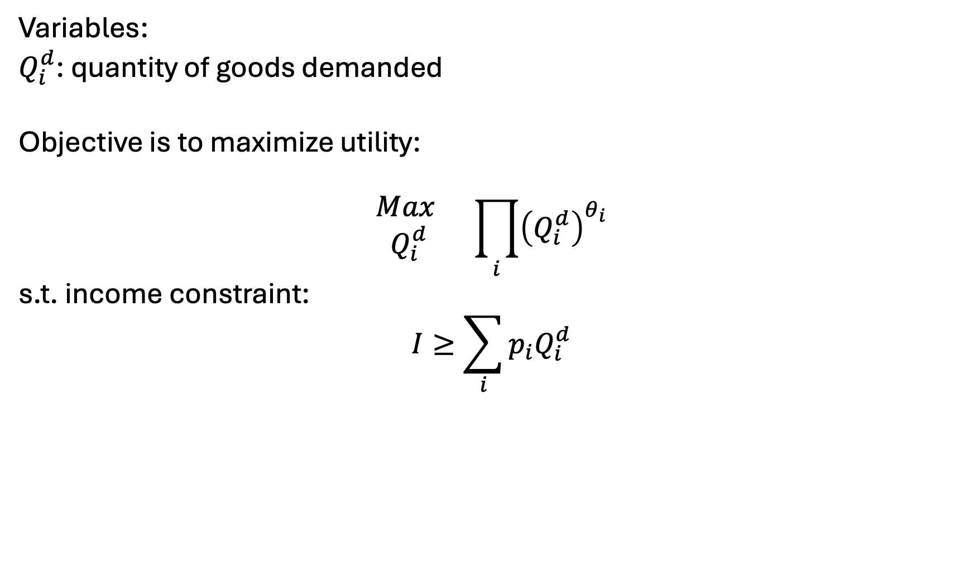
New model: Simple version
Variables:
$Q_{i}^{d}$: quantity of goods demanded
Objective is to maximize utility:
$$\begin{matrix}Max \\ Q_{i}^{d}\end{matrix} \prod_{i}{{\left(Q_{i}^{d}\right)}^{θ_{i}}}$$
s.t. income constraint:
$$I≥\sum_{i}{p_{i}Q_{i}^{d}}$$
Think of Cobb-Douglas:
$$q_{pizza}^{α}∗q_{beer}^{1−α}$$
Can add simple taxes/subsidies

Slide 36
Simple counterfactuals
What if Woody’s raises it’s pizza price by 10%?
What if our agent makes 50% more money?

Slide 37
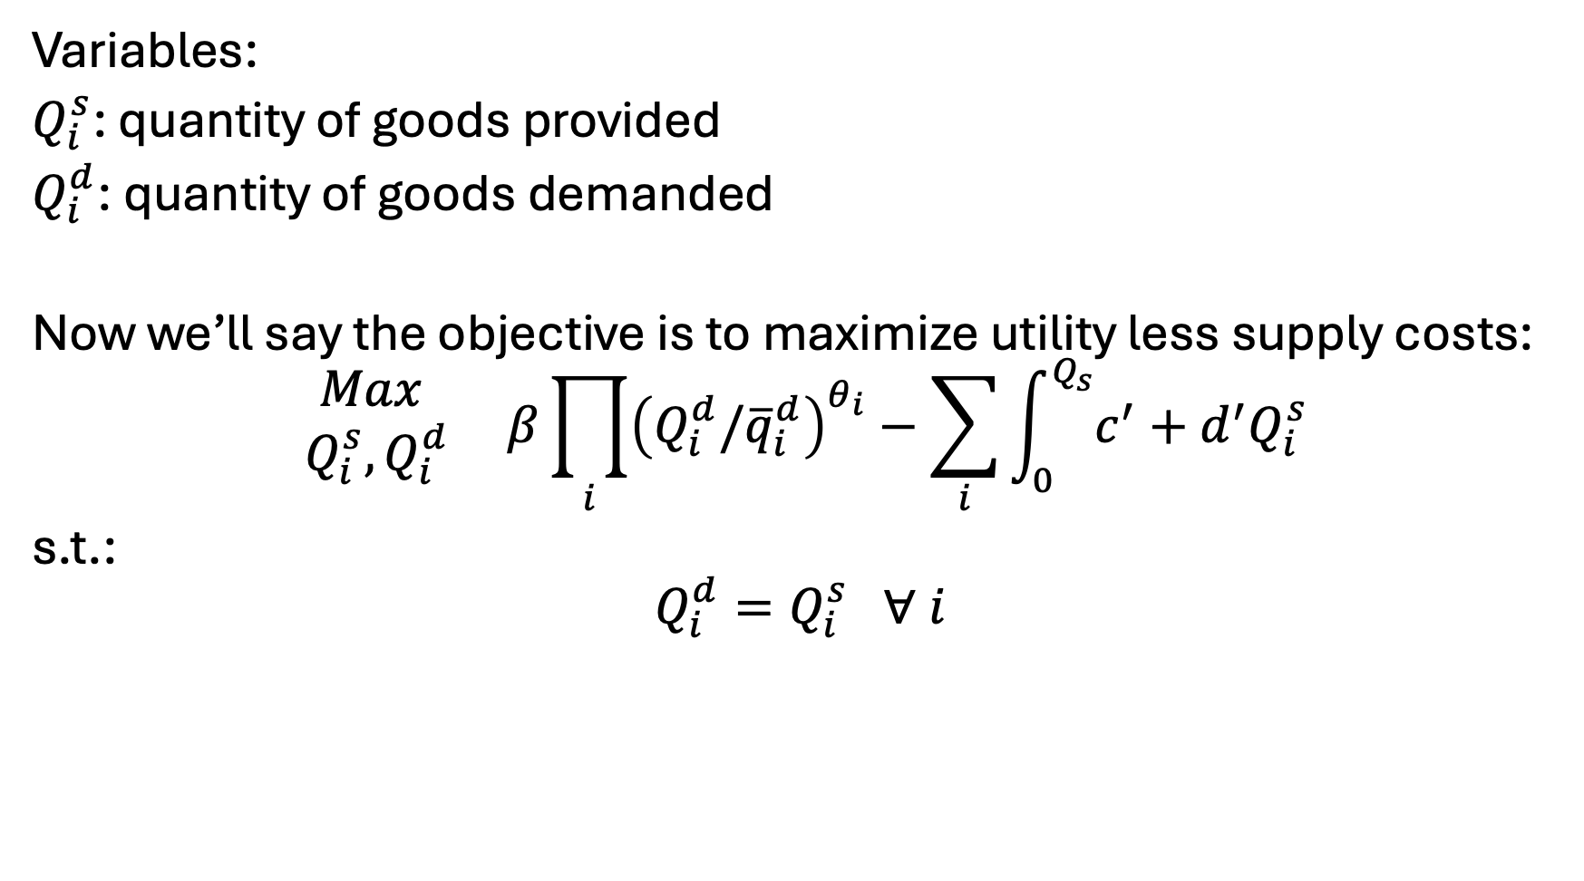
New model: Variables, Objective, Constraints
Variables:
$Q_{i}^{s}$: quantity of goods provided
$Q_{i}^{d}$: quantity of goods demanded
Now we’ll say the objective is to maximize utility less supply costs:
$$\begin{matrix}Max \\ Q_{i}^{s},Q_{i}^{d}\end{matrix} β\prod_{i}{{\left(Q_{i}^{d}/{\overline{q}}_{i}^{d}\right)}^{θ_{i}}}−\sum_{i}{\int_{0}^{Q_{s}}{c^{′}+d^{′}Q_{i}^{s}}}$$
s.t.:
$$Q_{i}^{d}=Q_{i}^{s} ∀ i$$

Slide 38
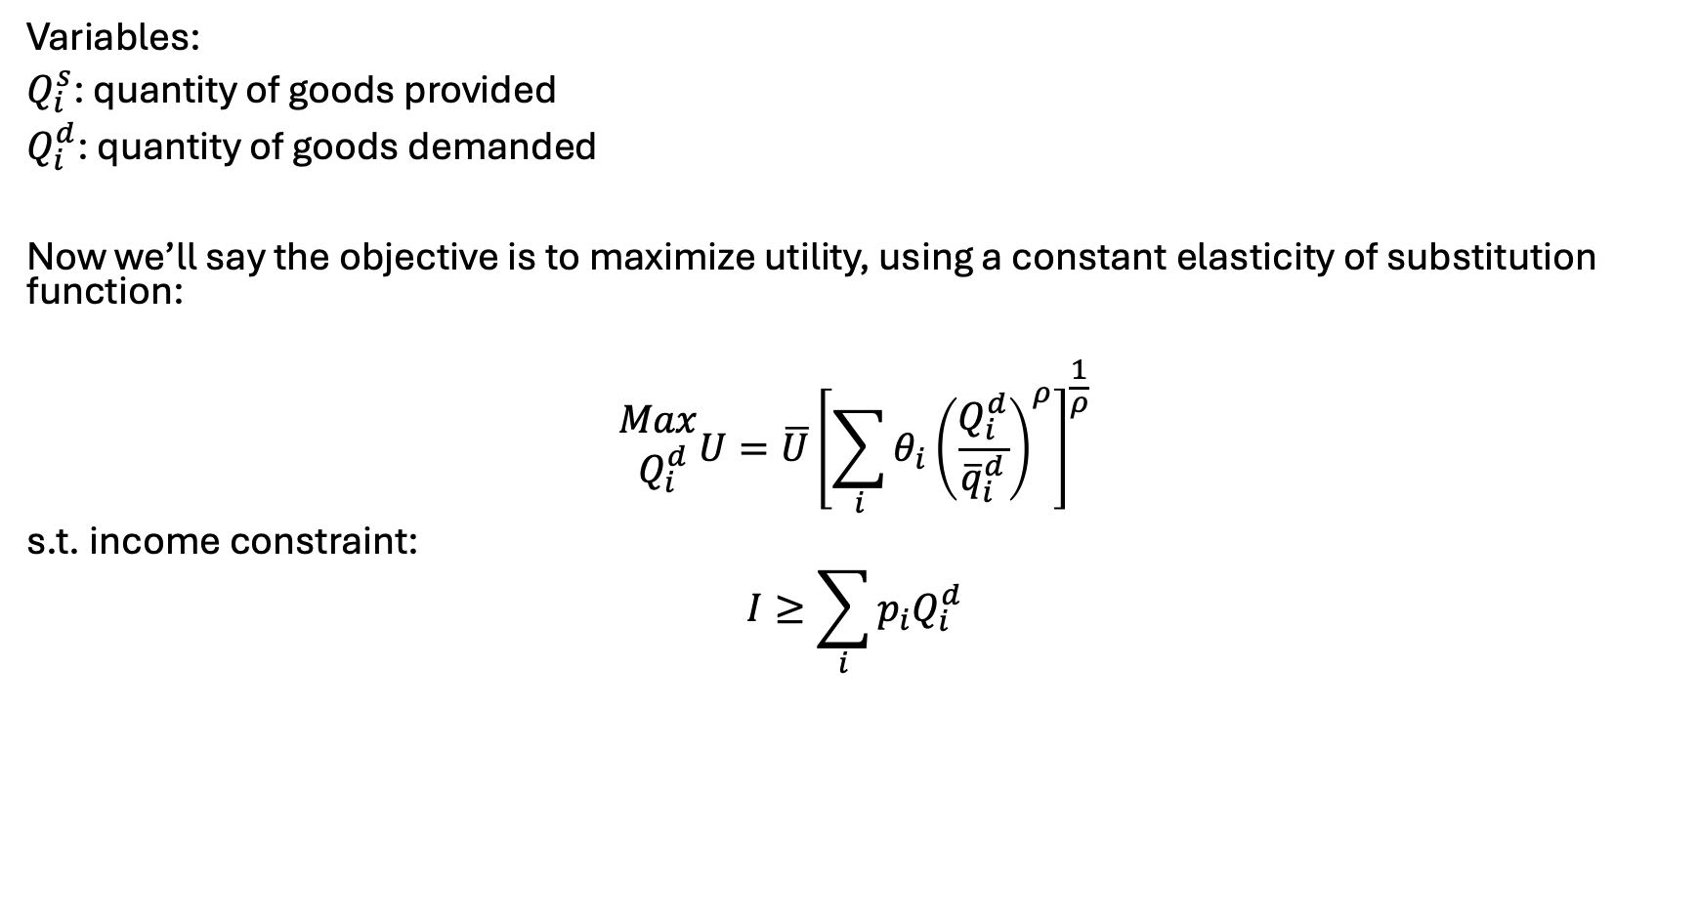
Another functional form.. Calibrated constant elasticity of substitution
Variables:
$Q_{i}^{s}$: quantity of goods provided
$Q_{i}^{d}$: quantity of goods demanded
Now we’ll say the objective is to maximize utility, using a constant elasticity of substitution function:
$$\begin{matrix}Max \\ Q_{i}^{d}\end{matrix}U=\overline{U}{\left[\sum_{i}{θ_{i}{\left(\frac{Q_{i}^{d}}{{\overline{q}}_{i}^{d}}\right)}^{ρ}}\right]}^{\frac{1}{ρ}}$$
s.t. income constraint:
$$I≥\sum_{i}{p_{i}Q_{i}^{d}}$$

Slide 39

Calibration in the alternative setup…
Need to only set $θ_{i}$
Can determine relative weighting such that:
$$θ_{i}=\frac{{\overline{q}}_{i}{\overline{p}}_{i}}{\sum_{i}{{\overline{q}}_{i}{\overline{p}}_{i} }}$$

Slide 40
Points of these exercises..
You can flexibly represent the consumption and production of goods in simplified setups
Ties it back to all our econ models – utility maximization, profit maximization, …
Presents a strong need for calibration and calibrated functional forms

Slide 41
Choosing parameters and functional forms
Easy to find P/Q pairs, search literature for elasticity values
Examples with TRACT, BioTrans, REE model, FINITO, …
Need for the final/calibrated P to match up to sum of costs
Especially true for supply chain and engineering models
Can solve with inelastic demand to disentangle price
Usually pulling values through a system
Note – we still do not have explicit and simultaneous price/quantity control
For econ proofs/theories – you will need to spend time justifying assumptions implied in form choice
E.g. homogeneity, homotheticity, substitutability, …
https://windc.wisc.edu/downloads/summercourse_2021/thursday/ces.pdf
https://www2.econ.iastate.edu/classes/econ501/Hallam/documents/FunctionalForms.pdf

Slide 42

Ramsey model – main points
(simple) economic growth model based on labor growth, capital accumulation, investment
Target of optimization is intertemporal utility
Two variables define output: capital and labor
Concept of the steady state
Barr-Manne terminal investment condition

Slide 43
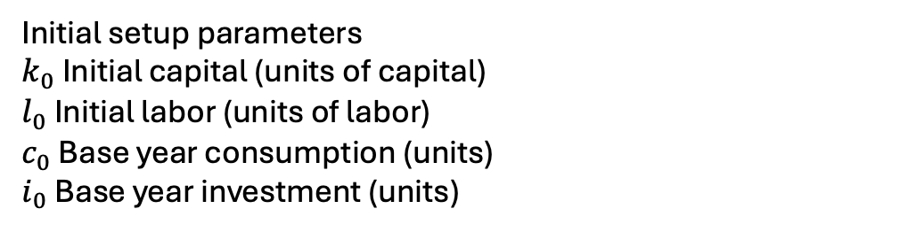

The Ramsey model – indices, parameters
Indices
$t$: time
$t_{0}$: initial period
$t_{T}$: final period
Parameters:
$β_{t}$: utility discount parameter
$g$ Labor growth rate in efficiency units (% / yr)
$δ$ Capital depreciation rate (% / yr)
$α$ Capital value share
$η$ Inverse intertemporal elasticity
$ρ$ Calibrated marginal product of capital
$a$ Cobb Douglas scale parameter;
Initial setup parameters
$k_{0}$ Initial capital (units of capital)
$l_{0}$ Initial labor (units of labor)
$c_{0}$ Base year consumption (units)
$i_{0}$ Base year investment (units)

Slide 44
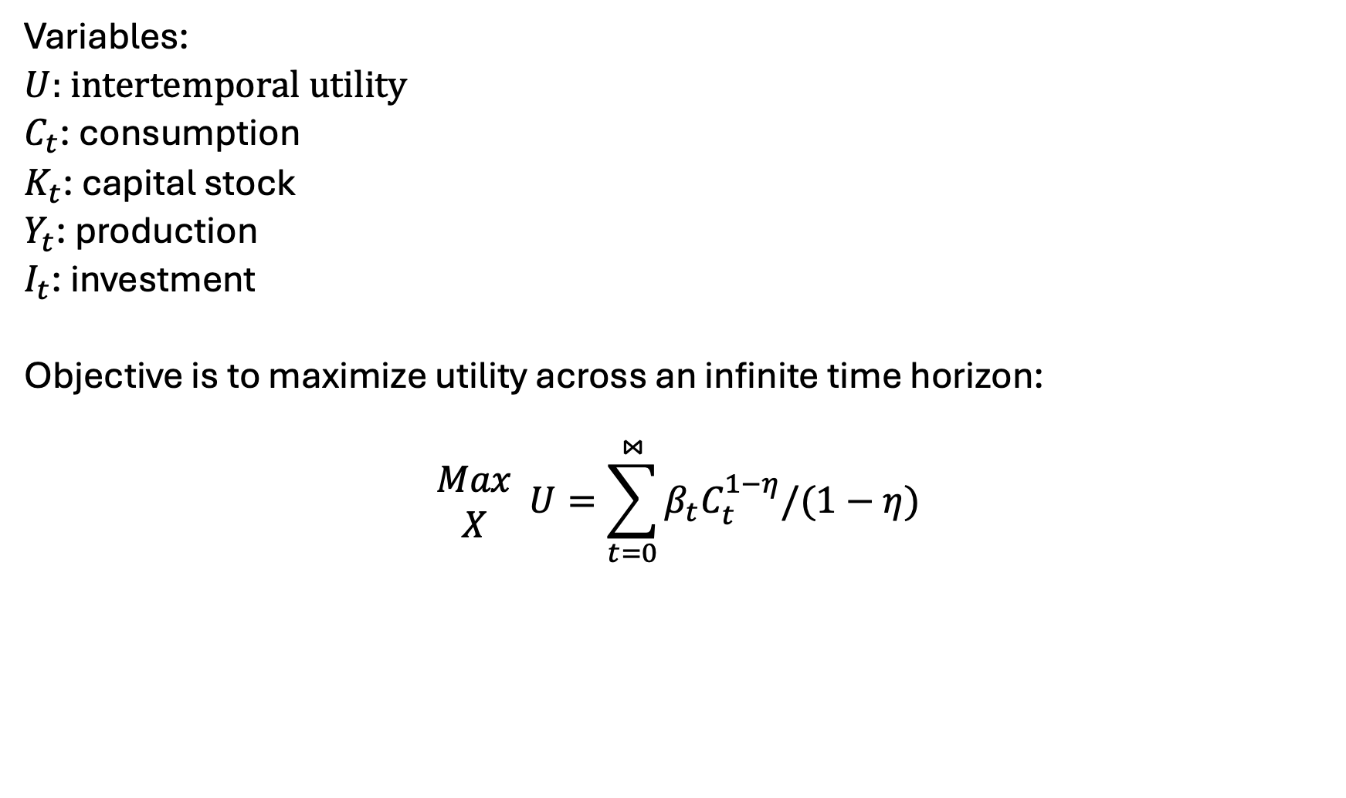
The Ramsey Model – Variables, Objective function
Variables:
$U$: intertemporal utility
$C_{t}$: consumption
$K_{t}$: capital stock
$Y_{t}$: production
$I_{t}$: investment
Objective is to maximize utility across an infinite time horizon:
$$\begin{matrix}Max \\ X\end{matrix} U=\sum_{t=0}^{⋈}{β_{t}C_{t}^{1−η}/(1−η)}$$

Slide 45
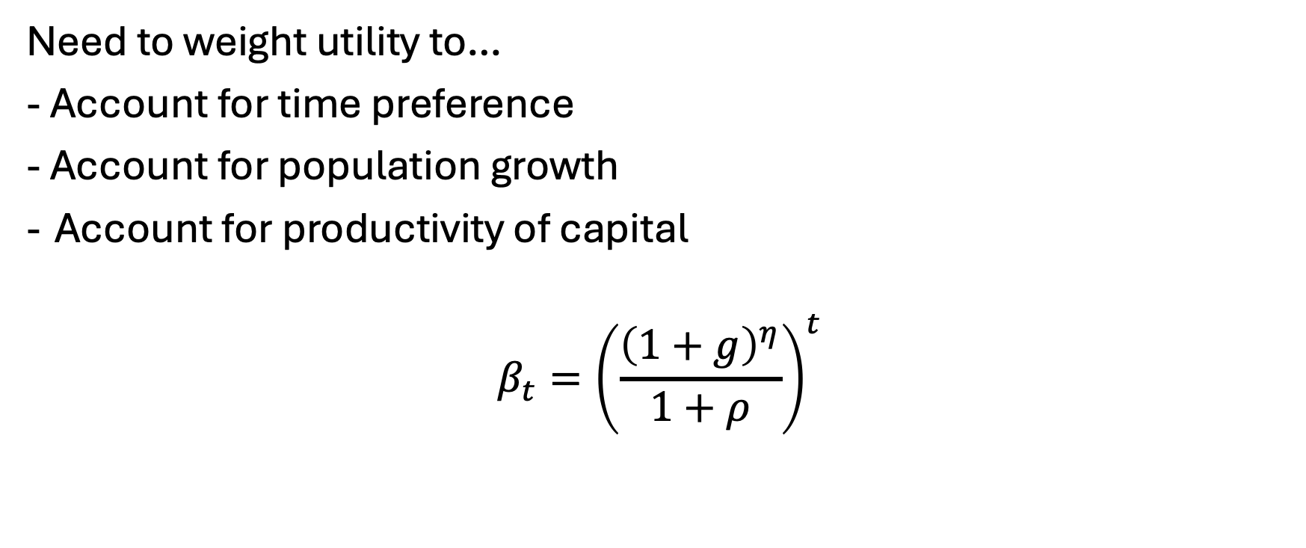
Setting the utility discount factor…
Need to weight utility to…
- Account for time preference
- Account for population growth
Account for productivity of capital
$$β_{t}={\left(\frac{{\left(1+g\right)}^{η}}{1+ρ}\right)}^{t}$$

Slide 46
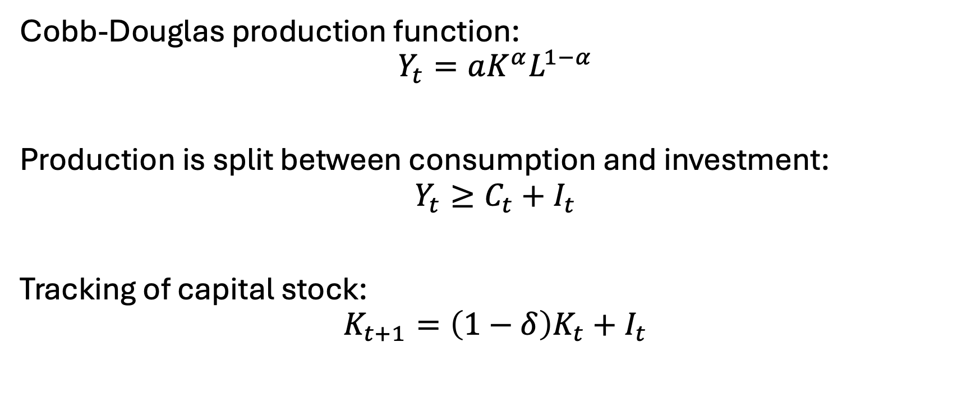
Constraints
Cobb-Douglas production function:
$$Y_{t}=aK^{α}L^{1−α}$$
Production is split between consumption and investment:
$$Y_{t}≥C_{t}+I_{t}$$
Tracking of capital stock:
$$K_{t+1}=\left(1−δ\right)K_{t}+I_{t}$$

Slide 47
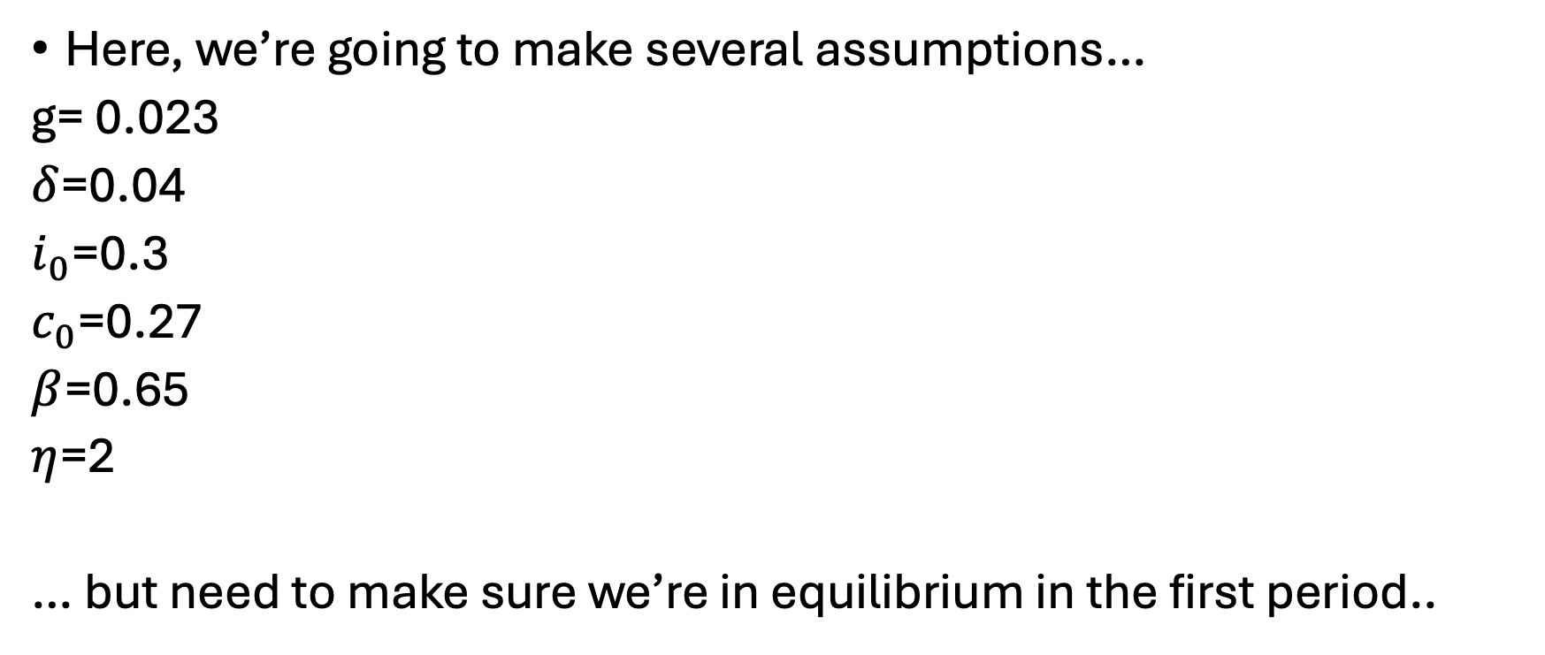
Calibration
Here, we’re going to make several assumptions…
g= 0.023
$δ$=0.04
$i_{0}$=0.3
$c_{0}$=0.27
$β$=0.65
$η$=2
… but need to make sure we’re in equilibrium in the first period..

Slide 48

Initial capital/labor calibration
Investment must cover depreciation plus population growth. Given the investment rate, we can back out the initial capital stock level. Knowing investment must cover initial capital stock’s expected growth rate and depreciation in the first period:
$$k_{0}\left(g+δ\right)=i_{0}$$
Can thus back out calibrated initial capital level:
$$k_{0}=\frac{i_{0}}{g+δ}$$
Labor supply is it’s share in production [times] initial production:
$$l_{0}=\left(1−α\right)∗(c_{0}+i_{0})$$
(exogenously-defined) labor grows at the labor growth rate:
$$l_{t}=l_{0}∗{\left(1+g\right)}^{t}$$

Slide 49
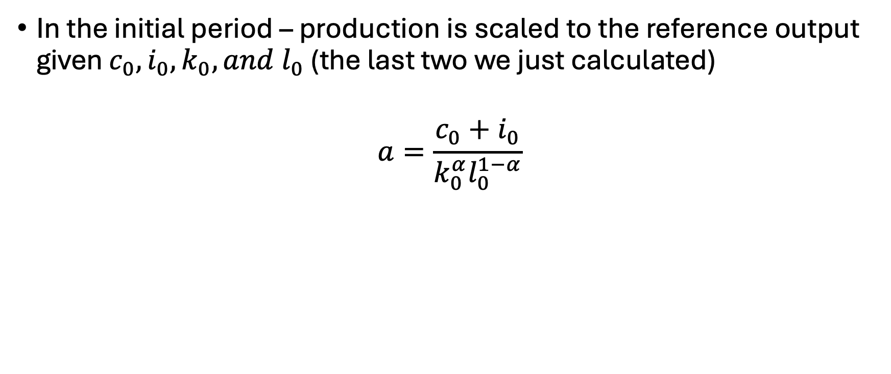
Calibrating the production scale parameter
In the initial period – production is scaled to the reference output given $c_{0}, i_{0},k_{0}, and l_{0}$ (the last two we just calculated)
$$a=\frac{c_{0}+i_{0}}{k_{0}^{α}l_{0}^{1−α}}$$

Slide 50
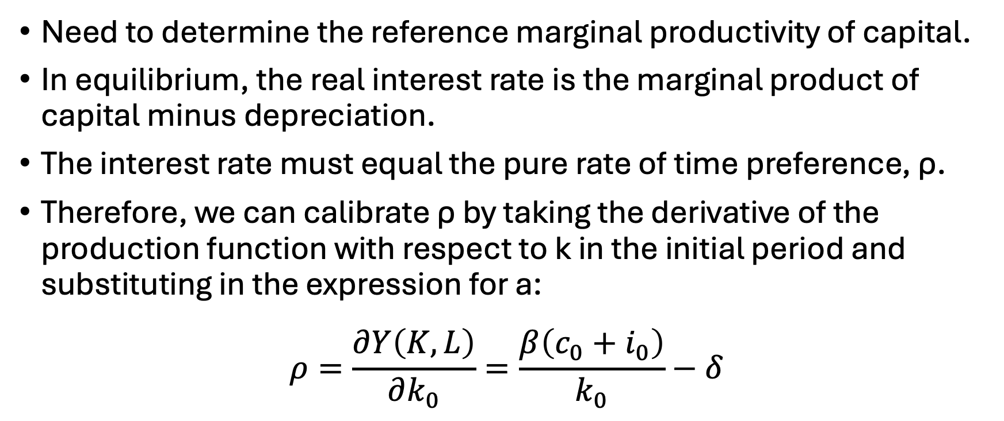
Calibrating the capital productivity
Need to determine the reference marginal productivity of capital.
In equilibrium, the real interest rate is the marginal product of capital minus depreciation.
The interest rate must equal the pure rate of time preference, ρ.
Therefore, we can calibrate ρ by taking the derivative of the production function with respect to k in the initial period and substituting in the expression for a:
$$ρ=\frac{∂Y\left(K,L\right)}{∂k_{0}}=\frac{β\left(c_{0}+i_{0}\right)}{k_{0}}−δ$$

Slide 51
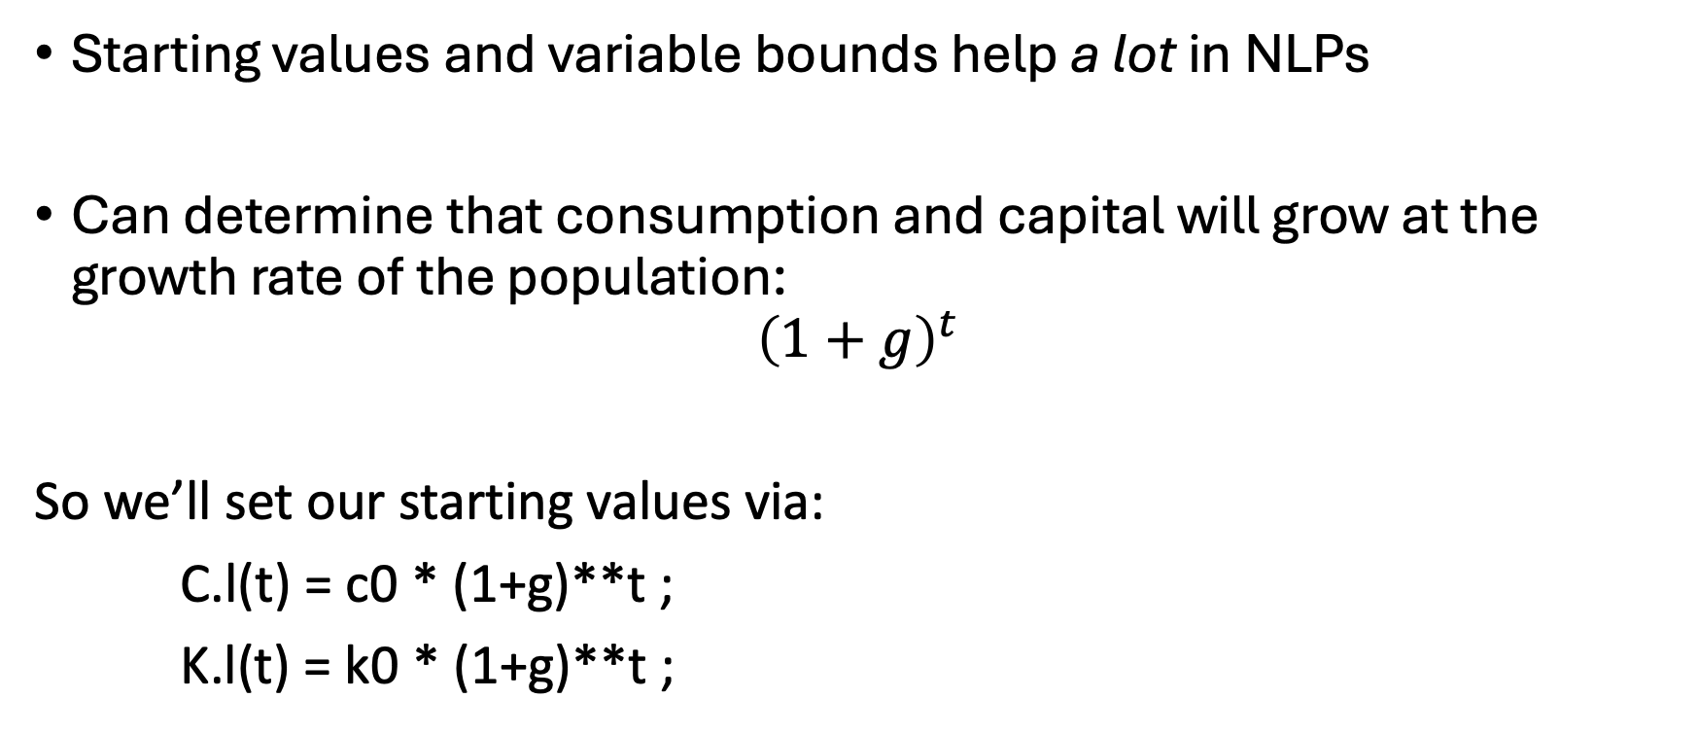
Some more notes…
Starting values and variable bounds help a lot in NLPs
Can determine that consumption and capital will grow at the growth rate of the population:
$${\left(1+g\right)}^{t}$$
So we’ll set our starting values via:
C.l(t) = c0 * (1+g)**t ;
K.l(t) = k0 * (1+g)**t ;

Slide 52
Some more notes..
Bounds on variables are needed to avoid mathematical problems
e.g. We don’t want consumption to be zero
C.lo(t) = 0.01 * C.l(t) ;
K.lo(t) = 0.01 * K.l(t) ;
Fix first period capital
K.fx(t)$tfirst(t) = k0 ;

Slide 53
Let’s build the base model…

Slide 54
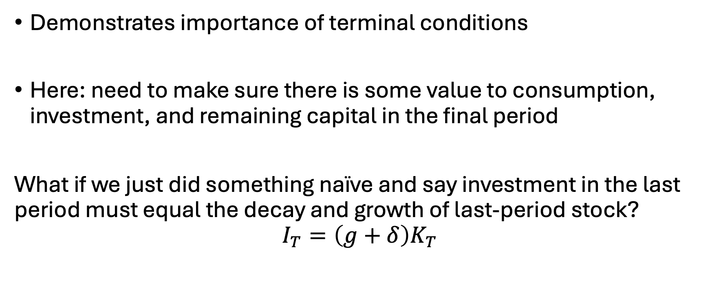
That’s weird…
Demonstrates importance of terminal conditions
Here: need to make sure there is some value to consumption, investment, and remaining capital in the final period
What if we just did something naïve and say investment in the last period must equal the decay and growth of last-period stock?
$$I_{T}=\left(g+δ\right)K_{T}$$

Slide 55
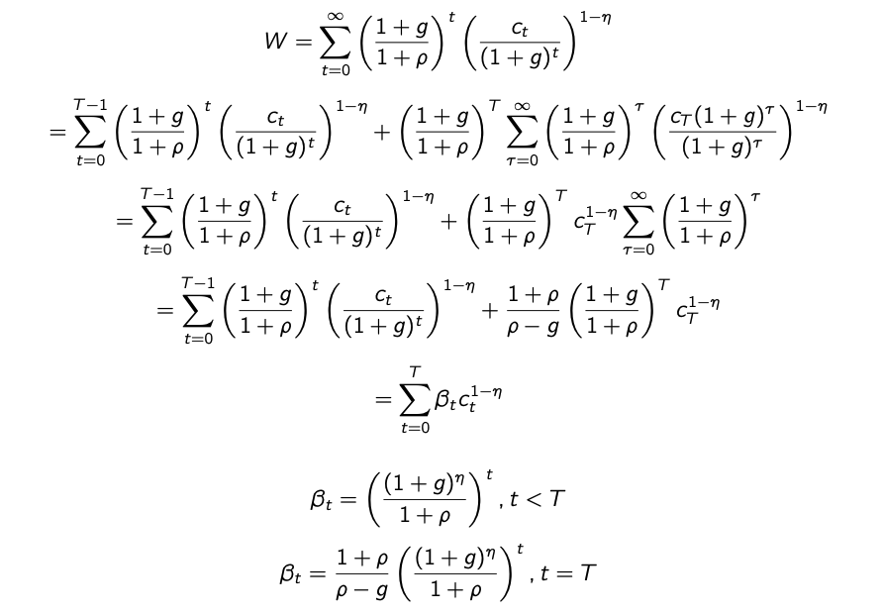
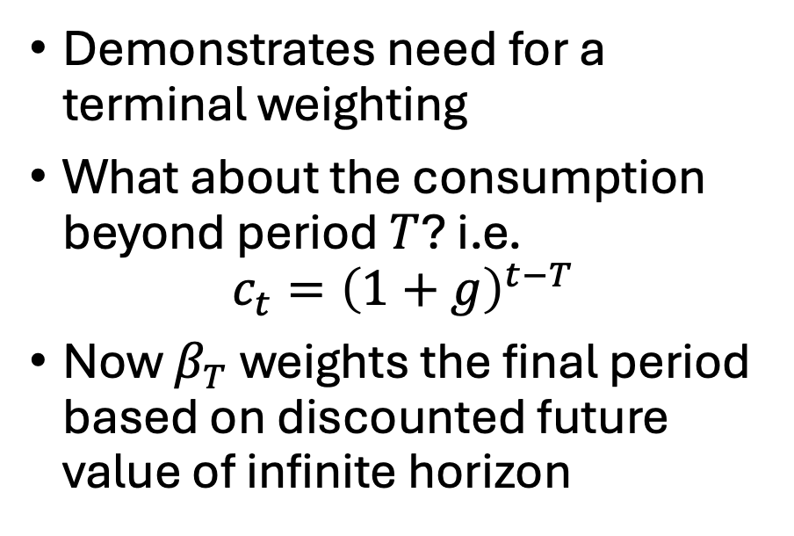
Plotting investment over time…
Demonstrates need for a terminal weighting
What about the consumption beyond period $T$? i.e.
$$c_{t}={\left(1+g\right)}^{t−T}$$
Now $β_{T}$ weights the final period based on discounted future value of infinite horizon

Slide 56
Duality introduction
Always two types of problems:
Primal: your original optimization problem
Dual: an equivalent problem but of opposite direction
Why do we care?
Helpful for consumer utility problems
I like to think of this as simultaneously representing both the physical (primal) and market (dual) problems
Leads us into presentation of MCPs

Slide 57
Duality – another perspective
Can think of the primal problem as the way in which we allocate resources – then the dual problem is how to allocate costs and/or values to those resources
Thus – dual can be thought of as the ‘worth’ of the constraints
Often call the dual constraints "zero profit conditions”

Slide 58
Formulating the dual..
$i$: # constraints
$j$: # variables
Primal:
$$\begin{matrix}max \\ x_{j}\end{matrix} \sum_{j}{c_{j}x_{j}}$$
s.t.
$$b_{i}≥\sum_{j}{a_{i,j}x_{j}}⊥λ_{i} ∀ i$$
Dual:
$$\begin{matrix}min \\ λ_{i}\end{matrix} \sum_{i}{b_{i}λ_{i}}$$
s.t.
$$\sum_{i}{a_{i,j}λ_{i}}≥c_{j}⊥x_{j} ∀ j$$

Slide 59
Formulating the dual..
$i$: # constraints
$j$: # variables
Primal:
$$\begin{matrix}max \\ x_{j}\end{matrix} \sum_{j}{c_{j}x_{j}}$$
s.t.
$$b_{i}≥\sum_{j}{a_{i,j}x_{j}}⊥λ_{i} ∀ i$$
Dual:
$$\begin{matrix}min \\ λ_{i}\end{matrix} \sum_{i}{b_{i}λ_{i}}$$
s.t.
$$\sum_{i}{a_{i,j}λ_{i}}≥c_{j}⊥x_{j} ∀ j$$

Slide 60
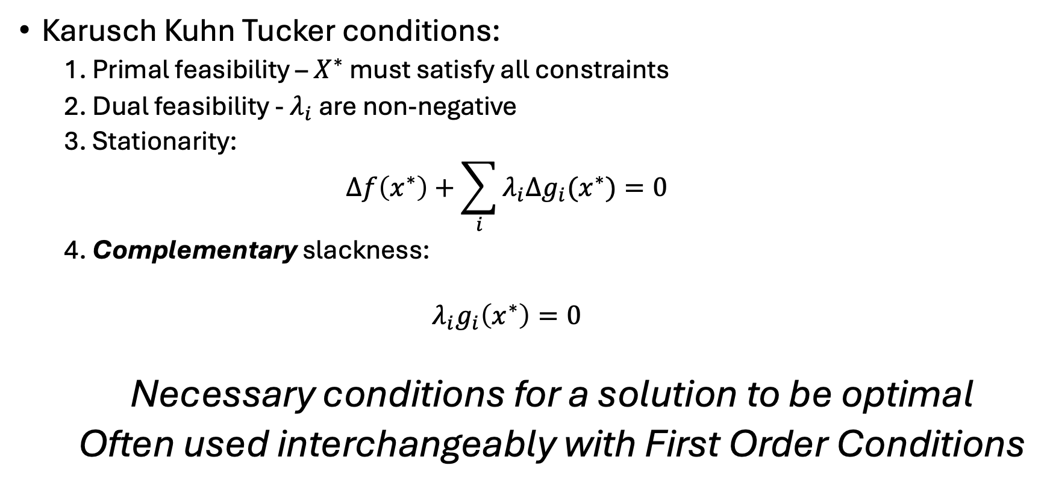
Summary of KKT conditions
Karusch Kuhn Tucker conditions:
1. Primal feasibility – $X^{∗}$ must satisfy all constraints
2. Dual feasibility - $λ_{i}$ are non-negative
3. Stationarity:
$$Δf\left(x^{∗}\right)+\sum_{i}{λ_{i}Δg_{i}(x^{∗})}=0$$
4. Complementary slackness:
$$λ_{i}g_{i}\left(x^{∗}\right)=0$$
Necessary conditions for a solution to be optimal
Often used interchangeably with First Order Conditions

Slide 61
A very simple example
Primal
$$\begin{matrix}max \\ x_{1},x_{2}\end{matrix} c_{1}x_{1}+c_{2}x_{2}$$
s.t.
$$b_{1}≥x_{1} ⊥λ_{1}$$
$$b_{2}≥x_{1}+x_{2}⊥λ_{2}$$
$$b_{3}≥x_{1}−x_{2}⊥λ_{3}$$
Dual
$$\begin{matrix}min \\ λ_{1},λ_{2},λ_{3} \end{matrix} λ_{1}b_{1}+λ_{2}b_{2}+λ_{3}b_{3}$$
s.t.
$${λ_{1}+λ_{2}+λ_{3}≥c}_{1}⊥x_{1}$$
$$λ_{2}−λ_{3}≥c_{2}⊥x_{2}$$
1 | 1 | 1
0 | 1 | -1
1 | 0
1 | 1
1 | -1

Slide 62

Application of Duality to Consumer Theory
Original problem:
$$Max U=U(X,Y)$$
s.t.
$$I=p_{x}X+p_{y}Y$$
Dual problem:
$$Min E=p_{x}X+p_{y}Y$$
s.t.
$$U\left(x,y\right)=U^{∗}$$

