Slide 1

EBGN645
Ramsey Model
Duality $→$ Complementarity problems

Slide 2
Note: Presentations
You do not need final results – you should plan to discuss:
What is your research question?
Why is this research important?
How did you formulate your model?
What are the important assumptions/data?
What are your (anticipated/final/working) results?
What conclusions can you (hope to) draw from the work?
If you had unlimited time/money/energy, what would this project look like?
Presentations should be ~10 minutes

Slide 3
Agenda
Ramsey Model
Duality -> MCP’s
Applications:
Simple example using Ripley’s restaurant
More complicated with electricity dispatch
Oligopolistic competition (Cournot games)

Slide 4

Ramsey model – main points
(simple) Economic growth model based on labor growth, capital accumulation, investment
Target of optimization is intertemporal utility
Two variables define/limit output: capital and labor
Terminal investment conditions

Slide 5
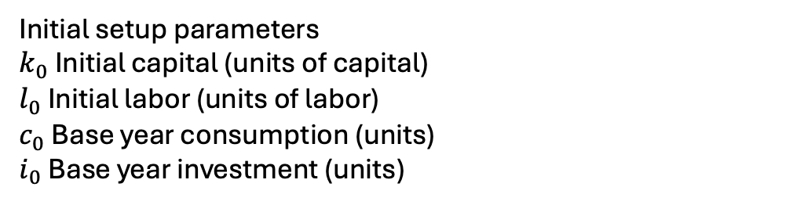

The Ramsey model – indices, parameters
Indices
$t$: time
$t_{0}$: initial period
$t_{T}$: final period
Parameters:
$β_{t}$: utility discount parameter
$g$ Labor growth rate in efficiency units (% / yr)
$δ$ Capital depreciation rate (% / yr)
$α$ Capital value share
$η$ Inverse intertemporal elasticity
$ρ$ Calibrated marginal product of capital
$a$ Cobb Douglas scale parameter;
Initial setup parameters
$k_{0}$ Initial capital (units of capital)
$l_{0}$ Initial labor (units of labor)
$c_{0}$ Base year consumption (units)
$i_{0}$ Base year investment (units)

Slide 6
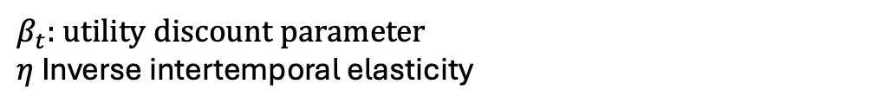
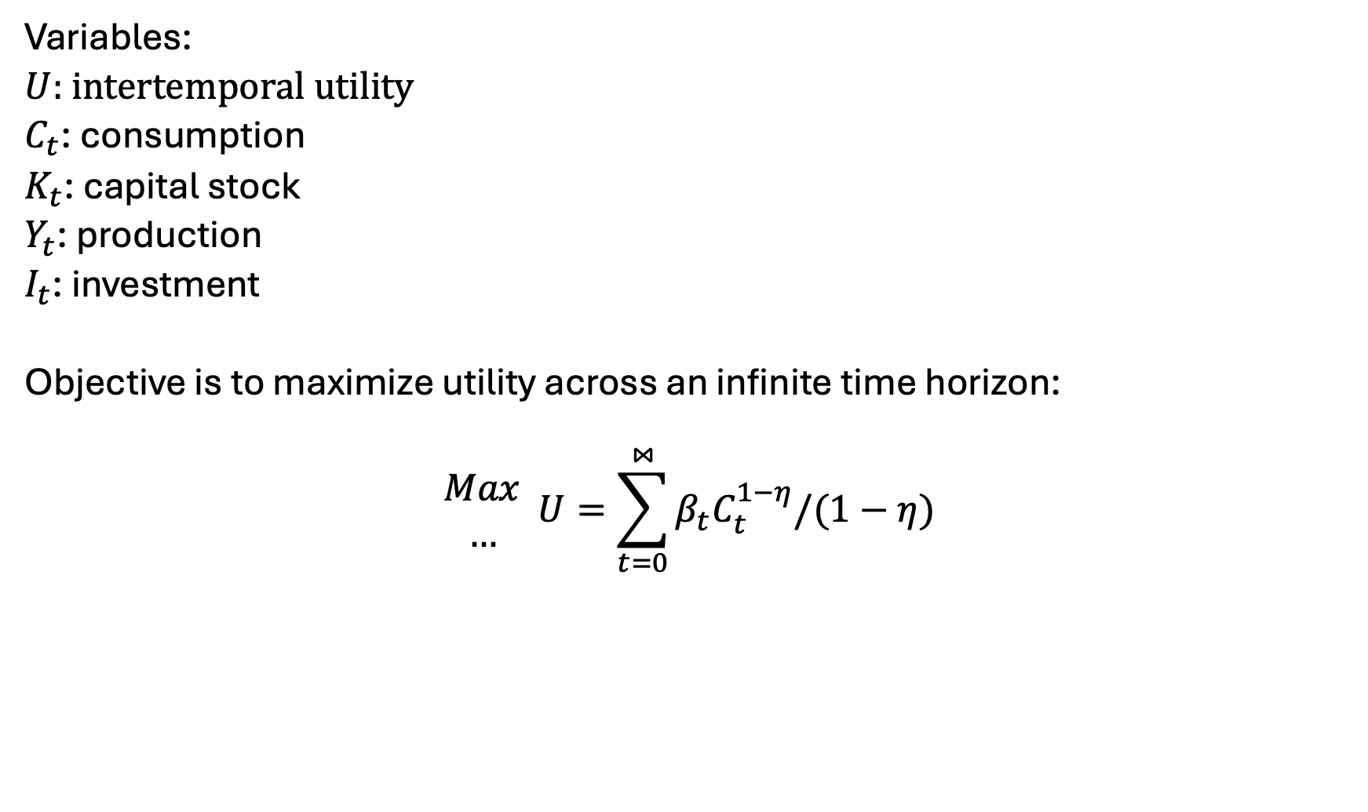
The Ramsey Model – Variables, Objective function
Variables:
$U$: intertemporal utility
$C_{t}$: consumption
$K_{t}$: capital stock
$Y_{t}$: production
$I_{t}$: investment
Objective is to maximize utility across an infinite time horizon:
$$\begin{matrix}Max \\ …\end{matrix} U=\sum_{t=0}^{⋈}{β_{t}C_{t}^{1−η}/(1−η)}$$
$β_{t}$: utility discount parameter
$η$ Inverse intertemporal elasticity

Slide 7
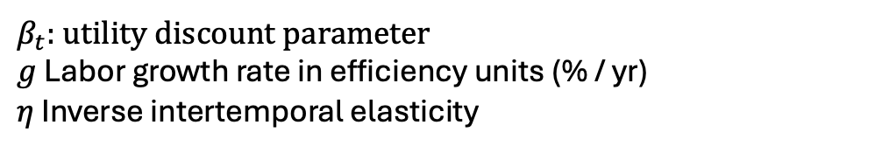
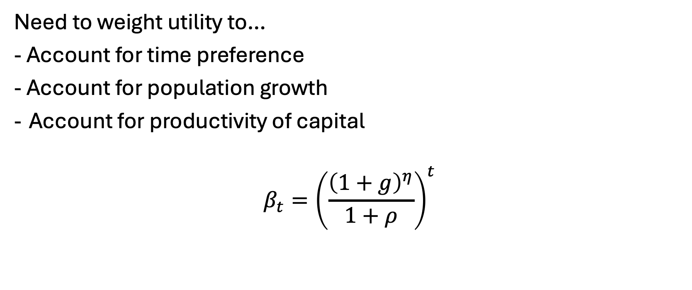
Setting the utility discount factor…
Need to weight utility to…
- Account for time preference
- Account for population growth
Account for productivity of capital
$$β_{t}={\left(\frac{{\left(1+g\right)}^{η}}{1+ρ}\right)}^{t}$$
Weighing future based on population growth,
future productivity of to capital
$β_{t}$: utility discount parameter
$g$ Labor growth rate in efficiency units (% / yr)
$η$ Inverse intertemporal elasticity
Making JG Wentworth proud

Slide 8
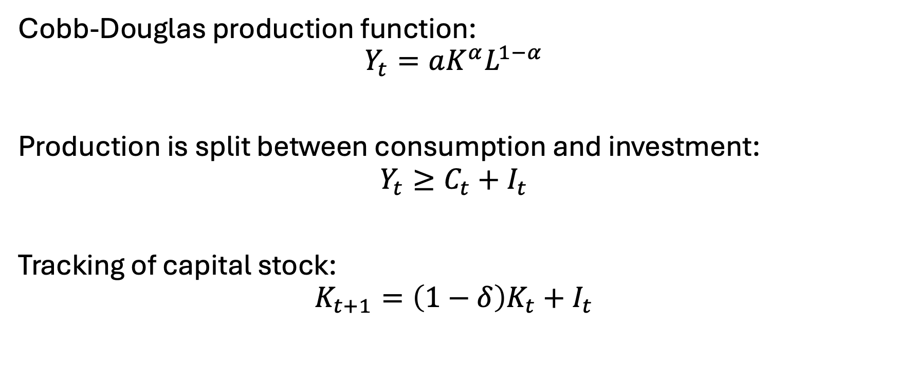
Constraints
Cobb-Douglas production function:
$$Y_{t}=aK^{α}L^{1−α}$$
Production is split between consumption and investment:
$$Y_{t}≥C_{t}+I_{t}$$
Tracking of capital stock:
$$K_{t+1}=\left(1−δ\right)K_{t}+I_{t}$$

Slide 9
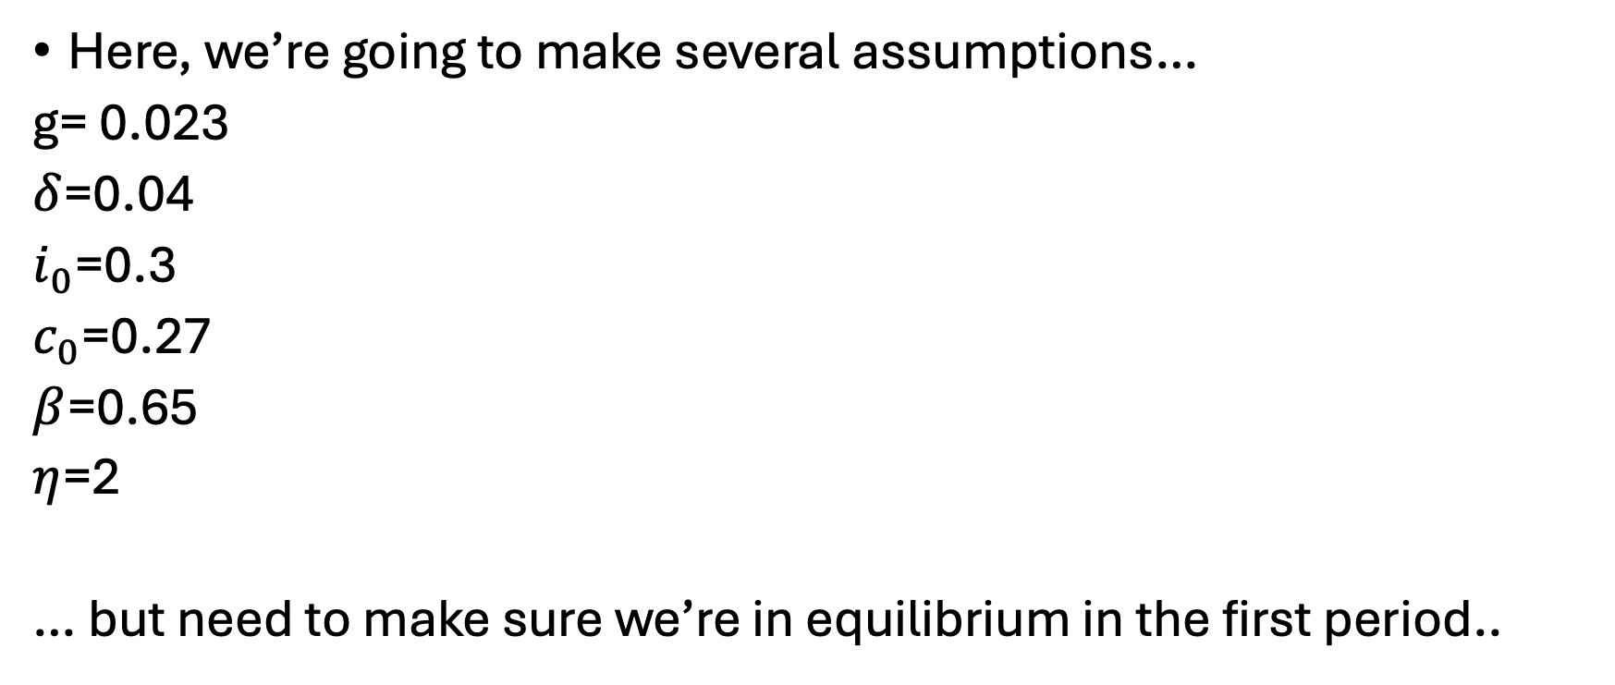
Calibration
Here, we’re going to make several assumptions…
g= 0.023
$δ$=0.04
$i_{0}$=0.3
$c_{0}$=0.27
$β$=0.65
$η$=2
… but need to make sure we’re in equilibrium in the first period..

Slide 10

Initial capital/labor calibration
Investment must cover depreciation plus population growth. Given the investment rate, we can back out the initial capital stock level. Knowing investment must cover initial capital stock’s expected growth rate and depreciation in the first period:
$$k_{0}\left(g+δ\right)=i_{0}$$
Can thus back out calibrated initial capital level:
$$k_{0}=\frac{i_{0}}{g+δ}$$
Labor supply is it’s share in production [times] initial production:
$$l_{0}=\left(1−α\right)∗(c_{0}+i_{0})$$
(exogenously-defined) labor grows at the labor growth rate:
$$l_{t}=l_{0}∗{\left(1+g\right)}^{t}$$

Slide 11
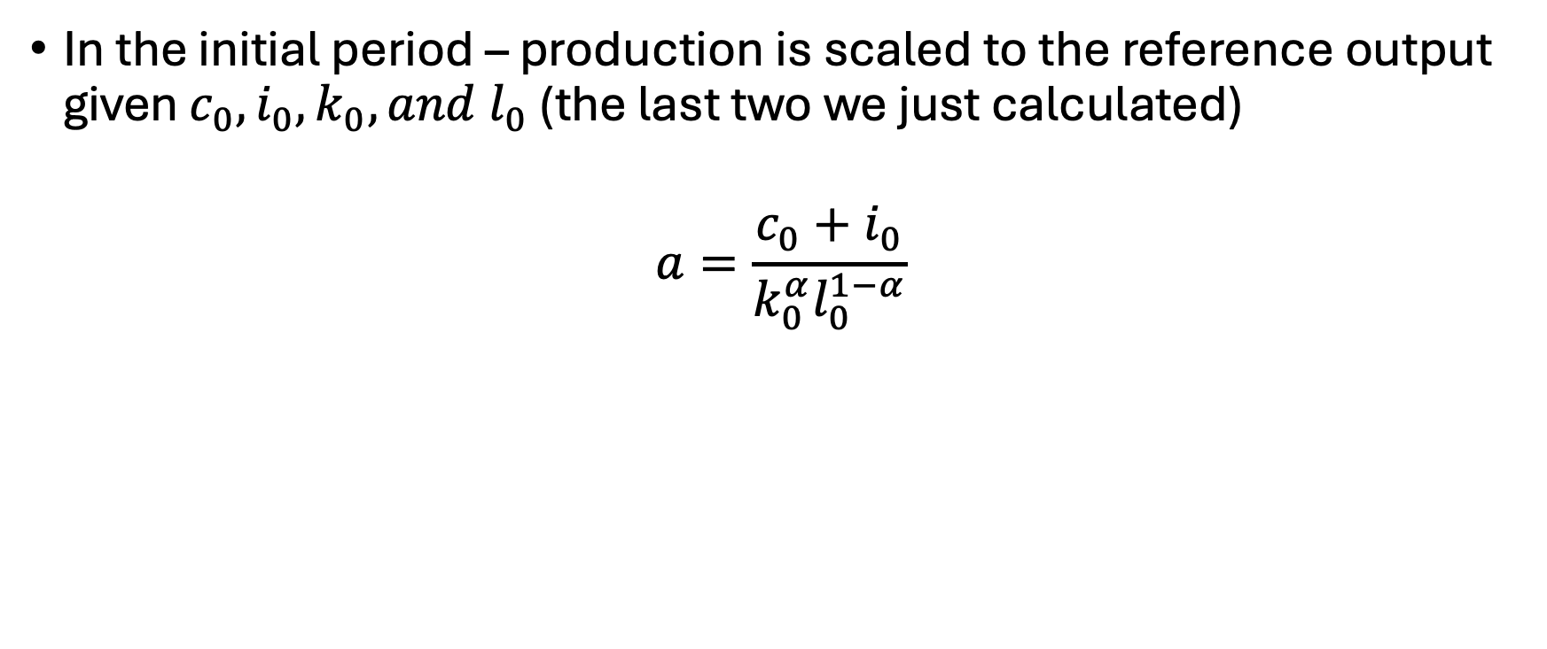
Calibrating the production scale parameter
In the initial period – production is scaled to the reference output given $c_{0}, i_{0},k_{0}, and l_{0}$ (the last two we just calculated)
$$a=\frac{c_{0}+i_{0}}{k_{0}^{α}l_{0}^{1−α}}$$

Slide 12
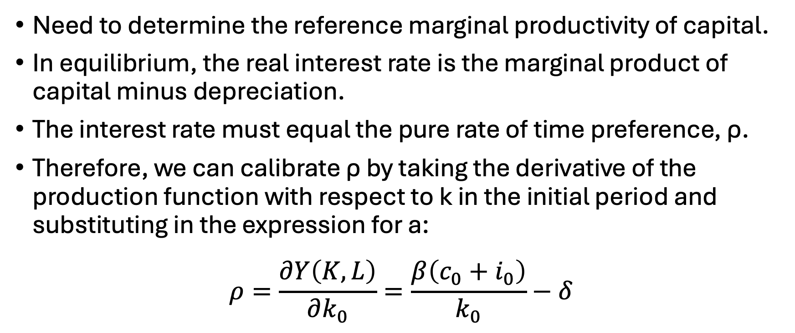
Calibrating the capital productivity
Need to determine the reference marginal productivity of capital.
In equilibrium, the real interest rate is the marginal product of capital minus depreciation.
The interest rate must equal the pure rate of time preference, ρ.
Therefore, we can calibrate ρ by taking the derivative of the production function with respect to k in the initial period and substituting in the expression for a:
$$ρ=\frac{∂Y\left(K,L\right)}{∂k_{0}}=\frac{β\left(c_{0}+i_{0}\right)}{k_{0}}−δ$$

Slide 13
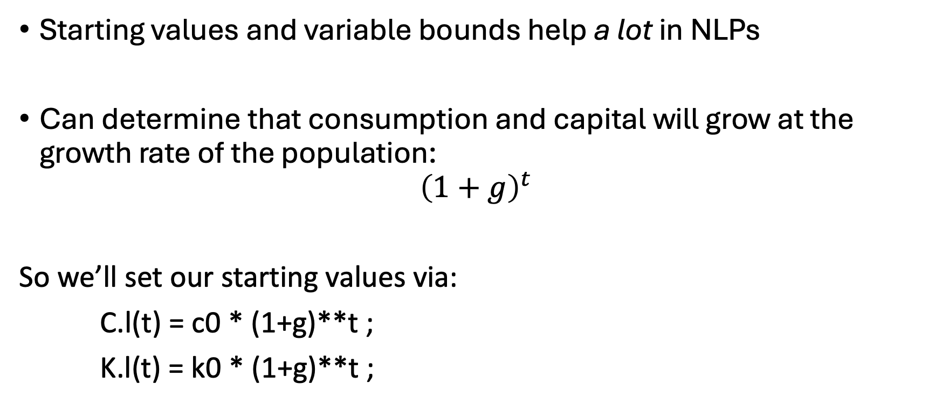
Some more notes…
Starting values and variable bounds help a lot in NLPs
Can determine that consumption and capital will grow at the growth rate of the population:
$${\left(1+g\right)}^{t}$$
So we’ll set our starting values via:
C.l(t) = c0 * (1+g)**t ;
K.l(t) = k0 * (1+g)**t ;

Slide 14
Some more notes..
Bounds on variables are needed to avoid mathematical problems
e.g. We don’t want consumption to be zero
C.lo(t) = 0.01 * C.l(t) ;
K.lo(t) = 0.01 * K.l(t) ;
Fix first period capital
K.fx(t)$tfirst(t) = k0 ;

Slide 15
Let’s build the base model…

Slide 16
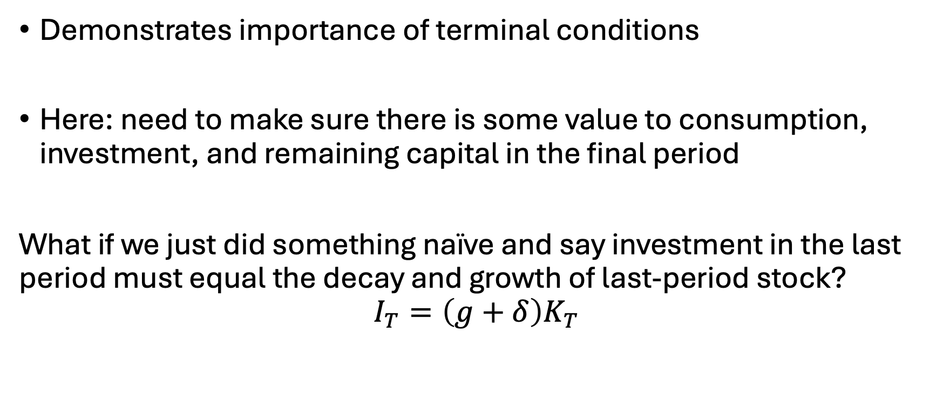
That’s weird…
Demonstrates importance of terminal conditions
Here: need to make sure there is some value to consumption, investment, and remaining capital in the final period
What if we just did something naïve and say investment in the last period must equal the decay and growth of last-period stock?
$$I_{T}=\left(g+δ\right)K_{T}$$

Slide 17
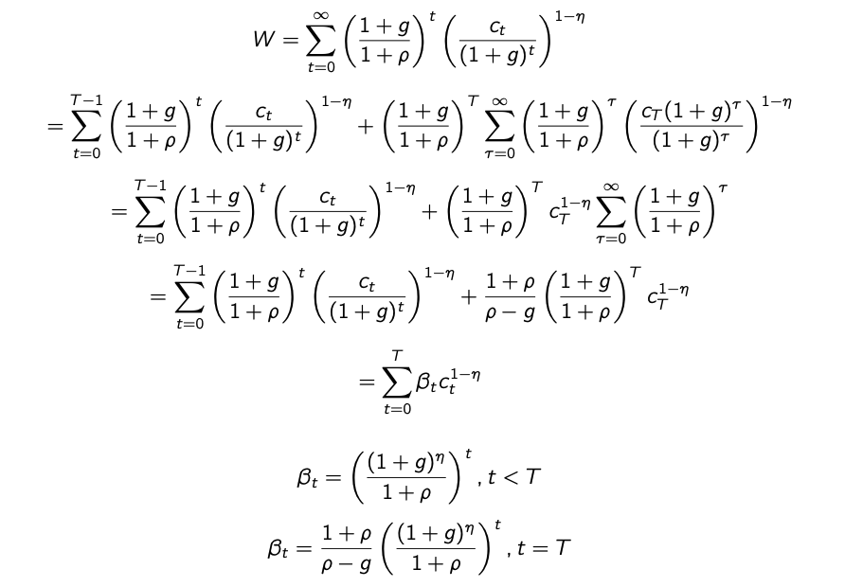
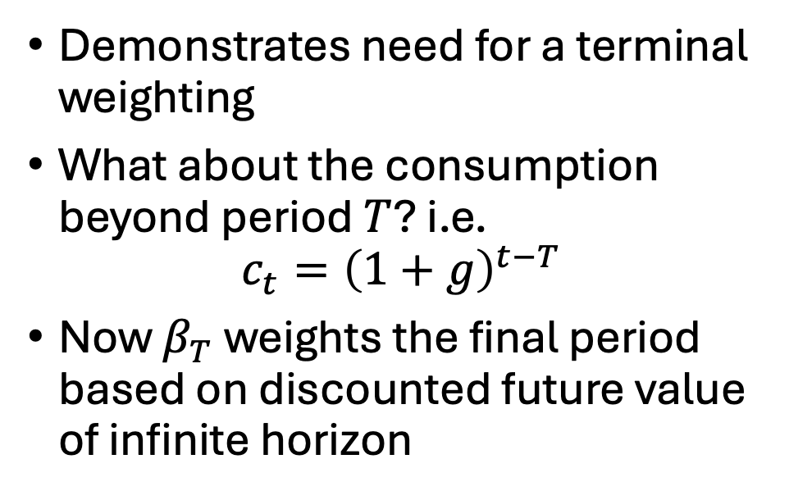
Barro-Mankiw Terminal Investment Condition
Demonstrates need for a terminal weighting
What about the consumption beyond period $T$? i.e.
$$c_{t}={\left(1+g\right)}^{t−T}$$
Now $β_{T}$ weights the final period based on discounted future value of infinite horizon

Slide 18
Complementarity Problems
Complementarity problems: start with the primal and dual constraints and remove the objective functions
More generally: equilibrium problems
Specific types but -almost- always referred to in practice as Mixed Complementarity Problems (MCPs).. All types:
Linear Complementarity Problems (LCPs)
Non-linear Complementarity Problems (NLCPs)
Both non-linear and linear complementarity problems are mixed (MCPs)
Also: integer, others..

Slide 19
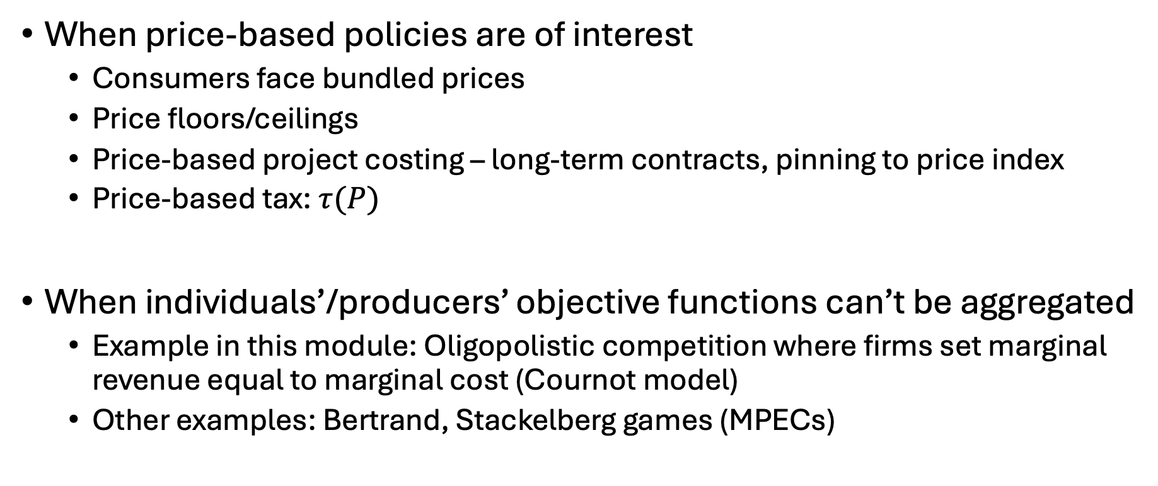
When should we use MCPs?
When price-based policies are of interest
Consumers face bundled prices
Price floors/ceilings
Price-based project costing – long-term contracts, pinning to price index
Price-based tax: $τ(P)$
When individuals’/producers’ objective functions can’t be aggregated
Example in this module: Oligopolistic competition where firms set marginal revenue equal to marginal cost (Cournot model)
Other examples: Bertrand, Stackelberg games (MPECs)

Slide 20

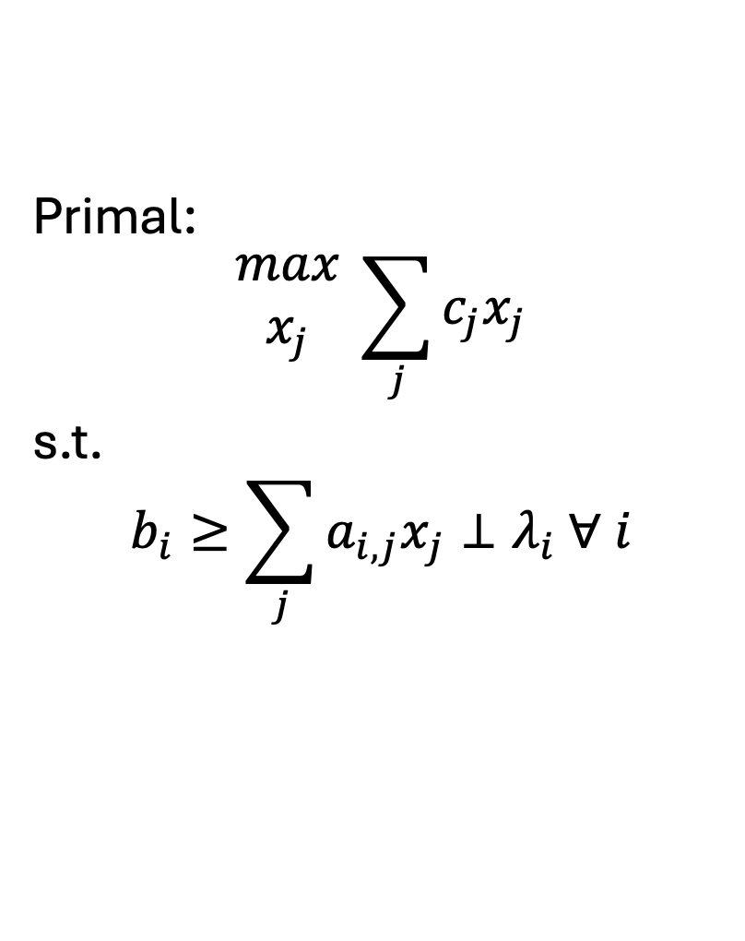
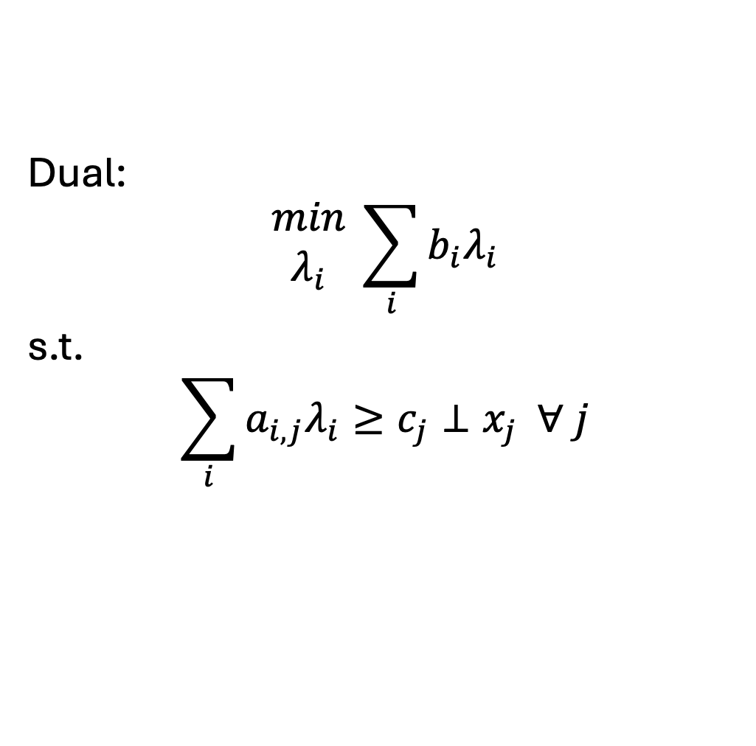
Formulating the dual..
$i$: # constraints (primal), # variables (dual)
$j$: # variables (primal), # constraints (dual)
Primal:
$$\begin{matrix}max \\ x_{j}\end{matrix} \sum_{j}{c_{j}x_{j}}$$
s.t.
$$b_{i}≥\sum_{j}{a_{i,j}x_{j}}⊥λ_{i} ∀ i$$
Dual:
$$\begin{matrix}min \\ λ_{i}\end{matrix} \sum_{i}{b_{i}λ_{i}}$$
s.t.
$$\sum_{i}{a_{i,j}λ_{i}}≥c_{j}⊥x_{j} ∀ j$$

Slide 21
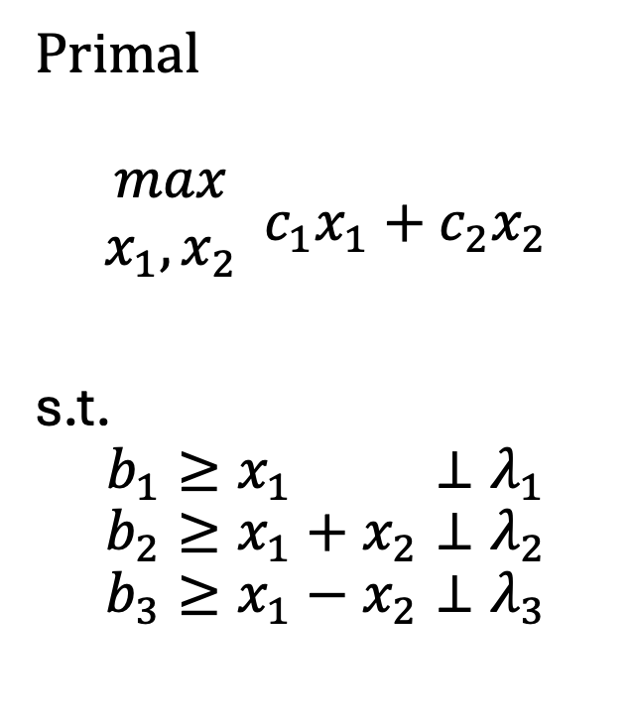
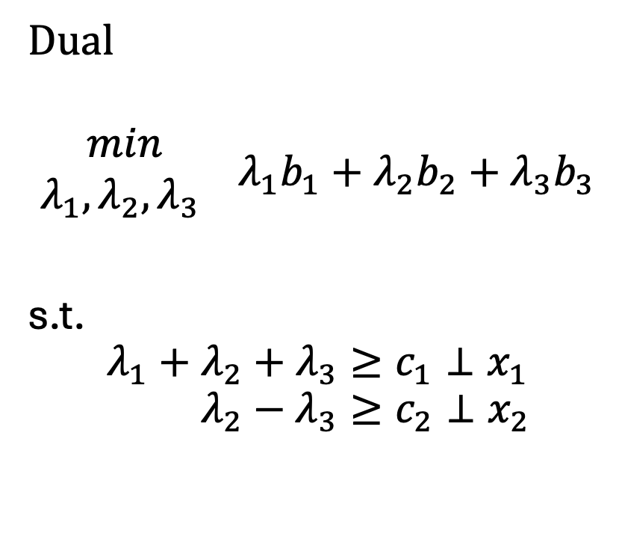
A very simple example
Primal
$$\begin{matrix}max \\ x_{1},x_{2}\end{matrix} c_{1}x_{1}+c_{2}x_{2}$$
s.t.
$$b_{1}≥x_{1} ⊥λ_{1}$$
$$b_{2}≥x_{1}+x_{2}⊥λ_{2}$$
$$b_{3}≥x_{1}−x_{2}⊥λ_{3}$$
Dual
$$\begin{matrix}min \\ λ_{1},λ_{2},λ_{3} \end{matrix} λ_{1}b_{1}+λ_{2}b_{2}+λ_{3}b_{3}$$
s.t.
$${λ_{1}+λ_{2}+λ_{3}≥c}_{1}⊥x_{1}$$
$$λ_{2}−λ_{3}≥c_{2}⊥x_{2}$$
1 | 1 | 1
0 | 1 | -1
1 | 0
1 | 1
1 | -1

Slide 22
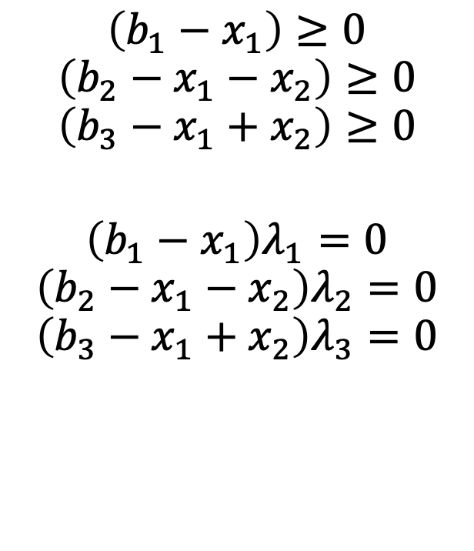

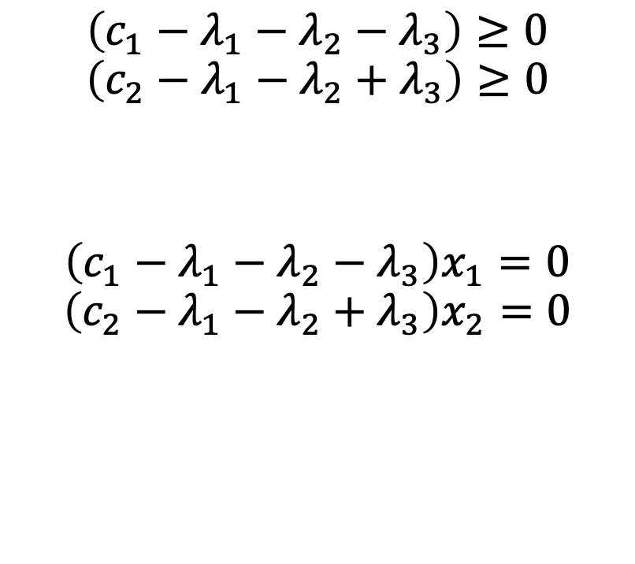
Complementarity conditions
$$\left(b_{1}−x_{1}\right)≥0$$
$$\left(b_{2}−x_{1}−x_{2}\right)≥0$$
$$\left(b_{3}−x_{1}+x_{2}\right)≥0$$
$$\left(b_{1}−x_{1}\right)λ_{1}=0$$
$$\left(b_{2}−x_{1}−x_{2}\right)λ_{2}=0$$
$$\left(b_{3}−x_{1}+x_{2}\right)λ_{3}=0$$
$$\left(c_{1}−λ_{1}−λ_{2}−λ_{3}\right)≥0$$
$$\left(c_{2}−λ_{1}−λ_{2}+λ_{3}\right)≥0$$
$$\left(c_{1}−λ_{1}−λ_{2}−λ_{3}\right)x_{1}=0$$
$$\left(c_{2}−λ_{1}−λ_{2}+λ_{3}\right)x_{2}=0$$
$$x_{1},x_{2}≥0$$
$$λ_{1},λ_{2},λ_{3}≥0$$

Slide 23
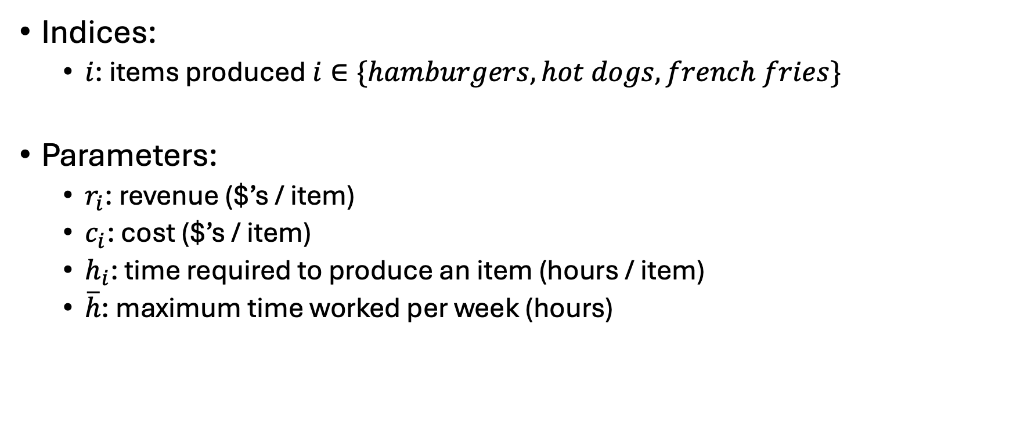
Ripley’s restaurant – now with the Dual
Indices:
$i$: items produced $i∈\{hamburgers, hot dogs, french fries\}$
Parameters:
$r_{i}$: revenue ($’s / item)
$c_{i}$: cost ($’s / item)
$h_{i}$: time required to produce an item (hours / item)
$\overline{h}$: maximum time worked per week (hours)
Item | Revenue | Cost | Hours
Hamburger | 1.5 | 0.75 | 0.5
Hot dog | 0.75 | 0.1 | 0.2
French fries | 0.25 | 0.05 | 0.1

Slide 24
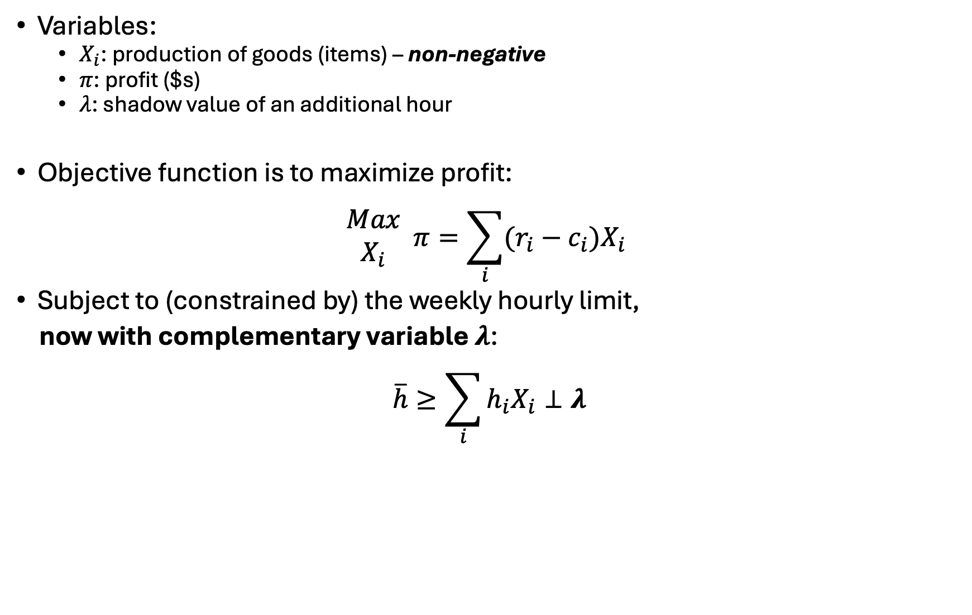
Ripley’s restaurant
Variables:
$X_{i}$: production of goods (items) – non-negative
$π$: profit ($s)
$λ$: shadow value of an additional hour
Objective function is to maximize profit:
$$\begin{matrix}Max \\ X_{i}\end{matrix} π=\sum_{i}{(r_{i}−c_{i})X_{i}}$$
Subject to (constrained by) the weekly hourly limit,
now with complementary variable $λ$:
$$\overline{h}≥\sum_{i}{h_{i}X_{i}}⊥λ$$

Slide 25
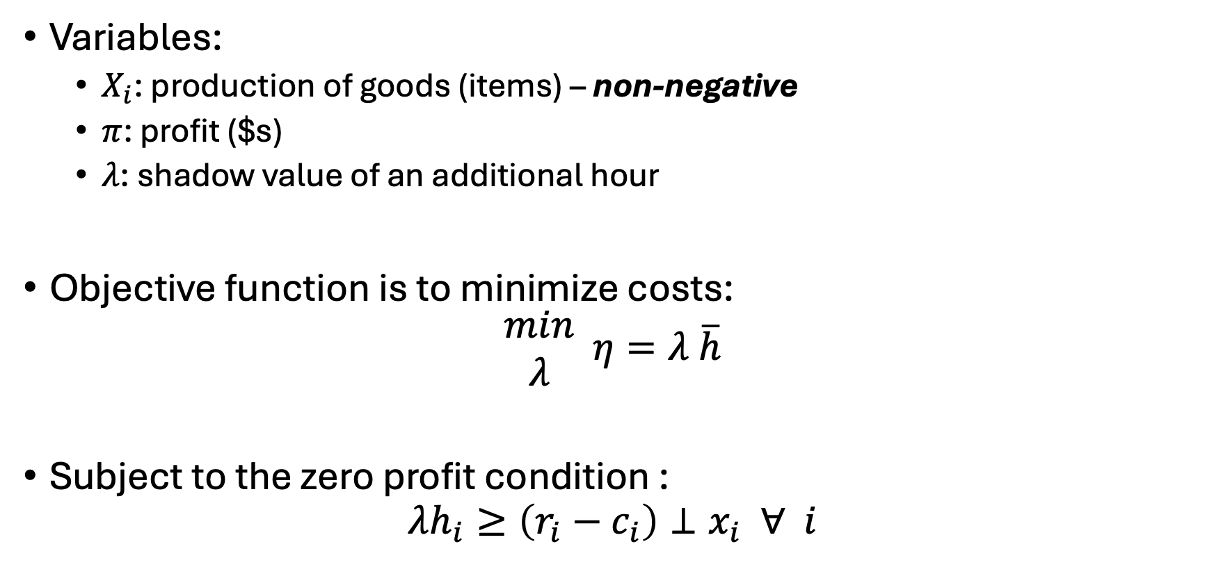
Ripley’s restaurant – the dual
Variables:
$X_{i}$: production of goods (items) – non-negative
$π$: profit ($s)
$λ$: shadow value of an additional hour
Objective function is to minimize costs:
$$\begin{matrix}min \\ λ\end{matrix} η=λ \overline{h}$$
Subject to the zero profit condition :
$$λh_{i}≥\left(r_{i}−c_{i}\right)⊥x_{i} ∀ i$$

Slide 26
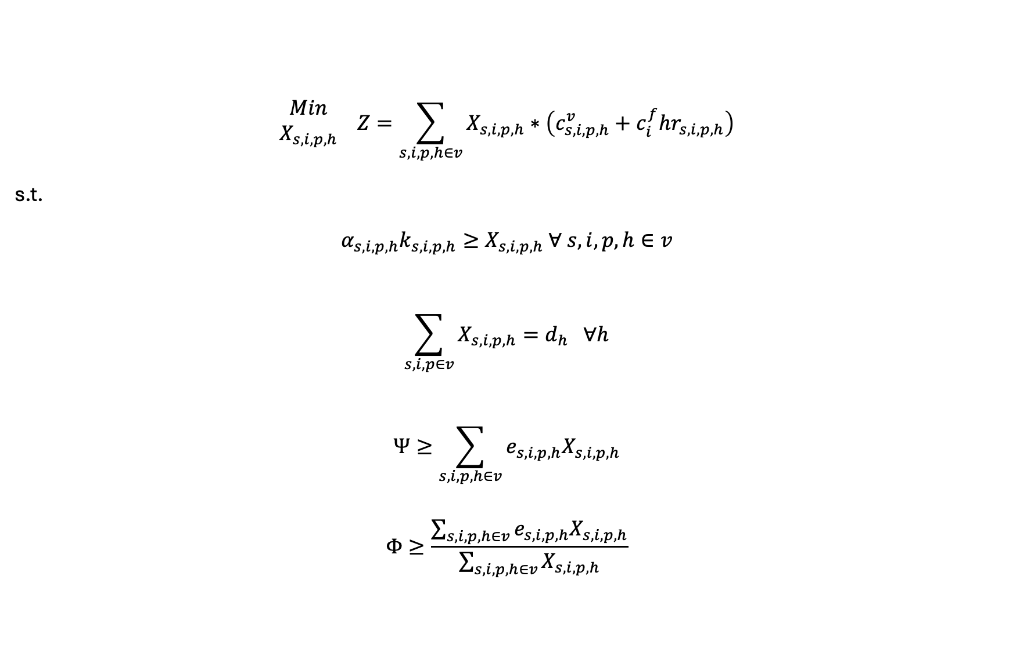
What about our simple electricity model?
$$\begin{matrix}Min \\ X_{s,i,p,h}\end{matrix} Z=\sum_{s,i,p,h∈v}{X_{s,i,p,h}}∗\left(c_{s,i,p,h}^{v}+c_{i}^{f}hr_{s,i,p,h}\right)$$
s.t.
$$α_{s,i,p,h}k_{s,i,p,h}≥X_{s,i,p,h} ∀ s,i,p,h∈v$$
$$\sum_{s,i,p∈v}{X_{s,i,p,h}}=d_{h} ∀h$$
$$Ψ≥\sum_{s,i,p,h∈v}{e_{s,i,p,h}X_{s,i,p,h}}$$
$$Φ≥\frac{\sum_{s,i,p,h∈v}{e_{s,i,p,h}X_{s,i,p,h}}}{\sum_{s,i,p,h∈v}{X_{s,i,p,h}}}$$

Slide 27

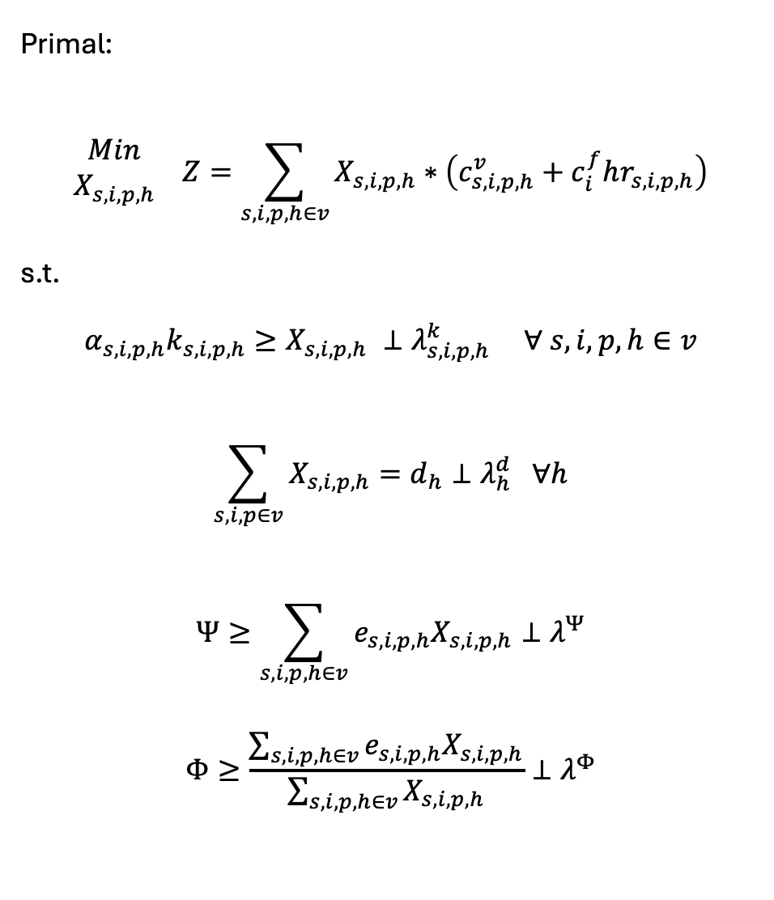
Primal:
$$\begin{matrix}Min \\ X_{s,i,p,h}\end{matrix} Z=\sum_{s,i,p,h∈v}{X_{s,i,p,h}}∗\left(c_{s,i,p,h}^{v}+c_{i}^{f}hr_{s,i,p,h}\right)$$
s.t.
$$α_{s,i,p,h}k_{s,i,p,h}≥X_{s,i,p,h} ⊥λ_{s,i,p,h}^{k} ∀ s,i,p,h∈v$$
$$\sum_{s,i,p∈v}{X_{s,i,p,h}}=d_{h}⊥λ_{h}^{d} ∀h$$
$$Ψ≥\sum_{s,i,p,h∈v}{e_{s,i,p,h}X_{s,i,p,h}}⊥λ^{Ψ}$$
$$Φ≥\frac{\sum_{s,i,p,h∈v}{e_{s,i,p,h}X_{s,i,p,h}}}{\sum_{s,i,p,h∈v}{X_{s,i,p,h}}}⊥λ^{Φ}$$
Dual:
$$\begin{matrix}Max \\ λ_{s,i,p,h}^{k},λ_{h}^{d},λ^{Ψ},λ^{Φ}\end{matrix} η=\sum_{h}{λ_{h}^{d}d_{h}}$$
$$−\sum_{s,i,p,h∈v}{λ_{s,i,p,h}^{k}α_{s,i,p,h}k_{s,i,p,h}}$$
$$−λ^{Ψ}Ψ−λ^{Φ}Φ$$
s.t.
$${ c}_{s,i,p,h}^{v}+c_{i}^{f}hr_{s,i,p,h}+λ_{s,i,p,h}^{k}$$
$$+ e_{s, i,p,h}λ^{Ψ}+λ^{Φ}\left(e_{s,i,p,h}−Ψ\right)$$
$$≥λ_{h}^{d}⊥X_{s, i,p,h} ∀ s,i,p,h∈v$$

Slide 28
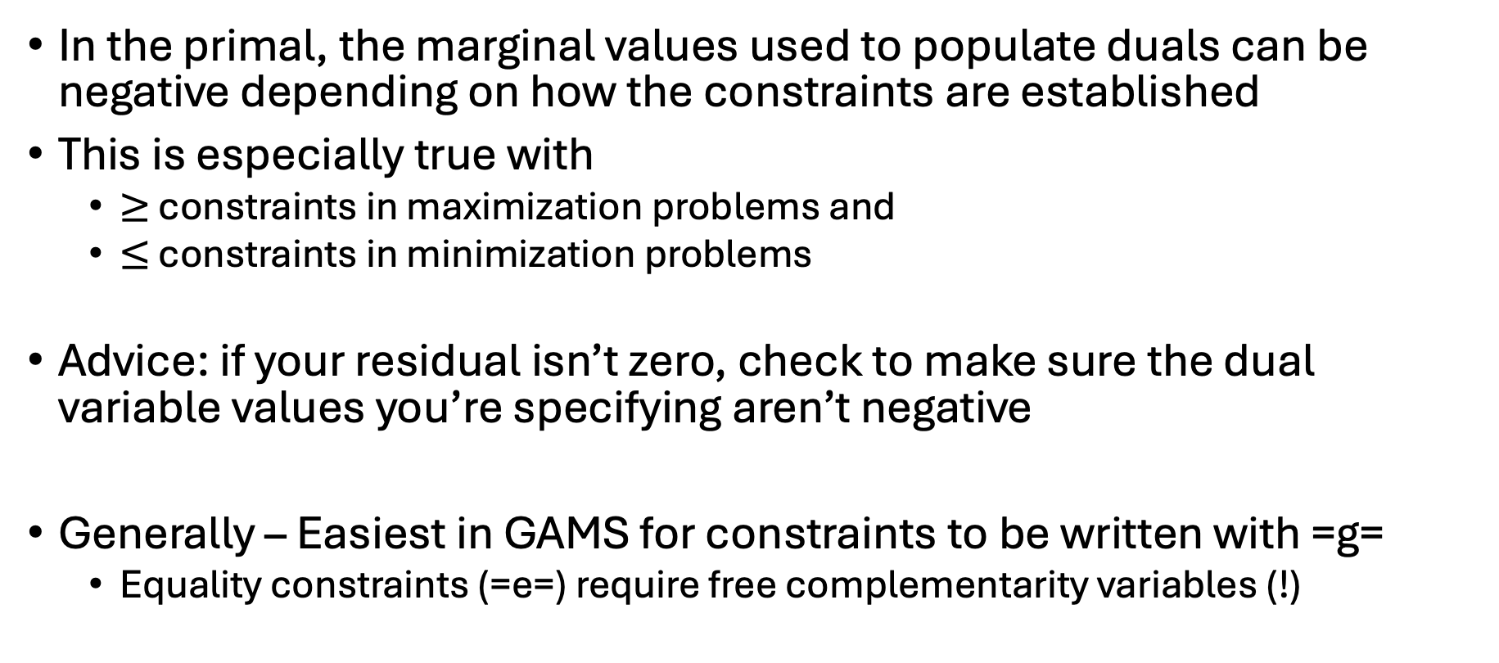
Caveat: Dual signs
In the primal, the marginal values used to populate duals can be negative depending on how the constraints are established
This is especially true with
$≥$ constraints in maximization problems and
$≤$ constraints in minimization problems
Advice: if your residual isn’t zero, check to make sure the dual variable values you’re specifying aren’t negative
Generally – Easiest in GAMS for constraints to be written with =g=
Equality constraints (=e=) require free complementarity variables (!)

Slide 29
Steps to creating an MCP from an existing LP/NLP
Write out initial problem
Derive complementarity conditions (dual w/o objective)
Set up problem as: [primal constraints] & [dual constraints]
Solve your initial problem
Assign level values to both primal variables and dual variables
Dual variable values set as marginal off the respective constraints
Alternatively, could solve both the primal and dual problem
Set iteration limit for MCP problem to zero
Make sure we have a zero residual

Slide 30
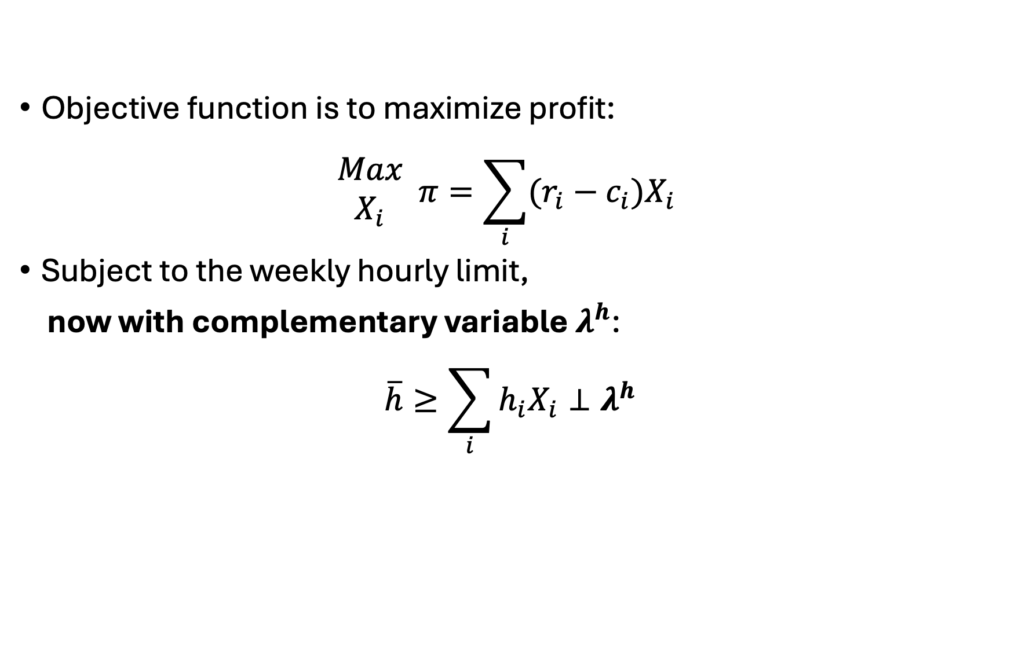
Write out initial problem
Objective function is to maximize profit:
$$\begin{matrix}Max \\ X_{i}\end{matrix} π=\sum_{i}{(r_{i}−c_{i})X_{i}}$$
Subject to the weekly hourly limit,
now with complementary variable $λ^{h}$:
$$\overline{h}≥\sum_{i}{h_{i}X_{i}}⊥λ^{h}$$

Slide 31
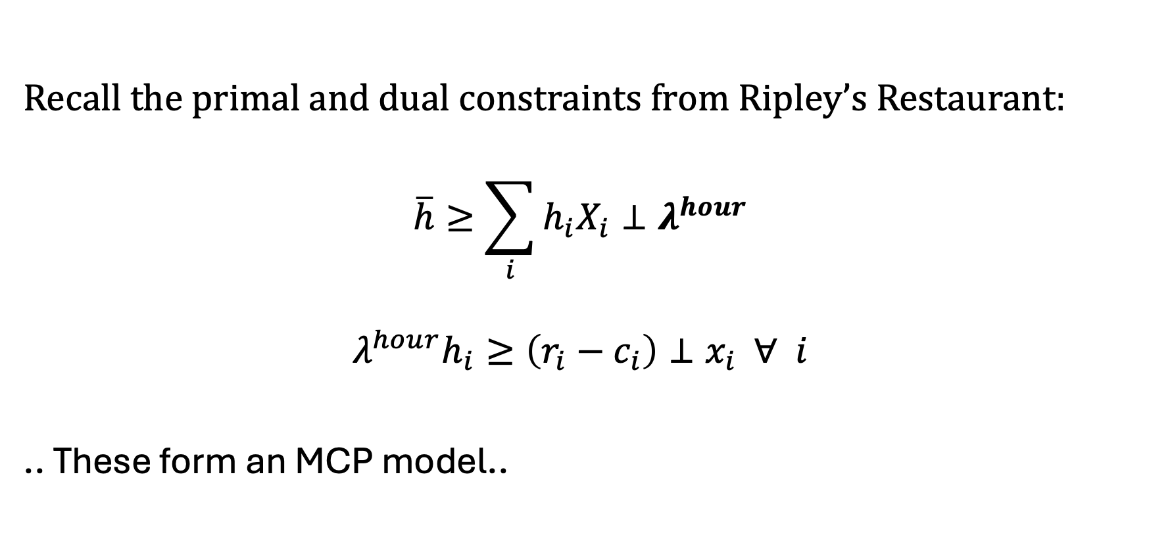
Derive complementarity conditions
Recall the primal and dual constraints from Ripley’s Restaurant:
$$\overline{h}≥\sum_{i}{h_{i}X_{i}}⊥λ^{hour}$$
$$λ^{hour}h_{i}≥\left(r_{i}−c_{i}\right)⊥x_{i} ∀ i$$
.. These form an MCP model..

Slide 32
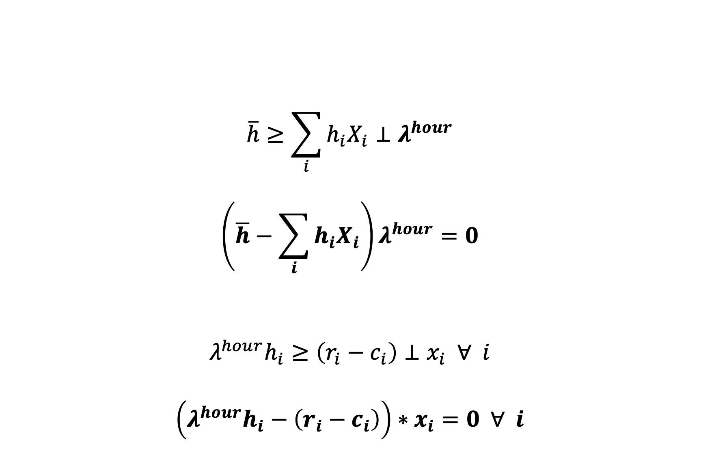
(Full) Complementarity Conditions
$$\overline{h}≥\sum_{i}{h_{i}X_{i}}⊥λ^{hour}$$
$$\left(\overline{h}−\sum_{i}{h_{i}X_{i}}\right)λ^{hour}=0$$
$$λ^{hour}h_{i}≥\left(r_{i}−c_{i}\right)⊥x_{i} ∀ i$$
$$\left(λ^{hour}h_{i}−\left(r_{i}−c_{i}\right)\right)∗x_{i}=0 ∀ i$$
These are generated by GAMS!

Slide 33
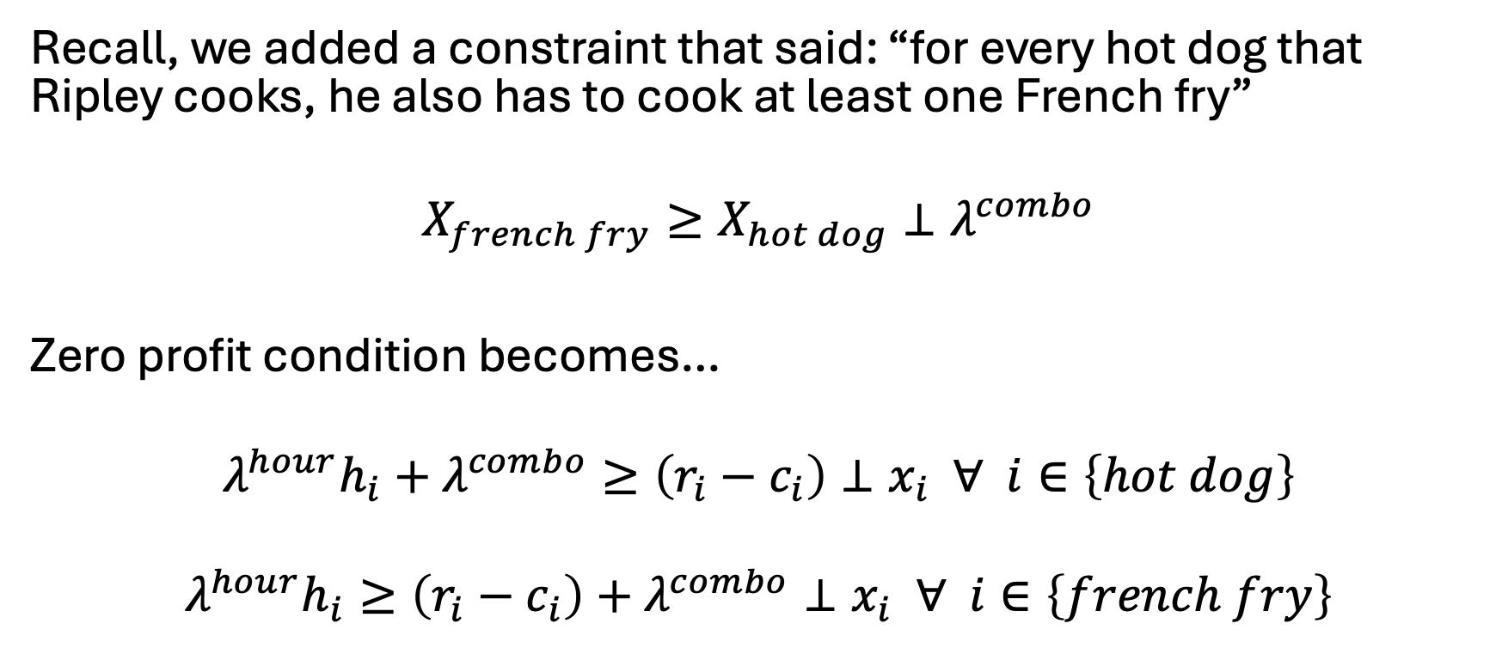
Let’s add the combo constraint…
Recall, we added a constraint that said: “for every hot dog that Ripley cooks, he also has to cook at least one French fry”
$$X_{french fry}≥X_{hot dog}⊥λ^{combo}$$
Zero profit condition becomes…
$$λ^{hour}h_{i}+λ^{combo}≥\left(r_{i}−c_{i}\right)⊥x_{i} ∀ i∈\left\{hot dog\right\}$$
$$λ^{hour}h_{i}≥\left(r_{i}−c_{i}\right)+λ^{combo}⊥x_{i} ∀ i∈\left\{french fry\right\}$$

Slide 34
Indices of the shadow value variable will always match the dimensions of its primal constraint – this also implies conditionals on the primal constraint indices need to be applied to the dual variable

Slide 35
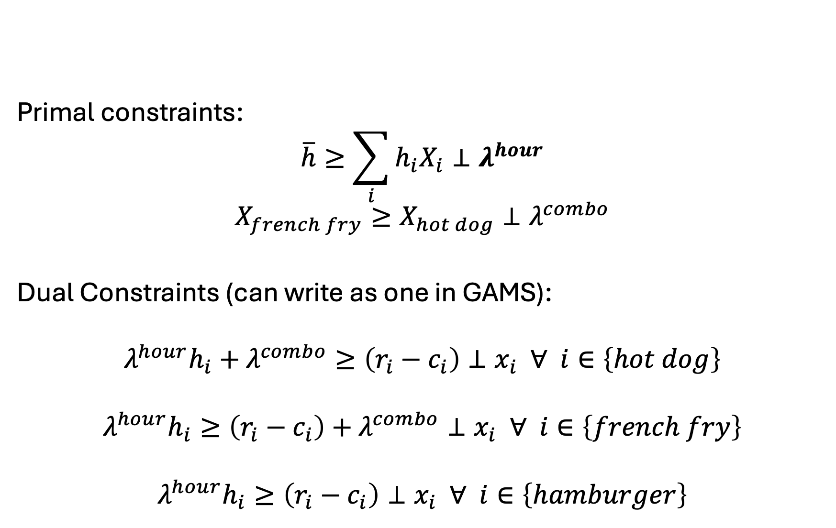
Set up problem as: [primal constraints] & [dual constraints]
Primal constraints:
$$\overline{h}≥\sum_{i}{h_{i}X_{i}}⊥λ^{hour}$$
$$X_{french fry}≥X_{hot dog}⊥λ^{combo}$$
Dual Constraints (can write as one in GAMS):
$$λ^{hour}h_{i}+λ^{combo}≥\left(r_{i}−c_{i}\right)⊥x_{i} ∀ i∈\left\{hot dog\right\}$$
$$λ^{hour}h_{i}≥\left(r_{i}−c_{i}\right)+λ^{combo}⊥x_{i} ∀ i∈\left\{french fry\right\}$$
$$λ^{hour}h_{i}≥\left(r_{i}−c_{i}\right)⊥x_{i} ∀ i∈\left\{hamburger\right\}$$

Slide 36
Now in GAMS, need to:
Solve your initial problem
Assign level values to both primal variables and dual variables
Dual variable values set as marginal off the respective constraints
Alternatively, could solve both the primal and dual problem
Set iteration limit for MCP problem to zero
Make sure we have a zero residual

Slide 37
Now let’s do the electricity example
Write out initial problem
Derive complementarity conditions (dual w/o objective)
Set up problem as: [primal constraints] & [dual constraints]
Solve your initial problem
Assign level values to both primal variables and dual variables
Dual variable values set as marginal off the respective constraints
Alternatively, could solve both the primal and dual problem
Set iteration limit for MCP problem to zero
Make sure we have a zero residual

Slide 38

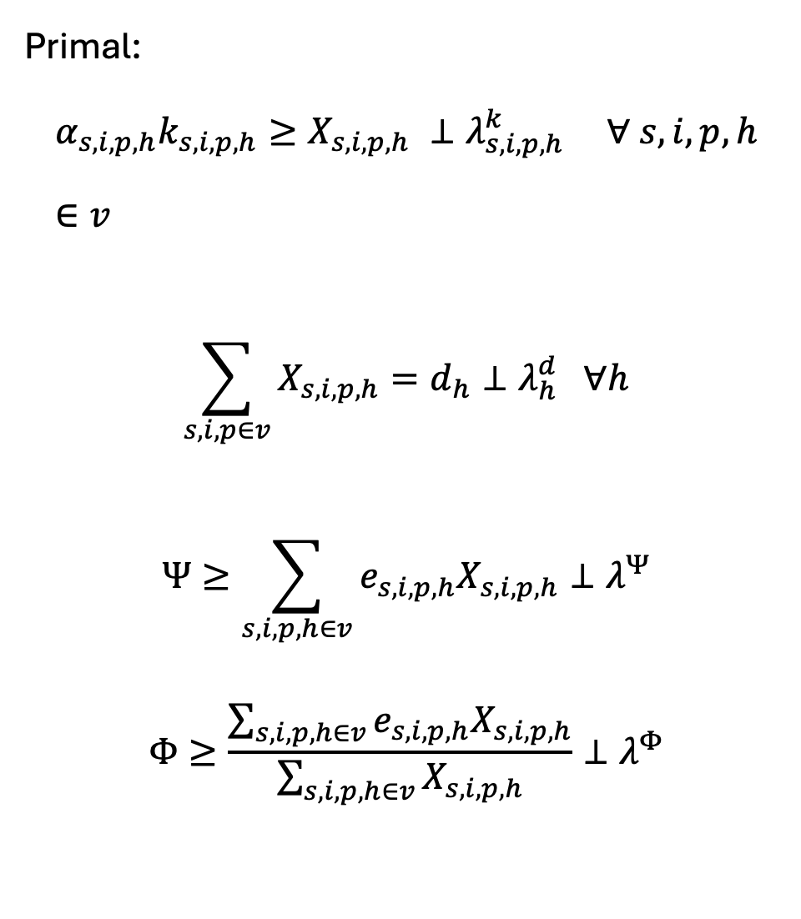
Primal:
$$α_{s,i,p,h}k_{s,i,p,h}≥X_{s,i,p,h} ⊥λ_{s,i,p,h}^{k} ∀ s,i,p,h∈v$$
$$\sum_{s,i,p∈v}{X_{s,i,p,h}}=d_{h}⊥λ_{h}^{d} ∀h$$
$$Ψ≥\sum_{s,i,p,h∈v}{e_{s,i,p,h}X_{s,i,p,h}}⊥λ^{Ψ}$$
$$Φ≥\frac{\sum_{s,i,p,h∈v}{e_{s,i,p,h}X_{s,i,p,h}}}{\sum_{s,i,p,h∈v}{X_{s,i,p,h}}}⊥λ^{Φ}$$
Dual:
$${ c}_{s,i,p,h}^{v}+c_{i}^{f}hr_{s,i,p,h}+λ_{s,i,p,h}^{k}$$
$$+ e_{s, i,p,h}λ^{Ψ}+λ^{Φ}\left(e_{s,i,p,h}−Ψ\right)$$
$$≥λ_{h}^{d}⊥X_{s, i,p,h} ∀ s,i,p,h∈v$$

Slide 39
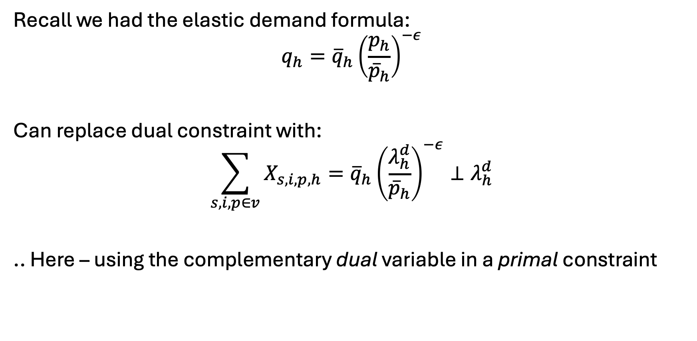
What about elastic demand?
Recall we had the elastic demand formula:
$$q_{h}={\overline{q}}_{h}{\left(\frac{p_{h}}{{\overline{p}}_{h}}\right)}^{−ε}$$
Can replace dual constraint with:
$$\sum_{s,i,p∈v}{X_{s,i,p,h}}={\overline{q}}_{h}{\left(\frac{λ_{h}^{d}}{{\overline{p}}_{h}}\right)}^{−ε}⊥λ_{h}^{d}$$
.. Here – using the complementary dual variable in a primal constraint

Slide 40
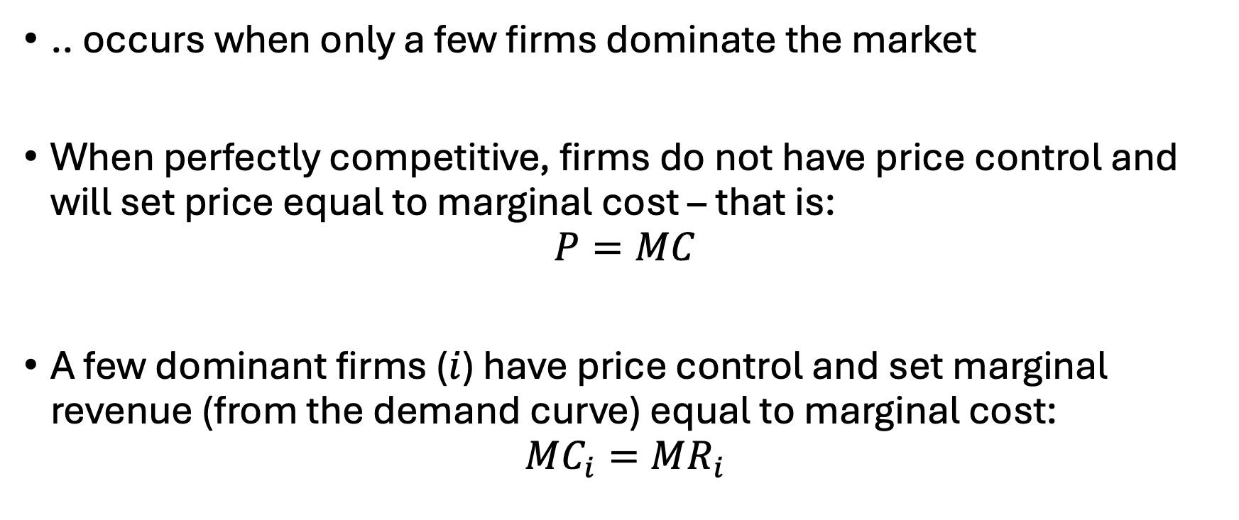
Oligopolistic Competition
.. occurs when only a few firms dominate the market
When perfectly competitive, firms do not have price control and will set price equal to marginal cost – that is:
$$P=MC$$
A few dominant firms ($i$) have price control and set marginal revenue (from the demand curve) equal to marginal cost:
$$MC_{i}=MR_{i}$$

Slide 41
Oligopolistic Competition
No longer…
maximizing social surplus as was done with supply and demand curves
able to aggregate objective functions as each firm is self-interested
Another perspective: Each firm is interacting in a shared market but acting individually in their own, profit-maximizing way
… thus can’t simply sumand maximize profits

Slide 42
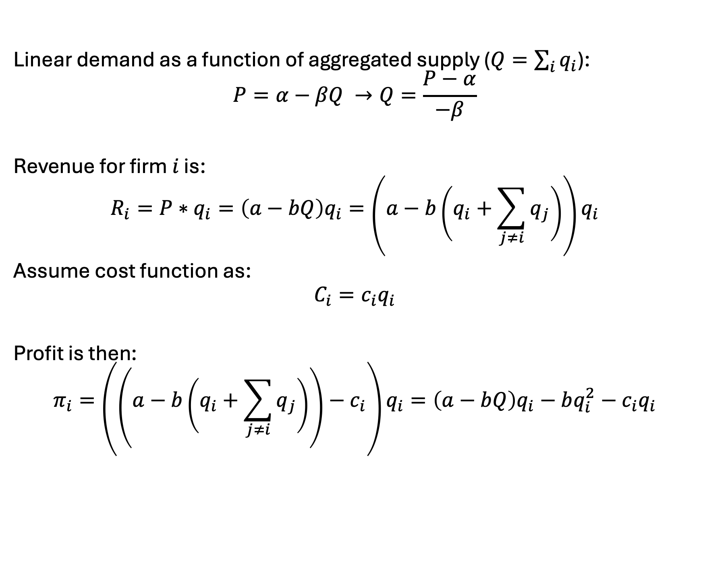
Cournot model derivation
Linear demand as a function of aggregated supply ($Q=\sum_{i}{q_{i}}$):
$$P=α−βQ →Q=\frac{P−α}{−β}$$
Revenue for firm $i$ is:
$$R_{i}=P∗q_{i}=\left(a−bQ\right)q_{i}=\left(a−b\left(q_{i}+\sum_{j≠i}{q_{j}}\right)\right)q_{i}$$
Assume cost function as:
$$C_{i}=c_{i}q_{i}$$
Profit is then:
$$π_{i}=\left(\left(a−b\left(q_{i}+\sum_{j≠i}{q_{j}}\right)\right)−c_{i}\right)q_{i}=\left(a−bQ\right)q_{i}−bq_{i}^{2}−c_{i}q_{i}$$

Slide 43
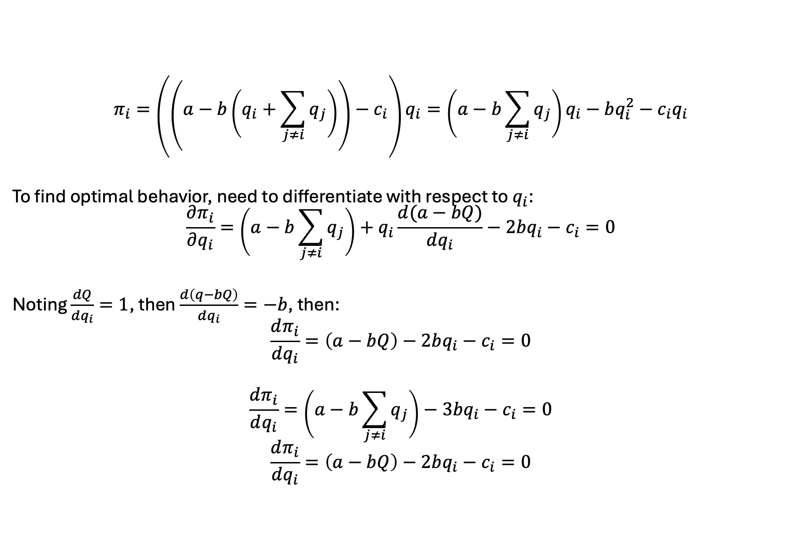
Cournot model derivation
$$π_{i}=\left(\left(a−b\left(q_{i}+\sum_{j≠i}{q_{j}}\right)\right)−c_{i}\right)q_{i}=\left(a−b\sum_{j≠i}{q_{j}}\right)q_{i}−bq_{i}^{2}−c_{i}q_{i}$$
To find optimal behavior, need to differentiate with respect to $q_{i}$:
$$\frac{∂π_{i}}{∂q_{i}}=\left(a−b\sum_{j≠i}{q_{j}}\right)+q_{i}\frac{d(a−bQ)}{dq_{i}}−2bq_{i}−c_{i}=0$$
Noting $\frac{dQ}{dq_{i}}=1$, then $\frac{d\left(q−bQ\right)}{dq_{i}}=−b$, then:
$$\frac{dπ_{i}}{dq_{i}}=\left(a−bQ\right)−2bq_{i}−c_{i}=0$$
$$\frac{dπ_{i}}{dq_{i}}=\left(a−b\sum_{j≠i}{q_{j}}\right)−3bq_{i}−c_{i}=0$$
$$\frac{dπ_{i}}{dq_{i}}=\left(a−bQ\right)−2bq_{i}−c_{i}=0$$

Slide 44
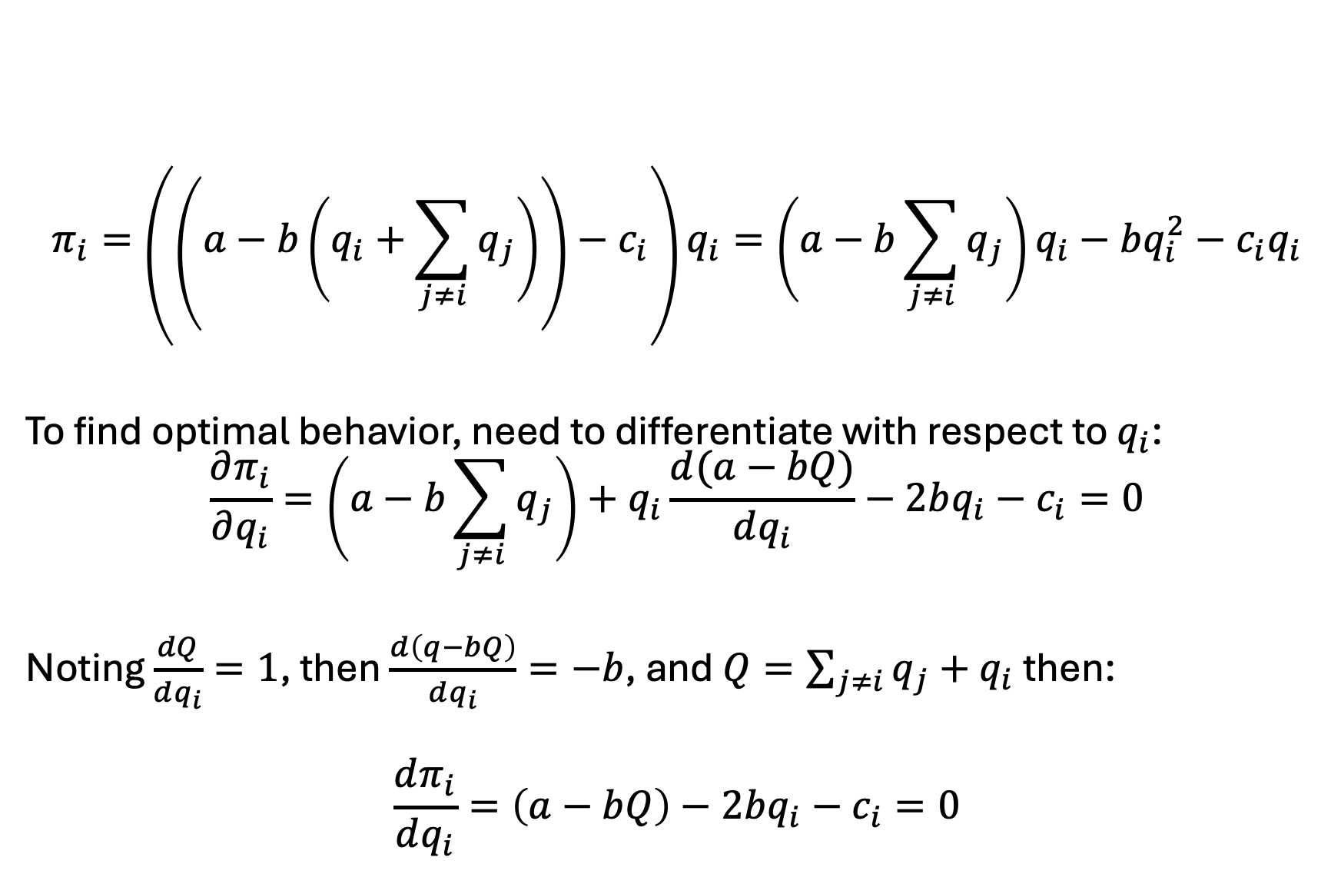
Cournot model derivation
$$π_{i}=\left(\left(a−b\left(q_{i}+\sum_{j≠i}{q_{j}}\right)\right)−c_{i}\right)q_{i}=\left(a−b\sum_{j≠i}{q_{j}}\right)q_{i}−bq_{i}^{2}−c_{i}q_{i}$$
To find optimal behavior, need to differentiate with respect to $q_{i}$:
$$\frac{∂π_{i}}{∂q_{i}}=\left(a−b\sum_{j≠i}{q_{j}}\right)+q_{i}\frac{d(a−bQ)}{dq_{i}}−2bq_{i}−c_{i}=0$$
Noting $\frac{dQ}{dq_{i}}=1$, then $\frac{d\left(q−bQ\right)}{dq_{i}}=−b$, and $Q=\sum_{j≠i}{q_{j}}+q_{i}$ then:
$$\frac{dπ_{i}}{dq_{i}}=\left(a−bQ\right)−2bq_{i}−c_{i}=0$$

Slide 45

Cournot model derivation
$$\frac{dπ_{i}}{dq_{i}}=\left(a−bQ\right)−bq_{i}−c_{i}=0$$
Implies (a) $MR_{i}=MC_{i}$ and (b):
$$q_{i}^{∗}=\frac{a−c_{i}−bQ}{b}$$

Slide 46
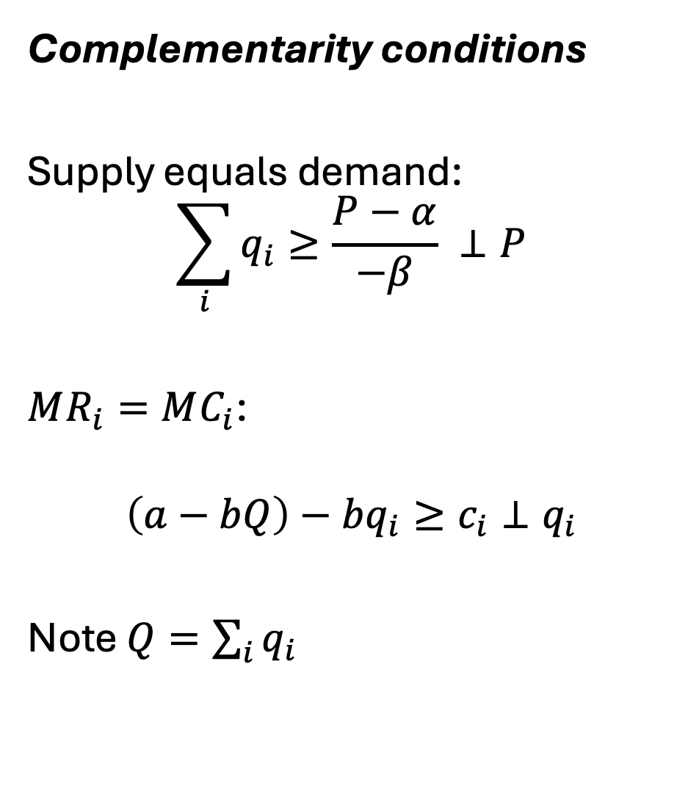
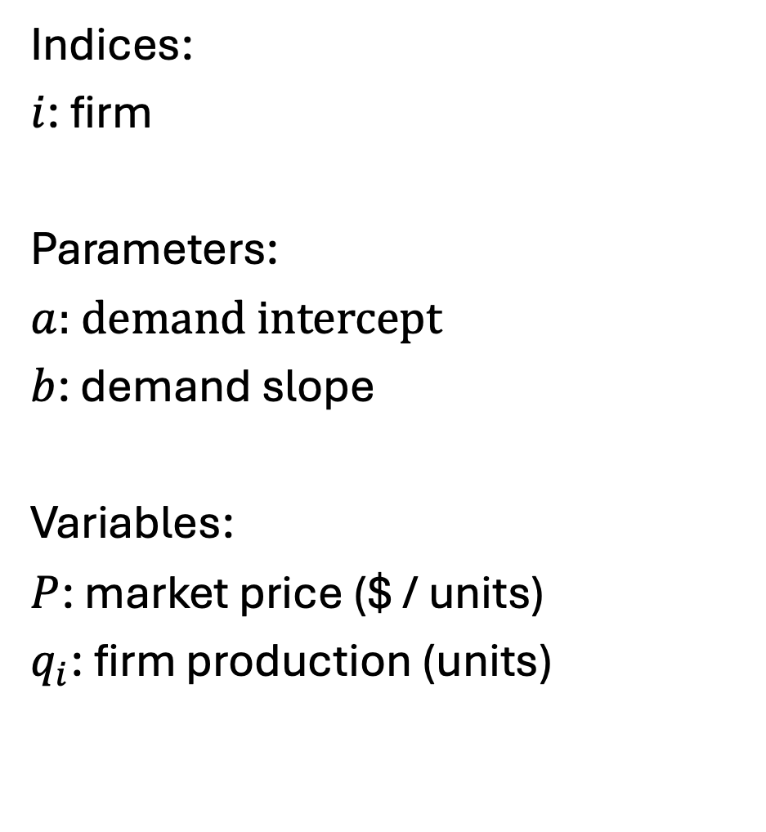
Cournot model as an MCP (linear)
Indices:
$i$: firm
Parameters:
$a$: demand intercept
$b$: demand slope
Variables:
$P$: market price ($ / units)
$q_{i}$: firm production (units)
Complementarity conditions
Supply equals demand:
$$\sum_{i}{q_{i}}≥\frac{P−α}{−β} ⊥P$$
$MR_{i}=MC_{i}$:
$$\left(a−bQ\right)−bq_{i}≥c_{i}⊥q_{i}$$
Note $Q=\sum_{i}{q_{i}}$

Slide 47
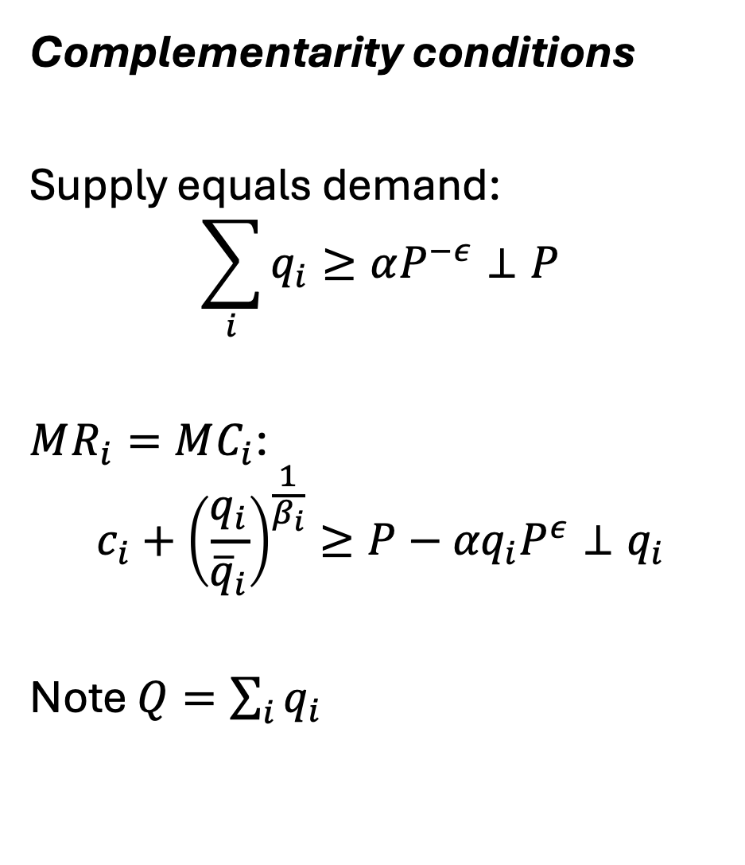
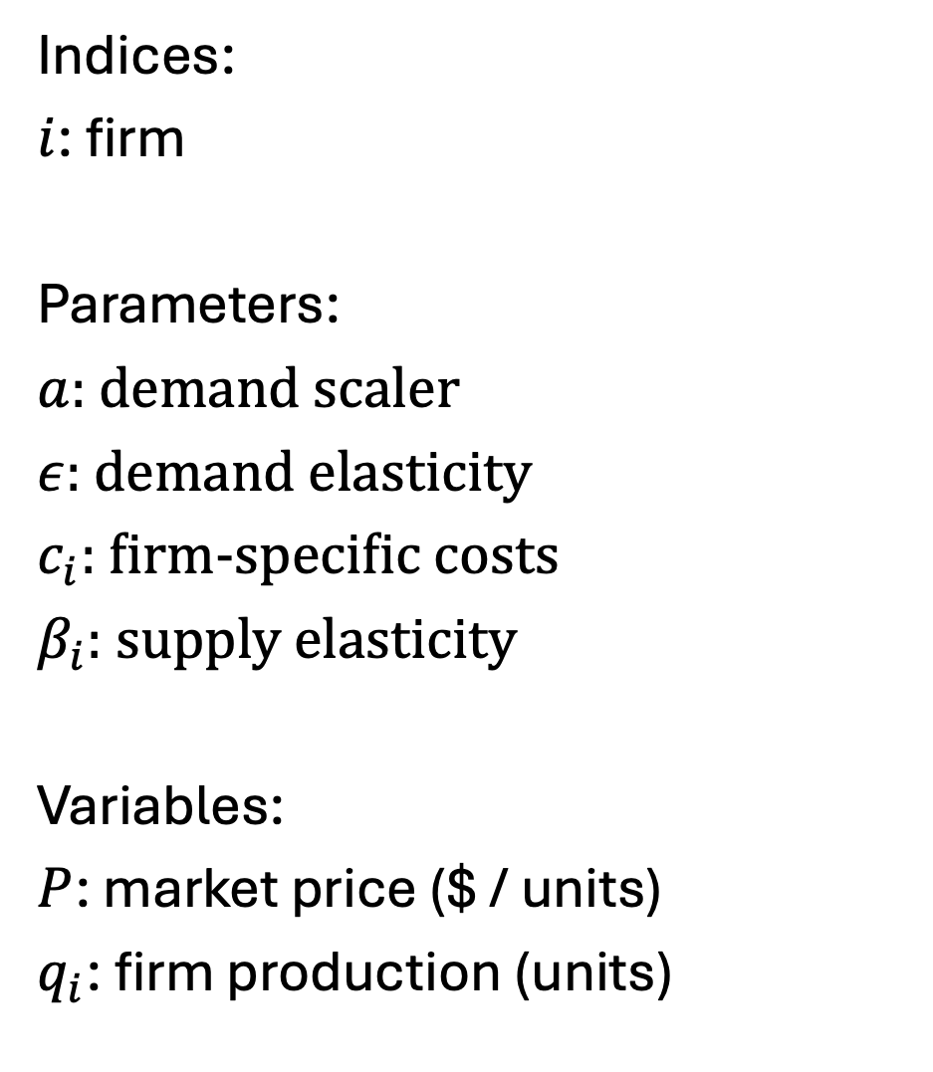
Cournot model as an MCP – from Murphy et al. 1982
Indices:
$i$: firm
Parameters:
$a$: demand scaler
$ε$: demand elasticity
$c_{i}$: firm-specific costs
$β_{i}$: supply elasticity
Variables:
$P$: market price ($ / units)
$q_{i}$: firm production (units)
Complementarity conditions
Supply equals demand:
$$\sum_{i}{q_{i}}≥αP^{−ε}⊥P$$
$MR_{i}=MC_{i}$:
$$c_{i}+{\left(\frac{q_{i}}{{\overline{q}}_{i}}\right)}^{\frac{1}{β_{i}}}≥P−{αq}_{i}P^{ε}⊥q_{i}$$
Note $Q=\sum_{i}{q_{i}}$

Slide 48

Note on deriving MC curves
Original function:
$$f_{i}=c_{i}∗q_{i}+\left(1+β\right)\frac{q^{β_{i}+1}}{{\overline{q}}_{i}^{\frac{1}{β_{i}}}β}$$
Implies:
$$\frac{df_{i}}{dq_{i}}=c_{i}+{\left(\frac{q_{i}}{{\overline{q}}_{i}}\right)}^{\frac{1}{β_{i}}}$$
From the wild west times of functional forms…

Slide 49
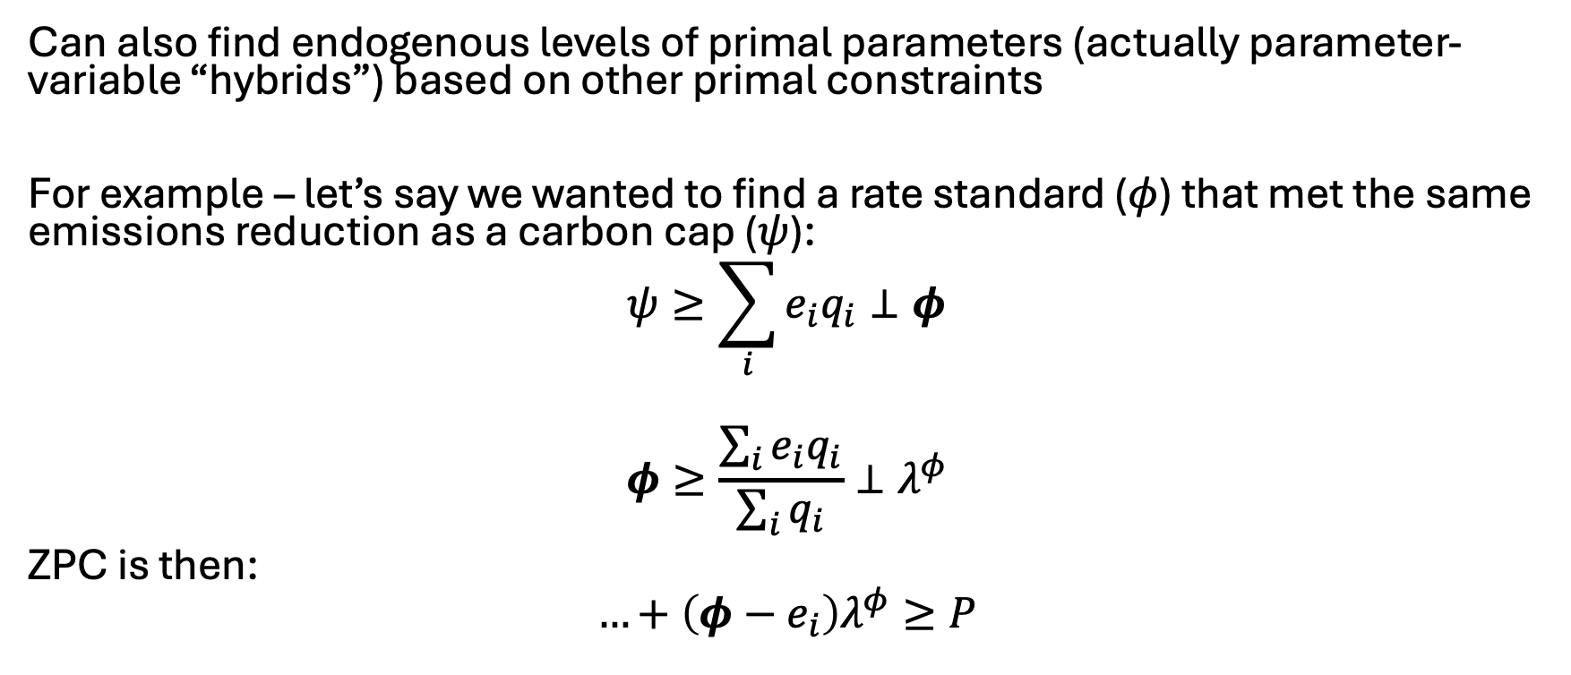
An MCP ‘hack’
Can also find endogenous levels of primal parameters (actually parameter-variable “hybrids”) based on other primal constraints
For example – let’s say we wanted to find a rate standard ($φ$) that met the same emissions reduction as a carbon cap ($ψ$):
$$ψ≥\sum_{i}{e_{i}q_{i}}⊥φ$$
$$φ≥\frac{\sum_{i}{e_{i}q_{i}}}{\sum_{i}{q_{i}}}⊥λ^{φ}$$
ZPC is then:
$$…+\left(φ−e_{i}\right)λ^{φ}≥P$$

