Slide 1

EBGN645
Duality $→$ Complementarity problems
Cournot models
MPECs for calibration

Slide 2
Upcoming Classes
Next Monday – know several of you will be gone
Could re-organize presentations and have cancelled/hangout class 12/10

Slide 3
A note on AI (aka don’t do this)
Reviewed a paper yesterday, clearly written by AI
Author did not check/review/compare values
Clearly biased, obviously wrong
Still submitted it to a journal
My comment to the editor: “I wouldn’t touch this with a 10ft pole”

Slide 4

The question nobody asked…
What watch are you wearing today?
A: “Dog” by Mr. Jones Watches

Slide 5

Agenda
Duality -> MCP’s (brief review)
Applications:
Simple example using Ripley’s restaurant
More complicated with electricity dispatch
Auto-Calibration via MPEC
Oligopolistic competition (of mineral markets)

Slide 6
Complementarity Problems
Complementarity problems: start with the primal and dual constraints and remove the objective functions
More generally: equilibrium problems
Specific types but -almost- always referred to in practice as Mixed Complementarity Problems (MCPs).. All types:
Linear Complementarity Problems (LCPs)
Non-linear Complementarity Problems (NLCPs)
Both non-linear and linear complementarity problems are mixed (MCPs)
Also: integer, others..

Slide 7
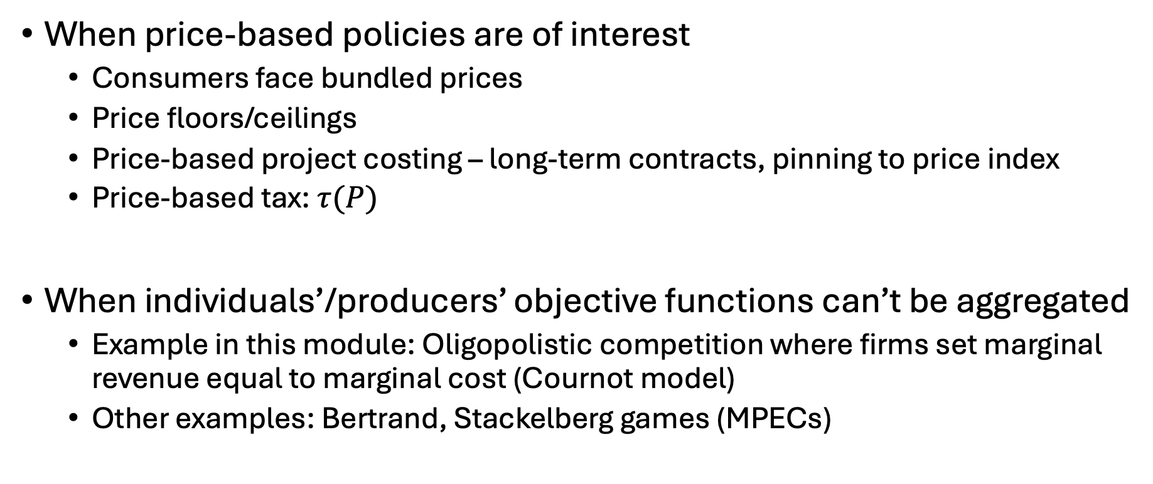
When should we use MCPs?
When price-based policies are of interest
Consumers face bundled prices
Price floors/ceilings
Price-based project costing – long-term contracts, pinning to price index
Price-based tax: $τ(P)$
When individuals’/producers’ objective functions can’t be aggregated
Example in this module: Oligopolistic competition where firms set marginal revenue equal to marginal cost (Cournot model)
Other examples: Bertrand, Stackelberg games (MPECs)

Slide 8

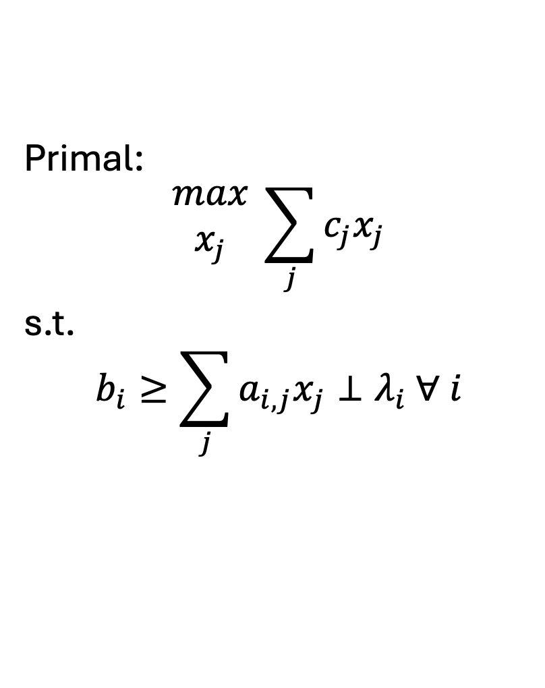
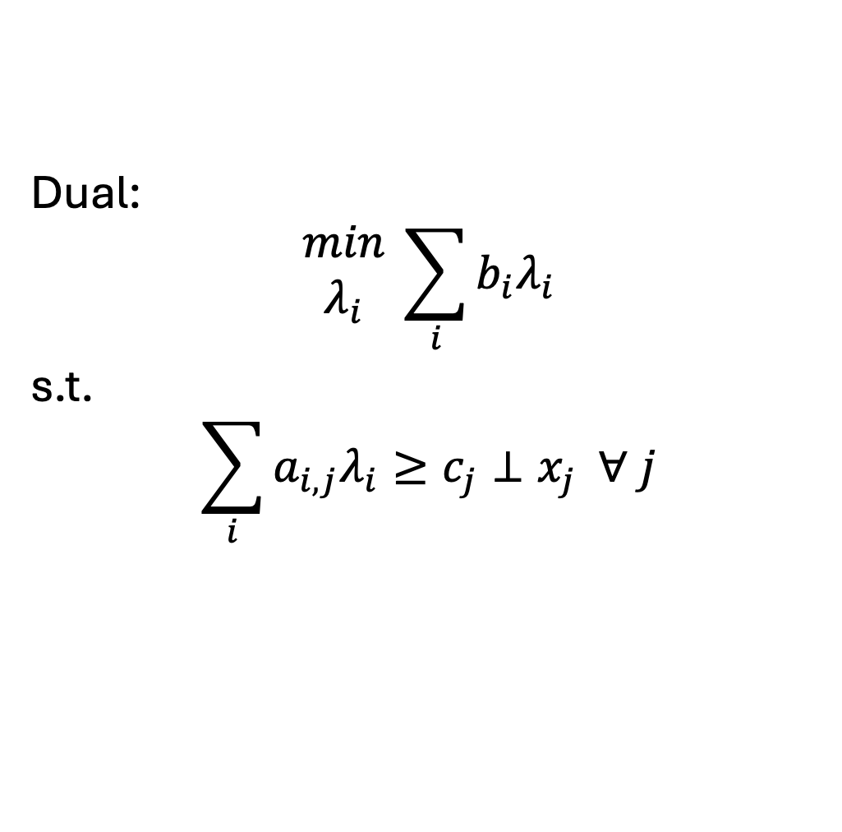
Formulating the dual..
$i$: # constraints (primal), # variables (dual)
$j$: # variables (primal), # constraints (dual)
Primal:
$$\begin{matrix}max \\ x_{j}\end{matrix} \sum_{j}{c_{j}x_{j}}$$
s.t.
$$b_{i}≥\sum_{j}{a_{i,j}x_{j}}⊥λ_{i} ∀ i$$
Dual:
$$\begin{matrix}min \\ λ_{i}\end{matrix} \sum_{i}{b_{i}λ_{i}}$$
s.t.
$$\sum_{i}{a_{i,j}λ_{i}}≥c_{j}⊥x_{j} ∀ j$$
Defines our MCP

Slide 9
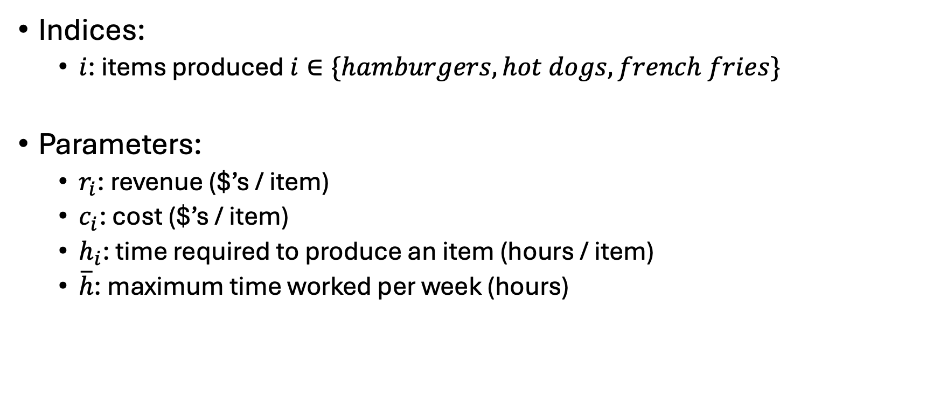
Ripley’s restaurant – now with the Dual
Indices:
$i$: items produced $i∈\{hamburgers, hot dogs, french fries\}$
Parameters:
$r_{i}$: revenue ($’s / item)
$c_{i}$: cost ($’s / item)
$h_{i}$: time required to produce an item (hours / item)
$\overline{h}$: maximum time worked per week (hours)
Item | Revenue | Cost | Hours
Hamburger | 1.5 | 0.75 | 0.5
Hot dog | 0.75 | 0.1 | 0.2
French fries | 0.25 | 0.05 | 0.1

Slide 10
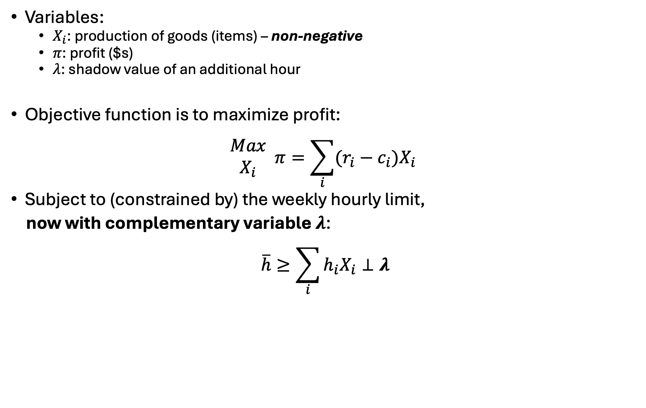
Ripley’s restaurant
Variables:
$X_{i}$: production of goods (items) – non-negative
$π$: profit ($s)
$λ$: shadow value of an additional hour
Objective function is to maximize profit:
$$\begin{matrix}Max \\ X_{i}\end{matrix} π=\sum_{i}{(r_{i}−c_{i})X_{i}}$$
Subject to (constrained by) the weekly hourly limit,
now with complementary variable $λ$:
$$\overline{h}≥\sum_{i}{h_{i}X_{i}}⊥λ$$

Slide 11
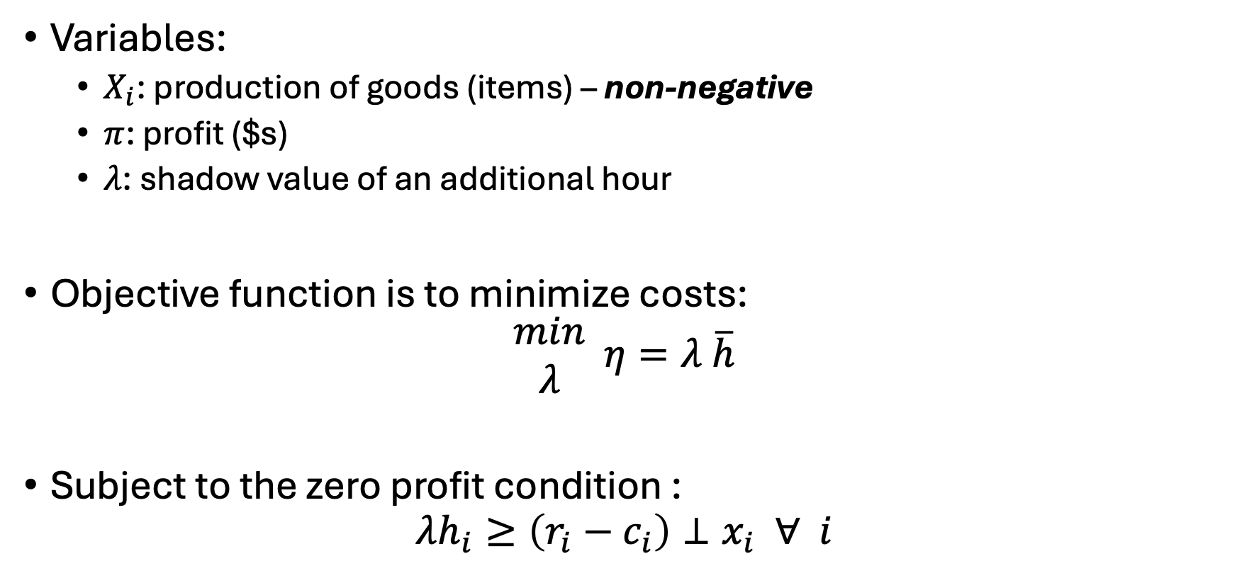
Ripley’s restaurant – the dual
Variables:
$X_{i}$: production of goods (items) – non-negative
$π$: profit ($s)
$λ$: shadow value of an additional hour
Objective function is to minimize costs:
$$\begin{matrix}min \\ λ\end{matrix} η=λ \overline{h}$$
Subject to the zero profit condition :
$$λh_{i}≥\left(r_{i}−c_{i}\right)⊥x_{i} ∀ i$$

Slide 12
Steps to creating an MCP from an existing LP/NLP
Write out initial problem
Derive complementarity conditions (dual w/o objective)
Set up problem as: [primal constraints] & [dual constraints]
Solve your initial problem
Assign level values to both primal variables and dual variables
Dual variable values set as marginal off the respective constraints
Alternatively, could solve both the primal and dual problem
Set iteration limit for MCP problem to zero
Make sure we have a zero residual

Slide 13
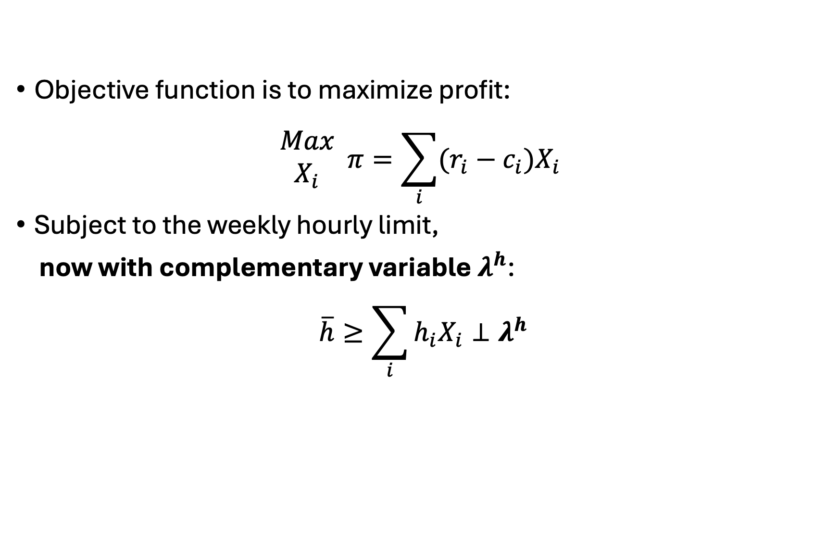
Write out initial problem
Objective function is to maximize profit:
$$\begin{matrix}Max \\ X_{i}\end{matrix} π=\sum_{i}{(r_{i}−c_{i})X_{i}}$$
Subject to the weekly hourly limit,
now with complementary variable $λ^{h}$:
$$\overline{h}≥\sum_{i}{h_{i}X_{i}}⊥λ^{h}$$

Slide 14
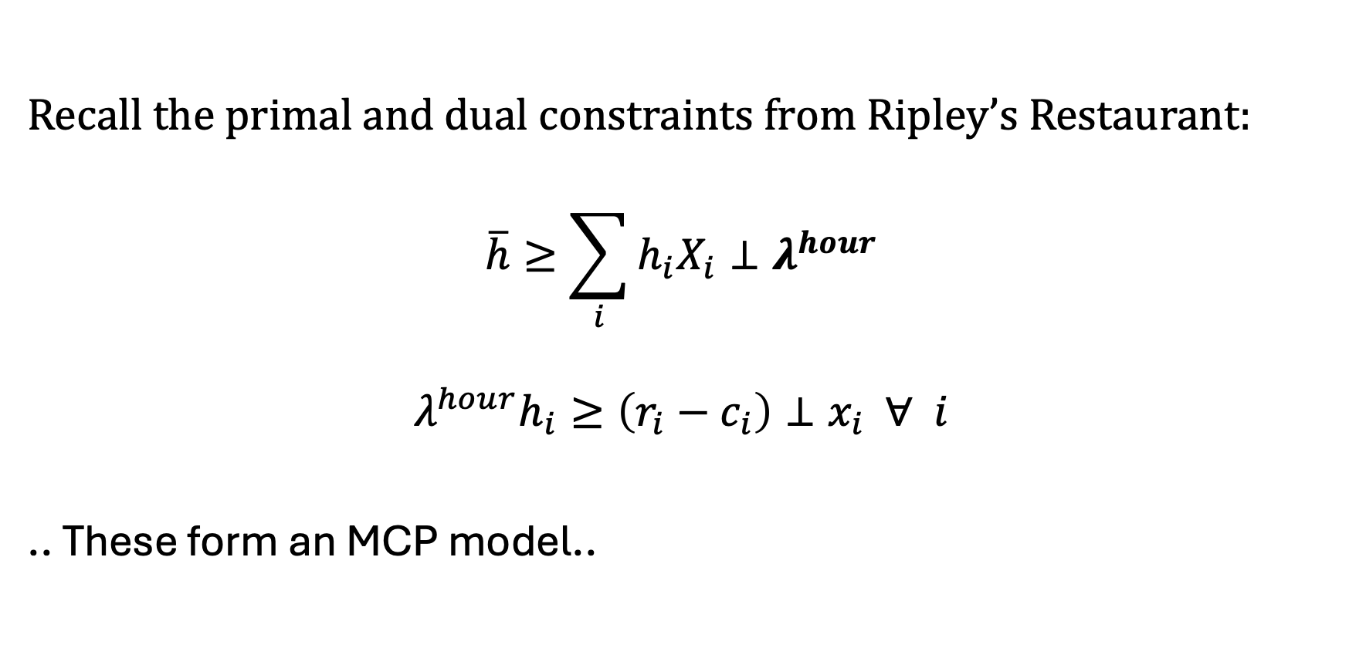
Derive complementarity conditions
Recall the primal and dual constraints from Ripley’s Restaurant:
$$\overline{h}≥\sum_{i}{h_{i}X_{i}}⊥λ^{hour}$$
$$λ^{hour}h_{i}≥\left(r_{i}−c_{i}\right)⊥x_{i} ∀ i$$
.. These form an MCP model..

Slide 15
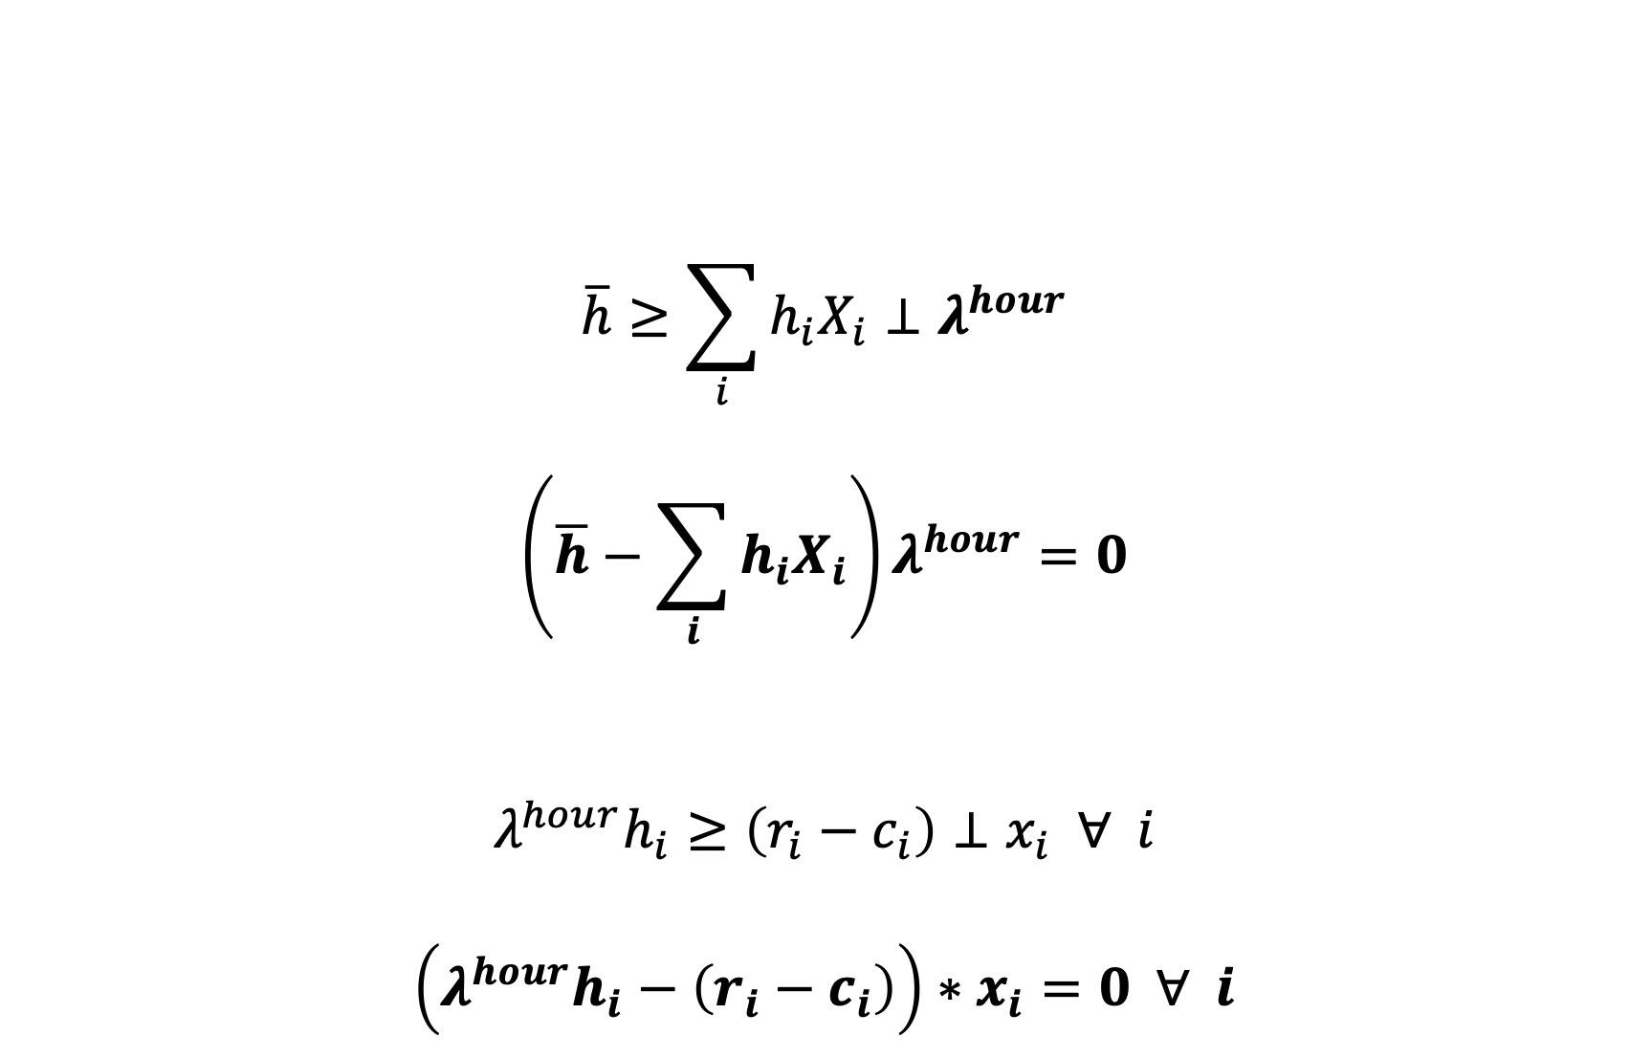
(Full) Complementarity Conditions
$$\overline{h}≥\sum_{i}{h_{i}X_{i}}⊥λ^{hour}$$
$$\left(\overline{h}−\sum_{i}{h_{i}X_{i}}\right)λ^{hour}=0$$
$$λ^{hour}h_{i}≥\left(r_{i}−c_{i}\right)⊥x_{i} ∀ i$$
$$\left(λ^{hour}h_{i}−\left(r_{i}−c_{i}\right)\right)∗x_{i}=0 ∀ i$$
These are generated by GAMS!

Slide 16
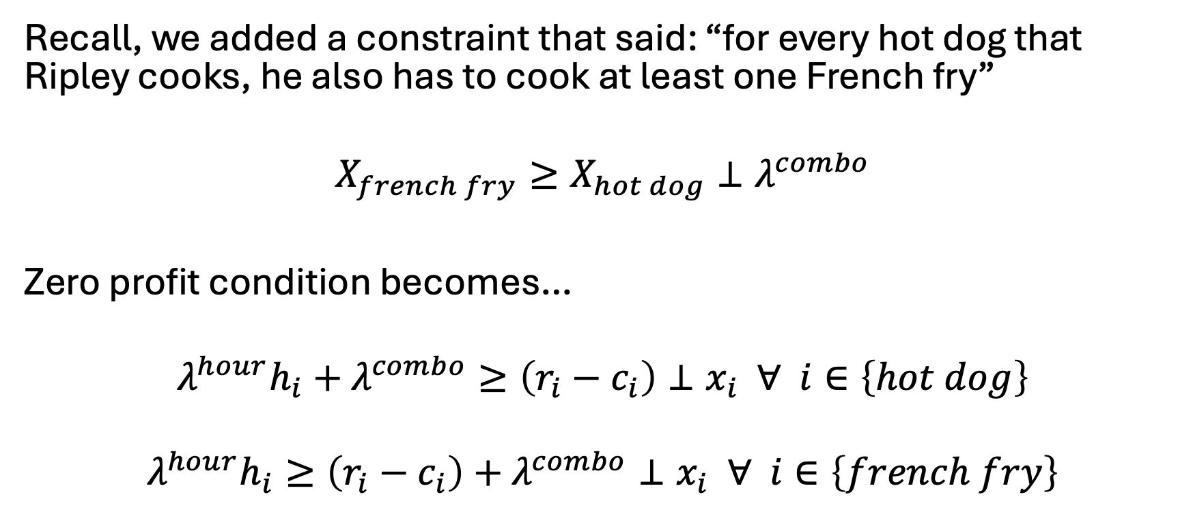
Let’s add the combo constraint…
Recall, we added a constraint that said: “for every hot dog that Ripley cooks, he also has to cook at least one French fry”
$$X_{french fry}≥X_{hot dog}⊥λ^{combo}$$
Zero profit condition becomes…
$$λ^{hour}h_{i}+λ^{combo}≥\left(r_{i}−c_{i}\right)⊥x_{i} ∀ i∈\left\{hot dog\right\}$$
$$λ^{hour}h_{i}≥\left(r_{i}−c_{i}\right)+λ^{combo}⊥x_{i} ∀ i∈\left\{french fry\right\}$$

Slide 17
Indices of the shadow value variable will always match the dimensions of its primal constraint – this also implies conditionals on the primal constraint indices need to match the dual variable

Slide 18
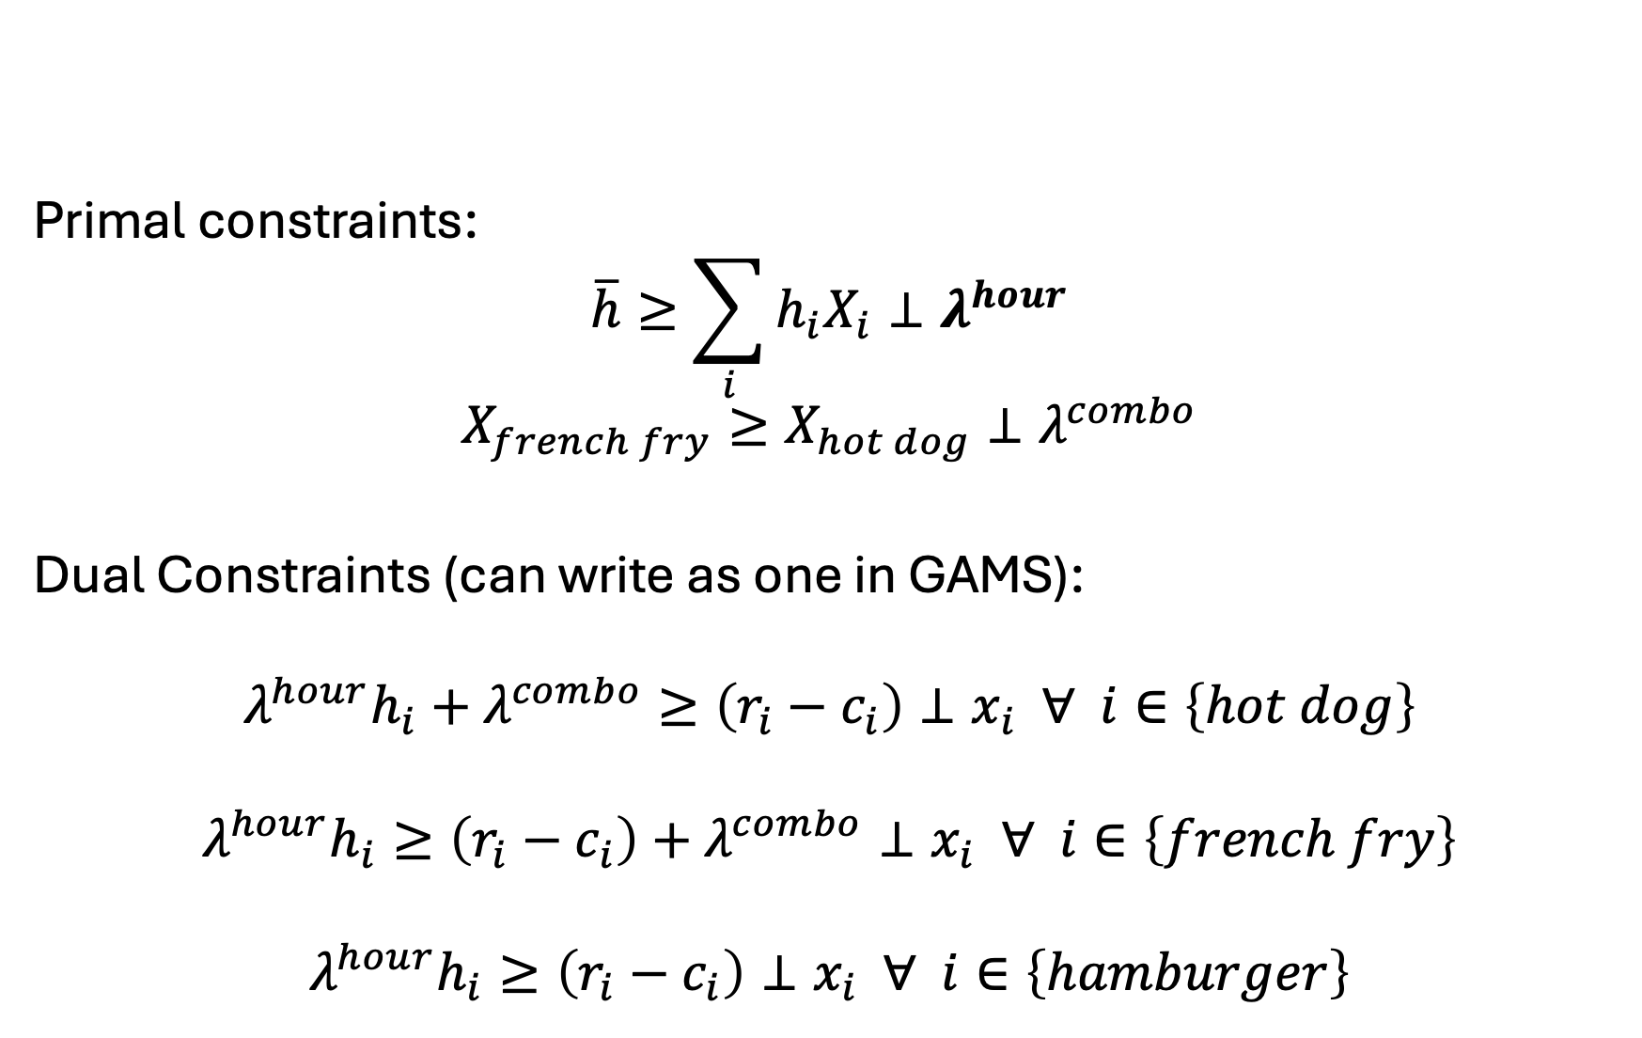
Set up problem as: [primal constraints] & [dual constraints]
Primal constraints:
$$\overline{h}≥\sum_{i}{h_{i}X_{i}}⊥λ^{hour}$$
$$X_{french fry}≥X_{hot dog}⊥λ^{combo}$$
Dual Constraints (can write as one in GAMS):
$$λ^{hour}h_{i}+λ^{combo}≥\left(r_{i}−c_{i}\right)⊥x_{i} ∀ i∈\left\{hot dog\right\}$$
$$λ^{hour}h_{i}≥\left(r_{i}−c_{i}\right)+λ^{combo}⊥x_{i} ∀ i∈\left\{french fry\right\}$$
$$λ^{hour}h_{i}≥\left(r_{i}−c_{i}\right)⊥x_{i} ∀ i∈\left\{hamburger\right\}$$

Slide 19
Now in GAMS, need to:
Solve your initial problem
Assign level values to both primal variables and dual variables
Dual variable values set as marginal off the respective constraints
Alternatively, could solve both the primal and dual problem
Set iteration limit for MCP problem to zero
Make sure we have a zero residual

Slide 20
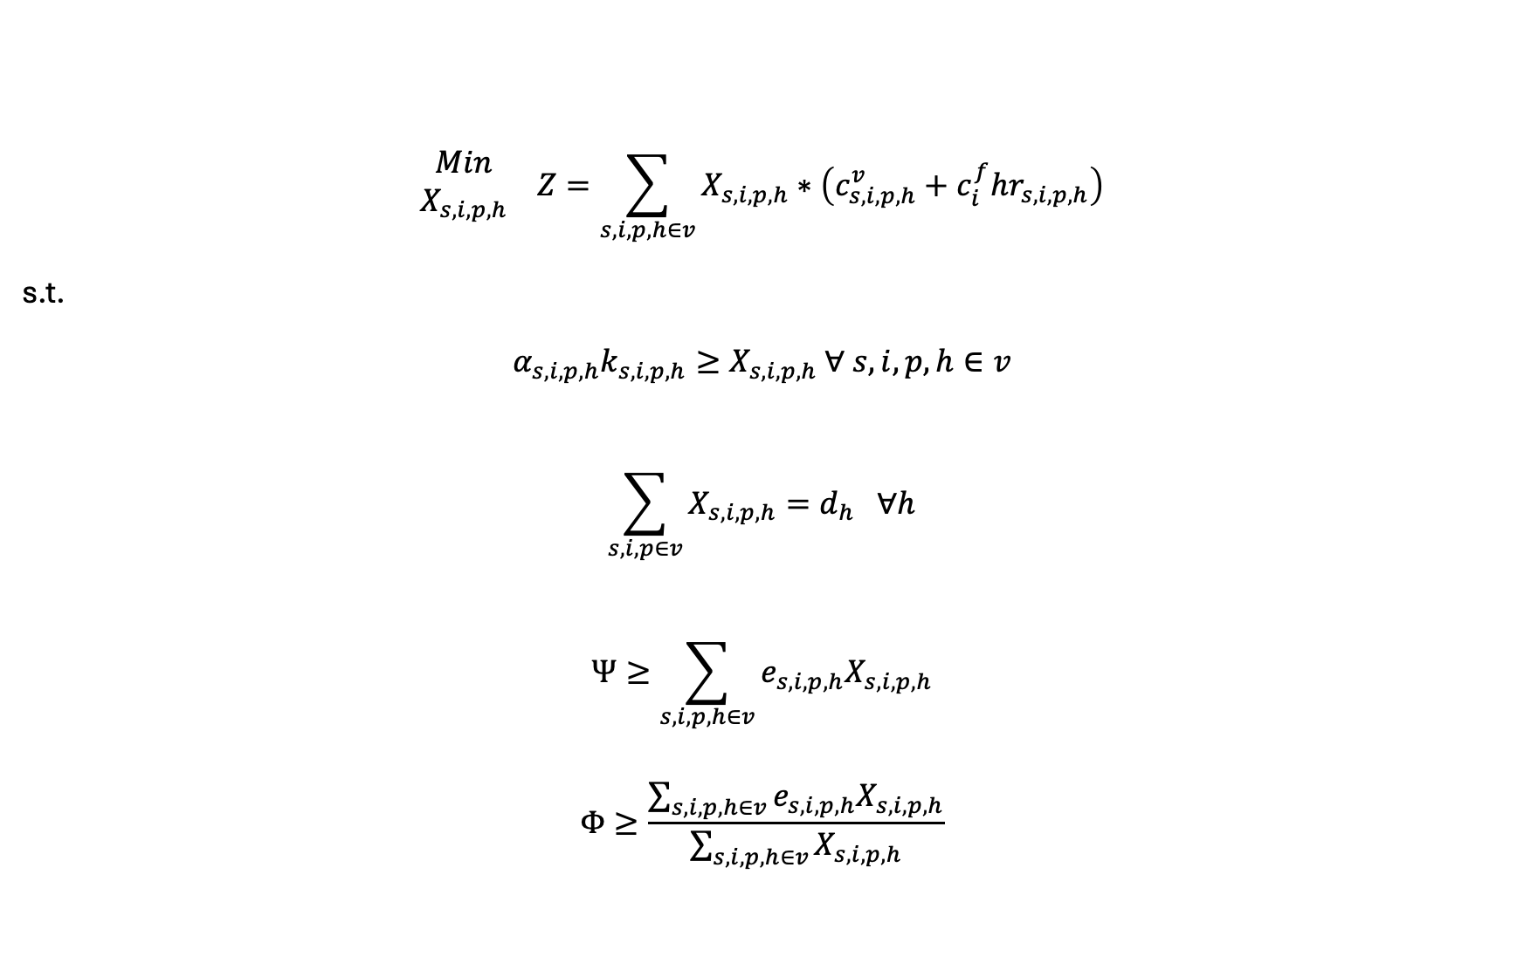
What about our simple electricity model?
$$\begin{matrix}Min \\ X_{s,i,p,h}\end{matrix} Z=\sum_{s,i,p,h∈v}{X_{s,i,p,h}}∗\left(c_{s,i,p,h}^{v}+c_{i}^{f}hr_{s,i,p,h}\right)$$
s.t.
$$α_{s,i,p,h}k_{s,i,p,h}≥X_{s,i,p,h} ∀ s,i,p,h∈v$$
$$\sum_{s,i,p∈v}{X_{s,i,p,h}}=d_{h} ∀h$$
$$Ψ≥\sum_{s,i,p,h∈v}{e_{s,i,p,h}X_{s,i,p,h}}$$
$$Φ≥\frac{\sum_{s,i,p,h∈v}{e_{s,i,p,h}X_{s,i,p,h}}}{\sum_{s,i,p,h∈v}{X_{s,i,p,h}}}$$

Slide 21

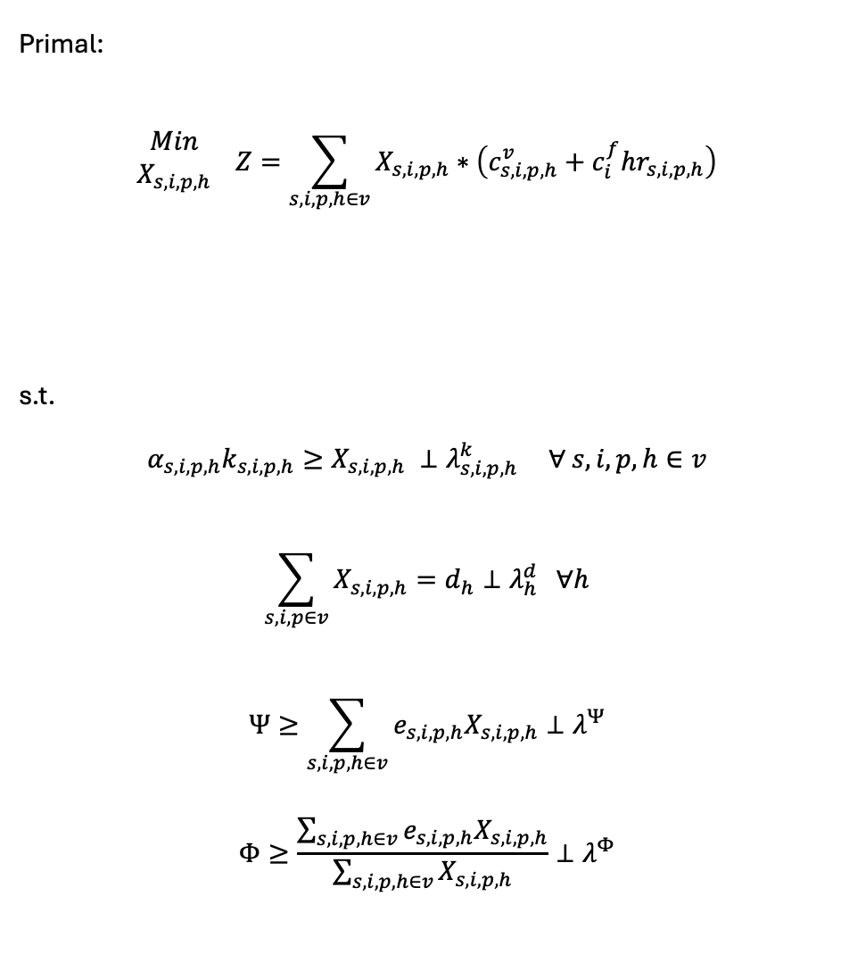
Dual:
$$\begin{matrix}Max \\ λ_{s,i,p,h}^{k},λ_{h}^{d},λ^{Ψ},λ^{Φ}\end{matrix} η=\sum_{h}{λ_{h}^{d}d_{h}}$$
$$−\sum_{s,i,p,h∈v}{λ_{s,i,p,h}^{k}α_{s,i,p,h}k_{s,i,p,h}}$$
$$−λ^{Ψ}Ψ−λ^{Φ}Φ$$
s.t.
$${ c}_{s,i,p,h}^{v}+c_{i}^{f}hr_{s,i,p,h}+λ_{s,i,p,h}^{k}$$
$$+ e_{s, i,p,h}λ^{Ψ}+λ^{Φ}\left(e_{s,i,p,h}−Ψ\right)$$
$$≥λ_{h}^{d}⊥X_{s, i,p,h} ∀ s,i,p,h∈v$$
Primal:
$$\begin{matrix}Min \\ X_{s,i,p,h}\end{matrix} Z=\sum_{s,i,p,h∈v}{X_{s,i,p,h}}∗\left(c_{s,i,p,h}^{v}+c_{i}^{f}hr_{s,i,p,h}\right)$$
s.t.
$$α_{s,i,p,h}k_{s,i,p,h}≥X_{s,i,p,h} ⊥λ_{s,i,p,h}^{k} ∀ s,i,p,h∈v$$
$$\sum_{s,i,p∈v}{X_{s,i,p,h}}=d_{h}⊥λ_{h}^{d} ∀h$$
$$Ψ≥\sum_{s,i,p,h∈v}{e_{s,i,p,h}X_{s,i,p,h}}⊥λ^{Ψ}$$
$$Φ≥\frac{\sum_{s,i,p,h∈v}{e_{s,i,p,h}X_{s,i,p,h}}}{\sum_{s,i,p,h∈v}{X_{s,i,p,h}}}⊥λ^{Φ}$$
Defines our MCP

Slide 22
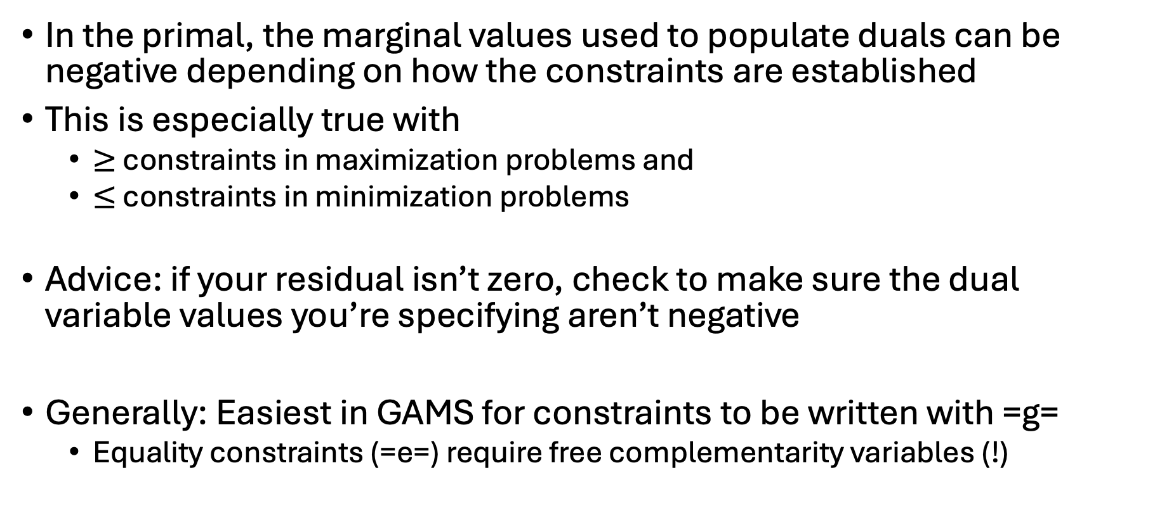
Caveat: Dual signs
In the primal, the marginal values used to populate duals can be negative depending on how the constraints are established
This is especially true with
$≥$ constraints in maximization problems and
$≤$ constraints in minimization problems
Advice: if your residual isn’t zero, check to make sure the dual variable values you’re specifying aren’t negative
Generally: Easiest in GAMS for constraints to be written with =g=
Equality constraints (=e=) require free complementarity variables (!)

Slide 23
Now let’s do the electricity example
Write out initial problem
Derive complementarity conditions (dual w/o objective)
Set up problem as: [primal constraints] & [dual constraints]
Solve your initial problem
Assign level values to both primal variables and dual variables
Dual variable values set as marginal off the respective constraints
Alternatively, could solve both the primal and dual problem
Set iteration limit for MCP problem to zero
Make sure we have a zero residual

Slide 24

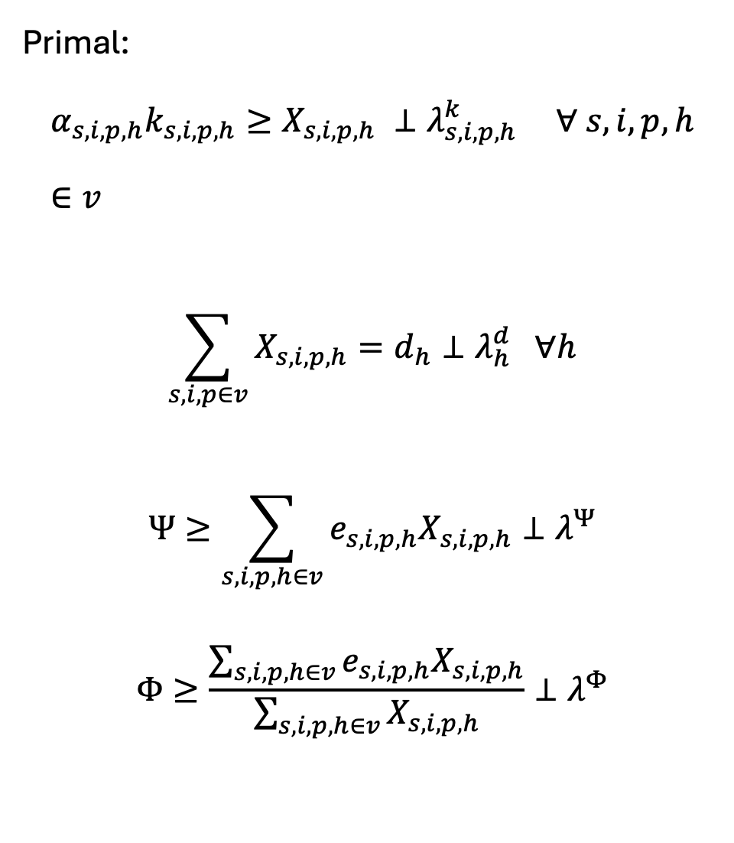
Primal:
$$α_{s,i,p,h}k_{s,i,p,h}≥X_{s,i,p,h} ⊥λ_{s,i,p,h}^{k} ∀ s,i,p,h∈v$$
$$\sum_{s,i,p∈v}{X_{s,i,p,h}}=d_{h}⊥λ_{h}^{d} ∀h$$
$$Ψ≥\sum_{s,i,p,h∈v}{e_{s,i,p,h}X_{s,i,p,h}}⊥λ^{Ψ}$$
$$Φ≥\frac{\sum_{s,i,p,h∈v}{e_{s,i,p,h}X_{s,i,p,h}}}{\sum_{s,i,p,h∈v}{X_{s,i,p,h}}}⊥λ^{Φ}$$
Dual:
$${ c}_{s,i,p,h}^{v}+c_{i}^{f}hr_{s,i,p,h}+λ_{s,i,p,h}^{k}$$
$$+ e_{s, i,p,h}λ^{Ψ}+λ^{Φ}\left(e_{s,i,p,h}−Ψ\right)$$
$$≥λ_{h}^{d}⊥X_{s, i,p,h} ∀ s,i,p,h∈v$$

Slide 25
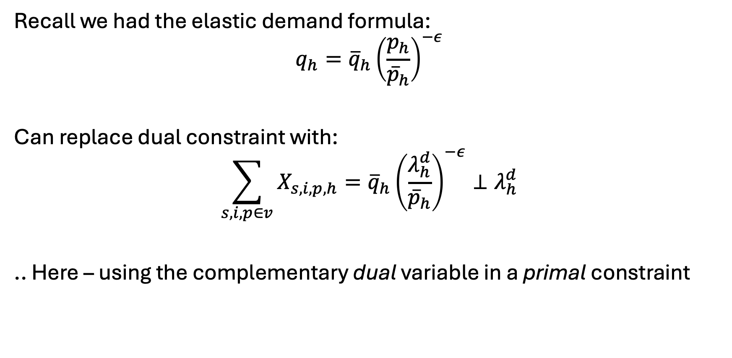
What about elastic demand?
Recall we had the elastic demand formula:
$$q_{h}={\overline{q}}_{h}{\left(\frac{p_{h}}{{\overline{p}}_{h}}\right)}^{−ε}$$
Can replace dual constraint with:
$$\sum_{s,i,p∈v}{X_{s,i,p,h}}={\overline{q}}_{h}{\left(\frac{λ_{h}^{d}}{{\overline{p}}_{h}}\right)}^{−ε}⊥λ_{h}^{d}$$
.. Here – using the complementary dual variable in a primal constraint

Slide 26
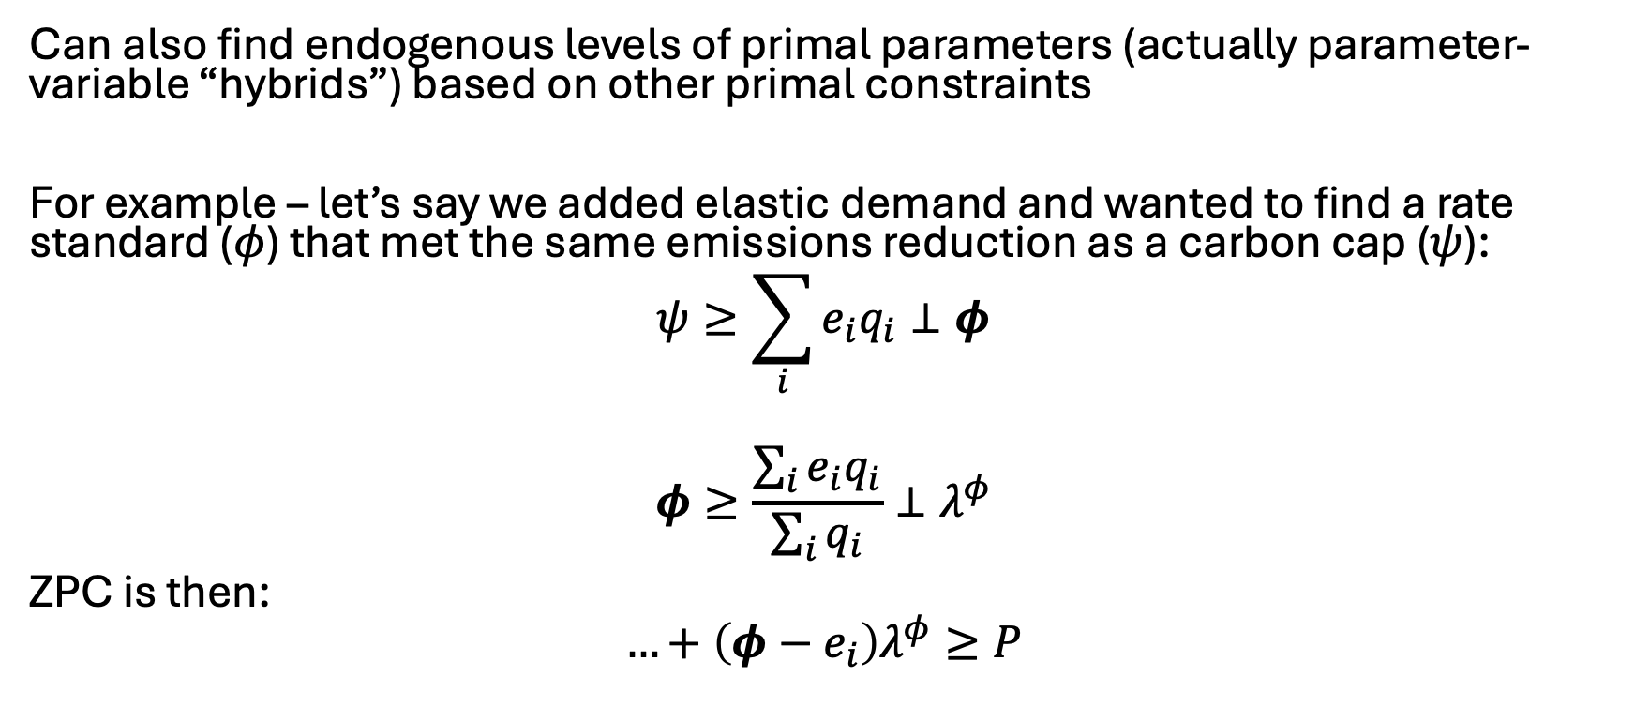
An MCP ‘hack’
Can also find endogenous levels of primal parameters (actually parameter-variable “hybrids”) based on other primal constraints
For example – let’s say we added elastic demand and wanted to find a rate standard ($φ$) that met the same emissions reduction as a carbon cap ($ψ$):
$$ψ≥\sum_{i}{e_{i}q_{i}}⊥φ$$
$$φ≥\frac{\sum_{i}{e_{i}q_{i}}}{\sum_{i}{q_{i}}}⊥λ^{φ}$$
ZPC is then:
$$…+\left(φ−e_{i}\right)λ^{φ}≥P$$

Slide 27

A good book..

Slide 28
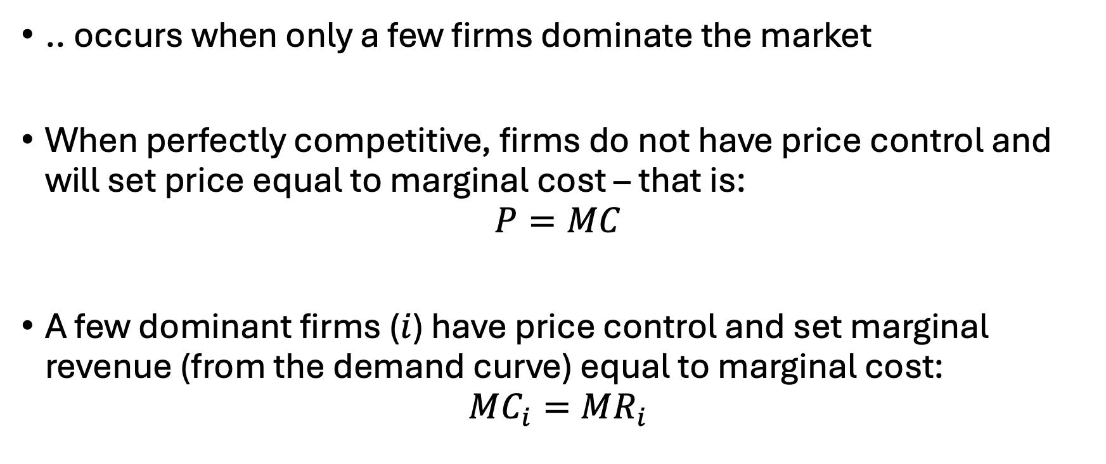
Oligopolistic Competition
.. occurs when only a few firms dominate the market
When perfectly competitive, firms do not have price control and will set price equal to marginal cost – that is:
$$P=MC$$
A few dominant firms ($i$) have price control and set marginal revenue (from the demand curve) equal to marginal cost:
$$MC_{i}=MR_{i}$$

Slide 29
Oligopolistic Competition (OC)
No longer…
maximizing social surplus/utility as was done with supply and demand curves
able to aggregate objective functions as each firm is self-interested
Another perspective: Each firm is interacting in a shared market but acting individually in their own, profit-maximizing way
… thus can’t simply sum profits

Slide 30


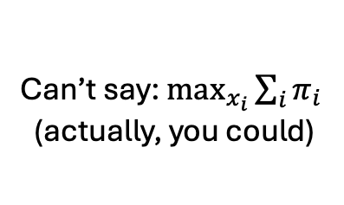
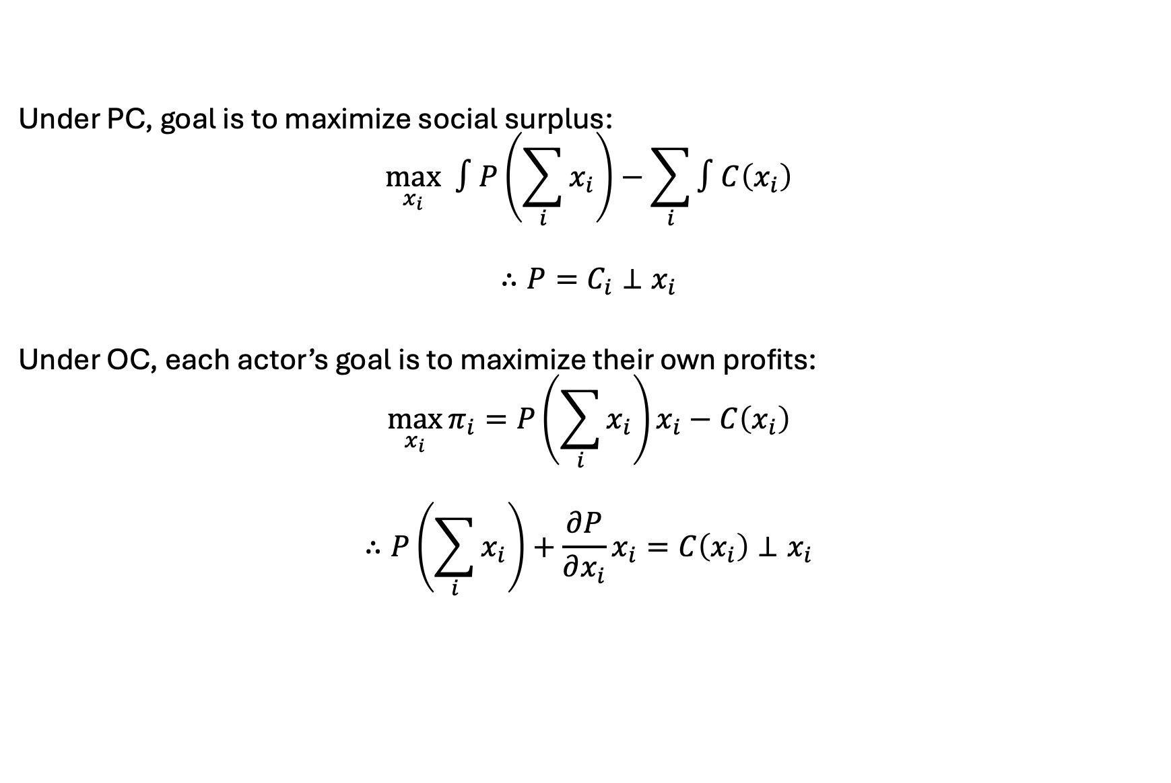
Another way to think about it
Under PC, goal is to maximize social surplus:
$$\max_{x_{i}} ∫P\left(\sum_{i}{x_{i}}\right)−\sum_{i}{∫C\left(x_{i}\right)}$$
$$∴P=C_{i}⊥x_{i}$$
Under OC, each actor’s goal is to maximize their own profits:
$$\max_{x_{i}}{π_{i}=P\left(\sum_{i}{x_{i}}\right)x_{i}−C\left(x_{i}\right)}$$
$$∴P\left(\sum_{i}{x_{i}}\right)+\frac{∂P}{∂x_{i}}x_{i}=C\left(x_{i}\right)⊥x_{i}$$
Can’t say: $\max_{x_{i}}{\sum_{i}{π_{i}}}$
(actually, you could)
$$MR_{i}=MC_{i}$$

Slide 31

Some background
Mineral data from USGS gathered by student
production - tonnes
price - $ / tonne
Currently – rare earths bundled
Used a tool (the ‘columnizer,py’) to dump all sets to CSVs
Built first as a calibrated, perfect-competition MCP
Market clearing and zero profit conditions
Check benchmark recreation
Added on game theory elements (Cournot)
Screwed up benchmark recreation
ie cannot recover
Set up auto-calibration via MPEC
Re-created equilibrium
Running supply/demand shocks

Slide 32
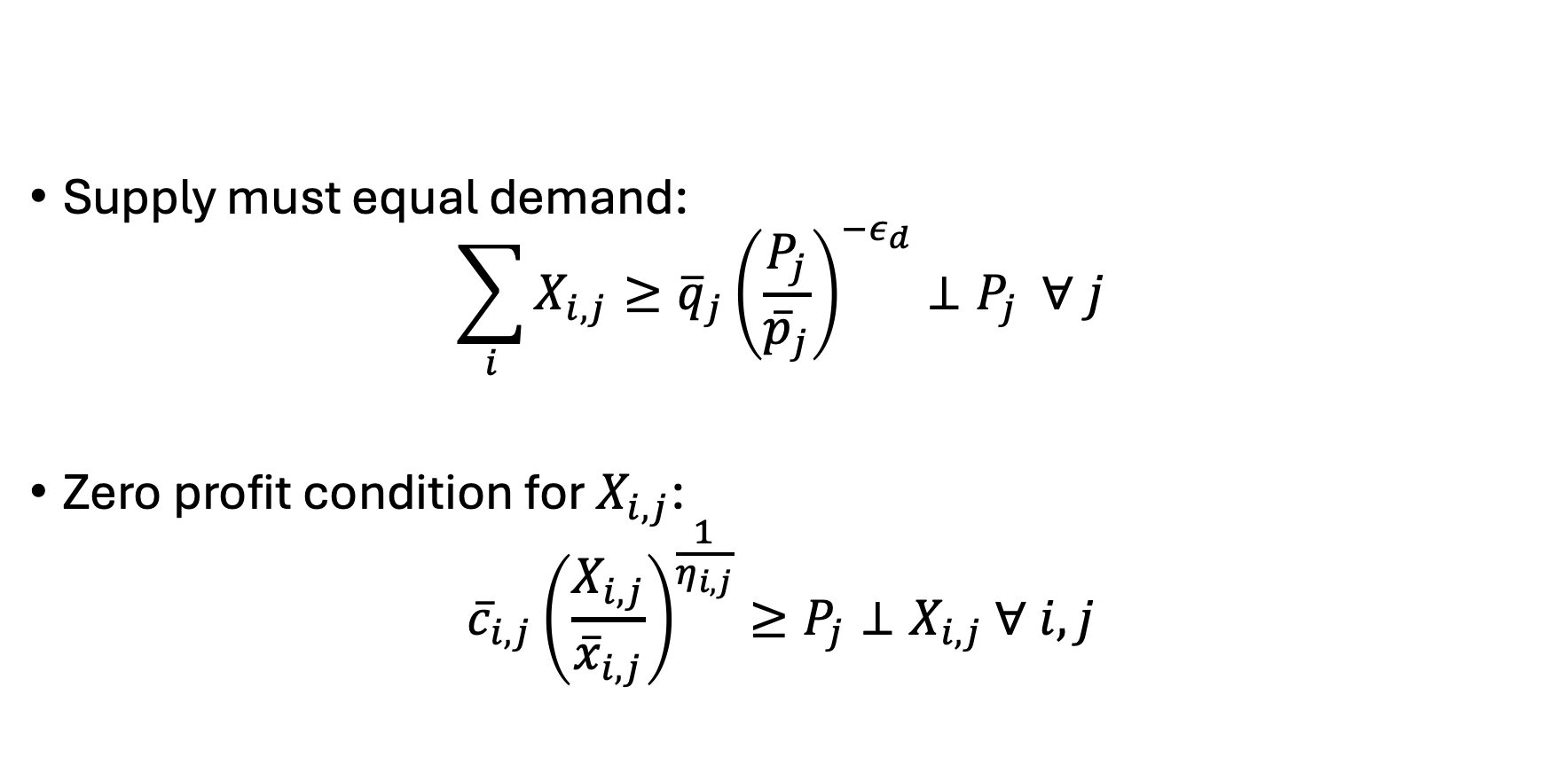
A perfect competition, calibrated constant elasticity of supply/demand, mixed complementarity problem (ie a PC-CCES/D-MCP)
Supply must equal demand:
$$\sum_{i}{X_{i,j}}≥{\overline{q}}_{j}{\left(\frac{P_{j}}{{\overline{p}}_{j}}\right)}^{−ε_{d}}⊥P_{j} ∀ j$$
Zero profit condition for $X_{i,j}$:
$${\overline{c}}_{i,j}{\left(\frac{X_{i,j}}{{\overline{x}}_{i,j}}\right)}^{\frac{1}{η_{i,j}}}≥P_{j}⊥X_{i,j} ∀ i,j$$
Why does this re-create our initial benchmark values?

Slide 33
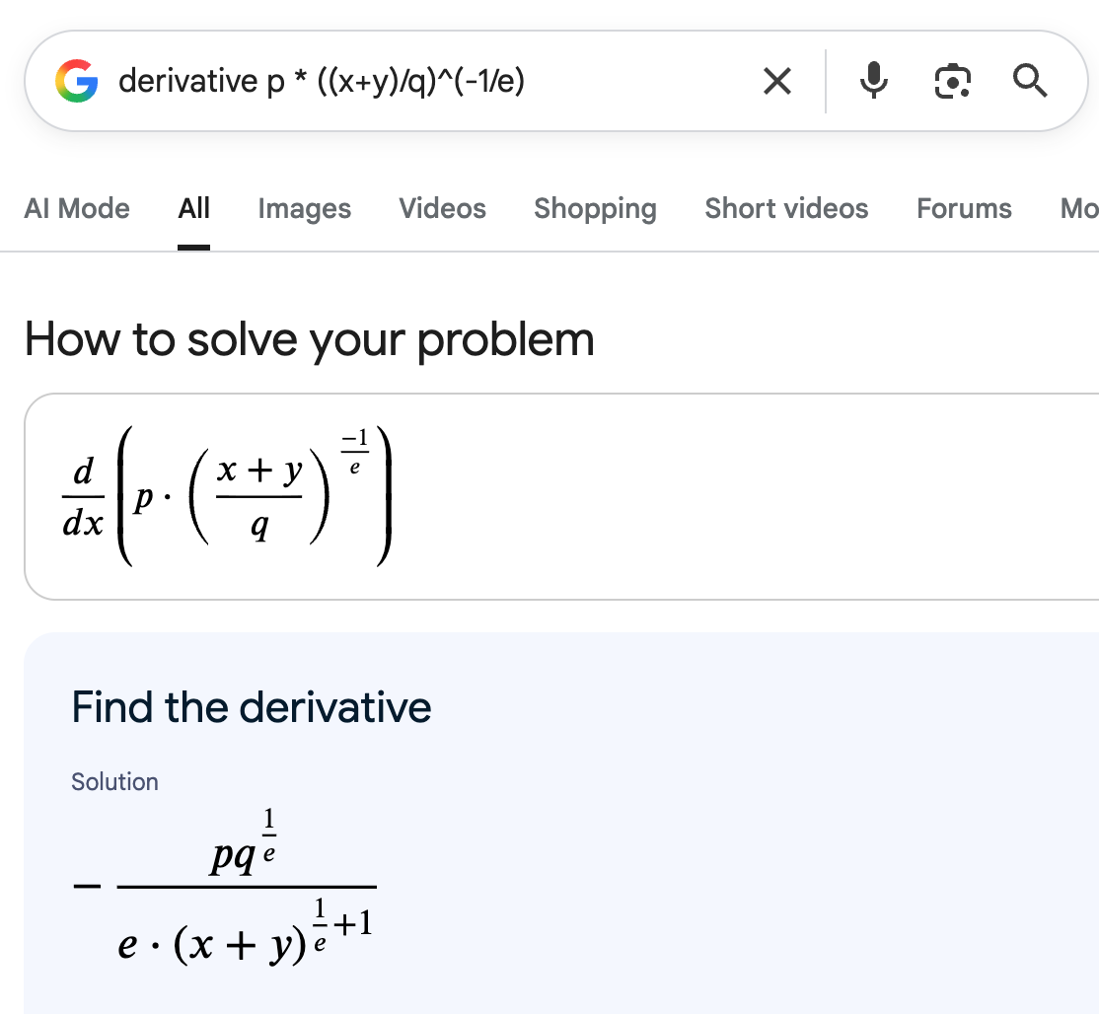
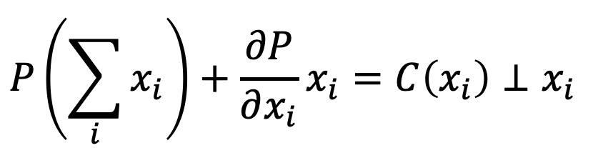
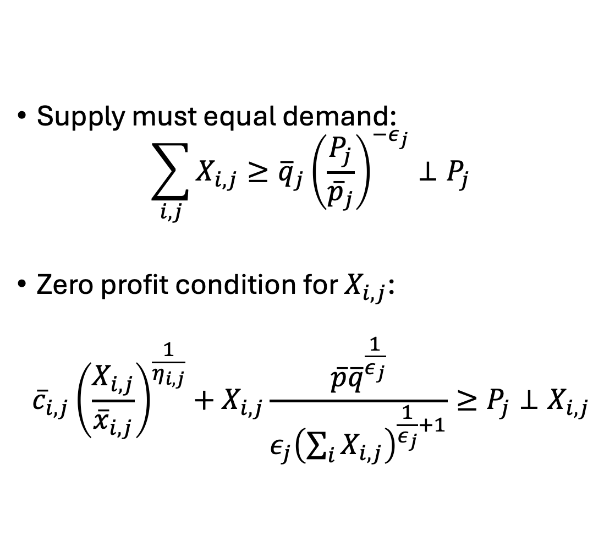
An oligopolistic competition, calibrated constant elasticity of supply/demand, mixed complementarity problem (ie a OC-CCES/D-MCP)
Supply must equal demand:
$$\sum_{i,j}{X_{i,j}}≥{\overline{q}}_{j}{\left(\frac{P_{j}}{{\overline{p}}_{j}}\right)}^{−ε_{j}}⊥P_{j}$$
Zero profit condition for $X_{i,j}$:
$${\overline{c}}_{i,j}{\left(\frac{X_{i,j}}{{\overline{x}}_{i,j}}\right)}^{\frac{1}{η_{i,j}}}+X_{i,j}\frac{\overline{p}{\overline{q}}^{\frac{1}{ε_{j}}}}{ε_{j}{\left(\sum_{i}{X_{i,j}}\right)}^{\frac{1}{ε_{j}}+1}}≥P_{j}⊥X_{i,j}$$

Slide 34
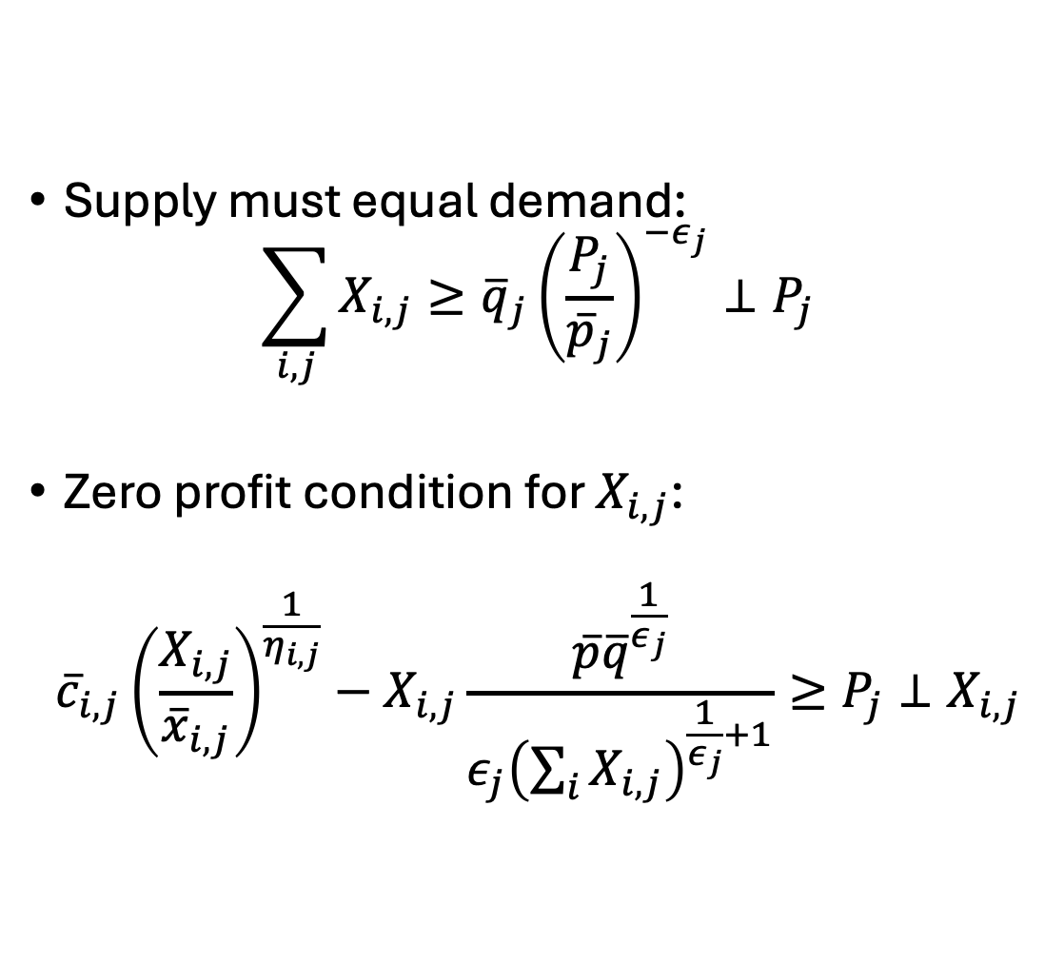
Problems with the OC-CCES/D-MCP)
Supply must equal demand:
$$\sum_{i,j}{X_{i,j}}≥{\overline{q}}_{j}{\left(\frac{P_{j}}{{\overline{p}}_{j}}\right)}^{−ε_{j}}⊥P_{j}$$
Zero profit condition for $X_{i,j}$:
$${\overline{c}}_{i,j}{\left(\frac{X_{i,j}}{{\overline{x}}_{i,j}}\right)}^{\frac{1}{η_{i,j}}}−X_{i,j}\frac{\overline{p}{\overline{q}}^{\frac{1}{ε_{j}}}}{ε_{j}{\left(\sum_{i}{X_{i,j}}\right)}^{\frac{1}{ε_{j}}+1}}≥P_{j}⊥X_{i,j}$$

Slide 35

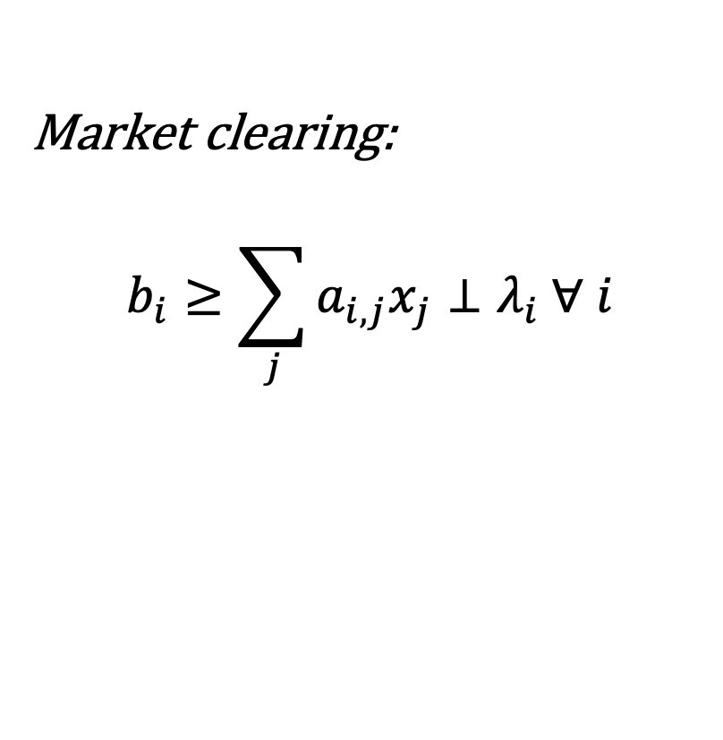
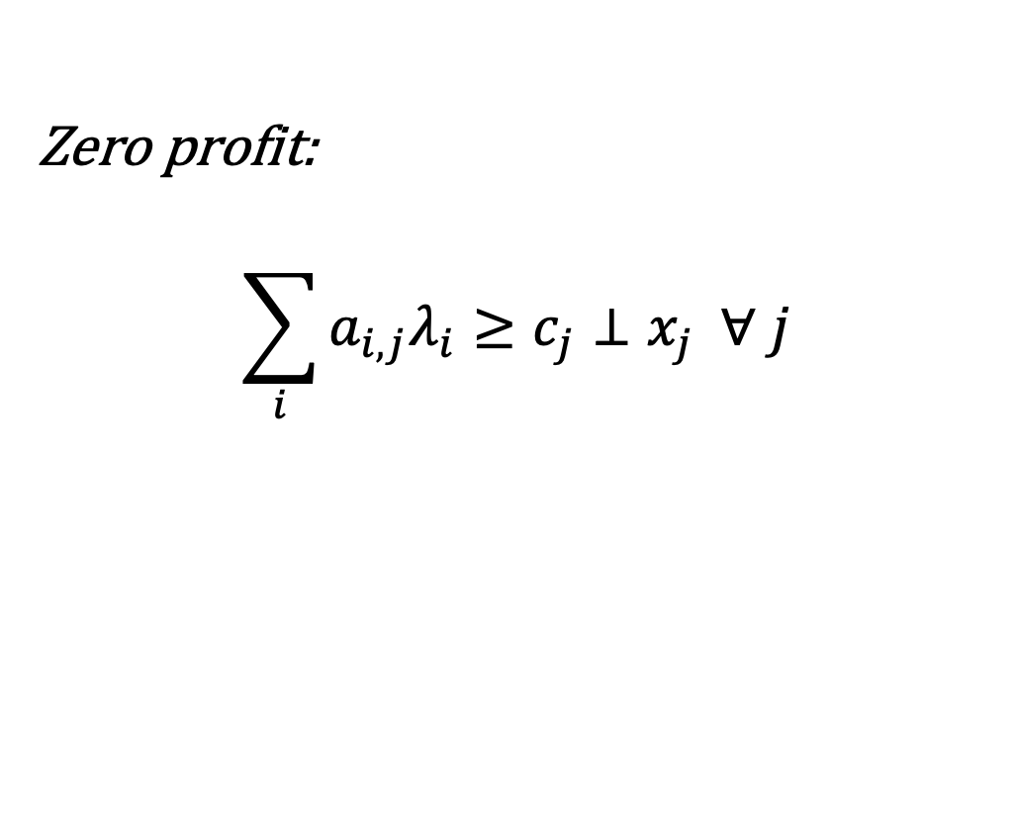
OG Complementarity conditions
Market clearing:
$$b_{i}≥\sum_{j}{a_{i,j}x_{j}}⊥λ_{i} ∀ i$$
Zero profit:
$$\sum_{i}{a_{i,j}λ_{i}}≥c_{j}⊥x_{j} ∀ j$$
$i$: # constraints
$j$: # variables

Slide 36
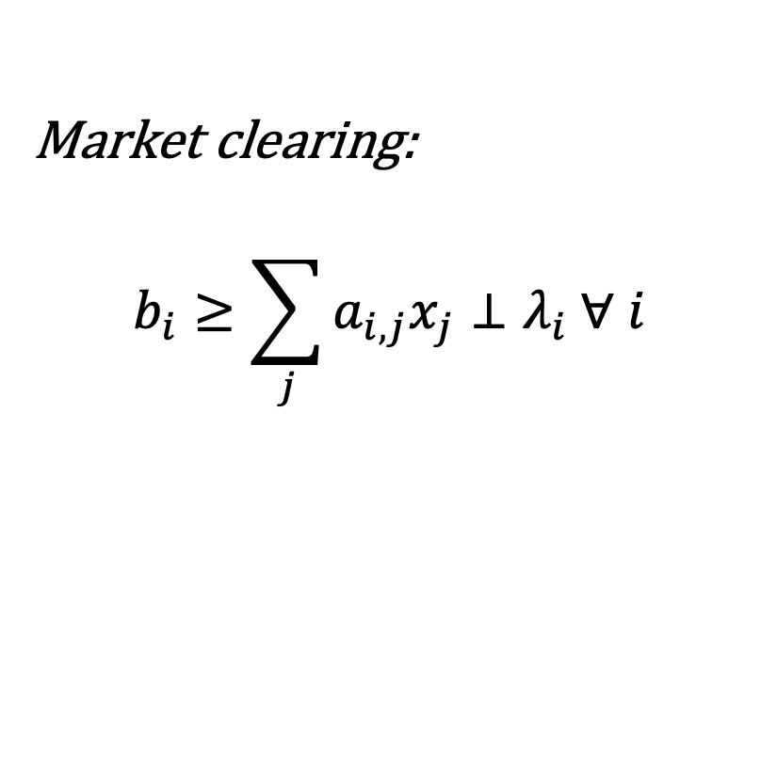

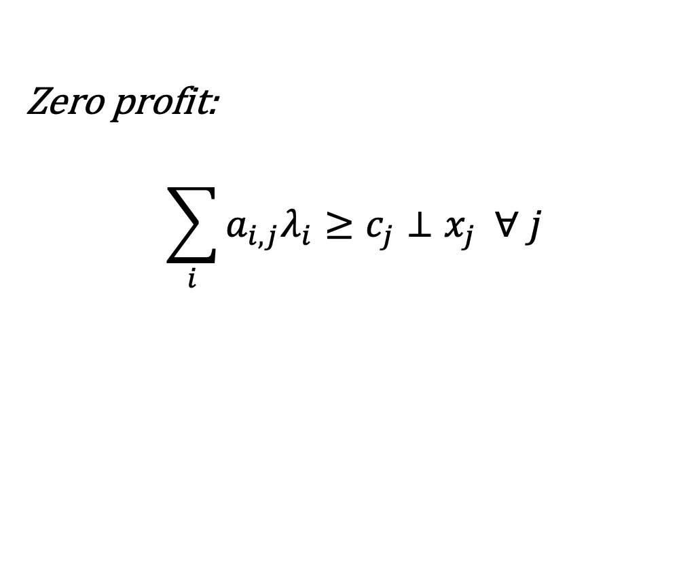
MPECs for calibration
CAVEAT: these are very difficult to solve and require a bit more art than science
$$\begin{matrix}Min \\ a_{i,j}∈σ\end{matrix} \left|\left|x_{j}−{\overline{x}}_{j}\right|\right|$$
Market clearing:
$$b_{i}≥\sum_{j}{a_{i,j}x_{j}}⊥λ_{i} ∀ i$$
Zero profit:
$$\sum_{i}{a_{i,j}λ_{i}}≥c_{j}⊥x_{j} ∀ j$$

Slide 37
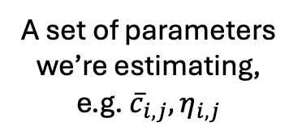
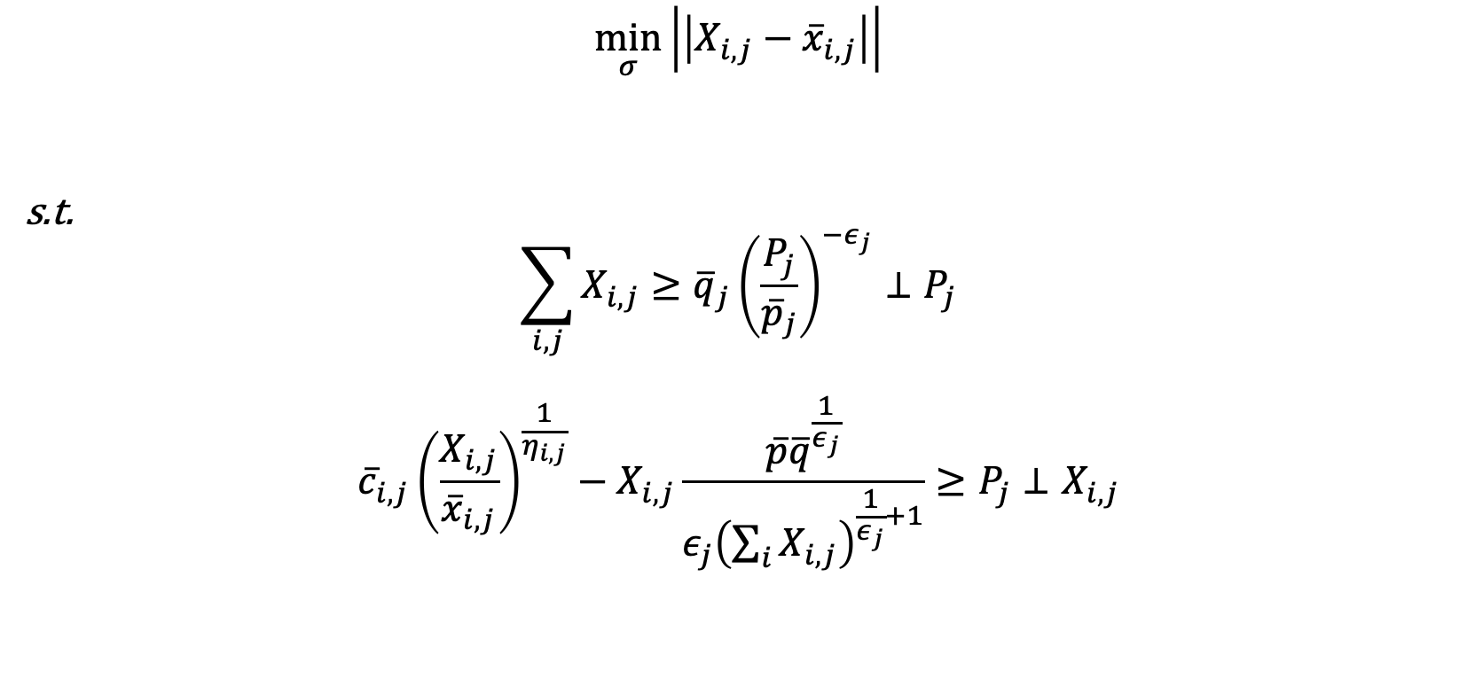
A mathematical program with equilibrium constraints to calibrate an oligopolistic competition, calibrated constant elasticity of supply/demand, mixed complementarity problem (ie a MPEC-OC-CCES/D-MCP) – aka “holy s*** it worked!”
Distance between endogenous and exogenous values (usually squared) – can add variables too
$$\min_{σ}\left|\left|X_{i,j}−{\overline{x}}_{i,j}\right|\right|$$
s.t.
$$\sum_{i,j}{X_{i,j}}≥{\overline{q}}_{j}{\left(\frac{P_{j}}{{\overline{p}}_{j}}\right)}^{−ε_{j}}⊥P_{j}$$
$${\overline{c}}_{i,j}{\left(\frac{X_{i,j}}{{\overline{x}}_{i,j}}\right)}^{\frac{1}{η_{i,j}}}−X_{i,j}\frac{\overline{p}{\overline{q}}^{\frac{1}{ε_{j}}}}{ε_{j}{\left(\sum_{i}{X_{i,j}}\right)}^{\frac{1}{ε_{j}}+1}}≥P_{j}⊥X_{i,j}$$
A set of parameters we’re estimating, e.g. ${\overline{c}}_{i,j},η_{i,j}$
Our original problem

Slide 38
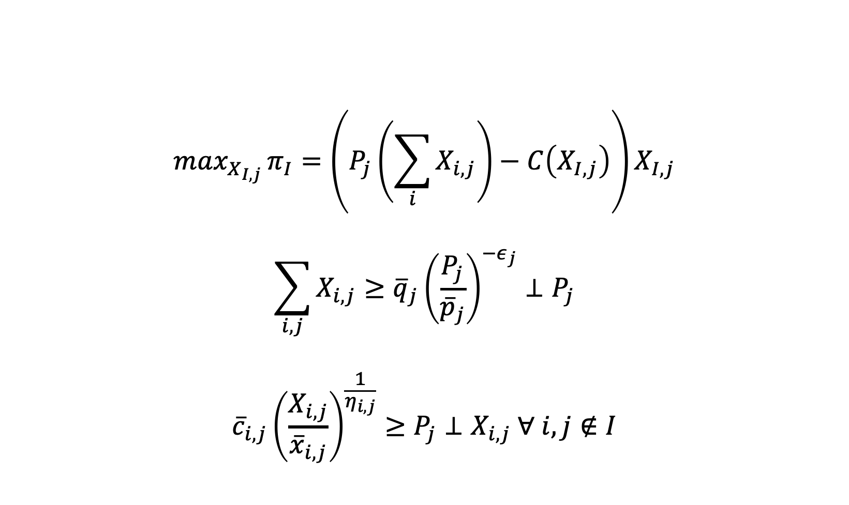
A mathematical program with equilibrium constraints to calibrate an oligopolistic competition, calibrated constant elasticity of supply/demand, mixed complementarity problem (ie a MPEC-OC-CCES/D-MCP) – aka “holy s*** it worked!”
$$max_{X_{I,j}}{π_{I}=\left(P_{j}\left(\sum_{i}{X_{i,j}}\right)−C\left(X_{I,j}\right)\right)X_{I,j}}$$
$$\sum_{i,j}{X_{i,j}}≥{\overline{q}}_{j}{\left(\frac{P_{j}}{{\overline{p}}_{j}}\right)}^{−ε_{j}}⊥P_{j}$$
$${\overline{c}}_{i,j}{\left(\frac{X_{i,j}}{{\overline{x}}_{i,j}}\right)}^{\frac{1}{η_{i,j}}}≥P_{j}⊥X_{i,j} ∀ i,j∉I$$

Slide 39
Extra slides…

Slide 40
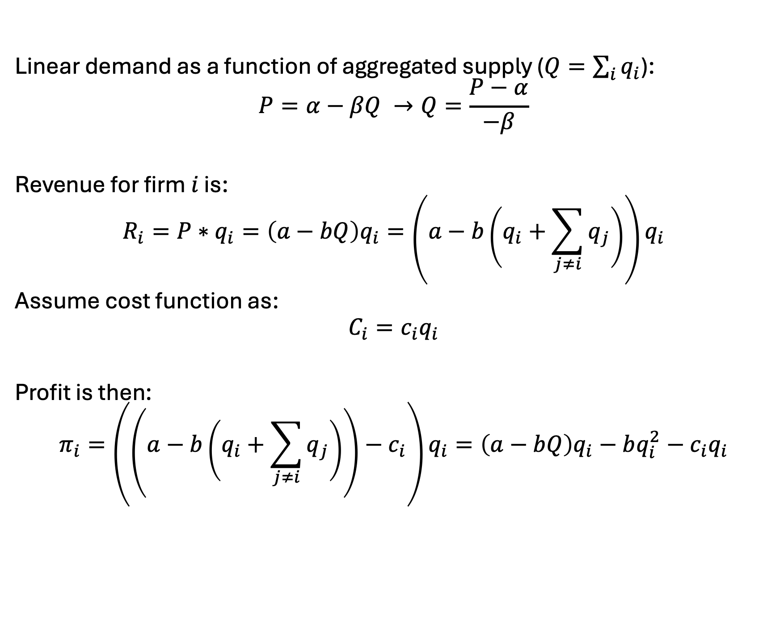
Cournot model derivation
Linear demand as a function of aggregated supply ($Q=\sum_{i}{q_{i}}$):
$$P=α−βQ →Q=\frac{P−α}{−β}$$
Revenue for firm $i$ is:
$$R_{i}=P∗q_{i}=\left(a−bQ\right)q_{i}=\left(a−b\left(q_{i}+\sum_{j≠i}{q_{j}}\right)\right)q_{i}$$
Assume cost function as:
$$C_{i}=c_{i}q_{i}$$
Profit is then:
$$π_{i}=\left(\left(a−b\left(q_{i}+\sum_{j≠i}{q_{j}}\right)\right)−c_{i}\right)q_{i}=\left(a−bQ\right)q_{i}−bq_{i}^{2}−c_{i}q_{i}$$

Slide 41
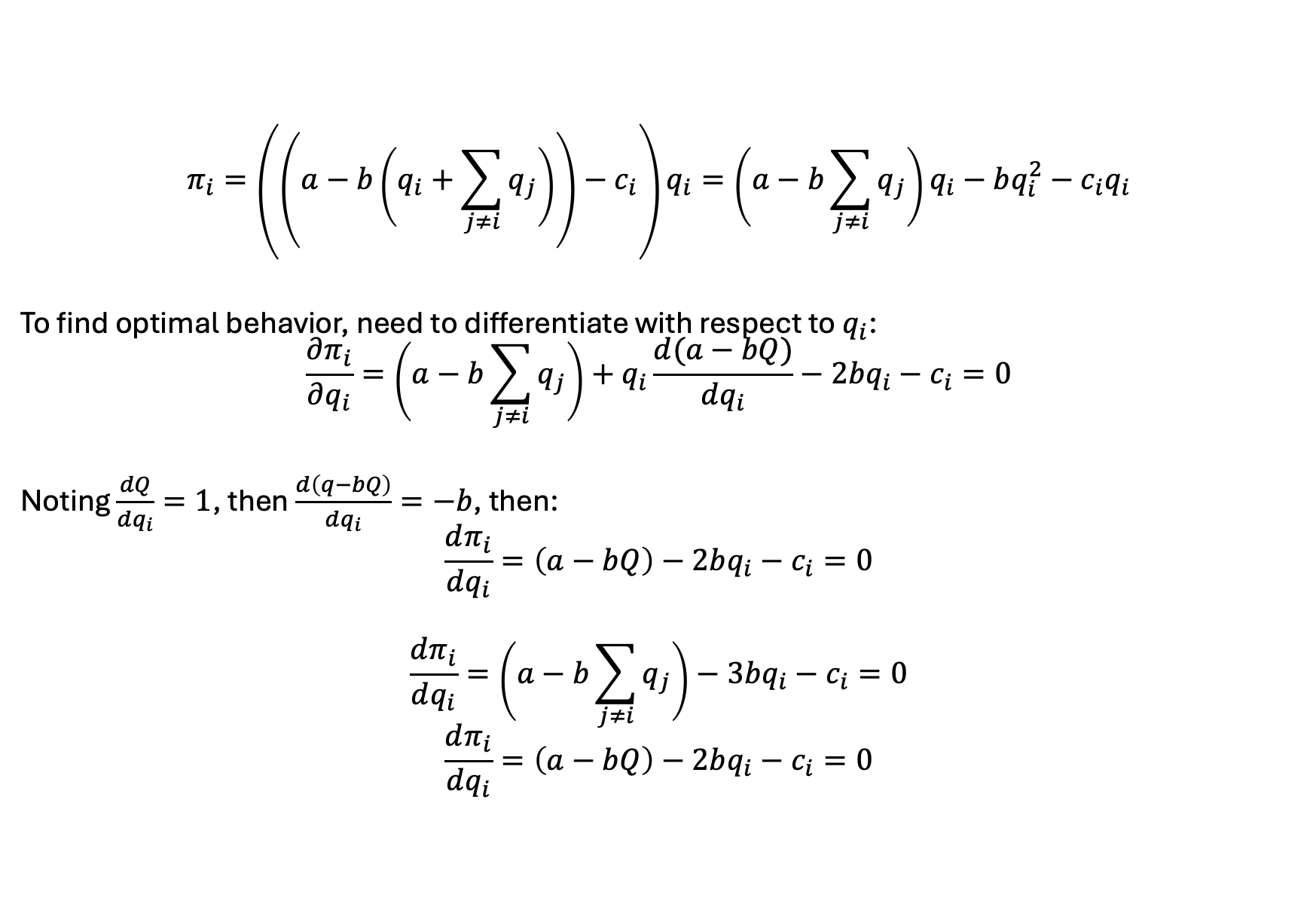
Cournot model derivation
$$π_{i}=\left(\left(a−b\left(q_{i}+\sum_{j≠i}{q_{j}}\right)\right)−c_{i}\right)q_{i}=\left(a−b\sum_{j≠i}{q_{j}}\right)q_{i}−bq_{i}^{2}−c_{i}q_{i}$$
To find optimal behavior, need to differentiate with respect to $q_{i}$:
$$\frac{∂π_{i}}{∂q_{i}}=\left(a−b\sum_{j≠i}{q_{j}}\right)+q_{i}\frac{d(a−bQ)}{dq_{i}}−2bq_{i}−c_{i}=0$$
Noting $\frac{dQ}{dq_{i}}=1$, then $\frac{d\left(q−bQ\right)}{dq_{i}}=−b$, then:
$$\frac{dπ_{i}}{dq_{i}}=\left(a−bQ\right)−2bq_{i}−c_{i}=0$$
$$\frac{dπ_{i}}{dq_{i}}=\left(a−b\sum_{j≠i}{q_{j}}\right)−3bq_{i}−c_{i}=0$$
$$\frac{dπ_{i}}{dq_{i}}=\left(a−bQ\right)−2bq_{i}−c_{i}=0$$

Slide 42
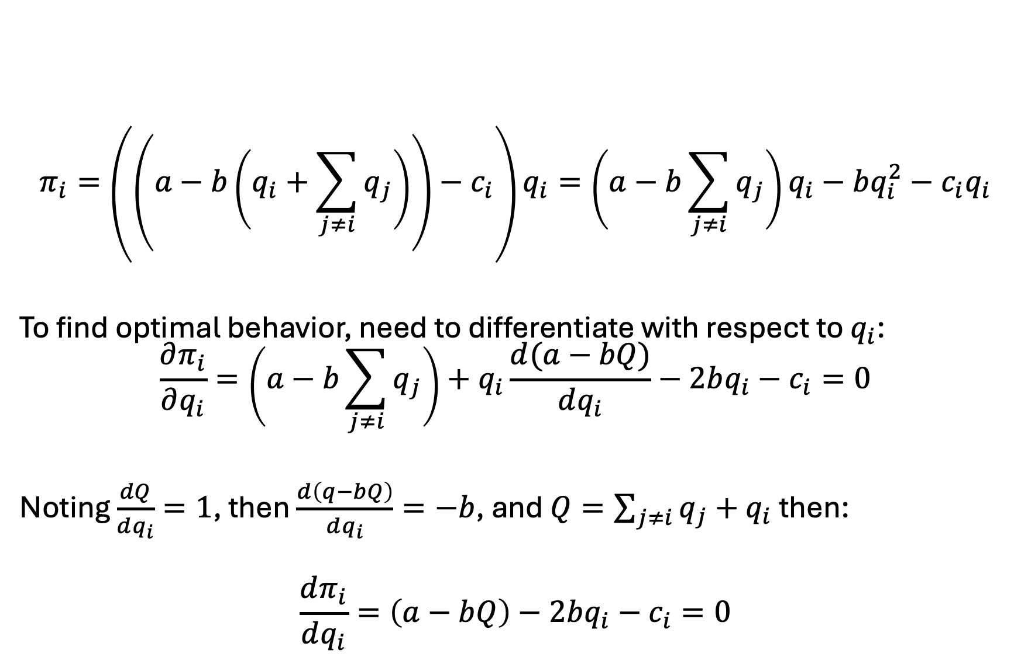
Cournot model derivation
$$π_{i}=\left(\left(a−b\left(q_{i}+\sum_{j≠i}{q_{j}}\right)\right)−c_{i}\right)q_{i}=\left(a−b\sum_{j≠i}{q_{j}}\right)q_{i}−bq_{i}^{2}−c_{i}q_{i}$$
To find optimal behavior, need to differentiate with respect to $q_{i}$:
$$\frac{∂π_{i}}{∂q_{i}}=\left(a−b\sum_{j≠i}{q_{j}}\right)+q_{i}\frac{d(a−bQ)}{dq_{i}}−2bq_{i}−c_{i}=0$$
Noting $\frac{dQ}{dq_{i}}=1$, then $\frac{d\left(q−bQ\right)}{dq_{i}}=−b$, and $Q=\sum_{j≠i}{q_{j}}+q_{i}$ then:
$$\frac{dπ_{i}}{dq_{i}}=\left(a−bQ\right)−2bq_{i}−c_{i}=0$$

Slide 43

Cournot model derivation
$$\frac{dπ_{i}}{dq_{i}}=\left(a−bQ\right)−bq_{i}−c_{i}=0$$
Implies (a) $MR_{i}=MC_{i}$ and (b):
$$q_{i}^{∗}=\frac{a−c_{i}−bQ}{b}$$

Slide 44
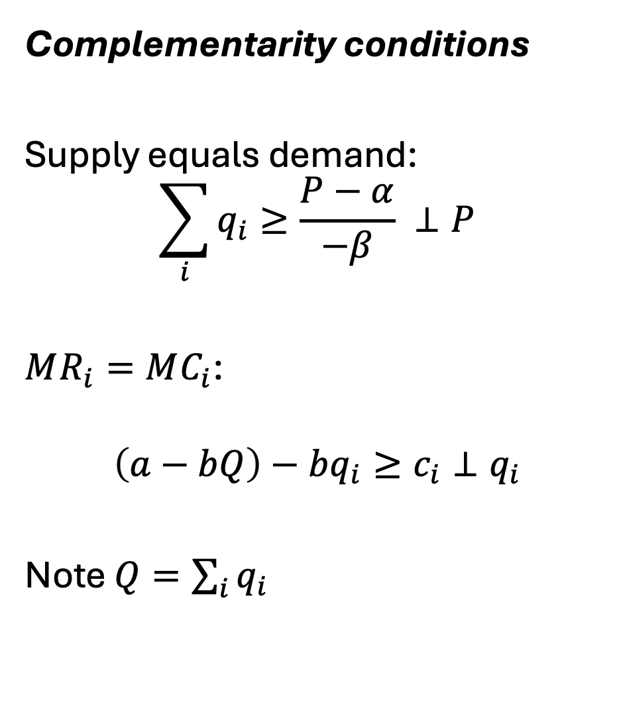
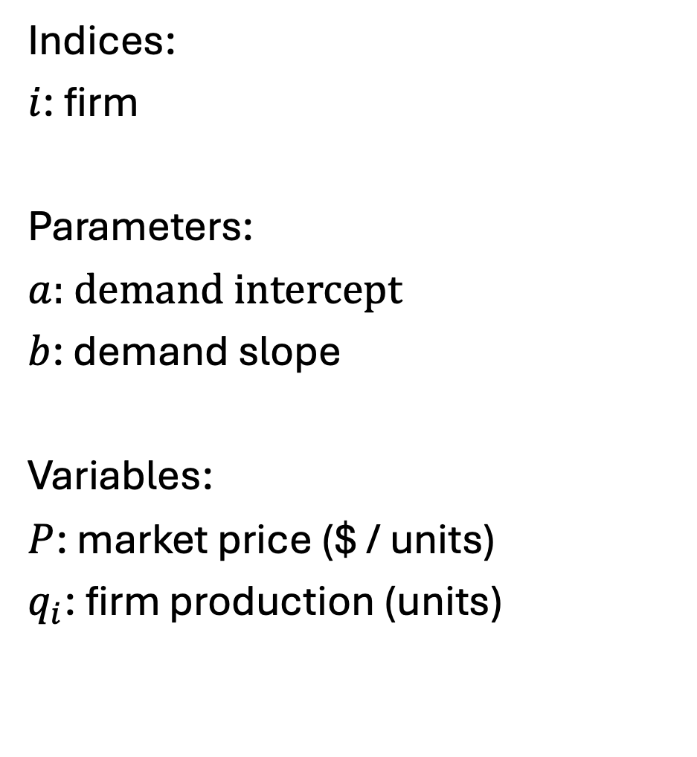
Cournot model as an MCP (linear)
Indices:
$i$: firm
Parameters:
$a$: demand intercept
$b$: demand slope
Variables:
$P$: market price ($ / units)
$q_{i}$: firm production (units)
Complementarity conditions
Supply equals demand:
$$\sum_{i}{q_{i}}≥\frac{P−α}{−β} ⊥P$$
$MR_{i}=MC_{i}$:
$$\left(a−bQ\right)−bq_{i}≥c_{i}⊥q_{i}$$
Note $Q=\sum_{i}{q_{i}}$

Slide 45
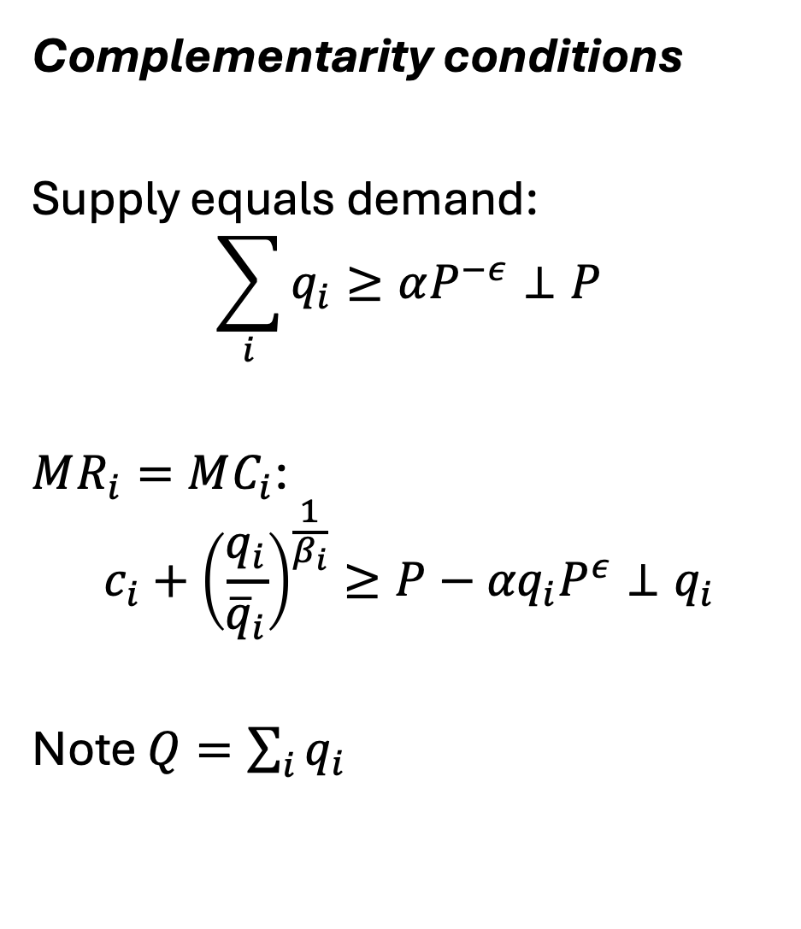
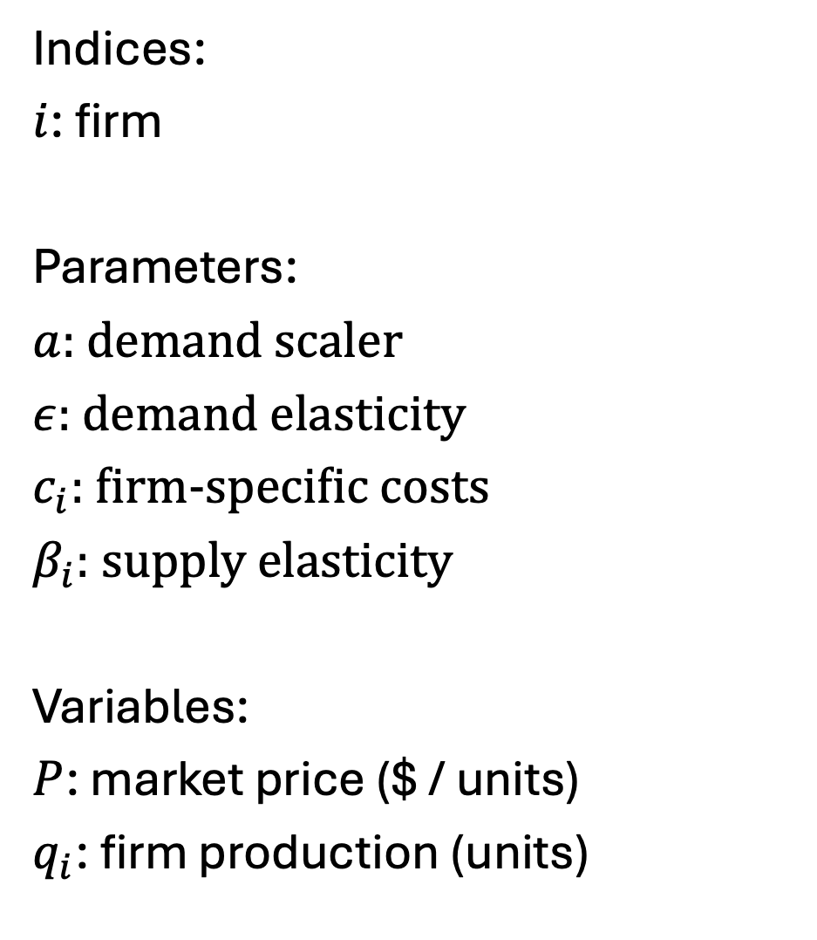
Cournot model as an MCP – from Murphy et al. 1982
Indices:
$i$: firm
Parameters:
$a$: demand scaler
$ε$: demand elasticity
$c_{i}$: firm-specific costs
$β_{i}$: supply elasticity
Variables:
$P$: market price ($ / units)
$q_{i}$: firm production (units)
Complementarity conditions
Supply equals demand:
$$\sum_{i}{q_{i}}≥αP^{−ε}⊥P$$
$MR_{i}=MC_{i}$:
$$c_{i}+{\left(\frac{q_{i}}{{\overline{q}}_{i}}\right)}^{\frac{1}{β_{i}}}≥P−{αq}_{i}P^{ε}⊥q_{i}$$
Note $Q=\sum_{i}{q_{i}}$

Slide 46

Note on deriving MC curves
Original function:
$$f_{i}=c_{i}∗q_{i}+\left(1+β\right)\frac{q^{β_{i}+1}}{{\overline{q}}_{i}^{\frac{1}{β_{i}}}β}$$
Implies:
$$\frac{df_{i}}{dq_{i}}=c_{i}+{\left(\frac{q_{i}}{{\overline{q}}_{i}}\right)}^{\frac{1}{β_{i}}}$$
From the wild west times of functional forms…

