Slide 1
EBGN645
Calibrated market models
MPECs for leader/follower games
CGE models

Slide 2
Upcoming Classes
Project due date: 12/15
Could re-organize presentations and have cancelled/hangout class 12/10

Slide 3

Question
Why convert a model to an MCP if it’s just going to be the exact same as the LP/NLP it was derived from?
If you want price control
If you want self-interested actors, disequilibrium
If you want to add another level (MPEC)
…
Also– MCPs can be very intuitive for equilibrium problems:
$S≥D(P)⊥P$
$C(S)≥P⊥S$

Slide 4
Discussion: final project

Slide 5
Discussion: Current Job Market
It is not easy out there
Many senior researcher friends of mine are having trouble
Not you and not just you
“It is hell out there”

Slide 6
Agenda
MCPs for calibrated market models
MPECs for leader-follower games (or individual actors)
EPECs for Stackelberg games
CGE models – intro/discussion

Slide 7
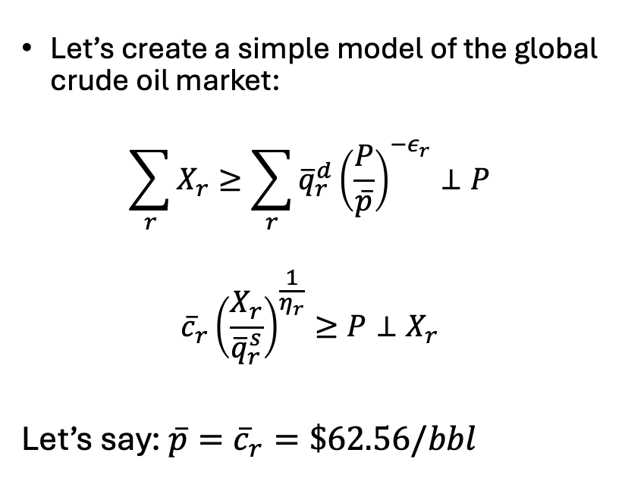
Equilibrium problems (Calibrated market models)
 | Production | Consumption
UnitedStates | 21.91 | 20.01
SaudiArabia | 11.13 | 3.65
Russia | 10.75 | 3.68
Canada | 5.76 | 2.41
China | 5.26 | 15.15
Iraq | 4.42 | 0.77
Brazil | 4.28 | 3.03
UAE | 4.16 | 1.13
Iran | 3.99 | 1.80
Kuwait | 2.91 | 0.44
India | 1.35 | 5.05
Japan | 0.123 | 3.38
SouthKorea | 0.09 | 2.55
Germany | 0.75 | 2.18
ROW | 25.69 | 32.49
Let’s create a simple model of the global crude oil market:
$$\sum_{r}{X_{r}≥\sum_{r}{{\overline{q}}_{r}^{d}{\left(\frac{P}{\overline{p}}\right)}^{−ε_{r}}}⊥P}$$
$${\overline{c}}_{r}{\left(\frac{X_{r}}{{\overline{q}}_{r}^{s}}\right)}^{\frac{1}{η_{r}}}≥P⊥X_{r}$$
Let’s say: $\overline{p}={\overline{c}}_{r}=\$62.56/bbl$

Slide 8
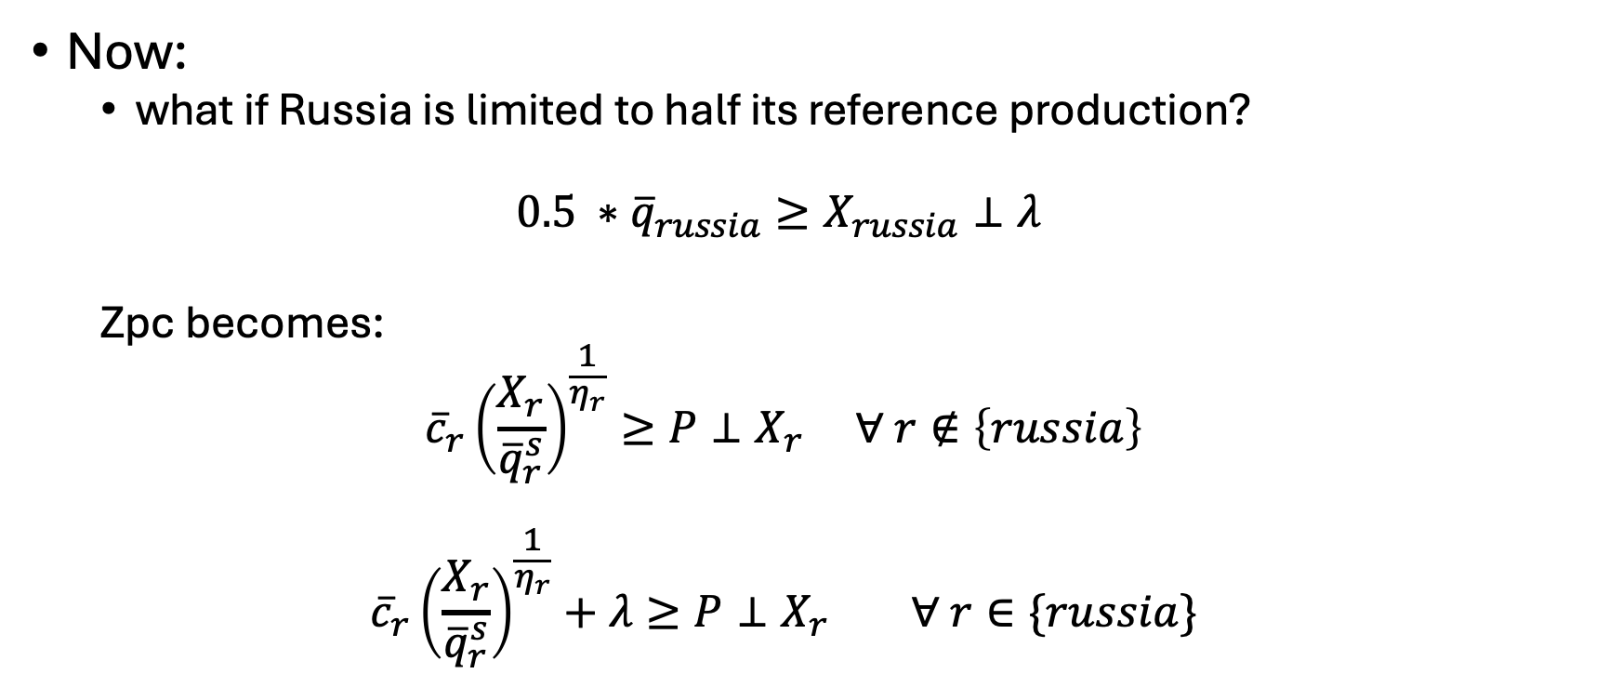
Ok, neat-o
Now:
what if Russia is limited to half its reference production?
$$0.5 ∗{\overline{q}}_{russia}≥X_{russia}⊥λ$$
Zpc becomes:
$${\overline{c}}_{r}{\left(\frac{X_{r}}{{\overline{q}}_{r}^{s}}\right)}^{\frac{1}{η_{r}}}≥P⊥X_{r} ∀ r∉\left\{russia\right\}$$
$${\overline{c}}_{r}{\left(\frac{X_{r}}{{\overline{q}}_{r}^{s}}\right)}^{\frac{1}{η_{r}}}+λ≥P⊥X_{r} ∀ r∈\{russia\}$$

Slide 9
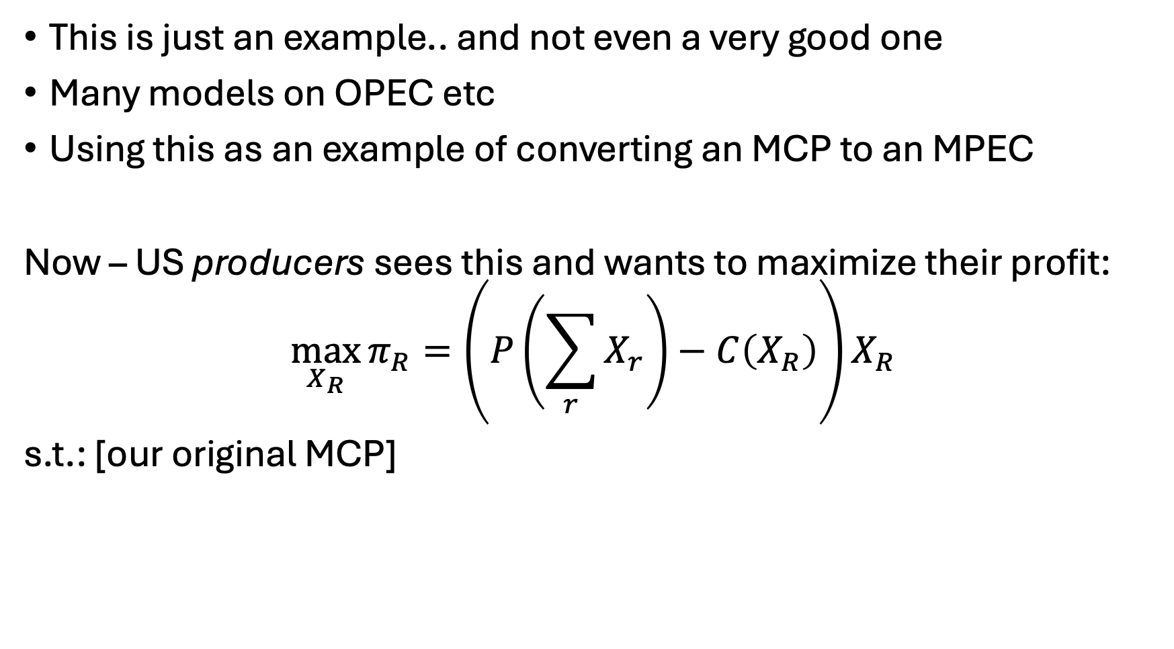
Now.. Let’s make a greedy producer
This is just an example.. and not even a very good one
Many models on OPEC etc
Using this as an example of converting an MCP to an MPEC
Now – US producers sees this and wants to maximize their profit:
$$\max_{X_{R}}{π_{R}=\left(P\left(\sum_{r}{X_{r}}\right)−C\left(X_{R}\right)\right)X_{R}}$$
s.t.: [our original MCP]

Slide 10

Let’s play a game

Slide 11
EPECs
$$Max π_{r}$$
𝑀𝑎𝑥 𝜋_𝑟
$$Max π_{s}$$
𝑀𝑎𝑥 𝜋_𝑠
$$Max π_{t}$$
𝑀𝑎𝑥 𝜋_𝑡
$$Max π_{u}$$
𝑀𝑎𝑥 𝜋_𝑢
$$Max π_{v}$$
𝑀𝑎𝑥 𝜋_𝑣
Equilibrium Programs with Equilibrium Constraints (EPECs)
Essentially a ‘round-robin’ of an MPEC
Problem: order matters.. Many different equilibria

Slide 12
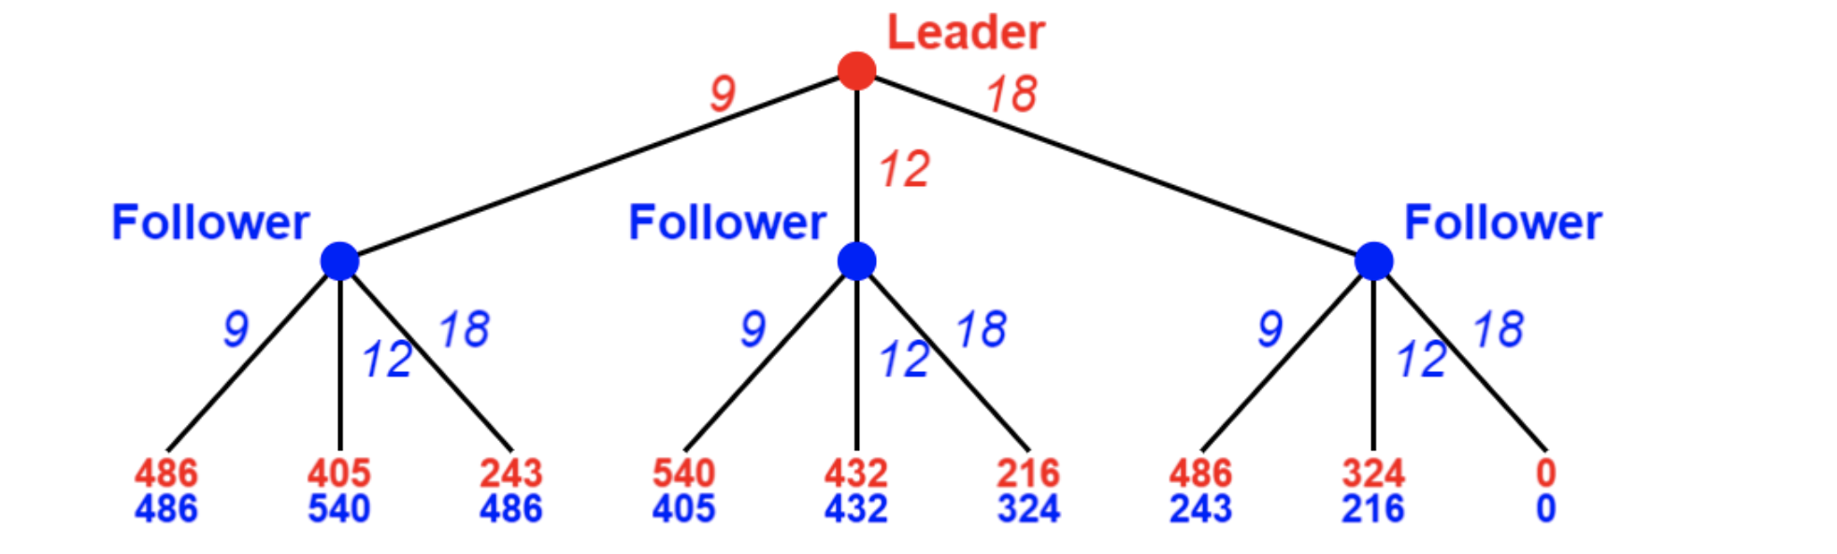
Stackelberg Games
Leader acts knowing the responses of the followers

Slide 13
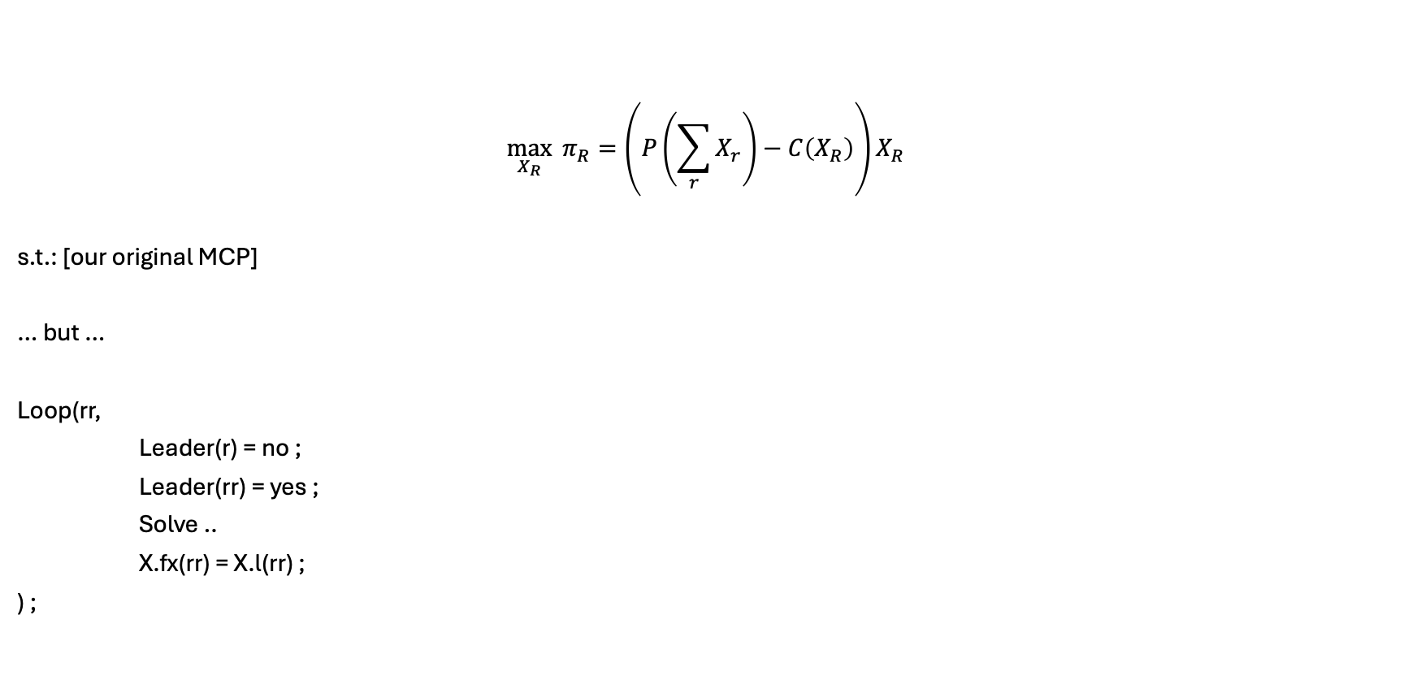
Let’s put this in our simple oil model
$$\max_{X_{R}}{ π_{R}=\left(P\left(\sum_{r}{X_{r}}\right)−C\left(X_{R}\right)\right)X_{R}}$$
s.t.: [our original MCP]
… but …
Loop(rr,
Leader(r) = no ;
Leader(rr) = yes ;
Solve ..
X.fx(rr) = X.l(rr) ;
) ;

Slide 14
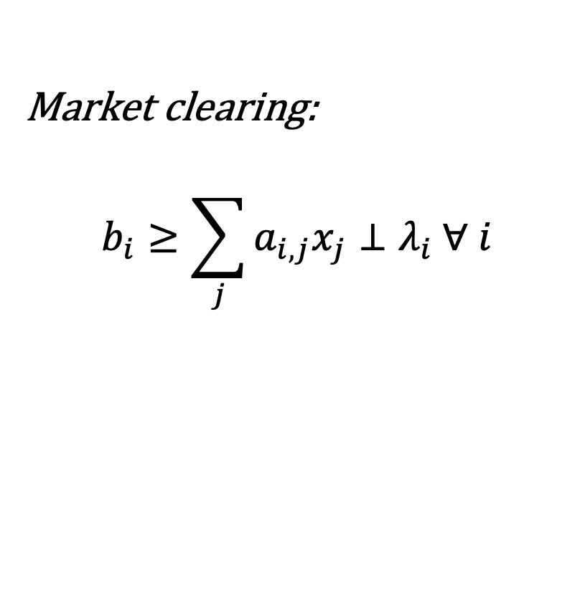

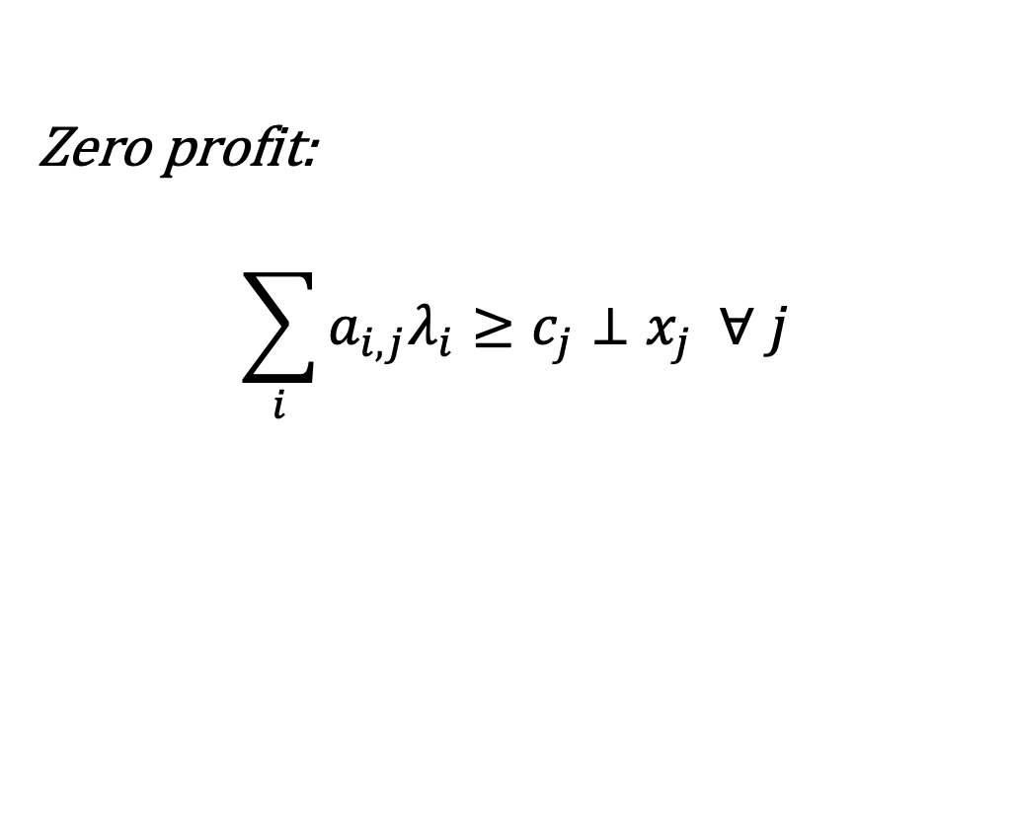
EPECs for Stackelberg Models Rare earths example (Brown and Eggert,2017)
China
Illegal
Australia
$$\begin{matrix}Max \\ x_{j}\end{matrix} π=\left(λ_{i}−c_{i}\right)x_{j}$$
Market clearing:
$$b_{i}≥\sum_{j}{a_{i,j}x_{j}}⊥λ_{i} ∀ i$$
Zero profit:
$$\sum_{i}{a_{i,j}λ_{i}}≥c_{j}⊥x_{j} ∀ j$$

Slide 15
Setup
Three actors
China (leader)
Illegal Chinese Producers (1st follower)
Australia (2nd follower)
Several Policies:
Production quotas
Environmental taxes
Stockpiling (Nd, Dy)
Increased recovery rates (Nd, Dy)

Slide 16
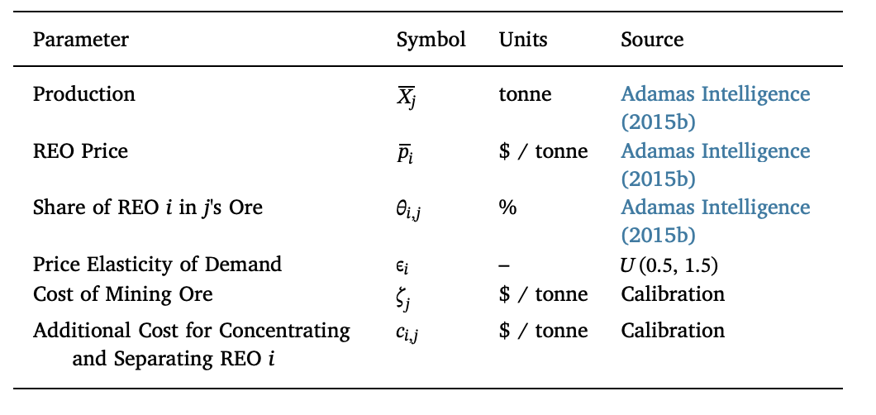
Rare Earth Stackelberg Game Dimensions

Slide 17
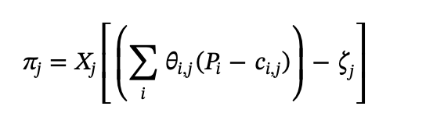
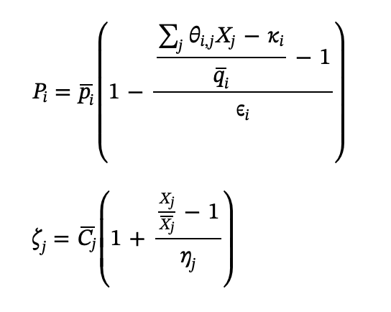
Rare Earth Stackelberg Game

Slide 18
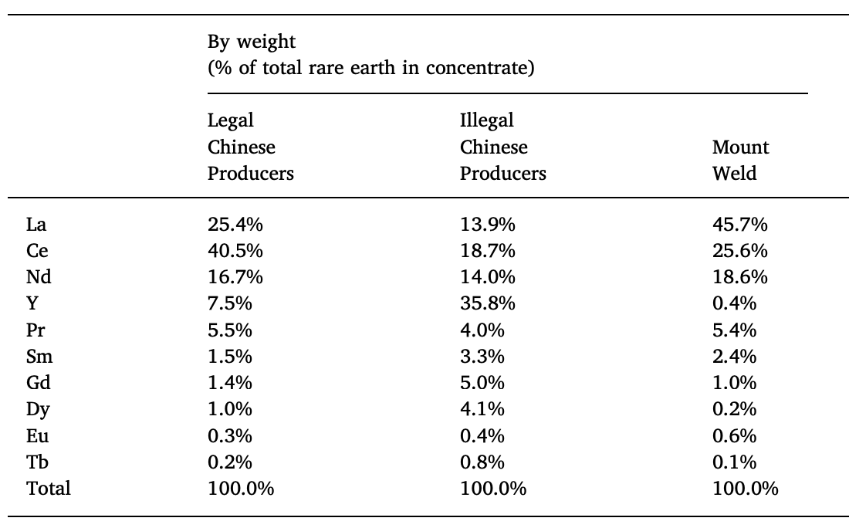
Production Shares

Slide 19
Results – To the paper!

Slide 20
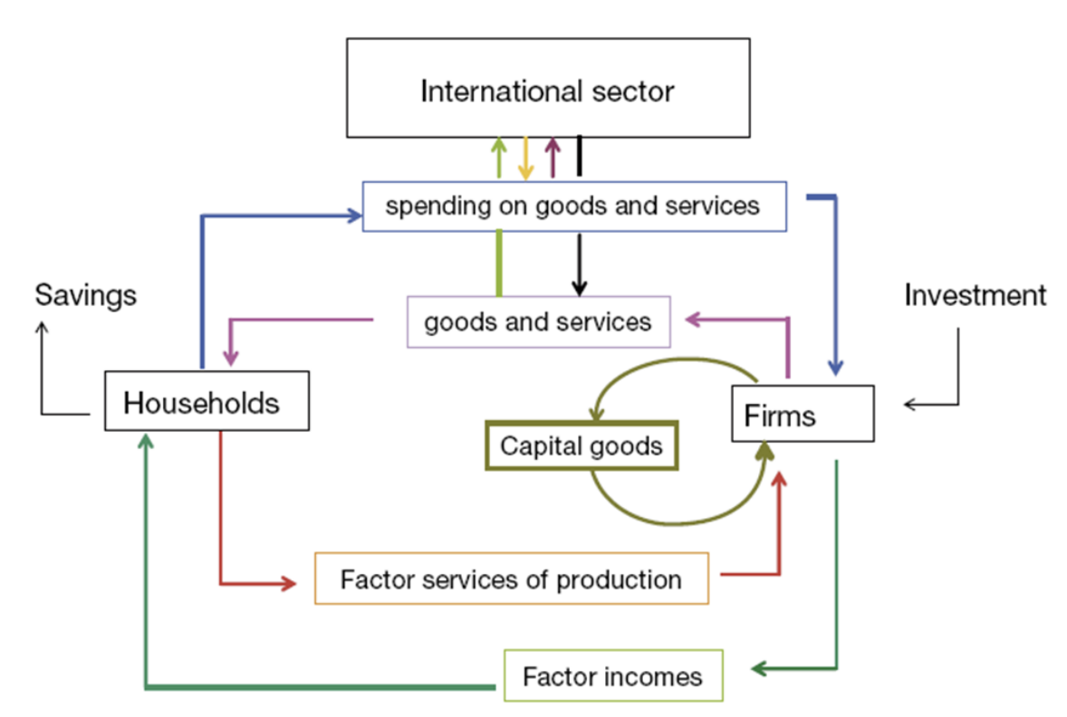
What is a CGE model?
Computable General Equilibrium (CGE)
“Everything depends on everything else”
Three main actors:
Households
Firms
Government
These lectures will serve as an introduction – we could have entire course on them
 | Buy | Sell | Goal
Households | Goods/Services | Capital/labor | Utility
Firms | Capital/Labor | Goods/services | Profit

Slide 21
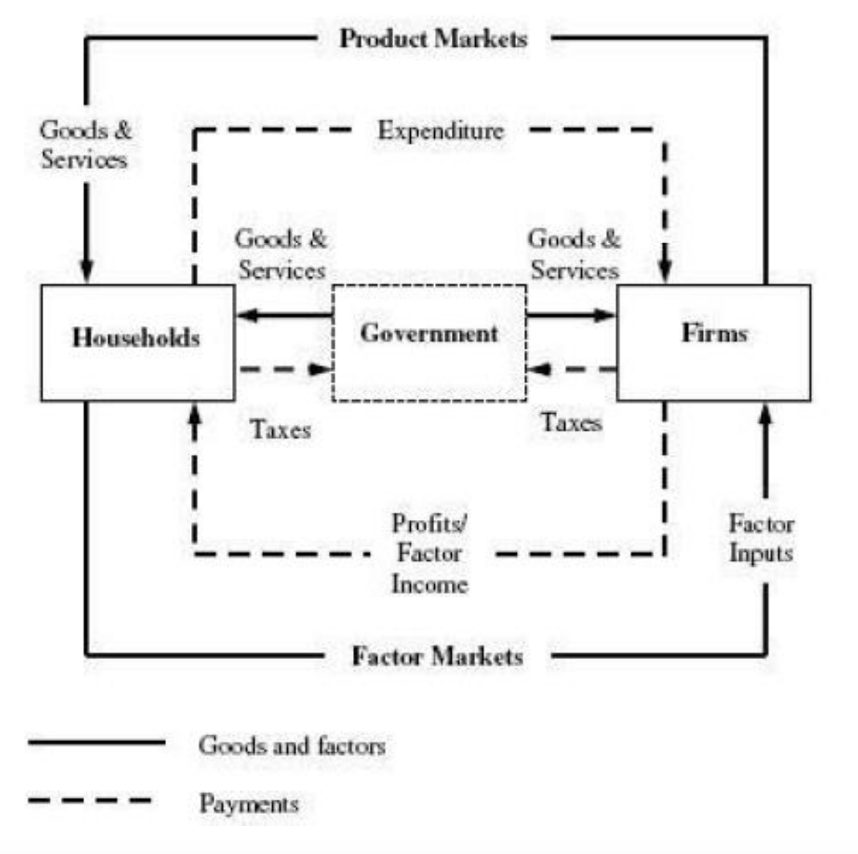
Features of CGE models
“General”:
Technically $→$ represents more than one sector
In practice, usually represents entire economy via ‘all other goods’
Factors of production:
Primary: capital, labor, land,
Intermediate: output from other firms/sectors
Trade
Armington
Gravity models
Explicit country-level representation

Slide 22

When should you use a CGE model?
Useful for…
Policy analysis
Government planning
Development planning
Welfare/utility analysis
Trade analysis
Extensions:
Interest rate and debt
Detailed backstop representation
Dynamic/stochastic/…

Slide 23
Shortcomings of CGE models
Always measuring as a deviation from a benchmark
Stuck in today’s world with ad hoc projections
“Black boxes”
Many assumptions

Slide 24
Examples of (good) CGE models
Wisconsin National Data Consortium’s canonical models:
https://windc.wisc.edu/models.html
Global Trade Analysis Project (GTAP):
https://www.gtap.agecon.purdue.edu/models/current.asp
EPA’s SAGE Model (great documentation):
https://www.epa.gov/environmental-economics/cge-modeling-regulatory-analysis
The New York Fed DSGE Model:
https://www.newyorkfed.org/research/policy/dsge#/overview
US Regional Energy Planning (USREP) Model:
https://globalchange.mit.edu/publication/17331

Slide 25
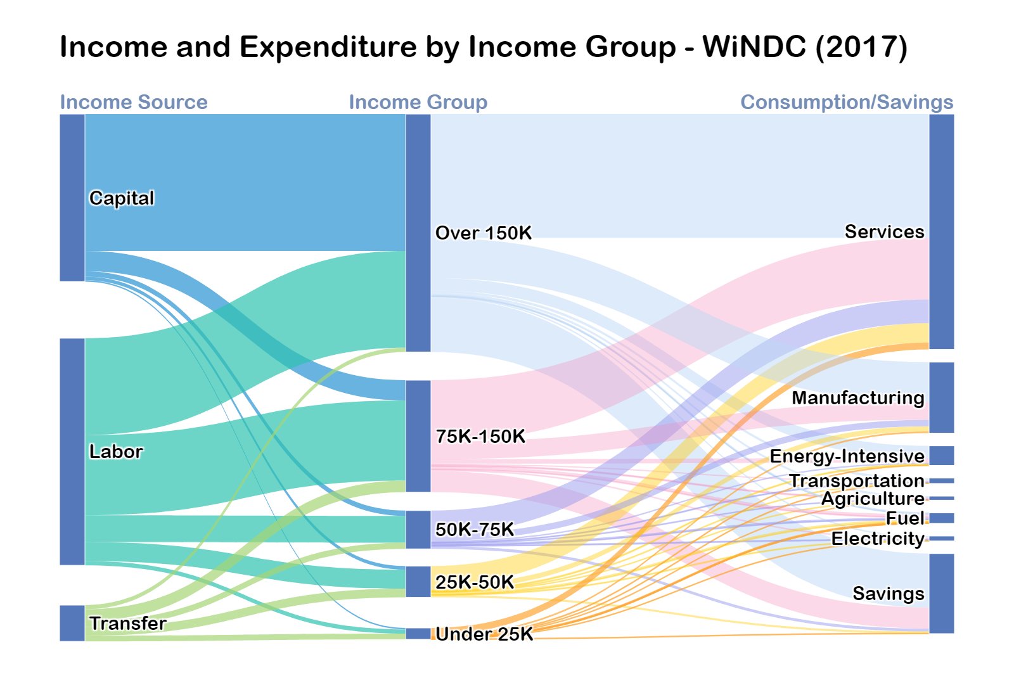
Highlights
The highest income group (Over 150K) makes over half of the total income of all groups. Specifically, the group earns over 80% of total capital income and 40% of total labor income
2/3 of the savings comes from the highest income group, and 1/4 from the mid income group (75K-150K)
Share of expenditure on energy increases as the income level decreases, growing from less than 2% for the highest income group to 14% for the lowest income group
15%
27%
16%
22%
21%
Notes:
hucval "unemployment compensation"
hwcval "workers compensation"
hssval "social security"
hssival "supplemental security"
hpawval "public assistance or welfare"
hvetval "veterans benefits"
hsurval "survivors income"
hdisval "disability"
hedval "educational assistance"
hcspval "child support"
hfinval "financial assistance"

Slide 26
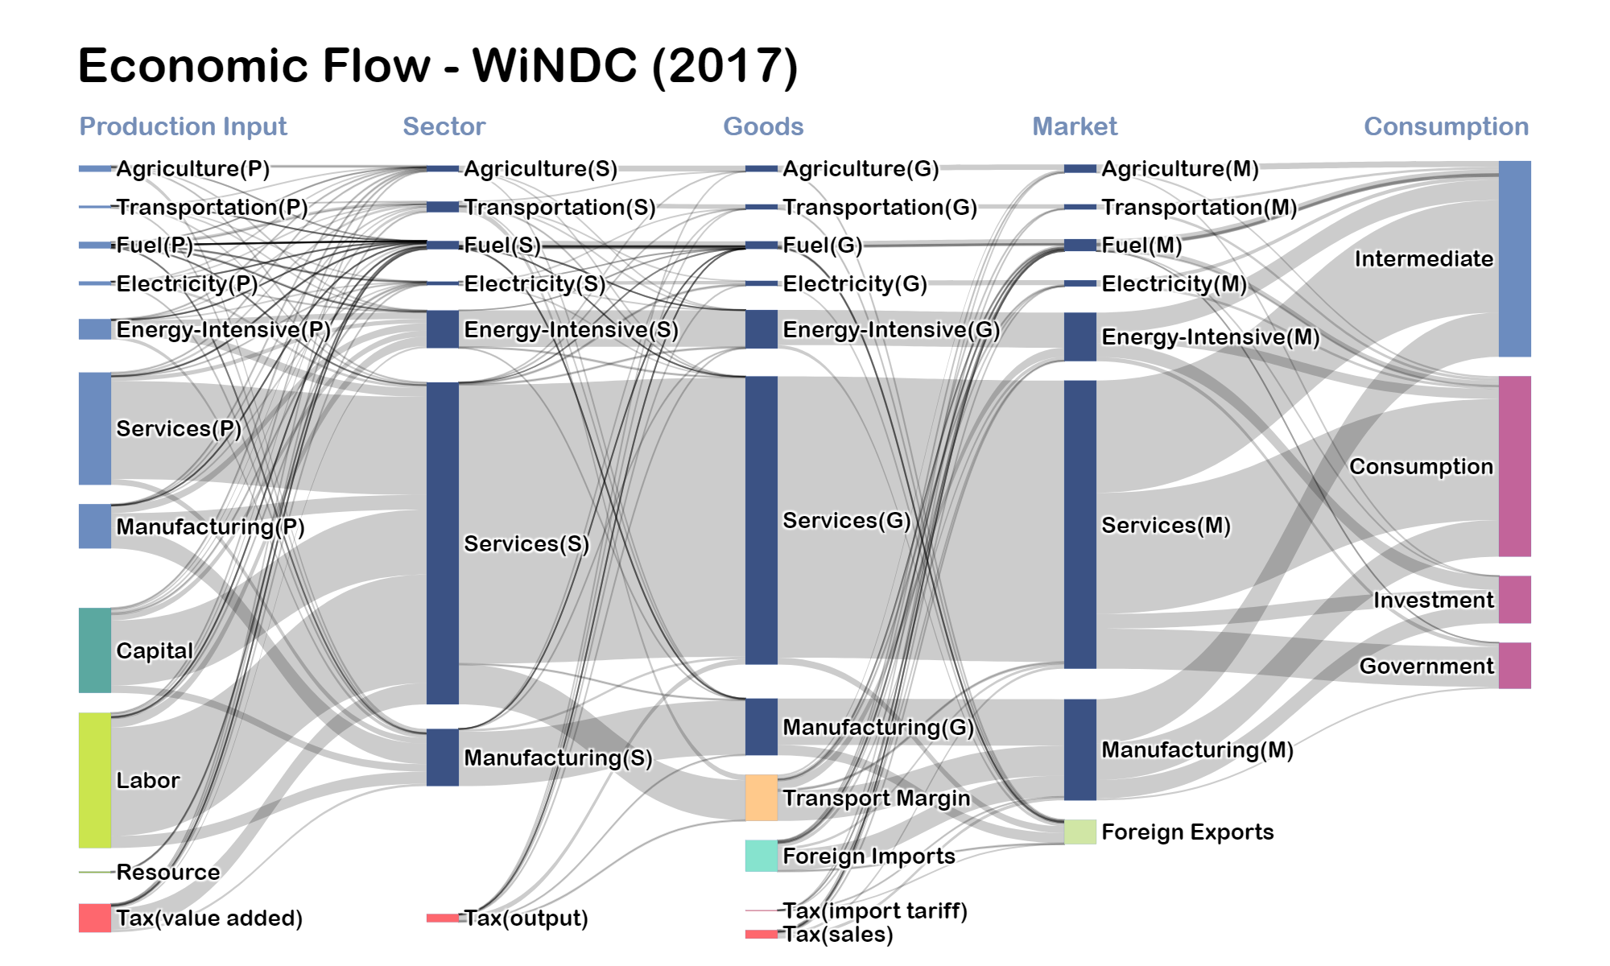

Slide 27
Why “computable” ?
Cannot find a single, concrete answer..
To me, combination of three things…
Walras’ law – we’ll get to this
Use of (usually high-level) data and assumed functional forms allow for representation of the entire economic system
Unable to solve by hand – need a computer

Slide 28

Next few slides
Consumer utility problem
Firm cost problem
Complementarity conditions
Calibrated share form of the constant elasticity of substitute function

Slide 29
Consumer problem
$$Max U=U\left(C_{1},…,C_{i}\right)$$
s.t.
$$M≥\sum_{i}{p_{i}C_{i}}$$
Where:
$U$: utility
$C_{i}$: Consumption of good $i$
$M$: Income
$p_{i}$: Price
Can solve for compensated demand function via:
$$C_{i}=C_{i}(p_{1},…,p_{i},M)$$
i equations
Notes:
a function that shows how much of a good a consumer will demand at different prices, while keeping their utility level constant, meaning their overall satisfaction remains the same regardless of price changes
quantity demanded as part of the solution to minimizing expenditure on all goods while delivering a fixed level of utility

Slide 30
Firm problem
$$\min{\sum_{f}{r_{f}K_{f,i}}}$$
s.t.
$$Y_{j}=Y_{j}\left(K_{1},…,K_{f}\right)$$
$$K_{f,j}=K_{f,j}\left(r_{1},…,p_{f},Y\right)$$
$$k_{f,j}=\frac{K_{f,j}}{Y_{j}}=k_{f,j}\left(r_{1},…,p_{F}\right)$$
$j$: firm (alias to$i$)
$f$: factor of production
$Y_{j}$: output of firm $j$
$K_{f,j}$: demand of $f$ for $j$
$k_{f,i}$: unit factor demand fn
Notes:
“represents the relationship between the quantity demanded of a single unit of a factor of production (like labor or capital) and the price of that factor, while holding the level of output constant”

Slide 31
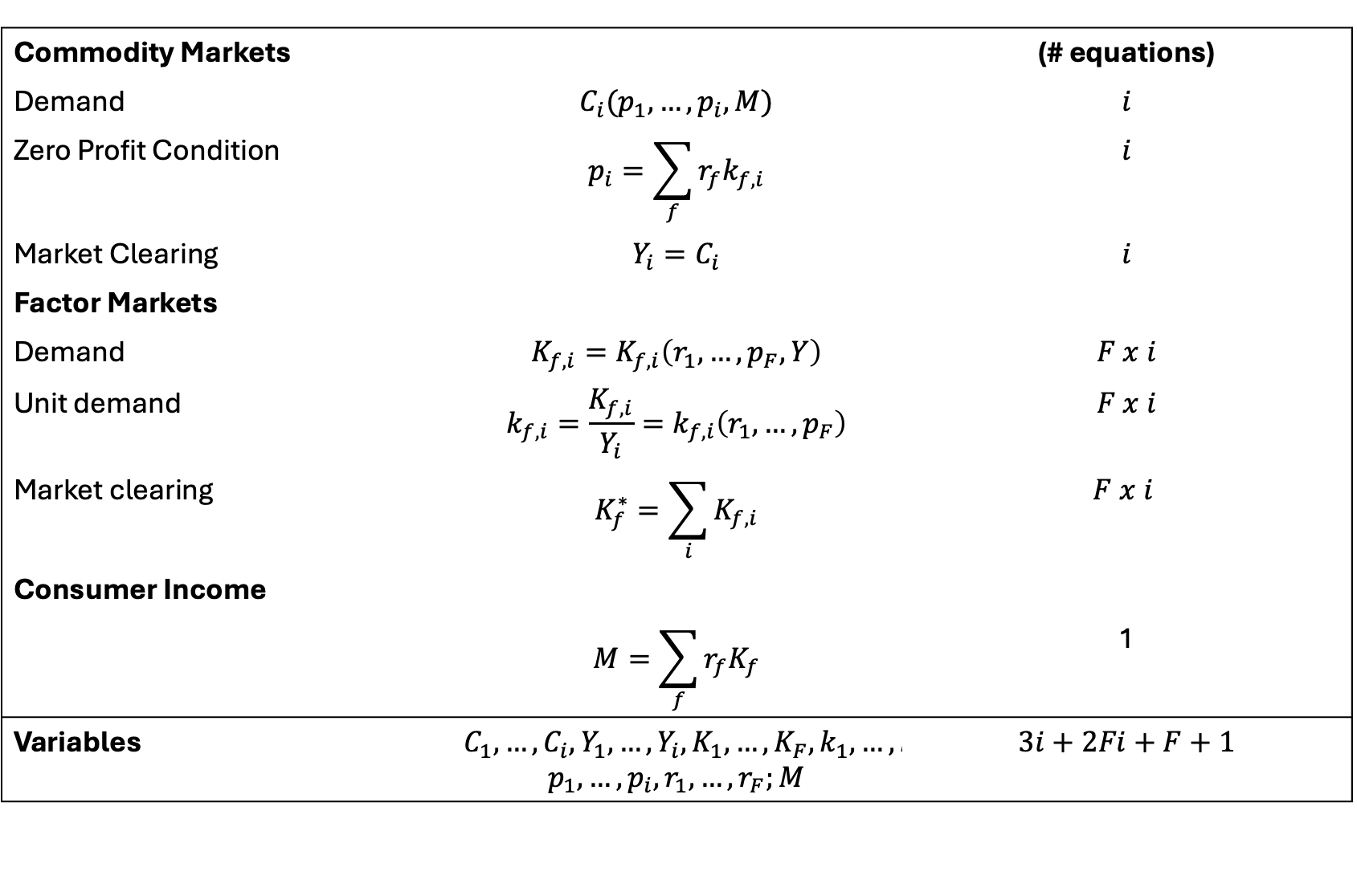
Setup
Commodity Markets |  | (# equations)
Demand | $$C_{i}(p_{1},…,p_{i},M)$$ | $$i$$
Zero Profit Condition | $$p_{i}=\sum_{f}{r_{f}k_{f,i}}$$ | $$i$$
Market Clearing | $$Y_{i}=C_{i}$$ | $$i$$
Factor Markets
Demand | $$K_{f,i}=K_{f,i}\left(r_{1},…,p_{F},Y\right)$$ | $$F x i$$
Unit demand | $$k_{f,i}=\frac{K_{f,i}}{Y_{i}}=k_{f,i}\left(r_{1},…,p_{F}\right)$$ | $$F x i$$
Market clearing | $$K_{f}^{∗}=\sum_{i}{K_{f,i}}$$ | $$F x i$$
Consumer Income
 | $$M=\sum_{f}{r_{f}K_{f}}$$ | 1
Variables | $$C_{1},…,C_{i},Y_{1},…,Y_{i},K_{1},…,K_{F},k_{1},…,k_{F};$$ $$p_{1},…,p_{i},r_{1},…,r_{F};M$$ | $$3i+2Fi+F+1$$

Slide 32
Walras’ Law [I]
# equations: $3i+2Fi+F+1=n$
# variables: $3i+2Fi+F+1=n$
Walras’ law states that for a set of prices, the sum of excess demand over all markets must be equal to zero, basically:
$$\sum_{i}{p_{j}(D_{j}−S_{j})}=0$$
Proofs show that if you have m agents and n commodities, you may drop the the $n^{th}$ market clearing condition as imposing the budget constraint for all agents makes the $n^{th}$ constraint redundant (linearly or non-linearly dependent)

Slide 33
Walras’ Law [II]
Problem is then:
# independent equations: $n−1$
# variables: $n$
Need to establish a numeraire
Numeraire: a commodity that serves as the reference unit of exchange
Think of the USD in oil markets, relative to gold, …
In practice $→$ fix the price of a good to one and make all other prices relative to that good

Slide 34
Social accounting matrices
Data for a CGE model are organized using a social accounting matrix (SAM)
A SAM represents data on all economic transactions that take place within an economy
Numbers in a SAM represent the values (price times quantity) of economic transactions at a point in time (e.g., within a year)
A SAM provides a matrix representation of the national accounts
When calibrating a CGE model, all prices are normalized to one
Choose quantity units so that all prices equal one (e.g., gasoline is measured in ¼ gallon units)

Slide 35
Example SAM
 |  | Commodities |  |  | Consumption
 |  | X | Y | W | C
Markets | PX | 100 |  | -100
 | PY |  | 100 | -100
 | PW |  |  | 200 | -200
 | PL | -40 | -60 |  | 100
 | PK | -60 | -40 |  | 100
Rows and columns always sum to zero $→$ a “Balanced” SAM

Slide 36

A balanced SAM

Slide 37
Example SAM
 |  | Commodities |  |  | Consumption
 |  | X | Y | W | C
Markets | PX | 100 |  | -100
 | PY |  | 100 | -100
 | PW |  |  | 200 | -200
 | PL | -40 | -60 |  | 100
 | PK | -60 | -40 |  | 100
Welfare (W) is produced through consuming 100 units of X and 100 units of Y

Slide 38
Example SAM
 |  | Commodities |  |  | Consumption
 |  | X | Y | W | C
Markets | PX | 100 |  | -100
 | PY |  | 100 | -100
 | PW |  |  | 200 | -200
 | PL | -40 | -60 |  | 100
 | PK | -60 | -40 |  | 100
Total consumption (200) is limited by the income of labor (100) and sale of capital (100)

Slide 39
Important note on the SAM
The next few slides will present functional forms that are, by definition, calibrated to the SAM – that is, all equations are locally “true” at the reference data points included in the SAM

Slide 40
Constant elasticity of substitution (CES) functions and calibrated the share form [I]
CES example:
$$y\left(K,L\right)=φ{\left(βK^{ρ}+\left(1−β\right)L^{ρ}\right)}^{\frac{1}{ρ}}$$
Perfect complements when $ρ→∞$
Perfect substitutes (linear function) when $ρ=1$
Cobb-Douglas when $ρ=0$
Useful references:
https://www.jamelsaadaoui.com/visualizing-ces-production-functions-with-wolfram-alpha/
https://windc.wisc.edu/downloads/summercourse_2021/thursday/ces.pdf
Important later:
$$Y=K^{β}L^{1−β}$$

Slide 41
Constant elasticity of substitution (CES) functions and calibrated the share form [II]
Calibrated share form:
$$y\left(K,L\right)=\overline{y}{\left(θ{\left(\frac{K}{\overline{K}}\right)}^{ρ}+\left(1−θ\right){\left(\frac{L}{\overline{L}}\right)}^{ρ}\right)}^{\frac{1}{ρ}}$$
Reference value share:
$$θ=\frac{{\overline{p}}_{k}\overline{K}}{{\overline{p}}_{K} \overline{K}+{\overline{p}}_{L} \overline{L}}$$
Importantly: user assumes/estimates $ρ$ and reference value shares and reference levels are computed via values in the SAM

Slide 42
CGE as an MCP
Market clearance for welfare
$$W≥\frac{M}{p_{w}}⊥p_{w}$$
Factor market clearing
$$K_{f}≥\sum_{i}{k_{f,i}Y_{f,i}}⊥r_{f}$$
Income accounting:
$$M=\sum_{f}{r_{f}K_{f}}⊥C$$
Zero profit condition for production
$$c_{i}\left(r_{1},…,r_{f}\right)≥p_{i}⊥Y_{i}$$
Utility value balance (ZPC for welfare)
$$e\left(p_{1},…,p_{n}\right)≥p_{w}⊥W$$
Market clear condition for commodities
$$Y_{i}≥d_{i}\left(p_{1},…,p_{n}\right)W⊥p_{i}$$
Denoting:
$c_{i}(r_{1},…,r_{f})$ as the unit cost function
$k_{i,f}(r_{1},…,r_{F})$ are the unit factor demand functions
$e(p_{1},…,p_{n})$ is the unit expenditure function
$d_{i}(p_{1},…,p_{n})$ are the unit compensated Hicksian demand functions
Notes:
Unit cost function -
cost of producing a single unit of a product, essentially the average cost per unit, by dividing the total production cost
Factor demand functions:
the amount of a single unit of a factor of production (like labor or capital) required to produce one unit of output
Unit expenditure functions:
amount of money a consumer needs to spend to achieve a desired level of utility
Hicksian demand functions:
Quantity demanded as part of the solution to minimizing their expenditure on all goods while delivering a fixed level of utility

Slide 43
Let’s work out a simple Cobb-Douglas example…
Zero profit condition for production
$$c_{i}\left(r_{1},…,r_{f}\right)≥p_{i}⊥Y_{i}$$
Translates to:
$$P_{k}^{θ_{i}}P_{L}^{1−θ_{i}}≥P_{i}⊥Y_{i}$$
$$θ_{i}=\frac{{\overline{p}}_{k}{\overline{K}}_{i}}{{\overline{p}}_{K} {\overline{K}}_{i}+{\overline{p}}_{L} {\overline{L}}_{i}}$$

Slide 44
Let’s work out a simple Cobb-Douglas example…
Utility value balance (ZPC for welfare)
$$e\left(p_{1},…,p_{n}\right)≥p_{w}⊥W$$
Translates to:
$$P_{x}^{γ}P_{y}^{1−γ}≥P_{w}⊥W$$
$$γ=\frac{{\overline{p}}_{x} \overline{X}}{{\overline{p}}_{x} \overline{X}+{\overline{p}}_{y} \overline{Y}}$$

Slide 45
Let’s work out a simple Cobb-Douglas example…
Market clear condition for commodities
$$Y_{i}≥d_{i}\left(p_{1},…,p_{n}\right)W⊥p_{i}$$
Translates to:
$${\overline{Y}}_{i}Y_{x}≥{\overline{e}}_{x}W\frac{P_{x}^{γ}P_{y}^{1−γ}}{P_{x}}⊥Y_{x}$$
$${\overline{Y}}_{i}Y_{y}≥{\overline{e}}_{y}W\frac{P_{x}^{γ}P_{y}^{1−γ}}{P_{y}}⊥Y_{y}$$

Slide 46
Let’s work out a simple Cobb-Douglas example…
Market clearance for welfare
$$W≥\frac{M}{p_{w}}⊥p_{w}$$
Translates to:
$$W\overline{W}≥\frac{C}{P_{w}}⊥P_{w}$$

Slide 47
Let’s work out a simple Cobb-Douglas example…
Factor market clearing
$$K_{f}≥\sum_{i}{k_{f,i}Y_{f,i}}⊥r_{f}$$
Translates to (noting $f∈\left\{K,L\right\}$:
$${\overline{K}}_{f}≥\sum_{i}{{\overline{f}}_{i,f}Y_{i}\frac{P_{k}^{θ_{i}}P_{L}^{1−θ_{i}}}{P_{f}}}⊥P_{f}$$

Slide 48
Let’s put this into GAMS..
See file:
[repo]/CGE/2x2_MCP.gms
Also added taxes to X and endowment modifications
Note – still seeking zero residual with no iterations

Slide 49
That was kinda clunky…
System was designed to make this much more automated
Note all these forms are general and calibrated from SAM
Aside from variables, all we needed to compute assign..
Reference value shares
Elasticities of substitution
Realizing this, the Mathematical Program for Solving General Equilibrium (MPSGE) system was created by Thomas Rutherford

Slide 50
MPSGE
Replicated example of the 2x2 MCP model version saved as:
[repo]/CGE/2x2_mpsge.gms
Note well:
$SECTORS
$COMMODITIES
$CONSUMERS
$PROD
$DEMAND

Slide 51
Regions
Flexibility in 50 states aggregation
The current version represents 7 regions consistent with the existing FrEDI study
Sectors
Flexibility in sector aggregation
The standard version represents 5 energy sectors and 6 non-energy sectors including personal transport
Multiple household earned-income groups
The disaggregated household allows to explore distributional impact
Labor-leisure choice affects the supply curve of labor
Income Groups
Technology
Advanced energy supply technologies
Options are available for electricity generation, fuel production, transport, and carbon removal
U.S. Regional Energy Policy Model
(USREP)
Recursive Dynamic Energy-Economic Model
of the U.S. Economy
Production distinguished by generations of technologies
Vintaging capital capturing inertia of technology transition in the short run
Coal and nuclear retirement schedule
Vintages
Domestic and foreign goods are imperfect substitutes
National market for domestic trade; national fuel market; pooled electricity markets
Foreign trade characterized by elasticity for export demand and import supply
Trade
Fuel Depletion
Fossil energy resource depletes based on production of fuel in the previous period
This specification captures the major long-run dynamics of resource prices
Government & Tax
Government collects tax revenue and maintains neutrality in revenue and expenditure
Tax applies to sector output, corporate income, payroll, personal income (based on NBER TAXSIM)
GHG Emissions
CO₂ and non-CO₂ GHG emissions (CH₄, N₂O, HFC_{S}, PFC_{S}, SF₆)

Slide 52
USREP Research Activities
Cost of regulatory policies and cost disparities across regions and income groups resulting from a wide range of carbon policies and revenue distribution methods
Uncertainties of the scale and cost of gas resources, the costs of competing technologies, the pattern of GHG mitigation, and the evolution of global natural gas markets
Efficiency
Natural Gas
& Equity
Caron, Cohen, Brown, and Reilly (2018)*
Rausch and Reilly (2015)
Rausch and Karplus (2014)
Rausch and Mowers (2012)*
Rausch (2012)
Lanz and Rausch (2011)*
Rausch, Metcalf, and Reilly (2011a)*
Rausch, Metcalf, Reilly, and Paltsev (2011b, 2010, 2009)
Carbon
Paltsev, Jacoby, Reilly, Ejaz, Morris, O’Sullivan, Rausch, Winchester, and Kragha (2011)
Leakage
Infrastructure
Air Pollution
Water
The economic value of expanding transmission capacity for hydro power imports along the regional decarbonization strategy
Carbon leakage through electricity trade and the associated energy markets affect the effectiveness of a regional carbon policy
Co-Benefits
Fiscal
Allowance
Issues
Allocation
Yuan, Tapia-Ahumada, Reilly (2021)*
Caron, Rausch, and Winchester (2014)
Caron and Rausch (2013)*
The monetized health benefits of reduced particulate air pollution and climate benefits using the social costs of carbon outweigh the mitigation cost, yield positive net benefit
An integrated assessments of water resources and water stress with consideration of climate change uncertainty, population and economic dynamics, assisting water resource planning
Carbon tax provides a source of revenue to finance federal fiscal initiatives
Emissions outcomes remain regardless of the allowance allocation to states, and the welfare results reflect income effects of allowance trading among states
Jacoby, Montgomery, and Yuan (2018)
Yuan, Metcalf, Reilly, Paltsev (2017)
Blanc, Strzepek, Schlosser, Jacoby, Gueneau, Fant, Rausch, and Reilly (2014)*
Yuan, Baron, Selin, Picciano, Metz, Reilly, and Jacoby (2021)*
Dimanchev,, Paltsev, Yuan, Rothenberg, Tessum, Marshall and Selin (2019)
Thompson, Rausch, Saari, and Selin (2016, 2014)
Yuan, Barron, Selin, Picciano, Metz, Reilly, Jacoby (2022)*
* Study conducted based on an integrated model that links USREP with a detailed sector model

Slide 53
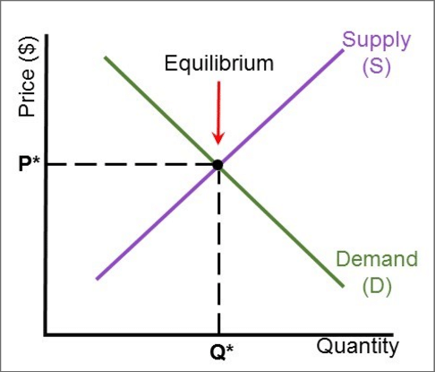
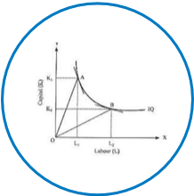


ReEDS-USREP
Fuel prices
Labor and capital price indices
Demand curve specification
ReEDS converted from LP to QCP to maximize social surplus (instead of minimizing cost)
USREP benchmark social accounting matrix calibrated to ReEDS electricity supply/prices, fuel demands, and capex/opex
Currently being used for United Nation’s Biennial Transparency Report
Method developed by Bohringer and Rutherford (2008); demonstrated in Caron et al. (2018a), Caron et al. (2018b), and Brown et al. (2024)
USREP
Fuel quantities
Labor and capital quantities
Electricity quantity and price
Notes:
Will people know USREP-ReEDS?
C. Böhringer and T. F. Rutherford, “Combining bottom-up and top-down,” Energy Econ, 30(2):574–596, Mar. 2008.
J. Caron, S. M. Cohen, M. Brown, and J. M. Reilly, “Exploring the impacts of a national U.S. CO2 tax and revenue recycling options with a coupled electricity-economy model,” Clim Chang Econ, 9(1):1840015, Mar. 2018.

Slide 54
Some final thoughts
Preview of USREP code
Co-optimization as a means for top-down/bottom-up linking

Slide 55
A video…
https://www.youtube.com/watch?v=aznOL753eiQ

