Slide 1
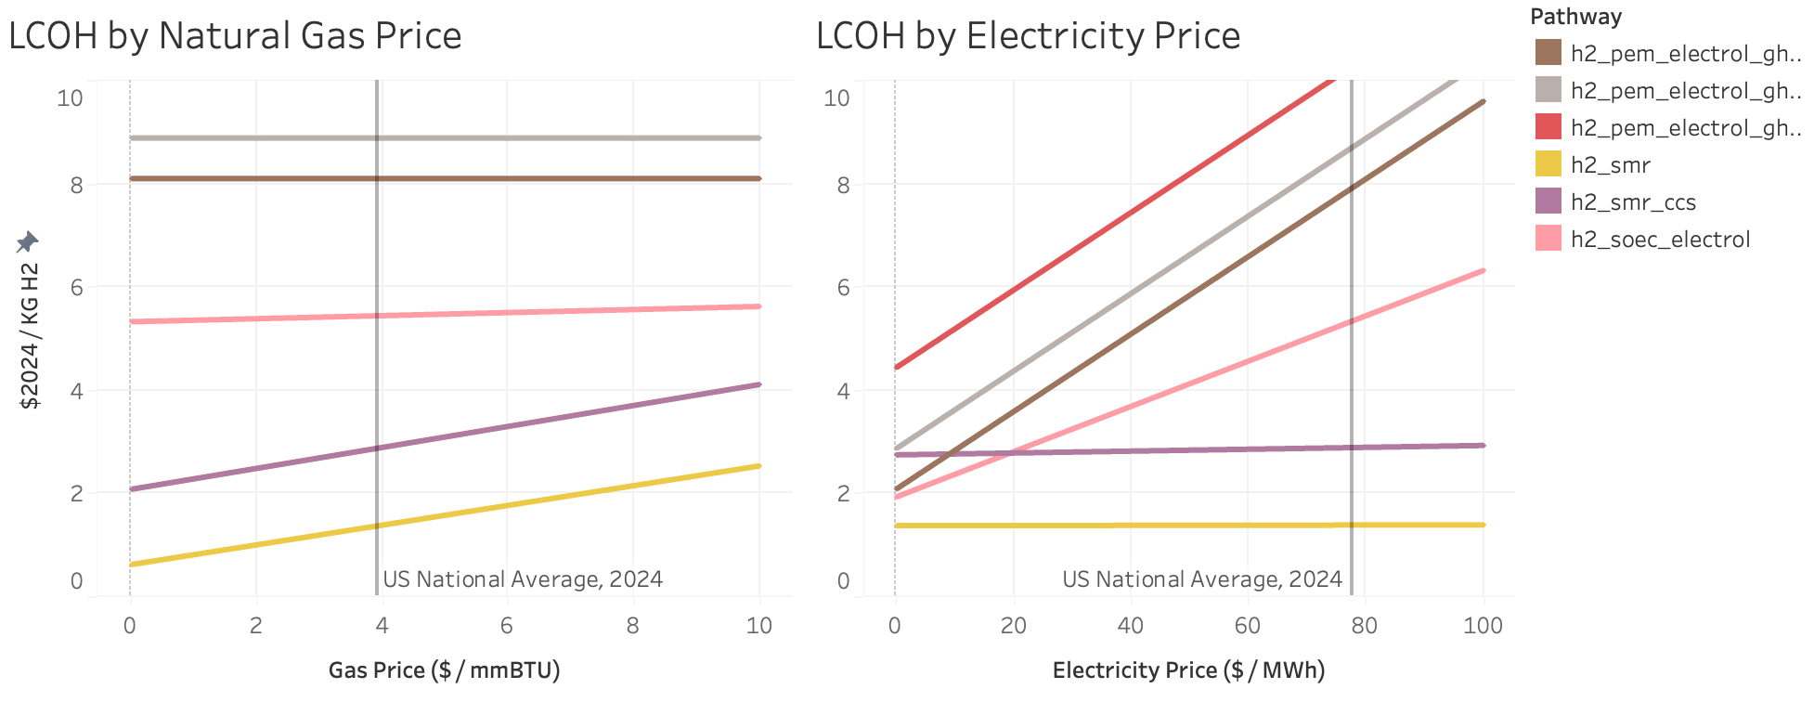
Basically..

Slide 2
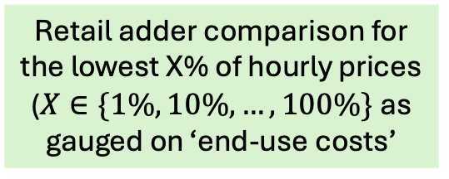
FINITO cost and performance characteristics for steel production technologies
Greenheart team costs/characteristics for electrolytic hydrogen production technologies
ReEDS-FINITO CCS and H2 transport and storage assumptions
(by BA/reservoir/technology)
SLOPE LCOE (county/technology)
EIA for average industrial natural gas and electricity prices (state)
AEO/FINITO for non-fuel and non-electricity prices (cendiv)
e.g. metallurgical coal, coke, ddfo, …
Subsection
Data
CAMBIUM
LCOH -> LCOS
Comparison at the county-level Using LCOE vs Retail
.. Essentially re-producing HERO then adding LCOS
Retail adder comparison for the lowest X% of hourly prices
($X∈\{1\%,10\%, …, 100\%\}$ as gauged on ‘end-use costs’
AEO (for gas/grid price changes), basic assumptions/permutations, CAMBIUM scenarios
Further sensitivities to gas prices, cost assumptions, …

Slide 3
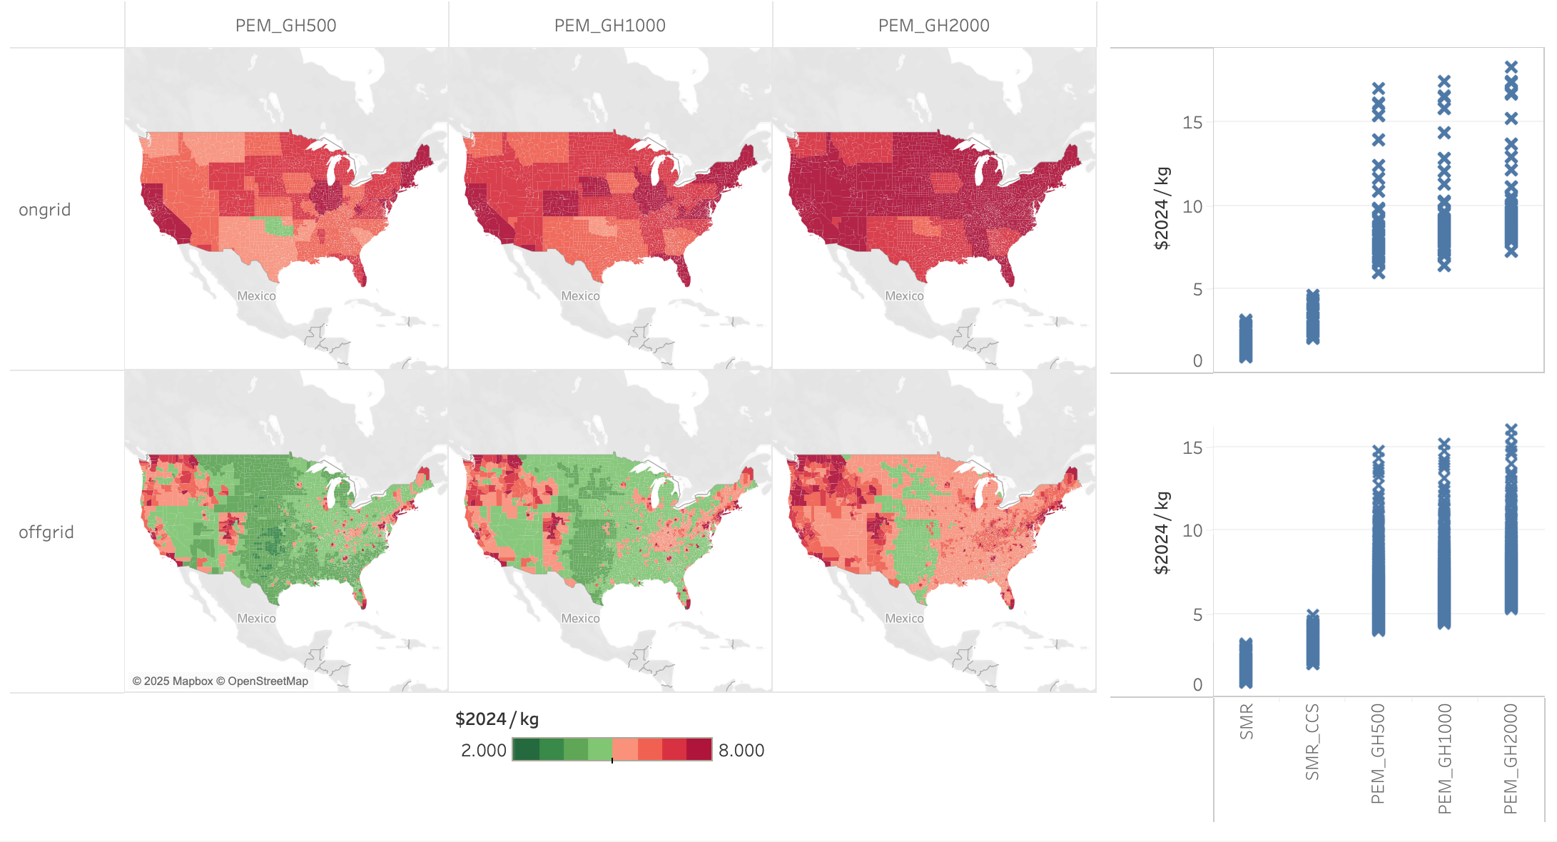
LCOH by electrolyzer cost assumption

Slide 4
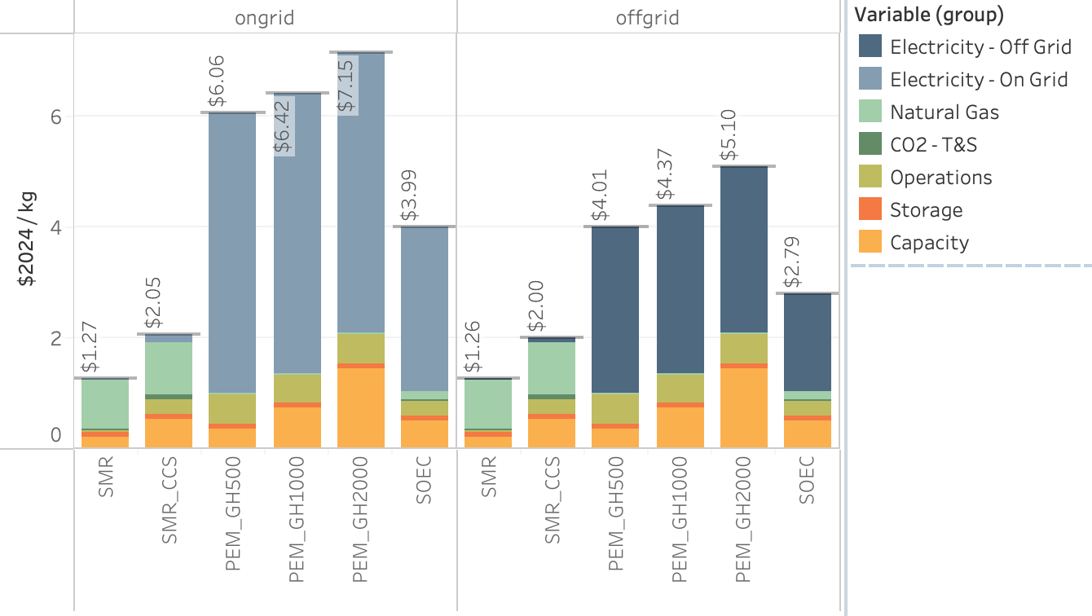
LCOH

Slide 5
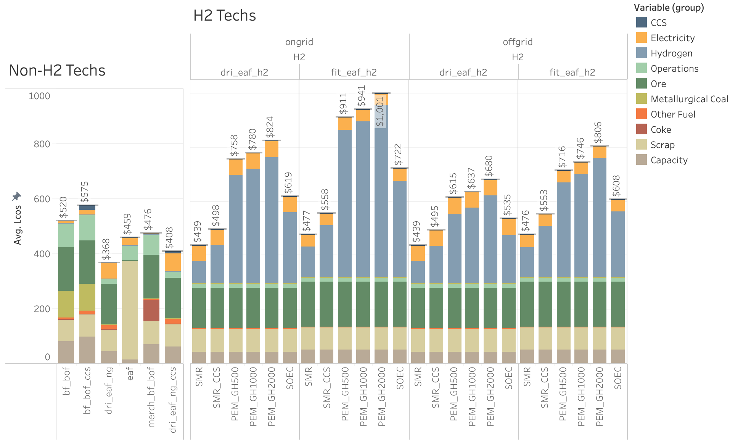
LCOS by steel production technology, grid configuration, hydrogen production technology, and cost component

Slide 6
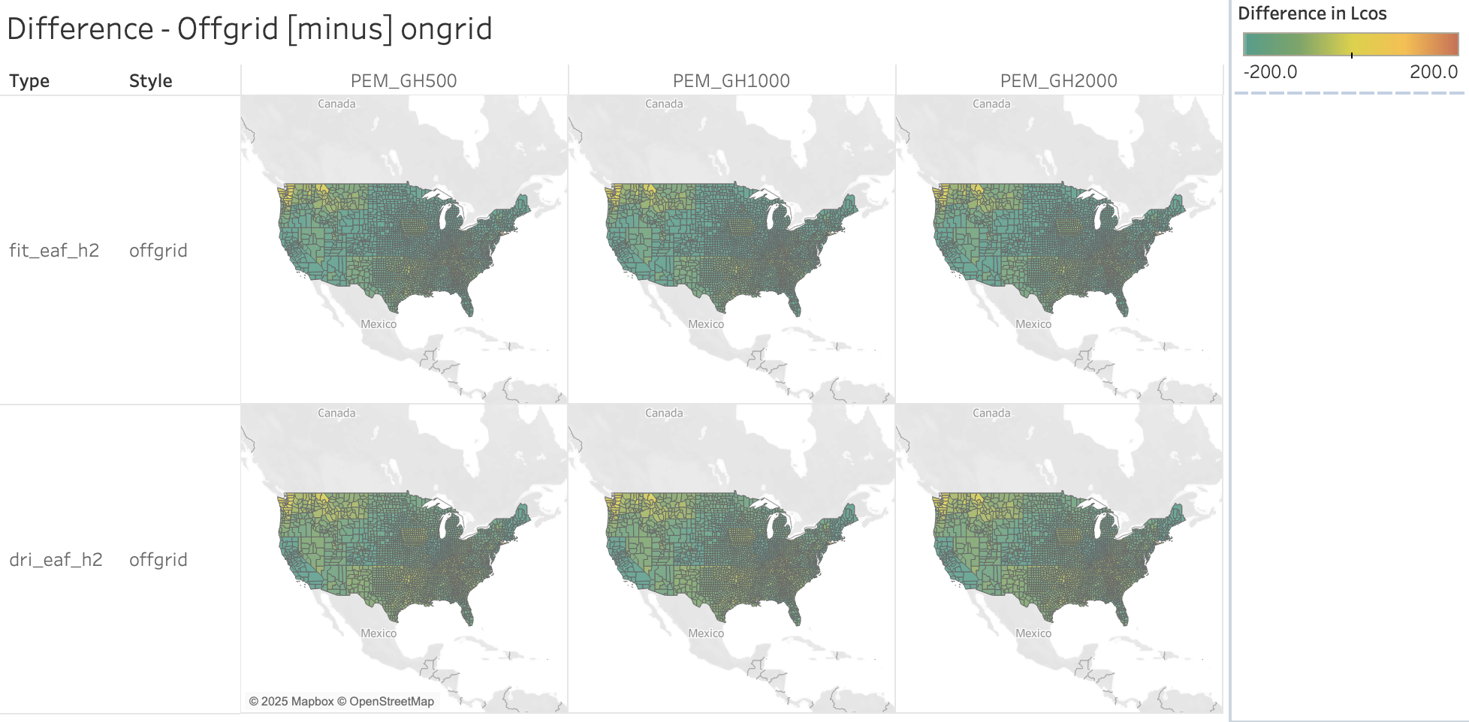
LCOS Map – retail minus LCOE for H2

Slide 8
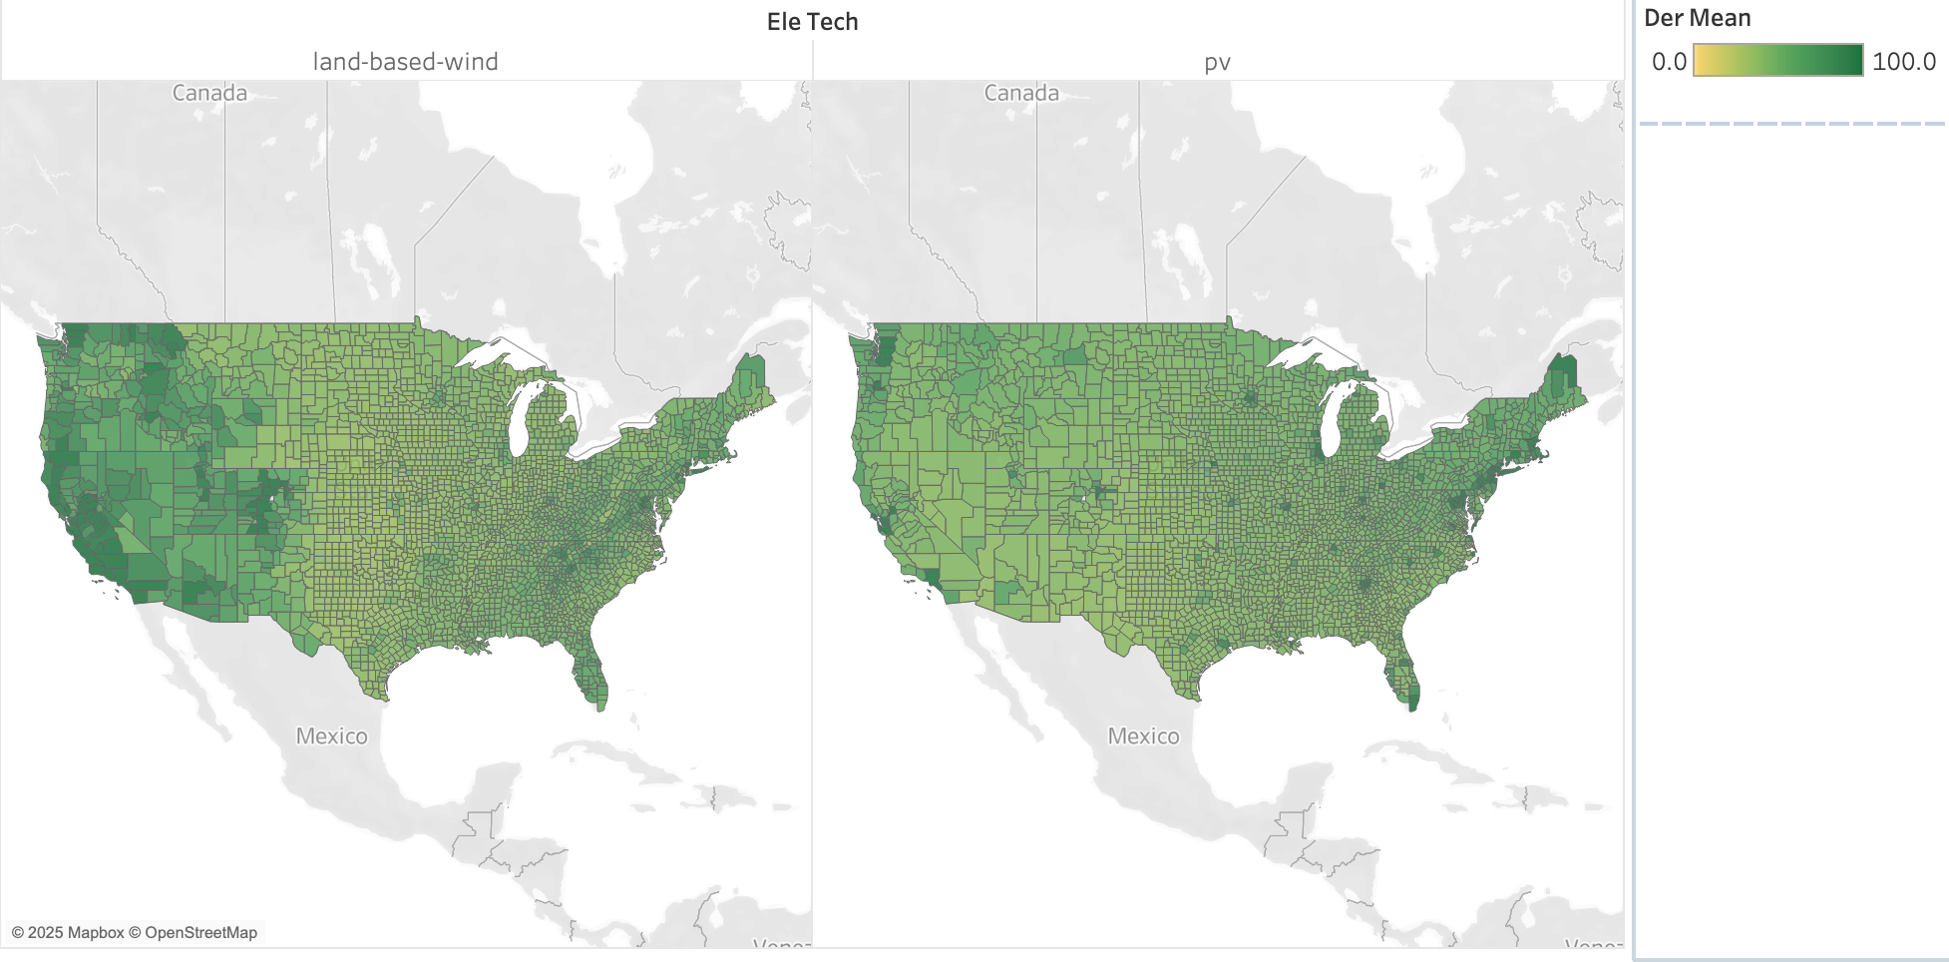
Data – LCOE from SLOPE

