Slide 1
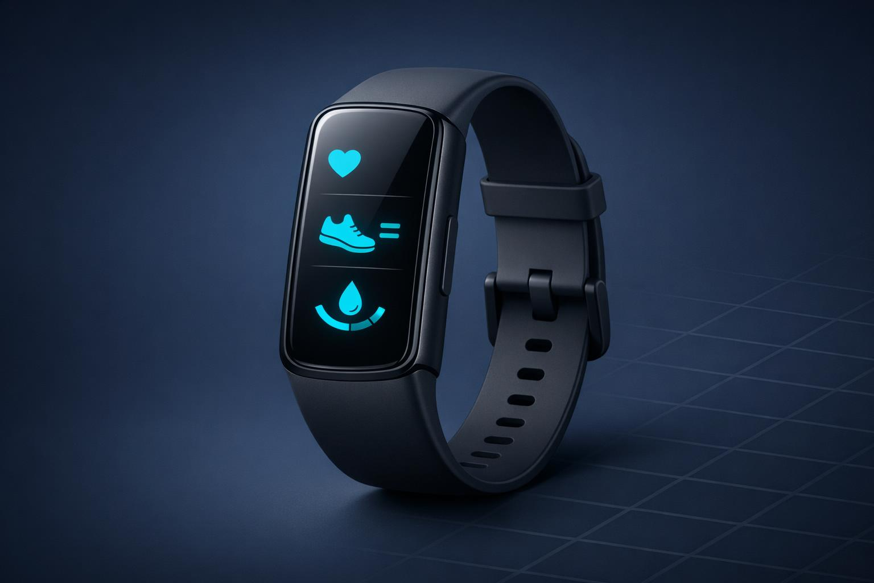
FitByte
AI Content Creator
Brand-aligned content generation powered by dual knowledge bases
Ironhack Data Analytics Bootcamp • Module 2 Project
May 2026

Slide 2
01 — PROBLEM & SOLUTION
What Problem Does It Solve?
THE PROBLEM
THE SOLUTION
▸
Generic AI content looks and sounds the same
▸
Dual knowledge base: brand guidelines + market research
▸
ChatGPT has no brand voice, no product knowledge
▸
5-stage pipeline: Document → Monitor → Brief → Publish → Iterate
▸
Content teams lack a scalable, consistent system
▸
Dynamic prompt templates injected with proprietary context
▸
AI outputs ignore market positioning & competitor gaps
▸
Human-in-the-loop for quality control & iteration
"FitByte. Track everything. Overthink nothing." — and now: create brand content that sounds like us.
Target Audiences:
Performance Athletes
Fitness Enthusiasts
Health Professionals
Upgraders
2

Slide 3
02 — KNOWLEDGE BASE ARCHITECTURE
Two-Layer Knowledge System
PRIMARY KNOWLEDGE BASE
SECONDARY RESEARCH LAYER
fitbyte_brand_guidelines.md
market_trends.md
• Brand voice rules (active voice, no serial comma)
• 2024-2025 consumer fitness trends
• 4 audience personas with tone guides
• 68% of serious athletes track recovery metrics
• Channel-specific writing standards
• Wearables market growth trajectory
fitbyte_product_specs.md
competitor_analysis.md
• 14-day battery, dual-frequency GPS
• Garmin, Apple Watch, Fitbit, Whoop positioning
• 6-stage sleep tracking, Recovery Score
• FitByte differentiators identified
• SpO2, VO2 max, 50m water-resistance
• Pricing & feature gap analysis
past_content/fitbyte_content_examples.md
• 10 real FitByte blog posts
• Few-shot style reference
• Proven brand-aligned tone
Primary = What FitByte IS | Secondary = What the MARKET looks like
3

Slide 4
03 — CONTENT PIPELINE
5-Stage Content Creation Pipeline
1
DOCUMENT
2
MONITOR
3
BRIEF
4
PUBLISH
5
ITERATE
Load & structure brand + market context from both KBs
LLM analyzes topic for brand fit & market relevance
Chain-of-thought prompt generates structured content brief
Few-shot + contextual placement generates final content for target channel
Human review: approve / edit / regenerate (Human-in-the-Loop)
▶
▶
▶
▶
python main.py --topic "why rest days matter" --channel blog --audience fitness_enthusiast
4

Slide 5
04 — EXAMPLE OUTPUT
Generated Content — Blog Post
TOPIC
CHANNEL
AUDIENCE
PROVIDER
How Training Load Prevents Injuries
Blog
Performance Athlete
OpenAI GPT-4o-mini
GENERATED OUTPUT
✓ Saved to /outputs/
Why Training Load Management is Your Best Defense Against Injuries Did you know that the right training load can be your best defense against injuries? Performance athletes often push their limits, but without understanding training load, they risk injury and burnout. FitByte's Recovery Score transforms complex data into one actionable number — telling you when to push harder and when to ease off. Athletes who manage their training loads report fewer injuries and improved overall performance. 68% of serious athletes now track recovery metrics. FitByte's dual-frequency GPS and 14-day battery keep you informed across every session. Ready to take control? Start tracking your training load today.
5

Slide 6
05 — UNIQUENESS DEMONSTRATION ⭐ CRITICAL
FitByte vs Generic ChatGPT
Topic: "Sleep quality and recovery" | Channel: Blog
FITBYTE BRANDED OUTPUT
GENERIC CHATGPT OUTPUT
6-Stage Sleep. Serious Recovery. You trained hard this week. But did you actually recover? FitByte's 6-stage sleep tracking doesn't just log light and deep sleep — it maps every sleep cycle against your Recovery Score. When your score drops below 60, your body is telling you something. 68% of serious athletes now monitor recovery. The ones who don't are guessing. FitByte gives you the data to stop guessing — and start performing on purpose.
Improving Your Sleep Quality Getting good sleep is essential for overall health and recovery. When you sleep well, your body repairs muscle tissue and consolidates memories. There are many ways to improve your sleep. Try going to bed at the same time each night, limiting screen time before bed, and keeping your bedroom cool and dark. Remember, quality sleep leads to better performance in your daily activities and workouts.
VS
FitByte advantages:
Brand voice
Specific product refs (6-stage, 14-day)
Real data (68% stat)
Audience insight
6

Slide 7
05B — HUMAN-IN-THE-LOOP EVALUATION
Iterative Refinement System
Test 1
Add Metrics
Test 2
Length Control
Test 3
Context Injection
Test 4
Combined
Human Input:
Human Input:
Human Input:
Human Input:
add metrics as proof
Shorten it to X words
tie it to the upcoming Ironman
add metrics + 350 words + Ironman context
Result:
Result:
Result:
Result:
Metrics added consistently Increased credibility Content shifts: generic → evidence-based
Model compresses well Maintains core message Channel-specific optimization
Content becomes scenario-specific Stronger emotional relevance Generic fitness → endurance focus
Increased depth & structure Natural metric integration Strong contextual anchoring
Key Finding: Context injection is the most powerful lever for uniqueness. Human iteration is essential — not optional.
6B

Slide 8
06 — TECHNICAL IMPLEMENTATION
Architecture & Key Technologies
llm_integration.py
document_processor.py
knowledge_base.py
• OpenAI GPT-4o-mini
• Markdown parsing
• Primary KB manager
• Anthropic Claude Haiku
• Text extraction & cleaning
• Secondary KB manager
• Auto-provider detection
• Knowledge base loading
• Unified context builder
• Exponential backoff
• Structured context dict
• Audience-aware filtering
• Token usage tracking
prompt_templates.py
content_pipeline.py
app.py (Gradio UI)
• PromptContext dataclass
• Orchestrates all 5 stages
• Web interface
• Channel-specific builders
• Batch mode support
• gr.State JSON pipeline
• Brief → Publish chain
• Uniqueness comparison runner
• Live streaming output
• Generic comparison baseline
• OutputManager saves files
• Channel / audience selector
• NO_EM_DASH / anti-AI rules
7

Slide 9
06B — PROMPT ENGINEERING
Dynamic Prompt Construction
BLOG
INSTAGRAM
LINKEDIN
EMAIL_SUBJECT
150-250 words Title + short paragraphs Few-shot style examples Benefit-first structure
1 strong hookline 2 short body sentences 1 closing sentence Gen Z tone + emojis
250-350 words Concrete insight opening 3 numbered takeaways Hashtags + CTA
5 subject lines Under 15 characters each Verb-led + emoji No spam words
HOW PROMPTS ARE ASSEMBLED
Brand Identity
Audience Insights
Product Specs
Market Context
Style Examples
Content Brief
→
PromptContext dataclass aggregates all inputs → channel-specific builder injects context → LLM generates brand-aligned content
8

Slide 10
07 — CHALLENGES & LEARNINGS
What We Faced — What We Learned
Generic Outputs
EM Dash Problem
Challenge:
Initial content was indistinguishable from vanilla ChatGPT
Challenge:
LLMs default to em-dash overuse — a strong "AI-writing" signal
Solution:
Deep KB injection into every prompt + few-shot style examples forced brand anchoring
Solution:
Added NO_EM_DASH_RULE to all system prompts; tested across 10+ outputs to verify removal
Prompt Chaining
Consistency Across Channels
Challenge:
Single-step prompts produced shallow content without strategic angle
Challenge:
Blog voice leaked into Instagram; LinkedIn felt too casual
Solution:
Added BRIEF stage before PUBLISH: forced angle + hook + insight before generating final content
Solution:
Built separate prompt builders per channel with strict character/tone/structure rules
Key Learning: Uniqueness comes from specific CONTEXT, not better prompts. Depth of knowledge base = depth of content differentiation.
9

Slide 11
08 — NEXT STEPS
Future Improvements
RAG / Vector Retrieval
Future Module
Future Module
Replace flat markdown loading with semantic vector search. Retrieves only the most relevant KB chunks per topic — not required for Project 2, planned for future module.
Advanced Monitoring
Next Sprint
Next Sprint
Track content performance metrics: engagement rates, A/B comparison, auto-scoring against brand guidelines on every generation.
Automated Publishing
Phase 2
Phase 2
Direct API publishing to Instagram, LinkedIn, email platforms. Approval workflow with one-click scheduling.
Multi-Brand Support
Phase 3
Phase 3
Parameterize the KB structure to support multiple brands/clients. Turn FitByte into a white-label content platform.
10

Slide 12
Thank You
Questions?
How did you ensure content uniqueness?
Knowledge base organization & structure
Prompt engineering techniques used
Why 5 pipeline stages vs 1 direct call?
Technical choices: OpenAI vs Anthropic
Kanban workflow & WIP limits
Built for Ironhack Data Analytics Bootcamp — Module 2 Project — May 2026
11

