Slide 1
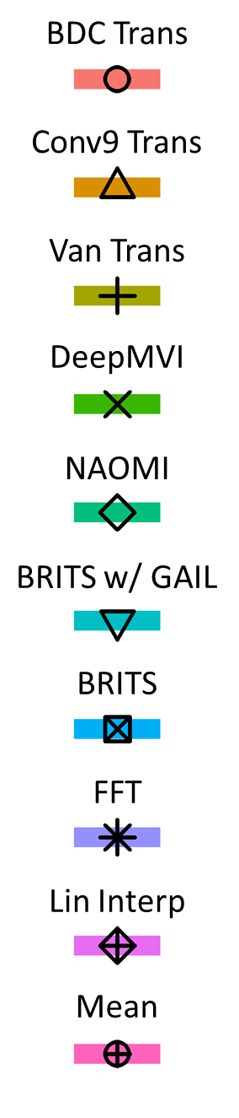
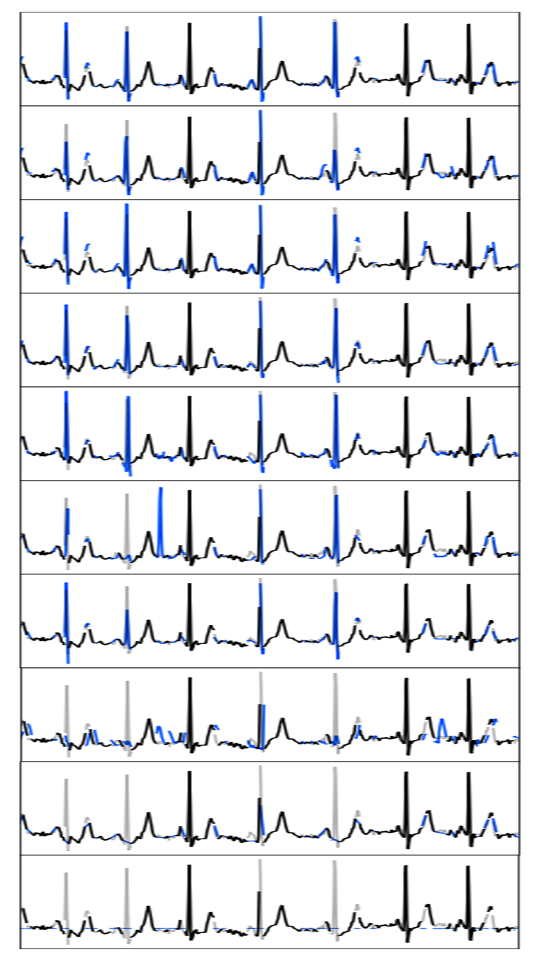
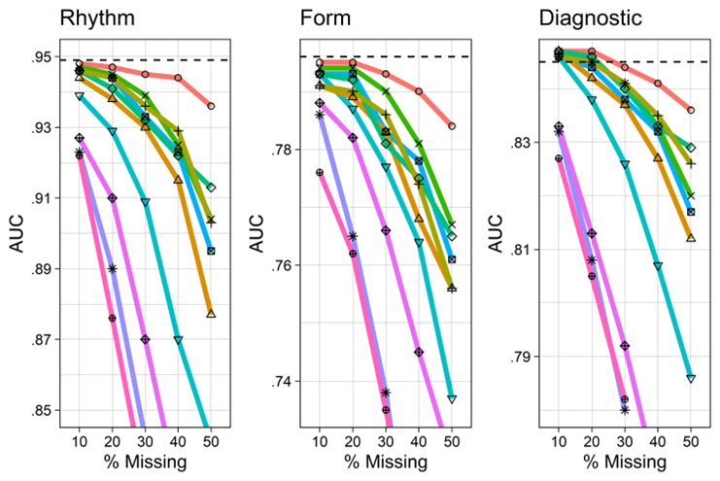
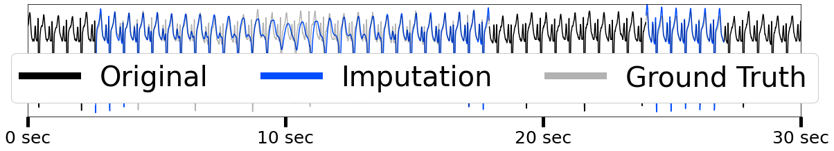
ECG Imputation with Transient Loss and Cardiac Classification
Visualization of Imputations
Most similar to prior work (e.g. BRITS). All methods perform well.
DL methods generally reconstruct peaks accurately, classical do not.
BDC Transformer has the best performance
Downstream Classification Results
Notes:
First, we discuss the results associated with ECG Imputation with Transient Loss and Cardiac Classification. In the transient loss setting, missingness gaps are typically quite short, which is similar to prior work, and as such, all methods perform well.

Slide 2
ECG Imputation with Transient Loss and Cardiac Classification
Visualization of Imputations
Most similar to prior work (e.g. BRITS). All methods perform well.
DL methods generally reconstruct peaks accurately, classical do not.
BDC Transformer has the best performance
Downstream Classification Results
Notes:
DL methods can generally reconstruct peaks accurately,

Slide 3
ECG Imputation with Transient Loss and Cardiac Classification
Visualization of Imputations
Most similar to prior work (e.g. BRITS). All methods perform well.
DL methods generally reconstruct peaks accurately, classical do not.
BDC Transformer has the best performance
Downstream Classification Results
Notes:
while classical cannot.

Slide 4
ECG Imputation with Transient Loss and Cardiac Classification
Visualization of Imputations
Most similar to prior work (e.g. BRITS). All methods perform well.
DL methods generally reconstruct peaks accurately, classical do not.
BDC Transformer has the best performance
Downstream Classification Results
Notes:
BDC transformer consistently has the best performance.

Slide 5
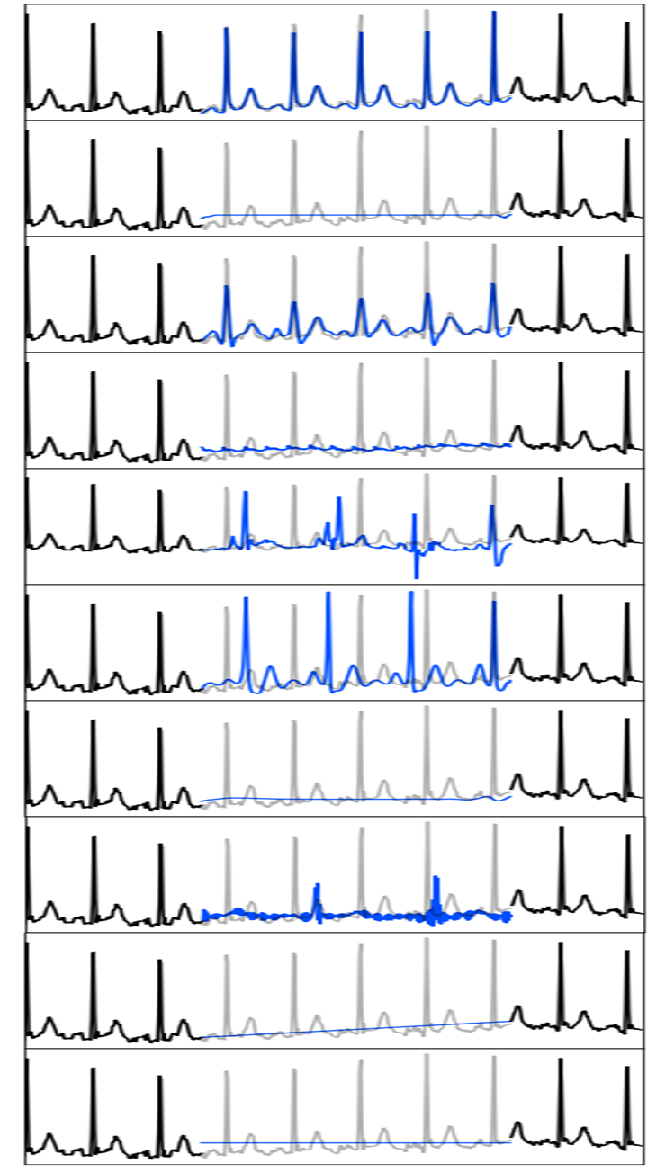
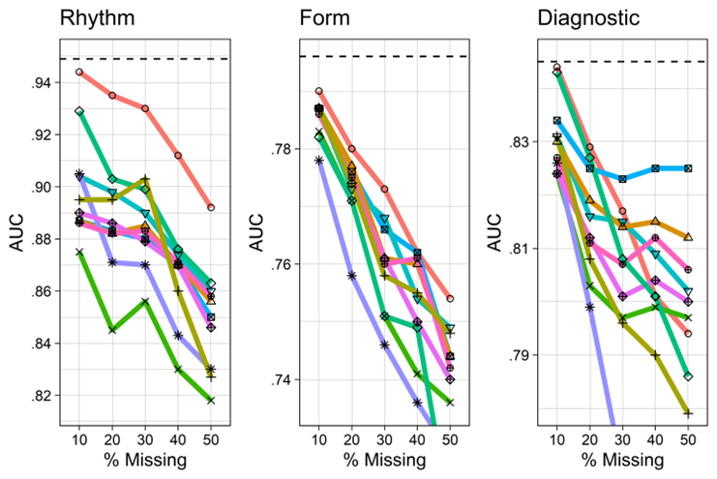
ECG Imputation with Extended Loss and Cardiac Classification
Visualization of Imputations
Higher difficulty imputing across longer gaps
GAN methods imitate shape, but do NOT reconstruct specific form and rhythm
BDC has best performance, usually correct on morphology and frequently correct on timing.
Downstream Classification Results
Notes:
The extended loss setting is much more difficult as methods must learn how to propagate information across longer missingness gaps.

Slide 6
ECG Imputation with Extended Loss and Cardiac Classification
Visualization of Imputations
Higher difficulty imputing across longer gaps
GAN methods imitate shape, but do NOT reconstruct specific form and rhythm
BDC has best performance, usually correct on morphology and frequently correct on timing.
Downstream Classification Results
Notes:
In particular, we see that GAN methods do very well in imitating the shape of the ECG structures, but do not reconstruct the specific form and rhythm found in the signal.

Slide 7
ECG Imputation with Extended Loss and Cardiac Classification
Visualization of Imputations
Higher difficulty imputing across longer gaps
GAN methods imitate shape, but do NOT reconstruct specific form and rhythm
BDC has best performance in Rhythm and Form, but suffers in the Diagnostic labels
Downstream Classification Results
Notes:
BDC has the best performance, being frequently correct on rhythm, usually correct on form and performing poorly in the diagnostic group.

Slide 8
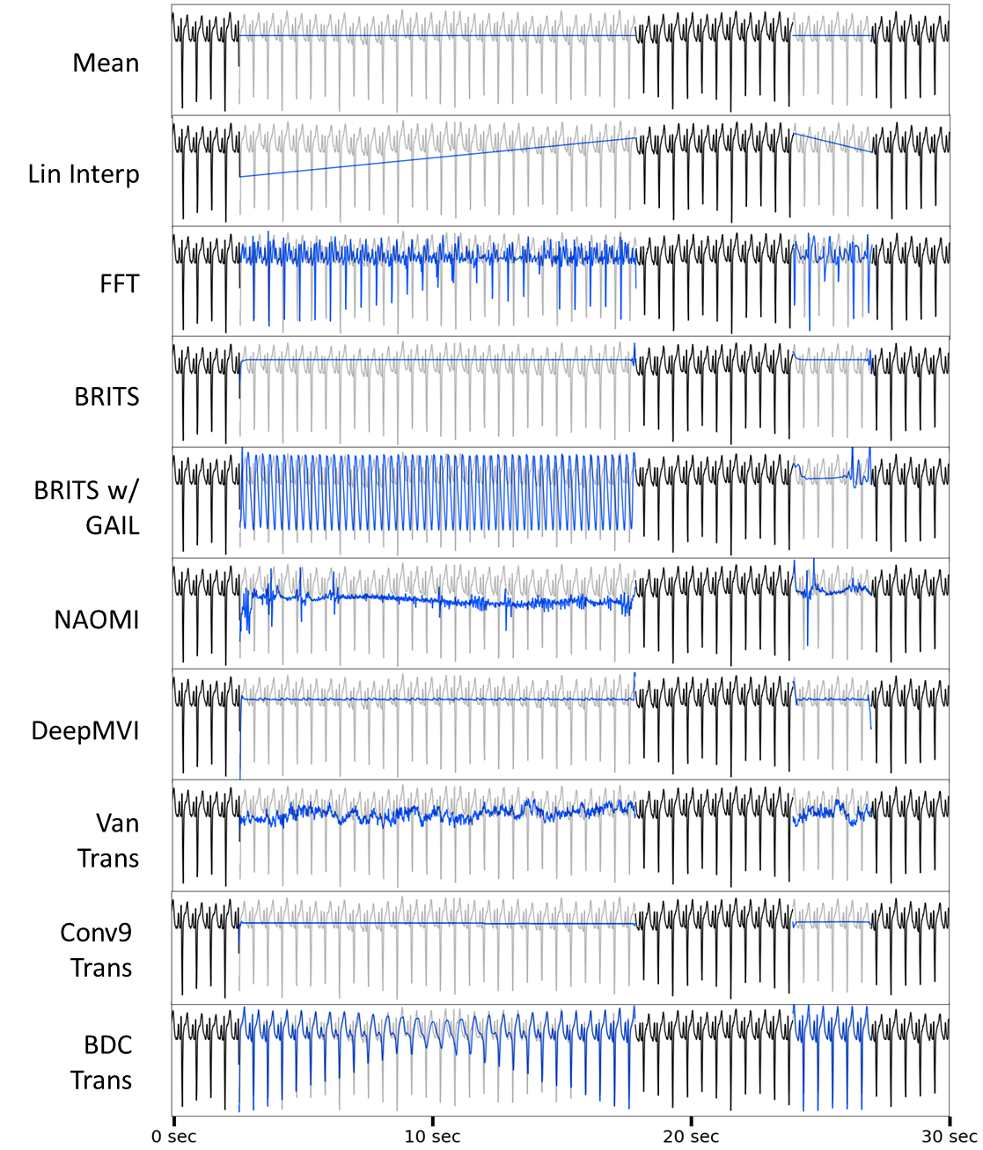
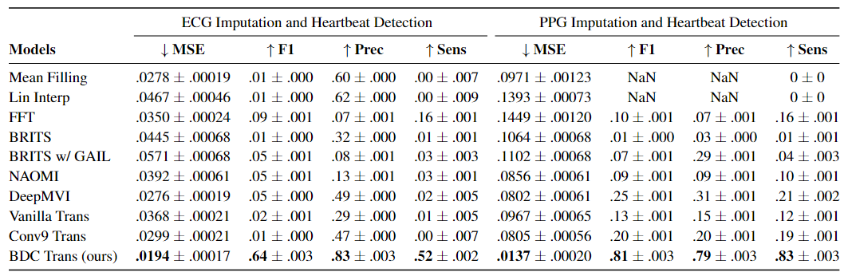
ECG Imputation with Extracted mHealth Missingness and Heartbeat Detection
Visualization of Imputations
Very long 5-minute signals (30,000 time points) with real ECG mHealth missingness
All methods perform poorly over longer missingness gaps (e.g. > 1 minute)
FFT and BDC are the best for reconstructing rhythm of heartbeats
BDC performs best overall
Downstream Heartbeat Detection Results
Notes:
Now we shift to the setting of ECG imputation with extracted mhealth missingness and heartbeat detection. In this setting, there are very long 5-minute signals and all methods perform poorly over the long missingness gaps that can last up to a minute long.

Slide 9
ECG Imputation with Extracted mHealth Missingness and Heartbeat Detection
Visualization of Imputations
Very long 5-minute signals (30,000 time points) with real ECG mHealth missingness
All methods perform poorly over longer missingness gaps (e.g. > 1 minute)
FFT and BDC are the best for reconstructing rhythm of heartbeats with BDC performing the best overall
Downstream Heartbeat Detection Results
Notes:
The two methods that exploit quasiperiodiicty, FFT and BDC, have the best downstream results, and reconstruct the heartbeat rhythm the best, but BDC easily is the best overall.

Slide 10
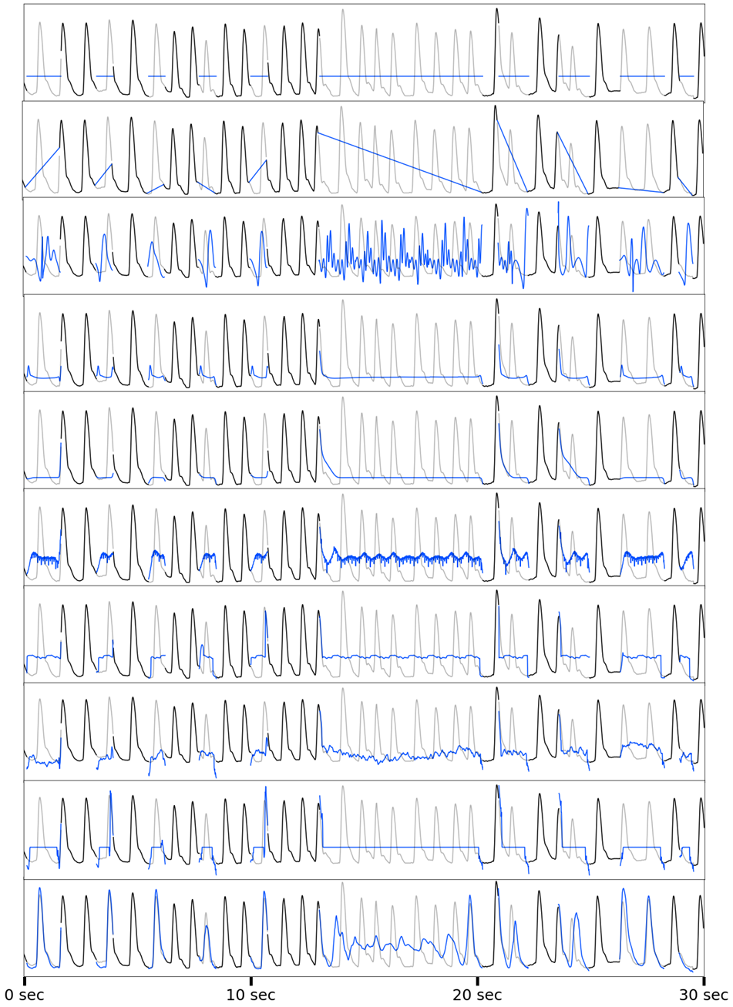
PPG Imputation with Extracted mHealth Missingness and Heartbeat Detection
Visualization of Imputations
Very long 5-minute signals (30,000 time points) with real PPG mHealth missingness
Simpler signal structure than ECG and all models perform better
Exploiting quasiperiodicity is useful across modalities, with FFT and BDC performing well, and BDC performing best overall
Downstream Heartbeat Detection Results
Notes:
In the PPG domain, the signals are much simpler morphologically, and overall all methods perform better. Finally we see that exploiting quasiperiodicity is useful across modalities for both PPG and ECG

