Slide 1
Statistical Uncertainty Quantification
for Hallucination Detection in LLMs
Kefei Wang · Yizhi Wang · Yifei Dou
STAT GR5293 — Spring 2026
GPT-2 XL · TriviaQA · 500 samples

Slide 2
01 · MOTIVATION & PROBLEM
Why Hallucination Detection Matters
The Problem
Blind Confidence
Our Approach
LLMs generate fluent but factually wrong answers — hallucination.
Models assign high token probability to wrong answers, making them indistinguishable.
Use statistical signals from token distributions to flag unreliable outputs.
Research Questions:
Can token-level log-probs and entropy detect hallucination? · Which signal works best? · Does combining features help?

Slide 3
02 · RELATED WORK
Prior Work
Calibration
Modern neural networks are overconfident — calibration is critical.
Guo et al., 2017
SelfCheckGPT
Detects hallucination via consistency across multiple stochastic samples. No reference needed.
Manakul et al., 2023
Semantic Entropy
Clusters semantically equivalent answers before measuring disagreement. Published in Nature.
Farquhar et al., 2024
Conformal Prediction
Provides coverage guarantees for LLM outputs using calibration sets.
Quach et al., 2023
Log-prob & Correctness
Model-predicted probabilities correlate with correctness on closed-book QA.
Kadavath et al., 2022

Slide 4
03 · METHODOLOGY
Framework Overview
TriviaQA
500 questions
GPT-2 XL
Greedy decode
Extract
5 features
Logistic
Regression
AUROC
Evaluation
Uncertainty Features
Task Formulation
avg_logprob
Mean token log-probability — overall confidence
Binary classification:
label = 1
→ Correct
label = 0
→ Hallucinated Matching: exact substring + fuzzy similarity (ratio > 0.7)
min_logprob
Minimum token log-prob — weakest step
std_logprob
Std dev of log-probs — confidence variability
avg_entropy
Mean token entropy — distributional uncertainty
max_entropy
Peak entropy — most uncertain step

Slide 5
04 · EXPERIMENTAL SETUP
Dataset & Model
500
19.2%
GPT-2 XL
5
Questions
(TriviaQA val)
Correct rate
(96 / 500)
Model
(1.5B params)
Uncertainty
features
TriviaQA (no-context)
GPT-2 XL
• Closed-book QA benchmark
• Each question has multiple accepted aliases
• Flexible matching: substring + fuzzy ratio
• Class imbalance: 80.8% hallucinated
• 1.5B parameter autoregressive LM
• Greedy decoding, prompt: Q: ... A:
• output_scores=True → token log-probs
• Hugging Face Transformers + PyTorch

Slide 6
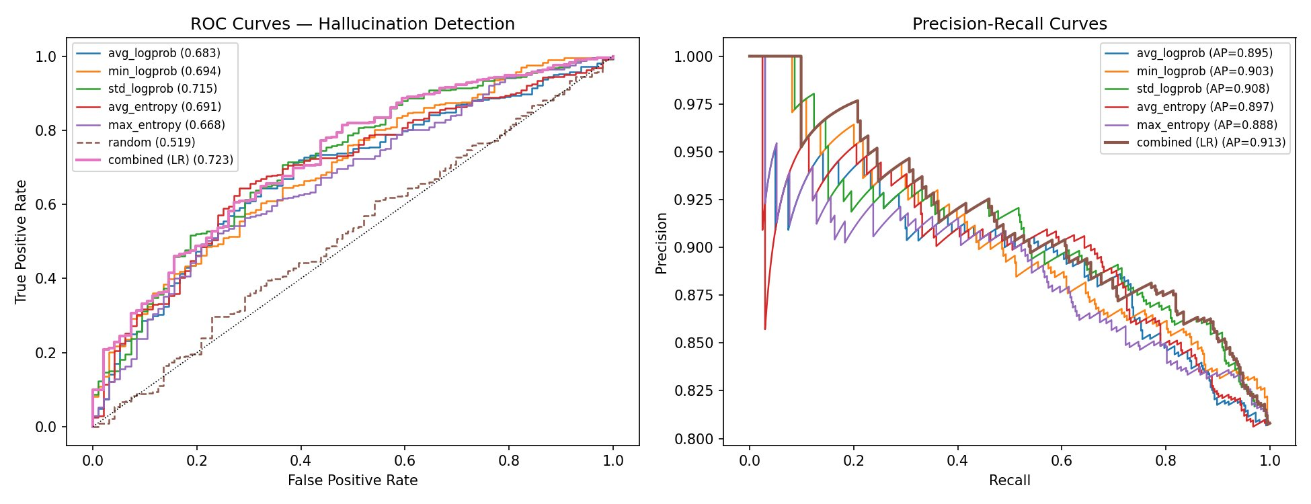
05 · RESULTS
Detection Performance
Method | AUROC | AUPRC
avg_logprob | 0.683 | 0.895
min_logprob | 0.694 | 0.903
std_logprob ★ | 0.715 | 0.908
avg_entropy | 0.691 | 0.897
max_entropy | 0.668 | 0.888
random | 0.519 | 0.813
combined (LR) ★ | 0.723 | 0.913
★ Best performers: std_logprob (single) & combined LR

Slide 7
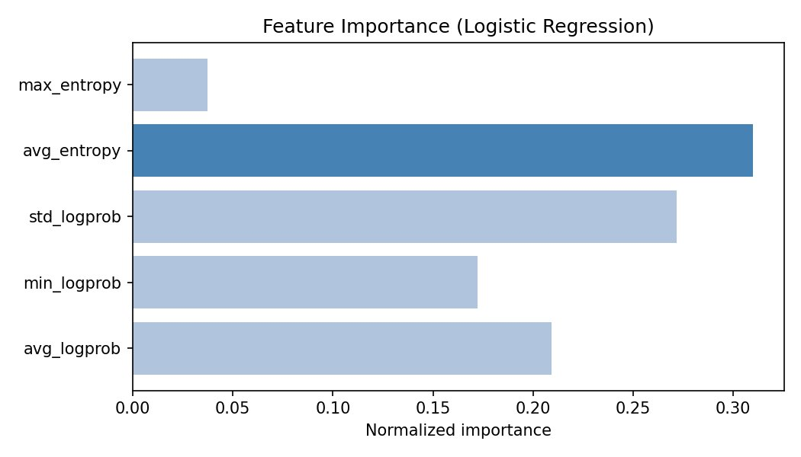
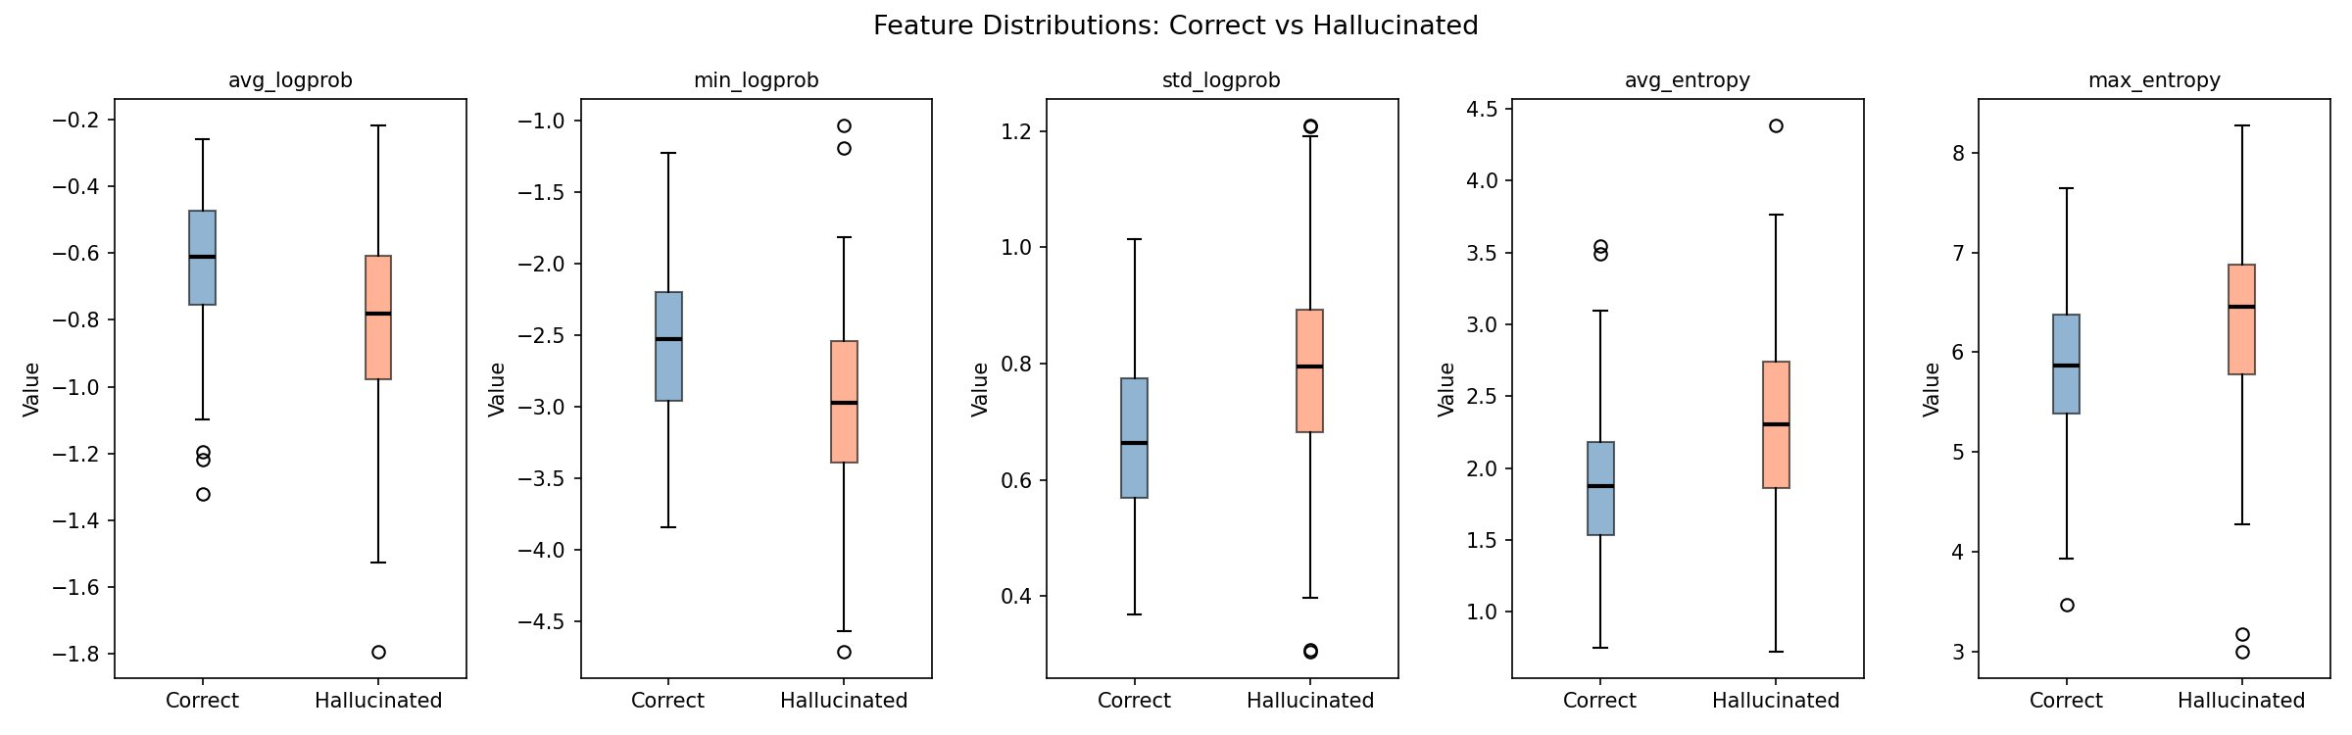
05 · RESULTS — FEATURE ANALYSIS
Feature Importance & Distributions
Key findings: avg_entropy (31%) and std_logprob (27%) dominate feature importance. Box plots confirm hallucinated responses have lower log-probs and higher entropy. max_entropy is largely redundant (4%).

Slide 8
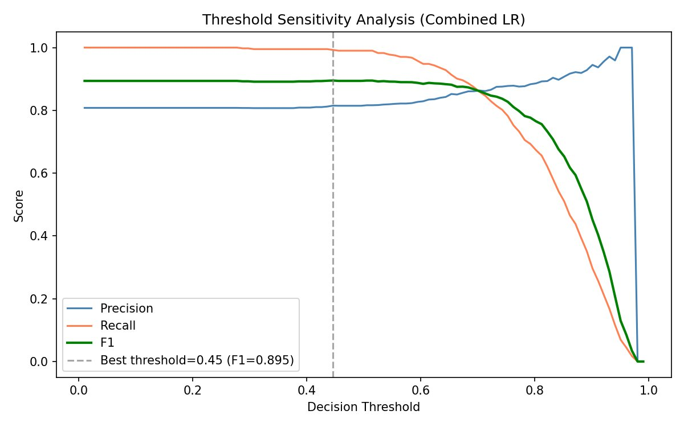
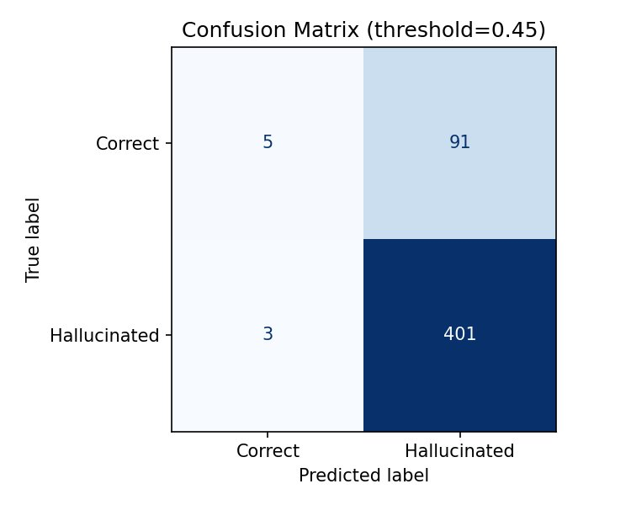
05 · RESULTS — THRESHOLD ANALYSIS
Threshold Sensitivity & Confusion Matrix
0.45
0.895
99.3%
Optimal threshold
(best F1)
Best F1 score
Recall at
threshold 0.45

Slide 9
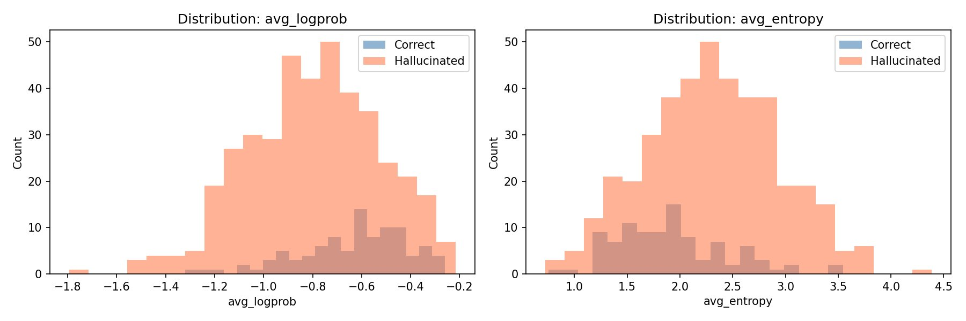
05 · RESULTS — DISTRIBUTIONS
Feature Distributions: Correct vs Hallucinated
avg_logprob
avg_entropy
std_logprob
Correct: -0.637 · Hallucinated: -0.800
Correct: 1.912 · Hallucinated: 2.308
Correct: 0.671 · Hallucinated: 0.792

Slide 10
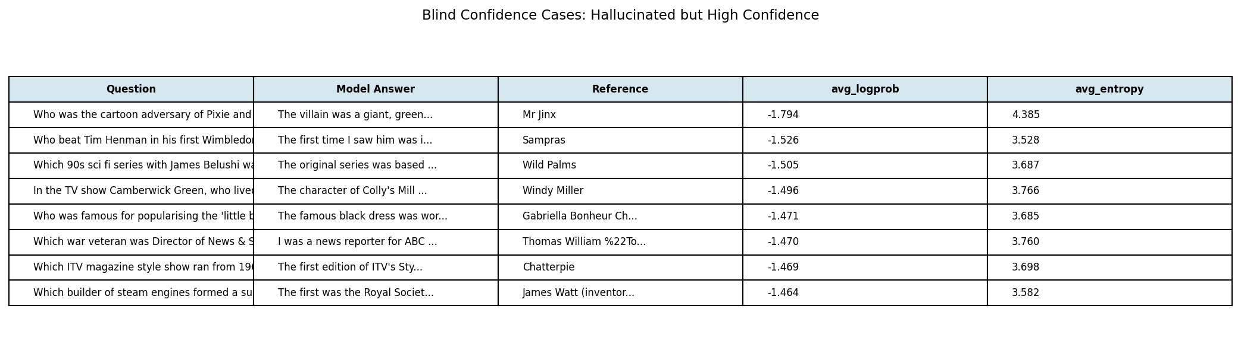
06 · QUALITATIVE ERROR ANALYSIS
Blind Confidence: Hallucinated but High Confidence
Observation: GPT-2 XL generates narrative/descriptive responses instead of concise factual answers. These responses are hallucinated but receive relatively high confidence scores — demonstrating blind confidence. Token-level probability alone is insufficient; the model's output style also matters.

Slide 11
07 · DISCUSSION
Discussion & Limitations
Why std_logprob?
AUPRC caveat
It is not average confidence that matters most, but variability. Hallucinated responses show uneven confidence profiles — confident on some tokens, uncertain on others.
High AUPRC (0.88–0.91) partly reflects class imbalance (80.8% hallucinated). The absolute numbers are inflated; the relative ordering across methods is what matters.
Model choice limitation
Self-consistency excluded
GPT-2 XL is weak by current standards. Larger models (LLaMA-3, Mistral-7B) would produce more balanced labels and a harder detection task.
Due to implementation constraints, consistency across multiple samples was not evaluated. SelfCheckGPT shows this is a promising direction for future work.

Slide 12
Conclusion
01
Token-level uncertainty signals (log-probs, entropy) carry meaningful information about hallucination risk.
02
std_logprob is the strongest single feature (AUROC 0.715) — confidence variability matters more than mean confidence.
03
Combining features via logistic regression achieves the best overall performance (AUROC 0.723, AUPRC 0.913).
04
Blind confidence is real — models generate wrong answers with high token-level confidence, motivating uncertainty-aware deployment.
Thank you · Questions?

