Slide 1
Skeleton Puzzle
Documentation

Slide 2
Purpose
- From a list of words, create several skeleton puzzles with a specified number of words.
The letters from the words will be stored and printed along with the puzzles

Slide 3
Design & Architecture
For my design, I decided to pipeline words from a list onto a SkeletonBoard object that deals with data-related logic.
The Driver class first obtains the list of words and sends the words to an API call which returns a list of logic characters. Once it has received the logical characters, it will create Letter objects and Word objects. The Letter and Word objects that are created will be “inserted” or sent to the skeleton board.
If the word placement is valid, then it will be inserted onto the board and the next word will be sent to the skeleton board to be verified. Once the appropriate number of words are on the board, it will create two power point slides that contain the blank puzzle and the solution.

Slide 4
Preferences
Private variables: now – captures the current time in milliseconds using System.currentTimeMillies(); timestamp – using ‘now’, a Timestamp object is created. Can be used to return date and time in nano or milliseconds.
Public variables: PROJECT_DIRECTORY – A string variable that stores the location of project path using System.getProperty("user.dir"); MAX_NUMBER_OF_WORDS - specifies the number of words that appear on each puzzle. (Can be anything that fits the BOARD_ROW & BOARD_COL dimensions)
MAX_NUMBER_OF_PUZZLES - specifies the number of puzzles to create. (The more puzzles, the longer it will take to generate)
WORD_LIST_FILE_NAME - specifies the file name of the word list you want to use.
PUZZLE_FILE_NAME - specifies the name of the output filename for the puzzle.
SOLUTION_FILE_NAME - specifies the name of the output filename for the solution.
OUTPUT_FOLDER_LOCATION - specifies the location of the output files.
WORD_LIST_FOLDER_LOCATION - specifies the location of the word list. (The location of where your wordlist is contained)
BOARD_FONT_COLOR - specifies the font color of the skeleton board
TABLE_FONT_BOLD - toggles the font bold on and off
BOARD_BORDER_COLOR - sets the border color of the board
BOARD_BORDER_INPLAY_COLOR - sets the color of the borders that are in play(squares with letters)
BOARD_BORDER_NOTINPLAY_COLOR - sets the color of the borders that are not in play.
BOARD_BACKGROUND_COLOR - sets the background color of the board
SLIDE_NUMBER_COLOR - sets the color of the slide number
SLIDE_NUMBER_FONTSIZE - change the size of the number
SLIDE_NUMBER_FONTBOLD - sets the slide number to bold or not
TABLE_FONT_SIZE - changes the font size of the letters in the board. Note: changing the font size can also change how big the board gets.

Slide 5
Preferences Cont.
UNUSED_WORDS_FILENAME – determines the name for the text file of unused words.
SLIDE_WIDTH - specifies how big the width of the ppt slide is.
SLIDE_HEIGHT - specifies what the height of the ppt slide is.
BOARD_ROW - specifies how many rows you want in your board. Note: changing this will affect how it appears on the ppt.
BOARD_COL - specifies how many columns you want in your board. Note: changing this will affect how it appears on the ppt.
TITLE_FONT_SIZE - specifies the font size of the title.
TITLE_FONT_COLOR - changes the color of the title.
TITLE_NAME - specifies the name of the title on the slides.
TITLE_BOLD - specifies if you want the title to be bold or not
GRID_WIDTH - specifies the width of the grid/board (NOT USED ANYMORE)
GRID_HEIGHT - specifies the height of the grid/board (NOT USED ANYMORE)
CLUE_TEXTBOX_WIDTH - specifies the width of the clue textbox
CLUE_TEXTBOX_HEIGHT - specifies the height of the clue textbox
CLUE_TEXT_COLOR - specifies the color of the text for the clues
CLUE_TEXT_SIZE specifies the text size of the clues

Slide 6
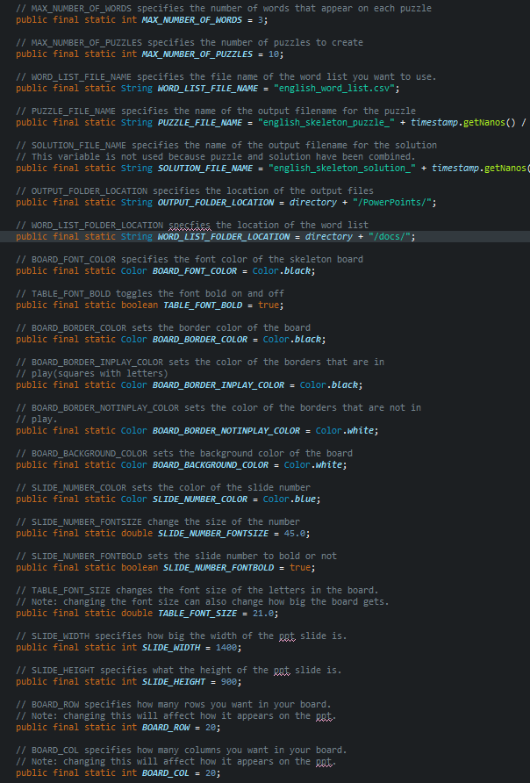
Preferences: Possible Values
The file names can be changed to anything, and the word list can be changed but must match what the file name is on your computer.
You can delete directory in some of the variables and replace it with whatever path you want. For Example: “E:\Folders\Classes\ICS499\Powerpoints”
Changing slide dimension and table dimensions will alter how they look.
When choosing color, eclipsejava has a selection of colors you can pick by calling the methods of Color
The number of words must be able to fit the dimensions of the board, for example, if you want 50 words but the board dimensions are 20x20, most likely it will just keep trying to fit in words and if it repeats a certain number of times it will wipe the board and do it all over again. 20 – 25 would be more reasonable for a size 20x20 board.
Because a single PowerPoint is created and pairs of solution and puzzle slides are created, it will take longer the more puzzles you want to generate.
The TABLE and SLIDE preferences just alter the dimensions and settings of the board/table.
The TITLE variables change the size and font of the text.
The Clue textbox variables change dimensions of the textbox. While the CLUE_TEXT variables change the size and color of the text.

Slide 7
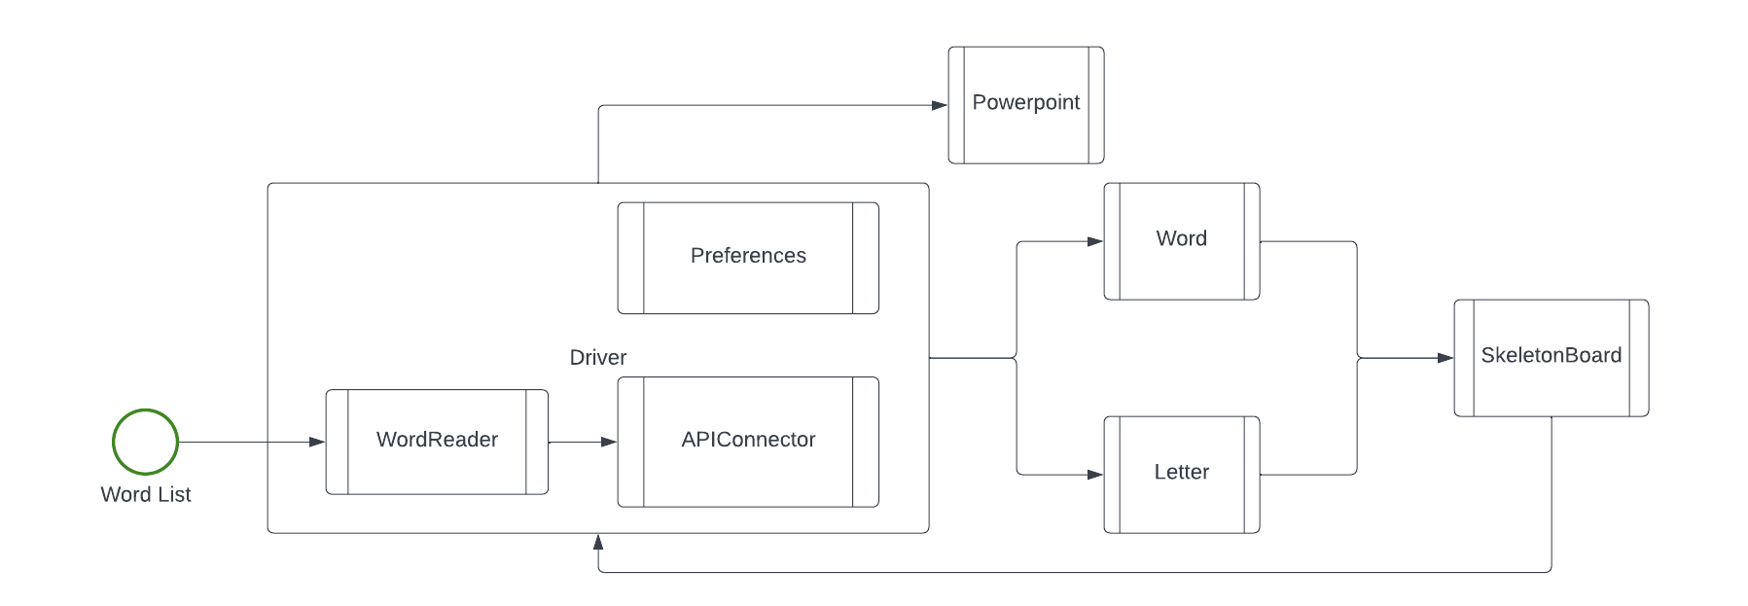
Diagram
This is the basic flow of the program. The program first reads in a word list and sends the words to an api call to retrieve logical characters. Once it receives the characters, it will create both Letter and Word objects. The driver will then send and try to insert the words onto the skeleton board. Once the skeleton board has satisfied enough words, the driver will create a PowerPoint of the board.

Slide 8
Diagram Cont.

Slide 9
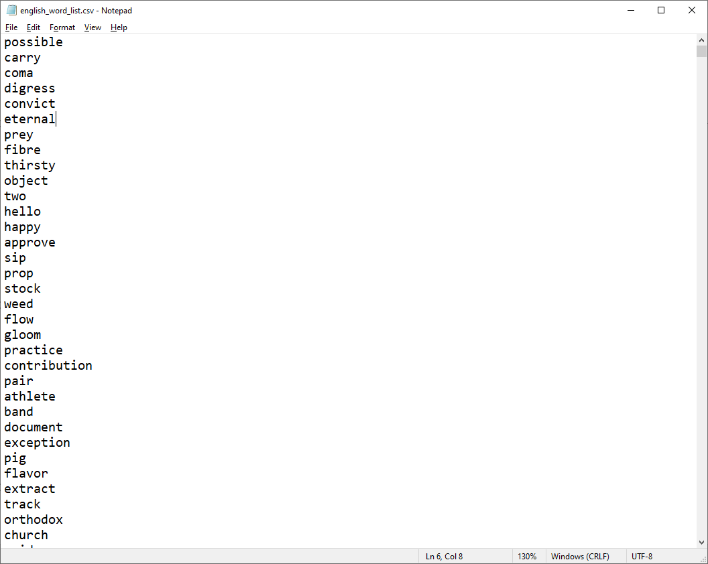
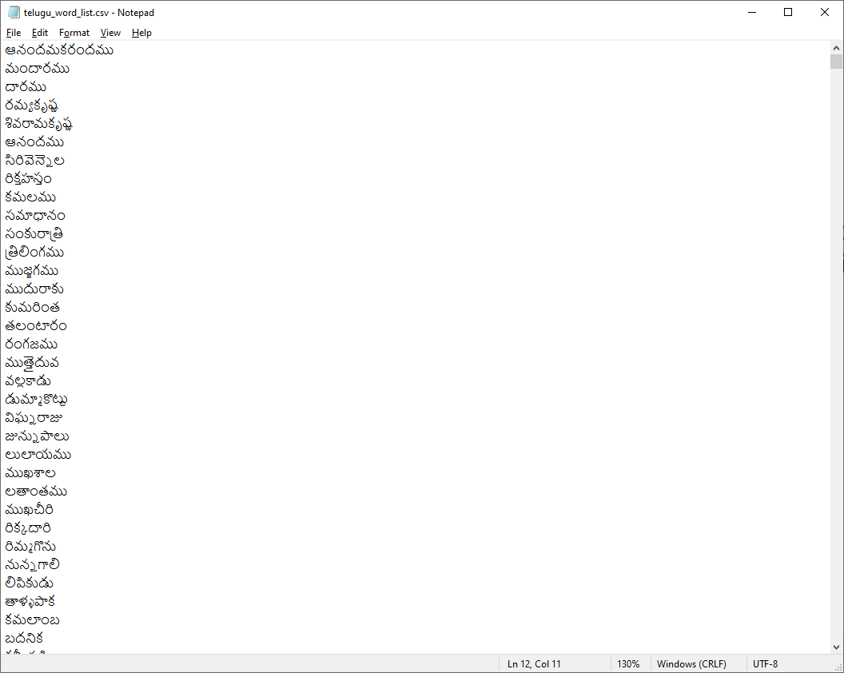
Input
The program needs a list of words from a .txt or .csv file. It will read the list of words and store it in a ‘wordlist’ variable of type ArrayList<String>.
Preferences.WORD_LIST_FOLDER_LOCATION & Preferences.WORD_LIST_FILE_NAME will determine what list is read.
"E:\\Folders\\Classes\\ICS499\\Workspace\\ICS499-Skeleton_Project\\docs\\“ + "english_word_list.csv";
Example:

Slide 10
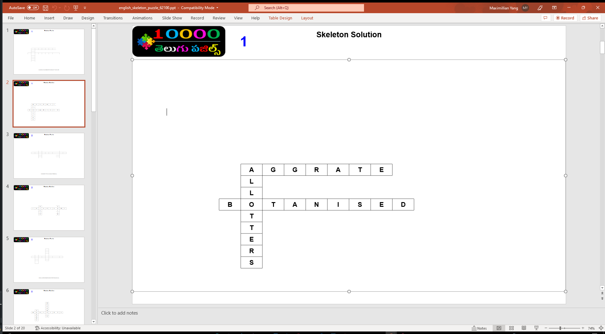
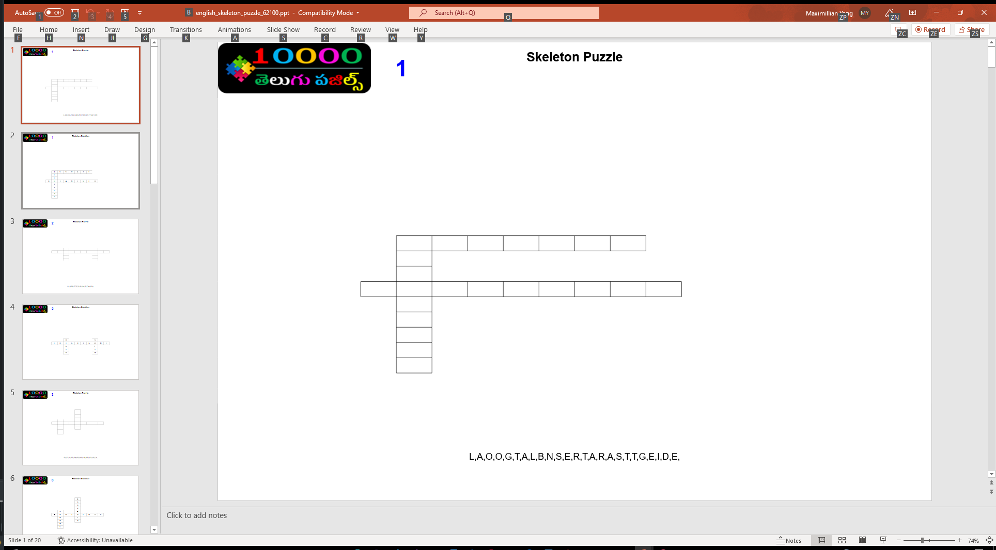
Output
After the program is done, it will create a PowerPoint with puzzles and solutions.

Slide 11
Word and Letter Classes
These classes are meant to imitate words and letters.
Words contain letters
Letters belong to words.
They allow for easier placement on the board and easier modification.
Each letter contain a row and col of where they belong on the board.

Slide 12
SkeletonBoard.InsertToBoard()
For every word that is inserted onto the board:
If the board is empty, it will insert the word in the middle of the board
If the board is not empty, it will call findMatch()
If findmatch() is not null, it will check if the word can be placed on the board by calling isValid()
Before it validates, it will find the direction and matched index of the word.
If the word is valid, it will place the word on the board in the correct position.
After the word is placed on the board, it will add the word to a list of strings called “wordsOnBoard” and increment numberOfWords.
After inserting or trying to insert the word, the method will return a Boolean.

Slide 13
SkeletonBoard.isValid()
This method verifies and checks to see if the word can be placed on the board where findMatch() has returned.
The method first determines which direction the word will go based on the direction parameter.
First, it will check to see if the matched index is 0 or greater.
Next, it will go through several if statements and a for loop to check conditions.
It will check if the word can fit the board.
It will check if the word is adjacent to another word or not.
It will check if there are letters before and after the word.
It will check if there are letters already in the spaces.
If the word is getting placed on the edge of the board, it will go through the same conditions but altered slightly. Instead of checking both sides of the word to see if it is adjacent, it will only check one side.
after checking the conditions, it will return true. If conditions did not pass, it will return false.
Note: The algorithm for vertical placement is the same for horizontal placement.

Slide 14
Utility Classes
PowerPoint – Handles creating the PPT and slides.
WordReader – Reads the word file and stores it in an ArrayList
APIConnector - Connects to the API to return logical characters.

Slide 15
Driver Class
Word List -> Driver -> API -> Letter/Word -> Skeleton -> Driver -> PPT
The word list file is read and stored into an ArrayList<String> variable called wordlist.
The SkeletonBoard object is created and filled with white spaces.
The empty PowerPoint are created.
What I create next is an Iterator to cycle through the words.
While the iterator (hasNext() && numOfPuzzles < settings.MaxNumberOfPuzzles()) keep looping
In the while loop, the next word will be sent to the API call and a list of logical characters will be returned.
After the logical characters are received, the Letter and Word objects are created.
In the while loop, board.insertToBoard(logicalChars,word)) is called.
If insertToBoard() returns true, then remove the current word from the word list and restart the iterator
If it returns false 100 times, the board will reset and start over with shuffled words.
Once the board has the designated number of words, two power point slides will be created and written into one PowerPoint that was created earlier.
Repeat until no more words or if while loop conditions have been met.

