Slide 1
Conceptos
Contenedor
Cluster
Nodo
Pod
Deployment
DaemonSet
Service
Balanceador
DNS

Slide 2
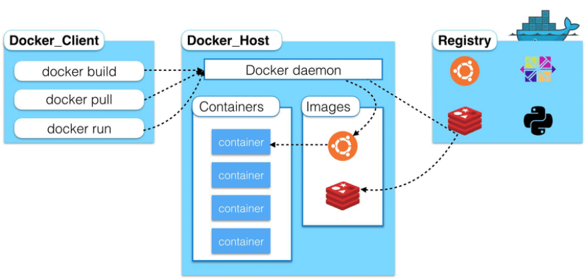
Contenedor

Slide 3
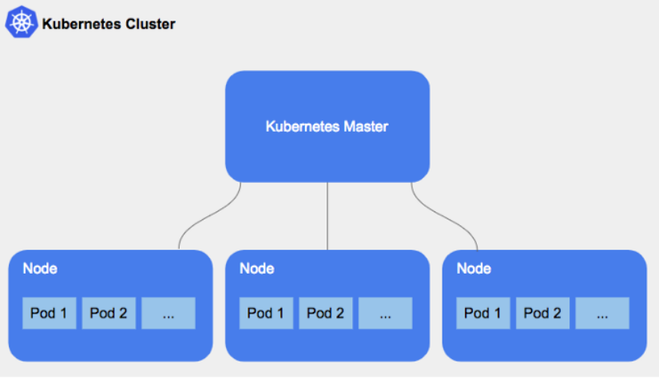
Cluster

Slide 4
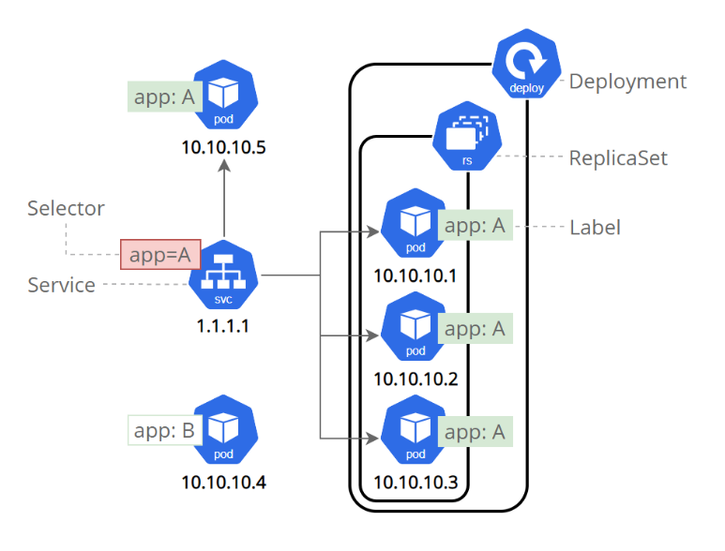
Pod - Deployment - Service

Slide 5
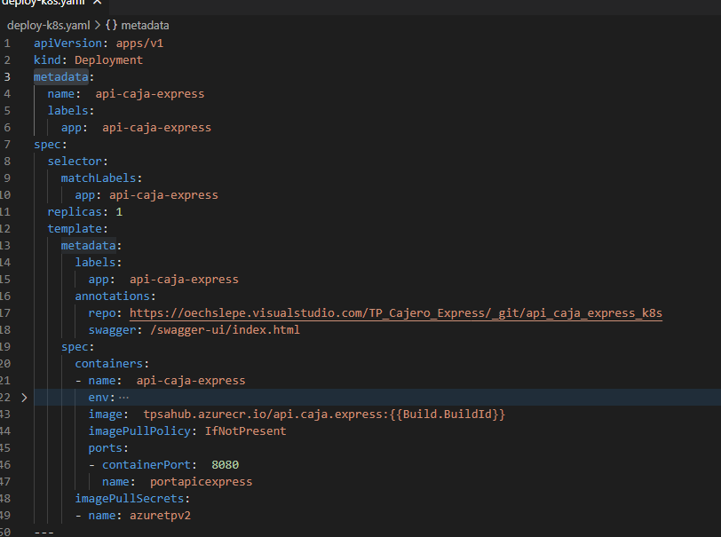

Slide 6
