Slide 1

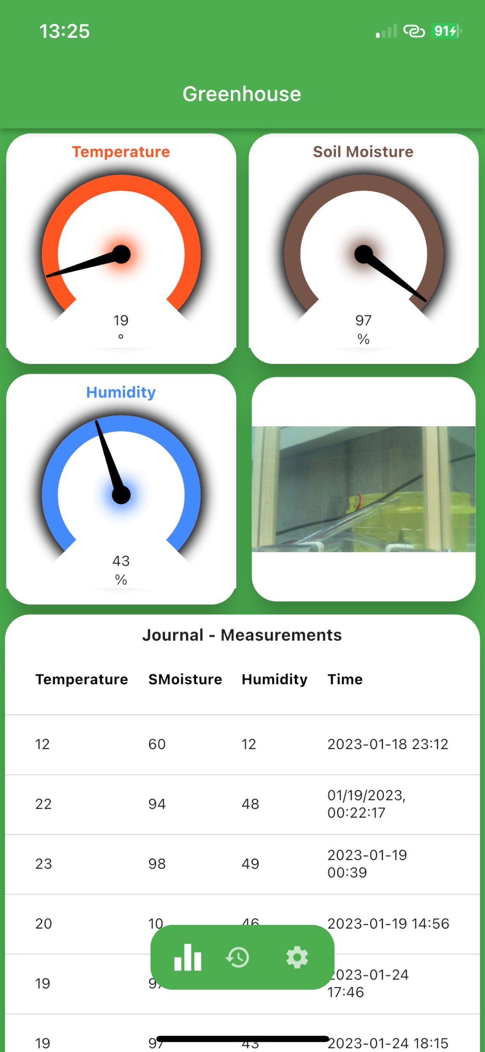
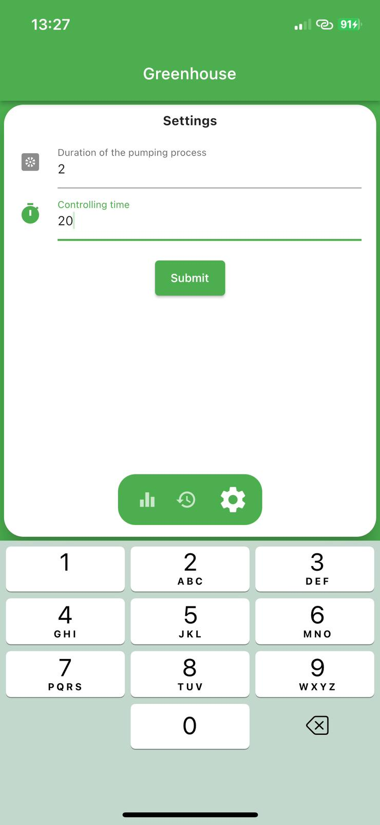
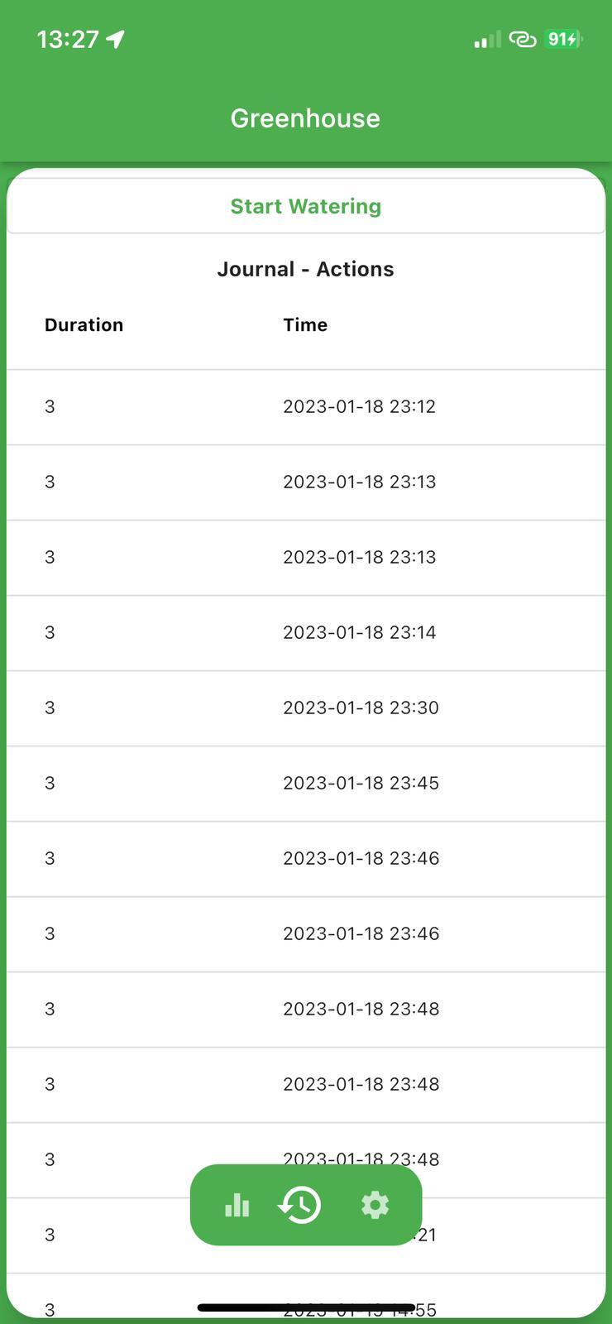
Mobile and Embedded Software Development
Smart Greenhouse
Christian Schmidt, Robin Röcker, Maximilian Zeger, Yannick Söll
The idea is to develop a System which can be integrated into a greenhouse. The greenhouse is controlled and monitored with this system. It is able to control the irrigation automatically and also offers a mobile app that can be used to query various measurement data. The app also provides the functionality of watering the green house via the app.
Each greenhouse can be regulated with this system, making maintenance easier.
The smart greenhouse application is a system that allows easy maintenance and control of any type of greenhouse. It basically consists of two components, the mobile app and a Raspberry Pi.
While the entire interface is provided by the mobile app, the Raspberry Pi takes over the regulatory control. The Pi has various sensors and actuators that it can read and control in a targeted manner.
For example the Pi can activate a water pump, which then carries out the watering process. All this without the need of manual intervention.
By reading the attached soil moisture sensor, the Raspberry Pi will always know if a new irrigation cycle is needed.
A camera is also connected, which regularly sends live images from the greenhouse to the app. As a result, the user always recives a live update on the condition of the plants.
The app consists of a main page that shows current greenhouse data and a list of all measured data.
There is also an action journal that documents all irrigation cycles. In this way, it is possible to see at what point an irrigation cycle took place.
The last feature is the opportunity to change the behaviour of the greenhouse by changing the duration of watering and the time interval at which the data is measured.
Tablet sicht
Set environment variables
Mobile application
The mobile app forms the interface between the user and the system. It represents the heart of the application and provides various functionality to control the greenhouse.
The mobile app is written in Flutter and can therefore be used on any mobile operating system.
Action journal

