Slide 1
Algorand
Blockchains & Cryptocurrencies
Instructors: Matthew Green & Abhishek Jain

Slide 2
Proof of Stake
Bitcoin uses proof of work to address sybil attacks and implement consensus
Philosophy: Chance of “winning” in a block mining round proportional to your (hash) computing power
Proof of Stake: Addresses sybil attacks by requiring that participants must have some “stake” (i.e., money) in the system
Philosophy: Chance of winning in a round proportional to your current stake

Slide 3
(Potential) Advantages
In Proof of Stake based cryptocurrency, users (who have money in the system) are the miners
Environment friendly
No ASIC advantage
51% (or higher) majority assumption potentially more realistic

Slide 4
Examples of PoS based Cryptocurrencies
Peercoin
Blackcoin
Nxt
Neucoin
…

Slide 5
PoS systems with security analysis
Algorand [Gilad-Hemo-Micali-Vlachos-Zeldovich’17]
Ourboros [Kiayias-Russel-David-Oliynykov’17]
Snow white [Daian-Pass-Shi’17]
…

Slide 6
Algorand: Main Highlights
Proof of Stake based Cryptocurrency
High throughput: ~1 min to confirm transactions vs an hour in Bitcoin
Public ledger with low probability of forks
Assumes 2/3-honest stake majority
Uses a gossip communication protocol
Notes:
Recap to earlier lectures?

Slide 7
Algorand: Main Highlights
Adaptive adversary: May corrupt dynamically, as long as 2/3 majority assumption holds
Achieves Consistency assuming “weak synchrony”
Network can be asynchronous for long bounded time period b, but then must have strong synchrony for short period s < b
Achieves Liveness assuming “strong synchrony”
Most honest users (e.g., 95%) can send messages that will reach within a known time bound

Slide 8
Main Design Ingredients
Users weighted by stake (to prevent sybil attacks)
Builds on byzantine agreement (BA) protocol of Micali [ITCS’17] for consensus
BA protocol executed between a small committee of users for scalability
Committee chosen at random, using cryptographic techniques
Notes:
Recap to earlier lectures?

Slide 9
Algorand Consensus: Main Highlights
BA protocol in expectation terminates in only 4 steps (in “honest” case) or 13 steps (in “dishonest” case)
Player replaceability: Players across different steps of BA protocol may not be the same
Possible because protocol does not require “private state”
For each step, players chosen at random, non-interactively, in a “publicly verifiable” manner
Notes:
Recap to earlier lectures?

Slide 10
Fast and Furious Byzantine Agreement
Micali [ITCS’17]

Slide 11
Byzantine Agreement
A protocol P is an (n,t) byzantine agreement protocol with soundness s if:
for every value set V and adversary A who corrupts t out of n players,
in an execution of P with A in which each player starts with value v_{i} in set V, each honest player halts with prob 1, outputting a value out_{i,} so as to satisfy, with prob s, the following properties:
Agreement: out_{i} = out_{j} for all honest players i and j
Consistency: if for some v, v_{i} = v for all honest players i, then out_{j} = v for all honest players j

Slide 12
Binary BA vs Arbitrary value BA
Binary BA: Input value set V is {0,1}
[Turpin-Coan’84]: general reduction to convert binary BA into arbitrary value BA
assuming 2/3 honest majority
requires only two additional rounds of communication
This talk: Focus on Binary BA

Slide 13
Why is Byzantine Agreement Hard?
Protocol executed over point-to-point channels
Adversarial parties may send different messages (including no message) to different honest parties
BA over broadcast channels is trivial

Slide 14
Micali’s Protocol: Main Intuition
Consider idealized Protocol P(r), where b_{i} is the initial input of party i:
Each player i sends b_{i} to all other players
A new random and independently selected bit c(r) appears in sky
Player i updates bit b_{i} as follows:
If #_{i,r}(0) >= 2t+1, set b_{i} = 0
If #_{i,r}(1) >= 2t+1, set b_{i} = 1
Else, set b_{i} = c(r)
#_{i,r}(b): Number of players from which i received b in “iteration” r

Slide 15
Quick Analysis
Assuming at least 2t+1 players are honest, P(r) achieves soundness 1/2
If honest players start in agreement, then they remain in agreement
If honest players do not start in agreement, then they end in agreement (on some bit) with probability 1/2

Slide 16
Implementing coin in sky using Crypto
Three Ingredients:
Unique Digital Signatures: For every public key pk and message m, only one valid signature for m w.r.t. pk
Can be constructed from standard cryptographic assumptions
Hash function: Modeled as a random oracle
Common random string R: fixed at the start of the protocol execution, known to each party, and not controlled by adversary

Slide 17
Implementing coin in sky using crypto
ConcreteCoin(r): Each player i does the following,
Send s_{i} = SIG_{i}(R, r)
Compute m s.t. H(s_{m}) <= H(s_{i}) for all i
Set c_{i}(r) = lsb(h), where h = H(s_{m})
Think: What is the probability that c_{i}(r) = c_{j}(r) for all honest i,j ?
Think: Why is c_{i}(r) random?

Slide 18
Using ConcreteCoin(r)
Replacing coin in sky with ConcreteCoin(r) in P(r):
If honest players start in agreement, then they remain in agreement
If honest players do not start in agreement, then they end in agreement (on some bit) with probability 1/3
Overall, the resulting protocol has soundness 1/3

Slide 19
Remaining Problem
Can we simply repeat the protocol indefinitely until agreement is reached?
The honest players do not know that agreement is reached
Thus, the protocol may never terminate

Slide 20
Remaining Problem
Can we simply repeat the protocol indefinitely until agreement is reached?
The honest players do not know that agreement is reached
Thus, the protocol may never terminate
Idea: Simply repeat say k = 200 times to ensure that agreement is reached, except with very small probability
Drawback: We waste many rounds since most times, agreement will be reached earlier

Slide 21
Micali’s Idea:
Protocol BBA* : It consists of sequential repetitions of P’(r), where each P’(r) consists of three correlated executions of P(r)
Execution of P(r) where c(r) = 0
Execution of P(r) where c(r) = 1
Execution of P(r) where c(r) is implemented via ConcreteCoin(r)
Note 1: In the first two executions, a party will terminate if it thinks agreement is reached
Note 2: While the number of repetitions of P’(r) are not fixed in advanced, the expected number of repetitions will be 3 (will follow from protocol analysis)

Slide 22
Notation:
A party i may at any point send special value b* (and HALT) meaning that in all future steps, other parties should think of i’s message as b
Counter 𝛾 which indicates how many times the 3-step loop has been executed. Initially set to 0
R denotes the common random string

Slide 23
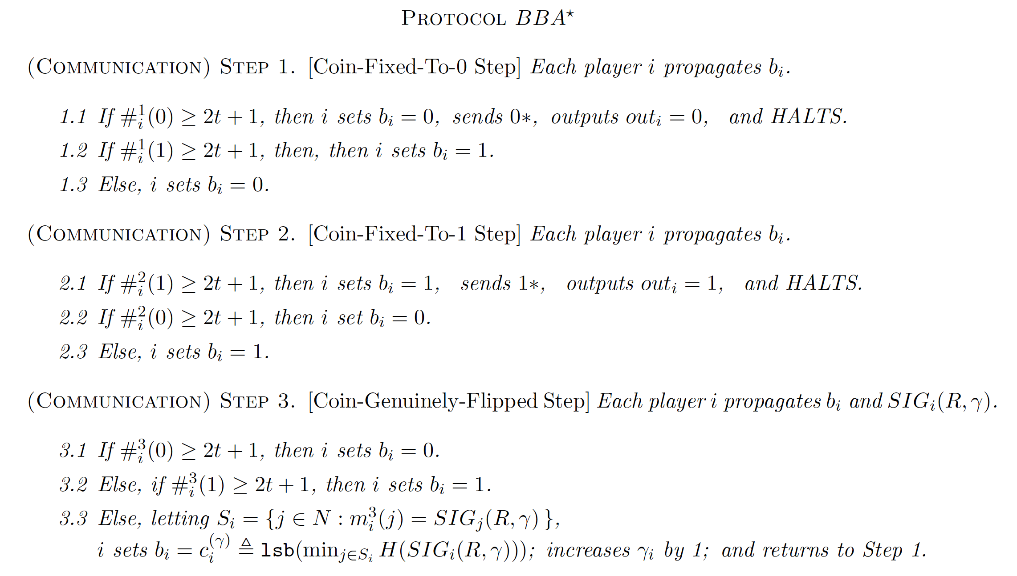

Slide 24
Analysis
Claim A: If at start of an execution of step 3, no player has halted and agreement has not been reached, then with prob 1/3, players will be in agreement at the end of the step

Slide 25
Analysis
Claim A: If at start of an execution of step 3, no player has halted and agreement has not been reached, then with prob 1/3, players will be in agreement at the end of the step
Proof: Consider 5 cases:
All honest i update b_{i} according to 3.1
All honest i update b_{i} according to 3.2
All honest i update b_{i} according to 3.3
Some honest i update b_{i} according to 3.1, others according to 3.3
Some honest i update b_{i} according to 3.2, others according to 3.3

Slide 26
Proof: Consider 5 cases:
All honest i update b_{i} according to 3.1
Agreement holds on 0
All honest i update b_{i} according to 3.2
Agreement holds on 1
All honest i update b_{i} according to 3.3
Agreement holds on c
Some honest i update b_{i} according to 3.1, others according to 3.3
Agreement on 0 reached with prob ½ (assuming c_{i}’s are same)
Some honest i update b_{i} according to 3.2, others according to 3.3
Agreement on 1 reached with prob ½ (assuming c_{i}’s are same)
Overall, when m is honest, agreement is reached with probability at least 1/2. m is honest with prob 2/3 (which means c_{i}’s are same), so overall agreement prob is 1/3

Slide 27
Analysis (contd.)
Claim B: If at some step, agreement holds on bit b, then it continues to hold on bit b

Slide 28
Analysis (contd.)
Claim B: If at some step, agreement holds on bit b, then it continues to hold on bit b
Proof: If agreement held at the start of step, then all honest parties send bit b, which means #_{i}(b) >= 2t+1

Slide 29
Analysis (contd.)
Claim B: If at some step, agreement holds on bit b, then it continues to hold on bit b
Proof: If agreement held at the start of step, then all honest parties send bit b, which means #_{i}(b) >= 2t+1
Claim C: If at some step, a player i halts, then agreement will hold at the end of the step

Slide 30
Analysis (contd.)
Claim B: If at some step, agreement holds on bit b, then it continues to hold on bit b
Proof: If agreement held at the start of step, then all honest parties send bit b, which means #_{i}(b) >= 2t+1
Claim C: If at some step, a player i halts, then agreement will hold at the end of the step
Proof: WLOG, suppose i halts in Coin-Fixed-To-0 step. Since #_{i}(0) >= 2t+1, at least t+1 honest players sent 0. Thus, #_{j}(0) >= t+1 for every other honest j. If #_{j}(0) >=2t+1, then j sets b_{j}=0 in step 1.1, else it sets b_{j}=0 in step 1.3. (Main point: step 1.2 cannot be executed)

Slide 31
Analysis (contd.)
Property 1: Consistency (if initial bit b for all honest players, then out_{i}=b)
Proof: Easily follows from Substep 1.1 or 2.2 (depending upon whether starting input was 0 or 1)
Property 2: Agreement (out_{i} = out_{j} for all honest i,j)
Proof: Follows from Claims A, B and C

Slide 32
Algorand using Byzantine Agreement

Slide 33
Main idea
Users weighted by stake (to prevent sybil attacks)
For every block generation round, a small committee of users is chosen at random, using crypto, based on user weights
One of the committee members who has the highest “priority” proposes a block
The committee then runs a BA protocol to reach consensus on the proposed block
Notes:
Recap to earlier lectures?

Slide 34
Verifiable Random Functions
On any input x, VRF_{sk}(x) outputs (hash,proof)
hash is uniquely determined given sk and x but indistinguishable from random to anyone who does not know sk
Given pk and proof, anyone can check that hash corresponds to x
Notes:
Recap to earlier lectures?

Slide 35
Notation
W: total amount of currency units
t: threshold, denoting expected number of users selected
p: t/W
w_{i}: stake/money of user i
B(k;w,p): Prob of getting k successes in w trials, where prob of success in each trial is p (Binomial distribution)
Division of interval [0,1) into multiple consecutive internals
Notes:
Recap to earlier lectures?

Slide 36
Cryptographic Sortition
Sortition(sk,seed,p,w):
VRF_{sk}(seed) → (hash,proof)
j → 0
While
j++
Return (hash,proof,j)
Notes:
Recap to earlier lectures?

Slide 37
Cryptographic Sortition
Any user can check on its own whether it was selected by using its sk, and then send a proof to others for the same
User whose hash is highest is the “block proposer”
Users then run BA to reach consensus on proposed block
Notes:
Recap to earlier lectures?

Slide 38
Consensus
For each step of the consensus protocol, a different set of users is chosen (using cryptographic sortition algorithm)
All users can passively participate in the protocol (by listening to the gossip network), and whenever selected for a step, they send a message based on what they heard so far on the network
BA protocol has player replaceability; therefore using different users in each step is possible
Notes:
Recap to earlier lectures?

Slide 39
Security Challenges
For BA to have any security, a high majority of players must be honest
Why can’t adversary simply corrupt all the committee members?
Main Idea: Committee members for any step are disclosed only when they send their respective messages. If adversary corrupts now, its too late. The messages are already sent.
Notes:
Recap to earlier lectures?

Slide 40
Security Challenges (contd.)
How to select the threshold t?
Use a threshold such that:
#good > threshold: for agreement
½ #good + #bad <= threshold: to avoid forks
Notes:
Recap to earlier lectures?

Slide 41
Other Points:
The seed (used in sortition) has to be chosen carefully. Initially, it is set to be a common random string; later, for each round r, seed is determined from seed for round r-1 by using VRF_{sk} of the block proposer in round r-1
What are the chances of forks? – Forks can happen with some probability (if network has weak synchrony), but a recovery process can be used to eliminate fork assuming there is a strong synchrony period, using same BA procedure
Notes:
Recap to earlier lectures?

Slide 42
Challenges
Can we reduce the 2/3-honest majority assumption to 1/2 ?
Consistency in Algorand requires strong synchrony periods interspersed between weak synchrony periods. Can this be relaxed?
Liveness in Algorand requires strong synchrony. Can this be relaxed?
Notes:
Recap to earlier lectures?

