Slide 1
Lecture 16
Applications of Blockchains - IV

Slide 2
Overcoming Cryptographic Impossibility Results using Blockchains
Rishab Goyal and Vipul Goyal
TCC 2017
Slides based on Rishab’s talk at TCC’17

Slide 3
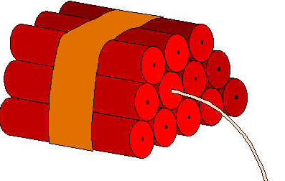

One-Time Programs [GoldwasserKalaiRothblum08]
Can only be executed on single input
Input chosen at run-time
x
x
f
f(x) +
f
x
x
y
f
⟂ +
f

Slide 4

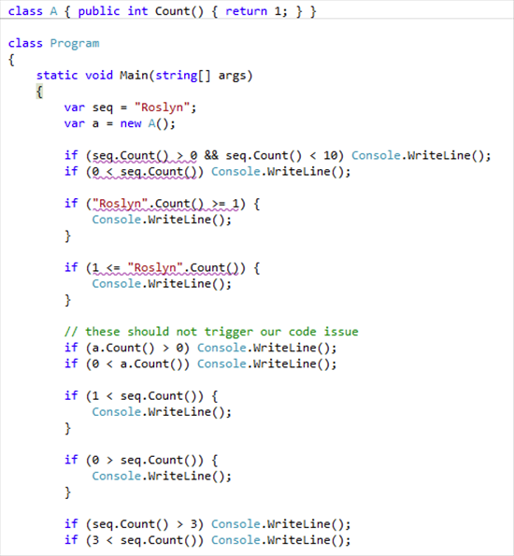
One-Time Programs
[GKR’08]: Construction based on “tamper-proof hardware tokens”
f
One-Time Compiler
f

Slide 5
One-Time Programs
[GKR’08]: Construction based on “tamper-proof hardware tokens”
[GG’17]: Software-only construction using blockchains
f
One-Time Compiler
f

Slide 6
Main Ingredients:
Extractable Witness Encryption (last lecture)
Garbled Circuits (today)
Blockchains with specific properties (today)
f

Slide 7
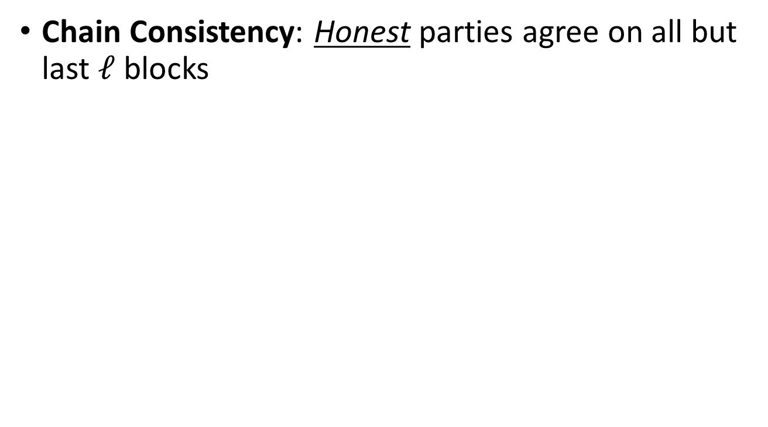

Blockchain Properties [GarayKiayiasLeonardos15,PassSeemanShelat16]
Chain Consistency: Honest parties agree on all but last $ℓ$ blocks
……
Last ≤ $ℓ$ inconsistent
……

Slide 8
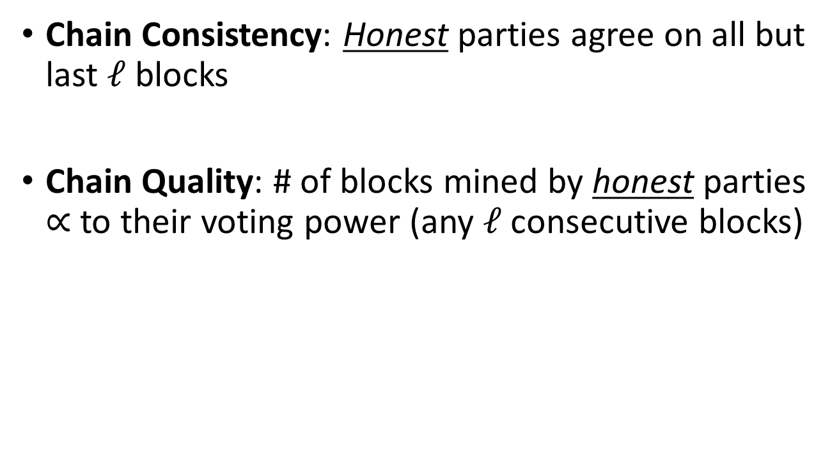
Blockchain Properties [GarayKiayiasLeonardos15,PassSeemanShelat16]
Chain Consistency: Honest parties agree on all but last $ℓ$ blocks
Chain Quality: # of blocks mined by honest parties $∝$ to their voting power (any $ℓ$ consecutive blocks)
Notes:
Say adversary controls 25% voting power. Then approximately at most one block in any 4 blocks is mined by some adversarial party.
A fairness type guarantee.

Slide 9
[GG’17]:
New Proof-of-Stake Specific Abstractions

Slide 10
Defining Stake Fraction
Measure of combined difficulty of POS puzzles solved
……
Mined by A
Proved 10% stake
Mined by B
Proved 5% stake
Mined by A
Proved 10% stake
Mined by C
Proved 15% stake
Notes:
Recall that when a new block is mined in POS-based blockchains, then it contains a (verifiable) proof-of-stake.

Slide 11
Defining Stake Fraction
Measure of combined difficulty of POS puzzles solved
……
Mined by A
Proved 10% stake
Mined by C
Proved 15% stake
Stake Fraction = 30%
Mined by A
Proved 10% stake
Mined by B
Proved 5% stake
Notes:
Recall that when a new block is mined in POS-based blockchains, then it contains a (verifiable) proof-of-stake.

Slide 12

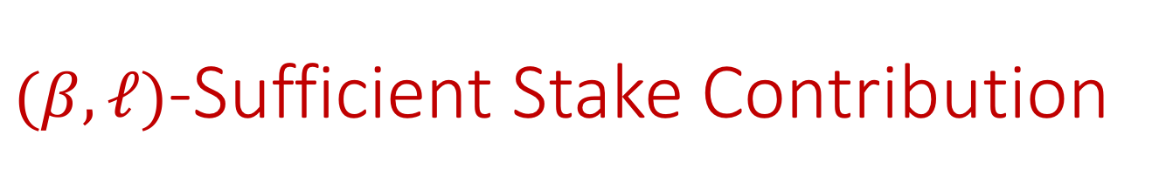
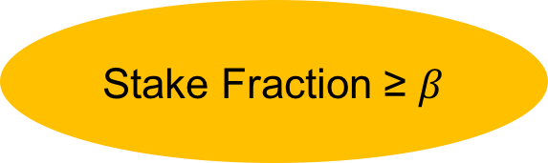
$(β, ℓ)$-Sufficient Stake Contribution
Total ‘stake-fraction’ in last $ℓ$ blocks is a (fairly) high fraction (≥ $β$)
……
Stake Fraction ≥ $β$

Slide 13
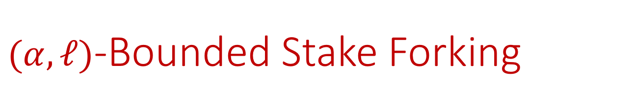

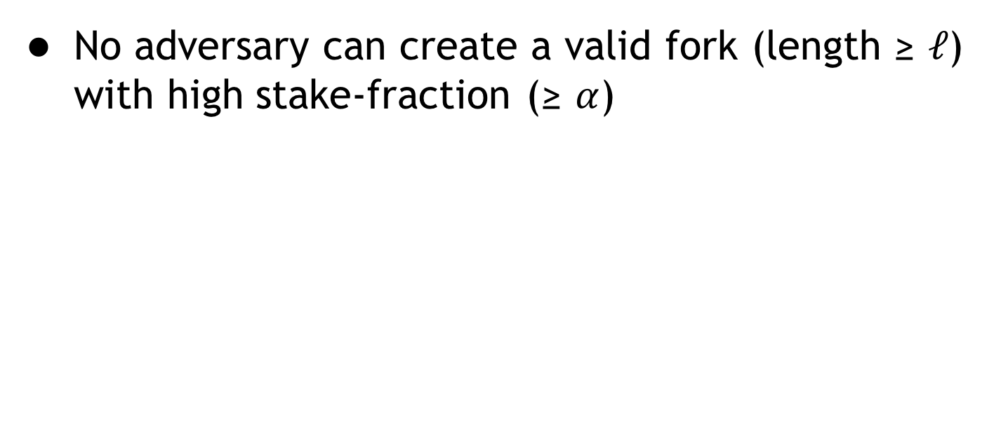
$(α, ℓ)$-Bounded Stake Forking
No adversary can create a valid fork (length ≥ $ℓ$) with high stake-fraction (≥ $α$)
Stake Fraction ≤ $α$
……
Notes:
For technical reasons, when we formally define the property we require two length parameters.

Slide 14

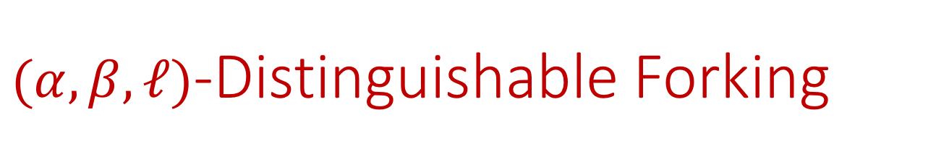


$(α,β, ℓ)$-Distinguishable Forking
Honest chain of blocks can be distinguished from adversarial fork
Stake Fraction ≤ $α$
$$α<β$$
……
Stake Fraction ≥ $β$
Notes:
For technical reasons, when we formally define the property we require two length parameters.

Slide 15
Connection to Previous Properties
[GG’17]: If a PoS blockchain satisfies chain consistency and chain quality, then it also satisfies the following properties:
sufficient (honest-) stake contribution
bounded stake forking
distinguishable forking
(for some choice of parameters)

Slide 16
[GG’17] One-Time Program
Compilation:
Garbled Circuit G
1. Garble
Circuit C
Input Key pairs
(w_{i,0} w_{i,1})
2. Witness Encryption
Encrypted Input Key pairs
(ct_{i,0} ct_{i,1})
Notes:
Garble the circuit computing f
Evaluator posts x on blockchain
Block containing x used as secret key for evaluating garbled circuit

Slide 17
[GG’17] One-Time Program
Evaluation steps (informal):
Evaluator posts its input x on the blockchain
Waits for the blockchain to be “sufficiently” extended
Uses the blockchain state as a witness to decrypt the WE ciphertexts to learn wire keys for x
Uses wire keys for x to evaluate the Garbled Circuit G and learn C(x)

Slide 18

[GG’17] One-Time Program
{
Garbled Circuit G
Garbling
+
Compilation
Circuit C
Encrypted Input
Key pairs (ct_{i,0} ct_{i,1})
WE
Stake Fraction > $\frac{1}{2}$
Evaluation
…
Last
Block
New
Block
Next
Block
……
Next
Block
--------------------
Present
Blockchain
Post input x
Extending Blockchain
Notes:
Garble the circuit computing f
Evaluator posts x on blockchain
Block containing x used as secret key for evaluating garbled circuit

Slide 19
[GG’17] One-Time Program
{
Garbled Circuit G
Garbling
+
Compilation
Circuit C
Encrypted Input
Key pairs (ct_{i,0} ct_{i,1})
WE
Evaluation
Use this as witness
…
Last
Block
New
Block
Next
Block
……
Next
Block
--------------------
Present
Blockchain
Post input x
Extending Blockchain
Notes:
Garble the circuit computing f
Evaluator posts x on blockchain
Block containing x used as secret key for evaluating garbled circuit

Slide 20
[GG’17] One-Time Program
Security (informal):
To evaluate OTP on any input x, adversary must first post it on the blockchain
If adversary posts x’ ≠ x after already posting x, blockchain state will contain both of them
Such a blockchain state is not a valid witness (rejected by WE)

Slide 21
WE Ciphertext
⟂
Use this as witness
“Hardwired” in WE ciphertexts
Last
Block
New
Block
Next
Block
Next
Block
……
Next
Block
…
--------------------
Present
Blockchain
Post input x
Post input x’
Notes:
Garble the circuit computing f
Evaluator posts x on blockchain
Block containing x used as secret key for evaluating garbled circuit

Slide 22
[GG’17] One-Time Program
Security (contd):
But what if adversary creates a fork from “last block” and posts x’ there?
To create a valid witness, adversary must extend the fork so that it has stake fraction > 1/2
Any such fork will be distinguishable from real chain due to distinguishable forking property

